Slide 1
Introduction
John Gordon, STFC
GDB meeting @CERN February 10th 2010

Slide 2
Since the Previous Meeting
EGEE All Activities Meeting, Amsterdam
EGI Council, Amsterdam
LHC Performance Workshop, Chamonix

Slide 3

GDB meetings in 2010
Second Wednesday of each month
Rooms booked for first six months
March 24, Amsterdam
  LHCb T1 Jamboree 22-23,
  MB Face to face on 23rd.
  See EGI.eu Headquarters ??
Pre-GDB rooms booked, May, June, July, August, October
Other offers to host a meeting?
January 13
February 10
March 24
May 12
June 9
July 14
August 11
September 8
October 13
November 10
December 8

Slide 4
Pre-GDB meetings
    None currently planned
    Tier1 (or all site) Best Practices
    More ideas please.

Slide 5
Forthcoming Events
LHC OPN, London, 8-9 March
ISGC, Taipei, 7-12 March
OGF28, München, 14-19 March
EGEE User Forum, Uppsala, 12-16 April,
HEPiX Spring Meeting, Lisboa, 19-23 April
WLCG Workshop, London, 7-9 July
EGI Conference, Amsterdam,13-17 September
CHEP 10, Taipei, 17-22 October
HEPiX Fall Meeting, Cornell, tbd

Slide 6
GDB Issues
Pilot Jobs, SCAS, gLExec
CREAM
SL5
Virtualisation
Installed capacity

Slide 7
Main Topics Today
Pilot Jobs – SCAS/glexec.
Operational Security
Middleware
Argus
Technical Forum – Pilot Jobs
OSG News

Slide 8
Installed Capacity
Please look at Sanity Checks run by Nagios on all sites.
  They show possible misconfigurations
Only the site can say whether the real resource data is correct.
Hope to produce monthly reports soon
  Do you want to look bad in them?

Slide 9
EGI Council
Met in Amsterdam 3rd February
The statutes were agreed and the Foundation created
An Executive Board of 7 was elected
  Chair Per Oster ,
1 month allowed for NGIs to formally confirm membership of foundation and hence confirm EB member. (Deadline, March 5th).
At end of this month, EGI will have a list of initial NGI participants and hence the formal council
Other NGIs can join upon application and approval by Council
EGI jobs have been advertised http://egi.eu/cms/about/jobs/

Slide 10
FP7 Proposals
EGI Inspire and EMI invited to hearings in Brussels this week.
ROSCOE and the other SSCs were not invited.
  Assumption is they will not be funded.
  Need to think again but wait to hear feedback.

Slide 11
LHC Startup
Chamonix Workshop agreed schedule 2010-2011

Slide 12
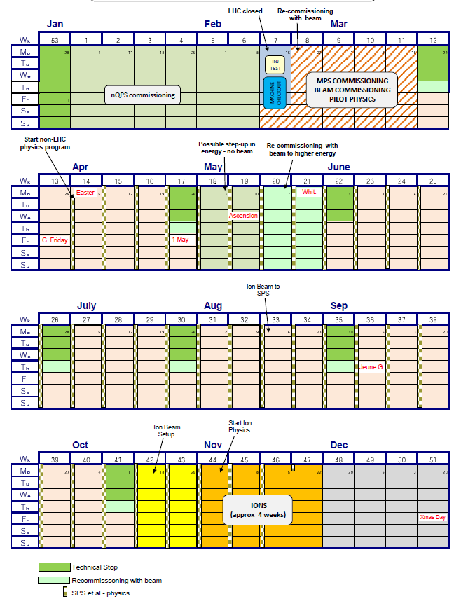
No break

Slide 13
Prelim. schedule 2010/11/12
2010 + 2011
  Running from mid-Feb – end Nov
  Pb-Pb in November
  In principle stop after 1 fb⁻¹ ; plan to run 2 years
    (0.2 in 2010, remainder in 2011)
2012: shutdown of accelerator (but not computing)
Must agree common assumptions for #days etc.
Guidance on availability for physics is 50%
182 days pp and 28 days HI in each 2010,2011
  7.9 Ms pp + 1.2 Ms HI each year assuming 50% avail
Experiments will also take data in March (pp setup) and Oct (HI setup)
  Assume 30 + 14 days at 35% availability
  1.3 Ms each year
Totals:
  7.9 Ms pp, 1.2 Ms HI, 1.3 Ms “setup” in each of 2010 and 2011

Slide 14
Process now
Agree preliminary requirements for 2011,12 at LHCC review next week
Foresee a MB in March with LHCC and RSG reps present to agree what is presented to RRB in April.

