Slide 1


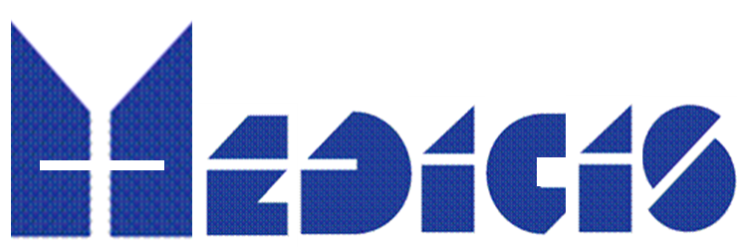
Radioactive Ion Beams for Medical Applications I :
Production by the Isotope mass Separation OnLine (ISOL) method
Thierry.stora@cern.ch
University of Oslo,
Spring workshop on nuclear and particle physics

Slide 2
Structure of the presentation
Radioactive Ion Beams for Medical Applications :
1.- Production by the Isotope mass Separation OnLine (ISOL) method
Radioisotopes
Accelerators for the production of radioisotope beams
Specificity of the Isotope mass separation
Questions, discussion
2.- CERN-MEDICIS, non-conventional radioisotopes for medical applications
Ion accelerators for radiotherapy
Principle of PET imaging
PET Molecular imaging in nuclear medicine
Concept of theranostics (therapy + diagnostics) in nuclear medicine
CERN-MEDICIS : a new facility and new projects
Virtual visit with cameras
Questions discussion

Slide 3
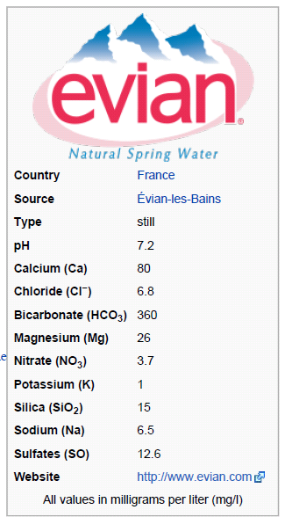
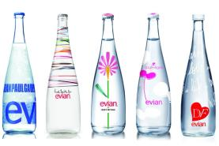
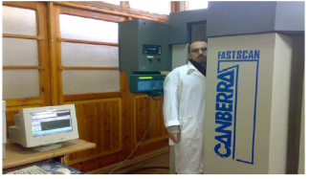
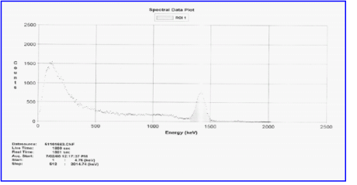
Radioisotopes in our every day’s lives
Daily, we “internalize” natural radioisotopes
M Goma et al

Slide 4
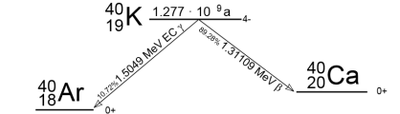
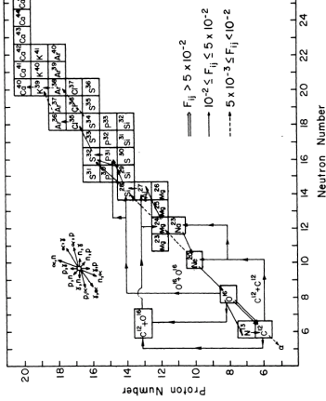
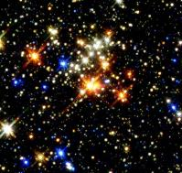
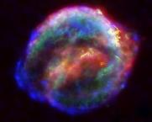
⁴⁰K, a natural or artifical radioisotope ?
Our whole body natural activity
is of ca 4 kBq (0.2 mSv/year)
⁴⁰K Method of production :
Nucleosynthesis in supernovae explosion
12C+16O→X, etc
Neutron capture s-process
in stars ³⁹K(n,γ)⁴⁰K
But none of these facilities is cheap and easy to implement !
S. Woosley, Astrophys j

Slide 5
Radioisotope decay scheme
Radioactivity, decay chain, etc

Slide 6

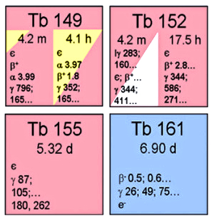
Nuclear Physics
ISOLDE and MEDICIS
Auger therapy
SPECT
14 years ago – now :
Innovative radioisotopes
β-therapy
PET
α-therapy

Slide 7
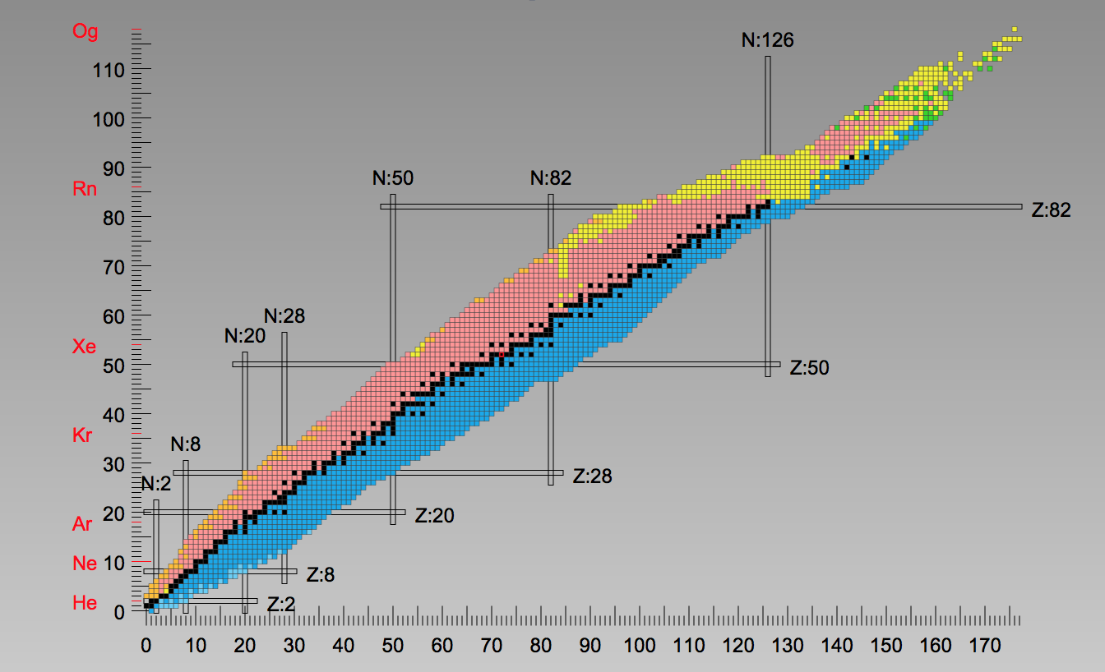
Nuclide Chart

Slide 8
Stopping range of particles in matter

Slide 9
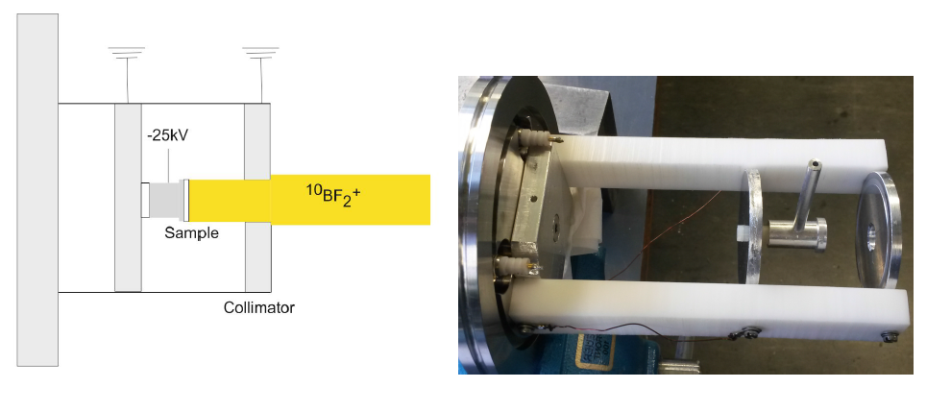
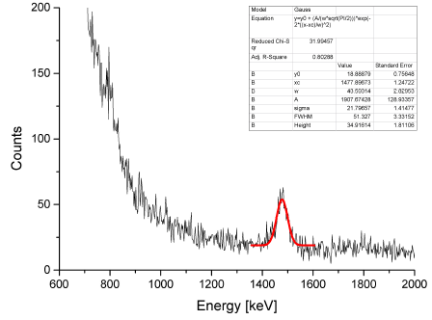
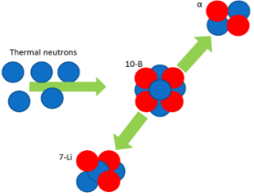
Neutron capture in Boron and emission of alpha particle
¹⁰B+n
94%: ⁷Li (0.840MeV + α (1.470MeV) +γ(0.478MeV)
6%: ⁷Li (1.015MeV + α (1.777MeV)
Si detector
α
σ_{th}(¹⁰B(n,α)⁷Li)=3840 barn
n
Sample
Pu-Be source: 1*10⁸ n/s @4π
C. Seiffert, PhD Thesis, CERN-THESIS-2014-332.

Slide 10
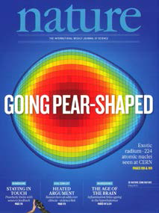
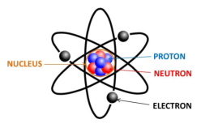
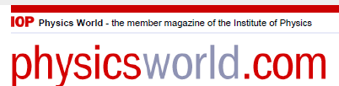
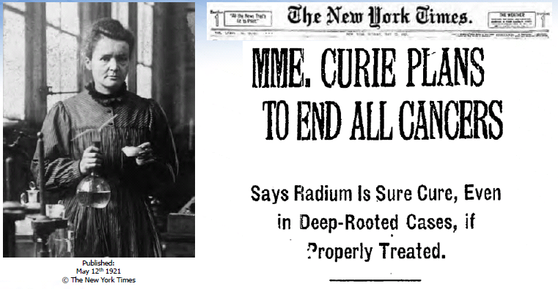
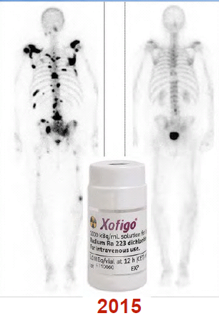
Where can we study fundamental properties of these isotopes
(aka nuclear physics) ?
²²⁴Radium is pear shaped
(Result from Isolde).
one of the 10 breakthroughs in 2013
Courtesy Prof. Ratib

Slide 11
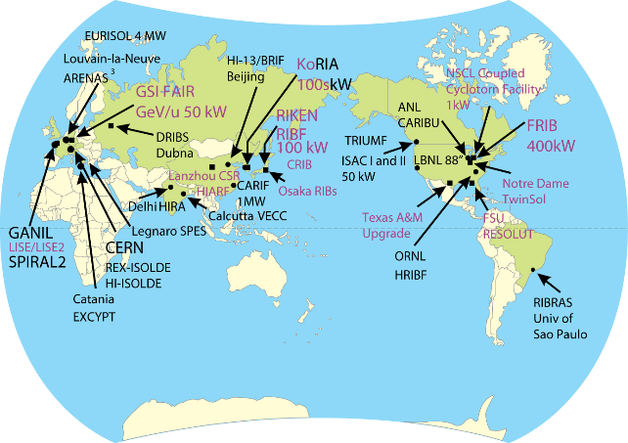
World map of radioisotope ion beam facilities*
In-flight
Fragmentation
Facilities (in red)
Isotope Separation
OnLine Facilities
ISOL (in black)
( ) RISP
( )
E
EXCYT/SPES
*As shown during FPRIB, Saha inst., Kolkata, India
(Apr 2012)

Slide 12
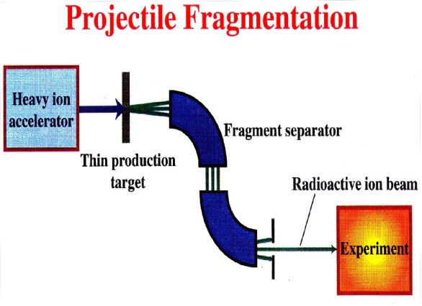
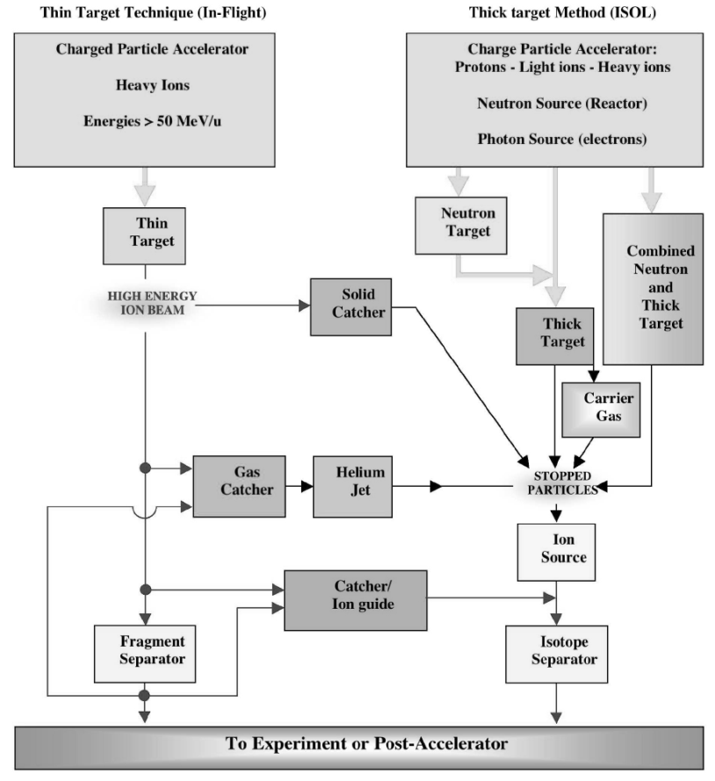

The main ingredients :An accelerator for isotope production + mass purification

Slide 13
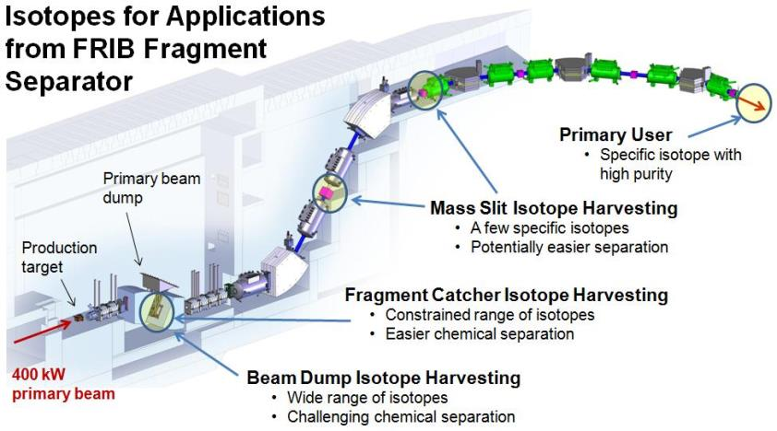
An example : FRIB under construction at MSU (USA)

Slide 14
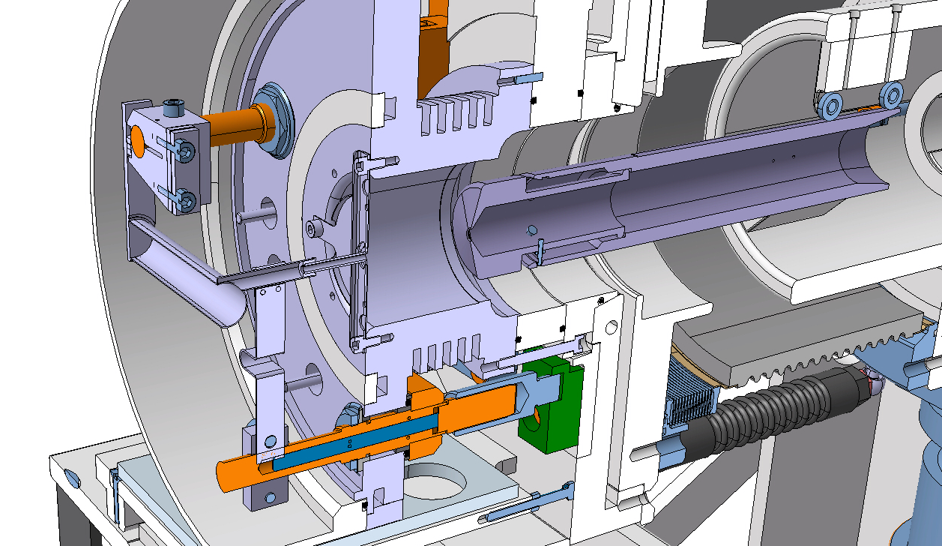
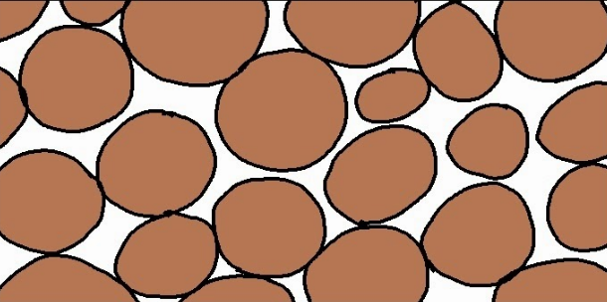
Principle of isotope production, release and acceleration
Radioisotopes
Standard ISOLDE target unit with surface ion source
Ions
Isotope purification in MEDICIS Laboratory

Slide 15
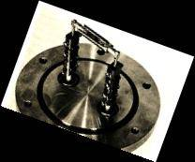
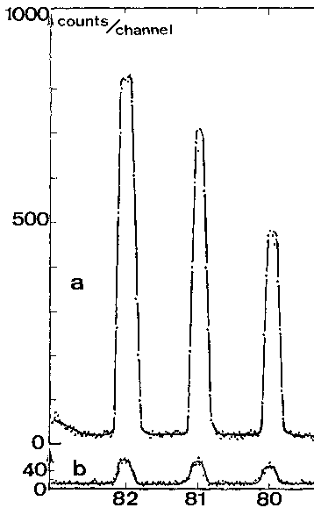
1st Targets used at CERN-PS for alkali metals (p 10-24 GeV)‏
Target preparation:
5cm long, 6mm diameter.
36x 70μm C, 1-10μm (1-8mg/cm²) U compound, 100μm gap: tot 0.3g/cm² U
Operated at ca 1500°C
Fission
(10.5GeV p on ThCx)‏
Rb release
Phys Rev Lett, 1968
After
Proton
pulse
R. Klapish et al.
(UCx at CERN-PS&IPNO/CSNSM, 1967)‏
Na from Ir/C target
After 8 sec.

Slide 16
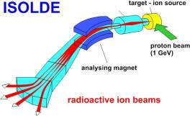
Isotope mass separation

Slide 17
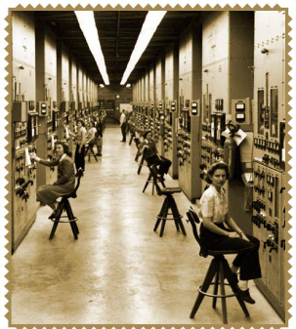
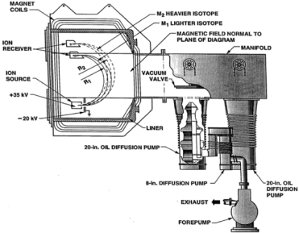
Isotope mass separation with long-lived isotopes
Can this process be applied in a large scale facility ?
A first terrifying use: 235 uranium enrichment of “Little Boy”
And later a much more positive application :
isotope enrichment for medical isotope production
The Calutron (E. Lawrence)

Slide 18
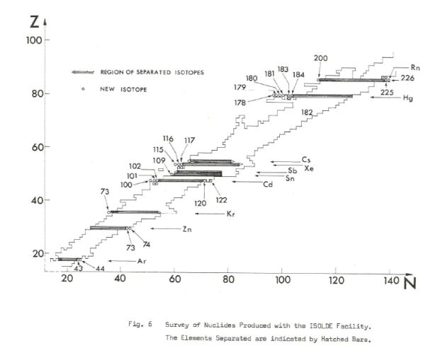
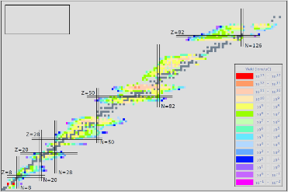
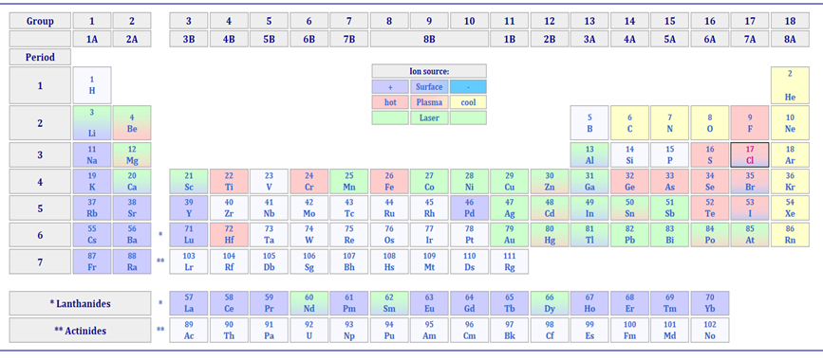
New isotope beams by mass separatio (ISOL)
2012
And more recently
at ISOLDE (2015)
We don’t evaporate/release
refractory elements in atomic
form
at GANIL
??
at JAEA (2013)
at TRIUMF
at JAEA (2016)
T. Sato, et al. http://dx.doi.org/10.1063/1.4789772 (2013).

Slide 19
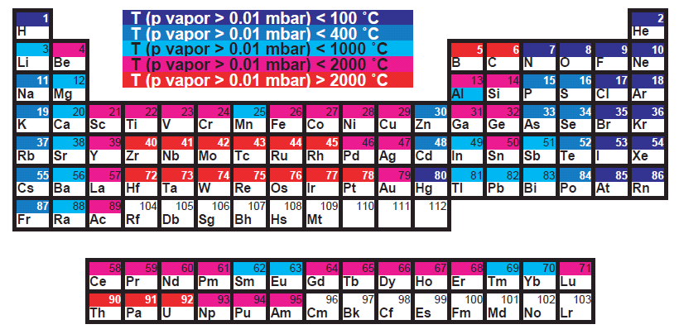
Principles of ISOL radioactive beam production
Primary beam
(MeV/u-GeV/u)
Or
neutrons‏
Plasma
Extracted
ion beam
~nA for Surface
~μA for FEBIAD
~mA for ECR
Target oven
Transfer line
Ion source
Extraction
Leaks
Leaks
Leaks
Neutrals
Release loss
Condensation
Condensation
Sidebands
Decay loss
Decay loss
Decay loss
Multiply charged
Make sure you collect a large fraction,
and fast,
and before it evaporates !
H. Ravn and W. Brian
"On-line mass separators.
" Treatise on heavy ion science. Springer US, 1989. 363-439.

Slide 20
From excitation function to production rate
I[pps] ~ Φ[pps] σ[barn] N[g/cm2] production rate
10¹⁰pps 100μA (6.10¹⁴) 1mbarn 1g/cm² for A_{target}=30g/mol
Incident particle
Beam intensity
Bragg peak possibly
in a dump
Target thickness

Slide 21
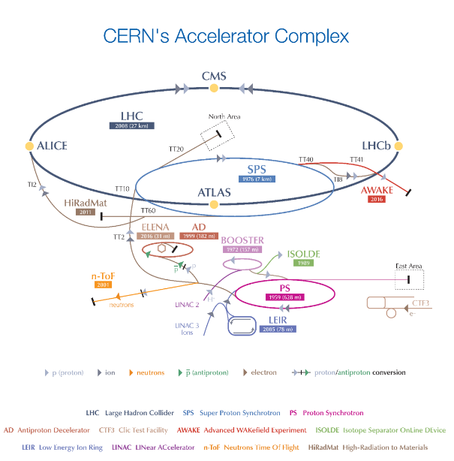
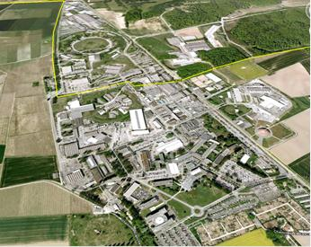
The ISOLDE and MEDICIS facility

Slide 22
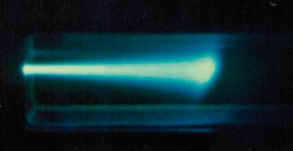
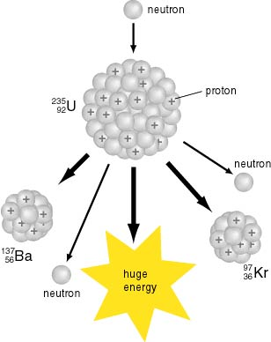

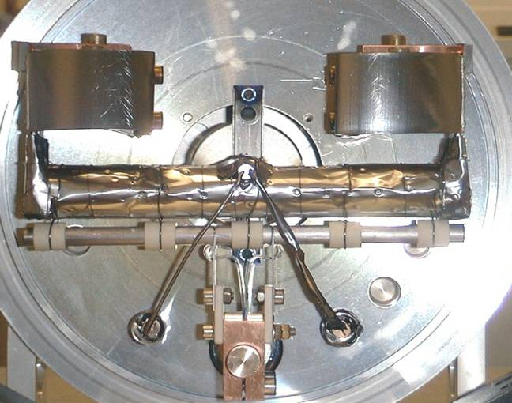
Beam – target interaction
Fast n,
1.4GeV p
238U
Gas target
(ie N₂ + trace of O₂ for ¹⁴N(p,α)¹¹CO₂)
Courtesy of E. Bouquerel

Slide 23
Beam – target interaction : use of the lost proton beam fraction

Slide 24


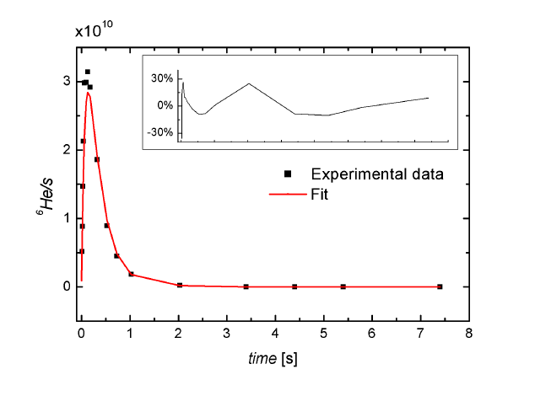
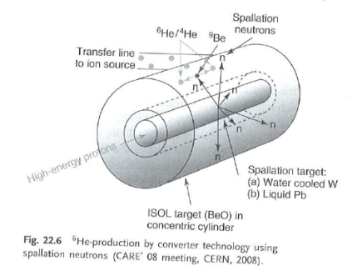
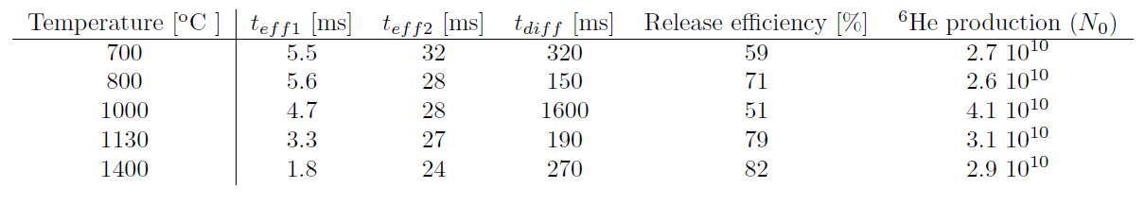
Isotope release : an analytical function
Isotope with
“short/long” T1/2
2009
(⁹Be (n,α) ⁶He
Eur. Phys. Lett. 98, 32001 (2012) & Europhysics news

Slide 25
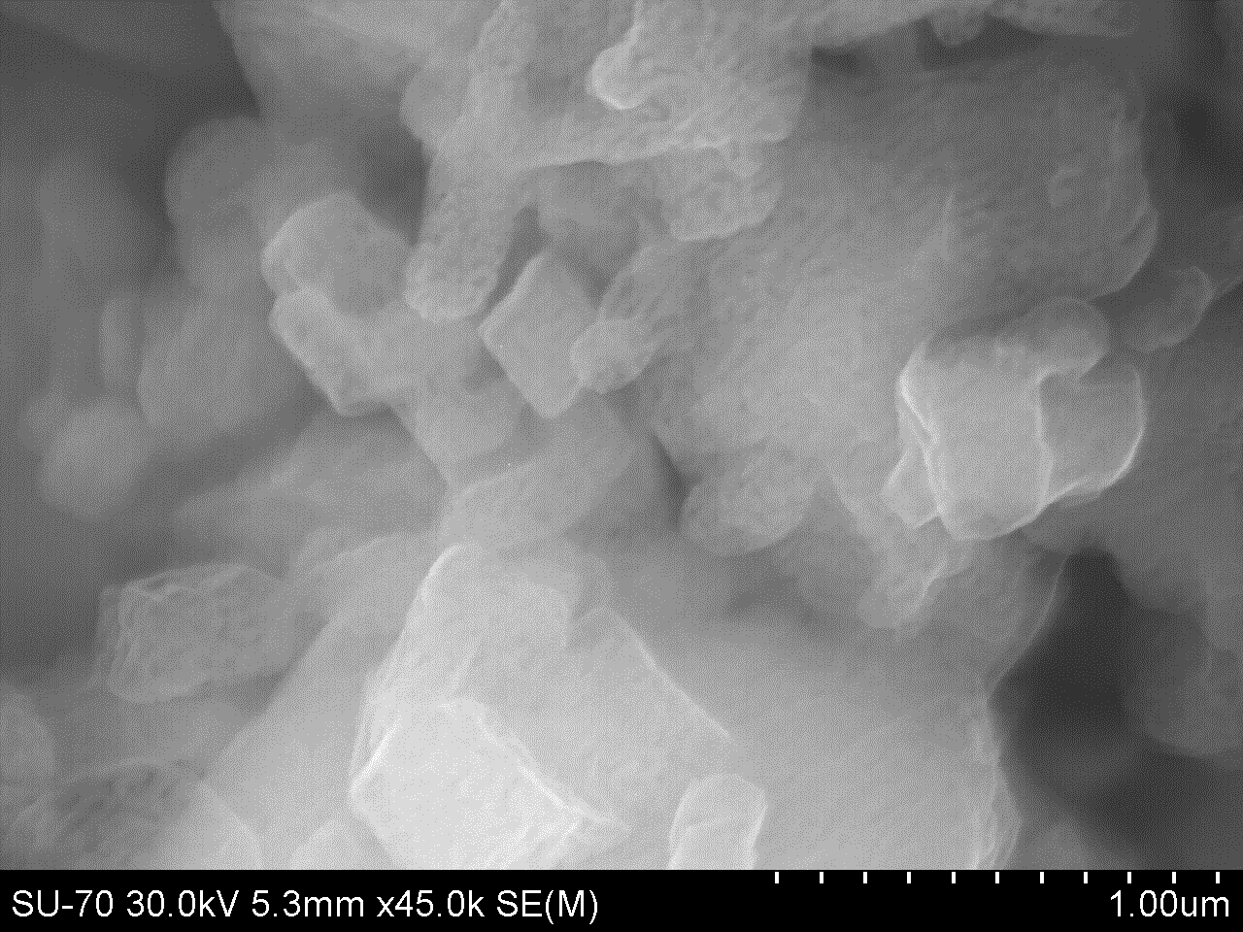
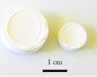
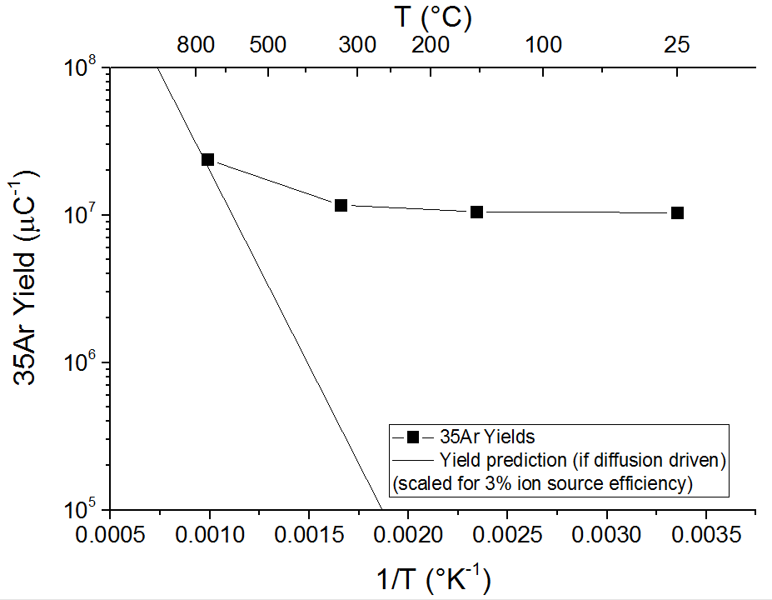
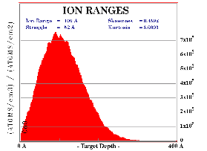
Release ³⁵Ar ⁺ from cold nanostructured targets !!
Fast release of ³⁵Ar from cold nanostructured CaO targets:
Recoil into nanomaterial
SSA = 38 m²/g
48h at 800ºC
400 nm
Fick’s law
for diffusion
J. P. Ramos et al., NIMB 376, 81 (2016).

Slide 26
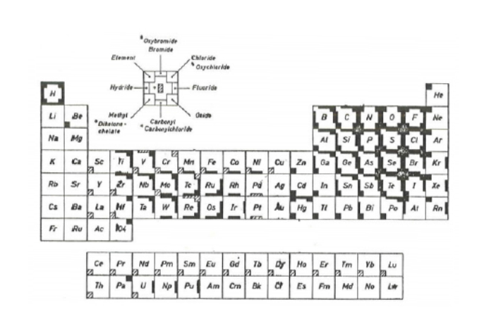
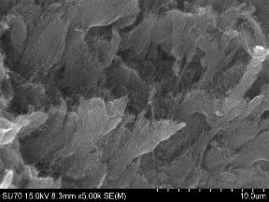
1st Boron ISOL beams: ⁸BF₂⁺ from carbon nanotubes
⁸BF₂⁺ (T_{1/2} 880ms) produced
from multiwall carbon nanotube target (fast diffusion)
and SF₆ reactive gaz injection (volatile BF₃ molecule)
« CHEMICAL EVAPORATION »
Multiwall Carbon Nanotubes
C. Seiffert, Production of radioactive molecular beams for CERN-ISOLDE.
PhD thesis TU Darmstadt, CERN (2015)

Slide 27
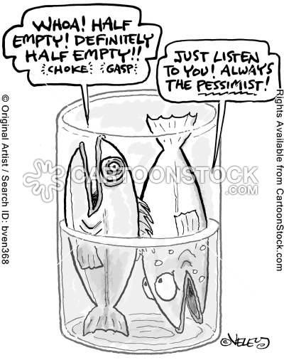
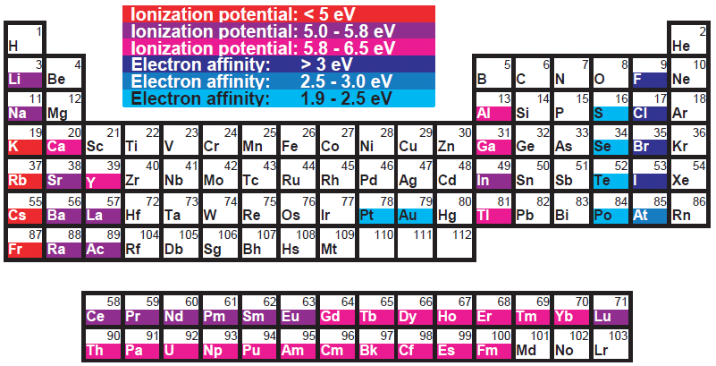

Ionization of radioisotopes
The related radio-isotopes have in addition
A finite half-life
( from a few ms to years at ISOL-Type facilities)

Slide 28




Surface Ion Sources
0
e-
+
Hot tube
Material work function Φ
Isotope 1st Ion. Pot. : Wi
Saha-Langmuir Equation
For Alkalis,
g₀=2 (2S1/2, degeneracy 2), g+=1
Some additional correction factors such as applied electrical potential or
surface coverage
Meghnad Saha, 1920

Slide 29
Clever use of Surface Ion Sources
New manuscript in preparation
For Elements Z=100-102
Ideas to measure Ionization potential
On element Z=112 have started

Slide 30


Isotope mass separation and post acceleration
REX-ISOLDE radioactive ion beam post-accelerator
Multiple charged
ions
Bunches and cools
ions
Analyzing magnet,
Doublets
Triplet
7-gap
resonator
RFQ
IH
Triplet
Accelerator
from
5 -> 300 keV/u
Accelerator
from
0.3 -> 1.2 MeV/u
Accelerator
from
1.2 -> max 2.2 MeV/u
HV platform
Switched
HV platform
60 kV
60 ↔ 20 kV
Target and
detectors
TRAP
EBIS
HIE-ISOLDE:
Superconducting
post-accelerator
(1st beam in 2015)
Charge
breeding
1⁺ ions
ISOLDE

Slide 31
Time for questions, discussion, before we embark on nuclear medicine and CERN-MEDICIS

Slide 32
Spare

Slide 33



From production to beam formation
spallation
1.4 GeV protons
fragmentation
fission
⁹⁹Mo*
*we don’t mean it’s « competitive »
in this context
2000C
30cm
10-100m
1cm

Slide 34


1000+ isotopes
(for 70+ elements) “online”
Exotic isotopes down to t_{1/2} ~ 10 ms)
Intensities up to 10¹¹ ions/s
30+ types of targets
Transfer lines
10+ ion sources

Slide 35




Principles of radioactive beam production
Primary beam
(MeV/u-GeV/u)‏
Plasma
Extracted
ion beam
~nA for Surface
~μA for FEBIAD
~mA for ECR
Target oven
Transfer line
Ion source
Extraction
Leaks
Leaks
Leaks
Neutrals
Release loss
Condensation
Condensation
Sidebands
Decay loss
Decay loss
Decay loss
Multiply charged
Ion sources: compact, simple and withstand 1 MGy
Ionize trace radioelements in larger impurities loads
Used to measure Ion. Pot. Lr (Z=103)
at “1 atom at a time” rate

Slide 36


ISOLDE “0”
O.Kofoed-Hansen
K.O. Nielsen
Dan. Mat.Fys.Medd. 26, no. 7 (1951)‏
10 MeV deuterons
d-to-n converter (Be)‏
n moderator (wax)‏
UO₂ (10 kg)
Baking powder
⁸⁹Kr (CO₂, H₂O, NH₃)‏
CERN 76-13, 3rd conf. nuclei far from stability

