Slide 1
CI updates

Slide 2
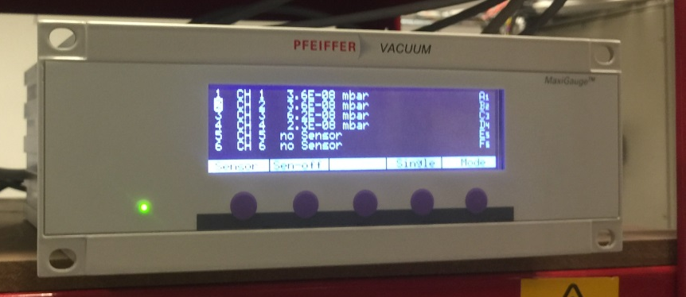
Chamber repair
Returned yesterday
Initial vacuum test
After 12 hour pumping, reaching to 10⁻⁸ mbar
No obvious leaking
Might have outgassing
Chamber | Pressure
Nozzle chamber | 3.6e-8 mbar
Skimmer chamber | 3.6e-8 mbar
Interaction | 6.2 e-8 mbar
Dumping | 2.3e-8 mbar

Slide 3
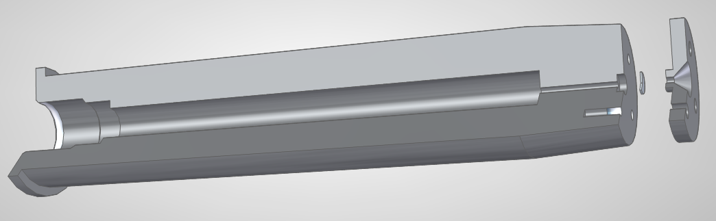
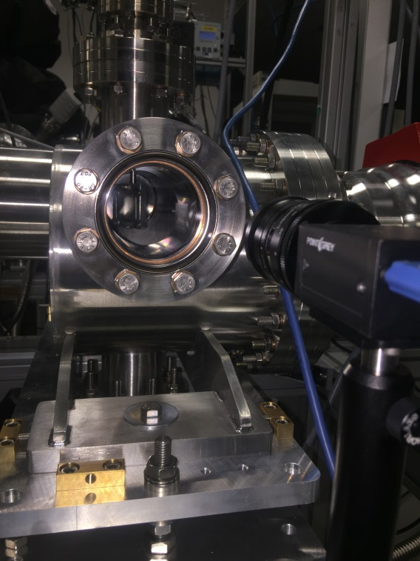
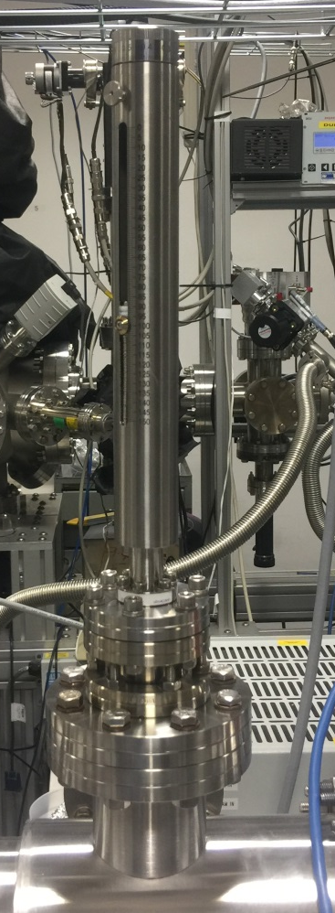
Alignment
Installed the reflecting mirror
Currently using the alternative designed nozzle.
Laser-nozzle-mirror is aligned.
Skimmers is waiting to reinstall
mirror
Camera

Slide 4
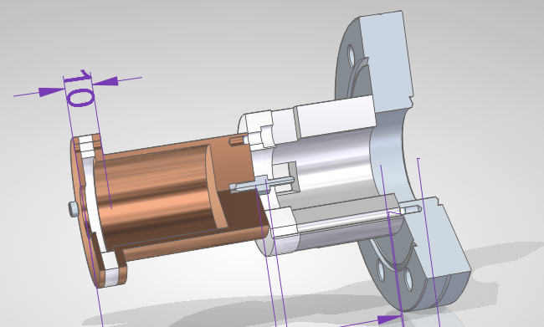
Faraday cup design
Based on previous faraday cup
On a DN63 to Dn40 reducer flange
DN40 feedthrough
High voltage plates
36 mm
Collecting pin
opening
20 mm
Cup

Slide 5
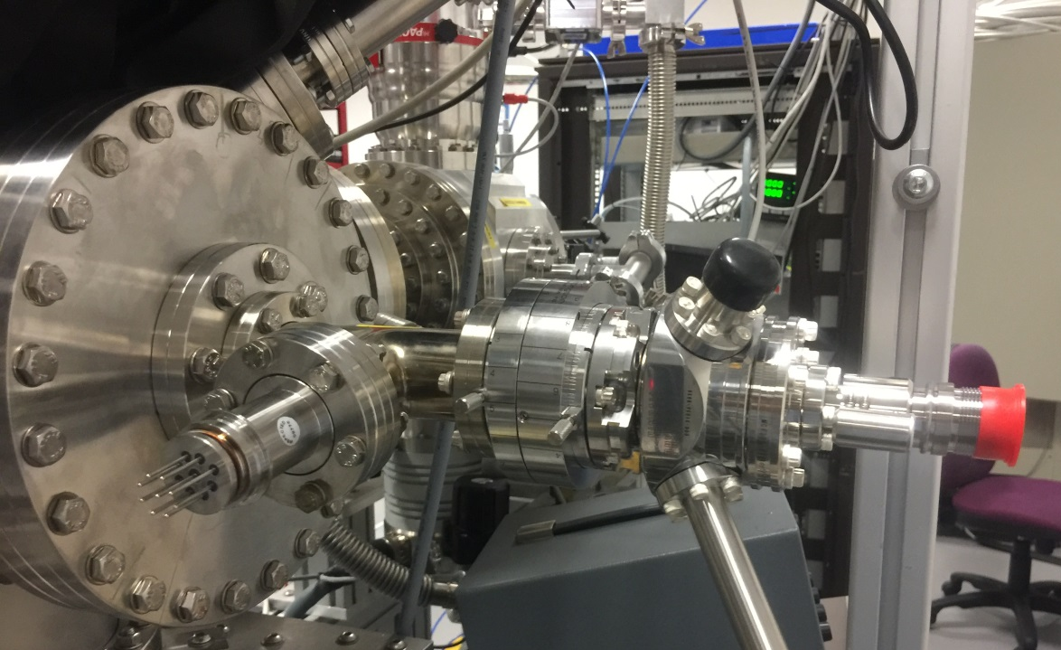
Electron Gun
Arrived this week
Installed in the old setup
Wait some modification of the old faraday cup then close the chamber to pump
Vacuum gauge
Port aligner
gun

Slide 6
Next
Install skimmers and align them with current reference laser.
Machining Faraday cup for the new setup.
Curry out experiments with new electron gun in the old setup.
Integration time
Gas density using the gauge

