Slide 1

LHC: past, present and future
E. Todesco
CERN, Technology Department
Magnet Superconductors and Cryostat Group
Italian teacher program, CERN 18 March 2019

Slide 2
CONTENTS
Where are we?
  Energy
  Luminosity
  Dirty beasts and the menace of spread
Where are we going?
  From 13 to 14 TeV (15 ?)
  Towards 4000 fb⁻¹
  Towards 35-100 TeV

Slide 3
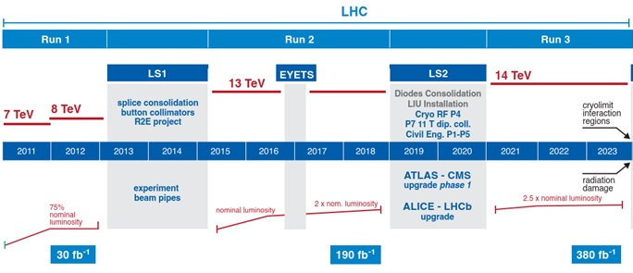
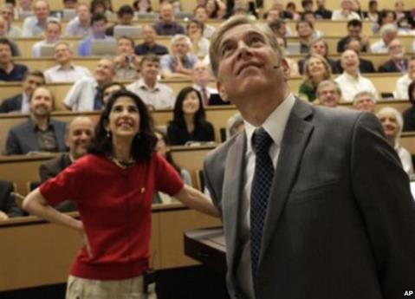

2008-2018: FROM ASHES TO HIGGS
2008: Incident due to faulty splices
2009: Repair
2010-2012: Run at 7-8 TeV
2012: Higgs boson discovery

Slide 4


2008-2018: WHY 4 TeV ?
In Run I energy limited to 4+4 TeV due to faulty splices
  Unforeseen limitation, due to a weakness in the interconnection between the superconducting magnets
  Repair in 2008 of the damaged sector
    Cause of the incident was not removed, so energy limited by maximum current tolerable by the splices
    Initial estimate was 3.5 TeV per proton beam (7 TeV center of mass)
    Then brough to 4 TeV per proton beam
Succesful consolidation of all splices in 2013-2014 (LS1) to remove this bottleneck
Cross-section of the intreconnection and radiography showing missing continuity
[F. Bordry, J. P. Tock and LS1 team]

Slide 5
2008-2018: WHY 6.5 TeV ?
After LS1, we met the second bottleneck in energy: training of the magnets
Training is one of the most obscure and fascinating and phenomena of applied superconductivity
  The magnet is designed to reach a maximum field of X tesla
    When you first power, it reaches only a fraction of X (typically 70%), then it has a irriversible transition to normal state (quench)
    This transition bring some zones of the magnet from 1.9 K to 300 K
    The thermal and mechanical shock allow at the successive powering to reach a higher fraction of X tesla (the magnet trains)
  It is extremely rare that a magnet reaches 100% of X tesla, typically training of a good magnet saturates at 90%-95%
  Typically accelerator magnets operate at 70-90% of the maximum reachable field
  This margin is quite expensive, how much is really needed is a open debate in our community
  LHC dipoles at 8.3 T (corresponding to 7 TeV energy) run at 86% of maximum reachable field

Slide 6
2008-2018: WHY 6.5 TeV ?
All LHC dipoles were trained above 8.3 T (7 TeV per proton) on individual test bench
  Half of them were trained to 9 T (7.5 TeV per proton)
  After installation, negligible retraining was expected (order 100 quenches for the whole machine to operate at 7 TeV)
  Before the incident one sector was powered towards 7 TeV, showing a worse performance (20 quenches to reach 6.5 TeV in 1/8 of the machine)
Training of the 5-6 sector in 2008
[A. Verweij and MP3 team]

Slide 7
2008-2018: WHY 6.5 TeV ?
After the LS1 consolidation of splices, it was decided to aim at 6.5 TeV operation
  We expected order of 100 quenches, we needed with 172 quenches
  With the confirmation of highly unexpected behaviours already observed in 2008 (see next sections about spread): magnets from Firm3 need many more quenches than the other magnets

Slide 8
CONTENTS
Where are we?
  Energy
  Luminosity
  Dirty beasts and the menace of spread
Where are we going?
  From 13 to 14 TeV (15 ?)
  Towards 4000 fb-1
  Towards 35-100 TeV

Slide 9
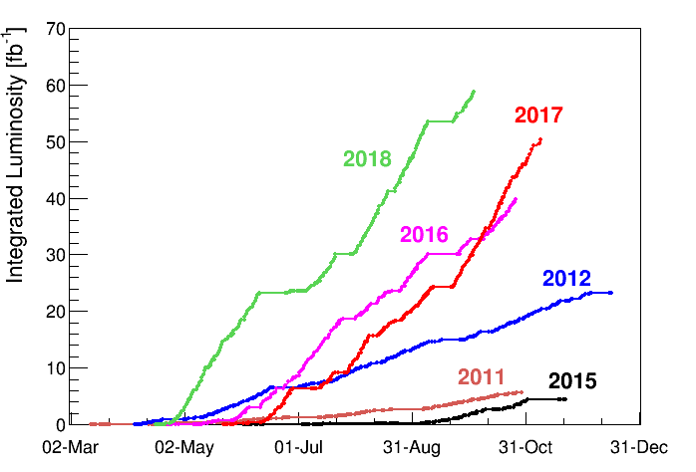
2008-2018: LUMINOSITY
The spectacular progression of data accumulation

Slide 10
2008-2018: LUMINOSITY
Equation for the luminosity
Accelerator features
  Energy of the machine 7 TeV
  Length of the machine 27 km
Beam intensity features
  N_{b} Number of particles per bunch 1.15×10¹¹
  n_{b} Number of bunches ~2808
  Beam geometry features
  ε_{n} Size of the beam from injectors: 3.75 mm mrad
  β* Squeeze of the beam in IP (LHC optics): 55 cm
  F: geometry reduction factor: 0.84

Slide 11
2008-2018: LUMINOSITY
Equation for the luminosity
We will outline some of the luminosity limits
  Beam beam (limit on N_{b}/e_{n})
  Electron cloud (limit on n_{b})
  Squeeze (limit on b* e_{n})
  Injectors (limit on N_{b}, n_{b}, e_{n})

Slide 12
THE BEAM-BEAM LIMIT
The beam-beam limit (Coulomb)
  N_{b} Number of particles per bunch ε_{n} transverse size of beam
  One cannot put too many particles in a “small space” (brightness)
    Otherwise the Coulomb interaction seen by a single particle when collides against the other bunch creates instabilities (tune-shift)
  This is an empirical limit, also related to nonlinearities in the lattice
    LHC has very low nonlinearities → larger limits
    LHC behaves better than expected: beam-beam up to 0.03 tolerable
    LHC in 2018 has run with 0.015 beam-beam parameter

Slide 13

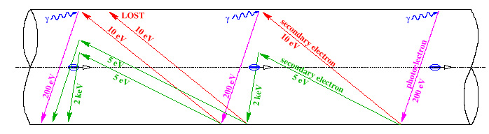
THE ELECTRON CLOUD LIMIT
The electron cloud
  This is related to the extraction of electrons in the vacuum chamber from the beam
  A critical parameter is the spacing of the bunches: smaller spacing larger electron cloud – threshold effect
    So this effect pushes for 50 ns w.r.t. 25 ns
  Spacing (length) ↔ spacing (time) ↔ number of bunches n_{b}
  7.5 m ↔ 25 ns ↔ 3560 free bunches (2808 used)
Mechanism of electron cloud formation [F. Ruggiero]

Slide 14
THE ELECTRON CLOUD LIMIT
Electron cloud has been observed where expected in RunI during 50 ns intensity ramp up
  Was cured by scrubbing of surface with intense beam
  In RunI we operated in a reliable way with 1300 bunches at 50 ns
RunII worked with 25 ns as baseline
  Looks non trivial but feasible
  More sensitive to other effects (see section on spread and strange beasts)
    2556 bunches reached instead of the nominal 2808
    Scrubbing run effective

Slide 15
THE OPTICS LIMIT
Optics: squeezing the beam
  Size of the beam in a magnetic lattice
  Luminosity is inverse prop to ε and β*
In the free path (no accelerator magnets) around the experiment, the β* has a nasty dependence
with s distance to IP
The limit to the squeeze is the magnet aperture
  Key word for magnets in HL LHC: not stronger but larger
Beta function close to the interaction points

Slide 16
THE OPTICS LIMIT
Optics: squeezing the beam
  Size of the beam in a magnetic lattice
LHC was designed to reach β* = 55 cm with 70 mm aperture IR quads
In RunI, less energy → larger beam → higher β*
  But lower emittance (2.5 instead of 3.75 μm), so we manage to run at 60 cm
In RunII, we arrived to run at 25 cm

Slide 17
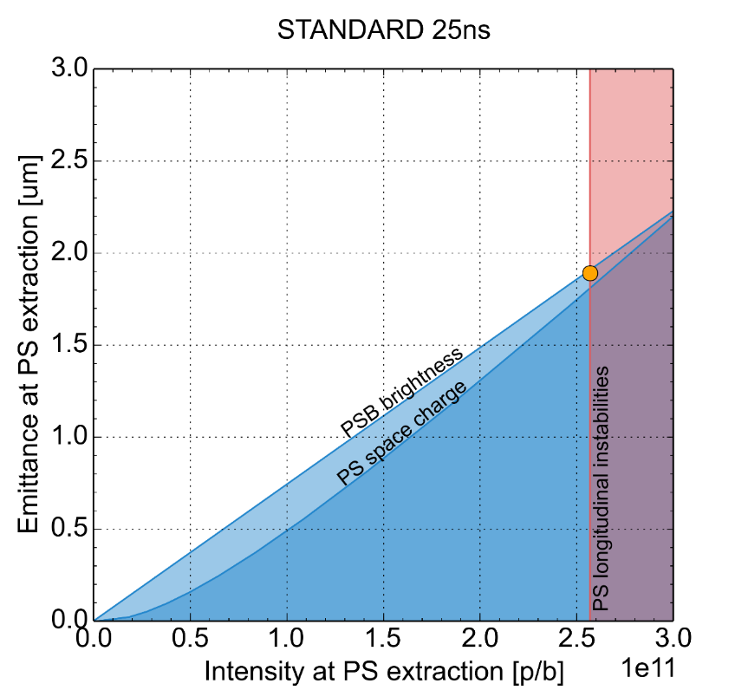
THE INJECTOR LIMIT
Injectors can provide beams with only a given combination of parameters
2017
2012, 50 ns
2018, 25 ns
Target for
2026, HL-LHC

Slide 18
2008-2018: LUMINOSITY
Summary of conditions in the runs
  Note: in 2018 we started using levelling to reduce pile up

Slide 19
CONTENTS
Where are we?
  Energy
  Luminosity
  Dirty beasts and the menace of spread
Where are we going?
  From 13 to 14 TeV (15 ?)
  Towards 4000 fb⁻¹
  Towards 35-100 TeV

Slide 20
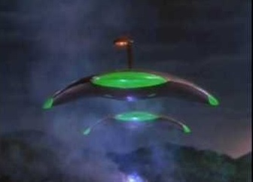
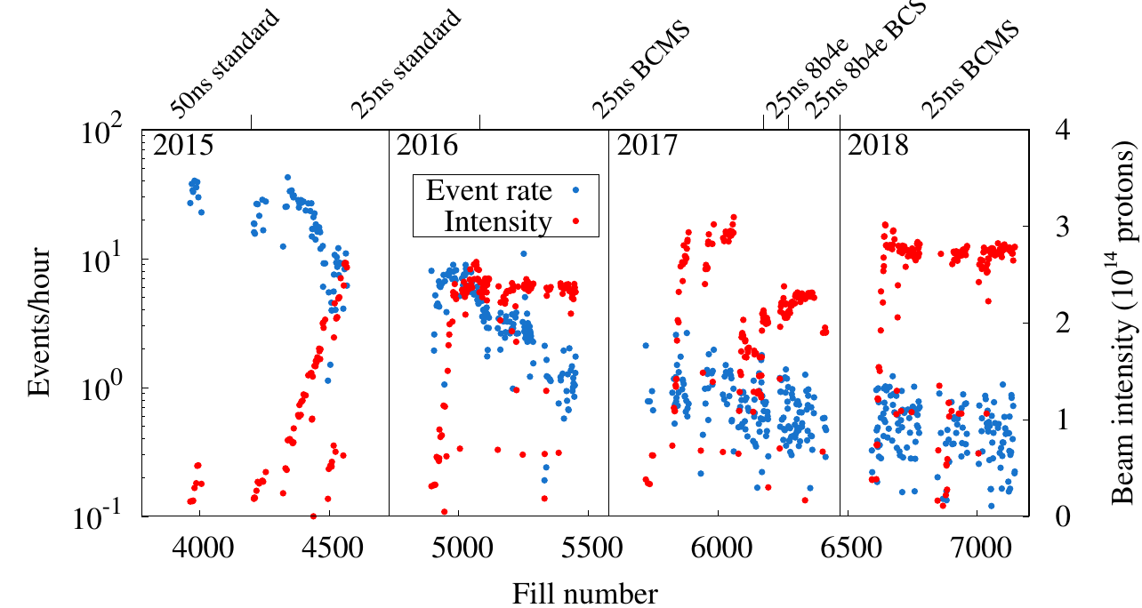
DIRTY BEASTS
And the UFO appeared in Geneva …
  Particles of dust moved by the beam (electrostatics), rapidly burned by the beam
  Losses can cause interlocks of beam related to beam loss monitor
  Very worrying in 2015, but conditioning visible so not an issue today
  What after the large intervention of LS2 ?
War of the worlds (B. Haskin, Paramount, 1953)
Number of UFO (above given threshold) observed in past years
(F. Bordry, HL-LHC meeting 2018)

Slide 21
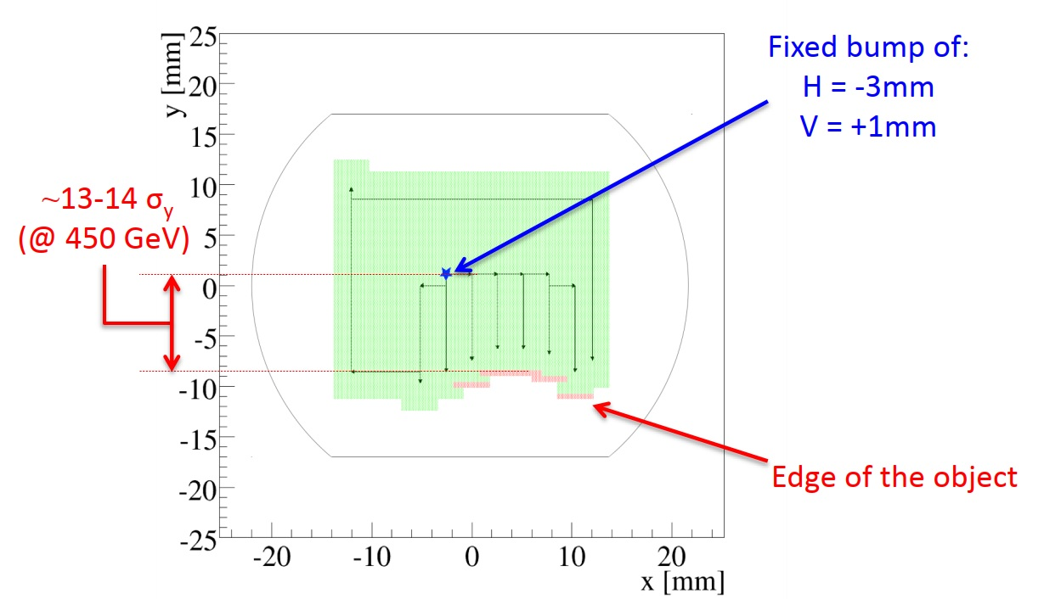
DIRTY BEASTS
ULO (2015 and 2016)
  Unidentified Lying Object in cell 15 right of point 8
  Provoking UFO and beam losses
  Frozen object, visible with beam scan, of few mm on the bottom of the vacuum chamber
  Bypassed by a chicane via orbit correctors
16L2 (2017 and 2018)
  Significant beam losses in cell 16 left of point 2, affecting operation in 2017 and 2018
  Air inlet during cool down is the most probable cause
  Bypassed by changing the pattern of bunches
D. Mirarchi, Evian workshop 2015

Slide 22
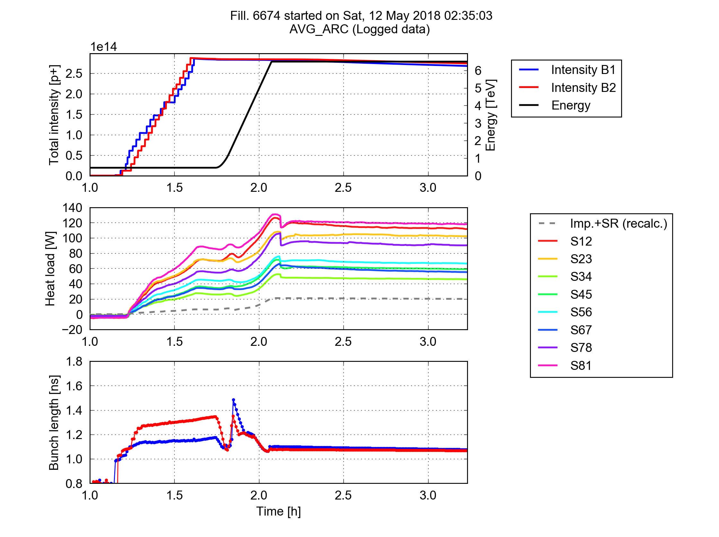
THE MENACE OF SPREAD
Spread in arc performance observed in RunII
  4 consecutive arcs have a much higher (twice) heat load than the other 4
  Source is most likely the electron cloud, generated by different surface properties (SEY, impurities?)
    Not understood
  The higher load sectors are touching the limit of cryogenics, could affect HL LHC
Acceleration
Collisions
Heat load measured in the different sectors (G. Iadarola, LMC 2018)

Slide 23
THE MENACE OF SPREAD
To reach 6.5 TeV, large spread between the three magnet manufacturers
  Firm1: 5% of quenches
  Firm2: 25% of quenches
  Firm3: 70% of quenches
Note that
  All magnets made with the same design and procedures provided by CERN
  Spread of performance is not only between producers, but also during time
  This behaviour is one of the main enigma of the LHC magnets
Magnets of Firm3 quenching in the LHC tunnel to reach 6.5-6.7 TeV
(E. Todesco et al. IEEE Trans Appl Supercond 2017)

Slide 24
CONTENTS
Where are we?
  Energy
  Luminosity
  Dirty beasts and the menace of spread
Where are we going?
  From 13 to 14 TeV (15 ?)
  Towards 4000 fb⁻¹
  Towards 35-100 TeV

Slide 25
FROM 13 TO 14 TeV
During the training to 6.5 TeV, two shorts appeared in the diode box of the dipoles
  Due to weakness in design of diode insulation
  Cured by a bold action: pulse of current to burn the short (A. Siemko and team)
  It worked, but the management decided to go for a global diode consolidation in LS2 (J. M. Jimenez, J. P. Tock et al.)
  This shall allow to carry on massive campaign of training if needed
The decision of the management is to run at 7+7 TeV after LS2
  Order of 500 quenches expected,
  based on the observation that the quench
  distribution is not far from a Gaussian
The training to 7 TeV will also tell us
more about the possibility of training
at 7.5 TeV (remote hypothesis, but not excluded)

Slide 26
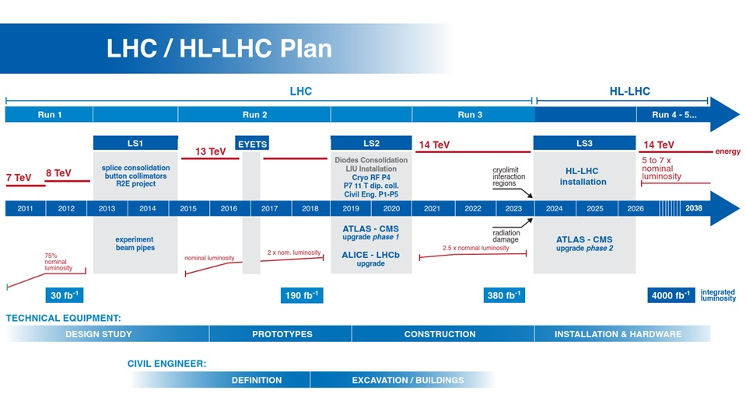
THE 20’s: TOWARDS 4000 fb⁻¹
HL-LHC project (L.Rossi)
  10 times more data in the decade 2025-2035

Slide 27
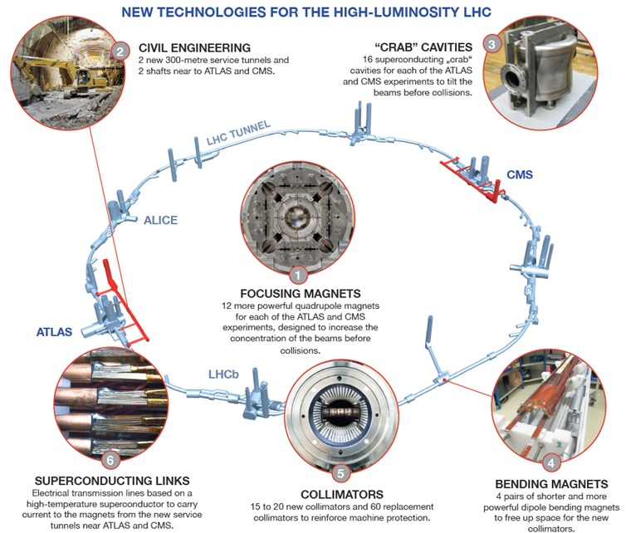
LHC UPGRADE
Upgrade relying on several technological pillars
20 large aperture quadrupoles
+other 60 IR magnets
to be installed in 2025
(WP3, E. Todesco)
4 high field dipoles
to make space
for colllimators
to be installed in 2021
(WP11, F. Savary)
HL LHC main technologies [L. Rossi]

Slide 28
THE 20’s: TOWARDS 4000 fb⁻¹
HL-LHC project (L.Rossi)
  10 times more data in the decade 2025-2035
How increase performance in such a good machine?
  With 950 MCHF, 12 T magnets, and ten years work
The path to more data
  Double beam intensity to 2.2×10¹¹ proton per bunch (together with LIU project)
  Half the beam size by doubling the magnet aperture around the IR
  Killing the adverse effects of crossing angle through crab cavities or flat beams
Plus make use of two essential tools
  Luminosity levelling (already operational since 2017)
  Novel optics to correct chromaticity (ATS scheme, S. Fartoukh)
In terms of magnets, HL LHC shall make use of a technology Nb₃Sn that has the potential of going from 8 to 16 T

Slide 29
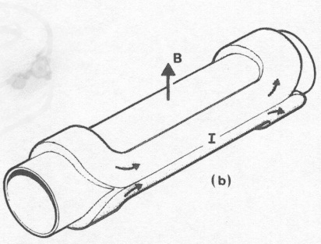
THE SCALE TOWARDS HIGHER FIELDS
The 80’s: 4 T in Tevatron
  Nb-Ti at 4.2 K, 15 mm coil
The 90’s: 6 T in SSC prototypes
  Nb-Ti at 4.2 K, 30 mm coil
The 90’s: 8 T in LHC prototypes
  Nb-Ti at 1.9 K, 30 mm coil
The 00’s: 8 T in LHC
  Nb-Ti at 1.9 K, 30 mm coil
The 00’s: 10 T in LARP prototypes
  Nb₃Sn at 1.9 K, 30 mm coil
The 10’s: 12 T in HL-LHC
  Nb₃Sn at 1.9 K, 35 mm coil
The 20’s: aiming to 16 T in FCC
  Nb₃Sn at 1.9 K, 50 mm coil

Slide 30
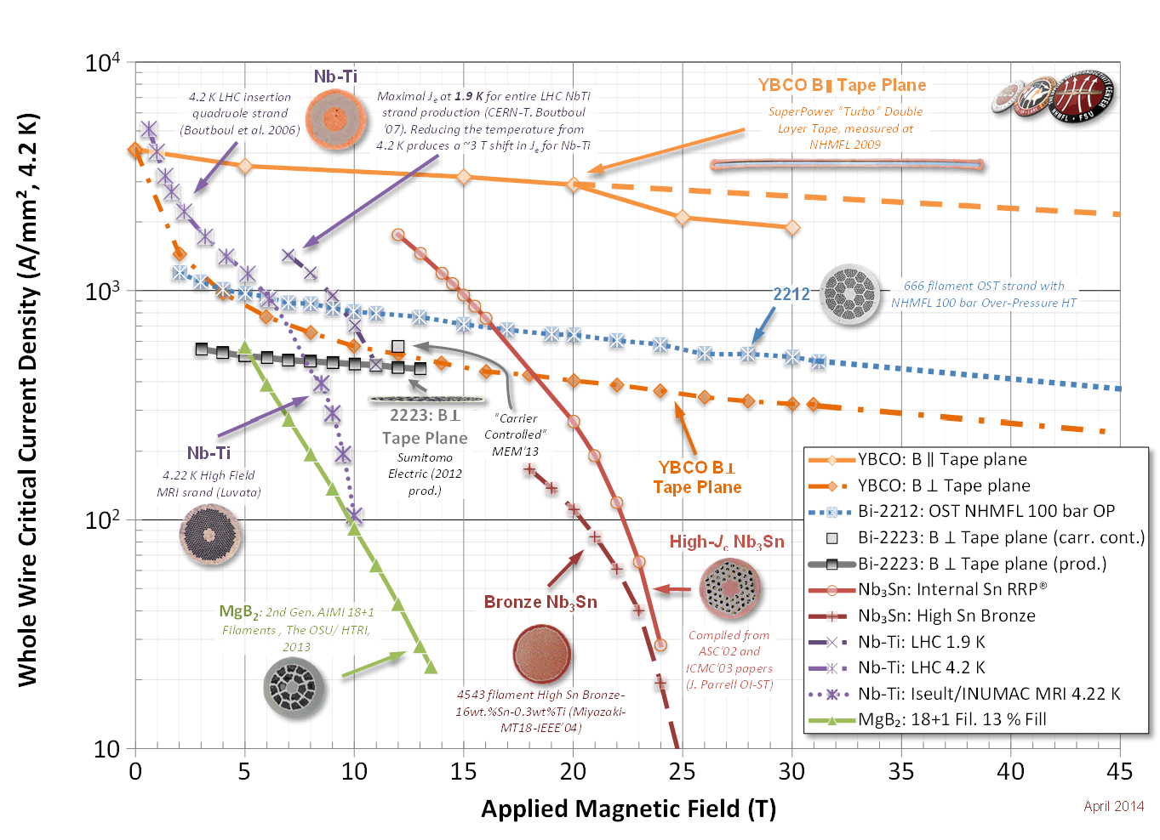
SUPERCONDUCTING MATERIALS
TOWARDS HIGHER FIELDS
Superconductivity is a quantistic property that is limited by temperature, magnetic field and current density
  Usually everybody talks about temperature – for HEP the most relevant are current density (compact device) and field (max attainable field)
  The hidden variable of this plot is the price – an essential ingredient
Critical surface of some superconducting materials
at 4.5 K (unless specified) (courtesy of P. Lee)

Slide 31
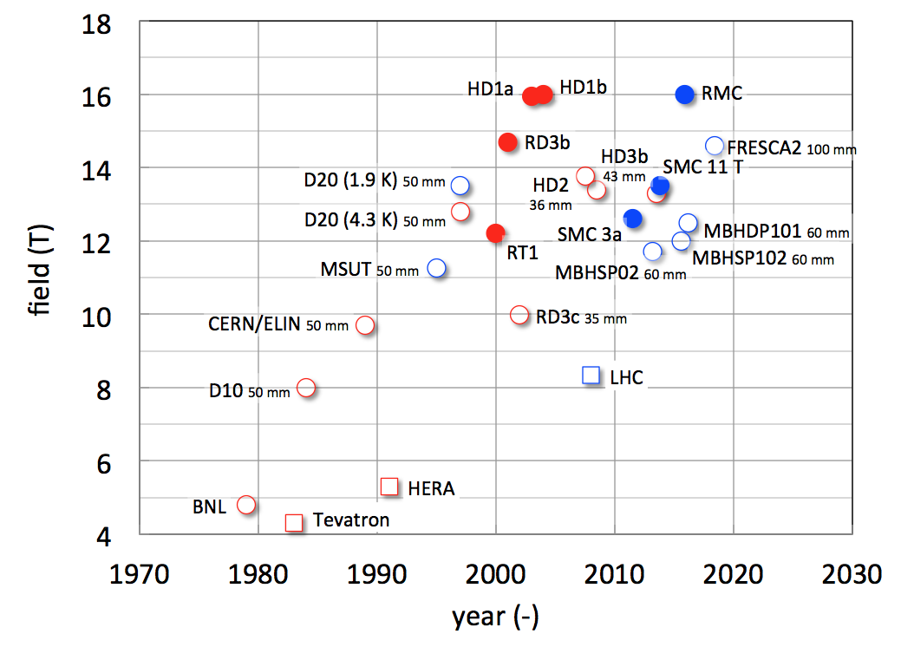
PRESENT ACHIEVEMENTS
In accelerators:
  Nb-Ti technology used in several machines, up to 8 T in the LHC
  Nb3Sn technology to be used in HL-LHC (12 T range), full length prototypes under construction – short model program aiming at 16 T for FCC is ongoing
  HTS technology being developed to build inserts to boost the field from 16 to 24 T – racetracks and short models providing 3-5 T have been built and tested in standalone configuration
Nb₃Sn
HL LHC
Nb-Ti
Operated in particle accelerators
Hall of fame of Nb-Ti and Nb₃Sn accelerator magnets [L. Bottura, MT25]

Slide 32
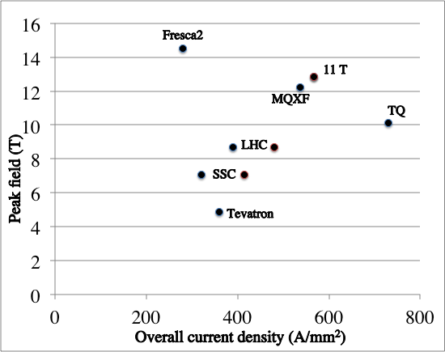
SUMMARY OF THE TESLA RACE
16 T

Slide 33

THE 30’s: TOWARDS 30-100 TeV
For an accelerator, more energy can be obtained through larger size (brute force) or larger field (technological advance)
Having a magnet in the 14-16 T range, one can envisage two options
  HE-LHC: replacing the LHC lattice with Nb₃Sn dipoles to double the LHC energy (around 30 TeV)
  FCC: New tunnel of 100 km, with Nb₃Sn dipoles (around 100 TeV)
Cost and time are a major point
  The last teslas are very expensive
  and can take a lot of time
Critical surface for Nb-Ti: j versus B and magnet loadline

Slide 34
CONCLUSIONS
LHC proves to be a very flexible accelerator, and reached ultimate luminosity at 6.5 TeV
Plans for 2021-2023
  Increase the energy to 7+7 TeV
  Substantial interventions on the LHC, recover the pre-LS2 performance could take time
Plans for 2026-2035
  Ten times more data through a double beam intensity, half of beam size, and heavvy use of levelling and new optics
  This will prove the ability of Nb₃Sn technology of providing 12 T magnets – 4 T jump in field for accelerator magnets
After HL-LHC
  Making use of Nb₃Sn technology at 16 T to increase energy to 30 TeV (in LHC tunnel) or to 100 TeV (in a new 100 km tunnel)
  Possibility of boosting up to 20-25 T with HTS (under study)
  Input of physics is essential …

