Slide 1







HARD PROBES FROM RHIC
TO LHC
Máté Csanád @ PIC 2017, Aug 5, 2017
Eötvös University, Budapest, Hungary

Slide 2
Content of this talk
INTRODUCTION
  Universe history, Big Bang and Little Bangs
  Time evolution of heavy ion collisions, phases of QCD
HARD PROBES, BASIC OBSERVATIONS
  Nuclear modification of high energy particles and jets
  Nuclear modification of hadrons versus photons
  Heavy flavors
RECENT RESULTS
  Suppression in asymmetric/small/low-energy systems
  Heavy flavors: beauty and charm, medium temperature
  Jet structure: energy loss via fragmentation and jet correlations

Slide 3
INTRODUCTION
Universe history, Big Bang and Little Bangs
Time evolution of heavy ion collisions
Phase map of QCD and the experimental control parameters
Accelerators, experiments
INTRODUCTION HARD PROBES BASICS RECENT RESULTS

Slide 4
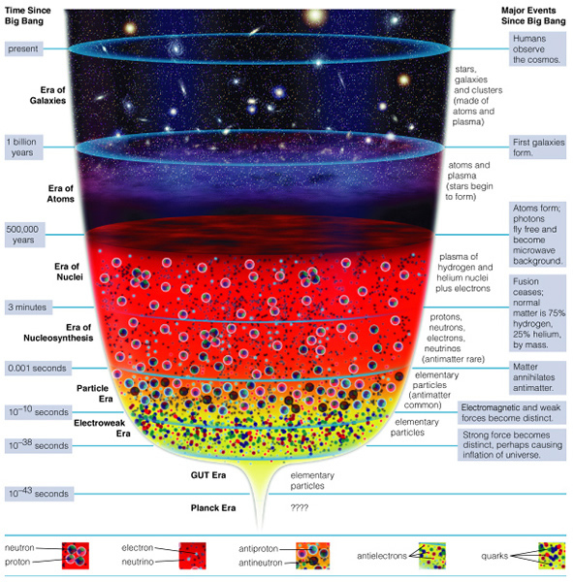
Big Bang in the lab
Ages of the Universe:
  Stars & Galaxies
  Atoms
  Nuclei
  Nucleosynthesis
  Elementary particles
  … ?
How to investigate?
Create little bangs
Collisions of heavy ions
Record outcoming particles
INTRODUCTION HARD PROBES BASICS RECENT RESULTS

Slide 5
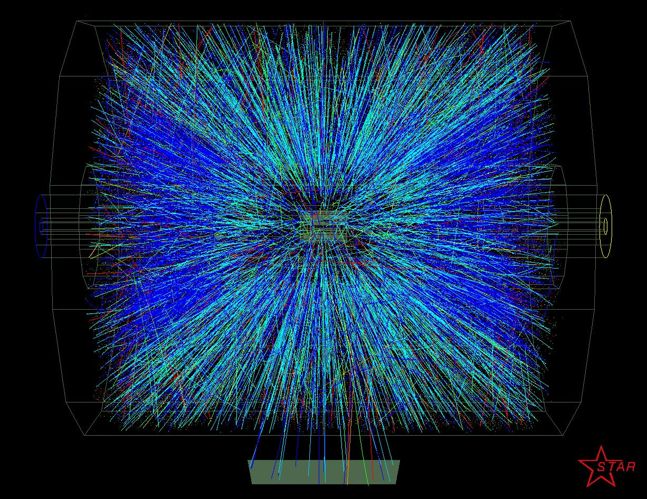
How to investigate these little bangs?
INTRODUCTION HARD PROBES BASICS RECENT RESULTS

Slide 6
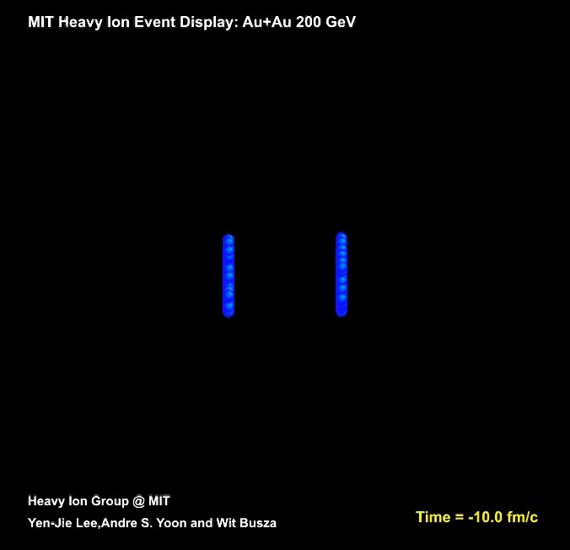
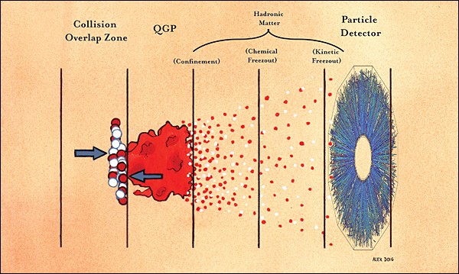
Timeline of a heavy ion collision
Pre-thermalization stage:
~1 fm/cm
Quark-hadron transition:
~7-10 fm/c
Chemical + kinetic freeze-out
INTRODUCTION HARD PROBES BASICS RECENT RESULTS

Slide 7
Time evolution of a heavy ion collision
γ, e±, μ±
γ, e±, μ±
π±, K±, p, ..
π±, K±, p, ..
Hadron gas
Initial stage:
  Hard scattering
  Jet formation
Leptons, photons:
  ”shine through”
Hadrons:
  Dissociation and coalescence
  ”Final” hadrons created at freeze-out
Freeze-out, hadrons
jets
sQGP
INTRODUCTION HARD PROBES BASICS RECENT RESULTS

Slide 8
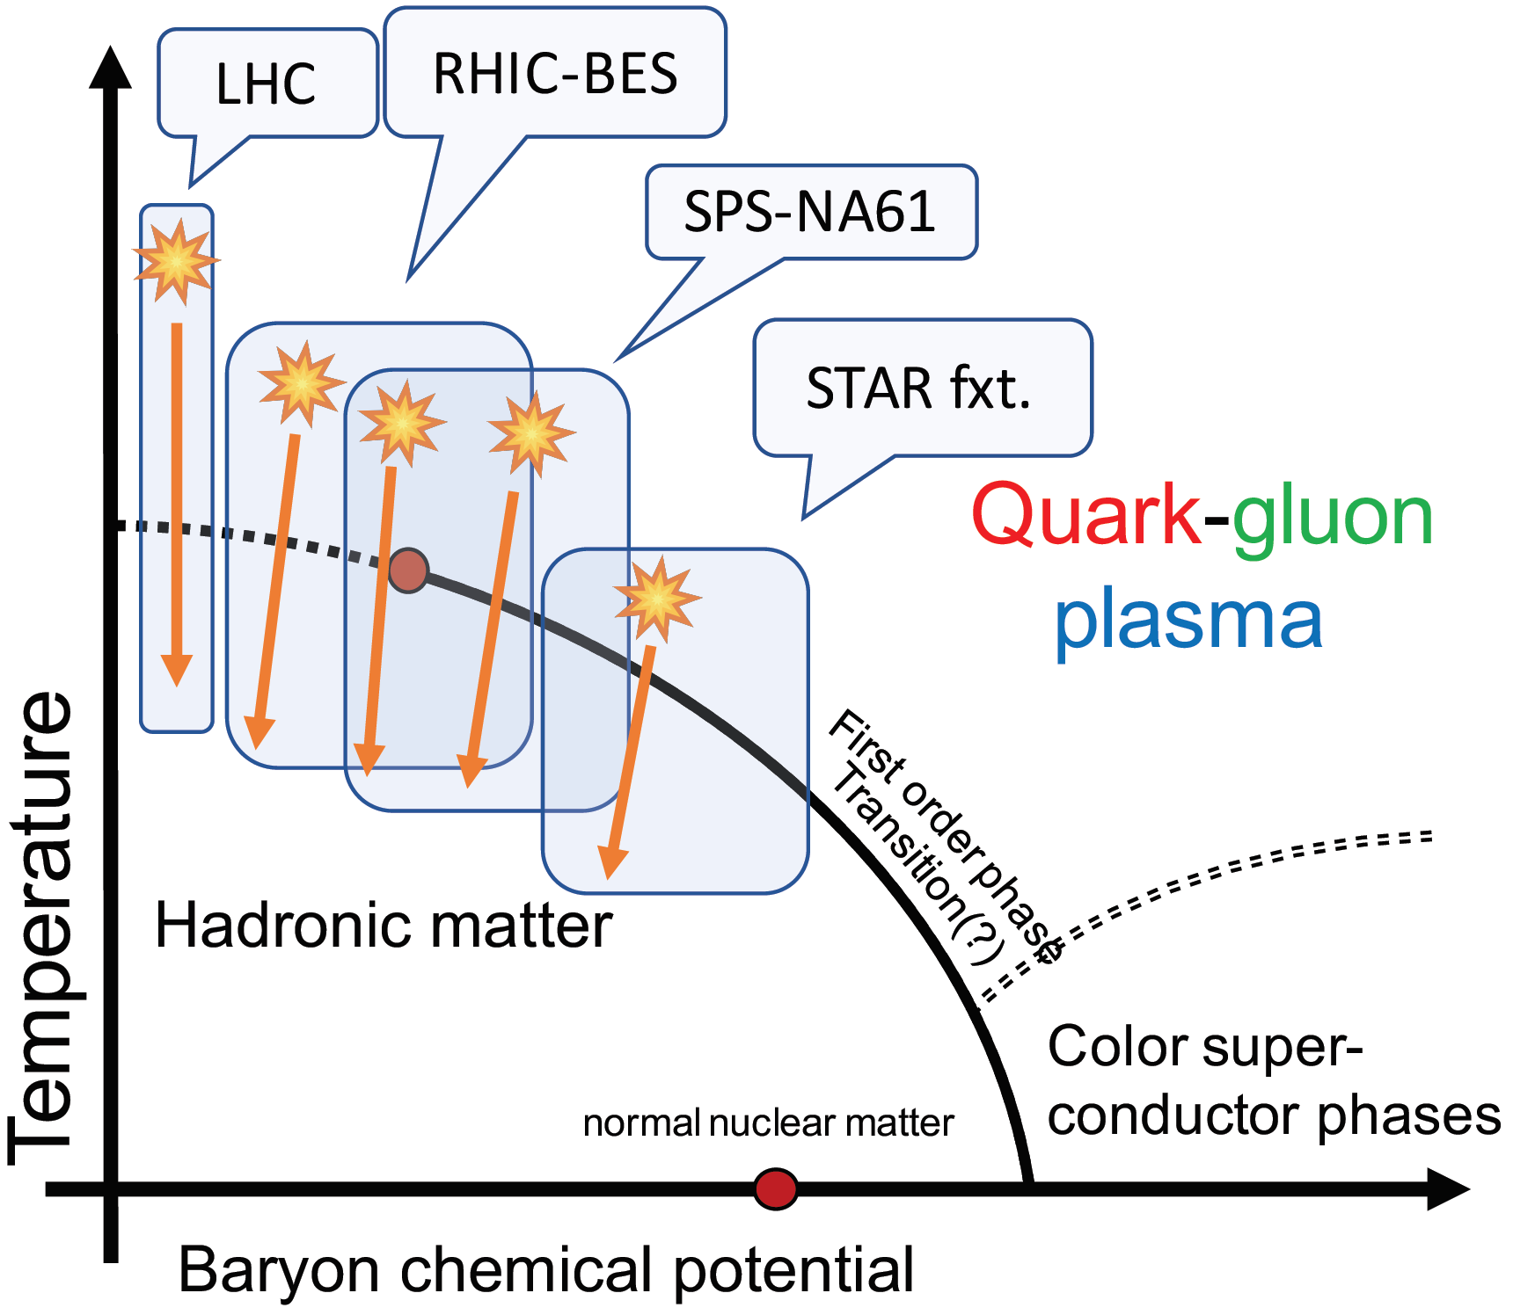

Exploring the Phase map of QCD
Phase map: temperature versus
matter excess (baryochem. pot. μ_{B})
1st order quark-hadron
phase transition at high μ_{B}
Crossover at low μ_{B} and T$≅$170 MeV
170 MeV $↔$ ~10¹² K
Control parameters:
  Collision energy
  Collision system
  Collision geometry
High μ_{B}: nuclear matter, neutron stars, color superconductors…
INTRODUCTION HARD PROBES BASICS RECENT RESULTS

Slide 9

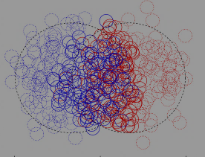
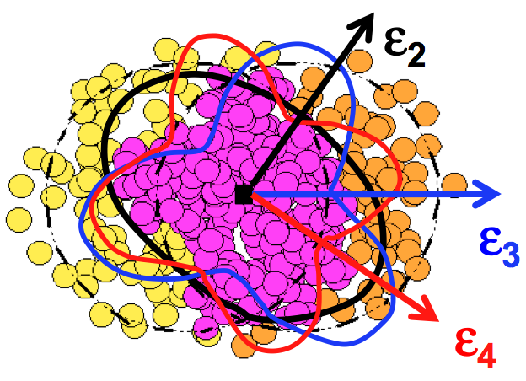
Experimental Control parameters
Collision energy: controls initial temperature, initial μ_{B}
Collision system & centrality: controls available volume
Event geometry: reaction plane, event plane, fluctuations
Important parameters: N_{part} (system size), N_{coll} (x-sect)
Central Au+Au
N_{part}~300
Peripheral Au+Au
N_{part}~50
d+Au
p+p
Reality
Multipole event planes
Reaction Plane
INTRODUCTION HARD PROBES BASICS RECENT RESULTS

Slide 10
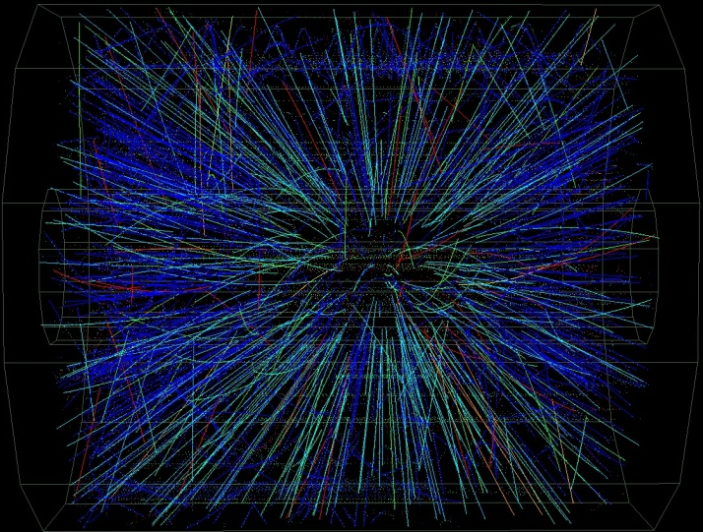
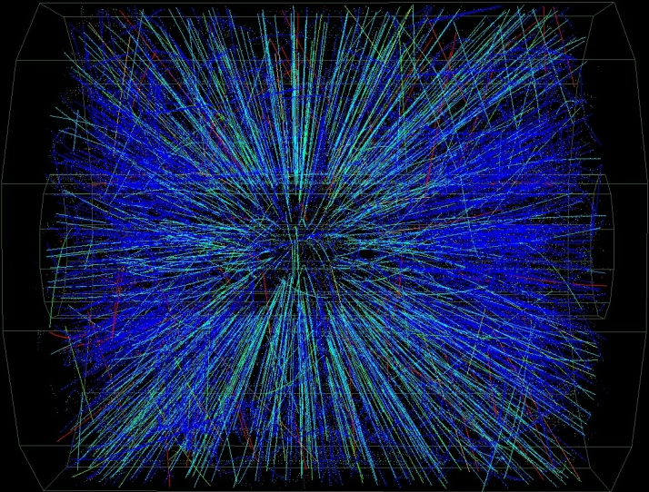
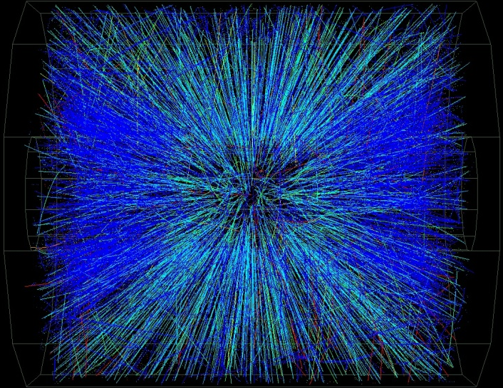
Collisions of different centrality
Peripheral
Central
INTRODUCTION HARD PROBES BASICS RECENT RESULTS

Slide 11
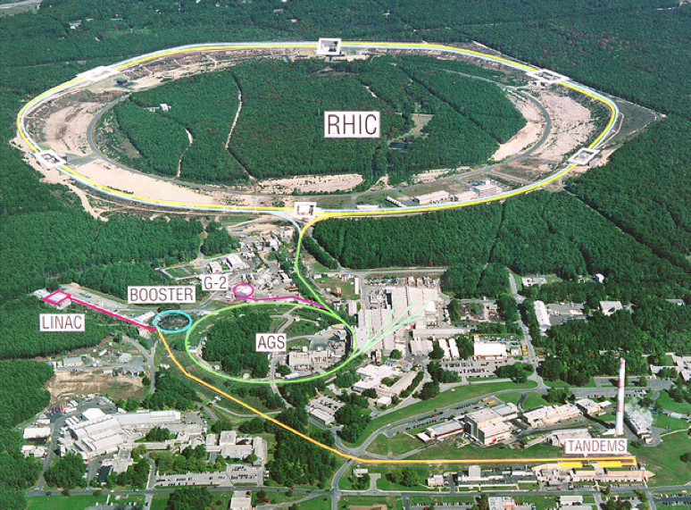


Facilities: Relativistic Heavy Ion Collider
At the Brookhaven National Laboratory, Long Island, New York, USA
Collisions of: $\vec{\text{p}}$, d, ³He, Al, Cu, Au, U
Collision energies: 7-200 GeV/nucleon, even 0.5 TeV for $\vec{\text{p}}$
Experiments: PHENIX & STAR; future: sPHENIX; past: BRAHMS & PHOBOS
INTRODUCTION HARD PROBES BASICS RECENT RESULTS

Slide 12
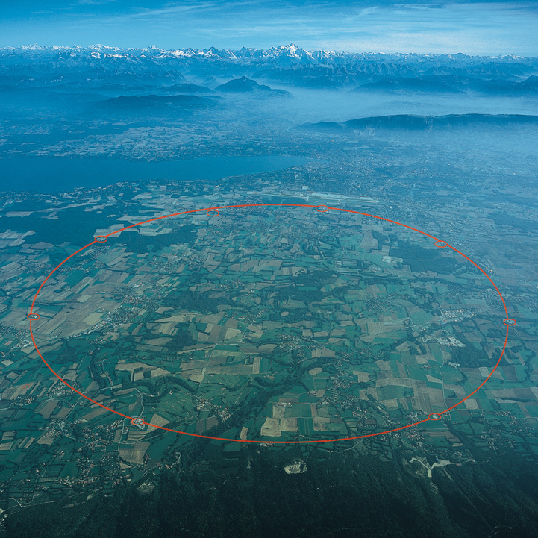
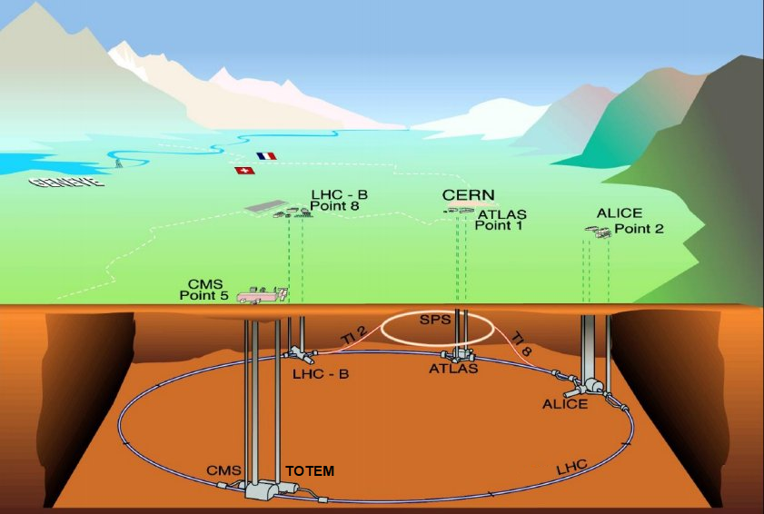
Facilities: Large Hadron Collider
Past high energy physics facilities: LEP, SPS (also currently in use)
LHC collisions: p+p, p+Pb and Pb+Pb
Energies: from 2.76 TeV/nucleon to 13 TeV (p+p only)
Experiments: ALICE, ATLAS, CMS, LHCb, LHCf, MoEDAL, TOTEM
INTRODUCTION HARD PROBES BASICS RECENT RESULTS

Slide 13
HARD PROBES, BASIC OBSERVATIONS
Nuclear modification: R_{AA}
Jet quenching
Hadrons, photons
Heavy flavors
INTRODUCTION HARD PROBES BASICS RECENT RESULTS

Slide 14
Nuclear modification: tomography!
nucleus+nucleus
proton+proton
Simply just more?
A+A = many p+p?
High p_{T} particle yield in A+A
R_{AA}=
High p_{T} particle yield in p+p
×
Number of p+p collisions
INTRODUCTION HARD PROBES BASICS RECENT RESULTS

Slide 15
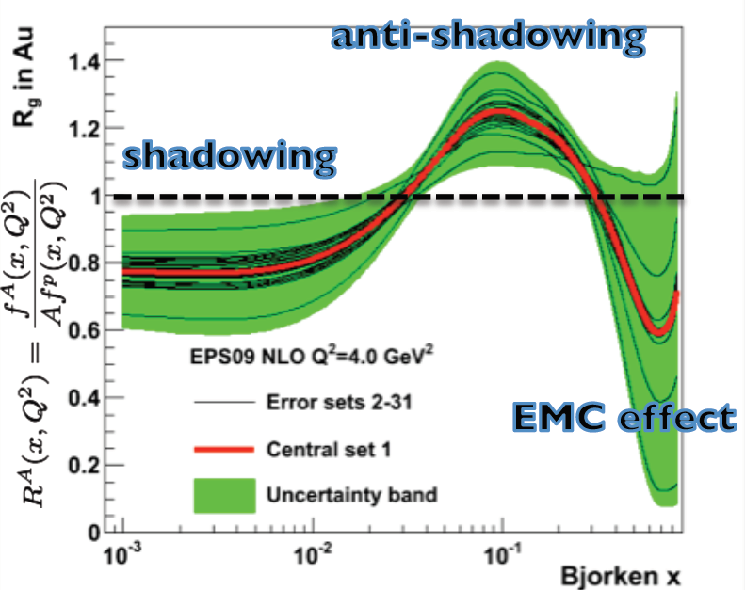
Cold versus hot nuclear matter effects
Modification of R_{AA} may be due to hot or cold nuclear matter effects
Hot matter: suppression/quenching of hard particles
Cold matter: initial state effect
  Nuclear modification of PDF’s
  Shadowing
  Energy loss of partons in nucleus
  kT broadening
Idea: hot nuclear matter
not present in d+Au
Cold nuclear matter: also in d+Au
Nuclear per parton PDF
INTRODUCTION HARD PROBES BASICS RECENT RESULTS

Slide 16
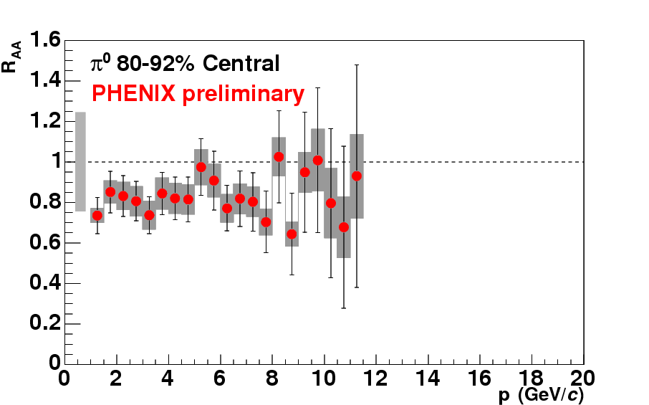
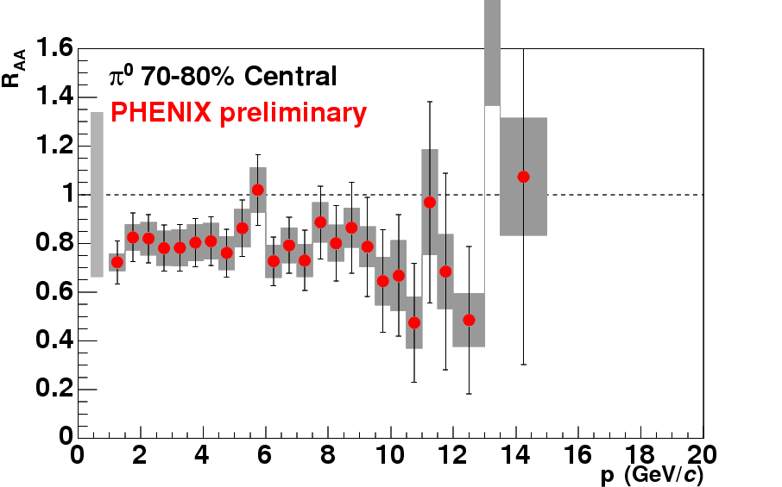
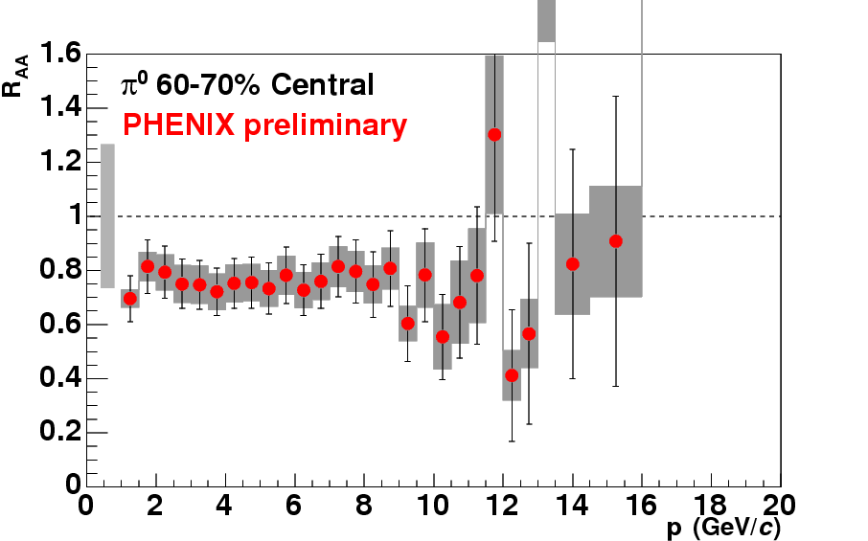
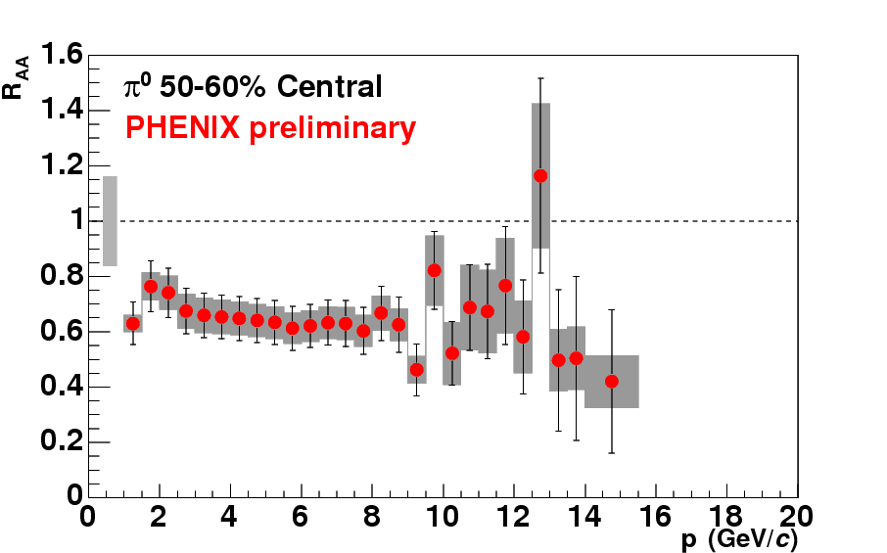
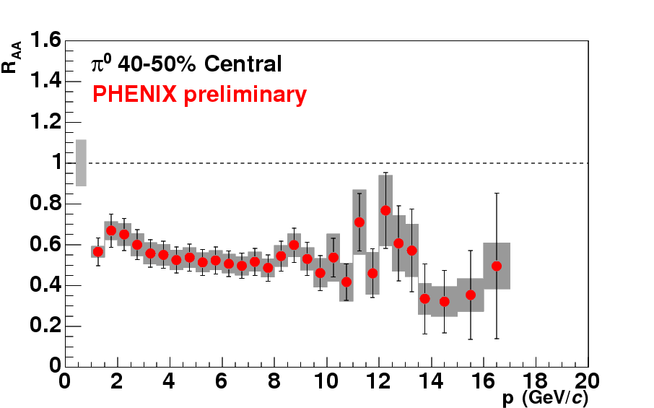
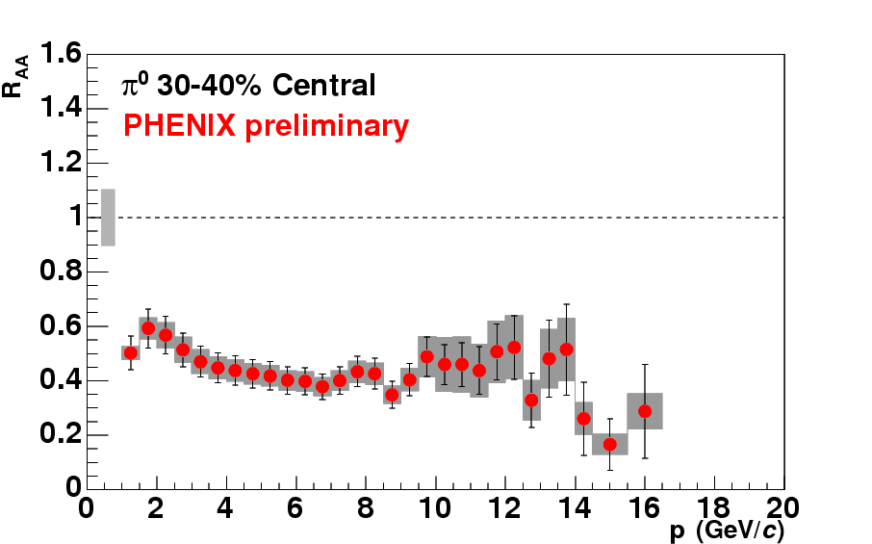
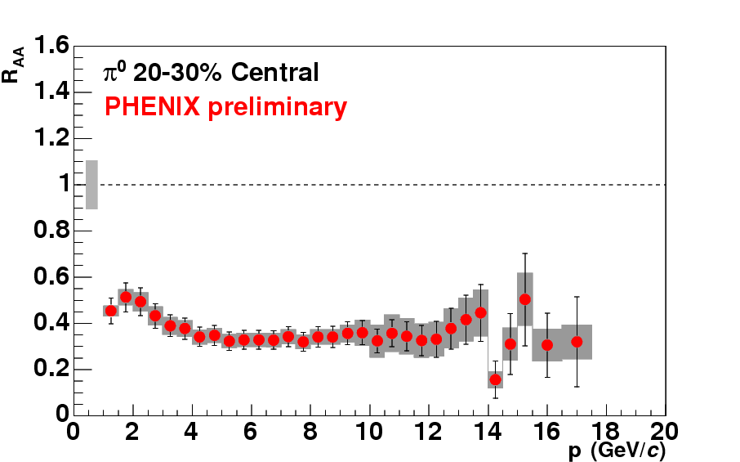
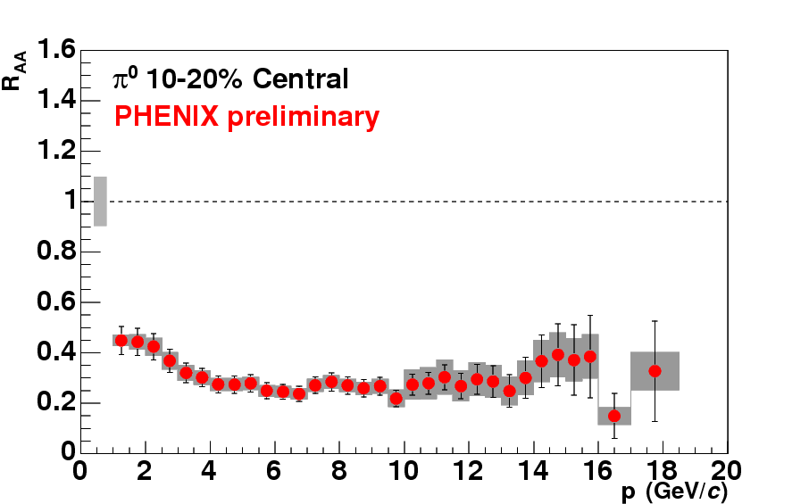
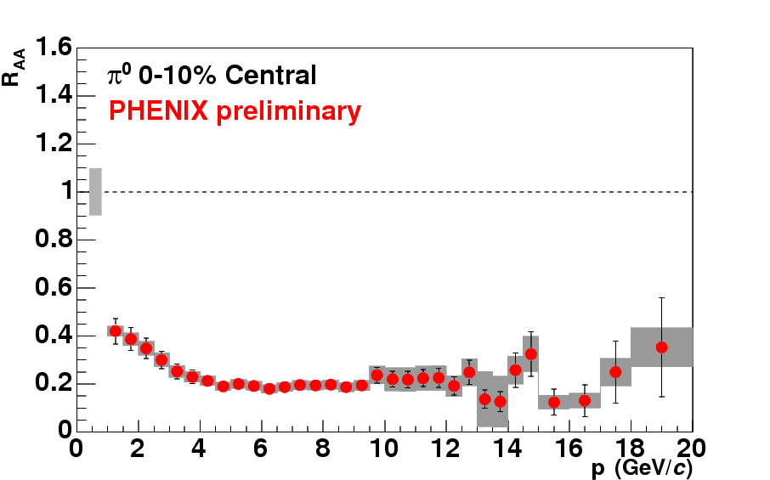
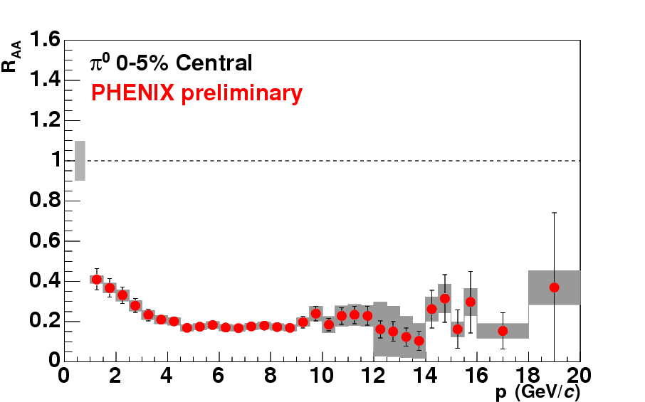
Suppression as a function of centrality
No suppression in d+Au or peripheral Au+Au; strong suppression in central!
Phys.Rev.C76:034904,2007
Enhanced
Suppressed
INTRODUCTION HARD PROBES BASICS RECENT RESULTS

Slide 17
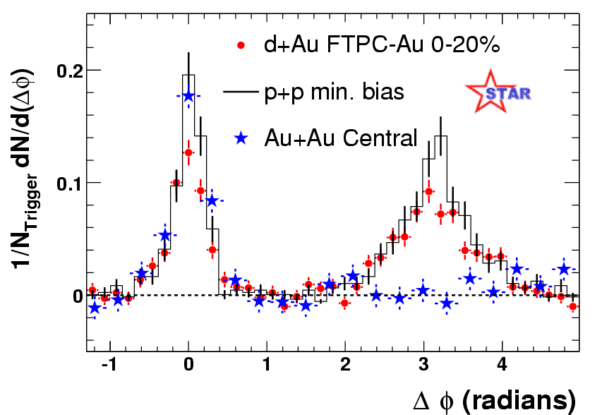
Suppression of the away side jet
Angular correlation of high energy hadrons
Outgoing jet: similar in p+p, d+Au, Au+Au
Inward going (away side) jet: missing in central Au+Au
PRL91(2003)072304
pedestal and flow subtracted
INTRODUCTION HARD PROBES BASICS RECENT RESULTS

Slide 18
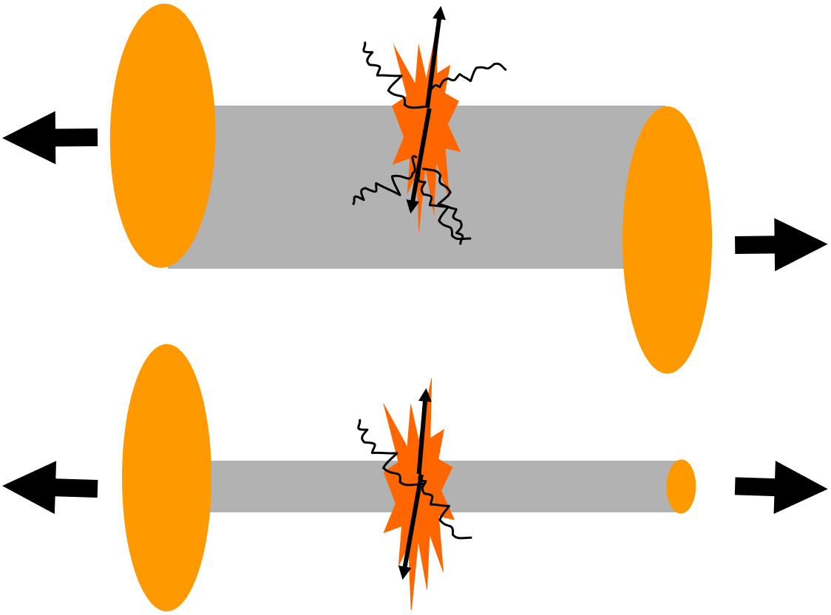
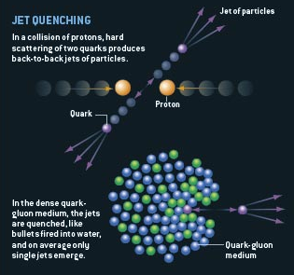
Suppression of high energy particles
Suppression in Au+Au collisions: 1st milestone
Lack of suppression in d+Au: 2nd milestone
Two PRL covers
Au+Au
d+Au
Zajc, Riordan, Scientific American
INTRODUCTION HARD PROBES BASICS RECENT RESULTS

Slide 19
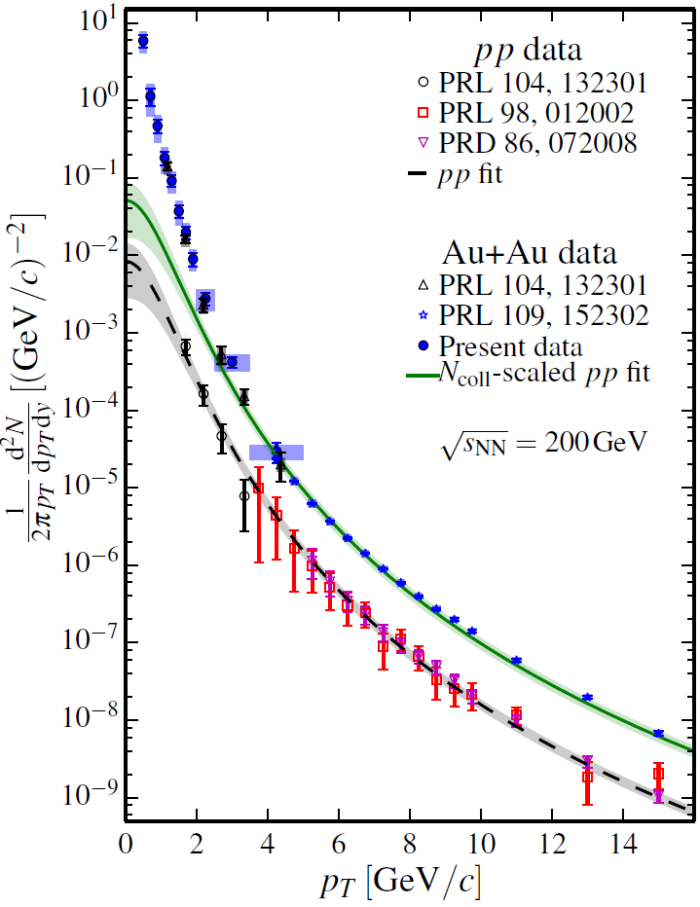
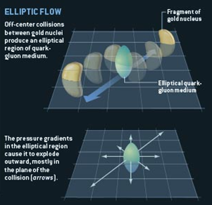
A new type of medium formed
More evidence from soft probes:
  Flow: strong coupling, hydro behavior
  Direct and thermal photons: large initial temp.
Low momentum direct photon enhancement
PRC 91,064904
Zajc, Riordan, Scientific American
INTRODUCTION HARD PROBES BASICS RECENT RESULTS

Slide 20
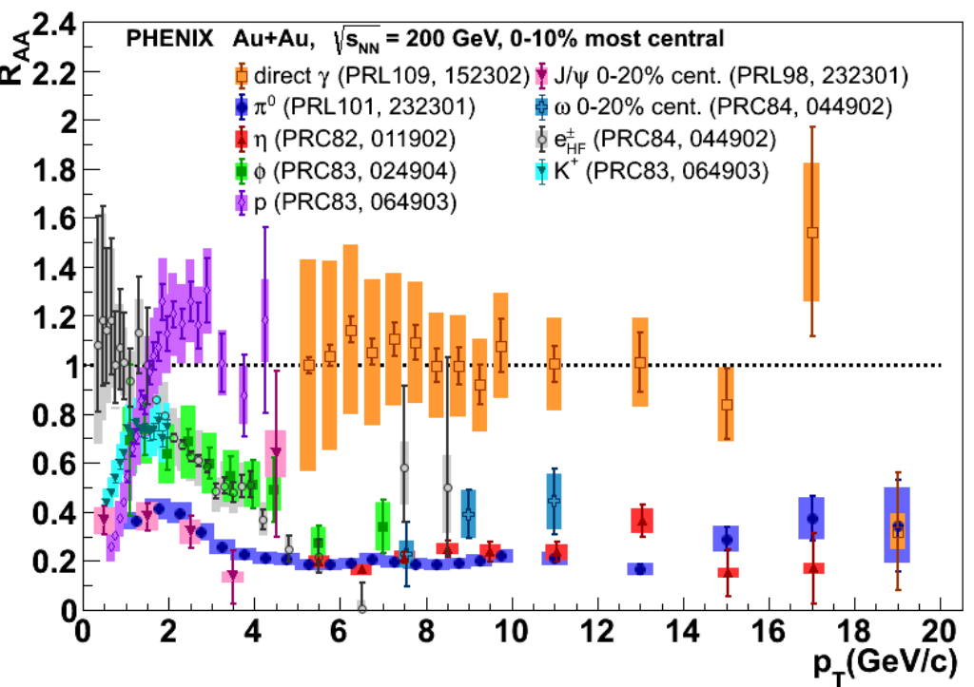
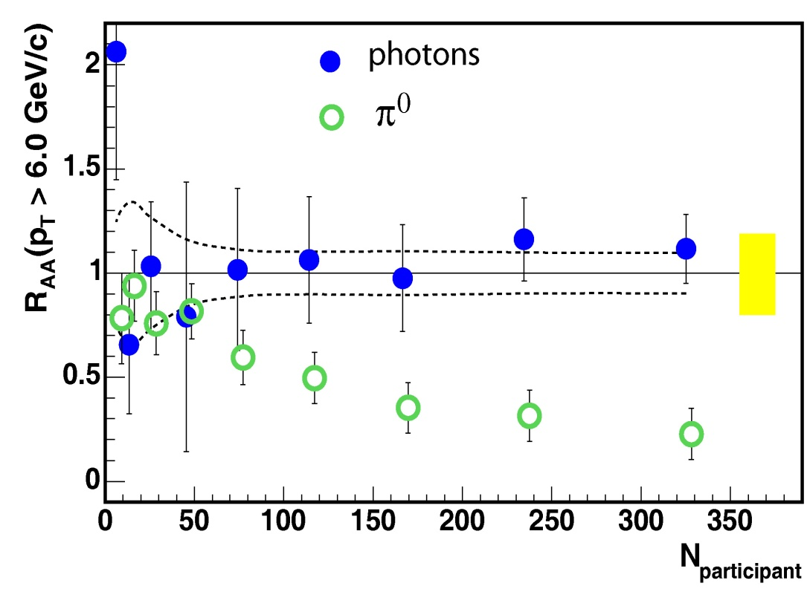

How do other particles behave?
All hadrons suppressed, direct photons „shine through”
Suppression dependent of system size (controlled by centrality or N_{part})
PHENIX Au+Au $\sqrt{s_{NN}}$=200 GeV
Phys.Rev.Lett. 94 (2005) 232301
INTRODUCTION HARD PROBES BASICS RECENT RESULTS

Slide 21
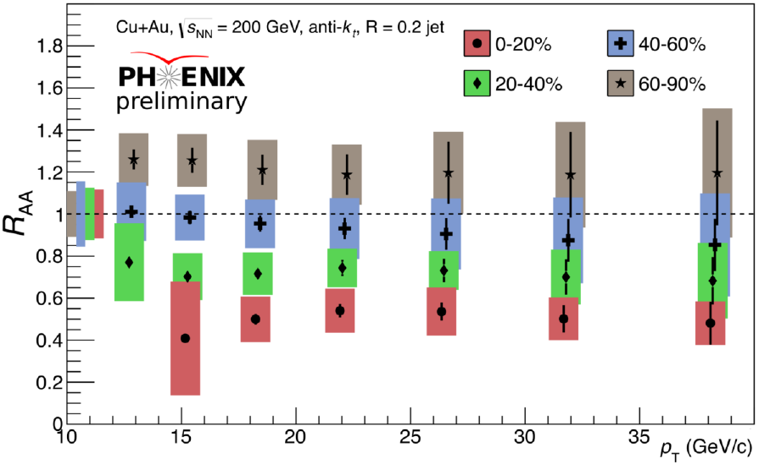
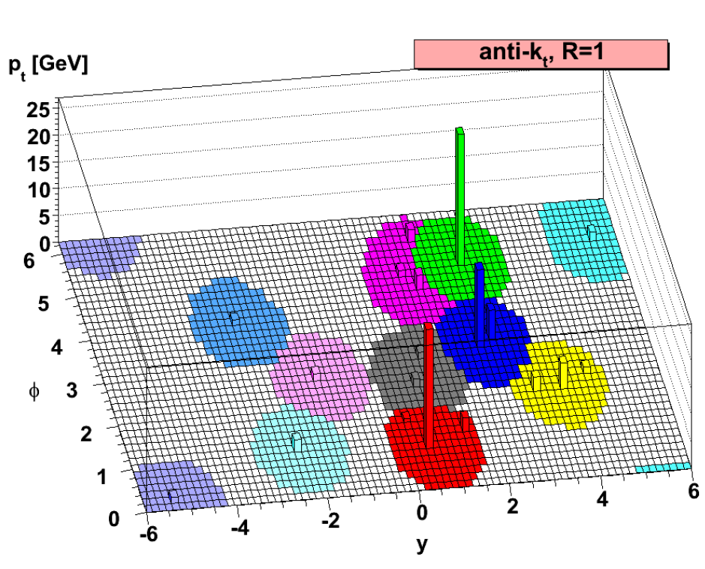

Jet reconstruction
Basic way to analyze suppression: yield of identified particles
Advanced medium probe: reconstructed jets (and their correlations…)
Jet measurement: algorithm required
  Define jet/particle distance: $d_{ij}=\frac{\min\left(k_{T.i}^{2p},k_{T.j}^{2p}\right)\left(Δy_{ij}^{2}+Δφ_{ij}^{2}\right)}{R^{2}}, d_{i,Beam}=k_{T.i}^{2p}$
  Widely used: anti-k_{T}, $p=−1$
  M. Cacciari, G. P. Salam, G. Soyez,
  JHEP 0804 (2008) 063,
  arXiv:0802.1189 [hep-ph]
S Zharko (PHENIX), Hard Probes 2016
INTRODUCTION HARD PROBES BASICS RECENT RESULTS

Slide 22
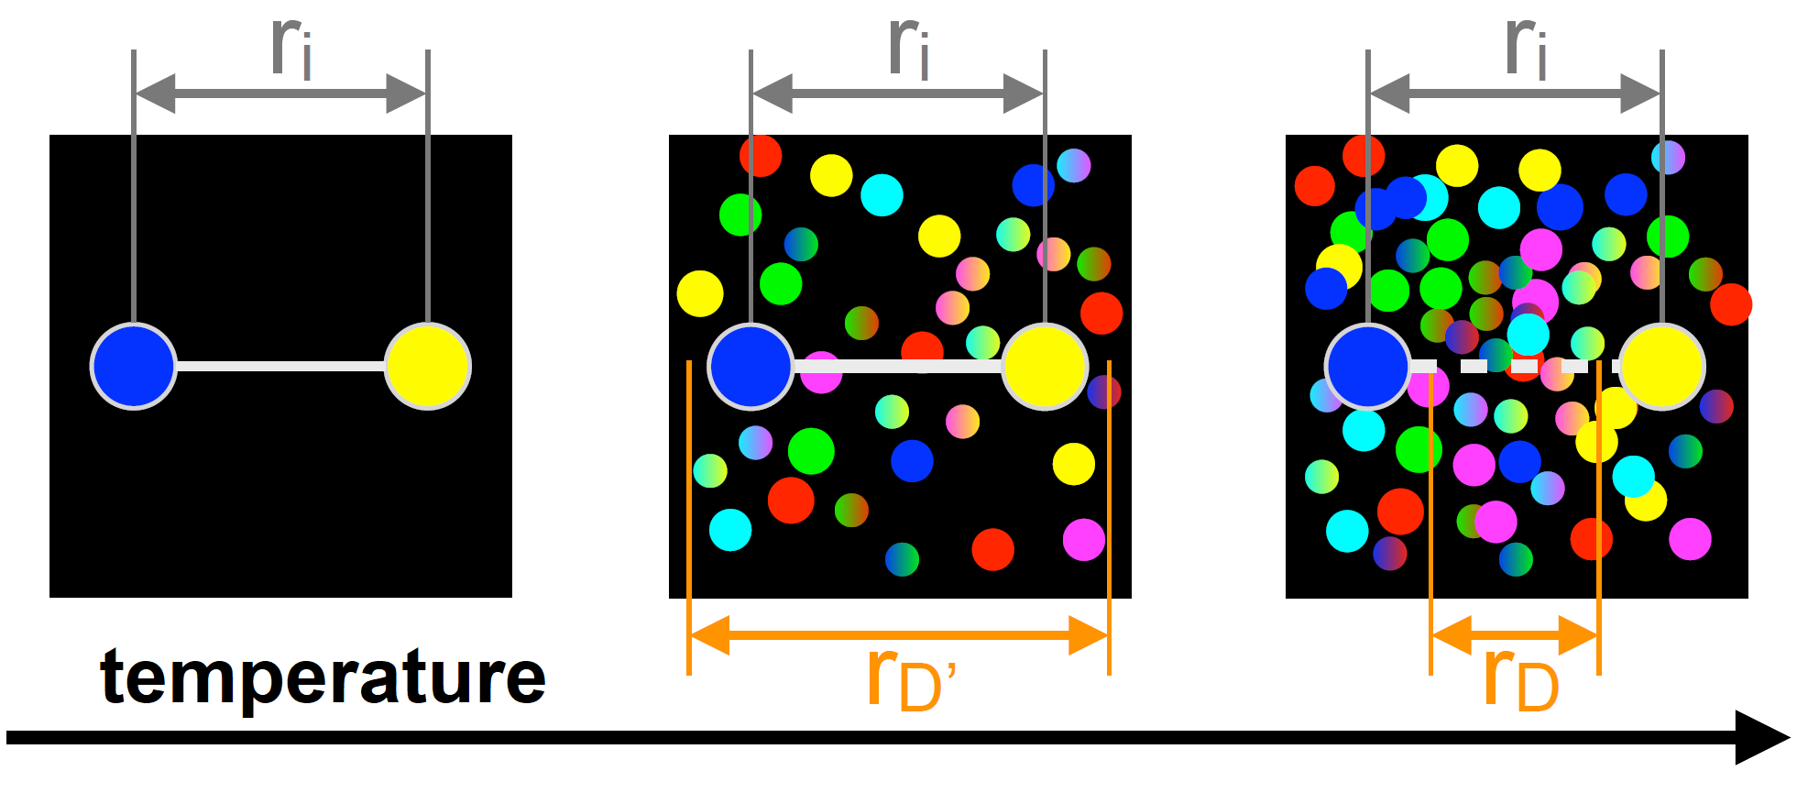
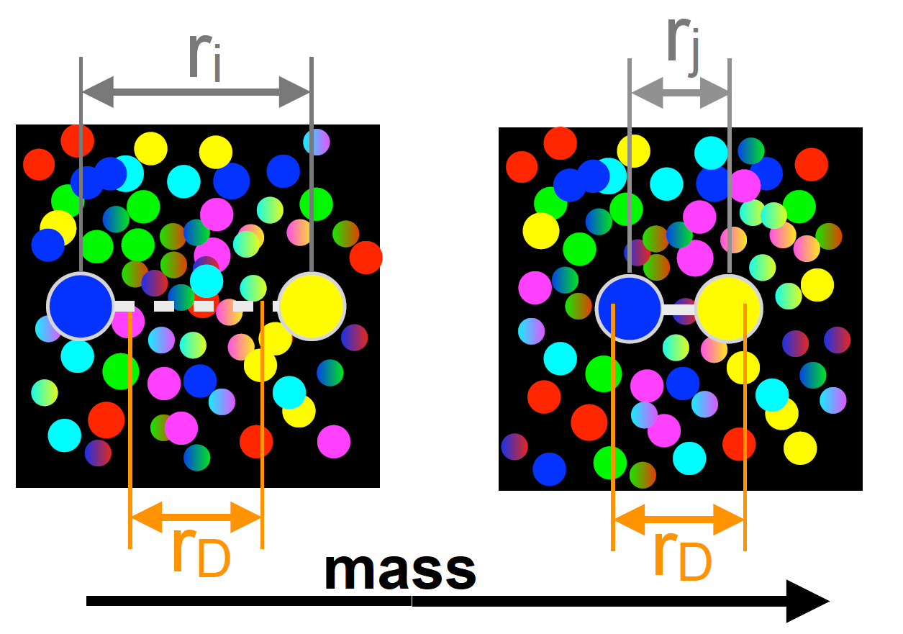
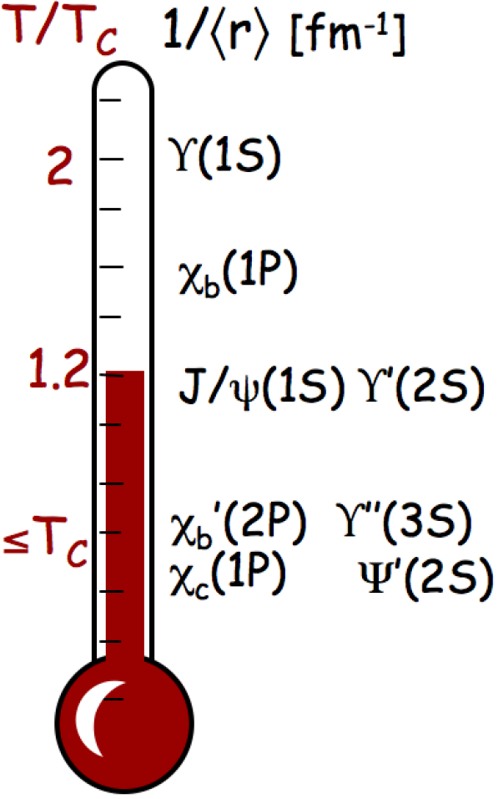
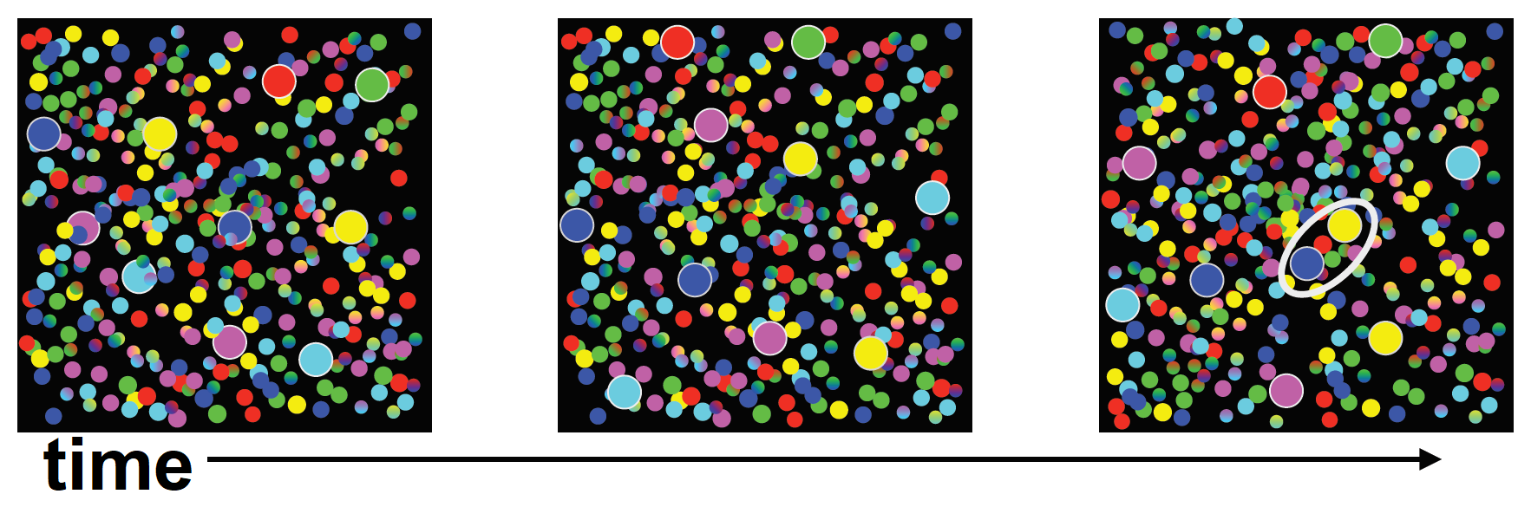

What about heavy flavor mesons?
Timeline: quarkonium ($\text{q}\overline{\text{q}}$) formation $→$ QGP evolution $→$ $\text{q}\overline{\text{q}}$ decay
Quarkonia experience the whole QGP evolution, competing processes
Suppression due to color-screening: temperature and size/mass dependence
Statistical
regeneration
in time:
Images from J Castillo, SQM17 and A Mócsy, HardProbes2009
INTRODUCTION HARD PROBES BASICS RECENT RESULTS

Slide 23
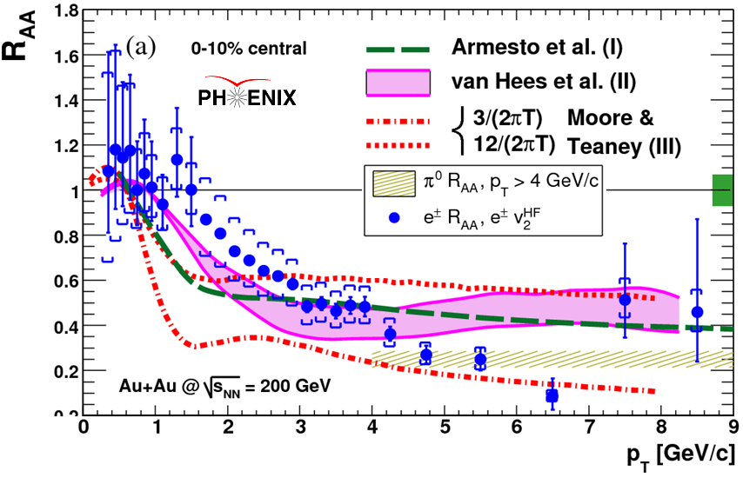
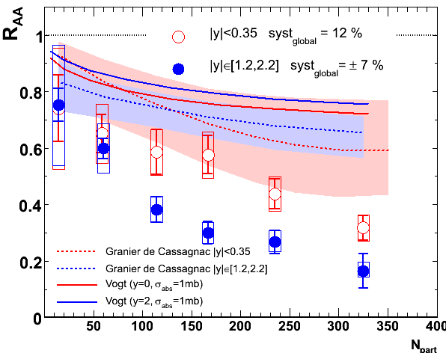
Suppression of heavy flavor
Electrons from HF decays are suppressed (collision or radiation, mass ordering)
J/Ψ are also suppressed
Described by strong coupling, large transport coefficients
HF
J/Ψ
Phys. Rev. Lett. 98, 172301 (2007)
Phys. Rev. Lett. 98, 232301 (2007)
INTRODUCTION HARD PROBES BASICS RECENT RESULTS

Slide 24
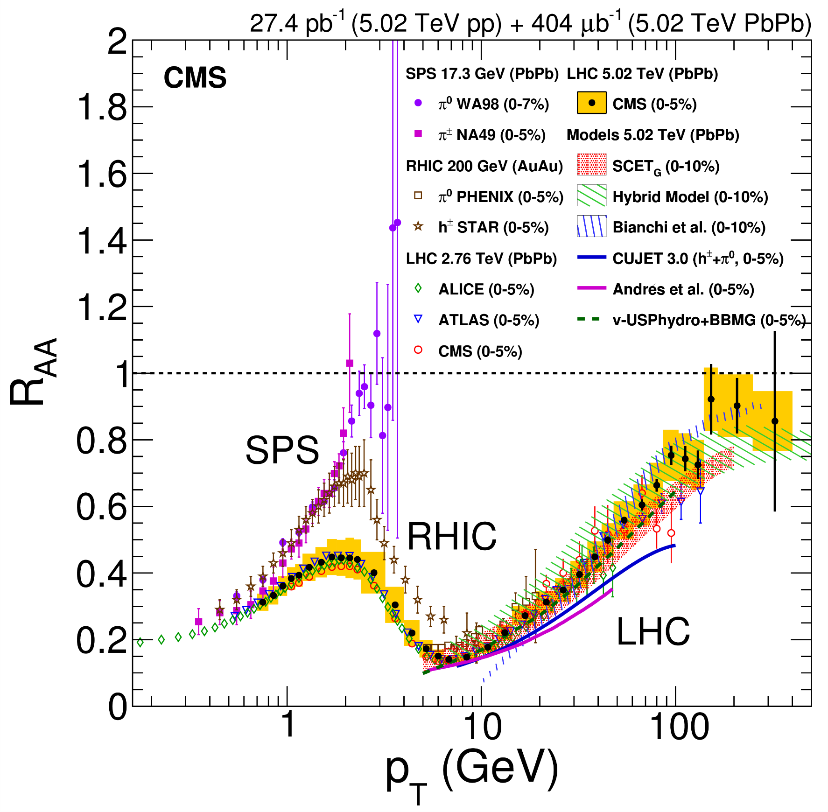

Hadron suppression: SPS $→$ RHIC $→$LHC
Similar results at
$\sqrt{\text{s}}\text{=}$2.76 and 5.02 TeV
Local maximum at p_{T}~2 GeV
Minimum at p_{T}~7 GeV
Less suppression at
very high momenta!
RHIC and LHC similar?
Competing effects:
  Spectra flattening with incr. $\sqrt{\text{s}}$
  Energy loss increasing with $\sqrt{\text{s}}$
JHEP 04 (2017) 039
INTRODUCTION HARD PROBES BASICS RECENT RESULTS

Slide 25
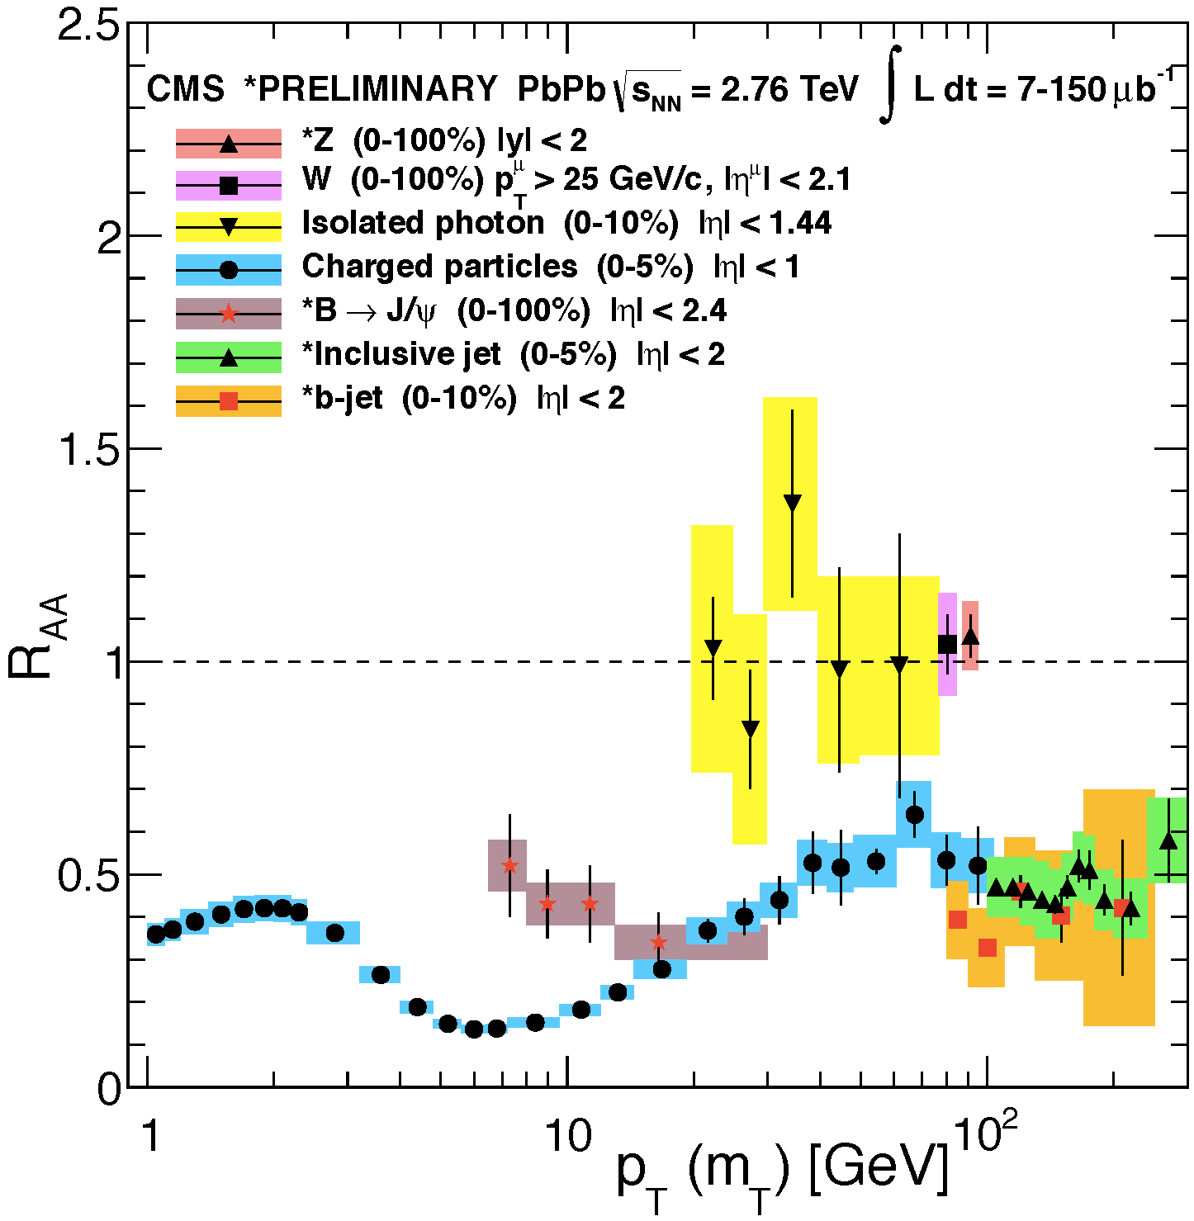
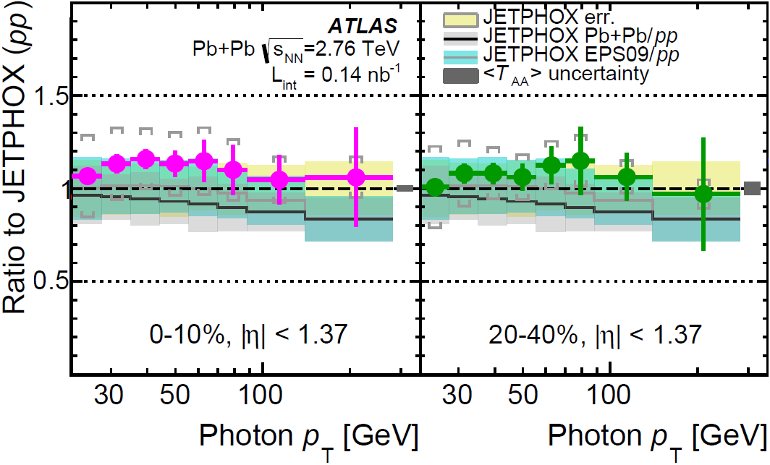
photons shine through at the LHC also
No photon suppression for any energy or any centrality
Electroweak bosons also not suppressed
Comparison to MC (JETPHOX) up to p_{T} of 200 GeV: similar conclusion
PRC93,034914(2016)
CMS talk at
Hard Probes 2013
Matthew Nguyen
INTRODUCTION HARD PROBES BASICS RECENT RESULTS

Slide 26
Summary of the status quo
Jet suppression in A+A, lack of suppression in d+A:
new, strongly interacting medium created at RHIC
Confirmed by soft probes: elliptic flow and thermal photons
Also heavy flavor hadrons suppressed
Photons shine through
Observations confirmed by the LHC
Rising trend for very large momenta
Jet reconstruction possible
γ
INTRODUCTION HARD PROBES BASICS RECENT RESULTS

Slide 27
Recent results
Suppression in asymmetric/small/low-energy systems
Heavy flavors: charm and beauty
Jets and jet correlations
INTRODUCTION HARD PROBES BASICS RECENT RESULTS

Slide 28
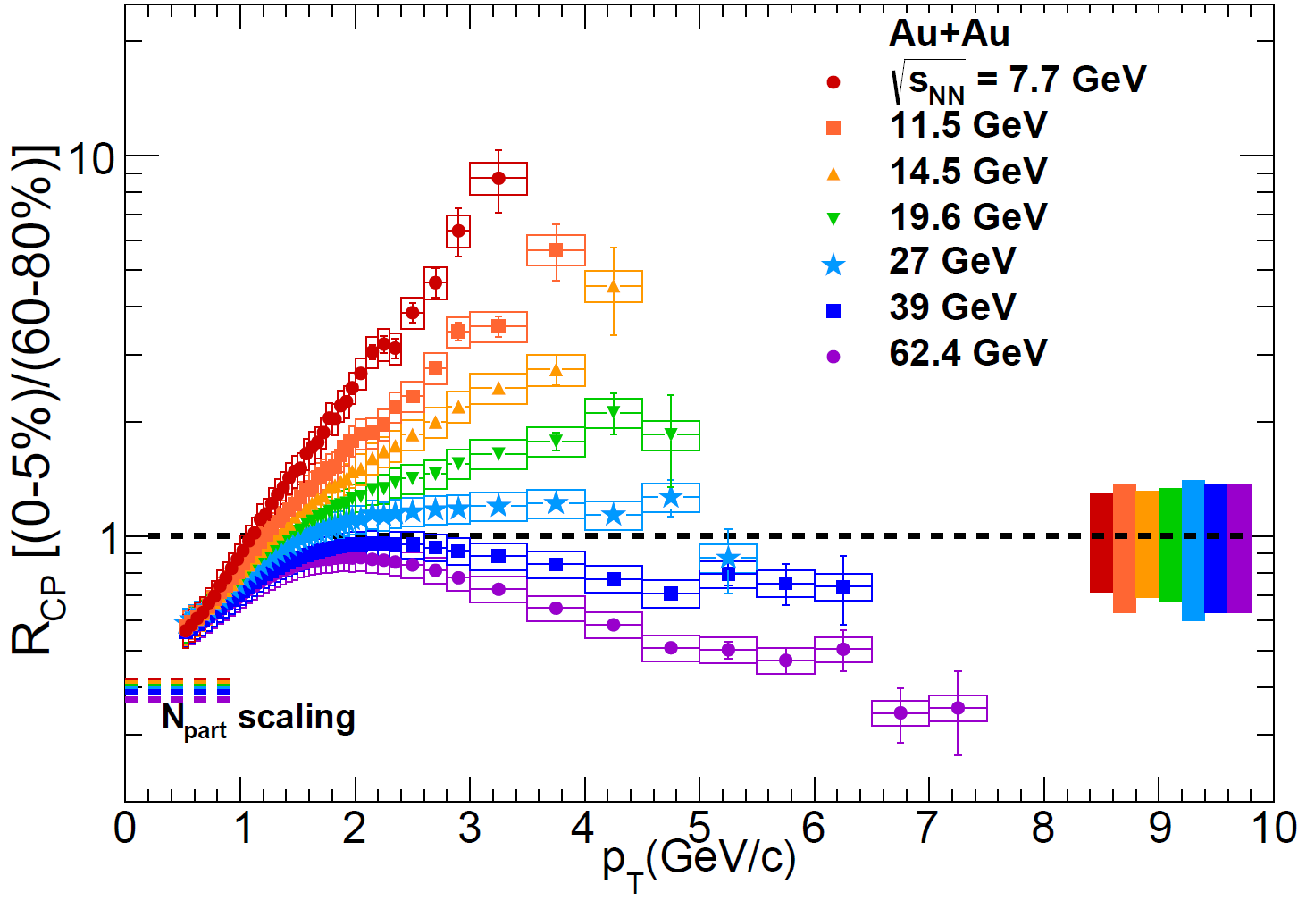
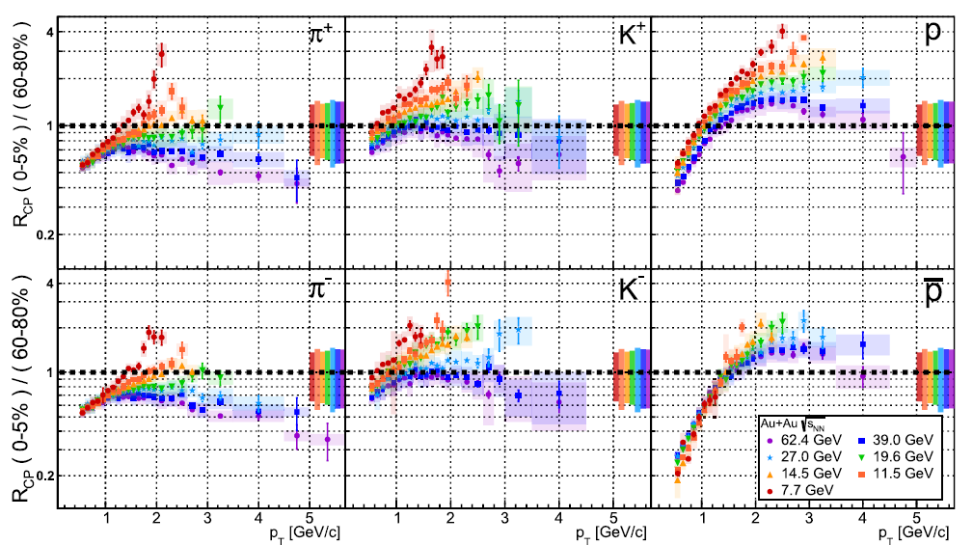
Suppression in the Beam Energy Scan
R_{CP} analyzed here instead of R_{AA}, transition above one with collision energy
Hadron enhancement: Cronin-effect, radial flow, coalescence domination
Identified particles: less suppression for kaons, enhancement for protons
STAR collaboration, arXiv:1707.01988
INTRODUCTION HARD PROBES BASICS RECENT RESULTS

Slide 29
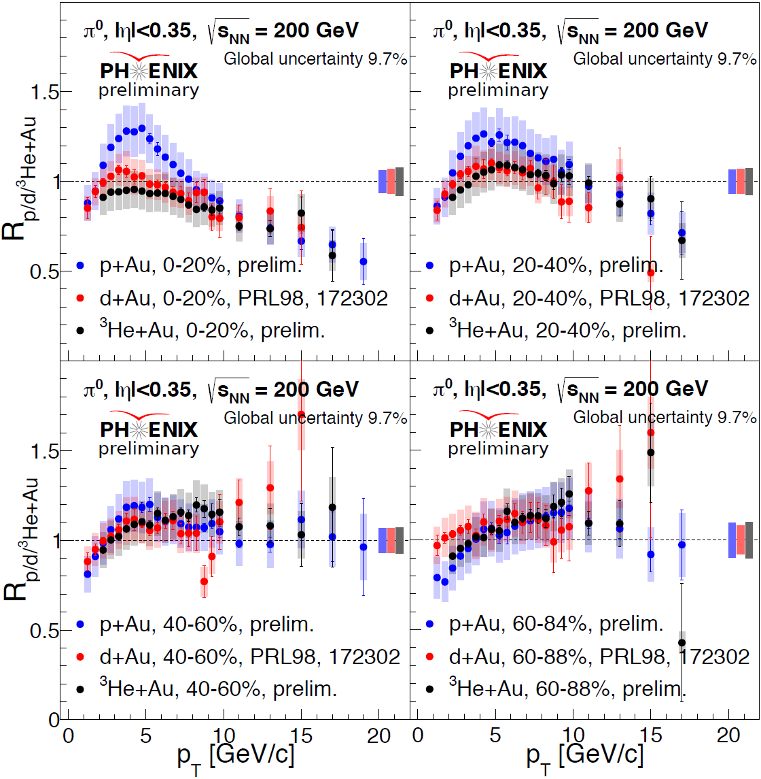
Suppression in small sytems at RHIC
p+Au, d+Au, ³He+Au compared
Centralities determined
as for large systems
New p+Au results show
large centrality dependence
System sizes agree at high pT
At moderate pT, ordering seen
Model comparision:
  Vitev, HIJING++ investigated
  No full match of ordering,
  peak location, etc
N. Novitzky, QM17
INTRODUCTION HARD PROBES BASICS RECENT RESULTS

Slide 30

Suppression in small systems at LHC
Jet energy dependence observed at LHC
Suppression/enhancement in central/peripheral pPb
Parton energy fraction dependent mechanism?
INTRODUCTION HARD PROBES BASICS RECENT RESULTS

Slide 31


Dependence on the initial system
Comparing different systems of the same size: Cu+Cu, Cu+Au, Au+Au
Different centrality but same number of nucleon participants (N_{part})
Clear N_{part} dependence („participant scaling”)
S Zharko, Hard Probes 2016
Phys. Rev. Lett. 101, 232301
Phys. Rev. Lett. 101, 162301
=
=
=
INTRODUCTION HARD PROBES BASICS RECENT RESULTS

Slide 32

Centrality dependence of suppression
Fine centrality binning up to very peripheral
Significant change of
behavior beyond 80%
Biases in event
selection and
collision geometry?
Pythia without
nuclear modification
explains this
No need for quenching
in peripheral PbPb?
M. Knichel (ALICE), QM18

Slide 33

Pb+Pb versus Xe+Xe, CMS
Extrapolated reference used (R*)
Compared at same centrality: same oscillatory shape, agreement below 3 GeV
Less suppression in Xe+Xe at high p_{T}
Note p_{T}-dependent event selection bias for peripheral collisions (not shown)
A. Baty (CMS), QM18

Slide 34

Pb+Pb versus Xe+XE, ALICE
Xe+Xe is very similar to Pb+Pb if same multiplicity is chosen
Not the initial state is the same!
Possible reason: non-trivial interplay of geometry and path length dependence
Sekihata (ALICE), QM18

Slide 35

Pb+Pb versus Xe+Xe, ATLAS
Characteristic shape: minimum
around 7 GeV
Xe+Xe and Pb+Pb very similar
Central events: Xe+Xe a bit more suppressed
Also shape difference

Slide 36

Recent Heavy flavor results
Heavy flavor folklore:
  Light quarks: u, d, s
  Heavy quarks: c, t, b
  Open charm: D (qc) or Lambda_{c} baryons
  Hidden charm / charmonium: $η_{c}$, J/Ψ (Ψ), $Χ$, …; excitations: 1S, 2S, 3S, …
  Open beauty: B (qb)
  Hidden beauty / bottomonium: $η_{b}$,$Υ$, $Χ_{b}$, …
  Unfortunately, no T meson or “toponium” ☺
Goal in hadron physics: spectroscopy
Goal in heavy ion physics: dynamics, suppression, melting, regeneration, …
Recall sequential melting, heavy quark thermometer effect

Slide 37


J/Ψ and D suppression at RHIC & LHC
Recall: heavy flavor probes medium beyond light quark mesons
Low p_{T} J/Ψ more suppressed at RHIC, smaller regeneration cross-section
High p_{T} J/Ψ more suppressed at LHC: more dissociation due to higher temp.
Strong D (open charm) suppression at LHC, comparable to light hadrons
T Todoroki and A Schmah
Quark Matter 2017
INTRODUCTION HARD PROBES BASICS RECENT RESULTS

Slide 38



Quarkonium suppression at RHIC & LHC
Upsilon (Υ(1-2-3S), $\text{b}\overline{\text{b}}$): more suppression in central collisions
Sequential melting: Υ(1S) less suppressed than Υ(2S+3S)
Zaochen Ye and Alexander Schmah, Quark Matter 2017
INTRODUCTION HARD PROBES BASICS RECENT RESULTS

Slide 39


Cold nuclear effects via J/Ψ in p+Pb
Suppressed Ψ(2S) compared to J/Ψ
Prompt J/Ψ enhanced at Pb-going rapidity and at midrapidity
Effect beyond shadowing and
energy loss in p+Pb?
G. Oh (CMS), QM18
?
G. Oh (CMS), QM18
INTRODUCTION HARD PROBES BASICS RECENT RESULTS

Slide 40


Bottomonius states with CMS
Clear suppression of all $Υ$(nS) states
Sequential suppression for all centralities
$Υ$(3S) not seen in Pb+Pb, limits only
Theory comparision:
T_{ini} = 500-800 MeV
(Strickland, Rapp)
S. Tuli (CMS), QM18

Slide 41



Beauty versus Charm suppression at RHIC
Nuclear modification factor for c$→$e, b$→$e, using unfolding results
Beauty is less suppressed than charm for 3-5 GeV/c
Charm in 0-10% is more suppressed than in Minimum Bias
Reasonable agreement with theory, strong coupling, very small diffusion coeff
K. Nagashima (PHENIX), Quark Matter 2017
INTRODUCTION HARD PROBES BASICS RECENT RESULTS

Slide 42




B meson suppression at RHIC
Three ways of measuring B (q+b): J/Ψ, D⁰, e
Suppression observed for all channels
Less suppression of B (qb) than D (qc)?
Kunsu Oh and Alexander Schmah, Quark Matter 2017
INTRODUCTION HARD PROBES BASICS RECENT RESULTS

Slide 43

Medium effects with heavy Flavor at CMS
Similar prompt J/Ψ and D⁰: charmonium suppression through energy loss?
High pT: flavor-independent energy loss; low pT: smaller b energy loss
J. M. B. for CMS, SQM17
CMS PAS HIN-16-001
CMS PAS HIN-16-025
INTRODUCTION HARD PROBES BASICS RECENT RESULTS

Slide 44


Beauty suppression via D meson
Similar suppression for
light and heavy at high pT
Enhanced B_{s}: recombination and strangeness enhancement?
T.-W. Wang (CMS), QM18
Z. Shi (CMS), QM18
INTRODUCTION HARD PROBES BASICS RECENT RESULTS

Slide 45


Family portrait of heavy flavor RAA
Even $Λ_{c}$ and $D_{s}$ measured
Ordering consistent with recombination expectations

Slide 46
Recent Jet Results
Jet reconstruction works very well
High energy physics: missing energy,
new decay channels, etc
Heavy ion physics: jet dynamics,
interaction with the medium
Basic observation: suppression as a function of …
New directions: jet structure
  Jet balance/asymmetry with leading/subleading jet
  Jet fragmentation with internal jet structure
  Jet-boson correlations: direct medium tomography!
  M. Cacciari, G. P. Salam, G. Soyez,
  JHEP 0804 (2008) 063,
  arXiv:0802.1189 [hep-ph]
γ,Z

Slide 47




Jet suppression at very high pT
Recall jet reconstruction
ALICE, ATLAS, CMS: compatible
Jets more suppressed than ${\text{h}}^{\text{±}}$
Note fwd suppression at high pT!
ATLAS-CONF-2017-009
ALICE: Phys.Lett. B746 (2015) 1
INTRODUCTION HARD PROBES BASICS RECENT RESULTS

Slide 48


Jet suppression versus centrality
Significant suppression even at 60-70%
Flattening at high momenta
Not shown here
  No $\sqrt{s_{NN}}$ dependence
  Strong forward supression at high momenta
  Note: m/p_{T} dependence also analyzed

Slide 49


Centrality dependent JET R_{AA} at LHC
Fully reconstructed anti-k_{T} jets analyzed with various jet cone parameters
No dependence on jet cone radius (for these small values)
Clear centrality dependence
PRC96,015202(2017)
INTRODUCTION HARD PROBES BASICS RECENT RESULTS

Slide 50


Dijet imbalance at RHIC
Dijet imbalance: $A_{J}=\left(p_{T,lead}−p_{T,sublead}\right)/\left(p_{T,lead}+p_{T,sublead}\right)$
p_{T}>2 GeV jets in Au+Au significantly more imbalanced than p+p di-jets
p_{T}>0.2 GeV: energy balance can be restored to p+p level
Smaller jet cone: not even jets with softer constituents compatible
Jet energy loss re-emerges via soft jet constituents, small broadening in Au+Au
Phys. Rev. Lett. 119, 062301 (2017)
Phys. Rev. Lett. 119, 062301 (2017)
INTRODUCTION HARD PROBES BASICS RECENT RESULTS

Slide 51



Dijet asymmetry at the LHC
Modified asymmetry compared to MC and pp, signature of jet-quenching
Consistent with medium-induced jet energy loss (quenching)
arXiv:1706.09363
$$x_{J}=p_{T,1}/p_{T,2}$$
INTRODUCTION HARD PROBES BASICS RECENT RESULTS

Slide 52


Dijet asymmetry: Xe+Xe vs Pb+Pb
Dijet asymmetry:
$$x_{J}=\frac{p_{T}^{sublead}}{p_{T}^{lead}}$$
Reminder: very different in p+p and Pb+Pb
Xe+Xe: smaller system, larger eccentricity, what happens?
Compared at the same centrality
Xe+Xe and Pb+Pb consistent
No unfolding for detector effects
Smeared: calorimeter fluctuations used
M. Spousta (ATLAS), QM18

Slide 53



Jet fragmentation with ATLAS
Jet fragmentation: $D\left(p_{T}\right)=N_{jet}^{−1}dN_{ch}/dp_{T}$, ratio: $R=D{\left(p_{T}\right)}_{AA}/D{\left(p_{T}\right)}_{pp}$
Clear enhancement/reduction pattern in Pb+Pb, no modification in p+Pb
Soft enhancement: jet energy loss transferred to soft particles
Large $p_{T}$ enhancement unexpected, detailed quenching calculations required
EPJC77(2017)379
arXiv:1706.02859
INTRODUCTION HARD PROBES BASICS RECENT RESULTS

Slide 54


Jet substructure within given radius
$D(p_{T},r)$: p_{T} distr. in the jet, within $r$
$R_{D}$: $D_{PbPb}/D_{pp}$
Low p_{T}: enhancement
Higher p_{T}: suppression
Energy lost is transferred to low momentum particles at large angle (r)
Dimensionless distance to jet axis

Slide 55



Photon tagged jet substructure
Jet with photon counterpart: controls jet initial state
Useful variable: jet or gamma momentum over projected track momentum
$ξ_{T}^{γ}=\ln{\frac{{−\left|p_{T}^{γ}\right|}^{2}}{p_{T}^{trk}⋅p_{T}^{γ}}}$ or $ξ^{jet}=\ln{\frac{{−\left|p_{T}^{jet}\right|}^{2}}{p_{T}^{trk}⋅p_{T}^{jet}}}$
Depletion at high $p_{T}$ (small $ξ$): understanding of jet modification
K. Tatar (CMS), QM18

Slide 56



Direct photon – hadron correlations
Photon as a trigger particle for the jet: unmodified momentum, no surface bias
Introduce $z_{T}=p_{T}^{h}/p_{T}^{γ}$, define $ξ=\ln{(1/z_{T})}$
Measure for fragmentation, broadening: I_{AA}=Yield_{AA}/Yield_{pp}
Energy redistribution leads to:
small pT and large angle hadron production
Compare I_{AA} for different away side ranges
Transition from suppression to enhancement at $ξ≈1$
γ
Joe Osborn (PHENIX)
Quark Matter 2017
INTRODUCTION HARD PROBES BASICS RECENT RESULTS

Slide 57


Jet asymmetries in jet-boson
ATLAS-CONF-2016-110
PRL119, 082301(2017)
γ,Z
Modification of momentum balance compared to pp at CMS and ATLAS
Constrains parton energy loss
INTRODUCTION HARD PROBES BASICS RECENT RESULTS

Slide 58
Summary
Little Bangs @ RHIC & LHC, probed w/ high energy particles and jets
Energy loss of very high momentum probes on very short distances
Photons & E-W bosons do not lose energy
Strongly interacting medium formed, non-hadronic medium
Medium properties explored in detail:
  Cold nuclear matter effects under control with systems of different sizes, energies
  Full jet reconstruction now possible
  Photon-jet correlations and jet fragmentation show details of jet quenching
  Heavy flavor probes: hadron creation and melting, temperature
Ongoing efforts for new, sophisticated results

Slide 59


Thank you for your attention
If you are interested in these subjects, come to our
Zimányi School 2018
December 3-7., Budapest, Hungary
http://zimanyischool.kfki.hu/18

Slide 60
BACKUP

Slide 61


Neutral pion – hadron correlations
Neutral pion as a trigger particle for the jet: unmodified momentum
p_{out}: non-perturbative momentum width
Increase in acoplanarity compared to pp
Decrease for p+Al versus p+Au
NTRODUCTION HARD PROBES BASICS RECENT RESULTS

Slide 62

Jet suppression in Cu+Au
Similar behavior to usual Au+Au observations

Slide 63

Quark participant scaling
fds
Suppression

Slide 64

Jet radius dependencies in pp at LHC
independent on jet cone radius

Slide 65



Heavy flavor suppression in Cu+Au
Charmonia, bound c$\overline{\text{c}}$ (prompt J/Ψ): suppressed due to breaking/melting
Open beauty (via non-prompt J/Ψ): unsuppressed
Consistent with expectations (EPS09)
Slight backward enhancement?
INTRODUCTION HARD PROBES BASICS RECENT RESULTS

