Slide 1

Pipe Joining Techniques Workshop 2018
CMS and Atlas Tracker Upgrades
Enhanced Miniature Removable Coupling Development
Chi Meng Lei, Stephanie Timpone, Dave Butler, James Schellpfeffer, Stefan Gruenendahl
May 18, 2018

Slide 2
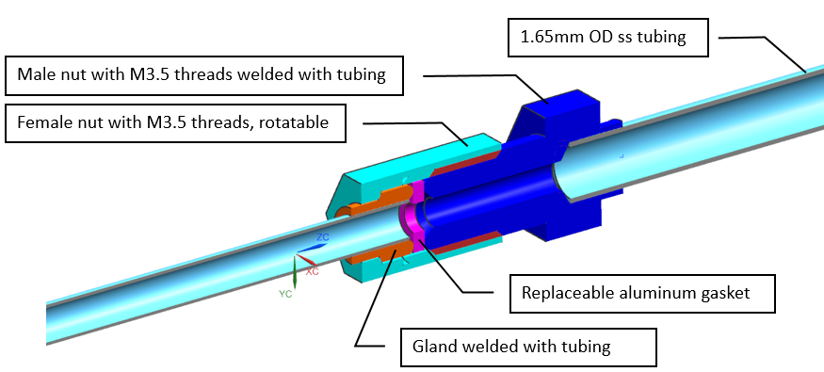
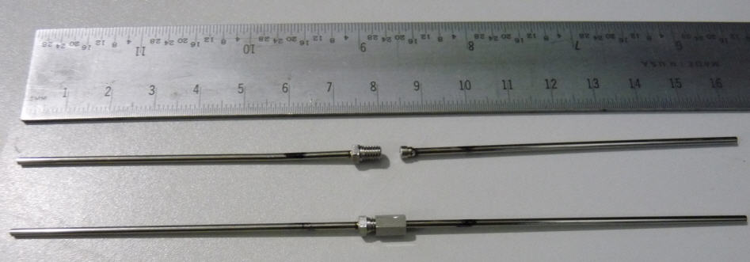
Existing Version
The existing version for tubing OD 1.65 mm, wall 0.1 mm stainless steel (ss) tubing is being used in FPIX 1
Similar to Swagelok VCR metal sealing technology
Female nut rotatable
Male nut and gland are laser-welded with ss tubing
Male nut and gland are made of VIMVAR 304L ss to avoid weld solidification cracking
Has been tested to pressure up to 276 bars (4,000 psi) without failure
Pass intense quality control tests

Slide 3
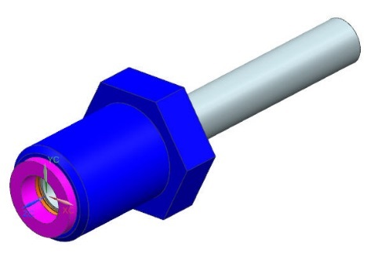
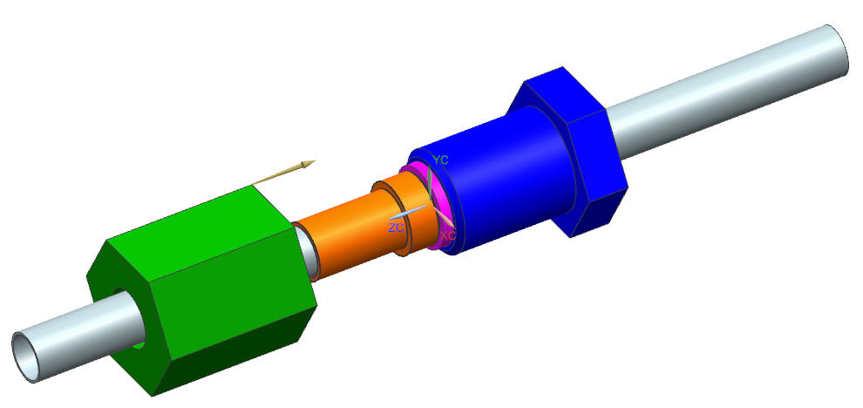
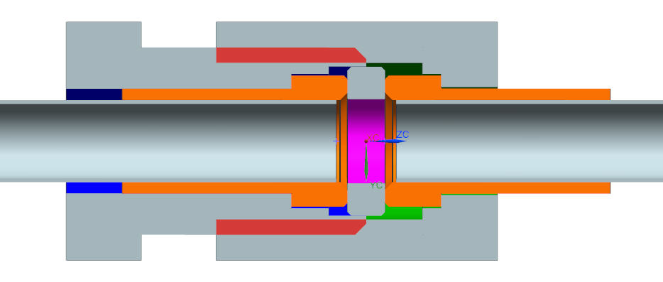
Removable Coupling Assembly for Tubing OD 2.4 mm
Enhanced Version
Designed to serve ss tubing OD 2.2 mm
Enhanced features
  Both nuts are rotatable to minimize torque transfer to tubing during fastening
  Gasket is captured in male nut before fastening >> extra handling to position this tiny part in place is avoided
  “bulky” male and female nuts are both made of aluminum, weight reduction.
Metal seal
Two identical ss glands are used to laser weld at the front face with the ss tubing
  Better weld cooling to minimize the chance of generating cracks.
Gland is made of VIMVAR 304L ss to avoid weld solidification cracking
Gasket is made of aluminum 6063 T6 with Brinell hardness 60
Nuts are made of high-strength 2024 T4 aluminum with Brinell hardness 120 (similar to ss 304)
Aluminum gasket being captured inside the male nut
¼” hex male nut M5.5 x 0.9 threads
Before Fastening of Nuts
¼” hex female nut with M5.5 x 0.9 threads
Identical glands
OD 2.2 mm, wall 0.1 mm 304L ss tubing
Laser-welding between gland and tubing
Notes: Yield strength of Al 2024 T4 = 47 ksi (324 MPa); SS 304L = 30 ksi (207 MPa).

Slide 4
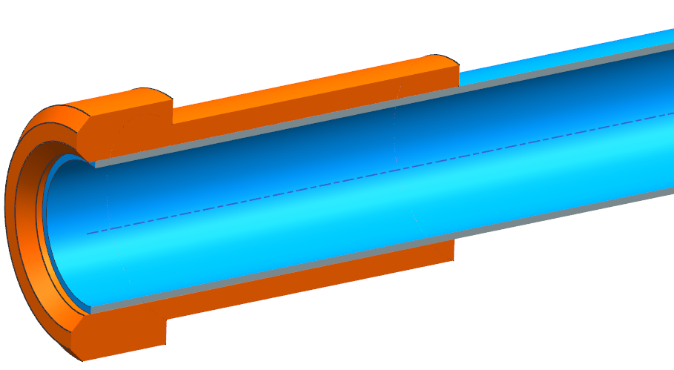
Laser Welding Parameters
It is important to control the depth of weld penetration, and hence we need to carefully control the laser welding parameters like laser pulse power, pulse width, spot size, pulse frequency, and weld spot overlap.
The optimal combination of parameters was determined by welding numerous test pieces and performing micrograph cross sections of welds.
Since the laser power of the machine can degrade over time, the pulse power delivered was measured and calibrated before welding each batch of glands to ensure the consistency.
Power % 34% (max power of machine)
Pulse Width 4.0 – 4.2 ms
Spot Size 3 (on machine dial)
Frequency N/A (single pulse mode)
Pulse Overlap Target 60 %
Welding Machine: LRS EVO Nd-Yag Laser (200 Watt)
316L ss tubing
VIMVAR 304L ss gland
Sealing laser-welding all around at front face;
Tubing position is preferred slightly below of the gland chamfer.
Note: Power was calibrated at the beginning of every welding session. Other parameters were tweaked as needed as well. Welding of the thinner material into the thicker material, as in this case of face welding, is much more forgiving. It would be much more difficult to achieve a target weld penetration when welding the thicker material into the thinner. Because of the tubing complexity, it was a manual operation to rotate the parts and weld with the aid of some simple support fixtures.

Slide 5
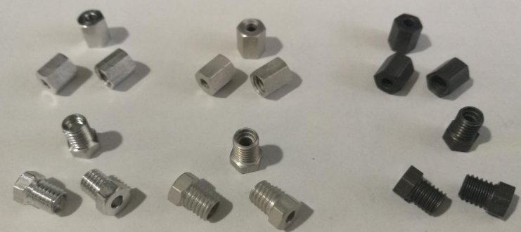
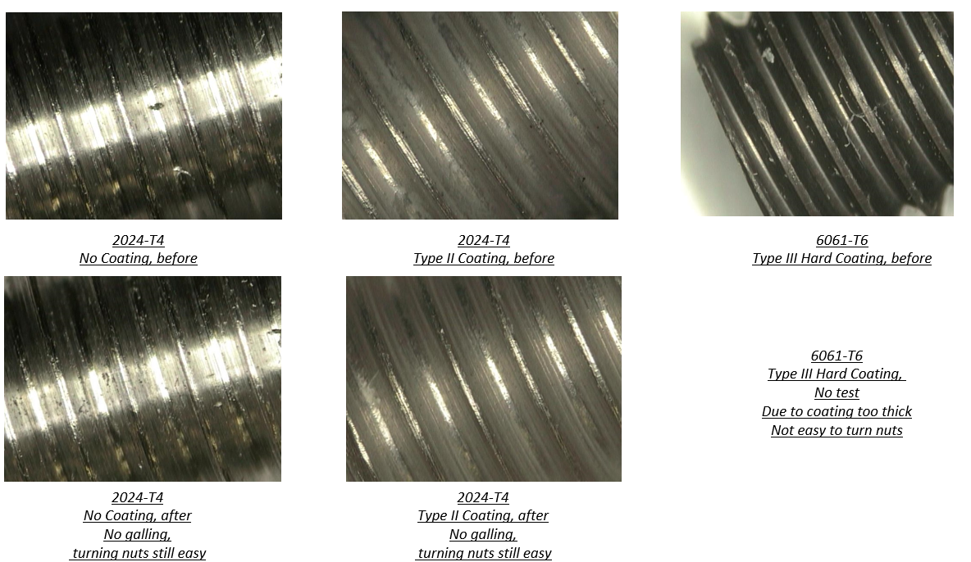
Anodization Coating on Aluminum Parts
To prevent aluminum nuts from galling during fastening, 2 types of coatings were made
  Aluminum 2024 nuts coated with Type II anodization with sulfuric acid
  Aluminum 6061 nuts hard-coated with Type III anodization with sulfuric acid
After 10 times of in-and-out fastenings for extra ¼ turn after hand-tightening, turning was still smooth and no galling was observed for Type II coating and for the nuts without coating. No test was done on Type III due to coating was too thick and difficult to initiate turning.
2024-T4
No Coating
2024-T4
Type II Coating
6061-T6
Type III Hard Coating
Note: The torque required to make an extra ¼ turn was about 0.8 to 1.3 N-m (7 to 12 inch-lbs) for uncoated nuts, and 0.8 to 2.0 N-m (7 to 18 inch-lbs) for coated nuts were observed.

Slide 6
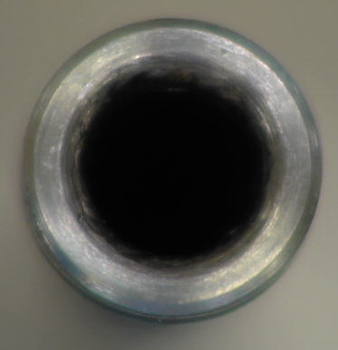
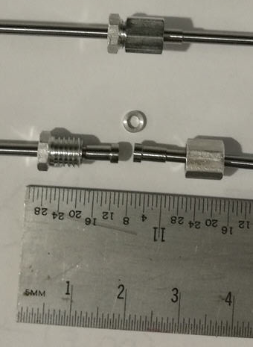
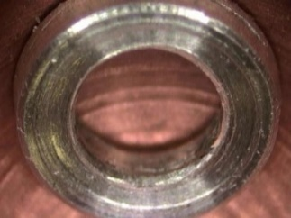
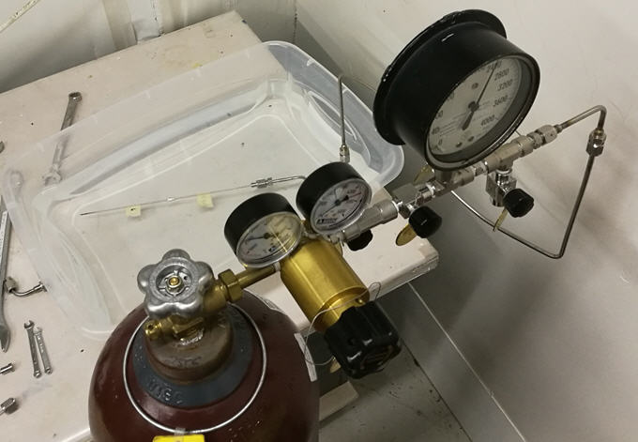
Removable Coupling Testing
Conducted a pressure hold-up test up to 4,000 psi (276 bars) for 2 minutes without failure and leakage.
Conducted a durability pressure hold-up test successfully
  Conducted an initial pressure test at 2,280 psi (157 bars) for 10 minutes
  Went through 10 thermal cycles from liquid nitrogen to room temperature.
  Repeated the pressure hold-up test at 2,280 psi in a water bath for 1 hour.
  Continued the pressure hold-up test at 1600 psi (110 bars) in a water bath for 1 week.
  No leak in final helium check.
gland
gasket
2280 psi (157 bars)
Coupling being tested in water

Slide 7
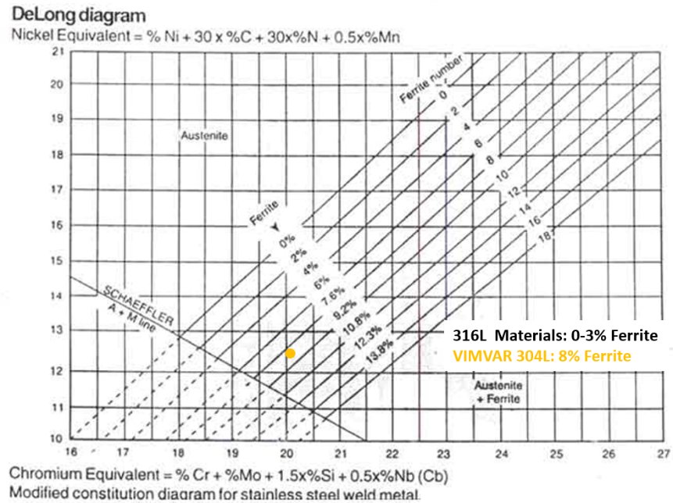
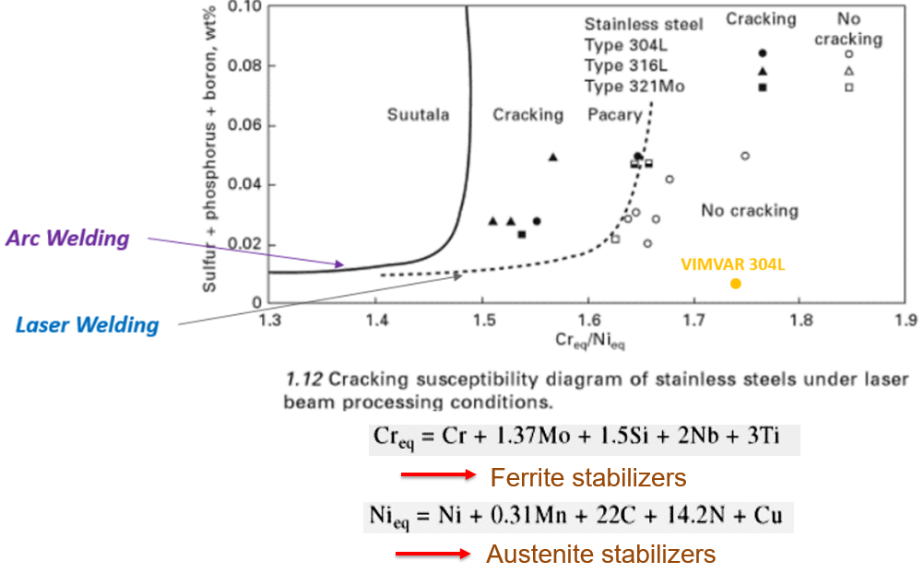
More Notes on Laser Welding Stainless Steel
Autogenous welds, no filler materials used.
Needs zero gap (< 10% of thinnest material) between welding parts
Parts must be cleaned, free of any contaminants and oxidation
Material composition plays a role in final microstructure and cracking susceptibility
“L” grade is preferred for welding in order to lower the C content down to a max of .03% so to reduce sensitization, (precipitation of chromium carbides at grain boundaries) caused by the high temperatures involved in welding.
VIMVAR 304L with very low P & S contents is recommended as one of the welding part materials (the other welding part can be typical “L” grade.)
  High P & S contents are susceptible to weld solidification cracking
Ferrite in 4%-8% is optimal for laser welding as P & S are soluble in ferrite
The higher cooling rates (on the order of ms) that occur under laser welding conditions demands a higher Cr/Ni ratio to reduce cracking susceptibility

Slide 8
Further Details on Laser Welding
See Stephanie Timpone’s slides at FTDM 2016
on laser welding the existing FPIX1 miniature coupling.
https://indico.cern.ch/event/469996/contributions/2148019/attachments/1277061/1895241/FPIX_Laser_Welding_Bonn_Forum_2016.pdf

Slide 9
Conclusions
Anodization coating is not really needed for the aluminum 2024 T4 nuts.
This enhanced design passes a series of intense tests.
This miniature removable coupling can be ready for production.
Thanks for your attention!

