Slide 1
RHUL Site Report
Antonio Perez,
Simon George, Barry Green, Tom Crane
HEP Sysman meeting @ RAL, May 2019

Slide 2
Group Activities (update)
ATLAS
Beneﬁt from strong collaboration in software support.
Large Tier3 batch compute and storage resources for data analysis.
DAQ test systems.
Dark Matter & Neutrino
Detector development: lab DAQ systems and significant quantities of test beam data to store and analyse.
Growing need for compute and storage resources to simulate and analyse data.
Need help with things like installation, data movement.
Have overtaken ATLAS as the largest user of Tier3 storage.
Accelerator
Small DAQ systems.
Many small activities around the world which generates unique and valuable data sets.
Simulation: both embarrassingly parallel and multi-process (MPI) computing.
Software development infrastructure (e.g. cdash server).
Theory
Occasional use of Tier3 and HPC clusters.

Slide 3
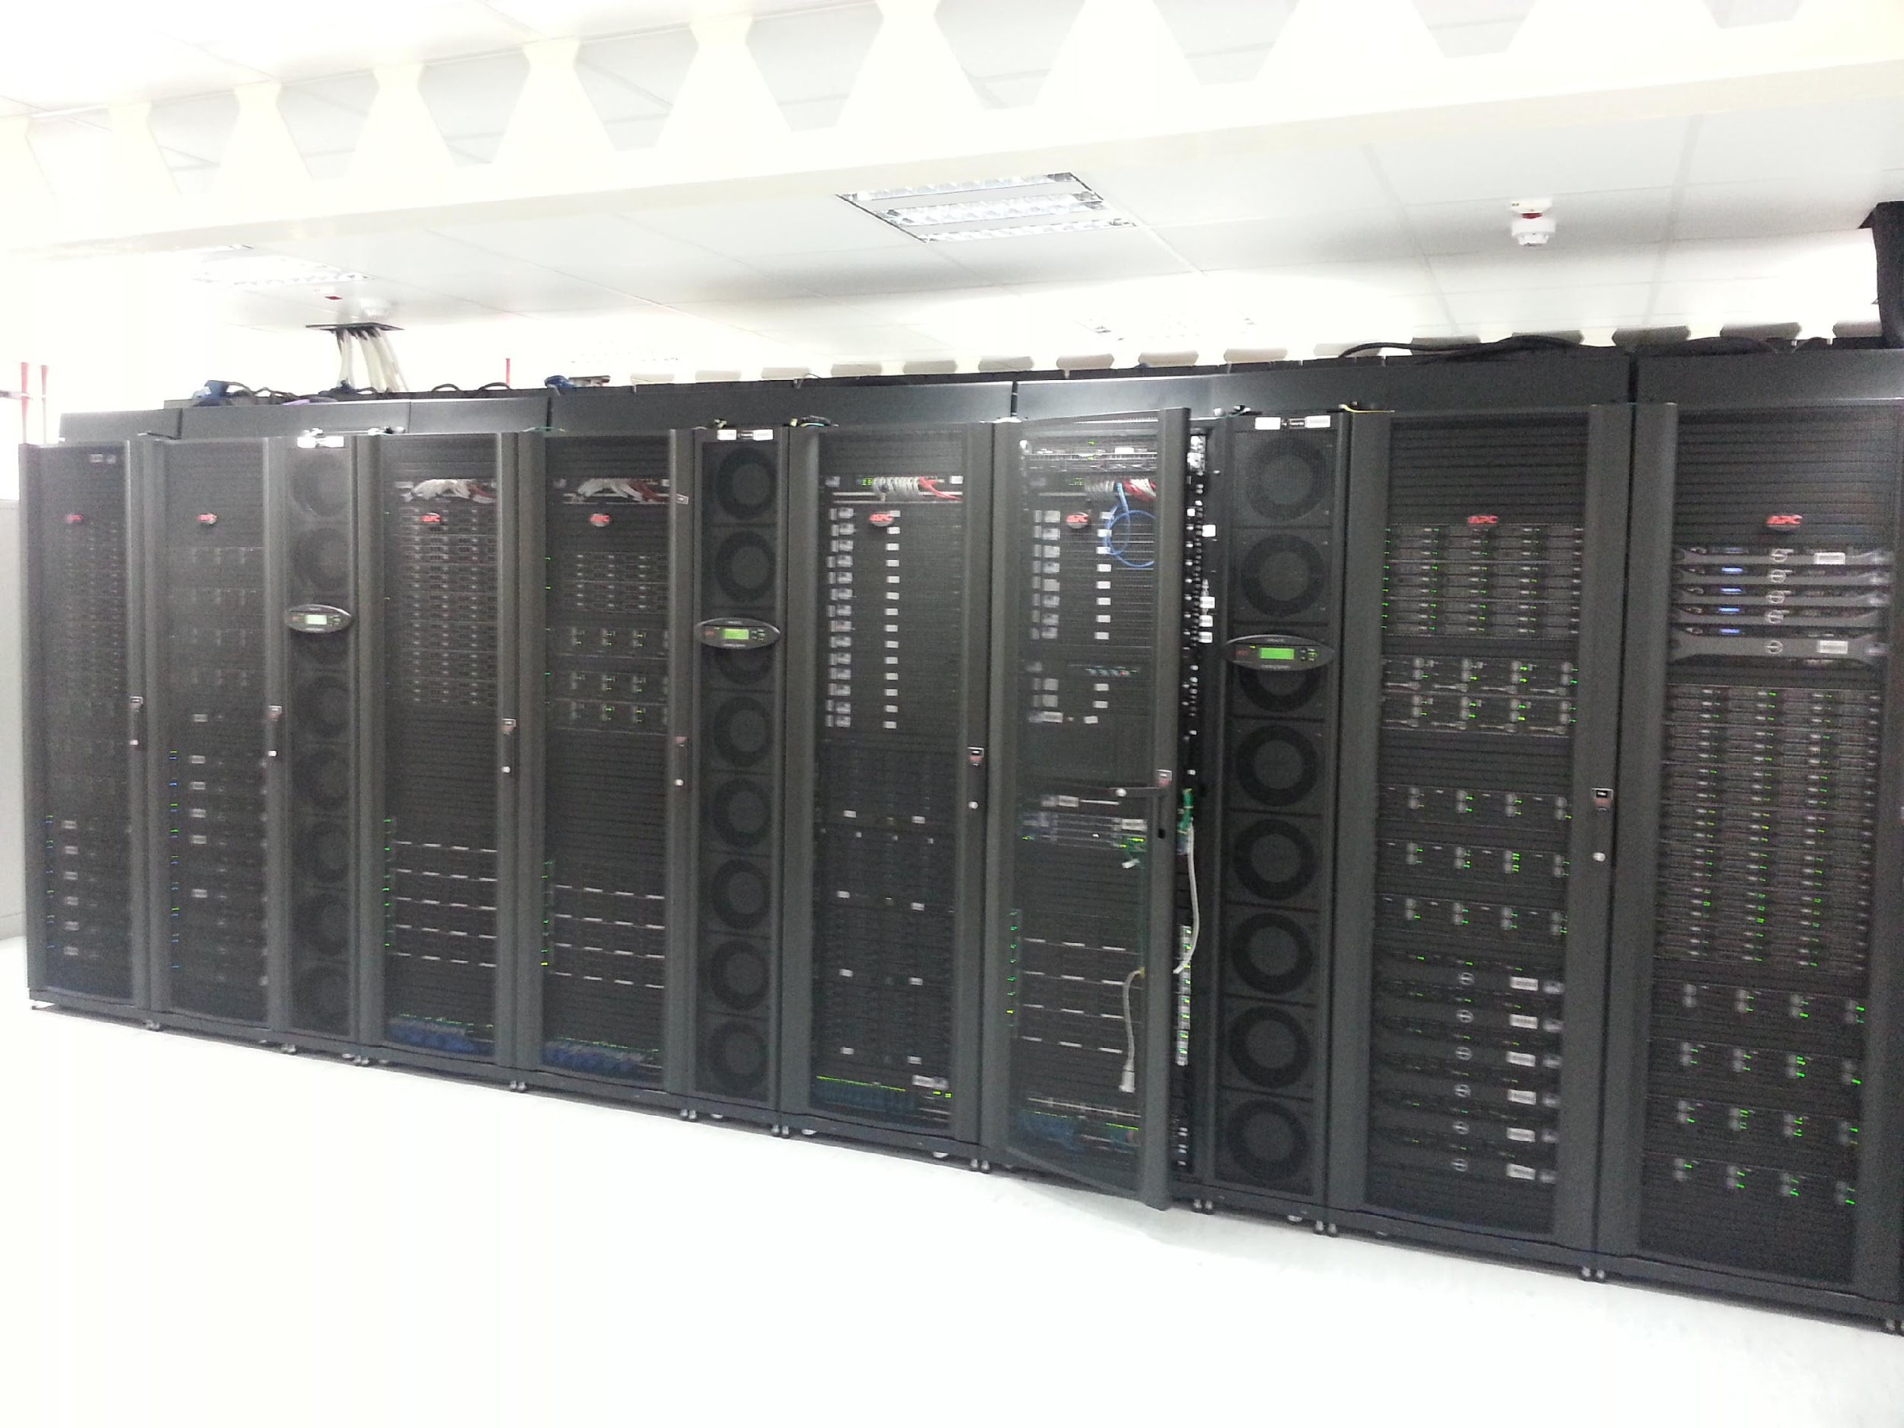
Tier-2 9 Racks in off-site machine room
Still using 9 racks, no room to expand

Slide 4
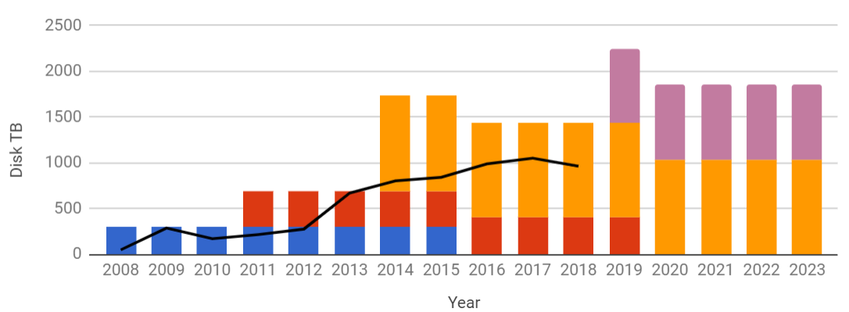
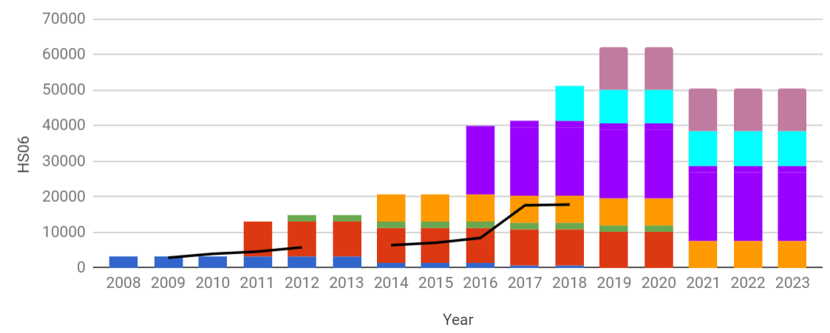
Tier-2
9 racks in modern machine room provided by central IT service.
46 kHS06 in 120 WN (SL6)
Cream/Torque CE x 2, moving to HTCondorCE & HTC
1.4 PB DPM SE in 47 servers
8 misc servers including 3 VM hosts running standard network services, provisioning, Grid services.
New kit from GridPP6 & RHUL funding arriving soon:
  12x Dell PowerEdge C6420, 2x Xeon Gold 6148, 80 cores per node, total 12 kHS06
  9x Dell R540 HBA 120TB raw, total 1 PB raw
Lack of space meant we had to remove old machines used to test VAC
Storage
Colours show distinct procurements
Pledge –
Compute
Pledge –

Slide 5
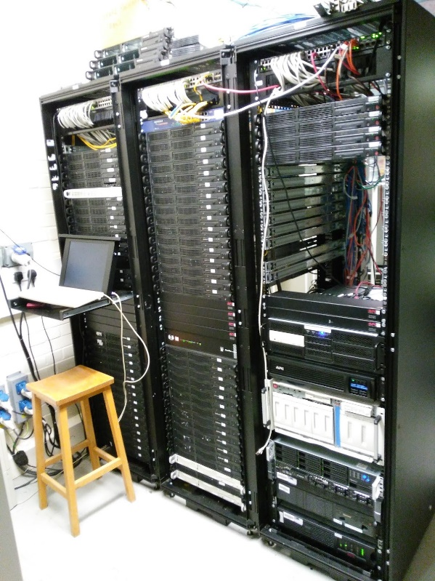
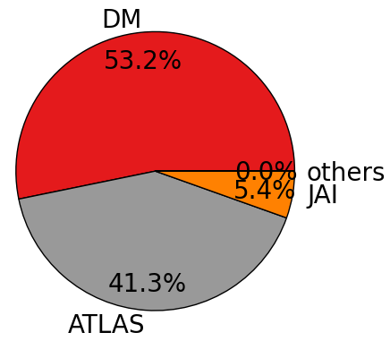
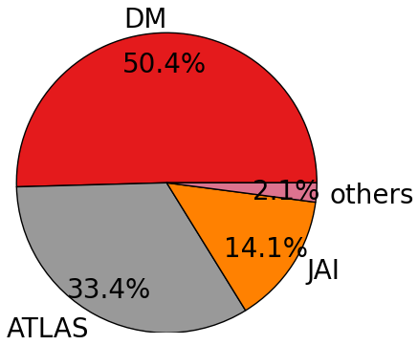
Tier 3
8 racks packed into home-made machine room
Now connected to Tier2 by 10Gb/s fibre
6 kHS06 in ~100 old WN, mostly hand downs from Tier2, some upgraded
Torque/Maui batch system with scaling problems
Storage:
  100 TB Hadoop (3 replicas) using 90 WNs
  226 TB NFS scratch over 3 servers
  11 TB NFS Home
3 VM host machines running multiple redundant squids & NATs, interactive user machines, network services, development services, odds & ends.
Hadoop
Scratch

Slide 6
Plans
Tier2
Migrate batch system to HTC on CC7 WNs
Replace CREAM CEs with HTCondorCE
DPM upgrade? Too soon to replace with cache?
Retire some older DPM pool nodes
Add redundant network connections to storage and between switches
Automate shutdown in case of power cut and backup generator fail
IPV6: still waiting for local networks team to do the paperwork for the JANET DNS service.
Tier3
Consolidate batch function onto Tier2 batch system and retire old worker nodes
Deploy new HDFS storage co-located with Tier2
Upgrade Tier2-Tier3 connection to 100Gb/s
Migrate home service to new hardware

Slide 7

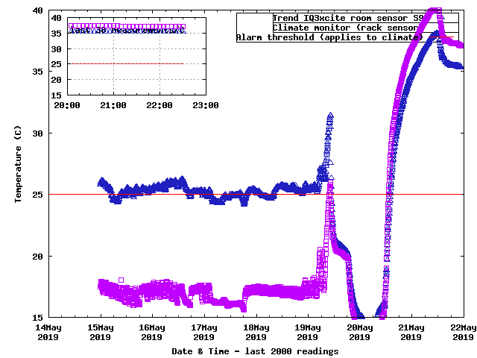
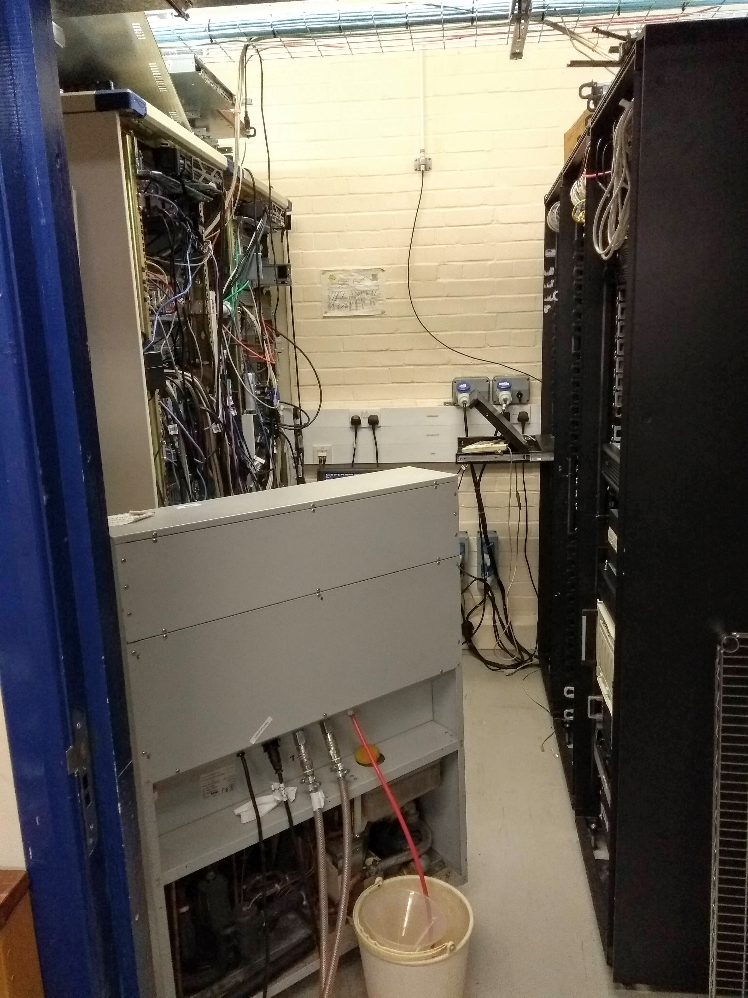
Problems
Tier3 hit by major aircon failure (again, last time was November 2017)
Good test of our automated shutdown procedures ✓
Leak in condenser system will take at least 2 weeks to fix
Struggling to run bare minimum of systems in indoor room
Leak found Monday morning,, system completely switched off
Automated shutdown of WNs triggered by high temperature
Cooling failed, Sunday 5am
Temporary 6kW unit installed

Slide 8
Thank You

