Slide 1
LIU BWS
Status and Plans for 2018
F.Roncarolo -- MSWG, 20-Apr-2018
P.Andersson, W.Andreazza, J.Emery, D. Gudkov, J.Sirvent-Blasco, J.Tassan-Viol, R.Veness

Slide 2
Contents
Introduction
Main features of LIU BWS w.r.t. present systems
Prototypes: examples of already achieved performances
Status and Plans
  Mechanics
  Control electronics
  Acquisition electronics
Outlook
Comprehensive set of documentation and links to meetings/reviews:
https://twiki.cern.ch/twiki/bin/view/BWSUpgrade/Project
https://twiki.cern.ch/twiki/bin/view/BWSUpgrade/Meetings

Slide 3
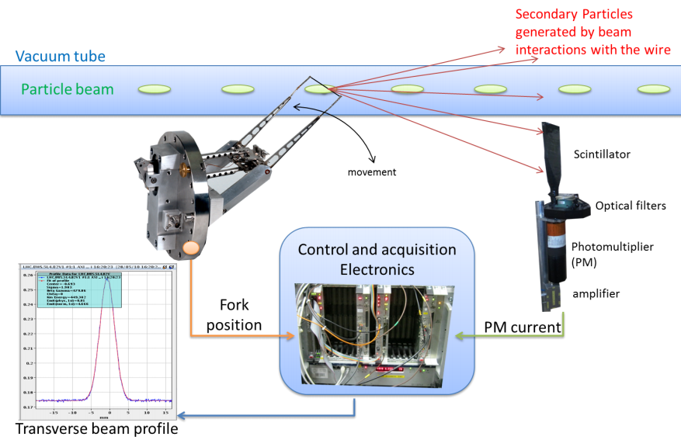
Wire Scanner System

Slide 4
WS – present generation
Sophisticated kinematic unit transforming motor rotation to ~linear wire scan through the beam
Requires accurate laboratory calibration of each unit

Slide 5
LIU BWS Generation
All components assembled on single rotational shaft
In-vacuum encoder disk → wire position
No bellows, minimized mechanical plays

Slide 6
LIU BWS – Upgrade Overview
Variant | Quantity (+spares) | Machine
1 | 4 (+ 1) | PS Booster (H) 4L1
2 | 4 (+ 1) | PS Booster (V) 11L1
3 | 5 (+ 1) | PS
4 | 4 (+ 1) | SPS
Total | 17 + 4 spares

Slide 7
Electronics Layout
Control and feedbacks provided by intelligent drive separated from VME supervising CPU

Slide 8
Control Electronics Unit
Compact intelligent drive chassis containing
Motor power stages and interface (inverter, charger)
FPGA motor control unit (VFC + Mezzanine)
First prototype produced and being validated

Slide 9
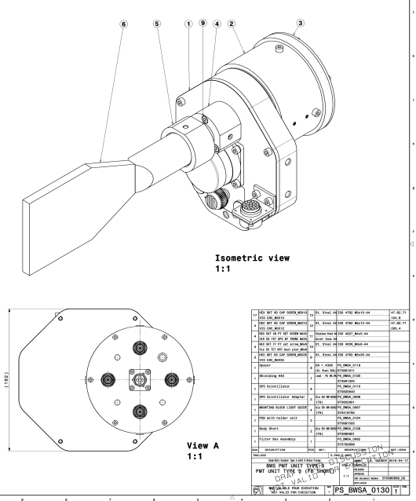
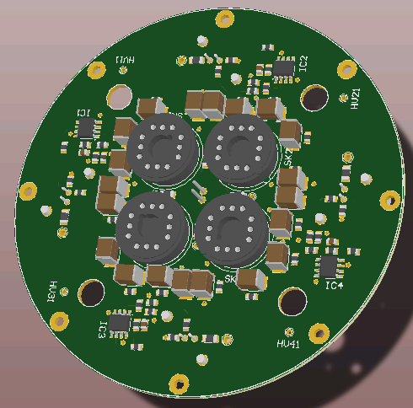
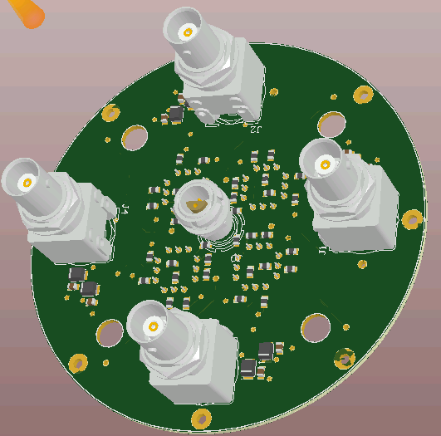
Secondary Shower Detector and Acquisition System
Multi-PMT detector coupled to scintillator
  Enhance dynamic range
  Fixed optical filters between scintillator and PMTs
  Automatic selection of PMT in the good range (high S/N, no saturation) to be performed by FW or SW, not the operator
Signal processing will be based FMC ADC on VFC
  Fast digitization in the surface, similar to new generation of FBCTs

Slide 10
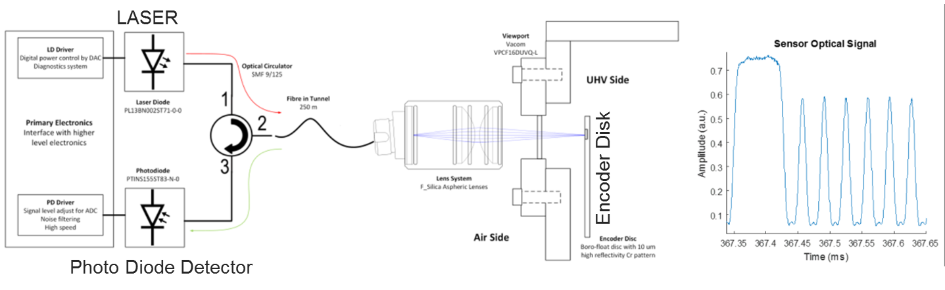
Encoder disk
Optical disk engraved with alternation of reflecting and anti-reflecting slits
Laser encoding of slits → disc angular position during a scan
Glass disk | Metallic disk (baseline)
Excellent optical properties | Robust, easy to install and hold
Requires delicate holding system | Challenging fabrication processes to achieve optical quality
Can’t be baked | Can be baked
Installed and tested in the SPS and PSB | Installed and validated without beam in the PSB

Slide 11
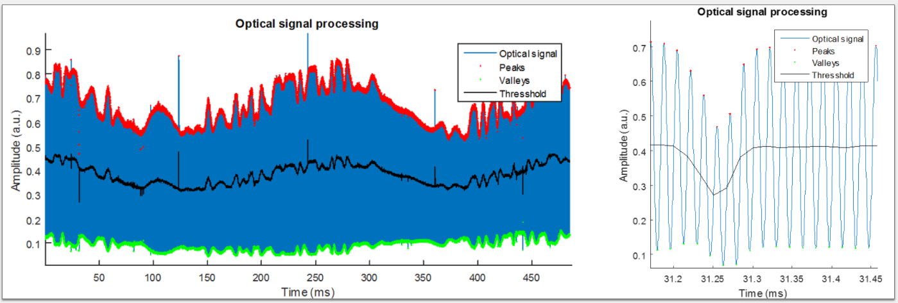
Encoder disk – signal processing
Raw signal affected by disk imperfections
Signal processing algorithm (based on adaptive threshold crossing) extensively tested and validated

Slide 12
Calibration Bench
Laser beam traversing the wire during a scan
Look at missing laser intensity == wire position on transverse meas. plane
Move laser (translation stage) at different positions
→ reconstruct wire angular position vs laser (transverse) position
→ evaluate residuals to analytical (from geometry) fit vs angular position
LASER
Translation stage
Photodetector

Slide 13
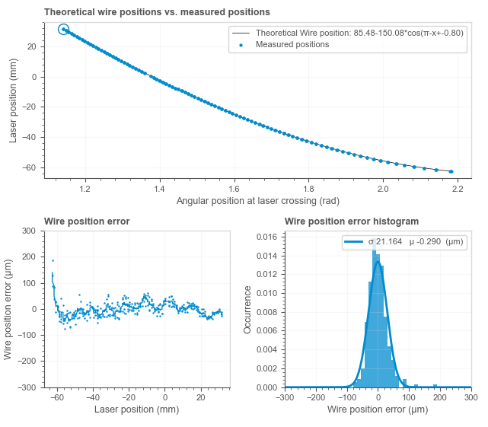
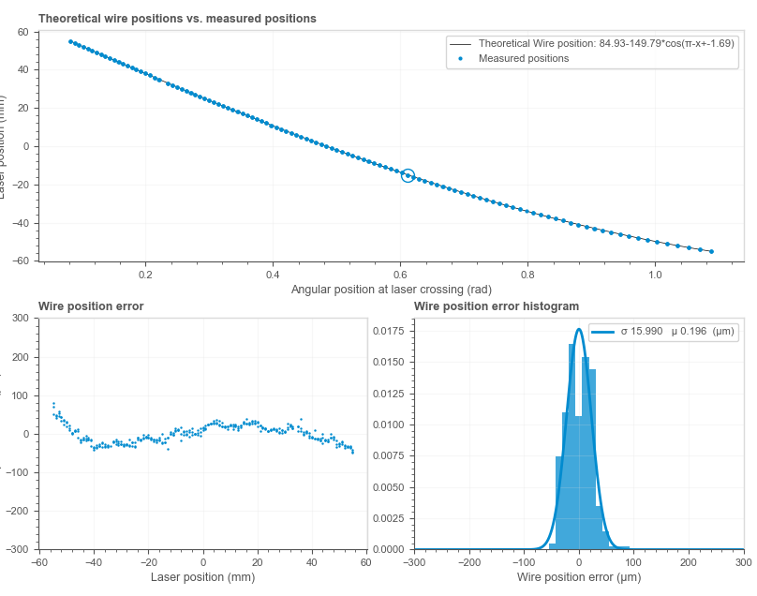
Calibration bench - examples
Metallic Disk
Glass Disk
⎯⎯ Theoretical
● Measured
⎯⎯ Theoretical
● Measured
Transverse Pos.
Transverse Pos.
Angular Pos. (from disk)
Angular Pos. (from disk)
Meas. – Theory [um]
RMS=21um
RMS=16um
Transverse Pos.
Meas.-Theory histogram
Meas.-Theory histogram
RMS= 21um
Values assessing the wire position determination statistical error, to be compared to ~100um of present generation scanners
RMS=16um

Slide 14
Motion Profiles examples
100 scans (without beam) with metallic disk installed in PSB
Very (low noise) reproducible position and speed profiles
Motor control feedback (based on motor resolver readout) good performance
To be mentioned: we are experiencing EM coupling and S/N level problems with the PS prototype resolver (long cables)
Position
Position (zoom around beam passage region)
Speed
Speed (zoom around beam passage region)

Slide 15
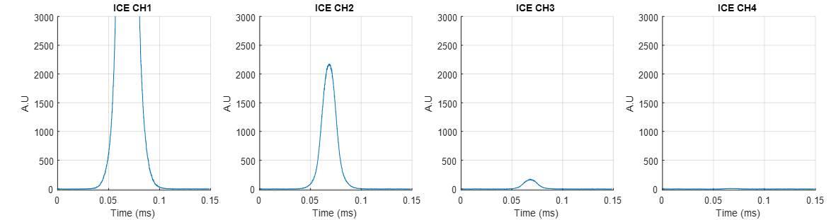
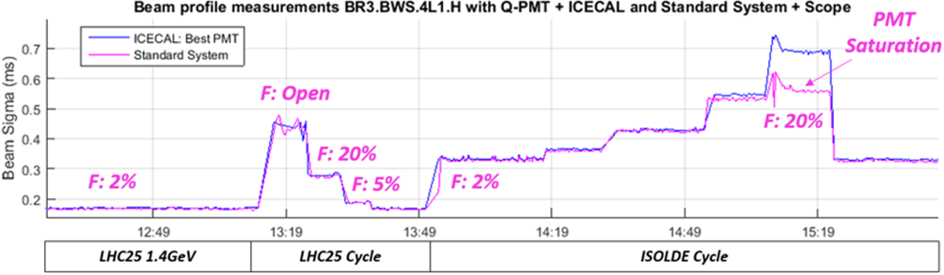
Performance – Beam Measurements
PSB Prototype
Mult-PMTs with fixed attenuation filters
Electronics FW or high level SW will select and publish ‘valid’ profile (== enough signal, no saturation)
Operational PMT system:
requires filter and HV tuning for different beams
LIU High Dynamic Range PMT system:
No filter changes
PMTs saturation free
Redundancy

Slide 16
Performance – Beam Measurements
SPS Prototype
Tests conditions:
Single bunch (0.23e11 Protons) at 270GeV.
Beam/Wire interceptions every 23us (SPS Trev)
Coasting Beam
Emittance growth with time.
Prototype scanner BWS.51740.V scans at 20m/s.
Reference scanner BWS.51731.V scans at 1m/s.
Beam Emittance
Beam Position
In
Out
Error ε*:
4.7%
Error ε*:
3.0%
Error :
94 um
Error :
48 um

Slide 17
Status and plans - General
3 prototypes installed (PSB, PS, SPS)
  ~ final mechanics – metallic encoder disk to be validated with beam
  Development (non-VME) electronics
    Install first VME electronics during ITS2
  Multi-PMT detector installed in the 3 machines
    Already tested in PSB
Series production
  Mechanics procurement on going, start mechanical assemblies beginning of summer
  Electronics board development ~completed, FW under development. Series production to start towards the end of the year

Slide 18
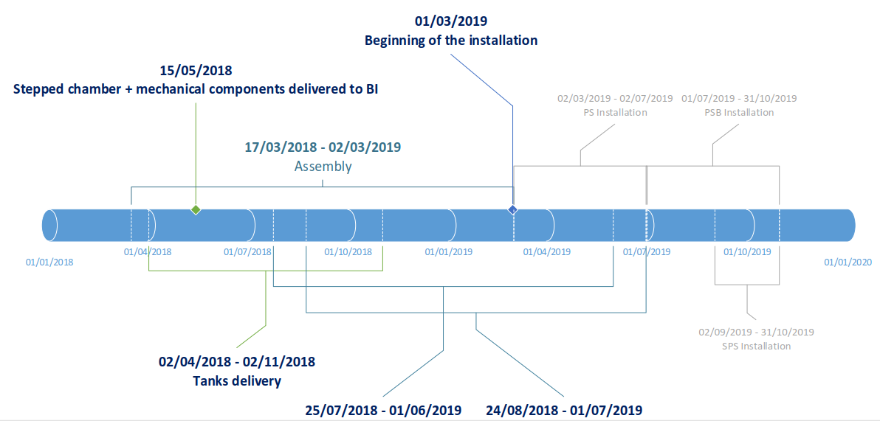
Mechanics – Plan and Milestones

Slide 19
Electronics – Plan and Milestones
2018 Milestone for the electronics control:
Feb Design modification on various board
Mar Start working on the VME side (TS)
Apr-May Pre-series production and assembly
Production test bench for power stage & charger
June-July System validation using calibration bench (Bld. 867)
Motion optimization
Procurement component for series production
Sep System validation using installed PS scanner prototype
Oct-Dec Start series assembly
2018 Milestone for the acquisition system:
End 2017 Final acquisition baseline
Sep-Dec Complete multi-PMT validation in all machines
Validate acquisition electronics (FMC ADC on VFC) on one prototype
Launch series production

Slide 20
2018 - Beam Test Plans
Before LS2, it will be fundamental to exploit the installed prototypes
BI expert operation
PSB
  Validation of metallic disk
  Statistics on performance and reliability, compare to operational scanners
PS
  Statistics on performance and reliability, compare to operational scanners
  Validation of Multi-PMT acquisition system
  After ITS2:
    Validation of VME based control system
    Test of fast ADC acquisition system
    Control via basic FESA server
SPS
  Validation of Multi-PMT acquisition system

Slide 21
PSB Prototype Broken Wire
2017-2018 YETS:
  Replaced PSB prototype with new system equipped with metallic disk
Wire integrity looked ok after installation
Successful scans on ZERO cycles, validation of control and motion profiles
Last week: tests with beam → no beam profiles
This week: electrical measurement + access for visual inspection via viewport
  Confirmation of broken carbon wire + loose kapton cables (outside beam pipe aperture)
Will launch more laboratory tests to reproduce the issue
Will ask to replace wire during ITS1 (or before if possible)

Slide 22
OUTLOOK
LIU BWS prototyping and series production preparation on track
Presented some of the available laboratory and beam based measurements assessing the expected performance
2018:
  beam tests will be fundamental in preparation of LS2 and the post-LS2 start-up
  ITS1 (Jun) : replace PSB wire, upgrade PS resolver
  ITS2 (Sep): install VME based electronics, deploy basic FESA class
Post LS2 start-up will anyhow require a commissioning period

Slide 23
SPARE SLIDES

Slide 24
Present WS limitations

Slide 25
New LIU BWS

