Slide 1
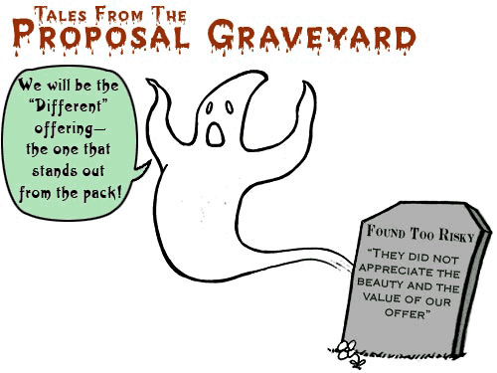
Fast know-how workshop on initiating
EU proposals
Module 2:
Writing Tips
Pablo Garcia Tello (EU Office)

Slide 2
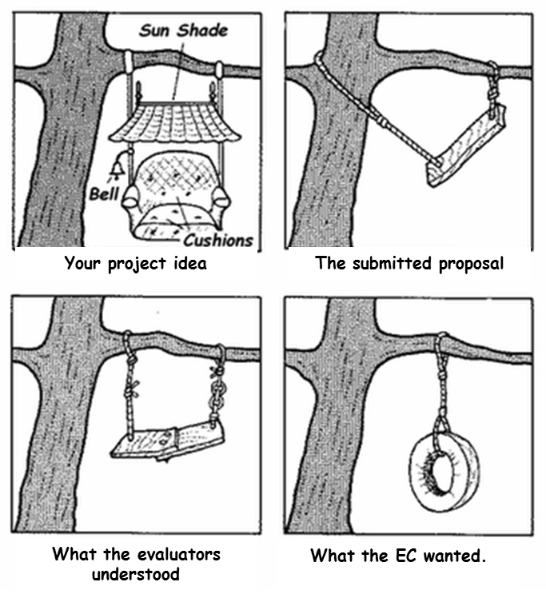
What to avoid…

Slide 3
Writing your proposal
This is THE MOST IMPORTANT tip I can give you:
You keep/lose the interest of an Evaluator
in the first page of your proposal.
After reading the first page it should be immediately clear:
    What is this project about?
    What the project wants to achieve (final result)?
    Why is it innovative?
    Why is needed (i.e. industry/public demand)?
    Why this is important for Europe (i.e. jobs/competitiveness/sustainability)?
    Why this is the best consortium possible (project value chain)?
IF you don’t manage to make clear this in the first page
your chances for funding are seriously slim.

Slide 4
Competitive project
(proposal)
Scientifically
and Technologically
Competitive
Methodologically Competitive
Strategically
and
Commercially Competitive
Fits with the call topic…no joke!!!

Slide 5
Scientifically and Technologically Competitive
(S&T section of the proposal)
My idea is new…is innovative.
My idea goes beyond the state of the art.
My idea will contribute to the advancement of the S&T knowledge, culture, etc.

Slide 6
Methodologically
Competitive
(Implementation Section)
My project objectives are concrete and clear.
My project is realizable in the time frame foreseen.
I have a clear and realistic management structures and execution plan and I have identified risks and mitigation measures.
I count with the best and necessary partners and our expertise is complementary and not overlapping.
I can define clearly my timeline, milestones and deliverables.
I can define clearly my budget lines and justify them.

Slide 7
Strategically and Commercially
Competitive
(Impact Section)
The results of my project have added value for the European industrial competitiveness.
The results of my project will contribute towards the goals of the EU Strategy Agendas.
I have a solid and detailed dissemination and exploitation plan.
My project connects and complements with other EU initiatives.
The results of my project can be disseminated and exploited and this will bring added value for Europe.
The results of my project will benefit its participants and other stakeholders in concrete ways.
The results of my project will benefit Europe and its citizens.

Slide 8
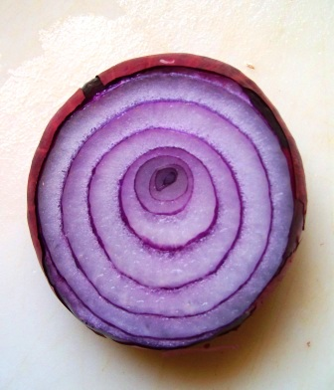
Tip: Helping on the Impact section…When a project has impact?
The onion approach
The project benefits
EU Society
(jobs, sustainability, wellness)
EU Competitiveness
(better industry, better businesses)
Industrial Community
(new products, new business)
Scientific Community
(new science, publications)
Consortium partners
(new science, new businesses, new jobs, new PhDs)
Don’t forget to make this quantitative in the proposal!!

Slide 9
Writing: General tips (1)
1) Pay due attention to all proposal sections
    Many proposers concentrate on the scientific element, but lose marks on project planning or impact description.
    REMEMBER: YOU HAVE TO SCORE IN 3 CRITERIA!!!!
2) Think of the finishing touches which signal quality work
    Clear language (tend to use short sentences).
    Well-organized contents, (always follow the EC template so an evaluator finds where she/he looking for where it should be).
    “Be graphical” as much as possible with sense-making, useful and understandable diagrams/tables.
    Take care of detail (no typos, no inconsistencies, no obvious paste-ins, no numbers which don’t add up, no missing pages …

Slide 10
Writing: General tips (2)
3) Make it easy for the evaluators to give you high marks!
Don’t write too little; cover what is requested.
Don’t write too much (always respect the page limits!!!)
Don’t leave them to figure out why it’s good, tell them why it’s good and if necessary highlight it in a box. Use comparison tables such as state-of-the-art vs. project innovation.
Leave nothing to the imagination (evaluators are specifically instructed to verdict only on what is written).
Back-up your assertions with concrete examples (i.e. market studies, statistics, literature citations, etc).

Slide 11

MAIN MESSAGE TO TAKE HOME…
Horizon 2020 is a Programme for innovation meant to help crossing the valley of death…
Make sure your project proposal explains how you are going to do it…
Make sure your project does what it promises…

Slide 12
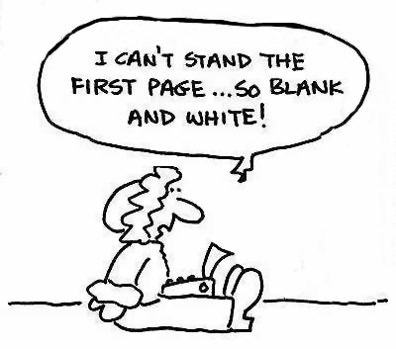
Module 2: General key messages…
Your first page of the proposal is fundamental: make sure all « Wh » questions are clearly reflected and are immediately understandable.
Horizon 2020 is a Programme for innovation meant to help crossing the valley of death…your project needs to explain its contribution to that.

Slide 13
Questions?

