Slide 1


Practical Sessions/Introduction
MEDICIS-Promed Summer School
“Development and Pre-clinical Evaluation of Radiopharmaceuticals”
ANTÓNIO PAULO
(apaulo@ctn.tecnico.ulisboa.pt)
Grupo de Ciências Radiofarmacêuticas
Centro de Ciências e Tecnologias Nucleares, IST-UL
Bobadela, 07/06/2018

Slide 2
09:45:-11:15* | Group1/ Session 1; Group 2/Session 2; Group 3/Session3
11:30-13:00 | Group1/Session 2; Group 2/Session 3; Group 3/Session 1
13:00-14:30 | Lunch
14:30-16:00 | Group1/Session 3; Group 2/Session 1; Group 3/Session 2
Group 1
Annie Ringvall Moberg
Nhat-Tan Vuong
Johanna Pitters
Marina Nazarova
Vadim Gadelshin
Roberto Formento Cavaier
SANJIB CHOWDHURY
Group 2
Maddalena Maietta
Simon Thomas Stegemann
Alexandra Litvinenko
Francesco Cicone
IOANNA PRIONISTI
Grigory Karateev
Daniel Thibaut
Group 3
Andrew Burgoyne
Kristof Dockx
Telma Marques
Mattia Mazza
Filip Puicea
Alina Raicu

Slide 3
Session 1: Synthesis, purification and characterization of a DOTA-conjugated peptide
(João Correia/Alice D’Onofrio)
Brief introduction to solid phase peptide synthesis
Manual versus automated peptide synthesis
Automated peptide synthesis: hands-on simulation of a peptide synthesis run
Cleavage and isolation of crude peptide
Purification by HPLC, analytical control and characterization by MS
Conjugation reactions on solid support or in solution

Slide 4
Session 2: Radiolabelling and radioanalytical control of a DOTA-conjugated peptide (Célia Fernandes)
Radiolabelling of a DOTA-conjugated peptide (ER3) with ¹¹¹In.
Radioanalytical control of the radiolabelled ¹¹¹In-ER3 by HPLC and ITLC-SG and determination of the radiochemical yield (RCY) and purity.
- If necessary, purification of ¹¹¹In-ER3 by solid phase extraction (using Sep-Pak C18 cartridges) and determination of RCP after purification

Slide 5
Session 3: Biodistribution studies and cell-based assays
(Lurdes Gano and Paula Raposinho)
Animal studies / Biodistribution of ¹¹¹In-ER3 in mice/Lurdes Gano:
- Evaluation of tissue distribution in CD1 female mice at different time points
- In vivo Stability Analysis
- Tumor Targeting in Balb/c nude mice MCF-7 Xenografts (Tumor induction/ Tumor uptake/ Target:non-target ratios and blockade studies)

Slide 6
Session 3: Biodistribution studies and cell-based assays
(Lurdes Gano and Paula Raposinho)
Cell-based assays/Paula Raposinho
Cell culture room: Equipment and organization of a cell culture laboratory.
Cell culture mediums: Properties and special requirements of media.
Types of cell cultures and typical adherence cell morphology.
Applications, advantages and limitations of cell-based assays.
MCF-7 cells culture: Morphological analysis of adherent MCF-7 living-cells in culture cell flasks, under an inverted phase microscope.
Subculturing and cryopreservation of cells culture.
Counting MCF-7 cells and preparation of a 24-well plate with cells for internalization assay.
Internalization of ¹¹¹In-ER3 in MCF-7 cells:
Preparation of radiopeptide solution
Incubation of ¹¹¹In-ER3 with cells
Removing membrane associated fraction and recovering internalized fraction
Analysis of counts and results

Slide 7
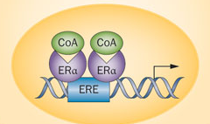
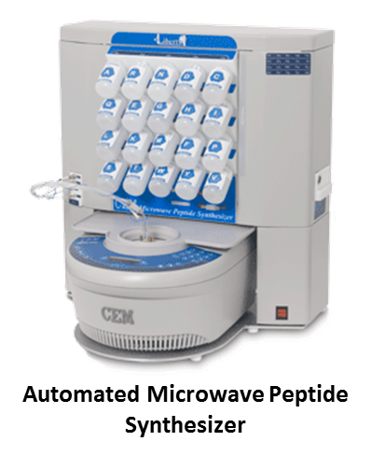



ER ligand
Peptides targeting the ER
Nuclear Compartment
Coactivators present NR boxes with LXXLL sequences (L- Leucine; X – any aminoacid) that bind to the LBD of ER
Peptidomimetics with high affinity and selectivity towards ER α
Nat. Rev. Endocrinol (2013) doi:10.1038/nrendo.2013.179
L
X
X
L
L
CoA: Coactivators
ERE: Estrogen Response Element
IC50 (μM) | 0.157 ± 0.008

Slide 8

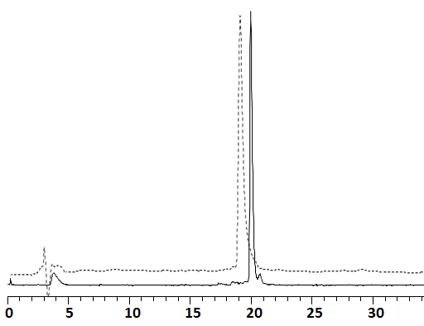
[¹¹¹In]DOTA-ER3
[In]DOTA-ER3
K
I
L
H
R
L
L
Q
Retention time (min)
High radiochemical yield and purity
High in vitro stability (>95%) in solution, blood serum and apotransferrin excess

