Slide 1

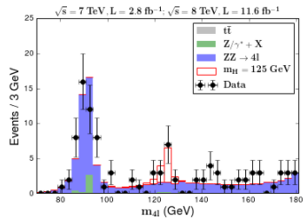
CMS masterclass update
New developments planned for IMC 2019
Move Higgs events out of WZH → WZ measurement
New measurement
  Use ~10² events with 4 leptons
  Make mass plot <90 GeV to >180 GeV
  Supplement to WZ?
  Use Jupyter notebook?
Old measurement
  Mostly stable
  Still need to add D-Y

