Slide 1
Emittance blowup studies from injection oscillations and Eddy currents in the injection bump.
Status and plans.
E. Senes, M. Fraser, A. Huschauer, F. Tecker, V. Forte

Slide 2
Outline
Injection steering studies
  Goal and methods
  Recap of last year measurements
  Simulations
  Plan for this year
Study of the eddy currents effect in the injection bump
  Motivation
  Optics models and first results

Slide 3
Missteering studies

Slide 4
Goal and methods
Goal: understand whether the steering is a source of emittance growth at the injection in the PS
Idea: from the optimal steering situation, randomly change the injection kicker strength of KFA45 and observe the emittance growth.
Kick strength: 90% to 106% of the nominal kick (due to power converter limitations)
Beam types: various beams tested featuring different brightness, most conclusive results with a modified Van der Meer beam
Beam | I (10¹⁰ ppb) | εx / εy (mm mrad) | Brightness index
MD2586_INDIV_VdM | 13 | 2.5/2.0 (3.0/2.0) | ~5
Away from resonances
Coupling corrected, TFB off
Low brigthness → limit Laslett tune shift to -0.05/-0.05
KEYPOINTS
Notes:
BCMS in different working points and with different coupling condition

Slide 5
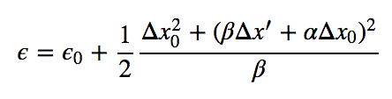
Analysis
EMITTANCE BLOWUP
ANALITICAL EXPECTATION
AFTER FILAMENTATION
Notes:
Formula after filamentation
Also different behaviour at C175 and C185
BPMs --> From last year

Slide 6

Analysis
EMITTANCE BLOWUP
ANALITICAL EXPECTATION
AFTER FILAMENTATION
SINGLE BPM
Δx from BPM
position
- β_{BPM} from model
Expected a = 0. 0224
Notes:
Formula after filamentation
Also different behaviour at C175 and C185
BPMs --> From last year

Slide 7

Analysis
EMITTANCE BLOWUP
ANALITICAL EXPECTATION
AFTER FILAMENTATION
SINGLE BPM
Δx from BPM
position
- β_{BPM} from model
Expected a = 0. 0224
ALL BPMs
Δx from RMS 1st-2nd
turn difference
- <β> from model
Expected a = 0. 031
Notes:
Formula after filamentation
Also different behaviour at C175 and C185
BPMs --> From last year

Slide 8

Analysis
EMITTANCE BLOWUP
ANALITICAL EXPECTATION
AFTER FILAMENTATION
SINGLE BPM
KICK FROM
PARAMETER
SET
Δx from BPM
position
- β_{BPM} from model
Expected a = 0. 0224
ALL BPMs
Δx from RMS 1st-2nd
turn difference
- <β> from model
Expected a = 11.26
Expected a = 0. 031
Notes:
Formula after filamentation
Also different behaviour at C175 and C185
BPMs --> From last year

Slide 9
Simulations
pyHeadtail simulations of missteering
PS toy model, single turn machine (from pyCERNmachines repository)
  β = 16 m, D = 0 or 2.5 m
  RF off
Emittance can be evaluated turn by turn
Non-linearity is given by chromaticity

Slide 10
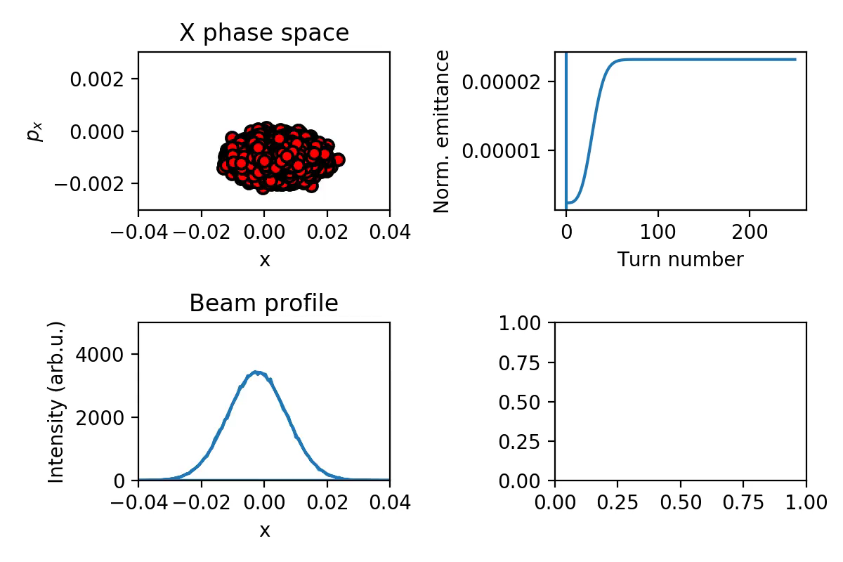
Beam injected off-orbit
100k macroparticles
6D gaussian initial distribution
400 turns
Beam profile is used
to compute the fit

Slide 11
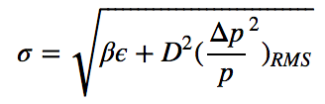
RMS emittance vs gaussian fit fo the profile
RMS statistical emittance vs emittance from the beam profile calculated with normal deconvolution with gaussian fit
<β> = 16 m
D_{x} = 2.5 m

Slide 12
Plan for this year
Even with the correction for the non gaussian profile, the ’missing’ blowup is not explained.
New measurement protocol to try to understand the measurements discrepancy with the analititcal model:
Inject and let filament
Measure the emittance
Kick the beam using KFA45 second injection instance
Let filament and measure emittance again

Slide 13
Test of the full deconvolution algorithm
Currently two methods are used to compute the emittance:
Full deconvolution, using Guido’s algorithm
Traditional deconvolution, from the formula
Comparison between 6D gaussian bunches and bunches featuring parabolic longitudinal profile (no steering, beams are matched):
PRELIMINARY
ε_{x,y} (μm) | ε_{L} (μm) | Traditional deconvolution gauss bunch | Full deconvolution gauss bunch | Traditional deconvolution parab. bunch | Full deconvolution parab. bunch
2.5 | 0.5 | - 0.15 % | - 0.35 % | + 0.21 % | - 0.30 %
2.5 | 0.75 | + 0.25 % | - 0.34 % | + 2.20 % | + 1.35 %
2.5 | 1 | + 0.29 % | - 0.79 % | + 1.97 % | + 0.32 %
2.5 | 1.25 | + 2.0 % | + 0.37 % | + 2.13 % | - 0.32 %
2.5 | 1.4 | + 2.8 % | + 0.77 % | + 3.69 % | + 0.99 %
Notes:
Difference calculated wrt the RMS statistical emittance
100k particles

Slide 14
Test of the full deconvolution algorithm
Same thing with parabolic long. Distribution, but this beam is still dominated by the betatronic component
When the bucket is almost full the longitudinal distribution has chopped tails → wrong estimation
PRELIMINARY
ε_{x,y} (μm) | ε_{L} (μm) | Traditional deconvolution gauss bunch | Full deconvolution gauss bunch | Traditional deconvolution parab. bunch | Full deconvolution parab. bunch
2.5 | 0.5 | - 0.15 % | - 0.35 % | + 0.21 % | - 0.30 %
2.5 | 0.75 | + 0.25 % | - 0.34 % | + 2.20 % | + 1.35 %
2.5 | 1 | + 0.29 % | - 0.79 % | + 1.97 % | + 0.32 %
2.5 | 1.25 | + 2.0 % | + 0.37 % | + 2.13 % | - 0.32 %
2.5 | 1.4 | + 2.8 % | + 0.77 % | + 3.69 % | + 0.99 %
Notes:
Difference calculated wrt the RMS statistical emittance

Slide 15
Status
Steering studies are not conclusive yet
  The blowup far from injection will be measured next week to see if it matches the analitical model
The deconvolution algorithm are under test
  Beams where the dispersive component of the emittance is predominant to be tested
  BCMS-like beam will be simulated
  Also real beam data can be used (WS+tomo)

Slide 16
Injection bump studies

Slide 17
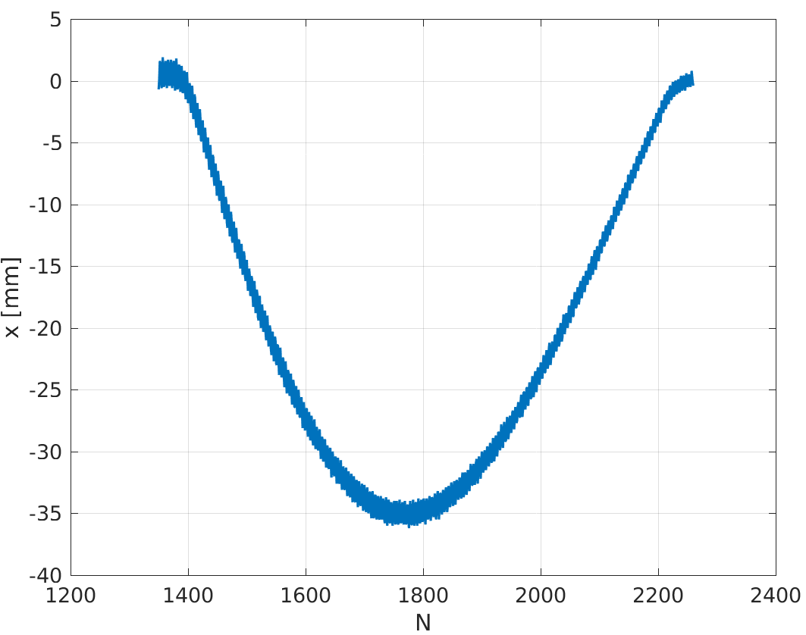
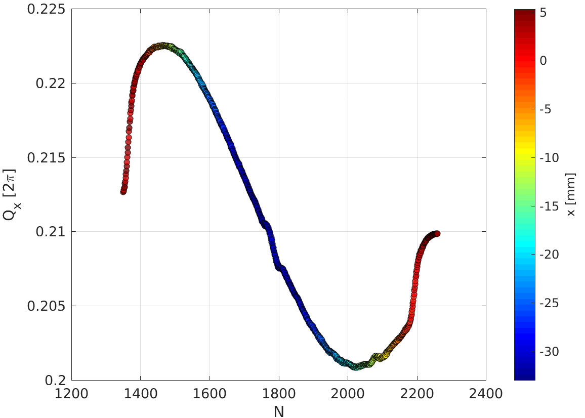
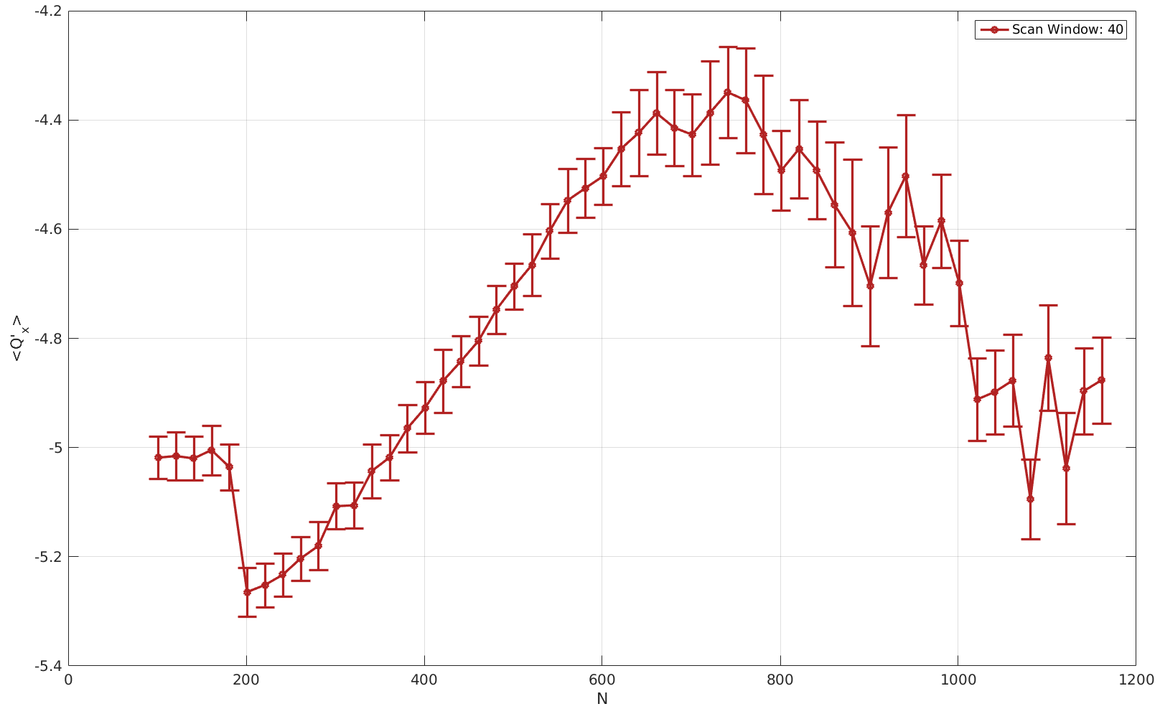
Motivation
A new fast tune measurement method has been developed
Measurements show a variation of the tune of the order of 0.01 when the bump is fired
Strong hint at important Eddy current effect during the injection bump. The modulation can be correlated to the Bdot.
Tune modulation
Chromaticity
P. Zisopoulos

Slide 18
Current/possible models:
A number of models can be used to describe the optics:
Standard closed orbit optics:
  Bumpers are off
Standard optics + bumpers:
  Bumpers are on, but no sextupoles are considered
Optics with sextupoles: to model the eddy currents
  Bumpers are on
  A thin sextupole is inserted in any bumper dipole magnet. The strenght ratio of the sextupoles is the same of the bumper dipoles

Slide 19
Closed orbit solution vs bump up
Bumper strengths measured in 2012
Closed solution optics perturbation due to the bump dipoles is negligible
  Beta-beat 0.2 %
  Dispersion max difference 5 cm
... So basically no difference between the optics without sextupoles

Slide 20
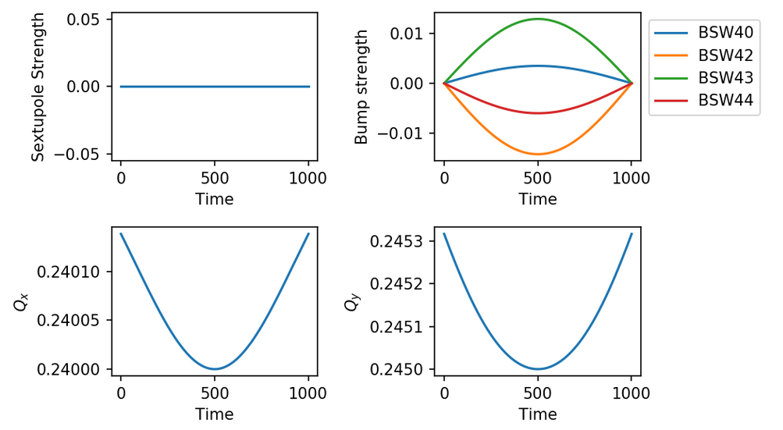
Optics without sextupoles
Tune variation
is negligible !

Slide 21
MADx results: tune variation
500 turns

Slide 22
MADx results: beta beat and chromaticity
Beta beat 5-6% w.r.t. to bump down closed orbit optics
Chromaticity change

Slide 23
MADx results: beta beat and chromaticity
Beta beat 5-6% w.r.t. to bump down closed orbit optics
Chromaticity change

Slide 24
Follow-ups → pyOrbit simulations
PyOrbit simulations have been set in place to study the induced emittance blowup from the bump action (if any):
From optics beating only
Adding space charge
To be continued ….

Slide 25
Notes:
Any input ???

Slide 26
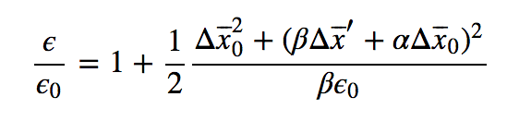
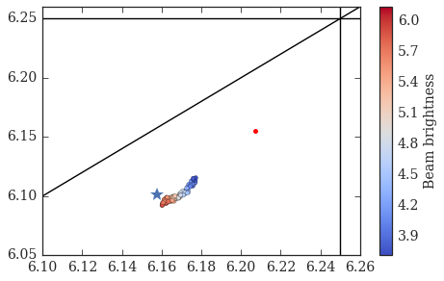
MD2586_INDIV_VdM
I = 13x10¹⁰ ppb
ε_{x_norm} = 2.509 +/- 0.119
ε_{y_norm} = 2.013 +/- 0.034
dp/p_rms = 5e-4
ƛ_max=0.39 A
B = I/0.5*(ε_{x} + ε_{y})
Blowup expectation from steering:
Goal: understand the emittance blowup from injection steering, need to
Stay away from resonances
Decoupled motion in the two transverse planes
Low brightness to limit space charge effects
Working point
PBS in PS optics

Slide 27
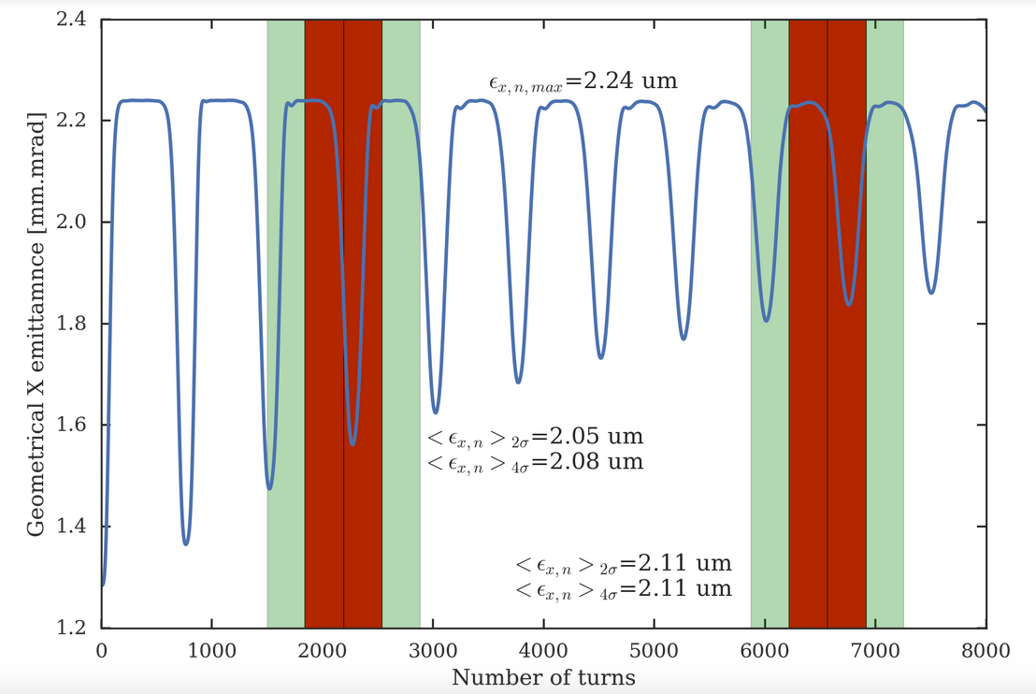
Measure recoherence (if any) with wirescanner
Amplitude | Time | Turns
2σ | 0.8 ms | 349
4σ | 1.6 ms | 690
Scan time | Turn number
175 ms | 2188
185 ms | 6564
Simulation parameters:
I = 15x10¹⁰ ppb
ε_{x_norm} = 2.9 um
ε_{y_norm} = 2.0 um
Kick = 0.35 mrad less than nominal
Recoherence would give us a measurement error of max ~10%
!
… and further simulations with space charge showed that the dips are basically invisible
Notes:
Rev time used = 2.29 us

Slide 28
In general

