Slide 1
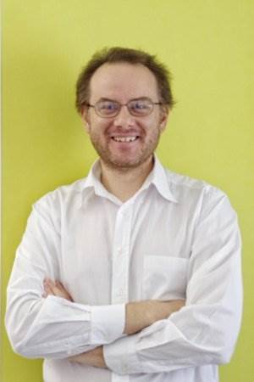
Massimiliano Chiorboli
JP Morgan

Slide 2




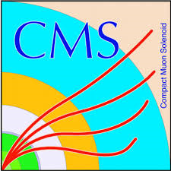
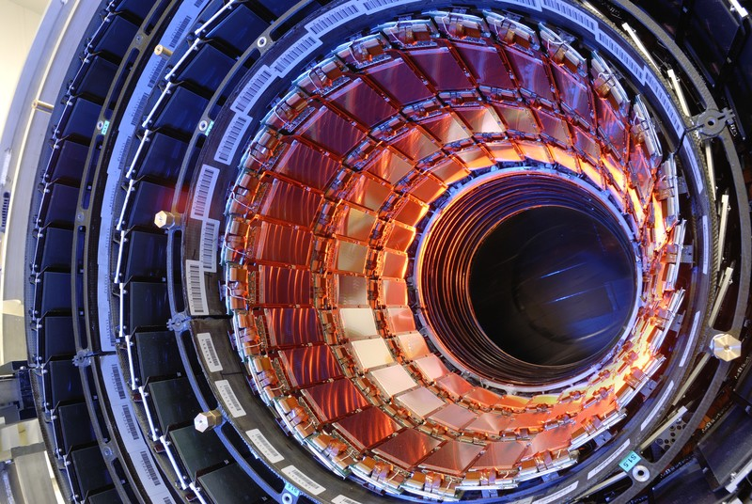
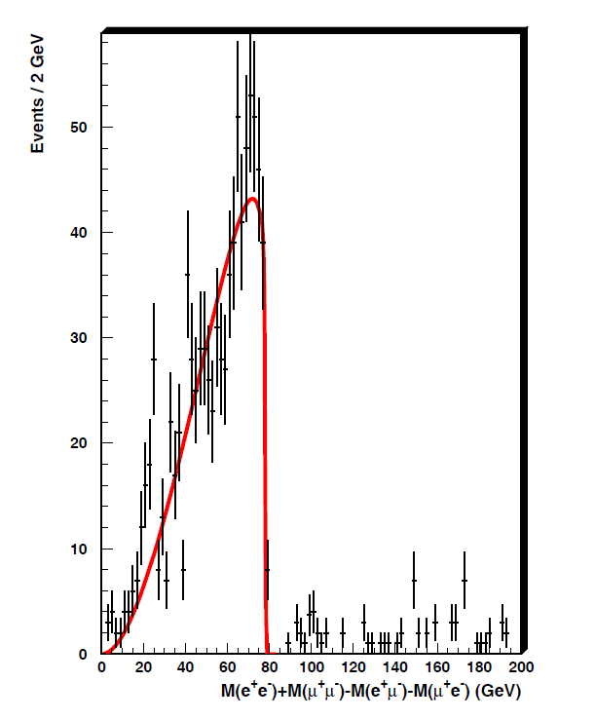
Career in Physics
2003: PhD in Physics, University of Catania
2003-2009: University of Catania – INFN
2009: Caltech
2010-2011: CERN – INFN
CMS experiment
  Tracker
  Susy analysis
  Trigger

Slide 3
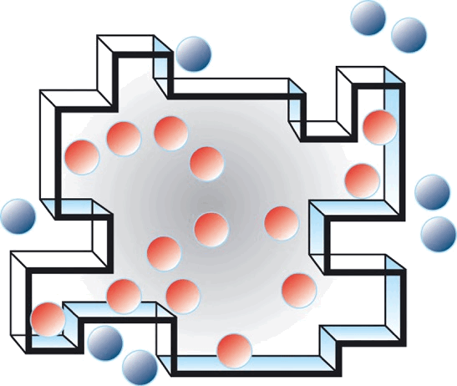

Career after physics
2011-2017: DERAM
  Software for Banks
  Database referential
  Data feeds: SIX, Reuters, Bloomberg
  Models for shares and bonds risk
2017-present: JP Morgan
  Big data team
  Data visualization

