Slide 1
Introduction to RooFit
  Introduction and overview
  Creation and basic use of models
  Composing models
  Working with (profile) likelihood
  Simultaneous fits and combined models
W. Verkerke (NIKHEF)

Slide 2
1
Introduction
& Overview

Slide 3
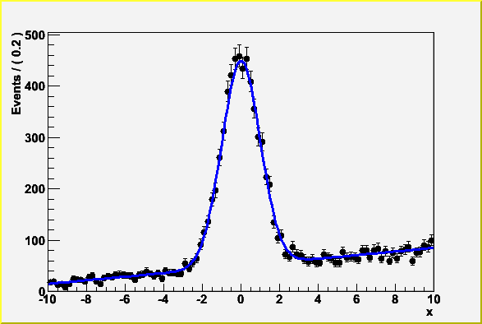
Introduction -- Focus: coding a probability density function
1
Focus on one practical aspect of many data analysis in HEP: How do you formulate your p.d.f. in ROOT
  For ‘simple’ problems (gauss, polynomial) this is easy
  But if you want to do unbinned ML fits, use non-trivial functions, or work with multidimensional functions you quickly find that you need some tools to help you

Slide 4
Introduction – Why RooFit was developed
2
BaBar experiment at SLAC: Extract sin(2β) from time dependent CP violation of B decay: e⁺e⁻ → Y(4s) → BB
  Reconstruct both Bs, measure decay time difference
  Physics of interest is in decay time dependent oscillation
Many issues arise
  Standard ROOT function framework clearly insufficient to handle such complicated functions → must develop new framework
  Normalization of p.d.f. not always trivial to calculate → may need numeric integration techniques
  Unbinned fit, >2 dimensions, many events → computation performance important → must try optimize code for acceptable performance
  Simultaneous fit to control samples to account for detector performance

Slide 5
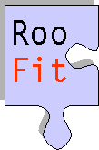

Introduction – Relation to ROOT
3
Extension to ROOT – (Almost) no overlap with existing functionality
Data Modeling
ToyMC data
Generation
Model
Visualization
Data/Model
Fitting
C++ command line
interface & macros
MINUIT
Data management &
histogramming
I/O support
Graphics interface

Slide 6
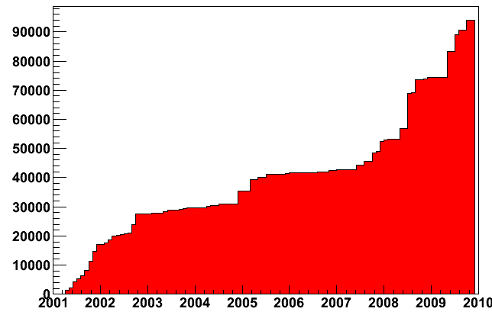
Project timeline
4
1999 : Project started
  First application: ‘sin2b’ measurement of BaBar
  (model with 5 observables, 37 floating parameters, simultaneous fit to multiple CP and control channels)
2000 : Complete overhaul of design based on
experience with sin2b fit
  Very useful exercise: new design is still current design
2003 : Public release of RooFit with ROOT
2004 : Over 50 BaBar physics publications using RooFit
2007 : Integration of RooFit in ROOT CVS source
2008 : Upgrade in functionality as part of RooStats project
  Improved analytical and
  numeric integration handling,
  improved toy MC generation,
  addition of workspace
2009 : Now ~100K lines of code
  (For comparison RooStats
  proper is ~5000 lines of code)
lines of code
last modification before date

Slide 7
RooFit core design philosophy
5
Mathematical objects are represented as C++ objects
Mathematical concept
RooFit class
variable
RooRealVar
function
RooAbsReal
PDF
RooAbsPdf
space point
RooArgSet
integral
RooRealIntegral
list of space points
RooAbsData

Slide 8
RooFit core design philosophy
6
Represent relations between variables and functions
as client/server links between objects
f(x,y,z)
Math
RooAbsReal f
RooFit
diagram
RooRealVar x
RooRealVar y
RooRealVar z
RooFit
code
RooRealVar x(“x”,”x”,5) ;
RooRealVar y(“y”,”y”,5) ;
RooRealVar z(“z”,”z”,5) ;
RooBogusFunction f(“f”,”f”,x,y,z) ;

Slide 9
Object-oriented data modeling
7
All objects are self documenting
    Name - Unique identifier of object
    Title – More elaborate description of object
Initial range
RooRealVar mass(“mass”,”Invariant mass”,5.20,5.30) ;
RooRealVar width(“width”,”B0 mass width”,0.00027,”GeV”);
RooRealVar mb0(“mb0”,”B0 mass”,5.2794,”GeV”) ;
RooGaussian b0sig(“b0sig”,”B0 sig PDF”,mass,mb0,width);
Objects
representing
a ‘real’ value.
Initial value
Optional unit
PDF object
References to variables

Slide 10
2
Basic use

Slide 11
The simplest possible example
8
We make a Gaussian p.d.f. with three variables:
mass, mean and sigma
Name of object
Title of object
Initial range
Objects
representing
a ‘real’ value.
RooRealVar x(“x”,”Observable”,-10,10) ;
RooRealVar mean(“mean”,”B0 mass”,0.00027);
RooRealVar sigma(“sigma”,”B0 mass width”,5.2794) ;
RooGaussian model(“model”,”signal pdf”,x,mean,sigma)
Initial value
PDF object
References to variables

Slide 12
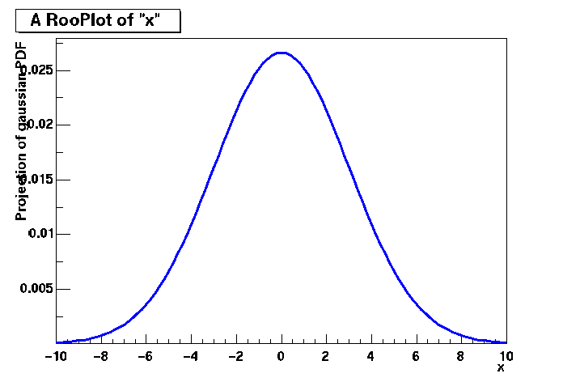
Basics – Creating and plotting a Gaussian p.d.f
9
Setup gaussian PDF and plot
// Create an empty plot frame
RooPlot* xframe = x.frame() ;
// Plot model on frame
model.plotOn(xframe) ;
// Draw frame on canvas
xframe->Draw() ;
Axis label from gauss title
Unit
normalization
A RooPlot is an empty frame
capable of holding anything
plotted versus it variable
Plot range taken from limits of x

Slide 13
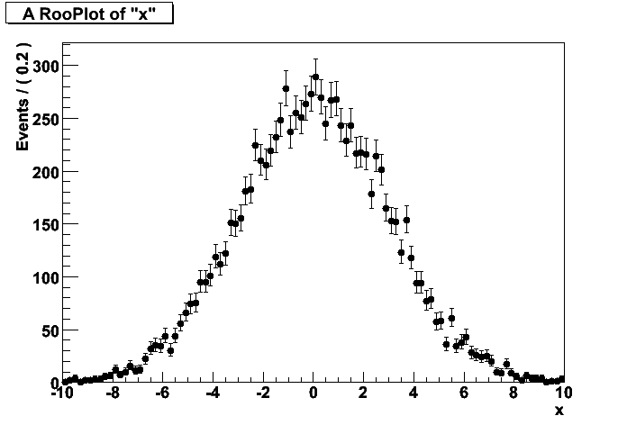
Basics – Generating toy MC events
10
Generate 10000 events from Gaussian p.d.f and show distribution
// Generate an unbinned toy MC set
RooDataSet* data = gauss.generate(x,10000) ;
// Generate an binned toy MC set
RooDataHist* data = gauss.generateBinned(x,10000) ;
// Plot PDF
RooPlot* xframe = x.frame() ;
data->plotOn(xframe) ;
xframe->Draw() ;
Can generate both binned and
unbinned datasets

Slide 14
Basics – Importing data
11
Unbinned data can also be imported from ROOT TTrees
  Imports TTree branch named “x”.
  Can be of type Double_t, Float_t, Int_t or UInt_t.
  All data is converted to Double_t internally
  Specify a RooArgSet of multiple observables to import
  multiple observables
Binned data can be imported from ROOT THx histograms
  Imports values, binning definition and SumW2 errors (if defined)
  Specify a RooArgList of observables when importing a TH2/3.
// Import unbinned data
RooDataSet data(“data”,”data”,x,Import(*myTree)) ;
// Import unbinned data
RooDataHist data(“data”,”data”,x,Import(*myTH1)) ;

Slide 15
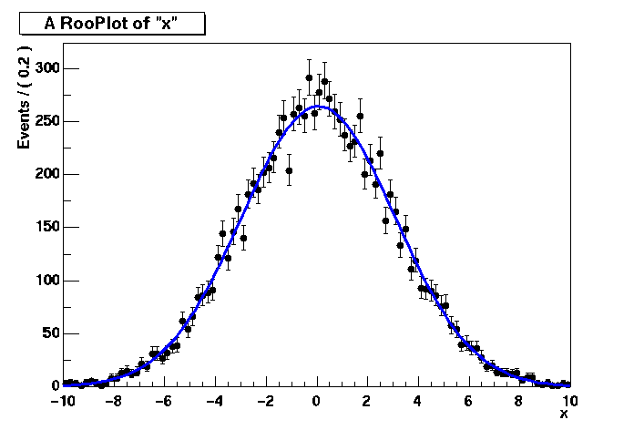
Basics – ML fit of p.d.f to unbinned data
12
// ML fit of gauss to data
gauss.fitTo(*data) ;
(MINUIT printout omitted)
// Parameters if gauss now
// reflect fitted values
mean.Print()
RooRealVar::mean = 0.0172335 +/- 0.0299542
sigma.Print()
RooRealVar::sigma = 2.98094 +/- 0.0217306
// Plot fitted PDF and toy data overlaid
RooPlot* xframe = x.frame() ;
data->plotOn(xframe) ;
gauss.plotOn(xframe) ;
PDF
automatically
normalized
to dataset

Slide 16
Basics – ML fit of p.d.f to unbinned data
13
Can also choose to save full detail of fit
RooFitResult* r = gauss.fitTo(*data,Save()) ;
r->Print() ;
RooFitResult: minimized FCN value: 25055.6,
estimated distance to minimum: 7.27598e-08
coviarance matrix quality:
Full, accurate covariance matrix
Floating Parameter FinalValue +/- Error
-------------------- --------------------------
mean 1.7233e-02 +/- 3.00e-02
sigma 2.9809e+00 +/- 2.17e-02
r->correlationMatrix().Print() ;
2x2 matrix is as follows
| 0 | 1 |
-------------------------------
0 | 1 0.0005869
1 | 0.0005869 1

Slide 17
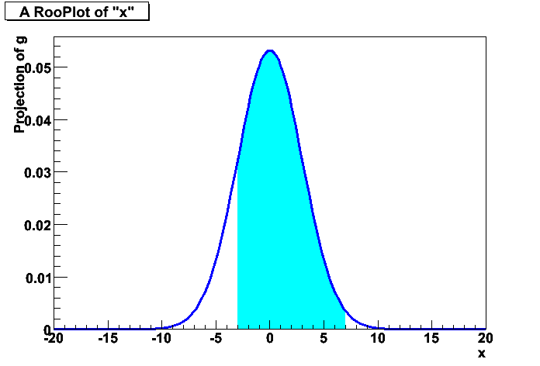
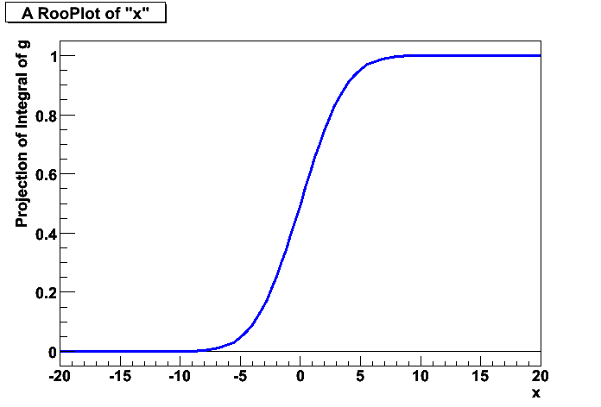
Basics – Integrals over p.d.f.s
14
It is easy to create an object representing integral over a normalized p.d.f in a sub-range
Similarly, one can also request
the cumulative distribution function
w::x.setRange(“sig”,-3,7) ;
RooAbsReal* ig = g.createIntegral(x,NormSet(x),Range(“sig”)) ;
cout << ig.getVal() ;
0.832519
mean=-1 ;
cout << ig.getVal() ;
0.743677
RooAbsReal* cdf = gauss.createCdf(x) ;

Slide 18
RooFit core design philosophy - Workspace
15
The workspace serves a container class for all
objects created
f(x,y,z)
Math
RooWorkspace
RooAbsReal f
RooFit
diagram
RooRealVar x
RooRealVar y
RooRealVar z
RooFit
code
RooRealVar x(“x”,”x”,5) ;
RooRealVar y(“y”,”y”,5) ;
RooRealVar z(“z”,”z”,5) ;
RooBogusFunction f(“f”,”f”,x,y,z) ;
RooWorkspace w(“w”) ;
w.import(f) ;

Slide 19
Using the workspace
16
Workspace
  A generic container class for all RooFit objects of your project
  Helps to organize analysis projects
Creating a workspace
Putting variables and function into a workspace
  When importing a function or pdf, all its components (variables) are automatically imported too
RooWorkspace w(“w”) ;
RooRealVar x(“x”,”x”,-10,10) ;
RooRealVar mean(“mean”,”mean”,5) ;
RooRealVar sigma(“sigma”,”sigma”,3) ;
RooGaussian f(“f”,”f”,x,mean,sigma) ;
// imports f,x,mean and sigma
w.import(myFunction) ;

Slide 20
Using the workspace
17
Looking into a workspace
Getting variables and functions out of a workspace
w.Print() ;
variables
---------
(mean,sigma,x)
p.d.f.s
-------
RooGaussian::f[ x=x mean=mean sigma=sigma ] = 0.249352
// Variety of accessors available
RooPlot* frame = w.var(“x”)->frame() ;
w.pdf(“f”)->plotOn(frame) ;

Slide 21
Using the workspace
18
Alternative access to contents through namespace
  Uses CINT extension of C++, works in interpreted code only
  (Alternatively construct workspace with kTRUE as 2nd arg)
Writing workspace and contents to file
// Variety of accessors available
w.exportToCint() ;
RooPlot* frame = w::x.frame() ;
w::f.plotOn(frame) ;
w.writeToFile(“wspace.root”) ;

Slide 22
Using the workspace
19
Organizing your code –
Separate construction and use of models
void driver() {
RooWorkspace w(“w”) ;
makeModel(w) ;
useModel(w) ;
}
void makeModel(RooWorkspace& w) {
// Construct model here
}
void useModel(RooWorkspace& w) {
// Make fit, plots etc here
}

Slide 23
Factory and Workspace
21
One C++ object per math symbol provides
ultimate level of control over each objects functionality, but results in lengthy user code for even simple macros
Solution: add factory that auto-generates objects from a math-like language. Accessed through factory() method of workspace
Example: reduce construction of Gaussian pdf and its parameters from 4 to 1 line of code
w.factory(“Gaussian::f(x[-10,10],mean[5],sigma[3])”) ;
RooRealVar x(“x”,”x”,-10,10) ;
RooRealVar mean(“mean”,”mean”,5) ;
RooRealVar sigma(“sigma”,”sigma”,3) ;
RooGaussian f(“f”,”f”,x,mean,sigma) ;

Slide 24
RooFit core design philosophy - Factory
20
The factory allows to fill a workspace with pdfs and variables using a simplified scripting language
f(x,y,z)
Math
RooWorkspace
RooAbsReal f
RooFit
diagram
RooRealVar x
RooRealVar y
RooRealVar z
RooFit
code
RooWorkspace w(“w”) ;
w.factory(“BogusFunction::f(x[5],y[5],z[5])”) ;

Slide 25
Factory language – Goal and scope
22
Aim of factory language is to be very simple.
The goal is to construct pdfs, functions and variables
  This limits the scope of the factory language (and allows to keep it simple)
  Objects can be customized after creation
The language syntax has only three elements
  Simplified expression for creation of variables
  Expression for creation of functions and pdf is trivial
  1-to-1 mapping of C++ constructor syntax of corresponding object
  Multiple objects (e.g. a pdf and its variables) can be nested in a single expression
Operator classes (sum,product) provide alternate syntax in factory that is closer to math notation

Slide 26
Factory syntax
23
Rule #1 – Create a variable
Rule #2 – Create a function or pdf object
  Leading ‘Roo’ in class name can be omitted
  Arguments are names of objects that already exist in the workspace
  Named objects must be of correct type, if not factory issues error
  Set and List arguments can be constructed with brackets {}
x[-10,10] // Create variable with given range
x[5,-10,10] // Create variable with initial value and range
x[5] // Create initially constant variable
ClassName::Objectname(arg1,[arg2],...)
Gaussian::g(x,mean,sigma)
→ RooGaussian(“g”,”g”,x,mean,sigma)
Polynomial::p(x,{a0,a1})
→ RooPolynomial(“p”,”p”,x”,RooArgList(a0,a1));

Slide 27
Factory syntax
24
Rule #3 – Each creation expression returns the name of the object created
  Allows to create input arguments to functions ‘in place’ rather than in advance
Miscellaneous points
  You can always use numeric literals where values or functions are expected
  It is not required to give component objects a name, e.g.
Gaussian::g(x[-10,10],mean[-10,10],sigma[3])
→ x[-10,10]
mean[-10,10]
sigma[3]
Gaussian::g(x,mean,sigma)
Gaussian::g(x[-10,10],0,3)
SUM::model(0.5*Gaussian(x[-10,10],0,3),Uniform(x)) ;

Slide 28
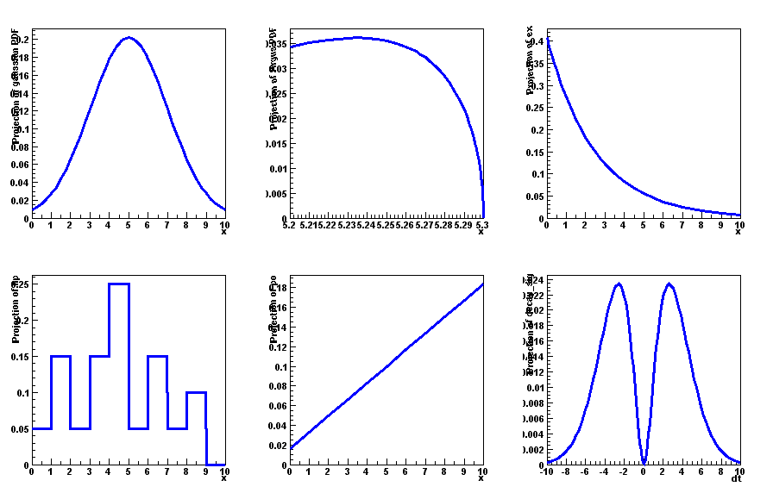
Model building – (Re)using standard components
25
RooFit provides a collection of compiled standard PDF classes
RooBMixDecay
Physics inspired
ARGUS,Crystal Ball,
Breit-Wigner, Voigtian,
B/D-Decay,….
RooPolynomial
RooHistPdf
RooArgusBG
Non-parametric
Histogram, KEYS
RooGaussian
Basic
Gaussian, Exponential, Polynomial,…
Chebychev polynomial
Easy to extend the library: each p.d.f. is a separate C++ class

Slide 29
Model building – (Re)using standard components
26
List of most frequently used pdfs and their factory spec
Gaussian Gaussian::g(x,mean,sigma)
Breit-Wigner BreitWigner::bw(x,mean,gamma)
Landau Landau::l(x,mean,sigma)
Exponential Exponental::e(x,alpha)
Polynomial Polynomial::p(x,{a0,a1,a2})
Chebychev Chebychev::p(x,{a0,a1,a2})
Kernel Estimation KeysPdf::k(x,dataSet)
Poisson Poisson::p(x,mu)
Voigtian Voigtian::v(x,mean,gamma,sigma)
(=BW⊗G)

Slide 30
Model building – Making your own
27
Interpreted expressions
Customized class, compiled and linked on the fly
Custom class written by you
  Offer option of providing analytical integrals, custom handling of toy MC generation (details in RooFit Manual)
Compiled classes are faster in use, but require O(1-2) seconds startup overhead
  Best choice depends on use context
w.factory(“EXPR::mypdf(‘sqrt(a*x)+b’,x,a,b)”) ;
w.factory(“CEXPR::mypdf(‘sqrt(a*x)+b’,x,a,b)”) ;

Slide 31
Model building – Adjusting parameterization
28
RooFit pdf classes do not require their parameter arguments to be variables, one can plug in functions as well
Simplest tool perform reparameterization is interpreted formula expression
  Note lower case: expr builds function, EXPR builds pdf
Example: Reparameterize pdf that expects mistag rate in terms of dilution
w.factory(“expr::w(‘(1-D)/2’,D[0,1])”) ;
w.factory(“BMixDecay::bmix(t,mixState,tagFlav,
tau,expr(‘(1-D)/2’,D[0,1]),dw,....”) ;

Slide 32
3
Composite
models

Slide 33
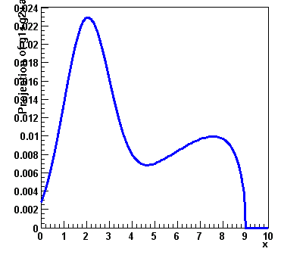
Model building – (Re)using standard components
29
Most realistic models are constructed as the sum of one or more p.d.f.s (e.g. signal and background)
Facilitated through operator p.d.f RooAddPdf
RooBMixDecay
RooPolynomial
RooHistPdf
RooArgusBG
RooGaussian
+
RooAddPdf

Slide 34
Adding p.d.f.s – Mathematical side
30
From math point of view adding p.d.f is simple
  Two components F, G
  Generically for N components P₀-P_{N}
For N p.d.f.s, there are N-1 fraction coefficients that should sum to less 1
  The remainder is by construction 1 minus the sum of all other coefficients

Slide 35
Adding p.d.f.s – Factory syntax
31
Additions created through a SUM expression
  Note that last PDF does not have an associated fraction
Complete example
SUM::name(frac1*PDF1,frac2*PDF2,...,PDFN)
w.factory(“Gaussian::gauss1(x[0,10],mean1[2],sigma[1]”) ;
w.factory(“Gaussian::gauss2(x,mean2[3],sigma)”) ;
w.factory(“ArgusBG::argus(x,k[-1],9.0)”) ;
w.factory(“SUM::sum(g1frac[0.5]*gauss1, g2frac[0.1]*gauss2, argus)”)

Slide 36
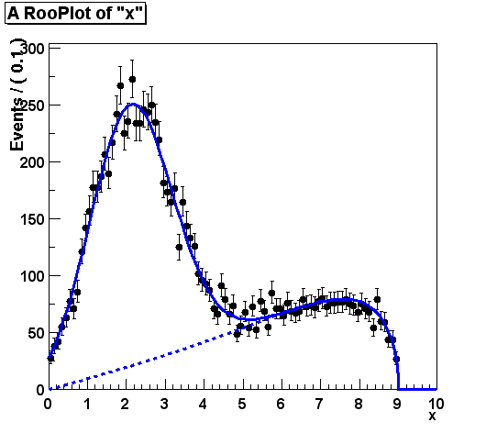
Component plotting - Introduction
32
Plotting, toy event generation and fitting works identically for composite p.d.f.s
  Several optimizations applied behind the scenes that are specific to composite models (e.g. delegate event generation to components)
Extra plotting functionality specific to composite pdfs
  Component plotting
// Plot only argus components
w::sum.plotOn(frame,Components(“argus”),LineStyle(kDashed)) ;
// Wildcards allowed
w::sum.plotOn(frame,Components(“gauss*”),LineStyle(kDashed)) ;

Slide 37
Extended ML fits
33
In an extended ML fit, an extra term is added to the likelihood
Poisson(N_{obs},N_{exp})
This is most useful in combination with a composite pdf
shape
normalization
Write like this,
extended term automatically included in –log(L)
SUM::name(Nsig*S,Nbkg*B)

Slide 38
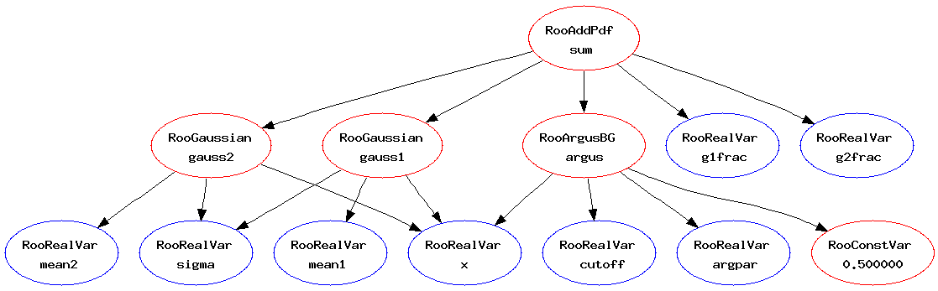
Operations on specific to composite pdfs
34
Tree printing mode of workspace reveals component structure – w.Print(“t”)
  Can also make input files for GraphViz visualization
  (w::sum.graphVizTree(“myfile.dot”))
  Graph output on ROOT Canvas in near future
  (pending ROOT integration
  of GraphViz package)
RooAddPdf::sum[ g1frac * g1 + g2frac * g2 + [%] * argus ] = 0.0687785
RooGaussian::g1[ x=x mean=mean1 sigma=sigma ] = 0.135335
RooGaussian::g2[ x=x mean=mean2 sigma=sigma ] = 0.011109
RooArgusBG::argus[ m=x m0=k c=9 p=0.5 ] = 0

Slide 39
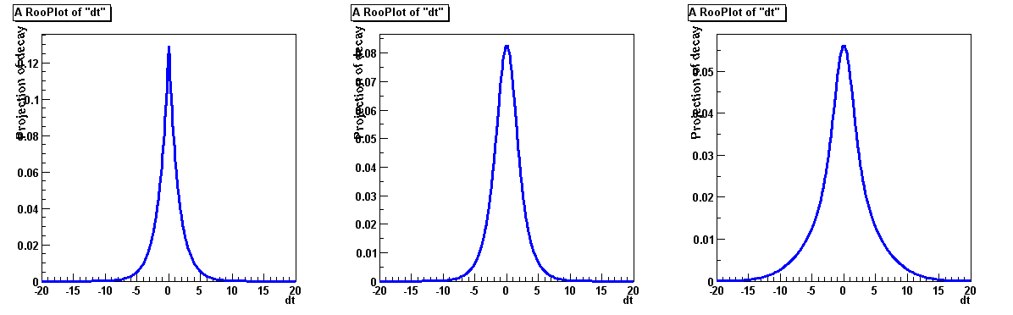
Convolution
35
Model representing a convolution of a theory model and a resolution model often useful
But numeric calculation of convolution integral can be
challenging. No one-size-fits-all solution, but 3 options available
  Analytical convolution (BW⊗Gauss, various B physics decays)
  Brute-force numeric calculation (slow)
  FFT numeric convolution (fast, but some side effects)
⊗
=

Slide 40
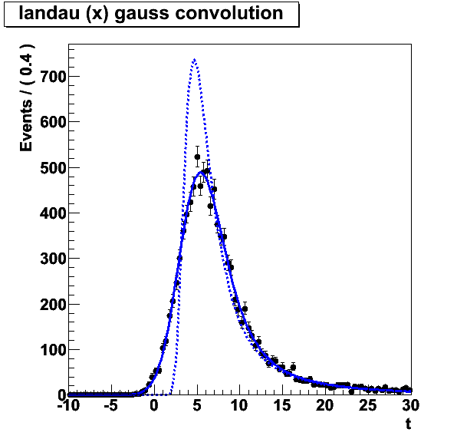
Convolution
36
Example
FFT usually best
  Fast: unbinned ML fit to 10K
  events take ~5 seconds
  NB: Requires installation of FFTW
  package (free, but not default)
  Beware of cyclical effects
  (some tools available to mitigate)
w.factory(“Landau::L(x[-10,30],5,1)”) :
w.factory(“Gaussian::G(x,0,2)”) ;
w::x.setBins(“cache”,10000) ; // FFT sampling density
w.factory(“FCONV::LGf(x,L,G)”) ; // FFT convolution
w.factory(“NCONV::LGb(x,L,G)”) ; // Numeric convolution

Slide 41
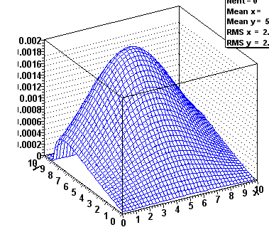
Model building – Products of uncorrelated p.d.f.s
37
RooBMixDecay
RooPolynomial
RooHistPdf
RooArgusBG
RooGaussian
*
RooProdPdf

Slide 42
Uncorrelated products – Mathematics and constructors
38
Mathematical construction of products of uncorrelated p.d.f.s is straightforward
  No explicit normalization required → If input p.d.f.s are unit normalized, product is also unit normalized
  (Partial) integration and toy MC generation automatically uses factorizing properties of product, e.g. is deduced from structure.
Corresponding factory operator is PROD
2D
nD
w.factory(“Gaussian::gx(x[-5,5],mx[2],sx[1])”) ;
w.factory(“Gaussian::gy(y[-5,5],my[-2],sy[3])”) ;
w.factory(“PROD::gxy(gx,gy)”) ;

Slide 43
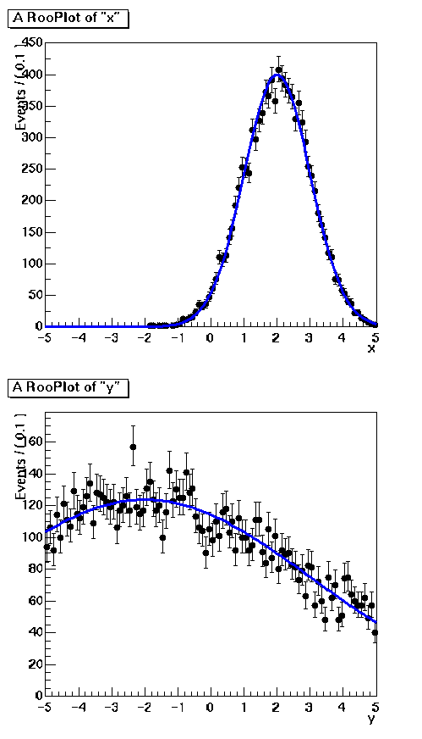
Plotting multi-dimensional models
39
N-D models usually projected on 1-D for visualization
  Happens automatically.
  RooPlots tracks observables of plotted data,
  subsequent models automatically integrated
  Projection integrals analytically reduced
  whenever possible
  (e.g. in case of factorizing pdf)
To make 2,3D histogram of pdf
RooDataSet* dxy =
w::gxy.generate(RooArgSet(w::x,w::y,10000));
RooPlot* frame = w::x.frame() ;
dxy->plotOn(frame) ;
w::gxy.plotOn(frame) ;
TH2* hh = w::gxy.createHistogram(“x,y”,50,50);

Slide 44
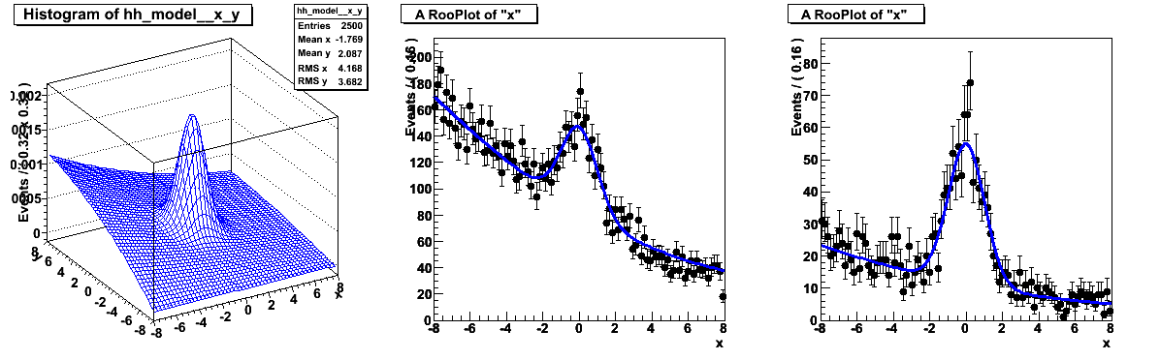
Can also project slices of a multi-dimensional pdf
40
model(x,y) = gauss(x)*gauss(y) + poly(x)*poly(y)
RooPlot* xframe = x.frame() ;
data->plotOn(xframe) ;
model.plotOn(xframe) ;
y.setRange(“sig”,-1,1) ;
RooPlot* xframe2 = x.frame() ;
data->plotOn(xframe2,CutRange("sig")) ;
model.plotOn(xframe2,ProjectionRange("sig")) ;
→ Works also with >2D projections (just specify projection range on all projected observables)
→ Works also with multidimensional p.d.fs that have correlations

Slide 45
Introducing correlations through composition
41
RooFit pdf building blocks do not require variables as input, just real-valued functions
  Can substitute any variable with a function expression in parameters and/or observables
  Example: Gaussian with shifting mean
  No assumption made in function on a,b,x,y being observables or parameters, any combination will work
w.factory(“expr::mean(‘a*y+b’,y[-10,10],a[0.7],b[0.3])”) ;
w.factory(“Gaussian::g(x[-10,10],mean,sigma[3])”) ;

Slide 46
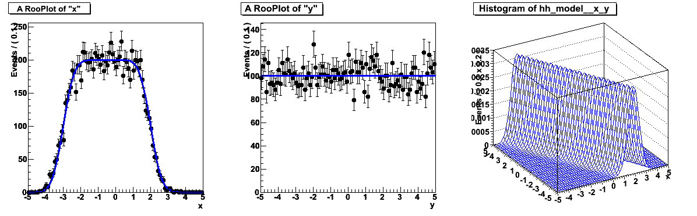
What does the example p.d.f look like?
42
Use example model with x,y as observables
Note flat distribution in y. Unlikely to describe data, solutions:
  Use as conditional p.d.f g(x|y,a,b)
  Use in conditional form multiplied by another pdf in y: g(x|y)*h(y)
Projection on Y
Projection on X

Slide 47
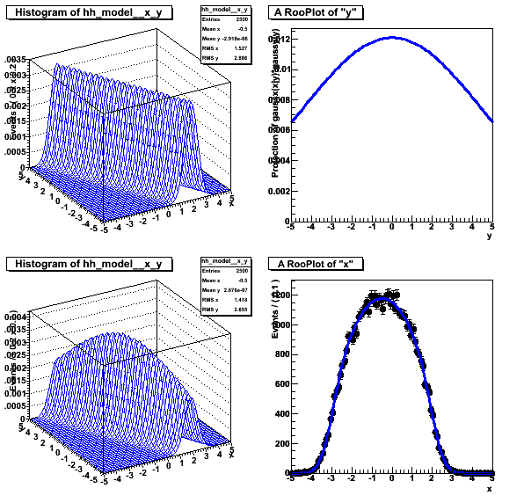
Example with product of conditional and plain p.d.f.
43
gx(x|y)
*
gy(y)
=
model(x,y)
// I - Use g as conditional pdf g(x|y)
w::g.fitTo(data,ConditionalObservables(w::y)) ;
// II - Construct product with another pdf in y
w.factory(“Gaussian::h(y,0,2)”) ;
w.factory(“PROD::gxy(g|y,h)”) ;

Slide 48
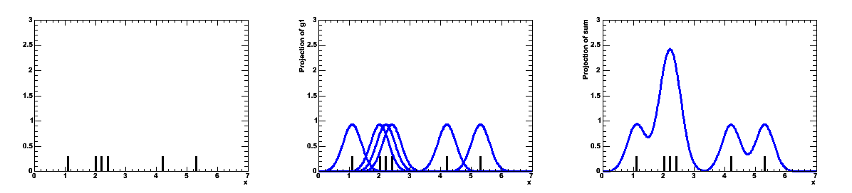
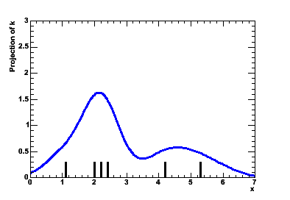
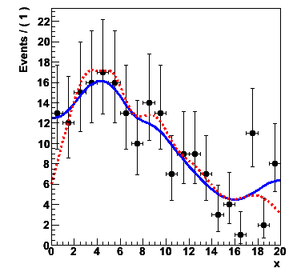
Special pdfs – Kernel estimation model
44
Kernel estimation model
  Construct smooth pdf from unbinned data,
  using kernel estimation technique
Example
Also available for n-D data
Adaptive Kernel:
width of Gaussian depends
on local event density
Gaussian pdf
for each event
Summed pdf
for all events
Sample of events
w.import(myData,Rename(“myData”)) ;
w.factory(“KeysPdf::k(x,myData)”) ;

Slide 49
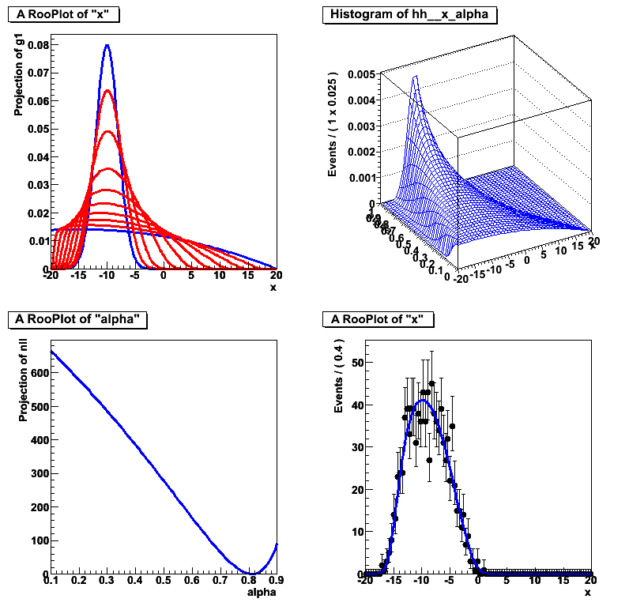
Special pdfs – Morphing interpolation
45
Special operator pdfs can interpolate existing pdf shapes
  Ex: interpolation between Gaussian and Polynomial
Two morphing algorithms available
  IntegralMorph (Alex Read algorithm).
  CPU intensive, but good with discontinuities
  MomentMorph (Max Baak).
  Fast, can handle multiple observables (and soon multiple interpolation parameters), but doesn’t work well for all pdfs
w.factory(“Gaussian::g(x[-20,20],-10,2)”) ;
w.factory(“Polynomial::p(x,{-0.03,-0.001})”) ;
w.factory(“IntegralMorph::gp(g,p,x,alpha[0,1])”) ;
α = 0.812 ± 0.008
Fit to data

Slide 50
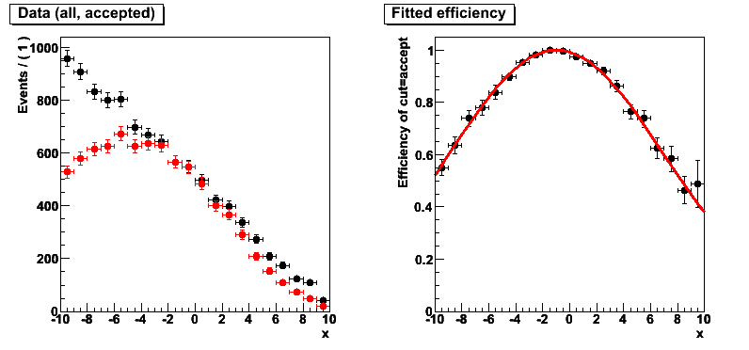
Special pdfs – Unbinned ML fit for efficiency function
46
Binomial pdf
  Constructs pdf that can estimate efficiency function e(x) in from dataset D(x,c) where ‘c’ distinguishes accepted and rejected events
w.factory(“expr::e(‘(1-a)+a*cos((x-c)/b)’,x,a,b,c);
w.factory(“Efficiency::model(e,cut[acc,rej],"acc")”) ;
w::model.fitTo(data,ConditionalObservables(w::x)) ;
RooPlot* frame = w::x.frame() ;
data->plotOn(frame,
Efficiency(cut)) ;
e.plotOn(frame) ;

Slide 51
4
Likelihood &
Profile Likelihood

Slide 52
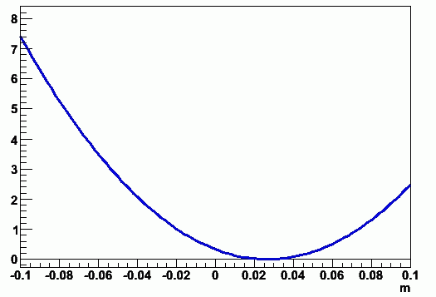
Constructing the likelihood
47
So far focus on construction of pdfs, and basic use for fitting and toy event generation
Can also explicitly construct the likelihood function of and pdf/data combination
  Can use (plot, integrate) likelihood like any RooFit function object
RooAbsReal* nll = w::model.createNLL(data) ;
RooPlot* frame = w::param.frame() ;
nll->plotOn(frame,ShiftToZero()) ;

Slide 53
Constructing the likelihood
48
Example – Manual MINUIT invocation
  After each MINUIT command, result of operation are immediately propagated to RooFit variable objects (values and errors)
  NB: Also other minimizers (Minuit2, GSL etc) supported since 5.24
Can also create χ² functions objects
// Create likelihood (calculation parallelized on 8 cores)
RooAbsReal* nll = w::model.createNLL(data,NumCPU(8)) ;
RooMinuit m(*nll) ; // Create MINUIT session
m.migrad() ; // Call MIGRAD
m.hesse() ; // Call HESSE
m.minos(w::param) ; // Call MINOS for ‘param’
RooFitResult* r = m.save() ; // Save status (cov matrix etc)
RooAbsReal* chi2 = w::model.createChi2(binnedData) ;
RooAbsReal* chi2 = w::model.createXYChi2(xyData) ;

Slide 54
Adding parameter pdfs to the likelihood
49
Systematic/external uncertainties can be modeled
with regular RooFit pdf objects.
To incorporate in likelihood, simply multiply with orig pdf
  Any pdf can be supplied, e.g. a RooMultiVarGaussian from a RooFitResult (or one you construct yourself)
w.factory(“Gaussian::g(x[-10,10],mean[-10,10],sigma[3])”) ;
w.factory(“PROD::gprime(f,Gaussian(mean,1.15,0.30))”) ;
w.import(*fr->createHessePdf(w::mean,w::sigma),”parampdf”) ;
w.factory(“PROD::gprime(f,parampdf)”) ;

Slide 55
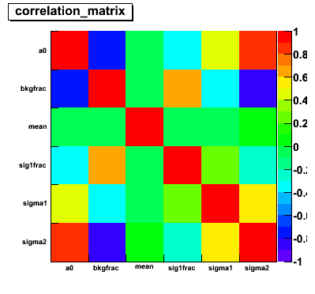
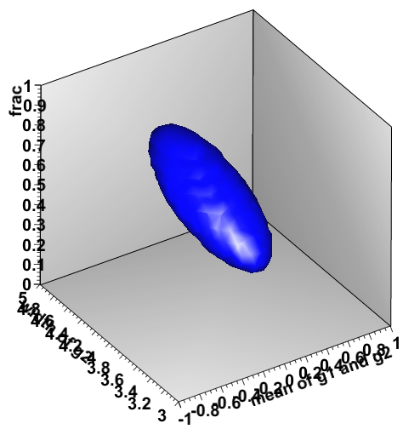
Using the fit result output
50
The fit result class contains the full MINUIT output
Easy visualization of correlation matrix
Construct multi-variate Gaussian pdf
representing pdf on parameters
  Returned pdf represents HESSE parabolic
  approximation of fit
fitresult->correlationHist->Draw(“colz”) ;
RooAbsPdf* paramPdf = fr->createHessePdf(RooArgSet(frac,mean,sigma));

Slide 56
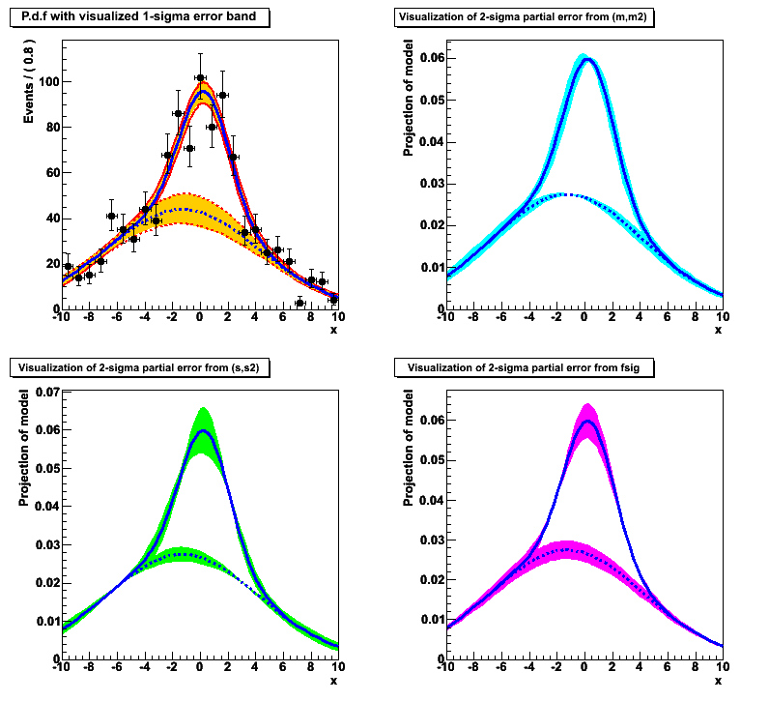
Using the fit result output – Error propagation
51
Can (as visual aid) propagate errors in covariance matrix of a fit result to a pdf projection
  Linear propagation on
  pdf projection
Propagated error can be
calculated on arbitrary function
  E.g fraction of events in signal range
w::model.plotOn(frame,VisualizeError(*fitresult)) ;
w::model.plotOn(frame,VisualizeError(*fitresult,fsig)) ;
RooAbsReal* fracSigRange =
w::model.createIntegral(x,x,”sig”) ;
Double_t err =
fracSigRange.getPropagatedError(*fr);

Slide 57
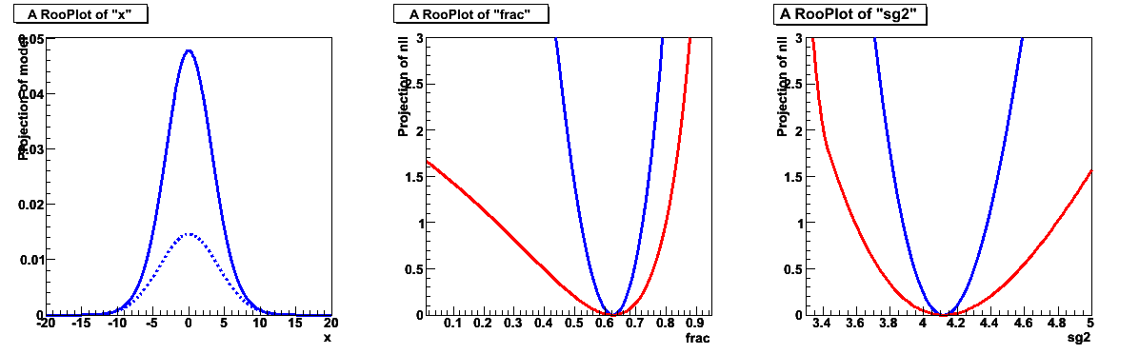
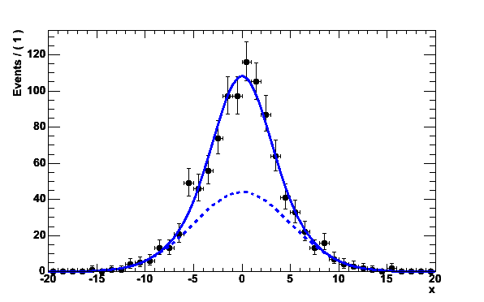
Working with profile likelihood
52
Best L for given p
A profile likelihood ratio
can be represent by a regular RooFit function
(albeit an expensive one to evaluate)
Best L
RooAbsReal* ll = model.createNLL(data,NumCPU(8)) ;
RooAbsReal* pll = ll->createProfile(params) ;
RooPlot* frame = w::frac.frame() ;
nll->plotOn(frame,ShiftToZero()) ;
pll->plotOn(frame,LineColor(kRed)) ;

Slide 58
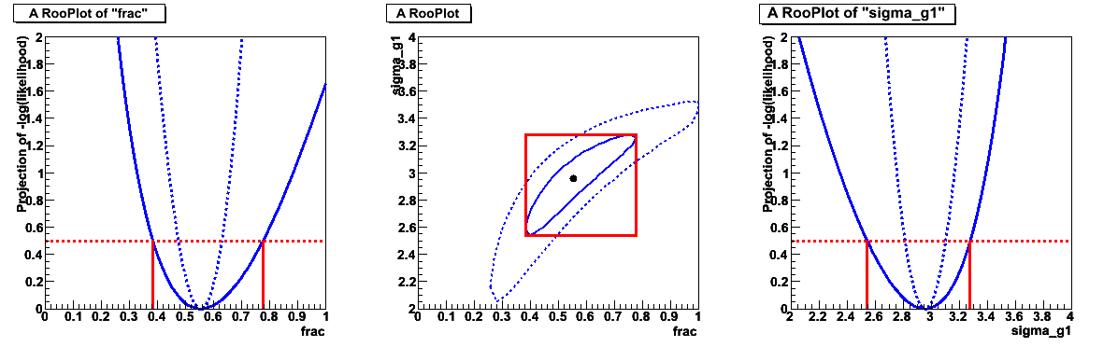
On the equivalence of profile likelihood and MINOS
53
Demonstration of equivalence
of (RooFit) profile likelihood
and MINOS errors
  Macro to make above plots is
  34 lines of code (+23 to beautify
  graphics appearance)

Slide 59
5
Simultaneous fits
and combinations

Slide 60
Constructing joint pdfs
54
Operator class SIMUL to construct joint models
at the pdf level
Can also construct joint datasets
// Pdfs for channels ‘A’ and ‘B’
w.factory(“Gaussian::pdfA(x[-10,10],mean[-10,10],sigma[3])”) ;
w.factory(“Uniform::pdfB(x)”) ;
// Create discrete observable to label channels
w.factory(“index[A,B]”) ;
// Create joint pdf
w.factory(“SIMUL::joint(index,A=pdfA,B=pdfB)”) ;
RooDataSet *dataA, *dataB ;
RooDataSet dataAB(“dataAB”,”dataAB”,Index(w::index),
Import(“A”,*dataA),Import(“B”,*dataB)) ;

Slide 61
Constructing joint likelihood
55
Can then construct the joint likelihood as usual
Also possible to make likelihood first and then join
  But then there is no definition of joint pdf
  and cannot execute frequentist techniques on joint models...
RooAbsReal* nllJoint = w::joint.createNLL(dataAB) ;
RooAbsReal* nllA = w::A.createNLL(*dataA) ; w.import(nllA) ;
RooAbsReal* nllB = w::B.createNLL(*dataB) ; w.import(nllB) ;
w.factory(sum::nllJoint(nllA,nllB)) ;

Slide 62
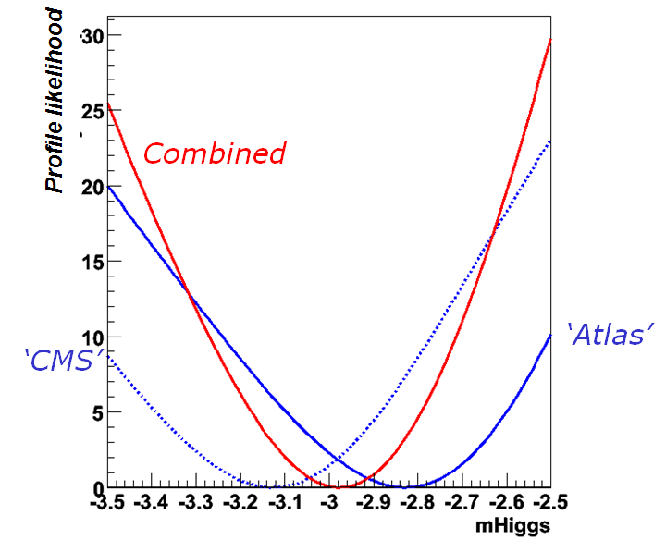
Using joint models
56
When constructing joint models and likelihoods:
parameters with the same name = same parameter
If intentional, you are done at this point.
  Takes all parameter correlations
  fully into account
  To add additional correlations,
  simply multiply joint pdf with
  appropriate RooMultiVarGaussian
  pdf in parameters of choice
RooAbsReal* pllJoint = nllJoint->createProfile(paramOfInterest) ;
w.factory(“MultiVarGaussian::corr
({a,b},{0,0},COV)”);
w.factory(“PROD::jointc(joint,corr)”) ;

Slide 63
Tools to aid logistics of building a joint model
57
Multiple experiments / analysis groups are unlikely to be organized to an extent where parameter naming schemes match exactly
  The workspace has tools to manage this
  These tools are the basis for (future) high level combination tools that will be part of the RooStats project
Import model from another workspace
  Example:: rename all variables of import model
  to unique names by appending a suffix _aHZZ,
  and rename mHiggs to MH
  Can also import straight from file using fileName:wspaceName:objName syntax
w.import(atlasHiggsZZ,
RenameAllVariablesExcept(“mHiggs”,”aHZZ”),
RenameVariable(“mHiggs”,”MH”) ;
w.importFromFile(“ahzz.root:w:atlasHiggsZZ”,…) ;

Slide 64
Summary
58
Brief overview of RooFit functionality, tailored to serve as introductory to RooStats
  Many features were not mentioned here
  No discussion of how this work internally (optimization, analytical deduction abilities)
  About 90% of the details were omitted
Documentation
  Starting point: http://root.cern.ch/drupal/content /roofit
  Users manual (134 pages ~ 1 year old)
  Quick Start Guide (20 pages, recent)
  Link to 84 tutorial macros (also in $ROOTSYS/tutorials/roofit)
Support
  Post your question on ‘Stat & Math Forum’ of ROOT
  (root.cern.ch → Forum → Stat & Math tools)
  I aim for <24h response (but I don’t manage every day!)

Slide 65
6
Hands-on
exercises

Slide 66
Getting started – ROOT setup
Start a ROOT 5.25/04 session
  Local installation on your laptop (PREFERRED due to limited wireless capacity)
  On lxplus (SLC4) or lx64slc5 (SLC5) choose appropriate line below
Now move to your personal working area
Load the roofit & roostats libraries
If you see a message that RooFit v3.11 is loaded
you are (almost) ready to go.
Import the namespace RooFit in CINT
Recommendation: put the last two lines in your ROOT
login script to automate the loading
lxplus> source ~verkerke/public/setup_slc4.csh
lxplus> source ~verkerke/public/setup_slc4.sh
lxplus> source ~verkerke/public/setup_slc5.csh
lxplus> source ~verkerke/public/setup_slc5.sh
root> gSystem->Load(“libRooStats”) ;
root> using namespace RooFit ;

Slide 67
Getting started – Online reference material
RooFit class documentation (from code)
  http://root.cern.ch/root/html/ROOFIT_ROOFITCORE_Index.html
  http://root.cern.ch/root/html/ROOFIT_ROOFIT_Index.html
RooFit home page at ROOT web site
  http://root.cern.ch/drupal/content/roofit
  Has links to manual and tutorial macros

Slide 68
Exercise 1 – A simple fit
Copy ~verkerke/public/ex1.C and run it.
  This macro uses the ‘w::’ shortcut syntax only available in CINT
  Look at ex1var.C to see the solution written in pure C++
This macro does the following for you:
  Creates a workspace “w”, and uses the factory to fill it with a Gaussian g(x,mean,sigma)
  Generates an unbinned dataset in x with 10K events from the pdf
  Performs an unbinned ML fit of the pdf to the data
  Makes a plot of the data with the pdf overlaid
  Calls the Print() function on the parameter to see that the parameter estimate and its error have been propagated to the variable
Modify the macro to generate a binned dataset instead of an unbinned dataset and run again
  Use generateBinned() instead of generate()

Slide 69
Exercise 2 – Making a composite model
Rename ex1.C to ex2.C
Using the factory, add a 2rd order Chebychev pdf to the workspace with coefficients a1=0 and a2=0.1 (each with range [-1,1])
  See pages 23, 26 of presentation for help on creating variables and Chebychev pdfs respectively
Using the SUM operator create a new extended pdf ‘model’ that adds the Gaussian and the Chebychev.
  To make an extended pdf you must give each component a coefficient (e.g. Nsig and Nbkg with a range [0,10000])
  See page 33 of presentation for the syntax of SUM for extended pdfs
  You can create Nsig and Nbkg in the same command as the SUM constructions following the logic explained on page 24 of the presentation

Slide 70
Exercise 2 – Making a composite model
Call the Print(“t”) method on the workspace to see the new contents in ‘tree-style’ organization
Generate a dataset with 1000 events from model, fit it, and plot the data, model, as well as the background component of model
  Use the Components() method to specify the background component.
  If you like you can add LineStyle(kDashed) option
  If you get ROOT error messages that ‘Components()’ is not defined, you have forgotten your ‘using namespace RooFit’ in the macro

Slide 71
Exercise 2 – Making a composite model (cont’d)
This part is optional – do it only when you feel you are progressing quickly, otherwise do it when you have completed the other exercises
Redo the fit, adding a Save() argument to fitTo() and save the returned RooFitResult* pointer
  See page 17 of presentation for help
Visualize the correlation matrix from the fit result
  gStyle->SetPalette(1) ;
  myFitResult->correlationHist()->Draw(“colz”) ;
Plot the fitted pdf with the error band defined by the
fit result
  Add a VisualizeError(*myFR) option in RooAbsPdf::plotOn().
  Do the same for the background component plot
  NB: You can change the color of the band using e.g. FillColor(kYellow), and have the band placed at the bottom of the draw stack with the additional MoveToBack() command

Slide 72
Demo 1 – FFT convolution of arbitrary pdfs
Copy ~verkerke/public/fftdemo.C and run it
This macro demonstrates how the FCONV fourier convolution operator is used to convolute a Landau pdf with a Gaussian resolution model
A binned likelihood fit of the numerically convoluted pdf with three floating parameters takes ~1 second

Slide 73
Exercise 3 – Persisting your model
Copy ex2.C to ex3a.C
At the end of the macro, import the toy data you generated into the workspace as follows
  w.import(data,Rename(“data”)) ;
Write your workspace to file
  using the method w.writeToFile(“model.root”).
Now quit your ROOT session
Copy ~verkerke/public/ex3b.C.
  This macro will read in your model.root file and plot the pdf and dataset contained in it
Look at the macro and run it

Slide 74
Demo 2 – simultaneous fitting
Copy ~verkerke/public/simfitdemo.C and run it
This macro demonstrates techniques to make simultaneous fits to a ‘signal’ and ‘control’ samples in multiple ways
Plain fit of model sigPdf+bkgPdf to ‘signal sample’
Plain fit of model sigPdf+bkgPdfCtrl to ‘control sample’
A simultaneous fit of 1) and 2).
  The determination of the parameters that occur in both model 1) and 2) are now determined from the joint likelihood fit
  The uncertainty of the signal pdf shape is now noticeably smaller then when fitting 1) by itself
Express parabolic likelihood approximation of control sample fit (2) as pdf on sigPdf parameters , multiply likelihood of signal sample fit (1) with this pdf
  Result is equivalent to 3) (in the limit that the actual likelihood of 2) is parabolic), but the ‘joint’ likelihood calculation is much faster than in 3) as the control sample likelihood is now parameterized

Slide 75
Exercise 4 – Working with the likelihood
Copy ex3b.C to ex4.C
Remove the plotting code and add a line to create a function object that represents the –log(likelihood)
  Use method RooAbsPdf::createNLL(RooAbsData&), the returned object is of type RooAbsReal*
  See page 47 in the presentation for help
Minimize the likelihood function ‘by hand’ by passing it to a RooMinuit object and calling its methods migrad() and hesse()
  See page page 48 in the presentation for help (also for below)
  Now call the minos() function only for parameter Nsig.
  Call w::Nsig.Print() afterwards to see that the asymmetric error has been propagated
  Fix the width of the Gaussian (use w::sigma.setConstant(kTRUE)), run MINOS again and observe the effect.

Slide 76
Exercise 4 – Working with the likelihood
Make a plot of –log(L) vs Nsig
  First create a plot frame in the parameter using
  RooPlot* frame = w::Nsig.frame() ;
  Now plot the likelihood function on the frame, using plotOn() as usual
  If you like you can add a ShiftToZero() argument to the plotOn() call and see what that does
  You can adjust the virtual range of the plot frame with SetMinimum() and SetMaximum().

Slide 77
Demo 3 – n-Dim models and likelihood ratio plot
Copy ~verkerke/public/llrdemo.C and run it
This macro builds a 3-dimensional model
  Flat background in (x,y,z)
  Gaussian signal in (x,y,z) with correlations
It plots three 2D projections (x,y), (x,z) and (y,z)
Then it makes three varieties of 1D plots of model and data
  Plain projection on x (shows lots of background)
  Projection on x in a ‘signal box’ in (y,z)
  Projection on x with a cut on the LR(y,z)>68%,
  where LR(y,z) is defined as
  (i.e. the signal probability according to the model using the (y,z) observables only)

Slide 78
Exercise 5 – Profile likelihood
Copy ~verkerke/public/ex4.C (standard solution to ex4) to ex5.C
Adjust the horizontal plot range of the likelihood plot so that it just covers the interval ΔLL=+25 units
  Make a new plot frame that zooms in on that range and plot the likelihood again (you can specify myparam.frame(pmin,pmax) when you construct the plot frame to control the plot range)
Create the profile likelihood function in Nsig
  Call method createProfile(w::Nsig) on the likelihood function object and save the returned pointer to the profile likelihood function (again of type RooAbsReal*)
  Plot the profile likelihood ratio on the Nsig frame too (make it red by adding a LineColor(kRed) to the plotOn() command)
Find the profile likelihood ratio interval of Nsig : find the points at which the PLR rises by +0.5 units
  Compare the interval to that of the MINOS error of exercise Ex 4.

Slide 79
Exercise 6 – Parallelizing the likelihood calculation
Check the number of CPU cores available on the current host (‘cat /proc/cpuinfo’)
Modify the createNLL() call of ex5 to take an extra NumCPU(N) argument
  The likelihood calculation will now be parallelized over N cores
Rerun ex5 and observe the difference in wall-time execution speed.
  The speedup is best demonstrated on an empty worker node (your best is lx64slc5)

