Slide 1
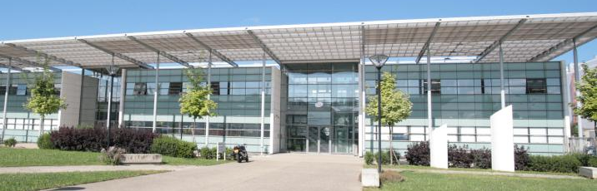

RADSAGA Summer School
Radiation Effects on Photonics and Optoelectronics
Saint-Etienne, September 10-14, 2018
Sylvain Girard, sylvain.girard@univ-st-etienne.fr

Slide 2
Saint Etienne Summer School
Organizing committee
    Sylvain GIRARD (if any issue: + 33 685145365)
    Emmanuel MARIN (if any issue: + 33 645945696)
    Youcef OUERDANE
    Aziz BOUKENTER
    Adriana MORANA
    Antonino ALESSI
RADSAGA project event (for RADSAGA members only)
  Sept 11th: MidTerm Review (MTR): RADSAGA representatives + ESRs
  Sept 12th: Supervisory Board: SB members
All details (& slides) on INDICO: https://indico.cern.ch/event/723970/

Slide 3
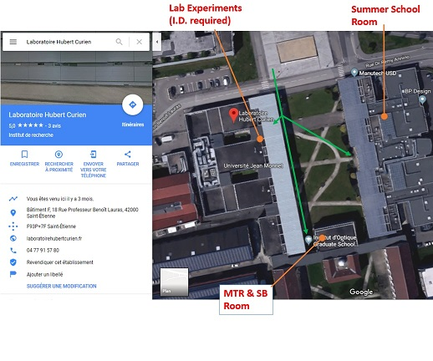
Summer School venue
WIFI (SB, MTR meeting room)
Network: UJM_invite
Login: radsag_uer
Password: XyK75cB3tN

Slide 4
Why a “Radiation Effects on Photonics and Optoelectronics” school in RADSAGA (1/2)?
Optoelectronics:
Any device operating as an electrical-to-optical (E/O) or optical-to-electrical (O/E) transducer.
Photonics:
A photon is the smallest unit of light just as an electron is the smallest unit of electricity.
➔ Photonics is the generation, process and manipulation of photon to achieve a certain function.

Slide 5
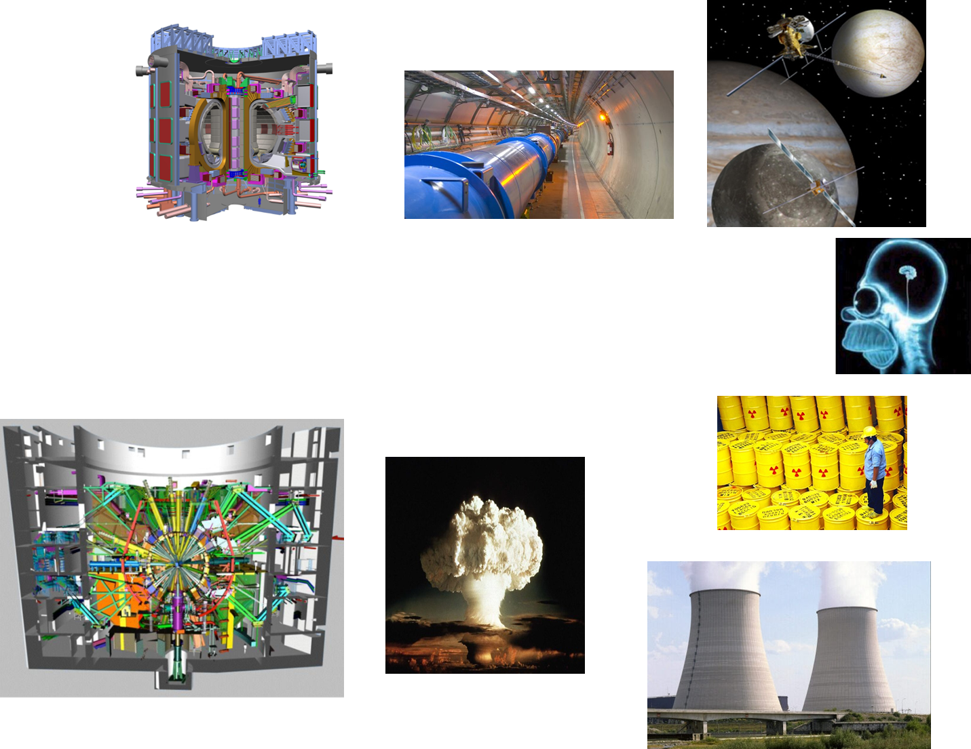
Why a “Radiation Effects on Photonics and Optoelectronics” school in RADSAGA (2/2)?
Different technologies and components:
  Transmitters - lasers, LEDs, modulators,….
  Receivers - Photodiodes, CIS,.…
  Passive components – optical fibres, lenses,….
  Switches – optocouplers
  …
Different Applications in harsh environments:
  Communication / Data transfer
  Sensing
  Imaging
  Diagnostics
  …

Slide 6
Lectures
&
Laboratory
Experiments

Slide 7
Lectures
Monday Sept 10th, 2018

Slide 8
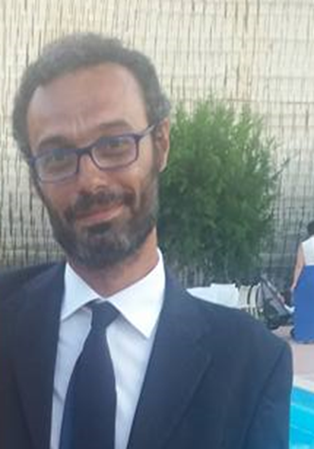

Lectures
Basics on Optical Fibres and Radiation Effects
Lecturer: Dr. Antonino Alessi (UJM, Laboratoire H. Curien, UMR CNRS 5516, Saint-Etienne, France)
Monday Sept 10, 9AM
Summer School Room
LabExp #1: Fiber-based dosimetry
LabExp #2: Point OFS: FBG
LabExp #3: Distributed OFS

Slide 9
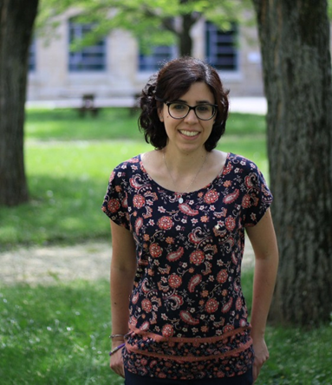
Lectures
Radiation Effects on Optical Fiber Sensors
Lecturer: Dr. Adriana Morana (UJM, Laboratoire H. Curien, UMR CNRS 5516, Saint-Etienne, France)
Monday Sept 10, 11AM
Summer School Room
LabExp #1: Fiber-based dosimetry
LabExp #2: Point OFS: FBG
LabExp #3: Distributed OFS

Slide 10
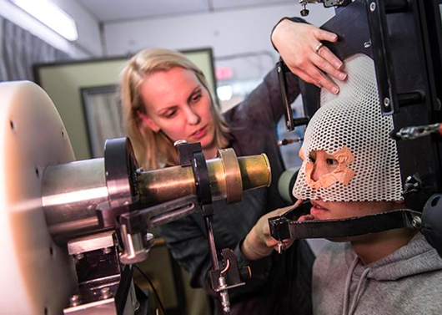

Lectures
Fiber-based Dosimetry
Lecturer: Pr. Cornelia Hoehr (TRIUMF, Canada)
Monday Sept 10, 1:30PM
Summer School Room
LabExp #1: Fiber-based dosimetry

Slide 11
Lectures
Tuesday Sept 11th
MTR meeting: IOGS room D03 (ESRs only !)
Program:
Reminder: RADSAGA ESRs Presentation Rehearsal (Sept 11, 3pm)
Participants:
- RADSAGA ESRs
- Coordination and Training Team: R. Garcia Alia, C. Granier, P. Leroux,
S. Allegretti

Slide 12
Lectures
Wesnesday Sept 12th, 2018

Slide 13
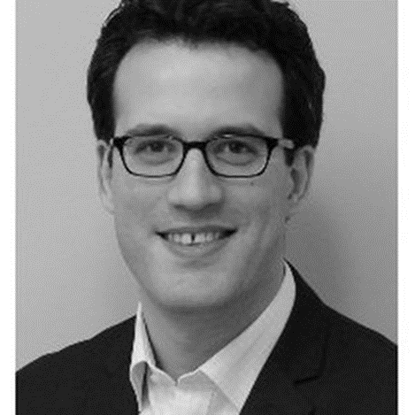

Lectures
CMOS Image Sensors: Technology Overview and Total Ionizing Dose Effects
Lecturer: Pr. Vincent GOIFFON (ISAE SUPAERO, France)
Wednesday Sept 12, 8:30AM
Summer School Room
LabExp #4: CMOS Image Sensor

Slide 14
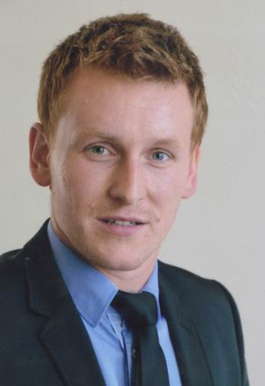

Lectures
CMOS Image Sensors: Displacement damage dose effects and Radiations impact on imager performances
Lecturer: Dr. Cédric Virmontois (Centre National d’Études Spatiales, CNES, France)
Wednesday Sept 12, 10:45AM
Summer School Room
LabExp #4: CMOS Image Sensor

Slide 15
Lectures
Thursday Sept 13th, 2018

Slide 16
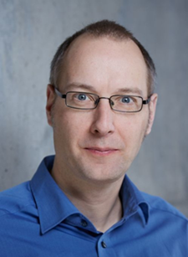

Lectures
Radiation Testing of Photonic Technologies
Lecturer: Dr. Jochen Kuhnhenn (Fraunhofer-Institute for Technological Trend Analysis, Germany)
Thursday Sept 13, 8:30AM
Summer School Room
LabExp #1: Fiber-based dosimetry
LabExp #2: Point OFS: FBG
LabExp #3: Distributed OFS

Slide 17
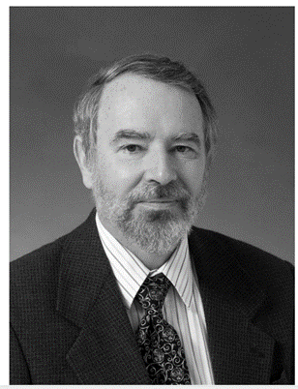


Lectures
Radiation Effects in Optoelectronic Devices
Lecturer: Dr. Allan Johnston (formerly at Jet Propulsion Laboratory, JPL, USA)
Thursday Sept 13, 10:45AM
Summer School Room
Distinguished Lecturer

Slide 18
Lectures
Friday Sept 14th, 2018

Slide 19
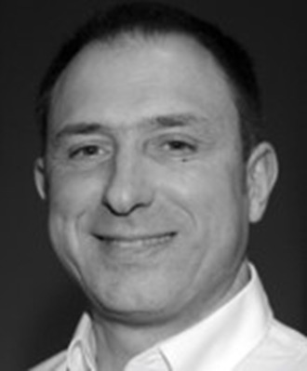

Lectures
Radiation hardening studies of cameras for harsh environments
Lecturer: Dr. Philippe Paillet (CEA DAM, France)
Friday Sept 14, 8:30AM
Summer School Room
LabExp #4: CMOS Image Sensor

Slide 20
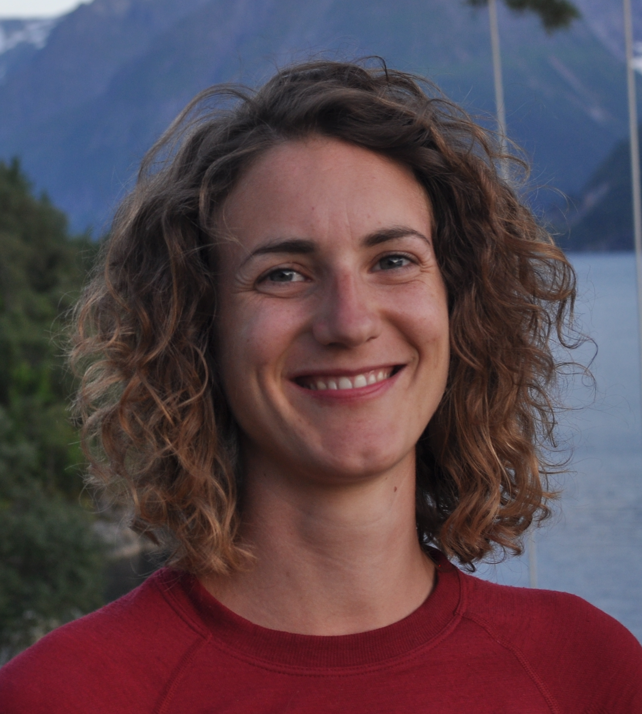

Lectures
Radiation Effects on Silicon Photonics
Lecturer: Dr. Andrea Kraxner (CERN, CH)
Friday Sept 14, 10:45AM
Summer School Room

