Slide 1
Status of the LBE line (Linac4 & Linac3)
The new LBE line will be used after LS2 for the Linac3 and Linac4.
Measurements will be performed via the “3 profile monitor method”.
Drawings are available in CDD.
  Sector1: PS_LM___0583
  Sector2: PS_LM___0584
  Sector3: PS_LM___0585
  Sector4: PS_LM___0586

Slide 2
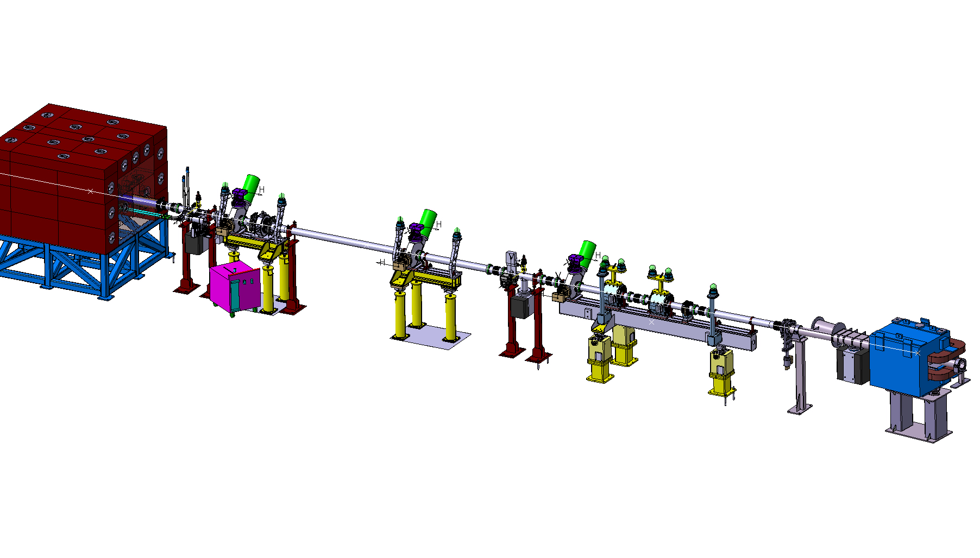
Beam dump and shielding
3 profile diagnostic tanks
LTB.BHZ40
Beam current transformer
2 quadrupoles and corrector magnets

Slide 3
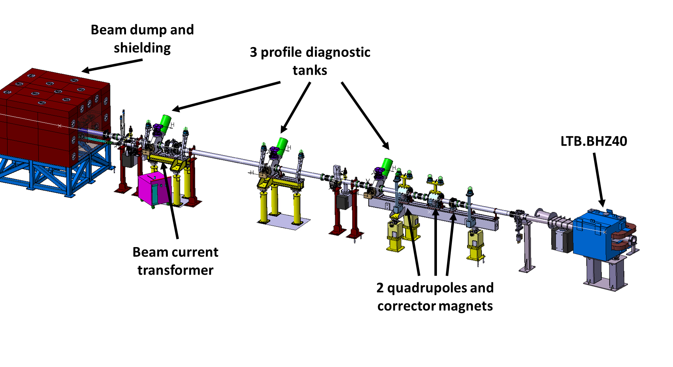
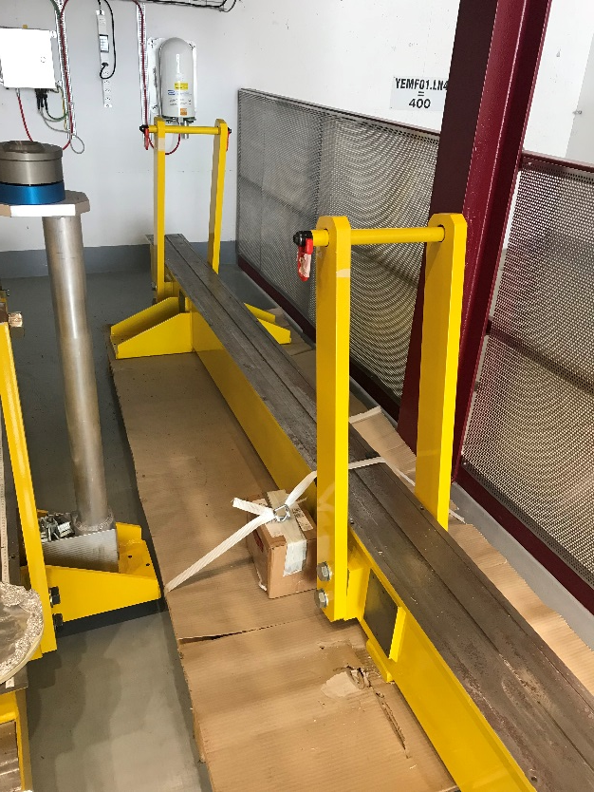
Equipment stored in the L4 building:
Supports, girders, feet, alignment arms (BE-ABP)
Vacuum chambers (BE-ABP – TE-VSC)
Diagnostics tanks - not furbished (BE-BI)
Grids and wire scanners missing.
BCT (to be checked).
Magnets available from the magnets groups (TE-MSC):
1 steerer (H & V).
2 quadrupole magnets.
Beam dump in house (EN-STI).
Dump, shielding and support.
To be checked: Vacuum equipment (pumps and valves)
Standard equipment.

