Slide 1
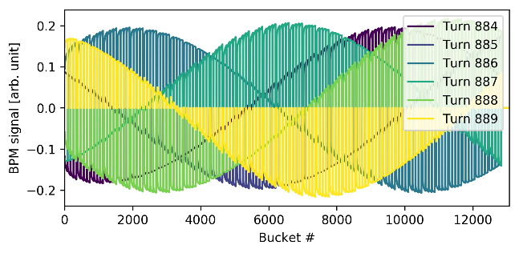
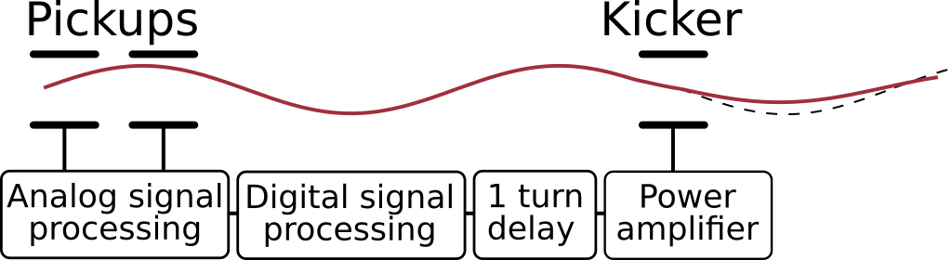
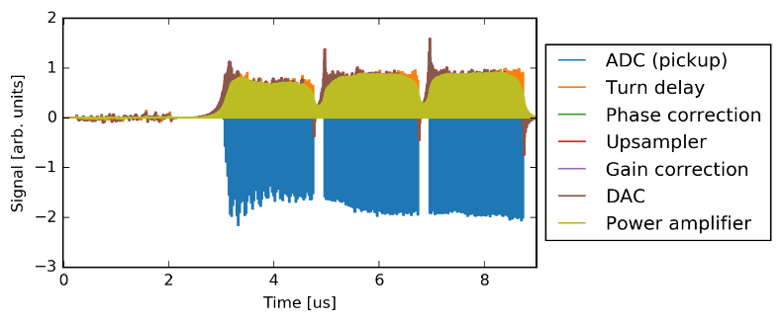
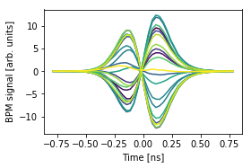
Multibunch PyHEADTAIL simulations
100 km / 330 us
Transverse feedback stabilization of the beam in the FCC-hh
>10 000 bunches
Intra bunch motion
Challenges have been:
  New code (bugs and optimization)
  New kind of studies (relevant questions to be answered)
  Amount of output data (relevant output parameters)
  How to use the cluster efficiently
So far the HPC PyHEADTAIL simulations have been focused on two cases
  FCC-hh CBI damping
    <20k turns, 10k bunches, 35k mppb, 39 turns wakes, detailed damper model
  HL-LHC HOM tests
    150k turns, 3.6k bunches, 20k mppb, 3 turns wakes, ideal damper
It is not only computing performance which is relevant but also the effort needed for launching and analyzing simulations
  Best questions beat the best supercomputers
Possible large variety of applications in future
  Required simulation parameters vary a lot between studies
    Wake field time scale from sub nanosecond to tens of milliseconds
    Tracking time from hundreds to millions of turns
    Number of bunches from one to tens of thousands
    Number of macro particles per bunch from one to million(s)
  How to detect the performance bottle necks and optimize
  the cluster use?

Slide 2
Some notes from the simulations
In general the HPC cluster works well
Some issues with the code and/or the mpi settings on the cluster
  Issue in the MPI H5py limits the maximum number of processor to one node
    Was problem multiple times during the last half year, various error messages
  Timeout crash? when RF matched buckets are used
    works well with the normal batch service (HTCondor + manually compiled MPI)
  So far mvapich2 have been used, would the other MPI options work better?
    WARNING: Error in initializing MVAPICH2 ptmalloc library.Continuing without InfiniBand registration cache support.
Monitoring tools?
  Challenging to optimize simulation parameters and the number of nodes needed, when requirements vary a lot between the studies
    N_bunches, N_slices, N_macro_particles_per_bunch, used PyHT modules, etc.
    Is it possible to develop easy (semi)automatic profiling for the customized simulations and new PyHEADTAIL modules in future?
  Memory and processor loads and traffic between the nodes

