Slide 1
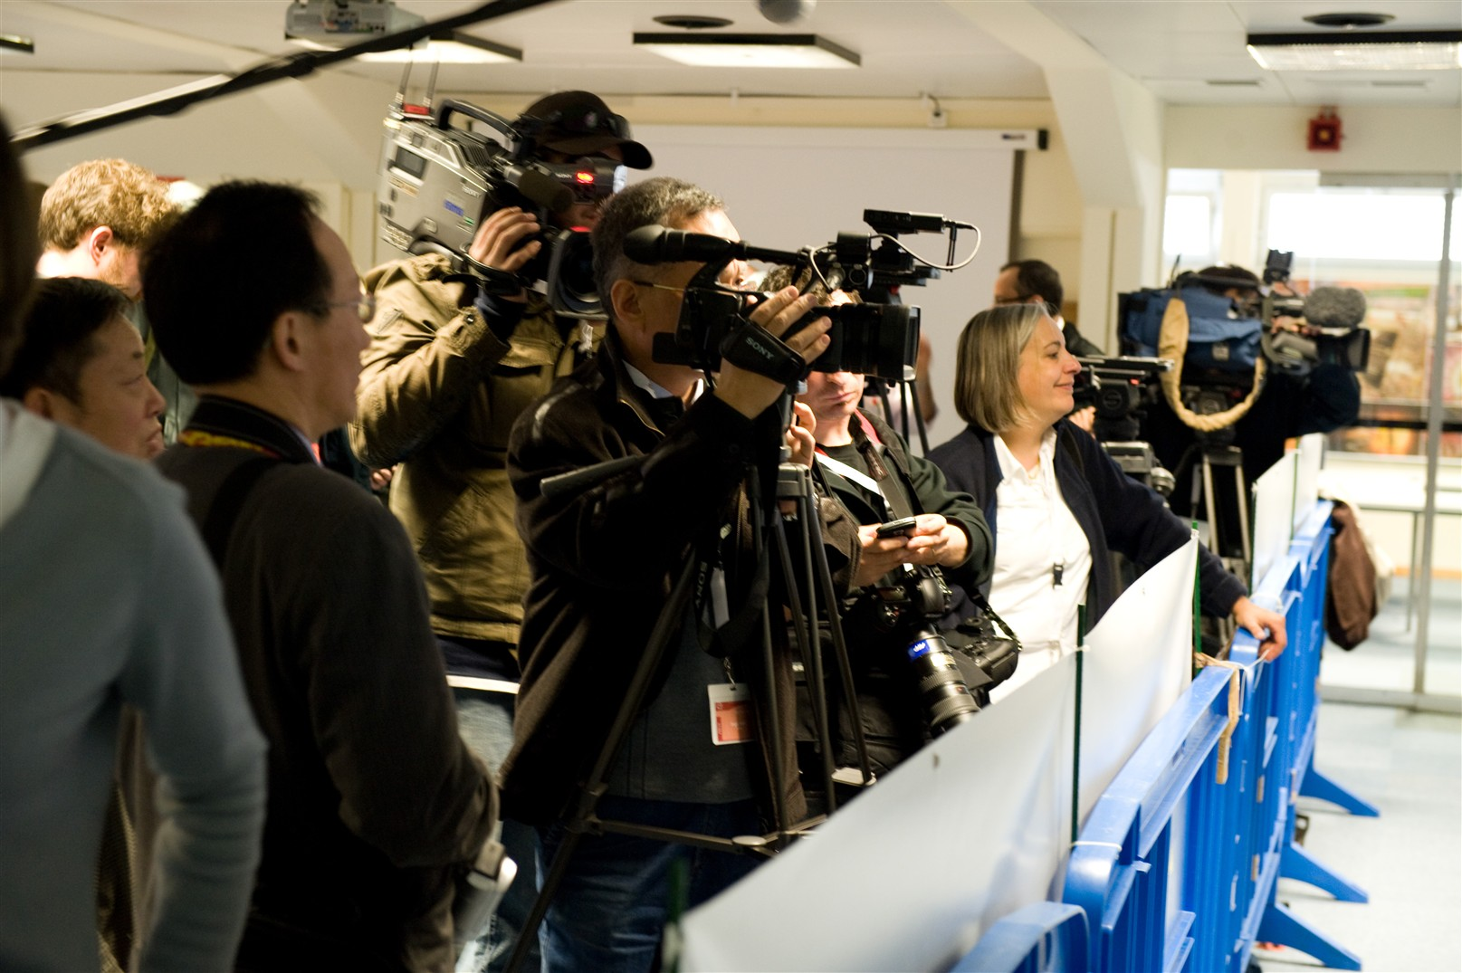
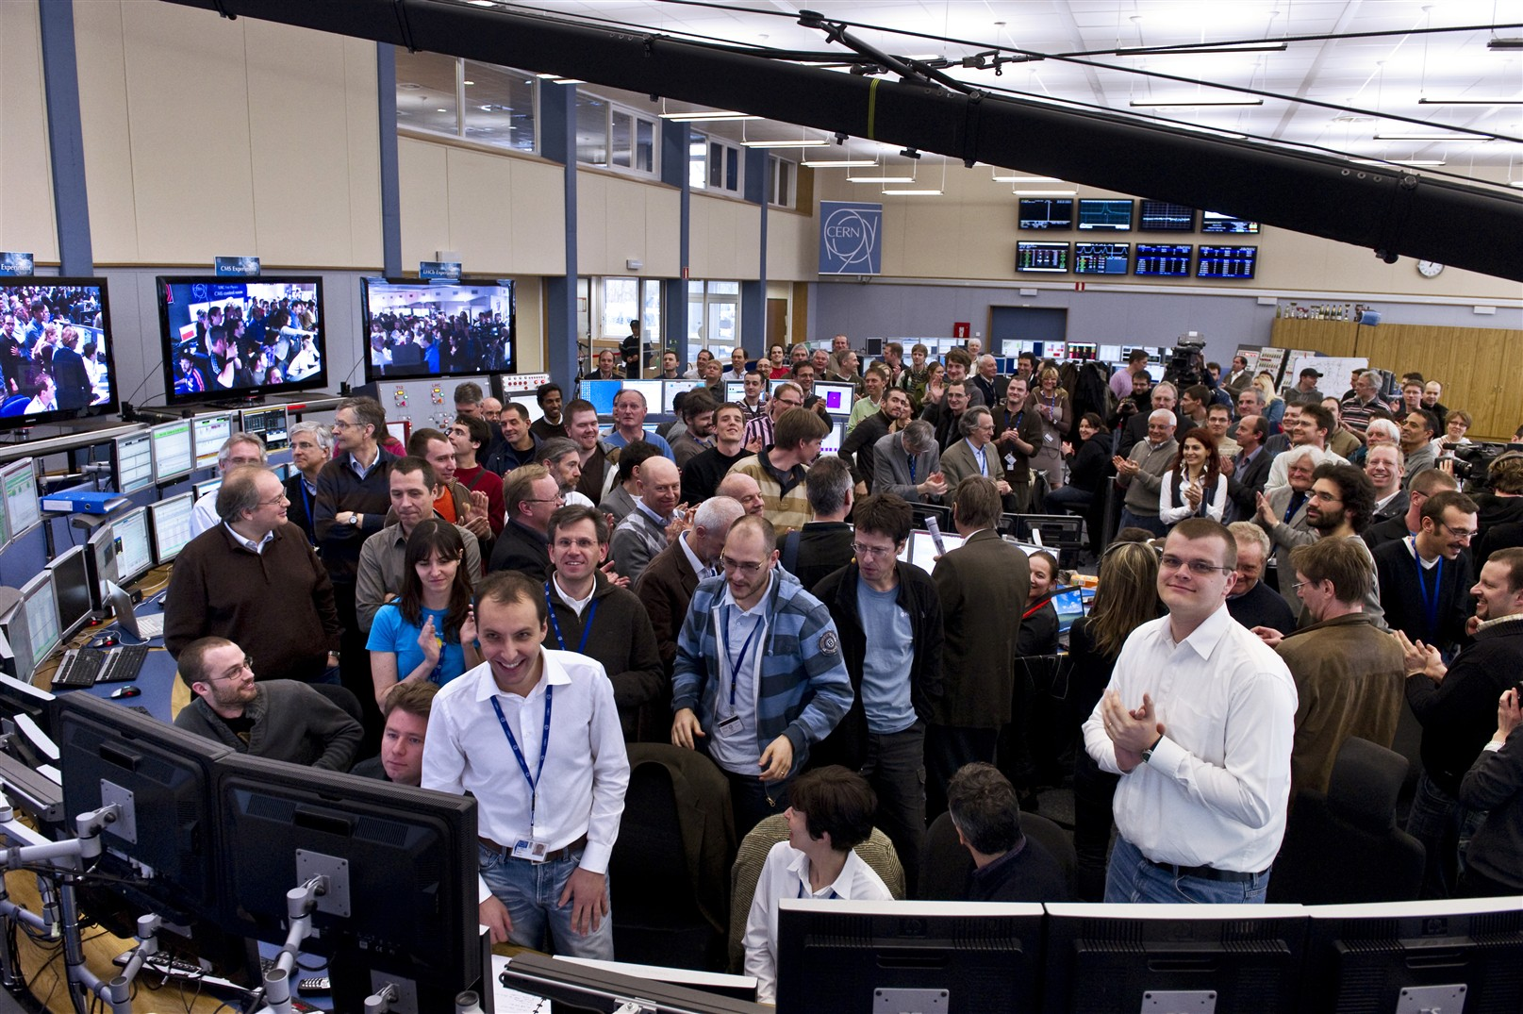
LHC First Physics
View from the CERN Press Office

Slide 2
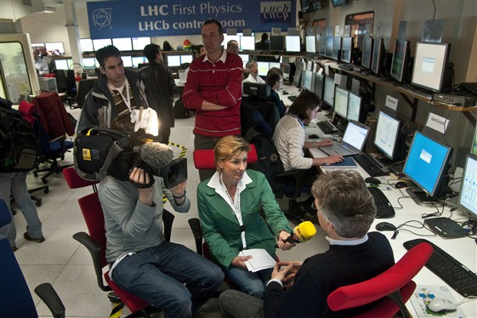
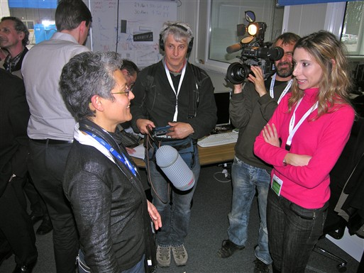
Media event at CERN
110 Journalists from 69 media in 18 countries
2 press centres + visits to experiments’ control rooms and computing centre
First journalists arrived before 6:00, last left at 19:00

Slide 3
Media coverage
At least 2,200 news items published on March 30
More than 800 news items broadcast worldwide on March 30 using CERN footage from Eurovision satellite
  Including Al Jazeera, ARD, Antena 3, BBC 1,2,world, TVN24, Globo, TF1, France2, France3, CNN (+ Asia, Arabic, Turkey), FOX, MSNBC, RTL
CERN published 10 video stories in March via Newsmarket.com. 706 video clips were ordered by 80 media outlets
  Including AFP, EFE, APTN, ARD, CNN, Discovery Channel, Globosat, LCI, Reuters, RTL, RTVE, Sky News, El Merucio, IDG News, Spiegel Online, Telegraph, Zoomin

Slide 4
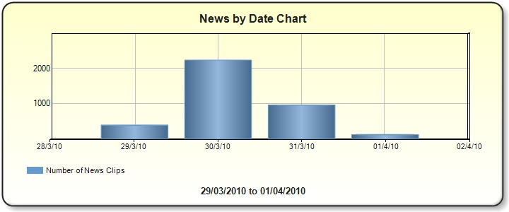
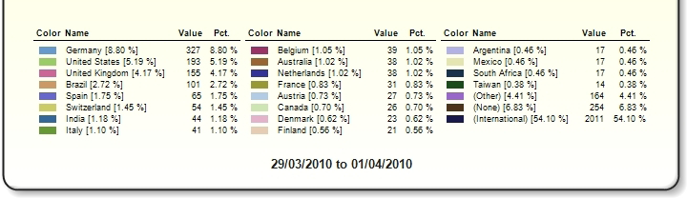

Slide 5
Some feedback
vielen Dank für ein aus Pressesicht hervorragend organisiertes Event. Selten treffen wir bei unserer Arbeit auf soviel Offenheit und Kommunikationswillen. Das fanden wir bemerkenswert und deswegen will ich diese bemerkung auch gerne loswerden, Sie dürfen das Lob gerne an die vielen Kollegen und Kolleginnen weiterreichen. Und ich komme gerne mal wieder ans CERN, wenn es über konkretere Ergebnisse zu berichten gibt. – ZDF
The LHC First Physics media event in Helsinki went very well with lots of people attending and lots of media visibility.

Slide 6
Webcast
231 peak simultaneous connections to CERN's HQ broadcast (from LHC institutes)
The CERN LHC First Physics day-long webcast was visited by 700,000 unique computers (IP addresses)
GroovyGecko general audience streams (their CEO said "make no mistake, this was a huge webcast”)
  By 17:00 on the 30th, more than 2 million videos viewed
  CCC (Main webcast) - 1,265,830 hits
  CMS - 181,064 hits
  ATLAS - 276,585 hits
  LHCb - 163,855 hits
  ALICE - 199,295 hits
Yospace mobile streaming: 3,521 stream requests
Rebroadcasters:
  TF1News: 35-40,000 viewers
  CARNet: 4,307 unique visitors
  Livestation: 6,749 unique visitors

Slide 7
Web site
CERN's public homepage recorded 205,000 visitors (unique IPs) from 185 countries, compared to a normal average of 10,000 visitors per day
The Press Office site (includes LHC First Physics site) recorded 154,000 visitors, up from a usual average of 2,000 per day

Slide 8
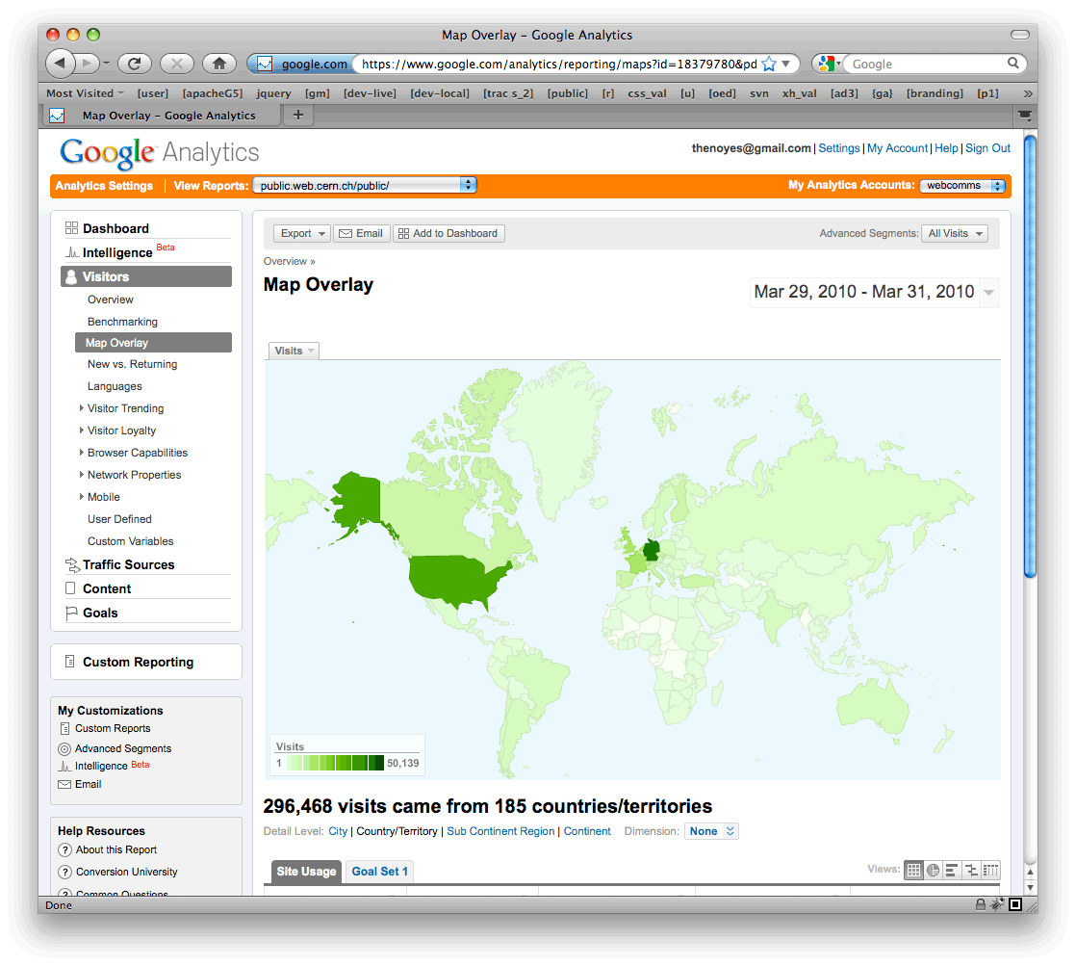

Slide 9
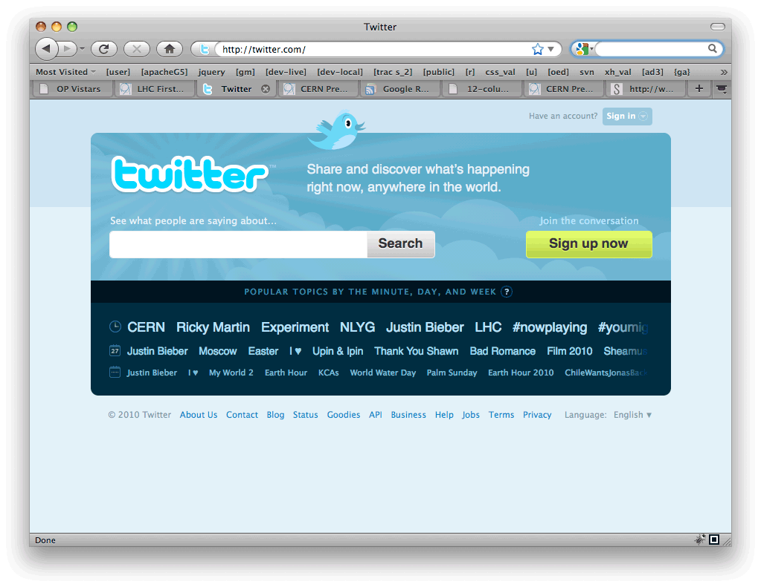
Twitter
Click statistics
  58,000 clicks on link to the press release
  16,000 clicks on link to CCC photos
  11,000 clicks on link to webcast
CERN went from 90,000 to 120,000 followers during the day
Keywords "LHC", "CERN", "TeV" and "experiment" were all global trends on Twitter at some point during the day

Slide 10
What worked well?
Almost everything
Huge audience for webcast
Media on-site very pleased with flexibility and openness
Schedule adapted remarkably well to last-minute time changes
Number of media on-site allowed everyone to be in a control room for big event

Slide 11
What would we change?
Webcast available also in French (morning satellite broadcast had French narration)
More rehearsal time for webcast team
How journalists are scheduled for visits to experiments
Make sound available from press conference
Communication of event to CERN internal audience

Slide 12
