Slide 1
SuperFGD beam tests preparations
24 April 2018
E. Noah

Slide 2
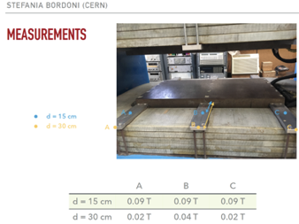
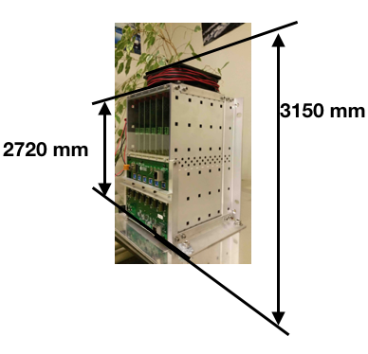
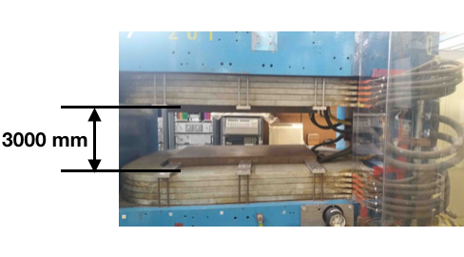
Positioning the minicrates

Slide 3
Minicrate distribution
Readout electronics minicrates
height
Max. 290 mm
Minicrate = 272 mm
Platform max. thickness = 18 mm
400 mm
1500 mm micro-coax
cables
100 mm
Outside magnet
300 mm
Inside magnet
Magnet coil
SuperFGD
proto
520 mm
Magnet platform
300 mm
100 mm
Outside magnet
400 mm
Beam
> 300 mm
< 900 mm
1000 mm

Slide 4
288 cables
(32x3x3)
288 cables
(32x3x3)
3 FEB: Top-Back
96 cables
(32x3)
96 cables
(32x3)
1 FEB: Left-Back
96 cables
(32x3)
3 FEB: Bottom-Back
1 FEB: Right-Back
Back MPPCs: higher dynamic range
1 FEB: Back
Front MPPCs: lower dynamic range OK
288 cables
(32x3x3)
96 cables
(32x3)
3 FEB: Top-Front
3 FEB: Bottom-Front
1 FEB: Left-Front
1 FEB: Front
96 cables
(32x3)
96 cables
(32x3)
1 FEB: Right-Front
288 cables
(32x3x3)

Slide 5
Side cabling
288 cables
(32x3x3)
288 cables
(32x3x3)
3 FEB: Top-Back
96 cables
(32x3)
96 cables
(32x3)
1 FEB: Left-Back
96 cables
(32x3)
3 FEB: Bottom-Back
1 FEB: Right-Back
Back MPPCs: higher dynamic range
1 FEB: Back
8 rows
8 rows
96 ch
96 ch
Front MPPCs: lower dynamic range OK
24/2 columns
24/2 columns
96 ch
96 ch
24/2 columns
8 rows
24/2 columns
8 rows
288 cables
(32x3x3)
96 cables
(32x3)
3 FEB: Top-Front
3 FEB: Bottom-Front
1 FEB: Left-Front
1 FEB: Front
96 cables
(32x3)
96 cables
(32x3)
1 FEB: Right-Front
288 cables
(32x3x3)

Slide 6
Front/back cabling
288 cables
(32x3x3)
288 cables
(32x3x3)
3 FEB: Top-Back
96 cables
(32x3)
96 cables
(32x3)
1 FEB: Left-Back
96 cables
(32x3)
3 FEB: Bottom-Back
1 FEB: Right-Back
Back MPPCs: higher dynamic range
1 FEB: Back
96 ch
8 rows
24/2 columns
Front MPPCs: higher dynamic range
24/2 columns
8 rows
96 ch
96 cables
(32x3)
288 cables
(32x3x3)
3 FEB: Top-Front
3 FEB: Bottom-Front
1 FEB: Left-Front
1 FEB: Front
96 cables
(32x3)
96 cables
(32x3)
1 FEB: Right-Front
288 cables
(32x3x3)

Slide 7
Top/Bottom cabling
288 cables
(32x3x3)
288 cables
(32x3x3)
3 FEB: Top-Back
96 cables
(32x3)
96 cables
(32x3)
1 FEB: Left-Back
96 cables
(32x3)
3 FEB: Bottom-Back
24/2 columns
1 FEB: Right-Back
Back MPPCs: higher dynamic range
96 ch
1 FEB: Back
8 rows x 3
96 ch
96 ch
96 ch
24/2 columns
Front MPPCs: lower dynamic range OK
8 rows x 3
96 ch
96 ch
8 rows x 3
24/2 columns
8 rows x 3
96 cables
(32x3)
288 cables
(32x3x3)
3 FEB: Top-Front
24/2 columns
3 FEB: Bottom-Front
1 FEB: Left-Front
1 FEB: Front
96 cables
(32x3)
96 cables
(32x3)
1 FEB: Right-Front
288 cables
(32x3x3)

Slide 8
Can INR send STEP files (CAD drawings to UniGe)
Front view: Interface between INR and UniGE mechanics
Magnet top platform
INR mechanics
150 mm
192 mm
beam
150 mm
UniGE mechanics
46 mm
Magnet bottom platform

Slide 9
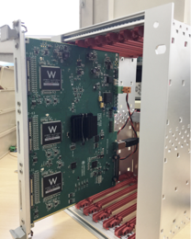
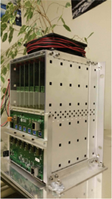
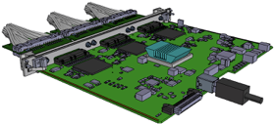
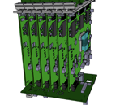
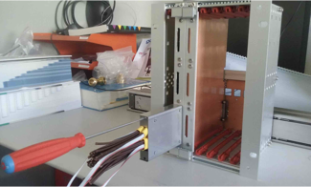
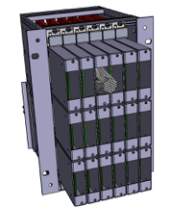

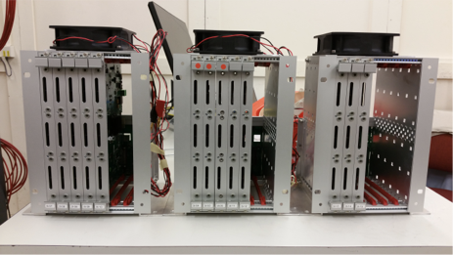
Electronics status (24 April 2018)
Front End Board: No re-design: 2000 CHF/unit. All components ordered for 17 FEBs)
  60 CITIROCs received by 20 April.
  FPGA: expected delivery: 12 8 May
  No FEBs before end May, + 1 week for tests by Yannick.
  Some components still missing (ADC received).
  Best case scenario: 18 FEBs 1st week June (worst case 15 FEBs end June).
Backplane: No re-design: 180 CHF/unit
  PCB received = 8, PCB to be mounted with components = 7.
  Components order by Georgi: waiting for reception.
  Expected complete: 1st week of May + 1 week for tests by Georgi.
HV_ON PCB: New PCB: 87 CHF/unit
  All ordered: 63, PCB received at UniGe.
  Assembly of components (sent from UniGe 11/04).
  Planned delivery of assembled cards to CERN: end April.
Clock fanout board: No re-design
  Components received 28/03/2018 for 4 units
Mini-PCBs: No re-design (URGENT):
  Type selected: DPNC315_03C
  Parts received for 2000 units, to be sent for assembly
Micro-coaxial cables: 1.46 $/unit (c.f. 8.98 $/unit DIGIKEY)
  Cable length 1.5 m.
  Order sent 12/04 for 2000 units.
  Long lead times, best case 1st week June.
All photos from Baby MIND systems for illustration only

Slide 10
Manpower (to be discussed), non-exhaustive list:
CERN: 1-2
KEK: 1-2?
Tokyo: 1-2?
INR: 3-4
UniGe: 2-3
Uppsala: 1-2
LLR: ….
.…

Slide 11
Budget (CERN NP/UniGe)

Slide 12
Spares

Slide 13
Front view
Magnet top platform
150 mm
78.7 mm
beam
78.7 mm
SuperFGD rotating platform
150 mm
25 mm
71 mm
SuperFGD fixed platform
46 mm
Magnet bottom platform

Slide 14
Cubes only
Cubes, connectors and MPPC
Cubes, connectors, MPPC
and support mechanics
48 cubes
> 480 mm
576 mm
556 mm
8 cubes
> 80 mm
157.35 mm
24 cubes
> 240 mm
192 mm
316 mm
336 mm

