Slide 1
3YP:
UFOs in the large hadron collider
Collection Group: Isobel Patterson, James Rudkin, Thomas Yates, Chloe Adams-Pickford
Supervised by: Alexander Korsunsky and Daniel Eakins

Slide 2
Contents
Defining the project scope: objectives, technical review, initial design ideas and final design criteria
Overview of the proposed solution
Detailed view of key components: generating and calculating air flow, filter, connector modules
Evaluation of design: comparisons with literature and simulation
Areas for further development

Slide 3
Project Definition
To develop a method or device to collect particles from within the Large Hadron Collider (LHC) at CERN

Slide 4
Motives
What is the problem?
Why is the problem important to solve?

Slide 5
Technical Review: UFOs
Assumptions on nature of UFOs
  Diameter ranging from 1-100µm
  Uncharged
  Spherical
  Metallic, ceramic or organic (solid at room temperature)

Slide 6
Design Criteria
Collected particles must be representative of the Unidentified Falling Objects (UFOs)
Must not interfere with the operation of the LHC
Must not produce further contamination – if possible use materials that are not used in the LHC to allow easy identification

Slide 7
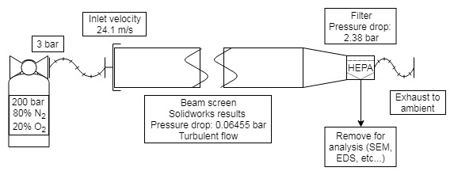
Overview of Proposed Solution
4

Slide 8
Overview of Proposed Solution
4

Slide 9
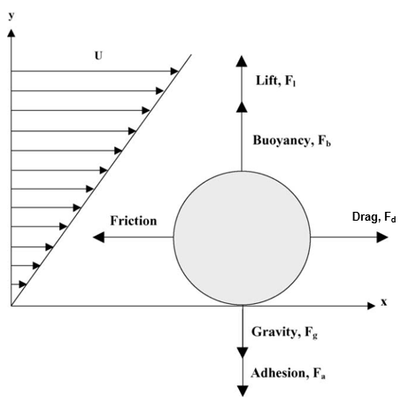
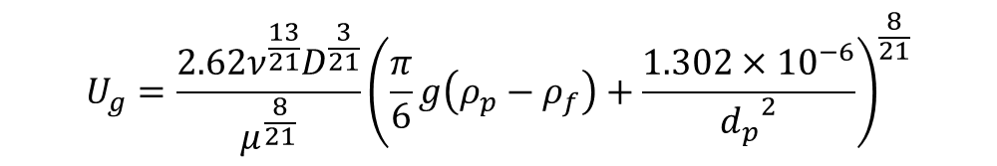
Detailed view: Air flow calculations
Assumptions:
Perfectly spherical
Properties of gold
Apply vertical equilibrium:
$$U_{g}=\frac{2.62ν^{\frac{13}{21}}D^{\frac{3}{21}}}{μ^{\frac{8}{21}}}{\left(\frac{π}{6}g\left(ρ_{p}−ρ_{f}\right)+\frac{1.302×{10}^{−6}}{{d_{p}}^{2}}\right)}^{\frac{8}{21}}$$
Free body diagram of the forces on a sphere in a linear velocity profile (Modified from Hayden et al (2003))

Slide 10
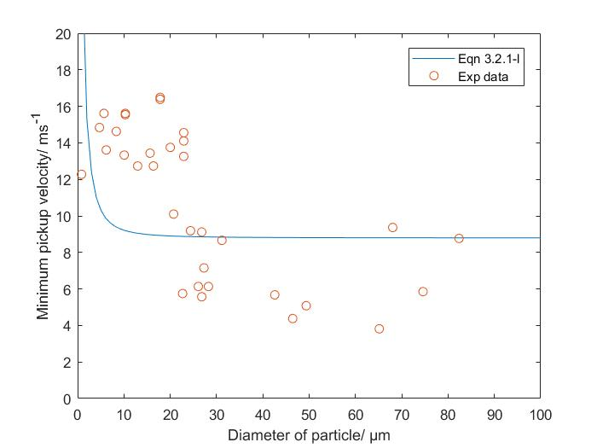
Detailed view: Air flow calculation (2)
Experimental data of minimum pick-up velocity from Hayden et al (2003) along with derived equation as a function of particle diameter.

Slide 11
Detailed view: Connector module
Purpose: to join the sample segment of cold bore tube to a filter
Criteria:
Connect to cold bore tube with diameter of 50mm
Connect to filter with inlet tube of diameter 8.5mm
Fits into space made available from removal of plug-in modules
Fabricated from a material not present in the LHC (to minimise production of further debris)
Minimise mass and cost where possible
Material capable of withstanding the applied force from air flow

Slide 12
Overview of Proposed Solution
4

Slide 13
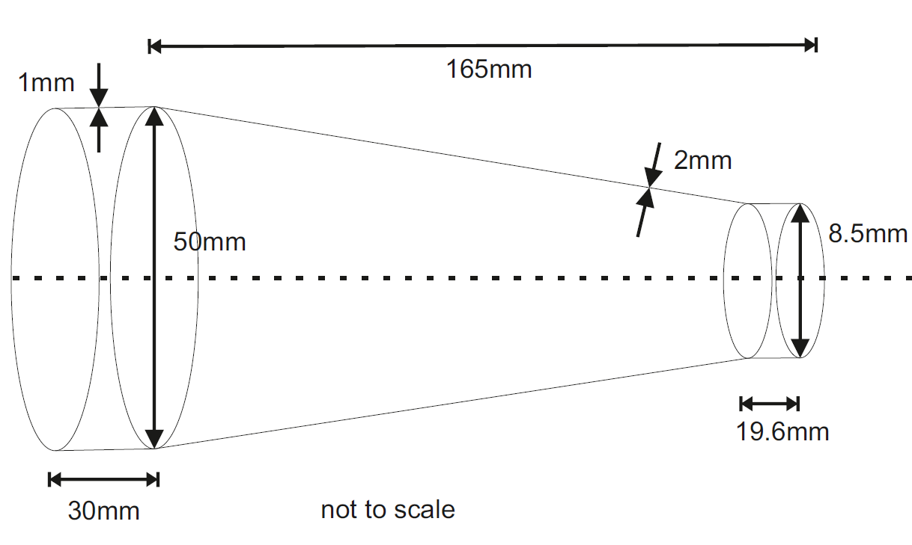
Detailed view: Connector module (2)

Slide 14
Overview of Proposed Solution
4

Slide 15
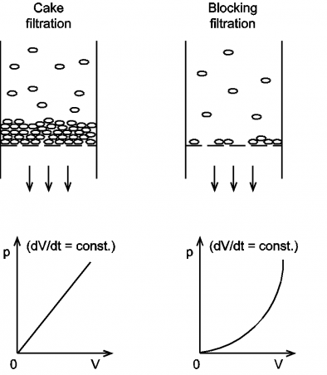
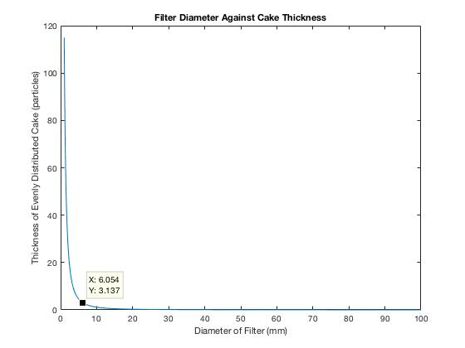
Detailed view: Filter
Criteria:
Collect particles
Withstand pressure drop
Diameter approx 6mm

Slide 16
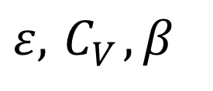
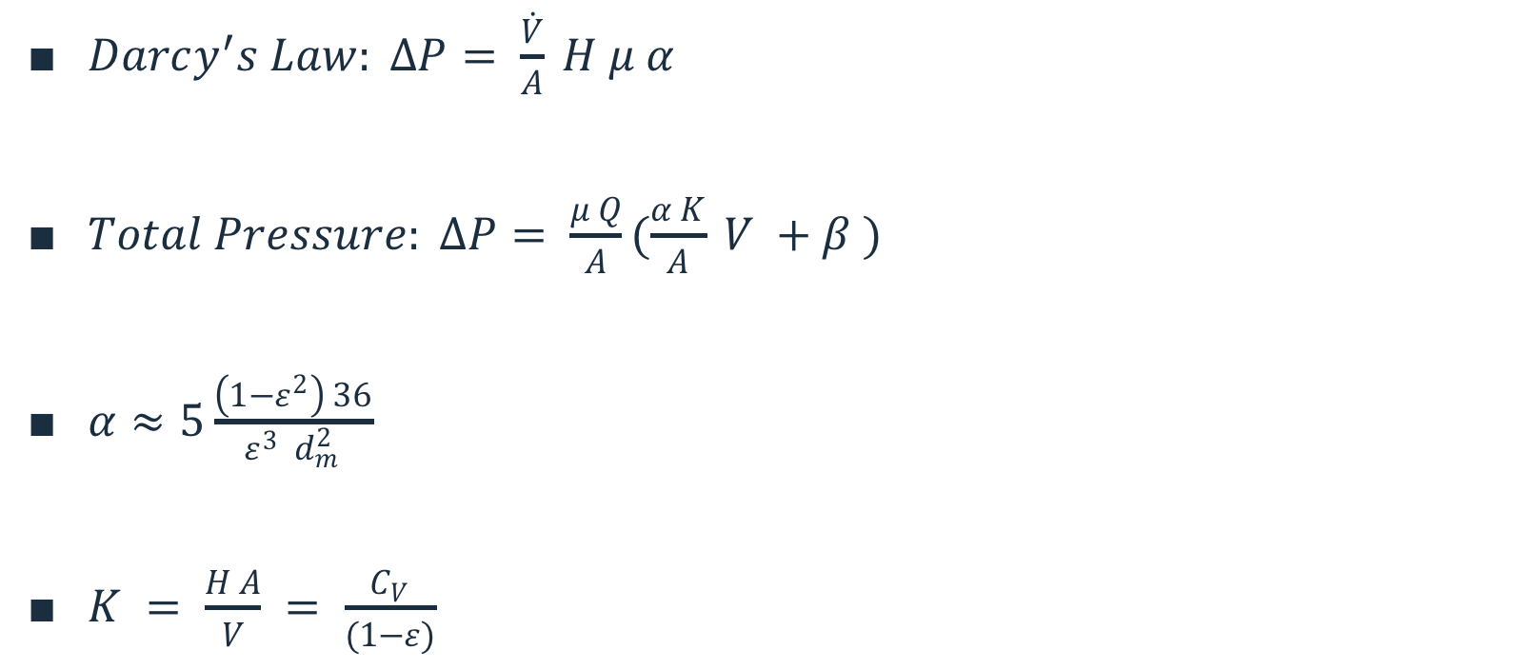
Detailed view: Filter (Pressure Drop)
$Darcy^{′}s Law: ∆P= \frac{\dot{V}}{A} H μ α$
$Total Pressure: ∆P= \frac{μ Q}{A}(\frac{α K}{A} V +β )$
$α≈5\frac{\left(1−ε^{2}\right) 36}{ε^{3} d_{m}^{2}}$
$K = \frac{H A}{V} = \frac{C_{V}}{(1−ε)}$
$$ε,{ C}_{V}, β$$

Slide 17
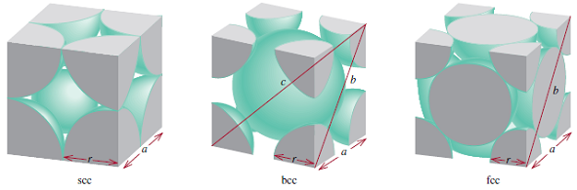

Filter: Pressure Drop Evaluation
$ε=0.260$
${ C}_{V} =2.00×{10}^{−9}$
$β=0$
$∆P=42,800 Pa$

Slide 18


Filter: selection
HEPA
Whatman HEPA-Vent filter
A = 16cm²
$∆P=$ 2.38 bar, ${∆P}_{max}=$ 4.1 bar

Slide 19
Overview of Proposed Solution
4

Slide 20

Detailed view: Overall Requirements
$$△p_{total}={△p}_{exhaust}+{△p}_{filter}+△p_{connector}+△p_{pipe}+{△p}_{inlet}$$

Slide 21
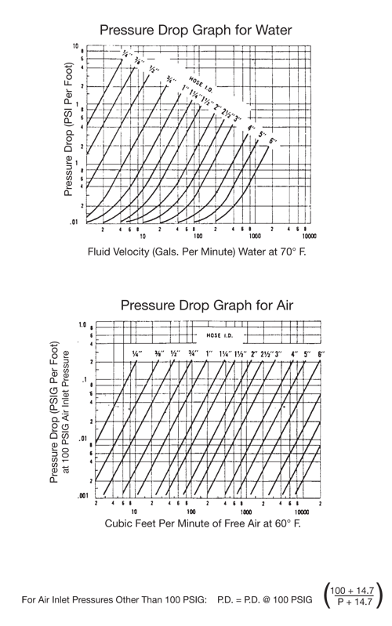
Detailed view: Air cylinder, inlet pipes
Air inlet – flexible hosing (PVC)
  Positives for non-lab applications
  Significant limitations due to ‘rule of thumb’ calculations
Exhaust – removed
Cylinder
  Late change of gas
  Synthetic air selected
Valve
  Limited information on valves included
  Recommendation of diaphragm valve
Opportunity for integration with other systems?

Slide 22
Overview of Proposed Solution
4

Slide 23

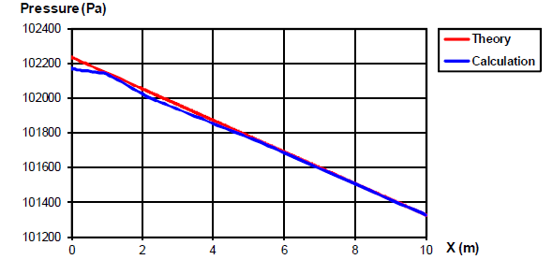
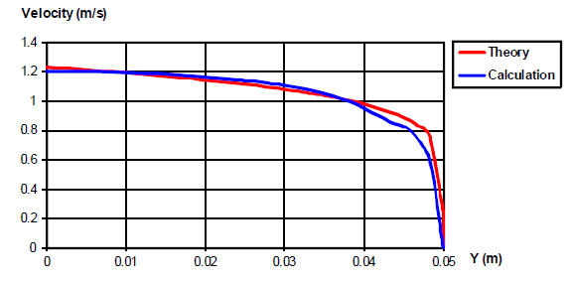
Solidworks
Simulation of Air Flow
Plots comparing theory and calculation for pressure and velocity from ‘VALIDATION EXAMPLES SOLIDWORKS’ FLOW’SIMULATION 2017’

Slide 24
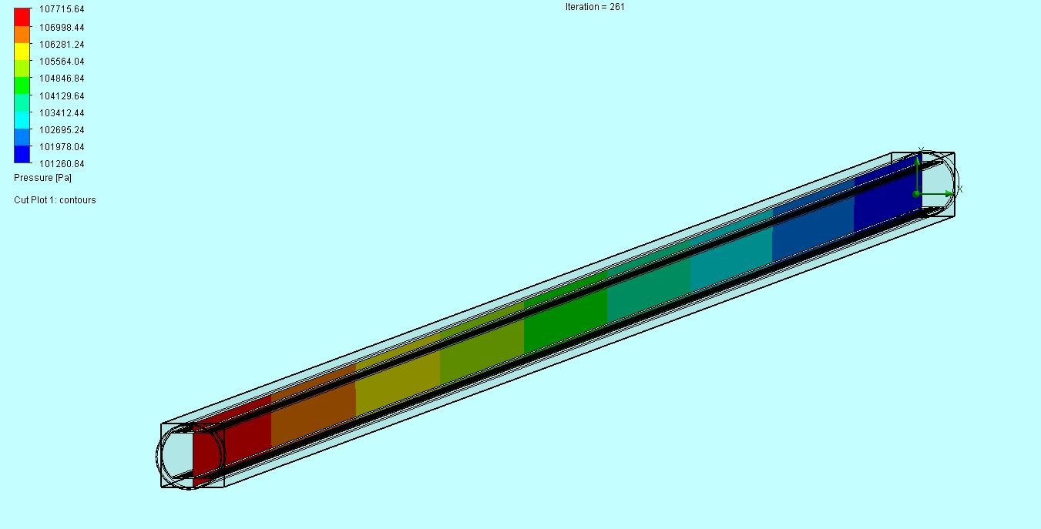
Pressure drop
The simulated/calculated pressure distribution along the 16m cold bore section.

Slide 25
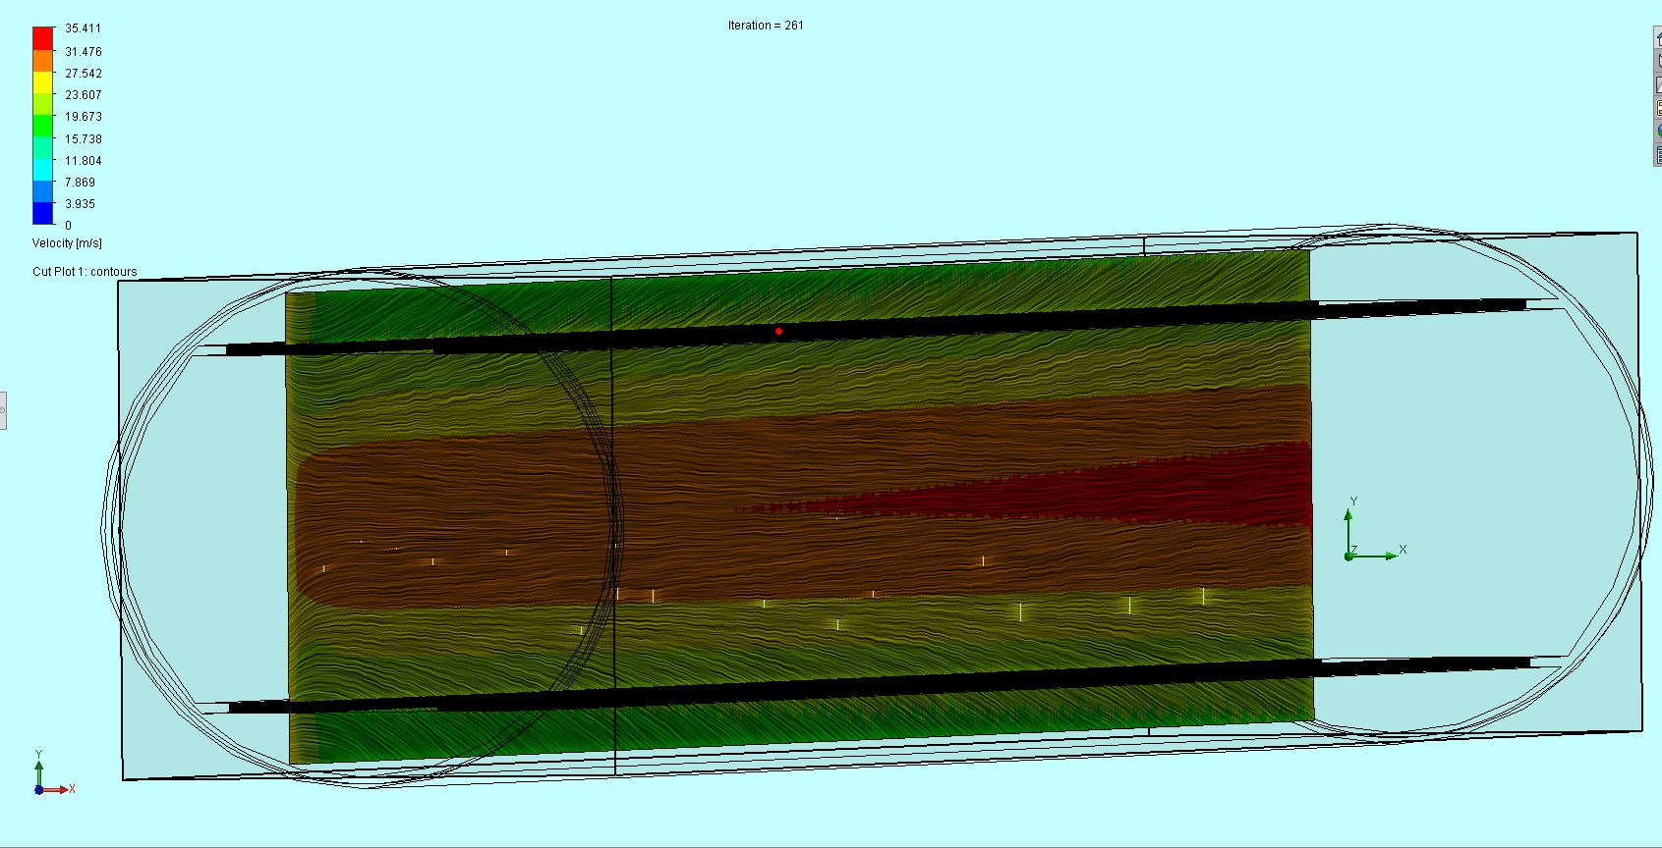
Velocity and streamlines
Figure 4.4H. The velocity profile along the cold bore and beam screen. Offset to be along the pumping slots. Also showing the velocity streamlines.

Slide 26
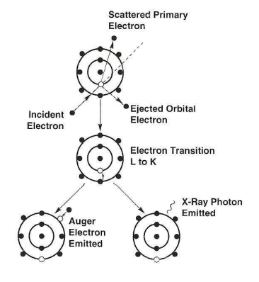
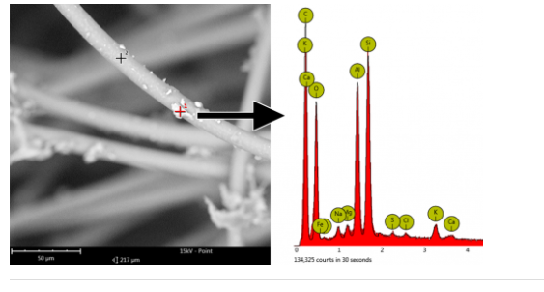
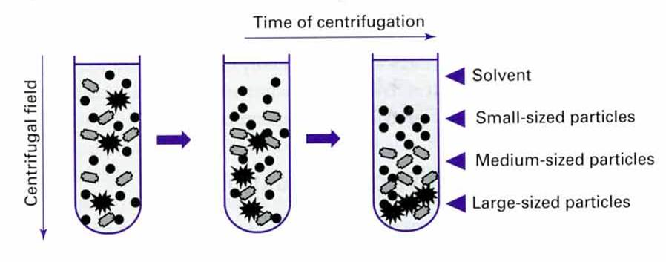
Post-Collection Particle Analysis
Scanning electron microscopes with energy dispersive X-ray spectroscopy
A SEM image (left) of HVAC filter with particulates and corresponding EDS spectrum
Courtesy of: Nanoscience Instruments
Other potential Method: Solvent bath and centrifugation
A diagram showing the X ray emission from an atom.
Courtesy of: ‘Generation of X-Rays in the SEM specimen’
A diagram showing the separating of particles in a solvent through centrifugation.
Courtesy of: Sofroniou 2012

Slide 27
Evaluation of Design
Assumptions
Testing and Iteration
Simulation

Slide 28
Areas for further development
Comparisons – before and after
Targeted post-collection analysis
Multiple filtration options

Slide 29
Thank you for your time
Any questions?

Slide 30
References?

