Slide 1
24/Apr, CERN
Simulation group
Hegde Megha
Cheng Xinghao
Stagkos Ion
Cartlidge James

Slide 2
Clues regarding the nature of UFOs
(Estimated acceleration of falling)=(658m/s² ,2055m/s²). (Baer, 2011)
UFOs do not fall solely under the influence of gravity.
Conditioning: Decrease in frequency of events. (Baer, 2012)
Some mechanism responsible for UFOs tends to saturate.
Vibrations caused by high current quenches do not increase UFO events. (Papotti, 2016)
No observed correlation between electron cloud and UFO events. (Papotti, 2016)
Dust particles collected by Laura Grob from the CERN team: Highest area percentages: calcium containing and copper containing.

Slide 3
List of Hypotheses of source
1. The cooling in the arc section forms cracks on the metal pipes (cold bore and/or beam screen). Grain sized particles detach from the pipes and form the UFOs.
2. Orbital welding generates liquid metal droplets (sparks from welding). They fly inside the tube and loosely attach to the pipes. During operation, either mechanical vibration or EM field or any other external, small force inputs acts on it and detaches to form UFOs.
3. Rubbing between the cold bore and the protective rings supporting the beam screen, either during installation (pushing the beam screen in to position) and/or thermal contraction during operation can result in particle detachment and therefore become a source of UFOs.
4. Dust directly falls off due to mechanical vibration during operation of LHC.

Slide 4
Wear
Typical particle size: A few mm to the size of a single ion (Chattopadhyay, 2001)
Main conditions affecting it: Temperature, Force, d_{slid}
Types:
Adhesive: Asperities detach. Mostly concerns metals.
Abrasive: Material trapped within contact interface. Concerns contact of a harder material on a softer one.
Fretting: Small amplitude oscillations.
Erosive: Solid or liquid particles sliding and rolling on surface.
Oxidation: Wear of oxidation layer.

Slide 5
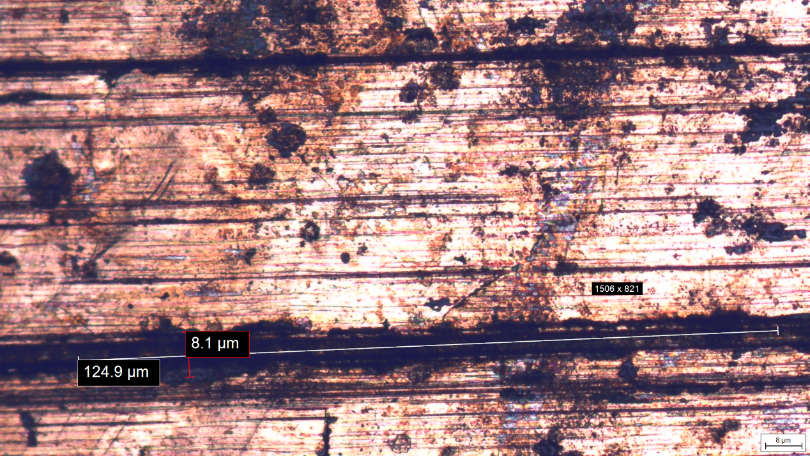
Protective ring’s coating under the Microscope
Energy-dispersive spectroscopy showed that the coating is a copper-tin alloy.
Straight, parallel grooves →
Unlikely to have been created after removal of sample form the LHC, due to careless handling.
Typical of abrasive wear.
UFO sized particles could have arisen from such grooves.
Figure 1: An image of the protective ring’s surface, taken with the optical microscope, at 5x magnification

Slide 6
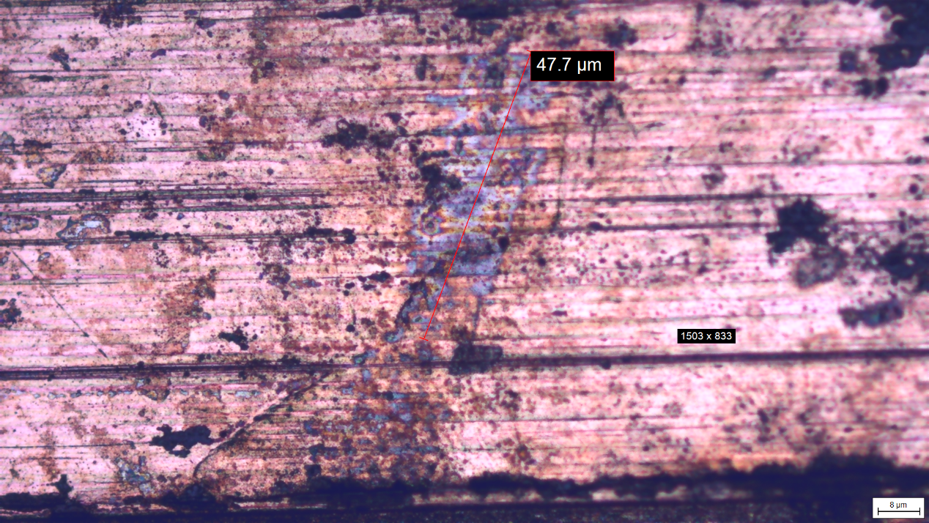
Protective ring’s coating under the Microscope continued
Silver colour from steel (316LN stainless) part of ring revealed as the coating has been worn off.
Unspecified shape.
No alignment in a particular direction.
Characteristics point towards adhesive wear.
Figure 2: An image of the protective ring’s surface, taken with the optical microscope, at 10x magnification

Slide 7
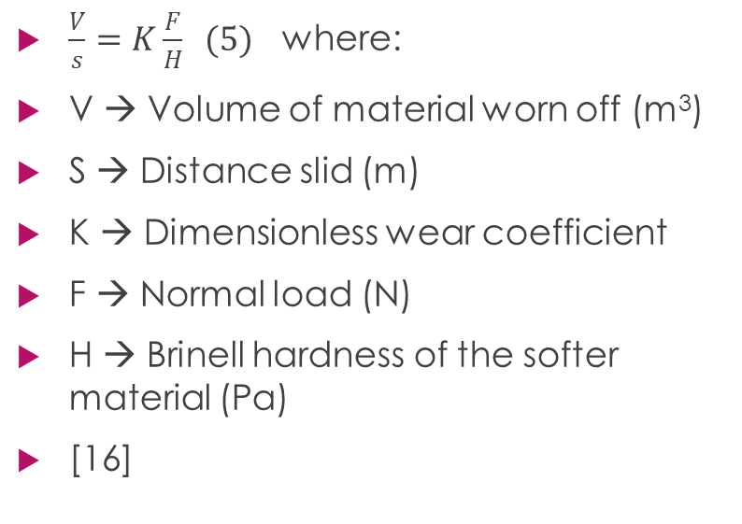
Archard’s Model
Macro-scale approach
Applies to adhesive and abrasive wear in combination.
$\frac{V}{s}=K\frac{F}{H} (5)$ where:
V → Volume of material worn off (m³)
S → Distance slid (m)
K → Dimensionless wear coefficient
F → Normal load (N)
H → Brinell hardness of the softer material (Pa)
[16]

Slide 8
Values Used
Parameter | Value
Dimensionless wear rate k | 0.5 x 10⁻³
Hardness H of UNS-C52100 bronze | 216 Mpa
Contact force F (supported per ring) | 22.46N
F = [(Weight of beam screen sample)/(Length of sample)]*(Length supported per ring)

Slide 9
Pressure Distribution: Neglecting effects of cooling
Hoop stress in beam screen, σh = 659 MPa
Maximum pressure on cold bore due to weight of beam screen, σMAX = 6.9 MPa
Might expect large contact forces between cold bore and beam screen
Radial strain of cold bore and beam screen is ≈ 0.2% (corresponding to changes in diameter of ≈ 0.1 mm)
Therefore contact forces should be negligible

Slide 10
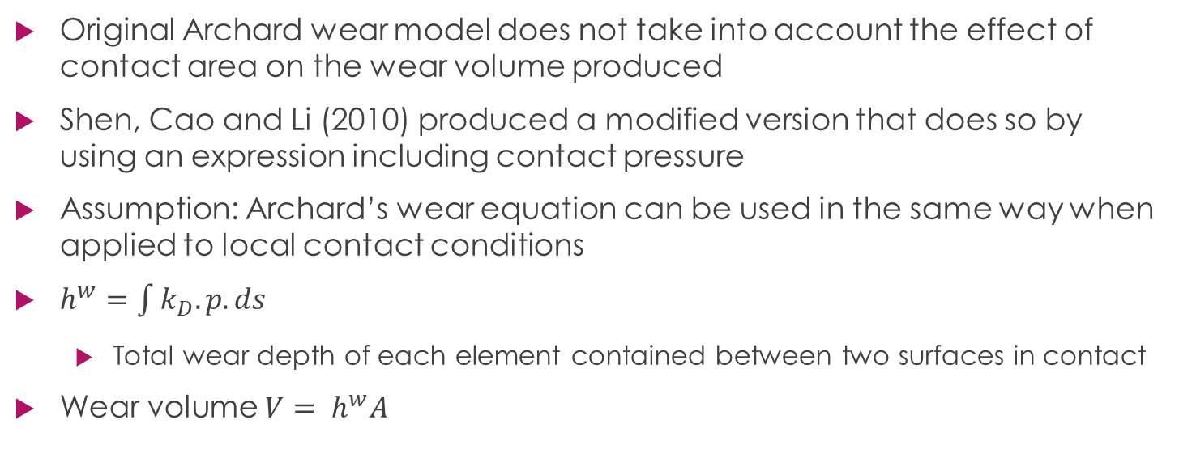
Modified Archard Wear Model
Original Archard wear model does not take into account the effect of contact area on the wear volume produced
Shen, Cao and Li (2010) produced a modified version that does so by using an expression including contact pressure
Assumption: Archard’s wear equation can be used in the same way when applied to local contact conditions
$h^{w}=\int{k_{D}.p.ds}$
  Total wear depth of each element contained between two surfaces in contact
Wear volume $V= h^{w}A$

Slide 11
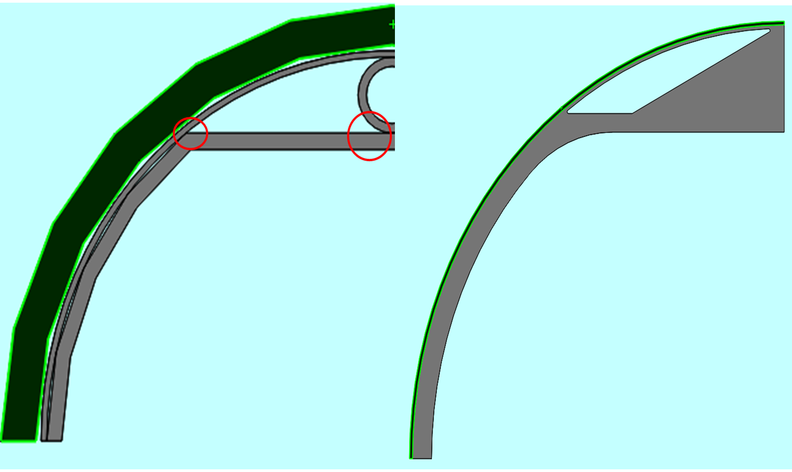
Actual vs Modified Model

Slide 12
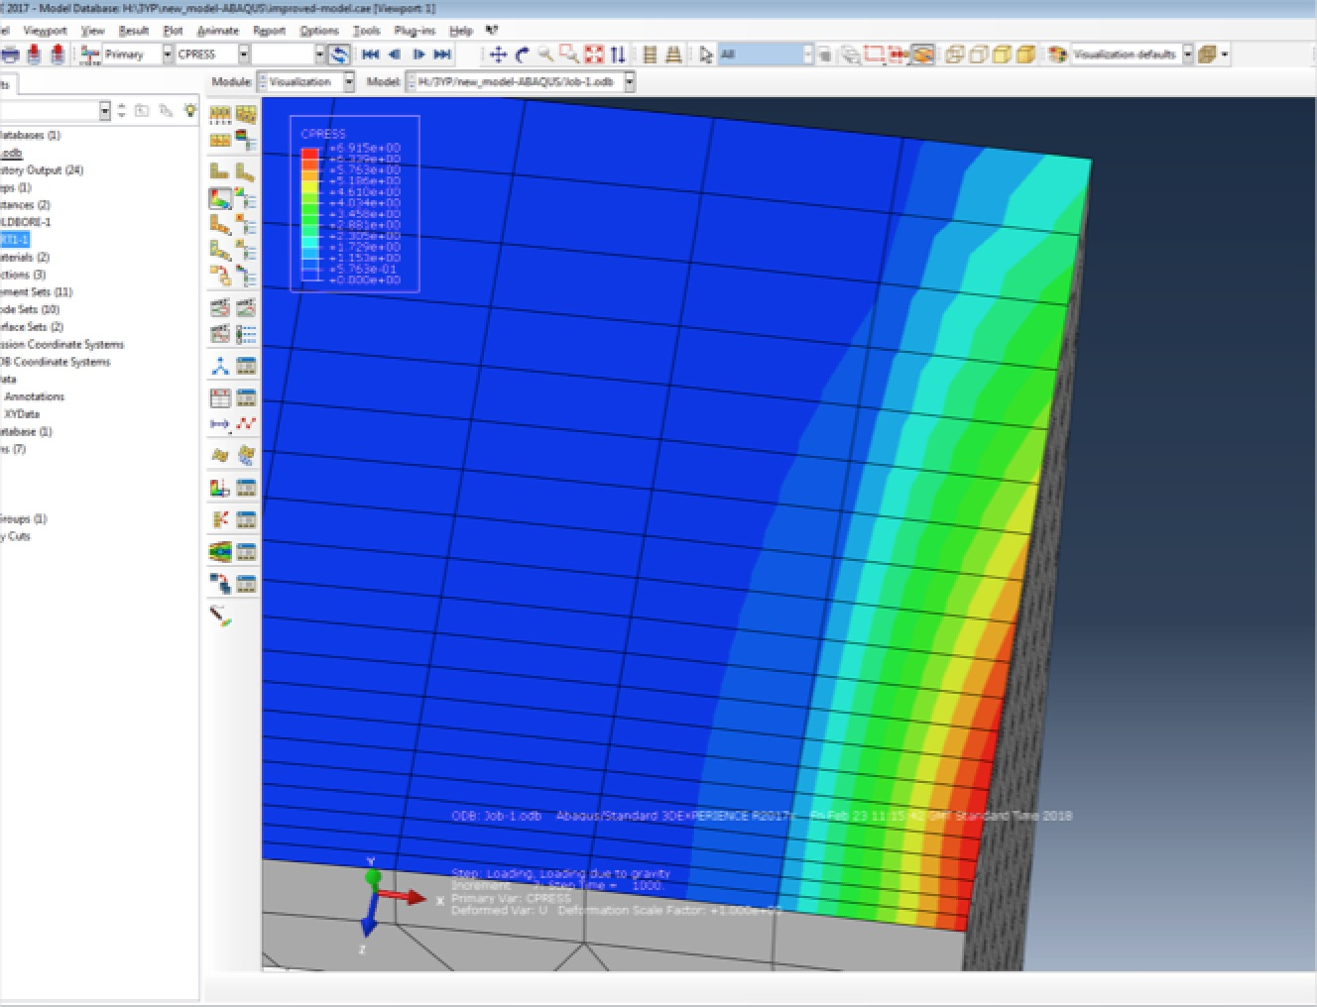
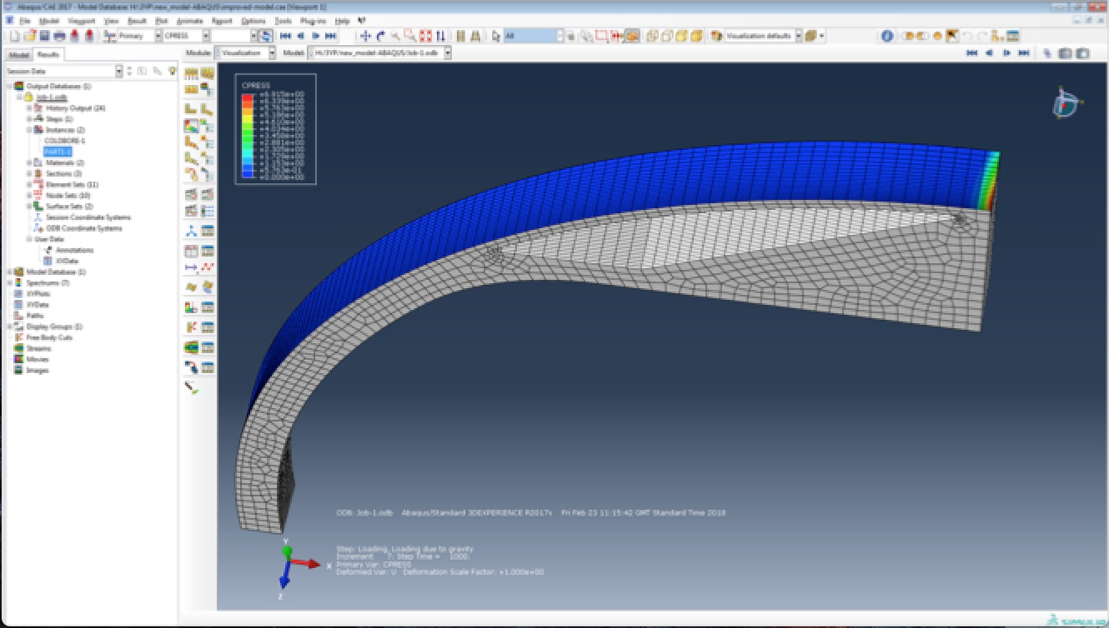
Pressure Distribution on cold bore, produced using ABAQUS

Slide 13
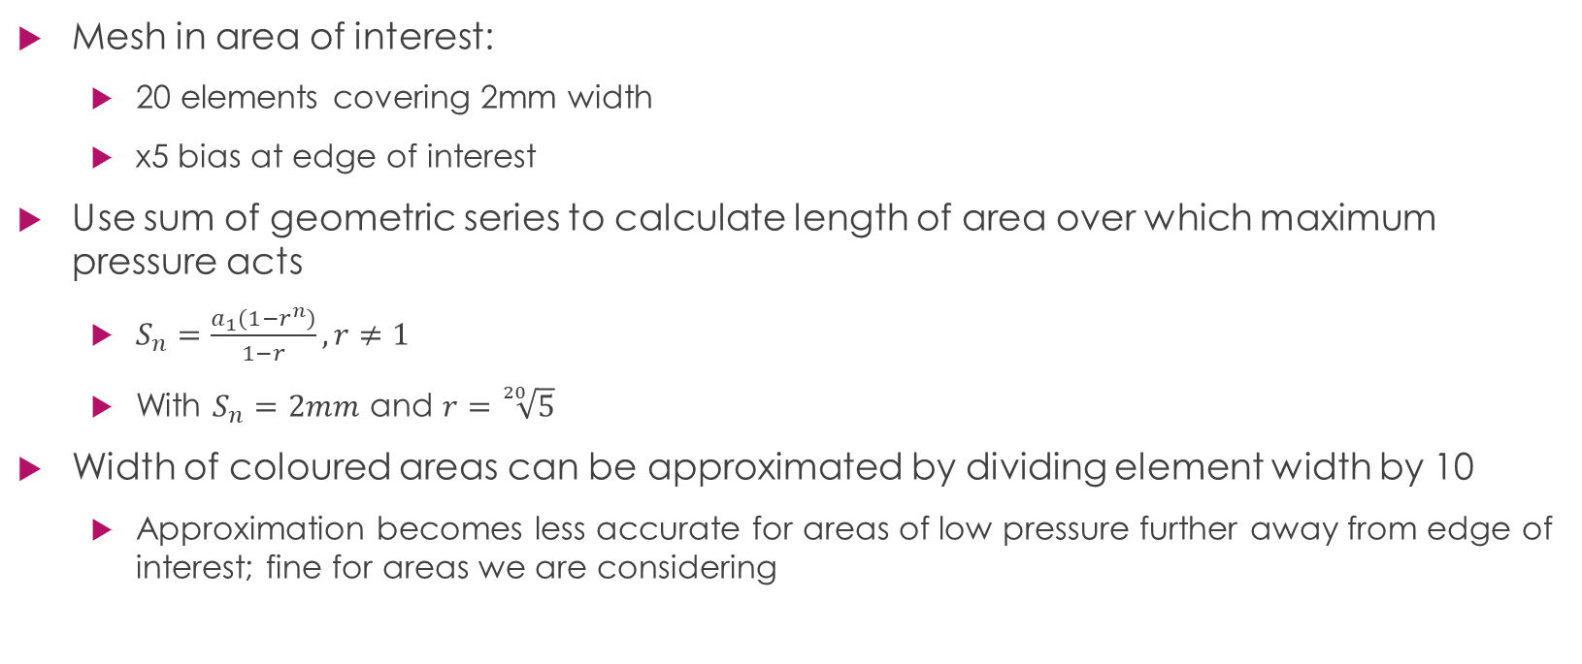
Analysis of Results from ABAQUS Simulation
Mesh in area of interest:
  20 elements covering 2mm width
  x5 bias at edge of interest
Use sum of geometric series to calculate length of area over which maximum pressure acts
  $S_{n}=\frac{a_{1}\left(1−r^{n}\right)}{1−r}, r≠1$
  With $S_{n}=2mm$ and $r=\sqrt[20]{5}$
Width of coloured areas can be approximated by dividing element width by 10
  Approximation becomes less accurate for areas of low pressure further away from edge of interest; fine for areas we are considering

Slide 14
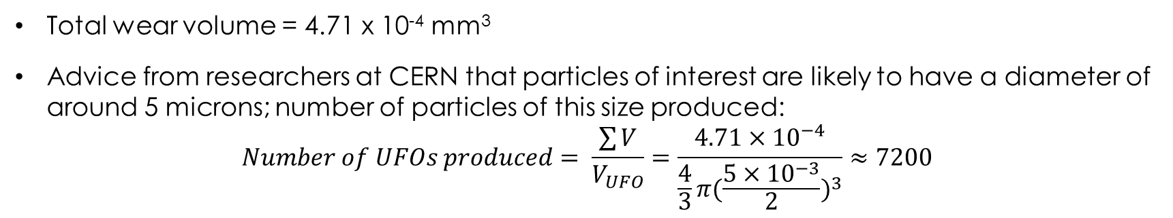
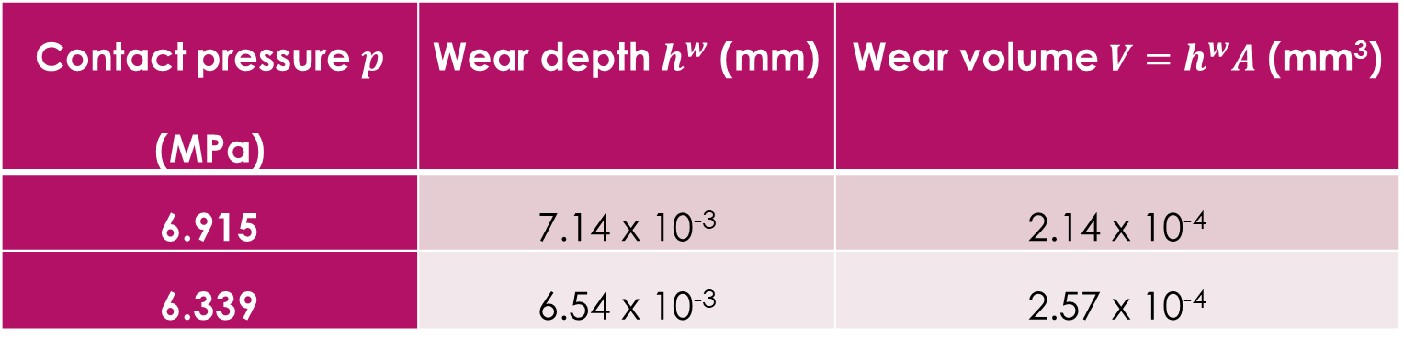
Analysis of Results from ABAQUS Simulation
Contact pressure $p$ (MPa) | Wear depth $h^{w}$ (mm) | Wear volume $V=h^{w}A$ (mm³)
6.915 | 7.14 x 10⁻³ | 2.14 x 10⁻⁴
6.339 | 6.54 x 10⁻³ | 2.57 x 10⁻⁴
Table showing contact pressures and calculate wear depths and wear volumes
Total wear volume = 4.71 x 10⁻⁴ mm³
Advice from researchers at CERN that particles of interest are likely to have a diameter of around 5 microns; number of particles of this size produced:
$$Number of UFOs produced= \frac{\sum{V}}{V_{UFO}}=\frac{4.71×{10}^{−4}}{\frac{4}{3}π{(\frac{5×{10}^{−3}}{2})}^{3}}≈7200$$

Slide 15
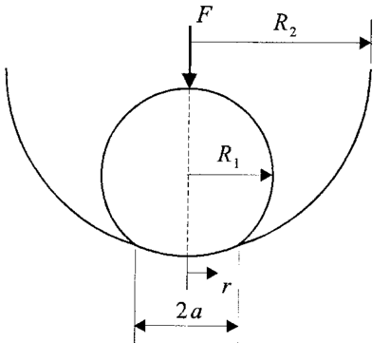
Hertzian calculation
A method for calculating contact area and pressure of curved surfaces.
Inaccurate for cylinders one inside the other.
Used to validate order of magnitude of ABAQUS result.
Quantity | Hertzian | ABAQUS | %Difference
P_{peak} (MPa) | 9.4 | 6.915 | 35.9%
Figure 10: An out-of-scale 2D representation of the cross section of the contact between the protective ring (inner circle for which subscript 1 is used) and the cold bore (outer cylinder for which subscript 2 is used). Sketch adapted from (Fagan, 2001)

Slide 16
Particle Volume Distribution
MATLAB program produces histogram of particle volumes, using total volume released during wear (Archard volume) and theoretical diameter probability distribution
(Bhushan, 2011) ‘the log normal distribution of particle size occurs when the dispersion is attained by comminution’
(Bhushan, 2011) the PDF is assumed to be linear for particle diameters less than 1μm and is exponential for diameters greater than 1μm

Slide 17
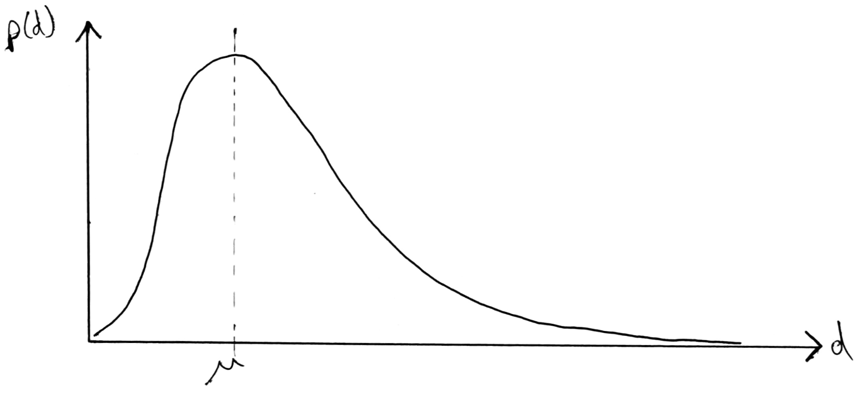
Particle Diameter PDF
p(d) = (1⁄dσ√(2π) )exp(-((ln(d)-μ)⁄(σ√2))⌃2)
PDF for particle volumes, V is obtained by transforming variables through V = (πd⌃2)/6
p(V) = p(d) × Ιδd/δvΙ
μ = ln(m/√(1+v/m⌃2))
σ⌃2 = ln(1+v/m⌃2)

Slide 18
Particle Volume PDF
p(V) = (1⁄Vσ’√(2π) )exp(-((ln(V)-μ’)⁄(σ’√2))⌃2)
μ’ = 3μ – ln(6/π)
σ’ = 3σ
The PDF is multiplied by the Archard Volume to obtain the actual volume distribution
MATLAB produces a histogram, displaying the number of particles with a given volume released per wear cycle

Slide 19
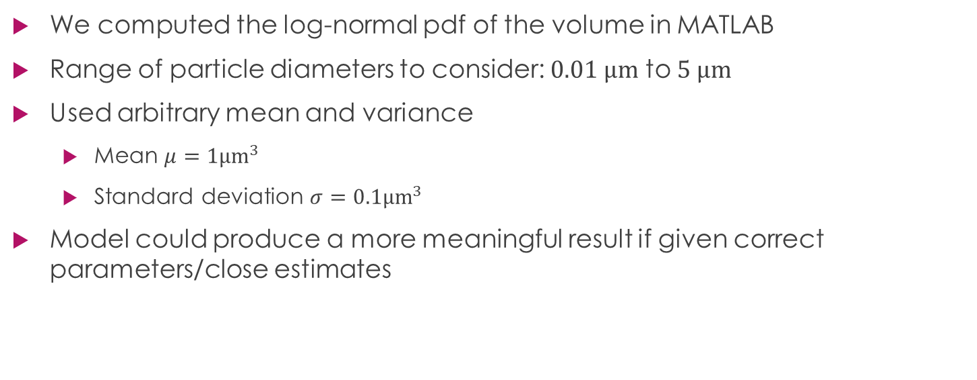
Modelling the distribution of wear particle volumes
We computed the log-normal pdf of the volume in MATLAB
Range of particle diameters to consider: $0.01 μm$ to $5 μm$
Used arbitrary mean and variance
  Mean $μ=1{μm}^{3}$
  Standard deviation $σ=0.1{μm}^{3}$
Model could produce a more meaningful result if given correct parameters/close estimates

Slide 20
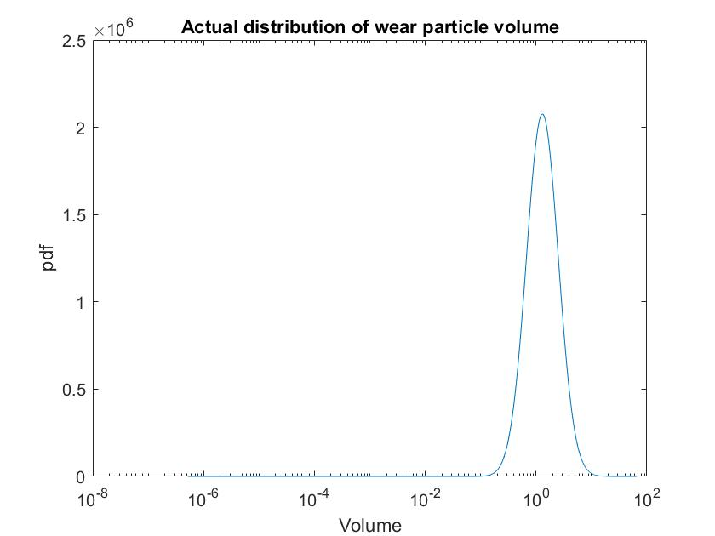
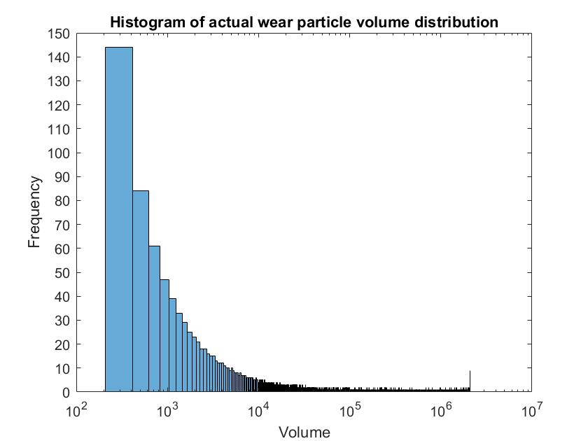
Modelling the distribution of wear particle volumes

Slide 21
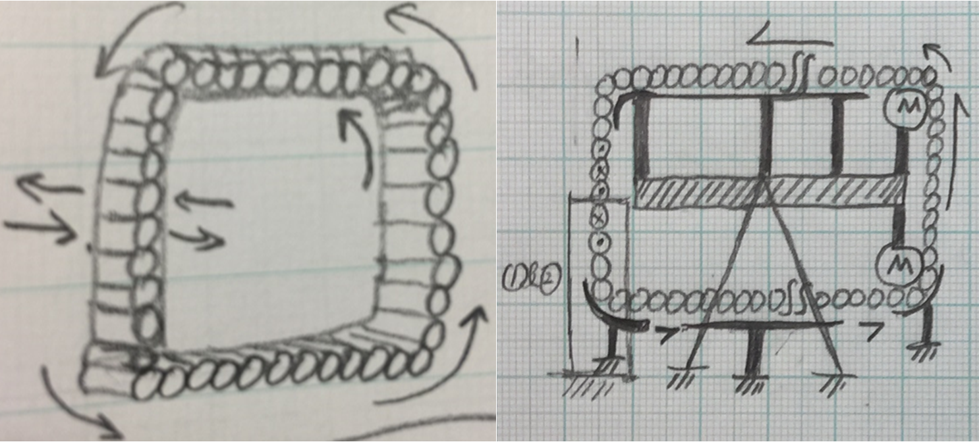
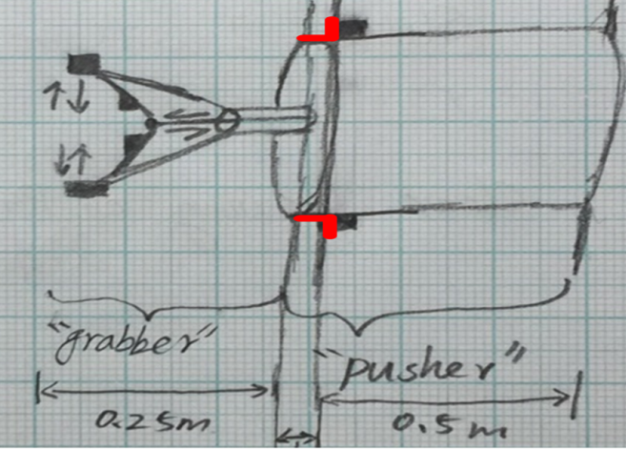
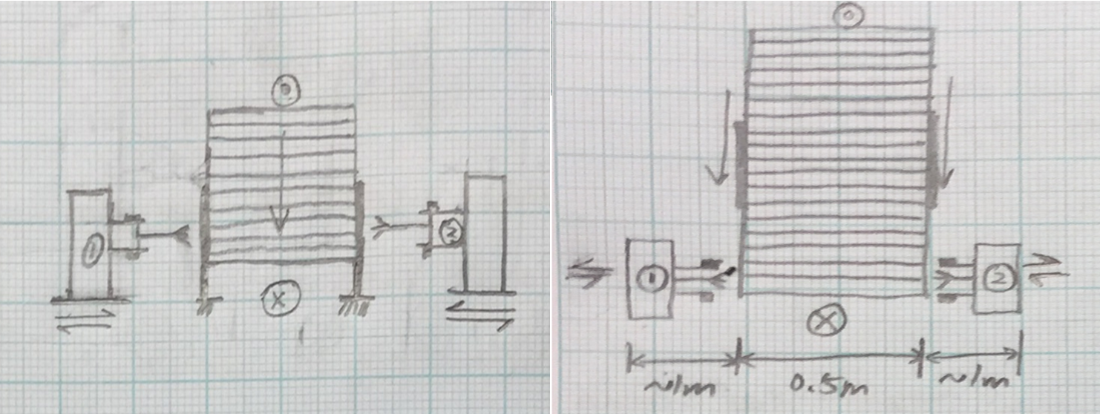
What’s Next: Device 1

Slide 22
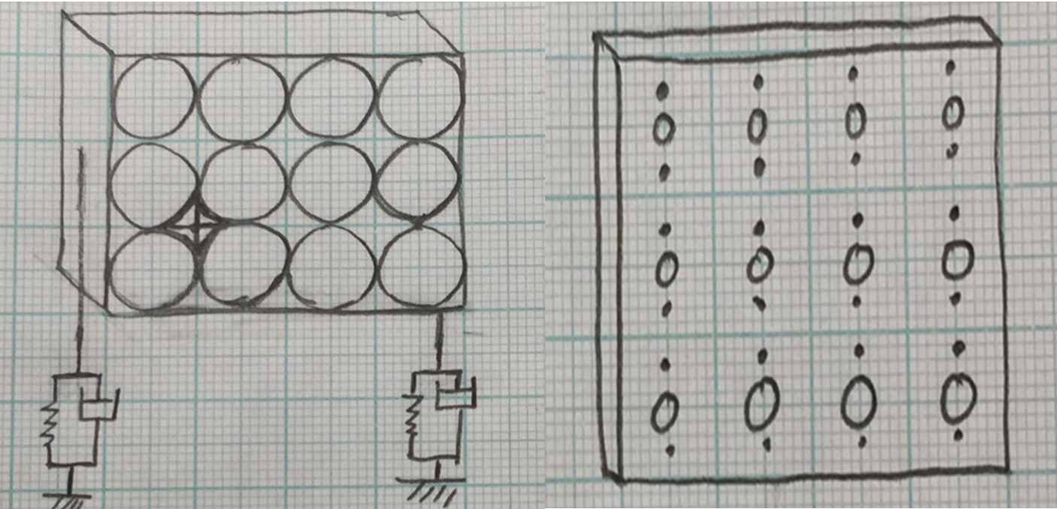
What’s Next: Device 2

Slide 23
Other Sources of Wear – RF Contact Fingers
MKI connects the Super Proton Synchrotron to the LHC
RF contact fingers ensure a reliable electrical contact between sections of the ceramic beam pipe
RF fingers are made of stainless steel 316L, coated with gold. This ensures a had on soft contact as a Rhodium plate covers the end of the beam pipe. (Rabinovitch, 2007)
During bake-out (holding the magnet for 300°C for one hour) the magnet and beam tube thermally expand and the fingers slide
In normal operation there is 40 grams contact pressure between the fingers and cylinder insert (Rabinovitch, 2007)
Therefore there is likely to be significant wear caused by the contact between RF fingers and beam pipe

