Slide 1
Summary on Longitudinal Loading of Nb₃Sn magnets at CERN
5th US MDP-FCC meeting. 30th May 2018
Susana Izquierdo Bermudez, with contributions from Giorgio Vallone, Paolo Ferracin, Etienne Rochepault and Charilaos Kokkinos

Slide 2
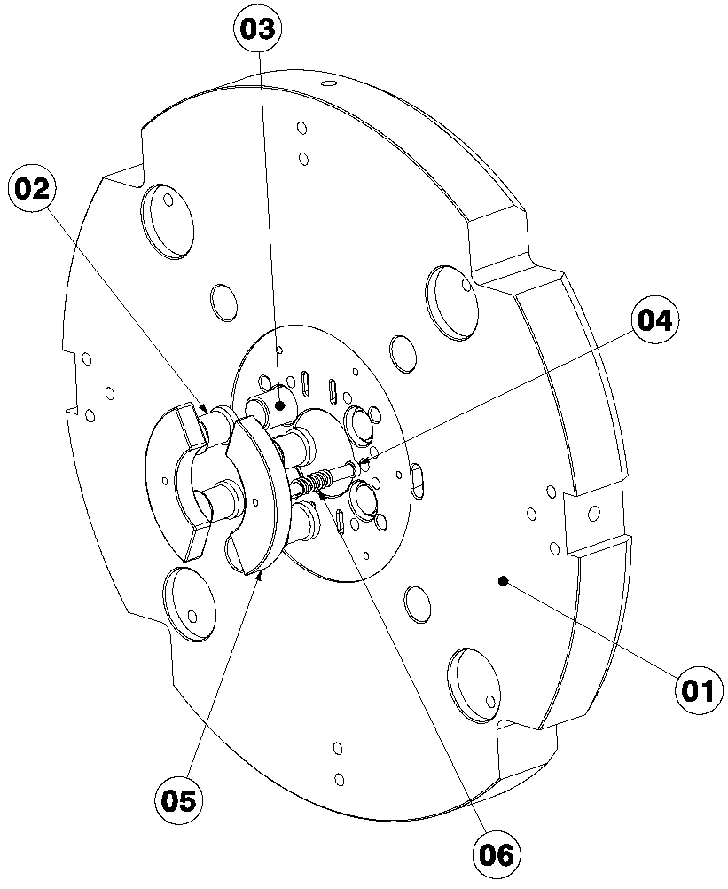
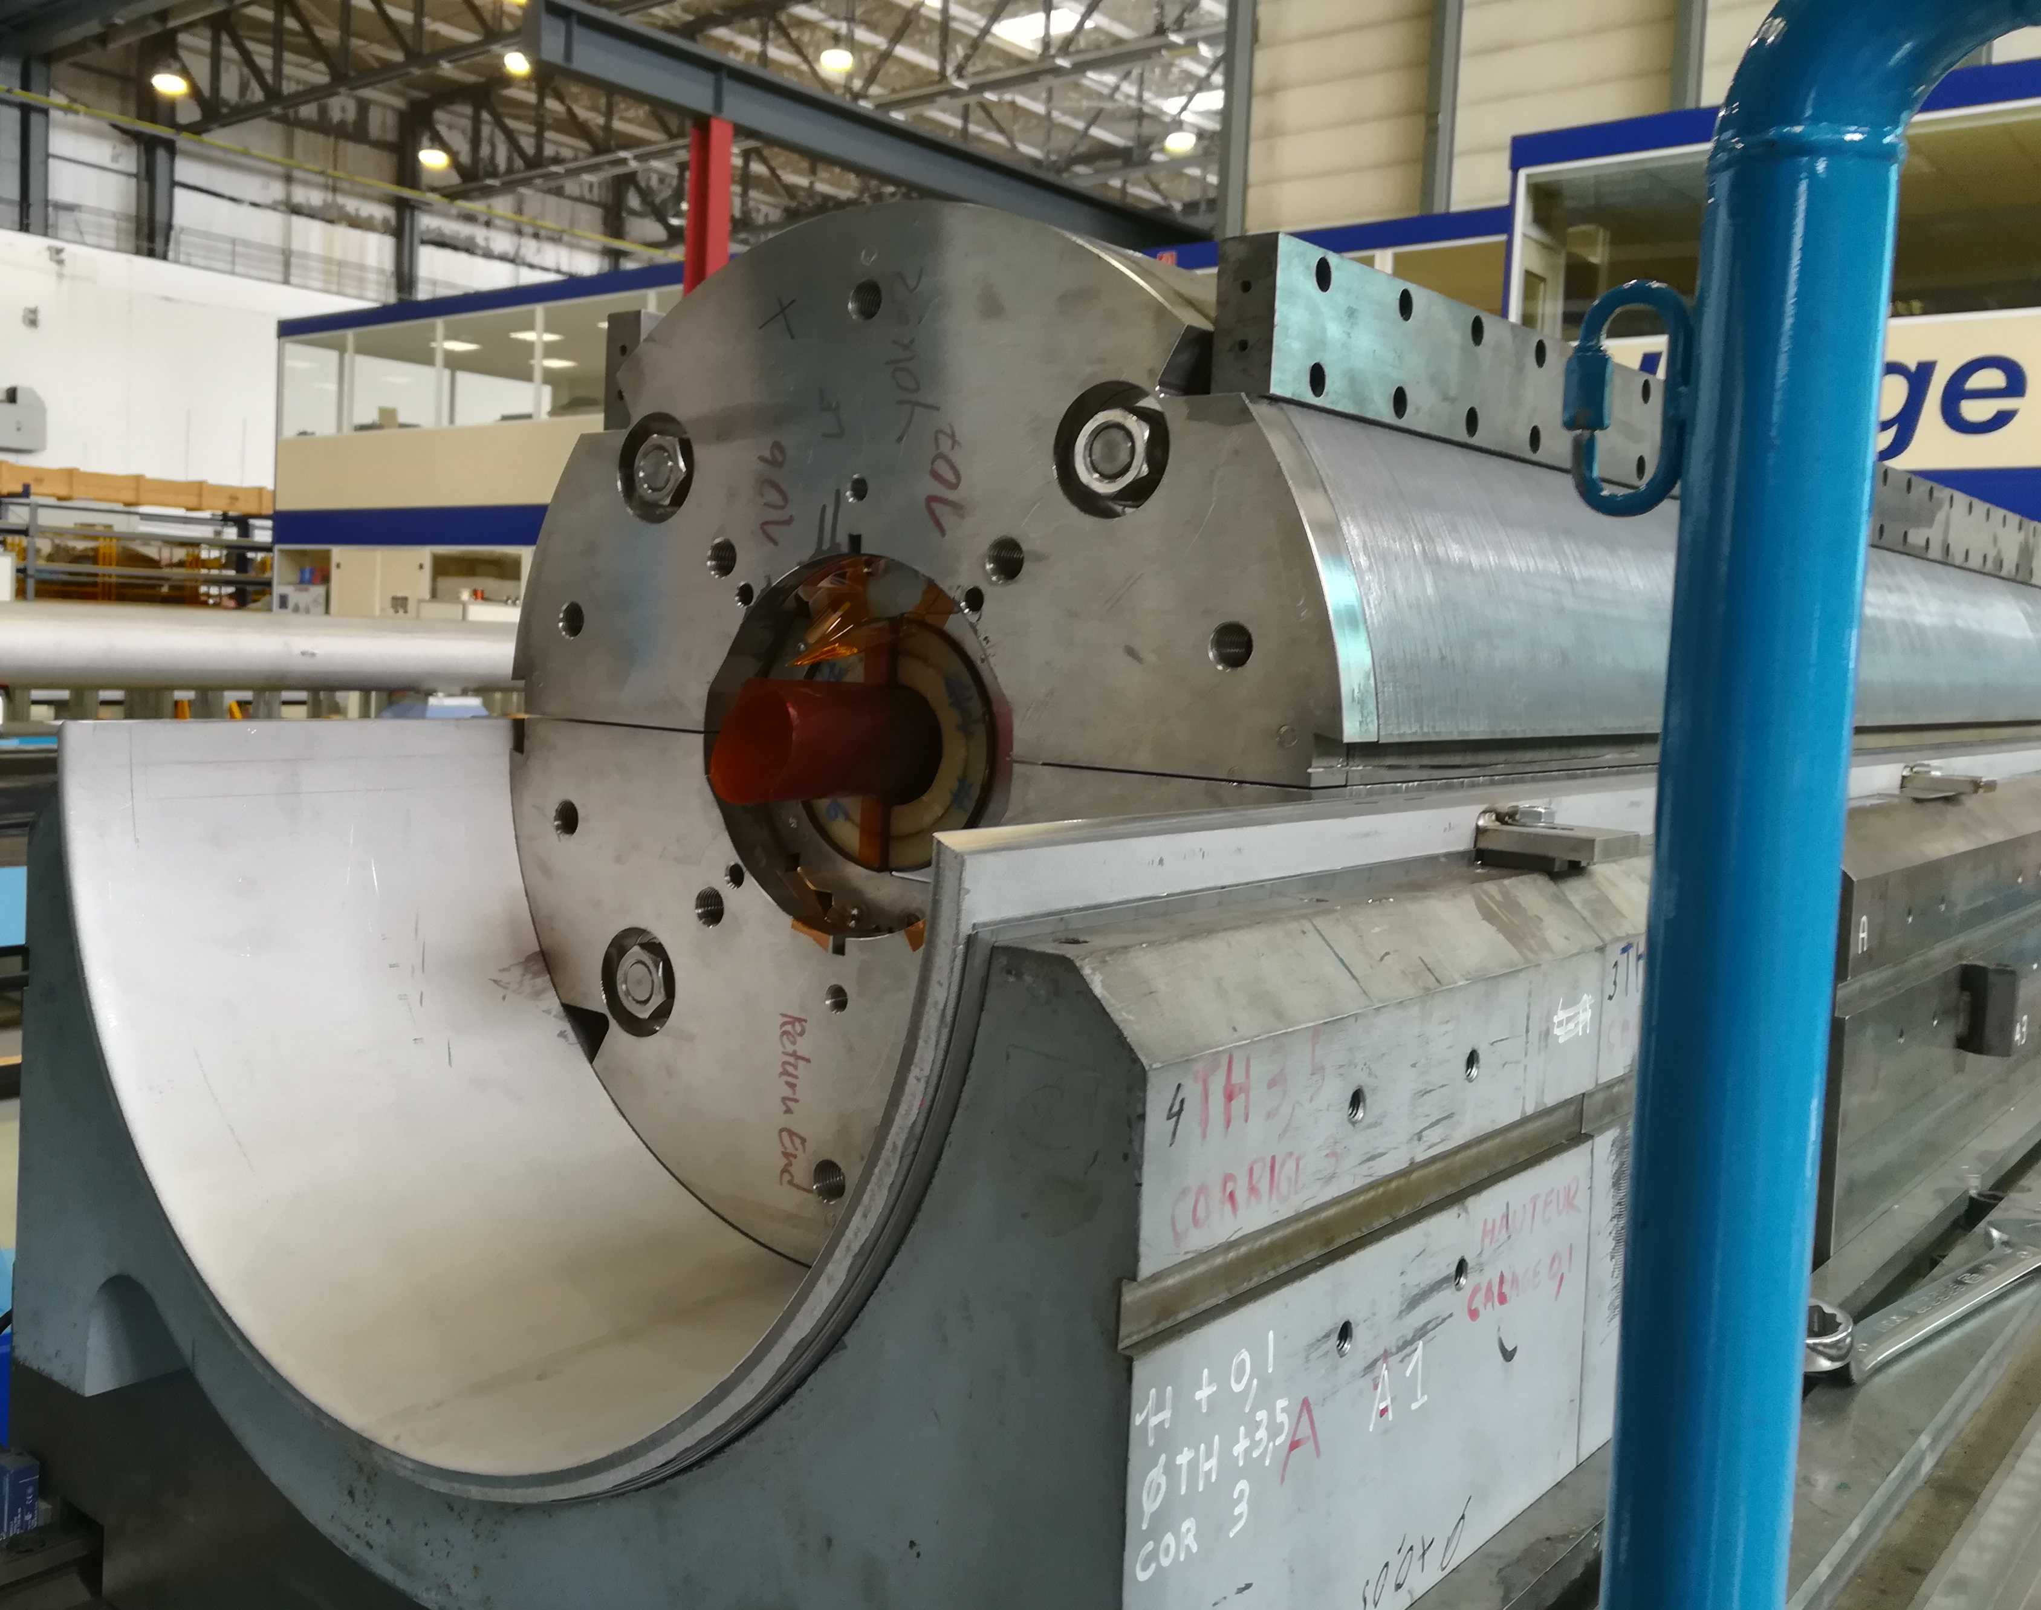
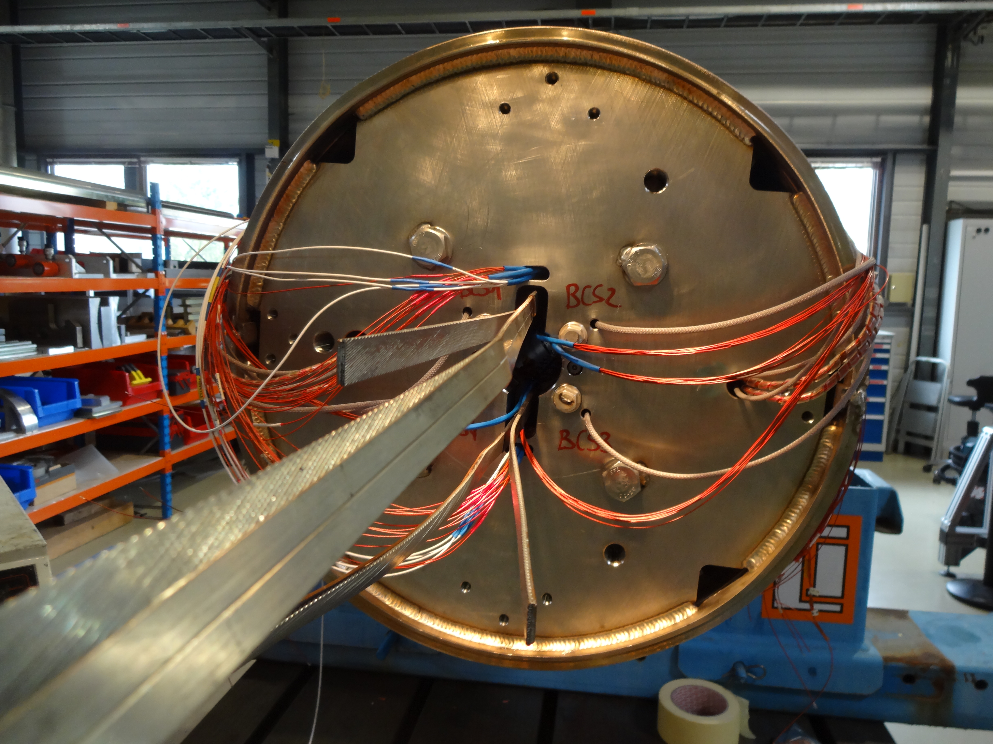
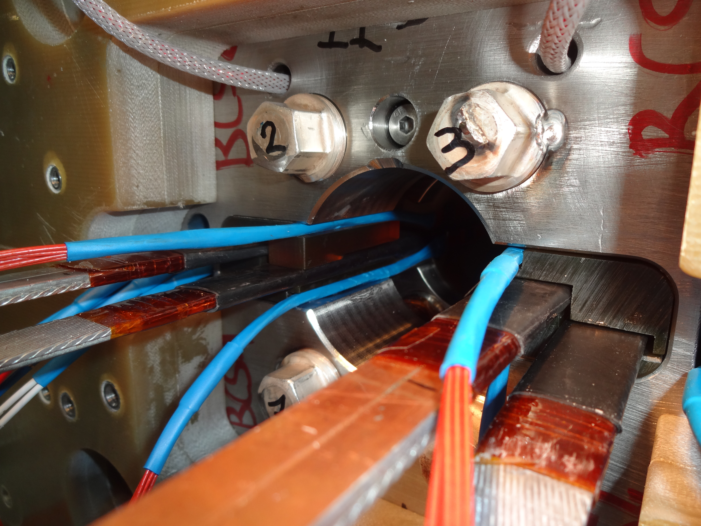
11 T - concept
Bullet gauges
Slight pre-load at room temperature, to guarantee that there is still contact coil to end plate at 1.9 K.
Goal: limit the coil displacements providing a rigid lateral support
1in1 models:
  43 mm thick end-plate, 12 mm stainless steel shell.
2in1 models:
  75 mm thick end-plate, 15 mm stainless steel shell.

Slide 3
11 T – longitudinal pre-load
Overall behavior:
Pre-load at room temperature at 30-60 kN/aperture (5-10 % of the electromagnetic forces)
During cool down, around 50 % of the force is lost (except in DP102, where the force seen by the bullets increases by a factor 3).
During powering, around 30 % of the load is transferred to the bullet gauges.

Slide 4
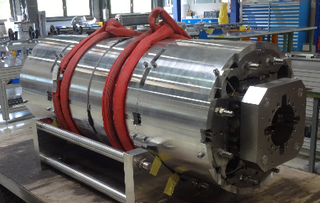
MQXF - Concept
Direct connection between the motion of the rod and the one of the coil ends
  Coil elongation measured by the strain gauges on the rods.
Goal: keep the pole turn under compression during powering.
Short models (1.2 m):
  Aluminum rods, 36 mm diameter
  Nitronic 50 end plate, 75 mm thick
Long magnets (7.2 m):
  Stainless steel rods, 36 mm diamter
  Nitronic 50 end plate, 75 mm thick

Slide 5
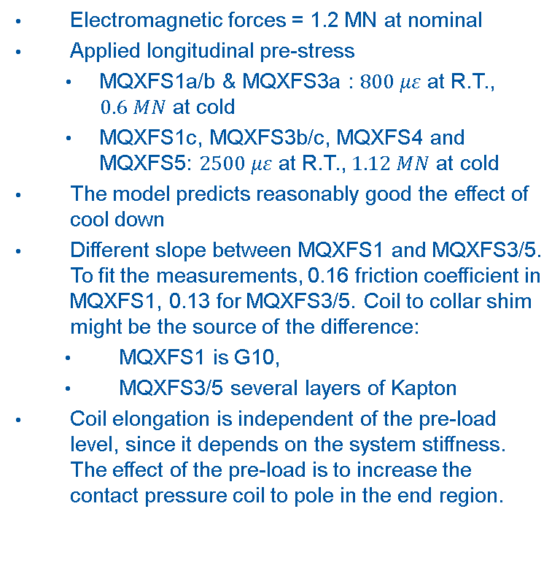
MQXF – Longitudinal Pre-load
Electromagnetic forces = 1.2 MN at nominal
Applied longitudinal pre-stress
  MQXFS1a/b & MQXFS3a : $800 με$ at R.T., $0.6 MN$ at cold
  MQXFS1c, MQXFS3b/c, MQXFS4 and MQXFS5: $2500 με$ at R.T., $1.12 MN$ at cold
The model predicts reasonably good the effect of cool down
Different slope between MQXFS1 and MQXFS3/5. To fit the measurements, 0.16 friction coefficient in MQXFS1, 0.13 for MQXFS3/5. Coil to collar shim might be the source of the difference:
  MQXFS1 is G10,
  MQXFS3/5 several layers of Kapton
Coil elongation is independent of the pre-load level, since it depends on the system stiffness. The effect of the pre-load is to increase the contact pressure coil to pole in the end region.
G. Vallone, et. al., Mechanical analysis of the short model magnets for the Nb₃Sn low-beta quadrupole MQXF, IEEE Trans. Appl. Supercond., vol. 26, no. 4, 2016.

Slide 6
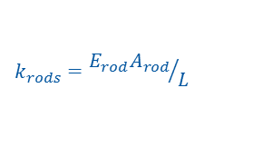
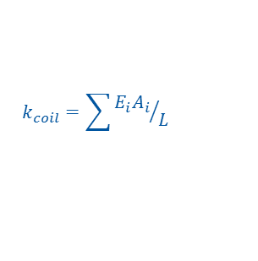
MQXF – From short to long
$$k_{rods}={E_{rod}A_{rod}}/L$$
Coil elongation during powering for the 7.2 m magnets:
  If not supported by the rods: 7.04 mm (0.098 %)
  With stainless steel rods, no friction: 4.22 mm (0.098 %)
  With stainless steel rods, friction: 0.28 mm (0.004 %)
$$k_{coil}=\sum{{E_{i}A_{i}}/L}$$
G. Vallone, et. al., Mechanical Design Analysis of MQXFB, the 7.2 m long-β quadrupole for the High-Luminosity LHC Upgrade, IEEE Trans. Appl. Supercond., vol. 26, no. 4, 2016.

Slide 7
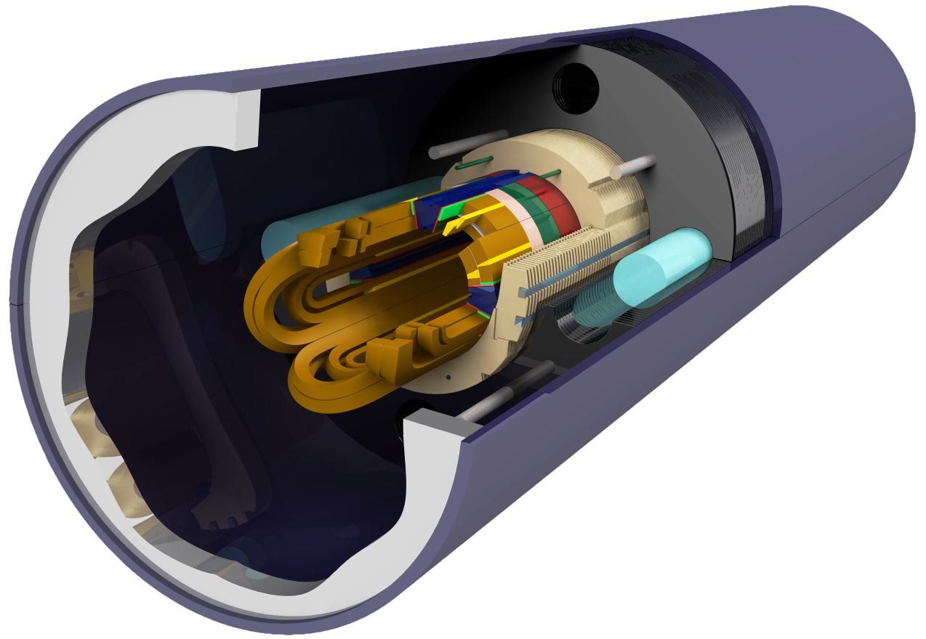
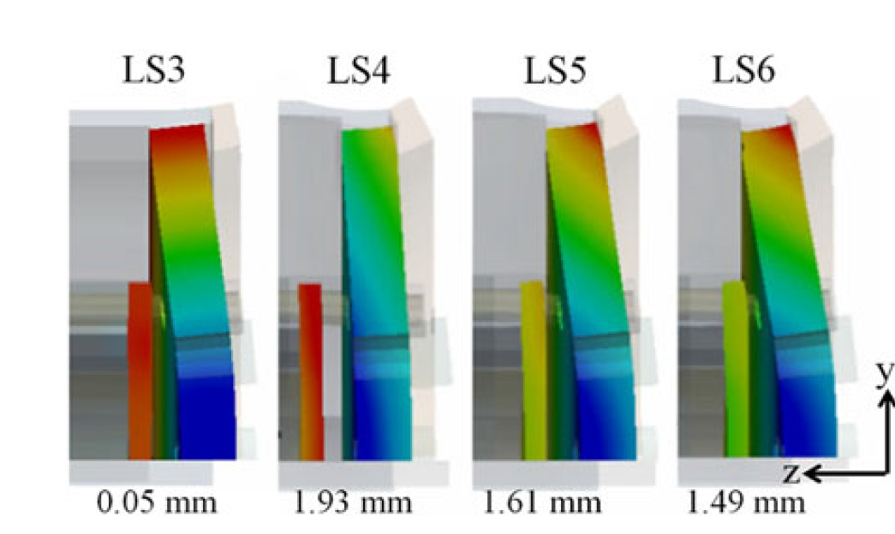
MKQXF (FEAC)
FEAC performed a design study on MKQXF, a pole loading concept magnet, using MQXF coils.
End design converged to a model with 4 bullets, a 50-mm-thick endplate, 4 rods of 30 mm diameter and pre-tension on the bullets that corresponds to an induced gap at the bullets – coil end plate interface of 0.5 mm.
Computed coil elongation during powering, for the 7.2 m magnet is 0.32 mm, due to the bending of the end-plate.
  Remark: Not so clear in [1] how the FEA model is scaled to the full length magnet: “The E-modulus of the stainless steel rods that connect the two end plates of the magnet was scaled down to the length of 1.55 m, to accurately model the behaviour of the assembly over the total length of the magnet.”
Assembly
4.2 K
140 T/m
155 T/m
[1] Charilaos Kokkinos; Mikko Karppinen, High Gradient Nb3Sn Quadrupole Demonstrator MKQXF Engineering Design IEEE Transactions on Applied Superconductivity Year: 2018, Volume: 28, Issue: 3

Slide 8


MQXF vs MKQXF
$$k_{rods}={E_{rod}A_{rod}}/L$$
$$k_{shell−yoke}≫k_{rods}$$
According to FEA, similar coil elongation in the two configurations. Possible origin:
  MKQXF larger bending of the end plate.
Further analysis on MKQXF FEA model might provide further clarifications.
$$k_{coil}=\sum{{E_{i}A_{i}}/L}$$
$$k_{coil}=\sum{{E_{i}A_{i}}/L}$$
 | MQXF | MKQXF
End plate thickness, mm | 75 (Nitronic 50) | 50 (stainless steel)
Rods diameter, mm | 36 (aluminium/stainless steel) | 30 (stainless steel)
Coil elongation for the 7.2 m magnet, including friction | 0.28 mm | 0.32 mm

Slide 9
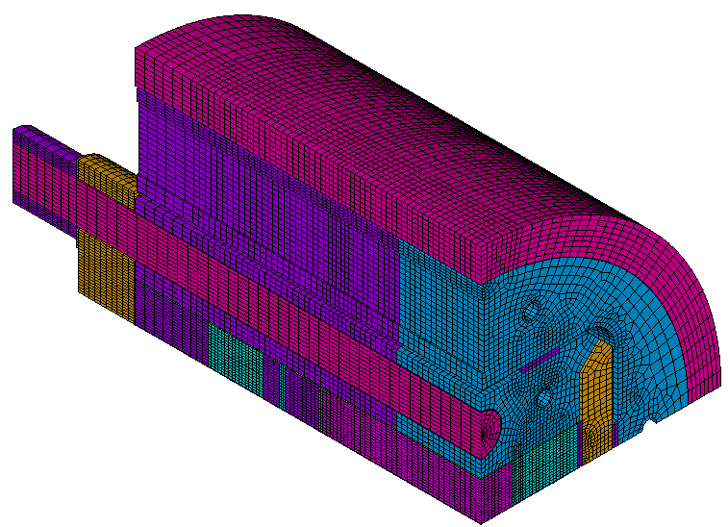
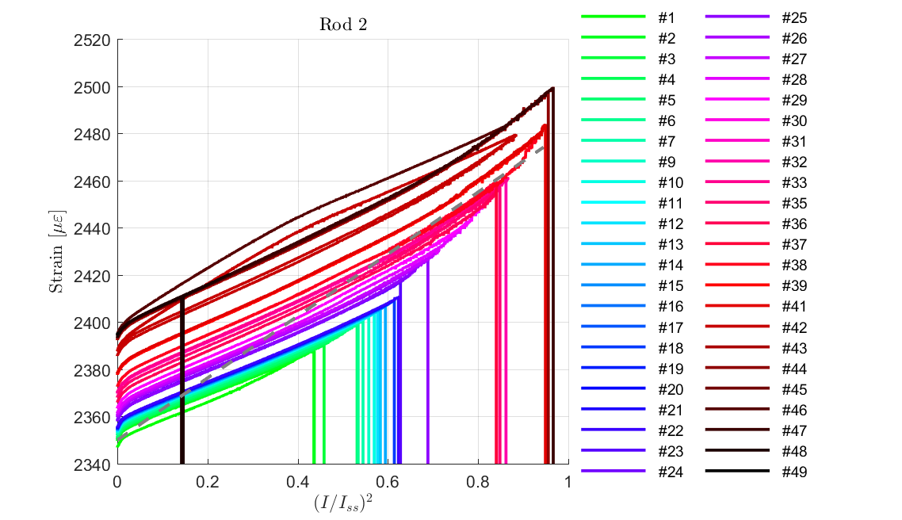
RMC
Axial loading concept as MQXF
  Longitudinal rods diameter = 48 mm (Aluminum)
  End plate thickness = 70 mm (Nitronic 50)
Axial pre-load in magnets tested: ∿ 30 % of the electromagnetic forces at room temperature, 60 % after cool down → around 45 MPa of tension in the end pole turn at maximum current.
Initial measured slope in the rods smaller than in the model → could be match using slightly larger friction coefficient.
Model μ = 0.2
RMC QXF |  | Targeted | Achieved
Rod strain RT | μstr | 1600 | 1359
Axial pre-load (RT+CD) | % EM | 30+30 | 24+28

Slide 10
RMM: Longitudinal stiffness
 | 11 T | MQXFS – Al rods | RMM- Al rods | RMM- SS rods
e.m. force per aperture at nominal field [MN] | 0.44 | 1.2 | 2.4
Coil length [mm] | 1.6 | 1.1 | 0.97
Magnet length [mm] | 2 | 1.55 | 1.5
Rod diameter [mm] | n.a. | 36 | 64
End-plate thickness [mm] | 43 | 75 | 100
Coil Stiffness [MN/mm] | 1.40 | 1.10 | 4.06 | 4.06
Rod Stiffness [MN/mm] | n.a. | 0.21 | 0.78 | 2.08
Coil elongation
No friction, no rods [mm] | 0.31 | 1.09 | 0.59
No friction, rods* [mm] | n.a. | 0.92 | 0.51 | 0.41
*Assuming infinitely rigid end-plate

Slide 11
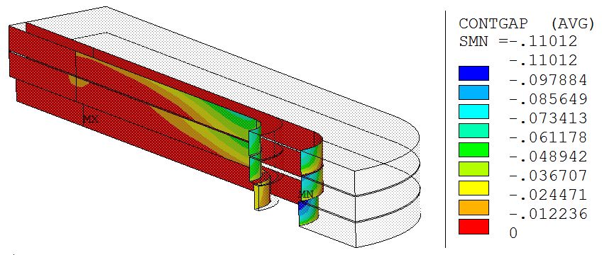
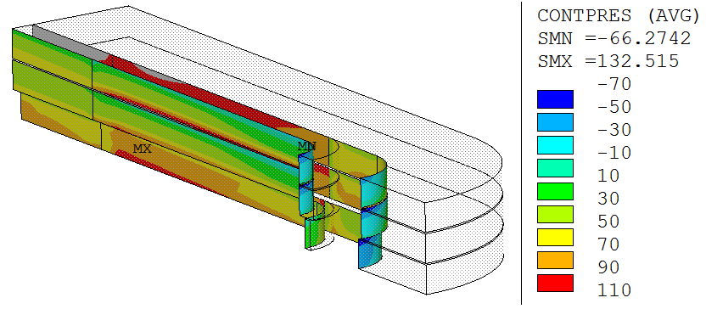
RMM: coil-pole contact
Main difficulty on the end design: keep the pole turn under compression during powering.
  Only 20% of the pre-load force applied in the rod reaches the coil-pole contact (assuming a friction coefficient of 0.2)
 | Rod Pre-load Fz | Rod Cool-Down Fz | Energization
 | [% L. F.]* | [% L. F.]* | Max. Tension [MPa] | Max. Gap [μm]
16 T | 14 | 76 | 64 | 106
18 T | 11 | 56 | 90 | 135
16 T | 32 | 100 | 56 | 94
18 T | 24 | 75 | 80 | 133
16 T | 72 | 139 | 46 | 76
18 T | 53 | 104 | 77 | 110
16 T | 97 | 167 | 40 | 62
18 T | 72 | 125 | 72 | 99
16 T | 135 | 208 | 30 | 44
18 T | 100 | 155 | 66 | 85
E. Rochepault, 3D Magnetic and Mechanical Design of Coil Ends for the Racetrack Model Magnet RMM, IEEE Appl. Supercond.

Slide 12
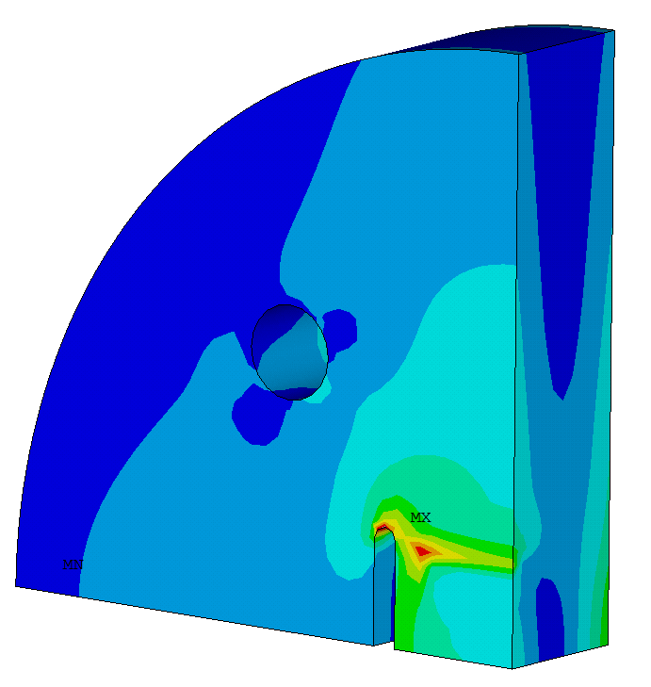
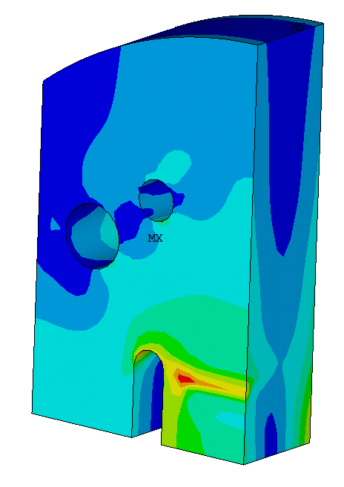
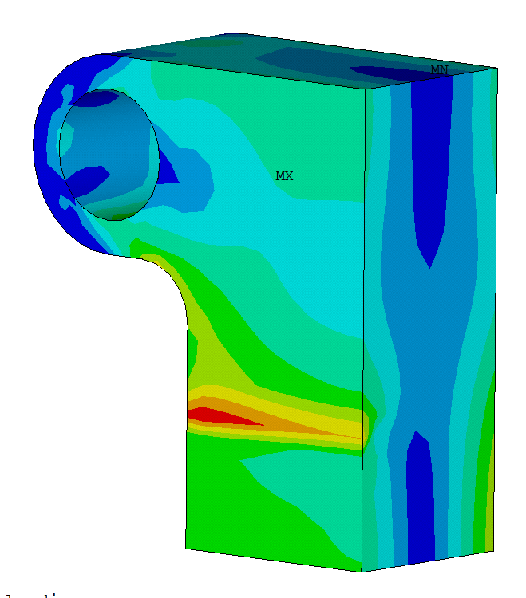
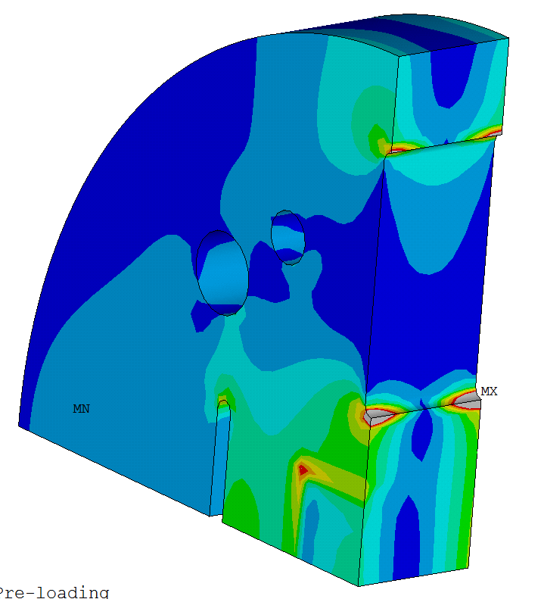
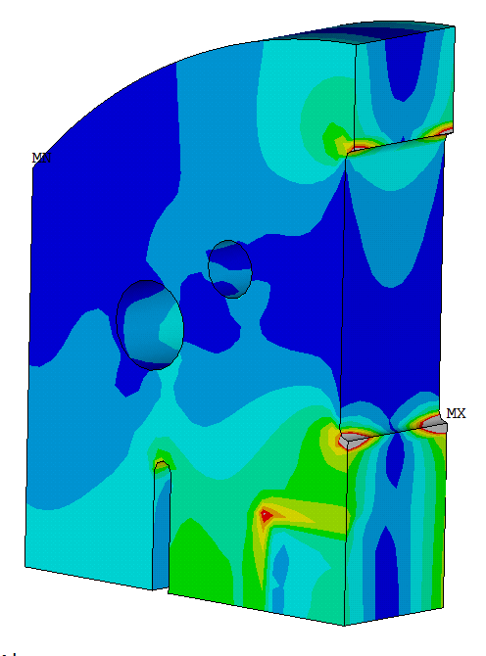
RMM: End-plate design
Goals:
Provide enough rigidity to the system, limiting coil displacements
Be able to apply up to 3 MN of pre-load
Keep stress below yield limit
Allow extraction of the leads on the Lead End
Allow bladders loading on the Return End
d. Removing un-necessary material
b. Adding material for higher rigidity
a. Increasing thickness and width for higher rigidity
Lead End
Return End
c. Different designs Lead End/Return End

Slide 13
Final remarks
In order to keep the pole turn under compression in RMM, excessive longitudinal force is needed during assembly → expect to have ∿ 40 MPa of tension ∿ 0.05 - 0.1 mm of gap on the pole tip.
The optimization was guided by designing a system as rigid as possible:
  Rods for longitudinal loading shall be as close as possible to the coil to minimize bending of the end plate (becomes hard in blocks coil if when one needs to leave the space for the flared ends).

