Slide 1
About the longitudinal pre-load of magnets built at LBNL
Shlomo Caspi
Lawrence Berkeley National Laboratory
USA
May 30, 2018
* Many thanks to the BNL, FNAL and LBNL SMP groups

Slide 2
General Statements
The mechanical state of superconducting magnets has the most impact on performance and training.
Understanding the 3D mechanical state of SC magnets is complex and requires a dedicate effort.
S. Caspi
2

Slide 3
Approach
The 2D cross-section design assumes axial condition :
    Plane-Stress
      the ends are lightly supported when transverse pressure is applied (like when collars are used)
    Plane-Strain
      the ends are externally supported with end-plates and rods
    3D lamination symmetry
      the ends are internally supported by a spar like in the CCT
The above assumptions are not needed in 3D modeling
Modeling and measuring the reaction process is not a simple task
S. Caspi
3

Slide 4
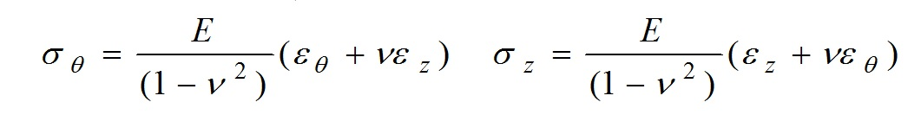
3D Mechanical Estimates
Strain “ε” in two principal directions “z,θ” (and no shear) is converted into stress “σ” using the relationships below (modulus of elasticity (E), and Poisson’s ratio (ν))
  HQ bore diameter 60 mm, 4 aluminum rods each r=17mm
  Assume:
  Coil is a cylinder
  Modulus E=40 Gpa, Poisson ratio ~1/3, no friction
  Coil azimuthally stress Sigma_t=-150 Mpa
  Constrains:
  Plain-stress radial forces generate -150 Mpa azimuthal stress, ends slide axially
  Plain-strain radial forces generate -150 Mpa azimuthal stress, ends fixed axially
S. Caspi
4

Slide 5
Coil Estimates
Plane-Stress Sigma_z=0
(free-axial, sliding)
Plane-Strain Epsilon_z=0
(fixed-axial)
Sigma_t = -150 MPa (solid cylinder)
Epsilon_t = -3750 Mic-strain
Epsilon_z = +1250 Mic-strain
Sigma_z= 0 MPa
Magnet length L=1m
Coil change in length = +1.25 mm
Sigma_t = -150 MPa (solid cylinder)
Epsilon_t = -3333 Mic-strain
Epsilon_z = 0 Mic-strain
Sigma_z = -50 Mpa coil
  Sigma_rods=-F_z/A_rods = +195 MPa (r-17mm)
  Aluminum rods E=80 GPa, 1 m long
  Rods_strain_z=195/80 = +2437 Mic-strain
  1m rods change in length = +2.4 mm

Slide 6
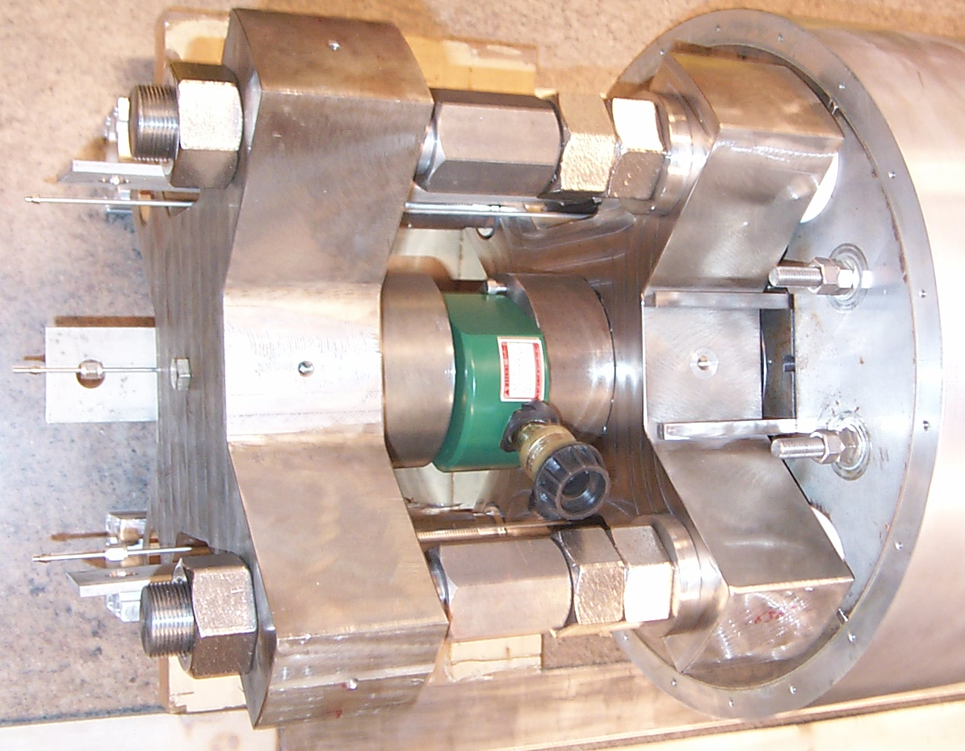
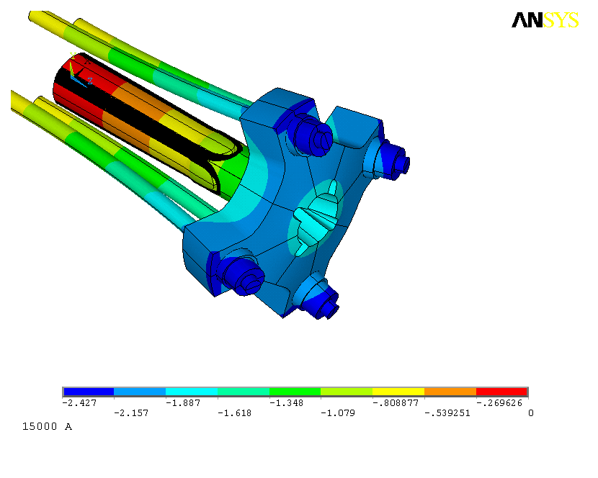
Axial Support Structure
S. Caspi
6

Slide 7
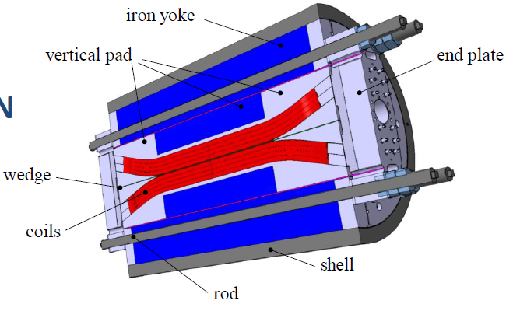
3D mechanical analysis
Support structure design
Axial support composed by
  Aluminum rods with a diameter of 60 mm
  Nitronic 50 end plate 150 mm thick
        Bullets to deliver pre-load to end-shoes and wedge
Rods axial force
FRESCA2 (13 T): 2.8 MN
  HD2 (13 T): 0.7 MN
  LQ (240 T/m): 0.5 MN
  TQ (>200 T/m): 0.35 MN
  HQ (170 T/m, 4 rods 34mm): 0.8 MN
  HQ (219 T/m, 34mm): 1.327 MN
LQ axial support system, composed by four, 25.4 mm diameter,
stainless steel axial rods with two stainless steel end-plates,
50 mm thick. = 500mm^2 per rod
Paolo Ferracin and Attilio Milanese March 2012
S. Caspi
7

Slide 8
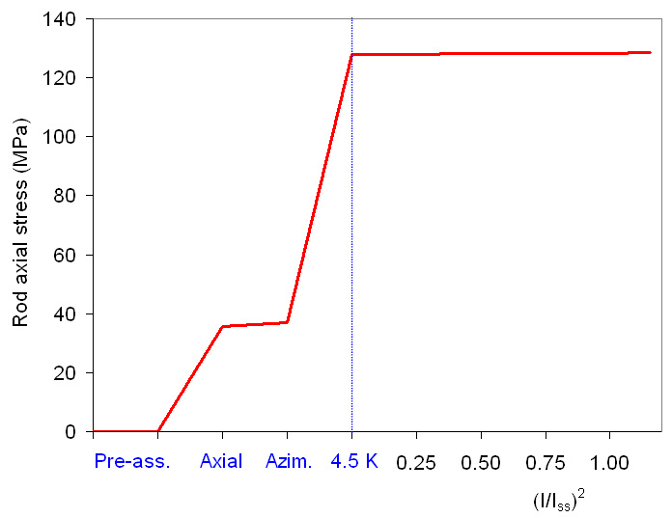
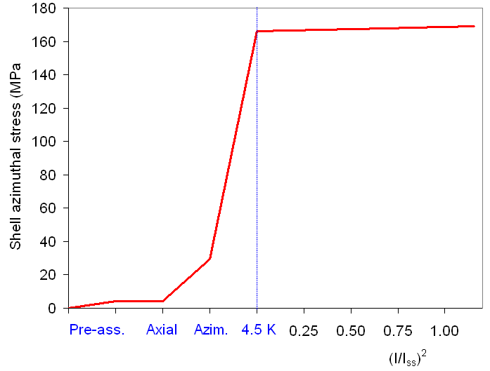
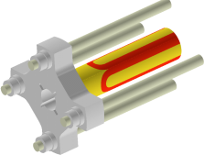
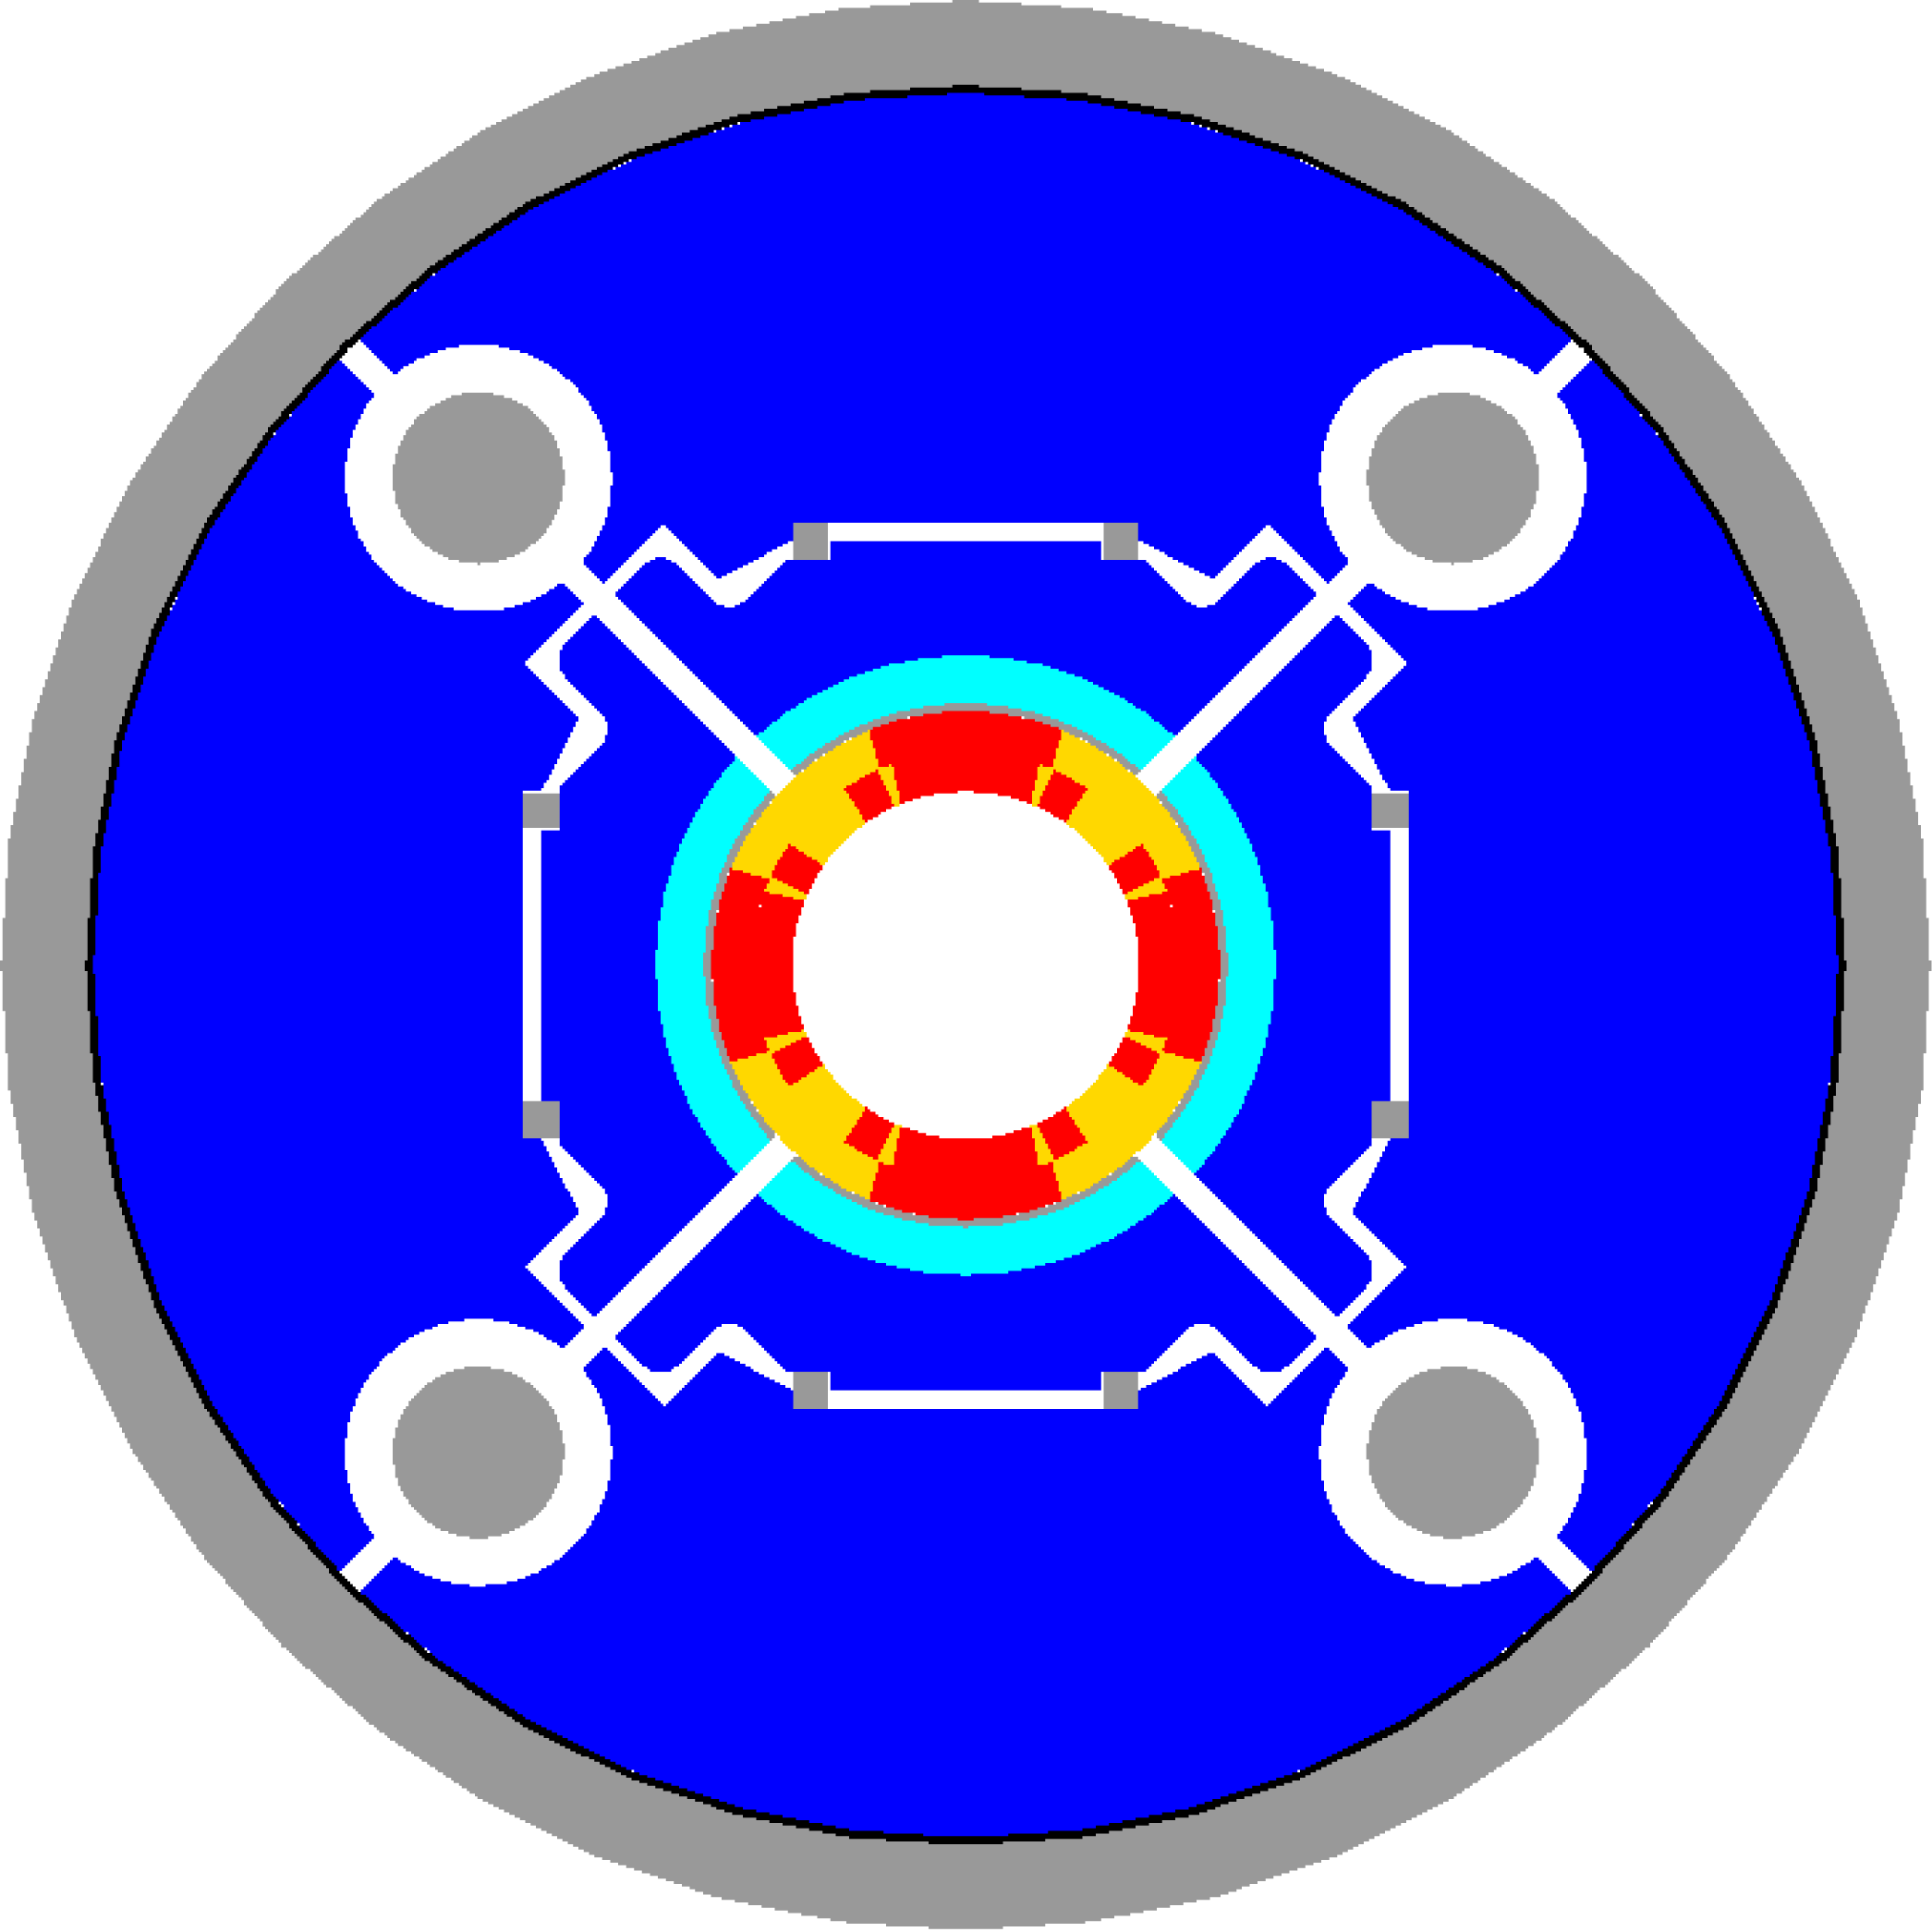
Overview of assembly and pre-load
Aluminum rods
  37 MPa at 293 K (230 kN)
  128 MPa at 4.3 K (800 kN)
  Small variation during ramp
Aluminum shell
  30 MPa at 293 K
  166 MPa at 4.3 K
  Small variation during ramp
S. Caspi
8

Slide 9
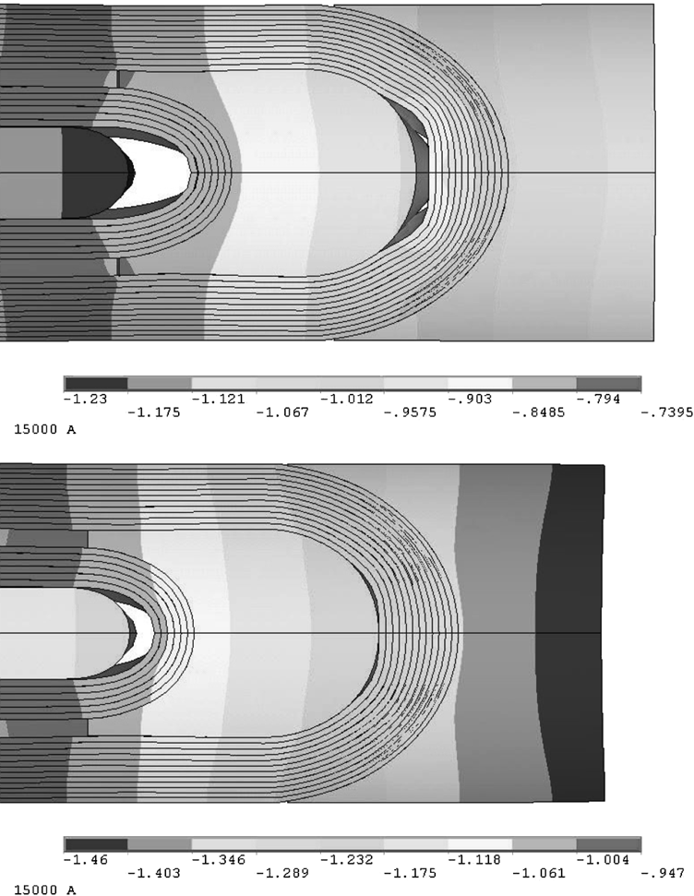
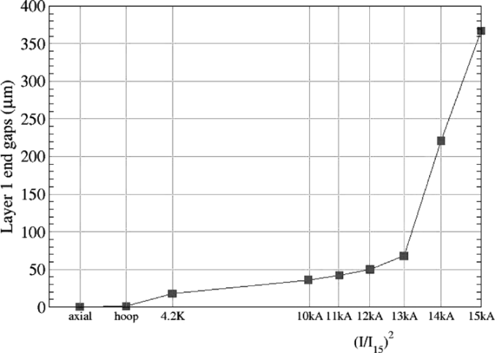
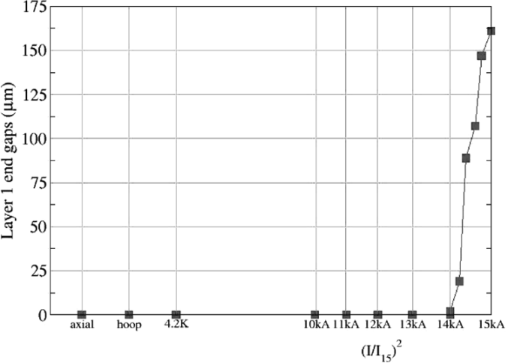
END GAPS
S. Caspi, P. Ferracin., “Towards integrated design and modeling of high field accelerator magnets,” IEEE Trans. Appl. Supercond., vol. 16, no. 2, pp. 1298–1303, June 2006.
Axial displacements of inner layer’s (0.2 friction factor assumed).
Limited axial support (top) and full axial support (bottom).
S. Caspi
9

Slide 10
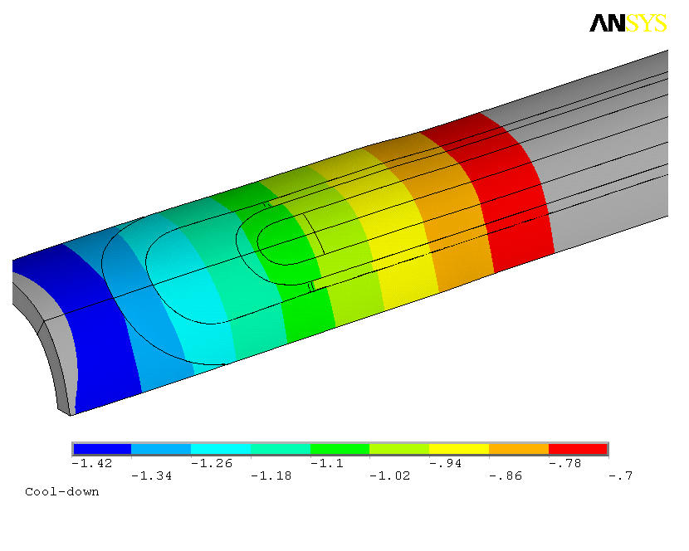
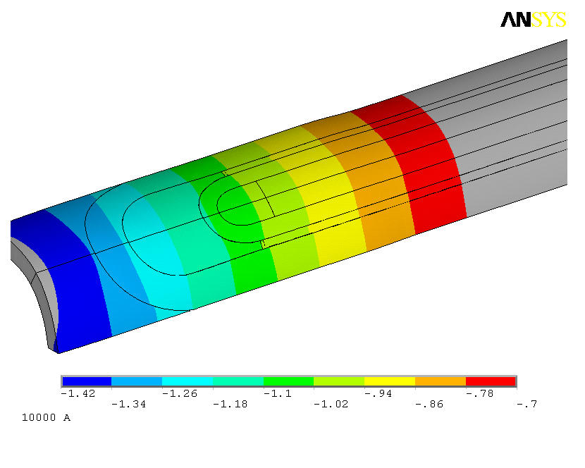


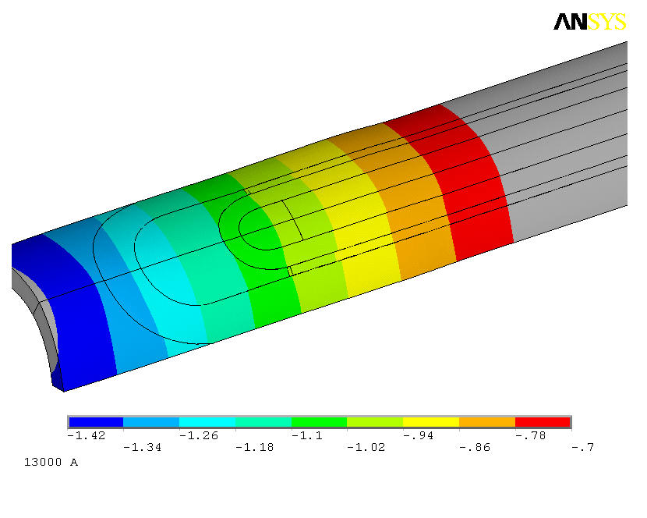
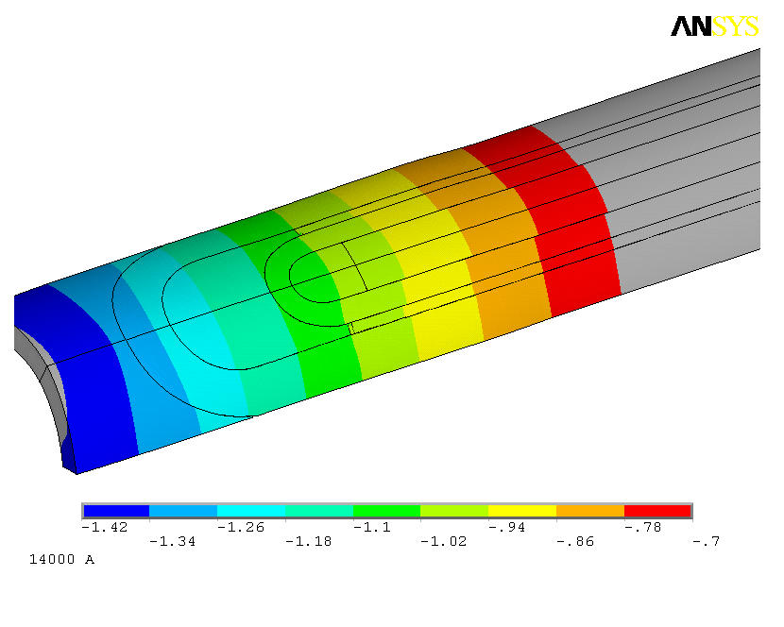
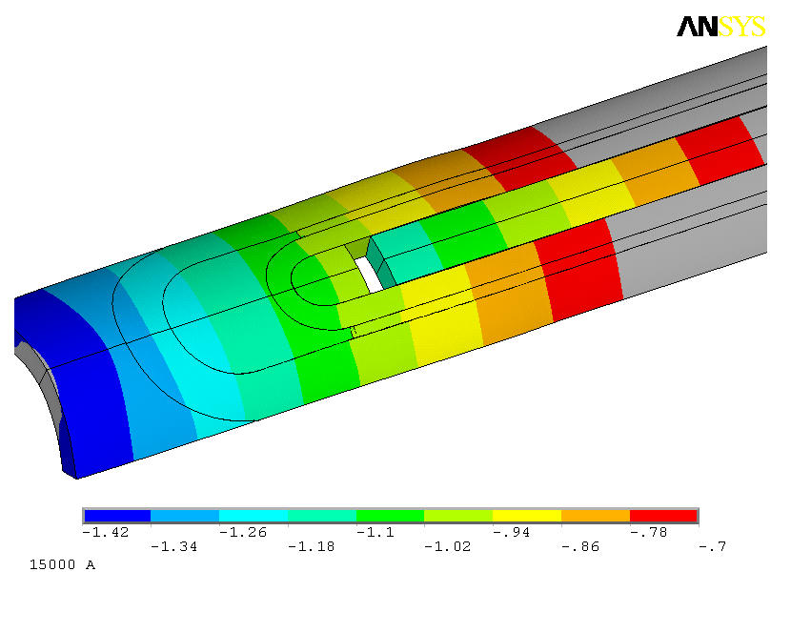
Axial displacement - pole with cut (with friction)
S. Caspi
10

Slide 11
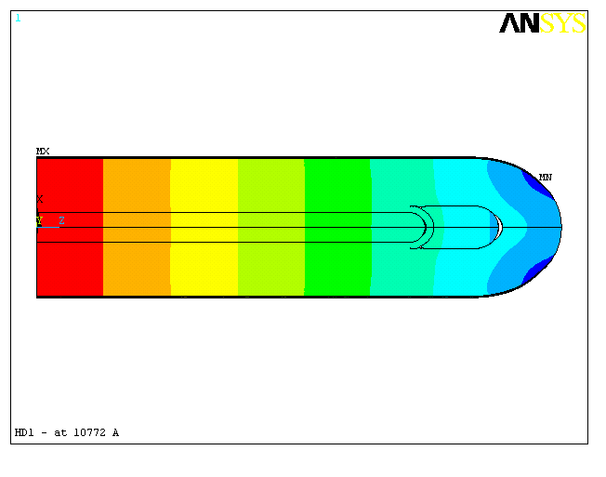
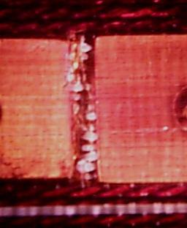
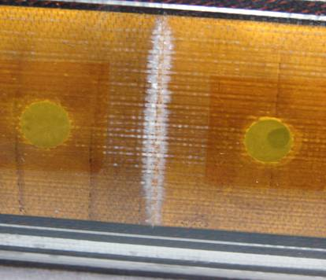
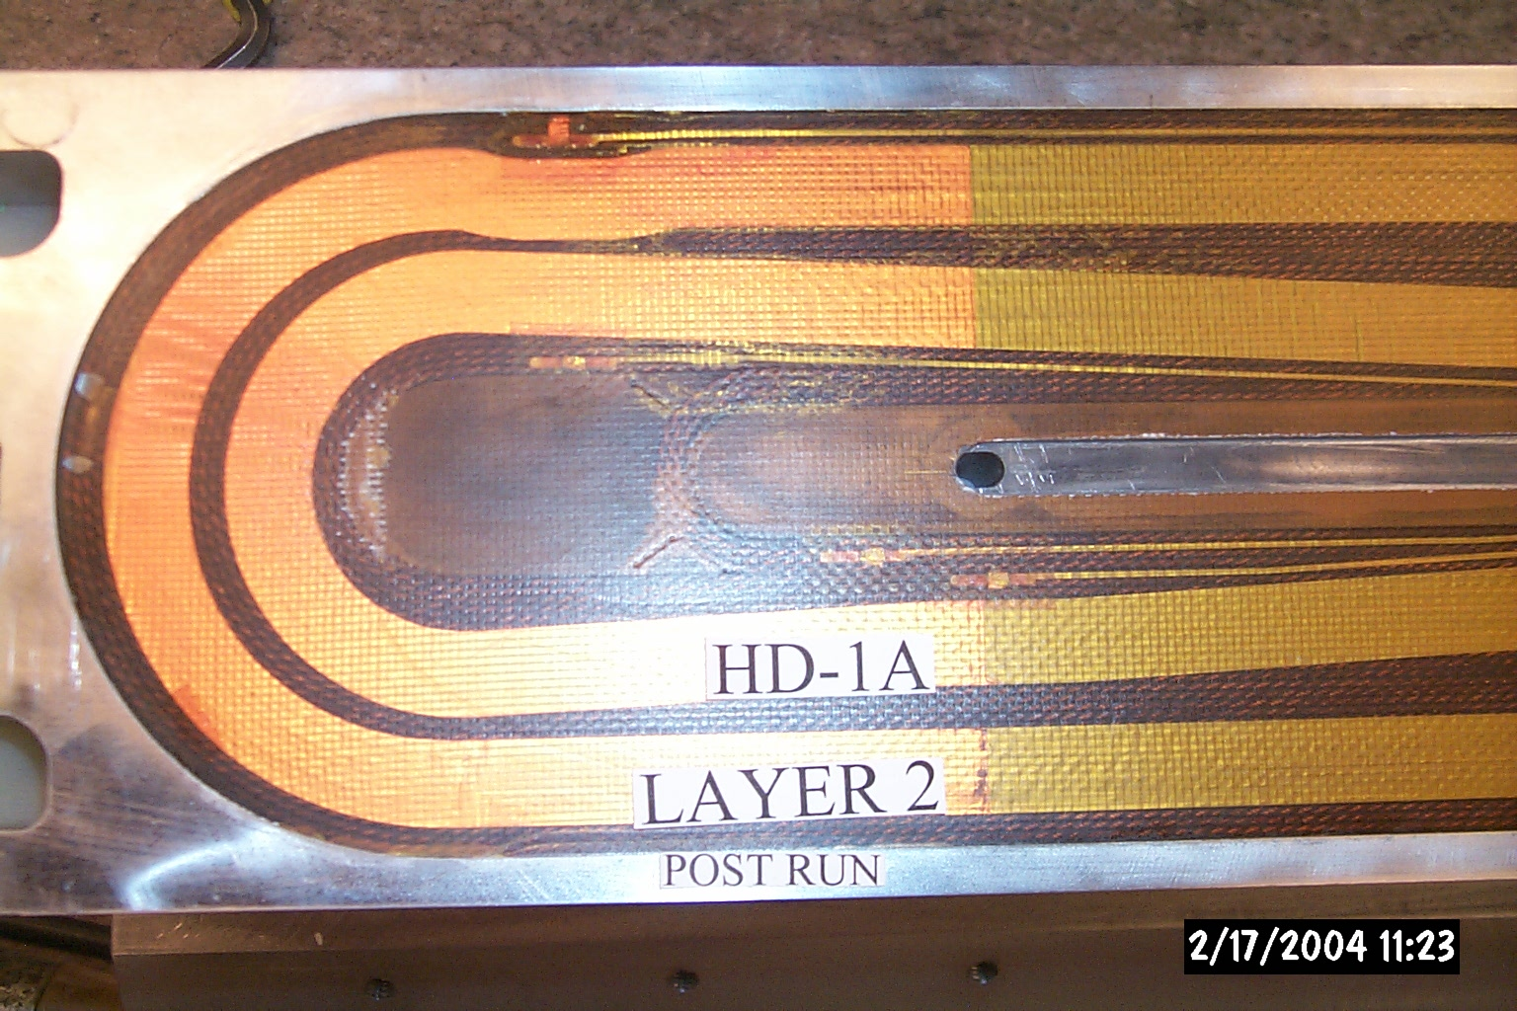
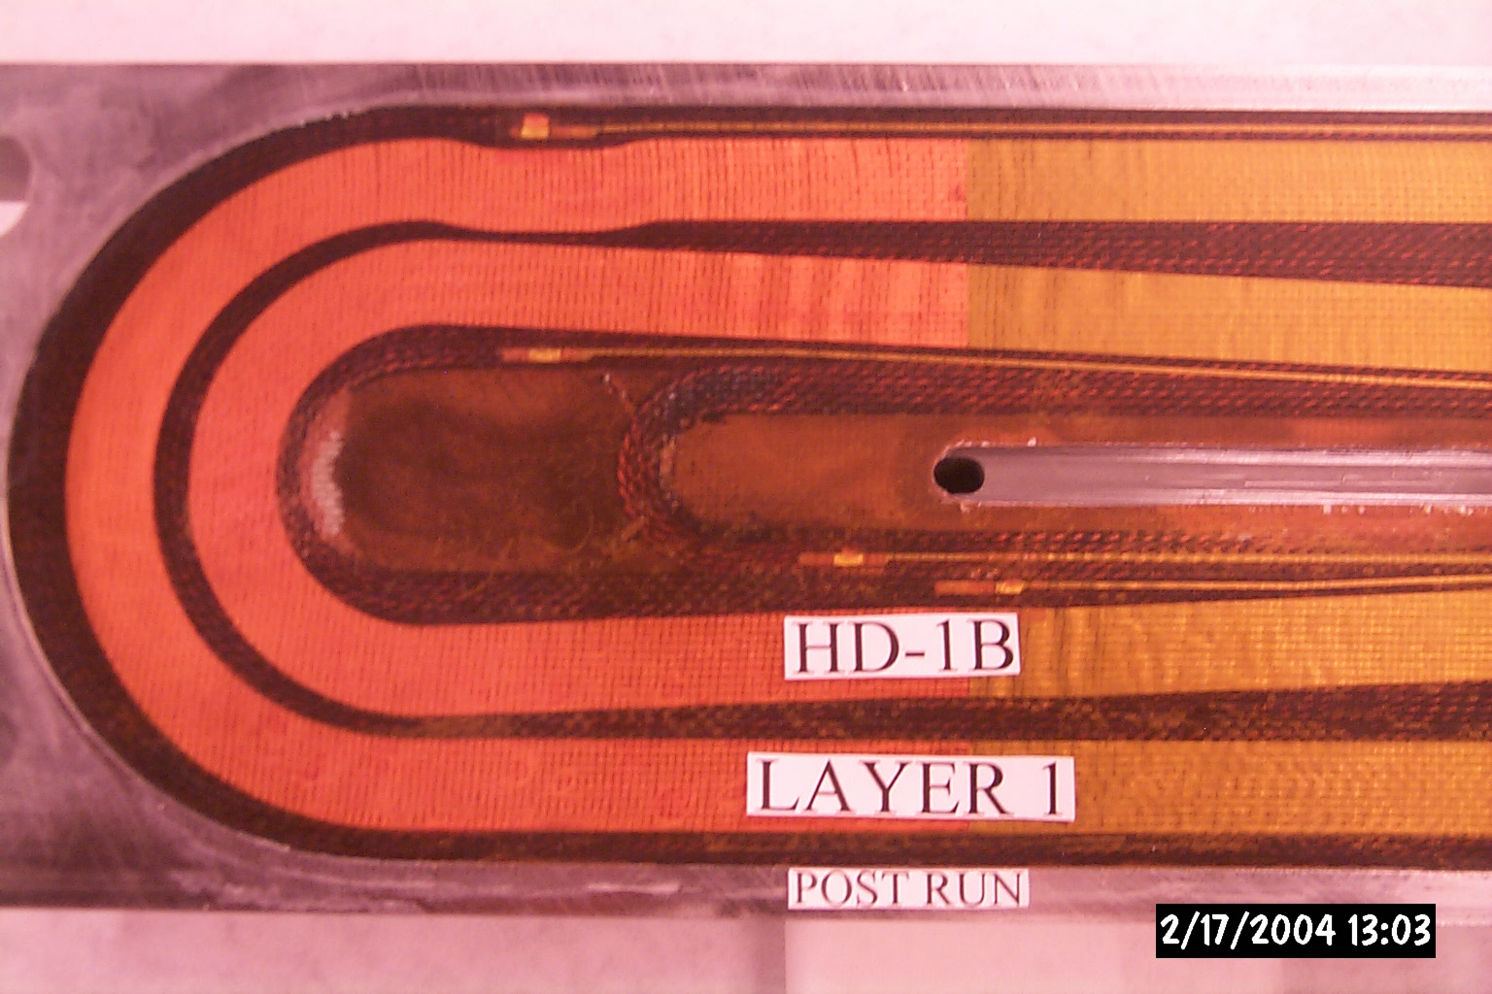
Axial displacements and quench location (HD1, TQ)
Epoxy discoloration
11
17
15
9
25
14,19
18
~20
32
6
~24
27
Gap: 80 μm
Coil 7
Broken fibers
S. Caspi
11

Slide 12
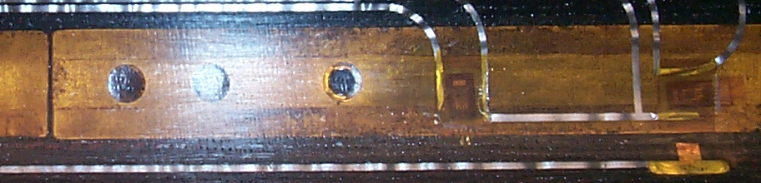
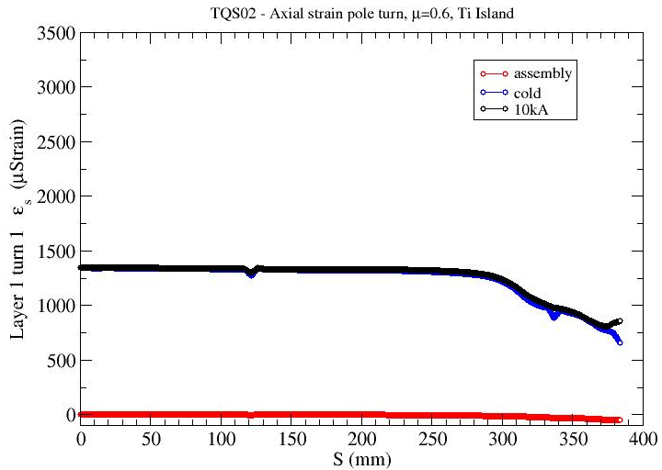
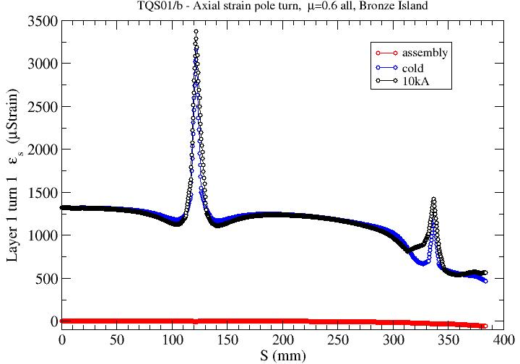
Conductor axial Strain - Bronze versus Ti
Gap
Island Gaps
SG-Z
SG-Theta
Axial tension in
bronze-islands is a source of localized strain in the coil near gaps.
TQS02 , Ti island, friction=0.6
TQS01/b, Bronze island, friction=0.6
S. Caspi
12

Slide 13
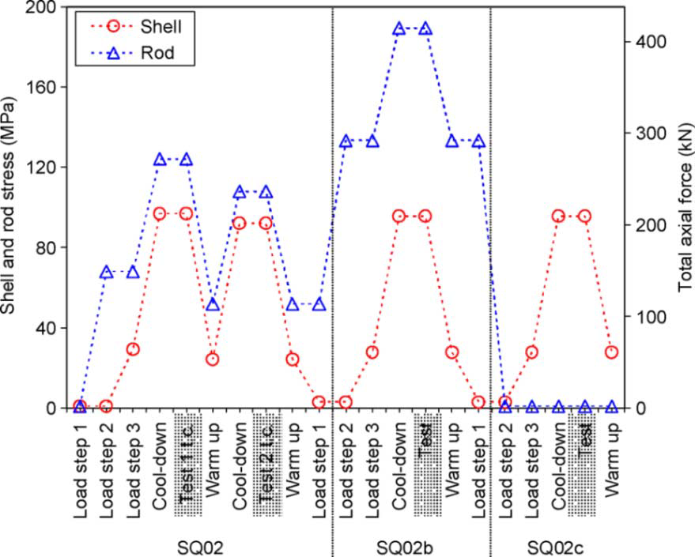
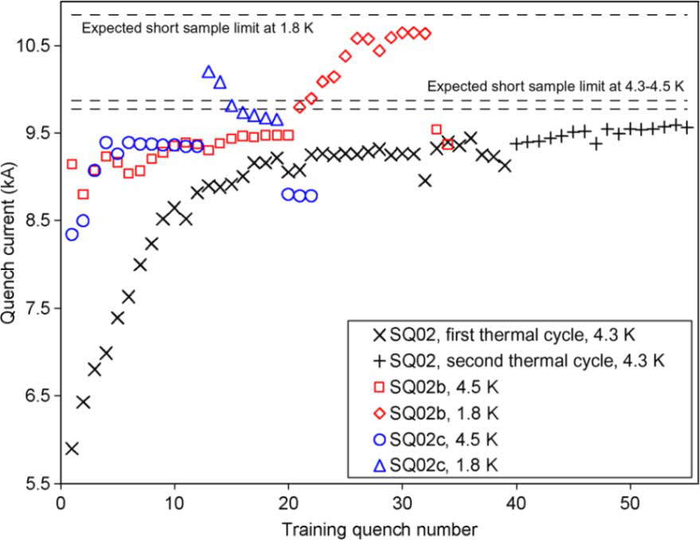
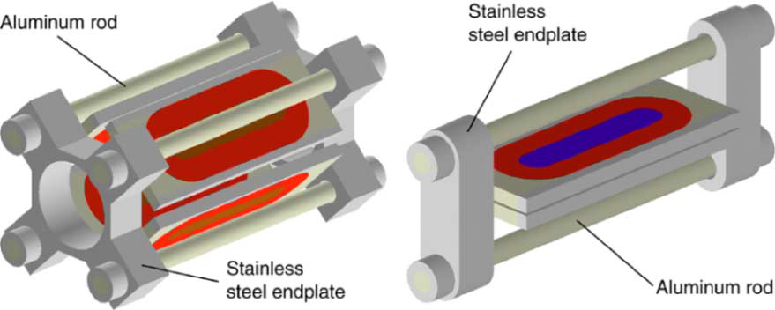
SQ02 axial support system
Fz @ Iss = 0.37 MN/end
P. Ferracin et al “Effect of Axial Loading on Quench Performance in Nb3Sn Magnets”
IEEE TRANSACTIONS ON APPLIED SUPERCONDUCTIVITY, VOL. 18, NO. 2, JUNE 2008
S. Caspi
13

Slide 14
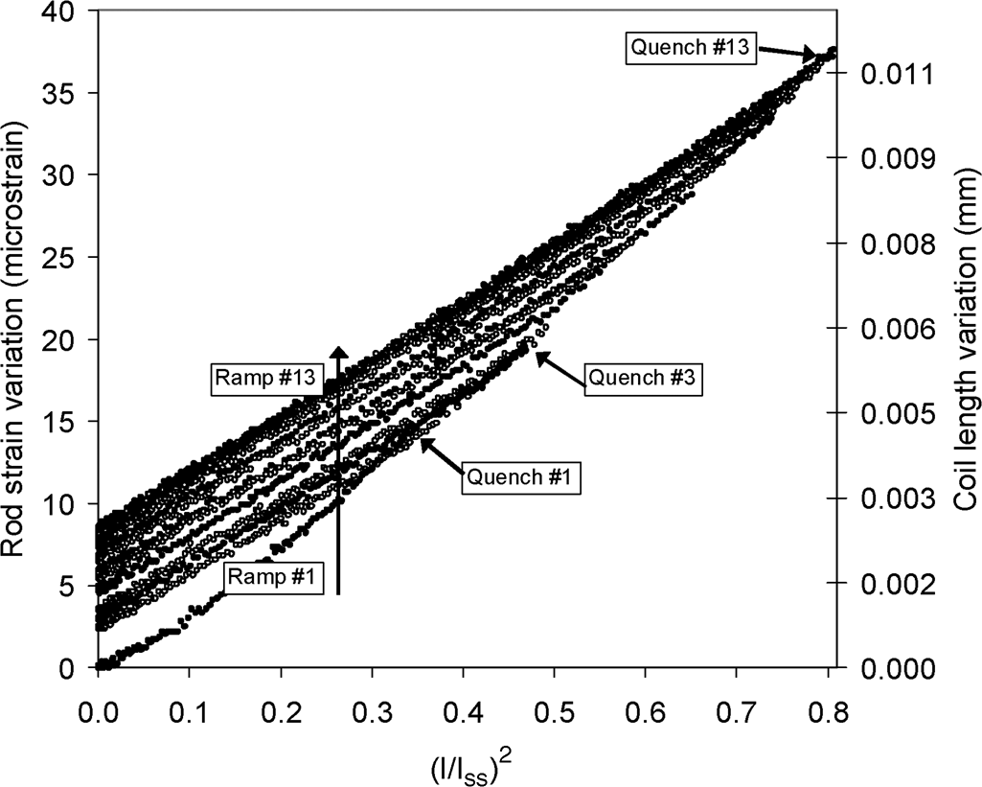
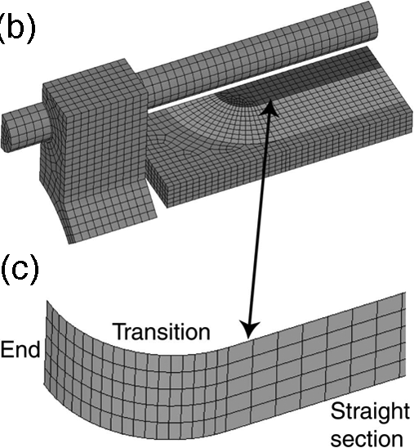
SQ02 - Ratcheting Model
frictional stress and sliding between coil and island result in an energy dissipation that quench the magnet
SQ02 geometry with contact region between coil and island
Measured rod strain as a function of the Lorentz force.
P. Ferracin, S. Caspi, and A. F. Lietzke “Towards Computing Ratcheting and Training in Superconducting Magnets” IEEE TRANSACTIONS ON APPLIED SUPERCONDUCTIVITY, VOL. 17, NO. 2, JUNE 2007
S. Caspi
14

Slide 15
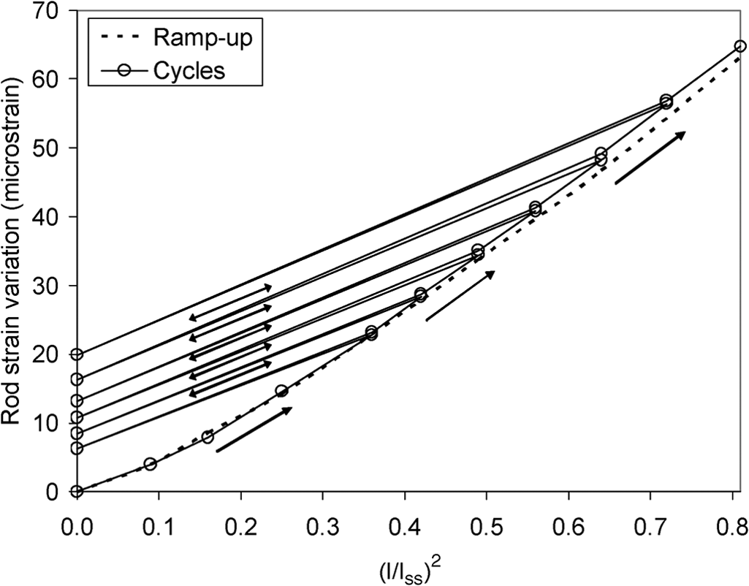
Ratcheting Model
SQ02 geometry with contact region between coil and island
Computed variation of rod strain as a function of the Lorentz force.
S. Caspi
15

Slide 16
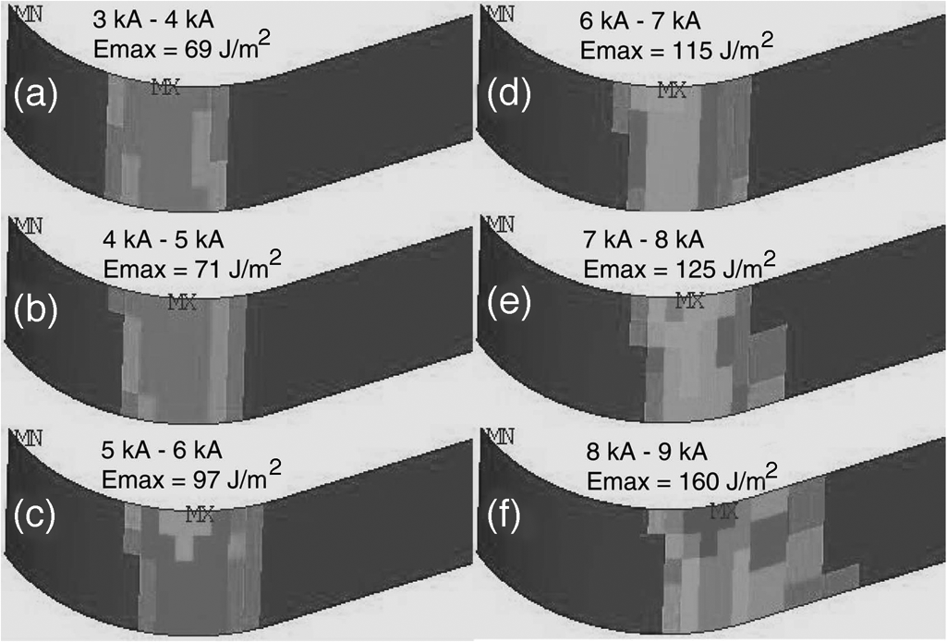
Ratcheting Model
SQ02 geometry with contact region between coil and island
Frictional energy (J/m2 ) dissipated during excitation from 3 kA to
9 kA in steps of 1 kA. Emax is the peak frictional energy dissipated in one step.
S. Caspi
16

Slide 17
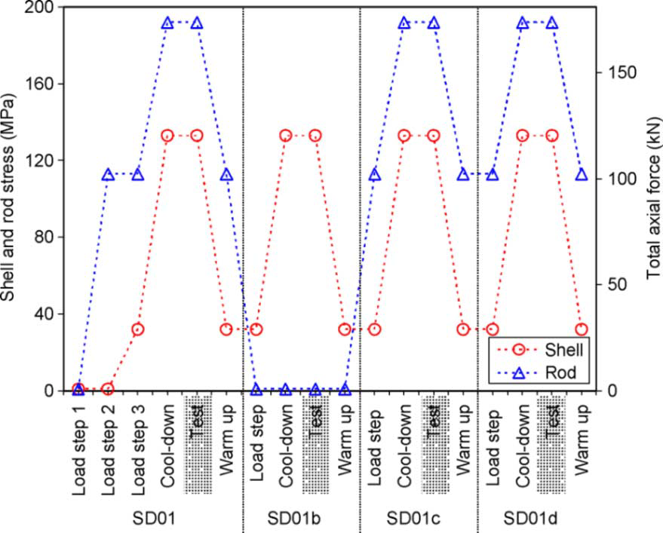
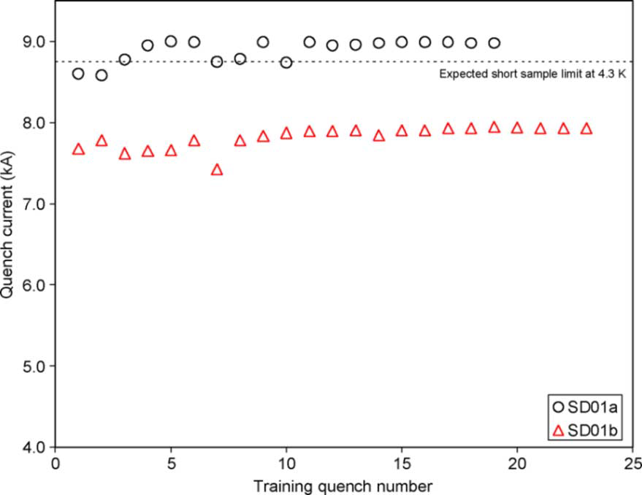
SD01 axial support system
Fz @ Iss = 0.17 MN/end
SQ02 ansdSD01 show a clear degradation in training performance with no axial support
S. Caspi
17

Slide 18
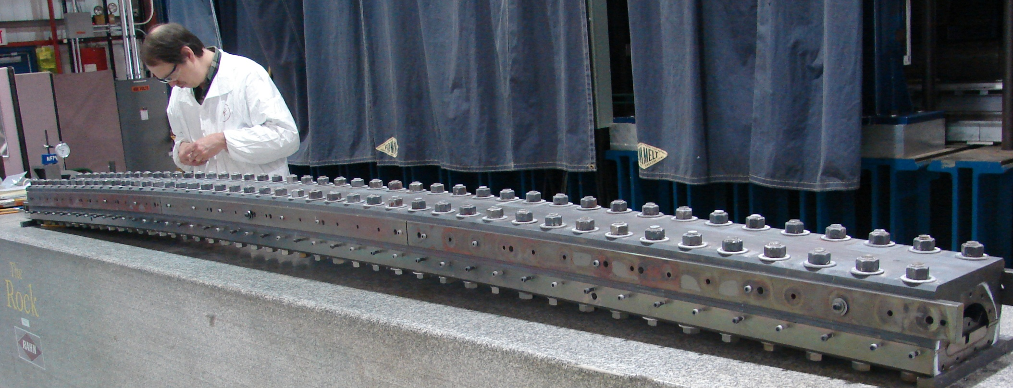
LQ – 3.7 m long quad for LARP
A 3.4 mm bowed reaction fixture (using ONE top plate) after heat treatment
Coil is unrestrained axially.
“Development and coil fabrication for the LARP 3.7-m Long Nb3Sn Quadrupole” 19 August 2008
S. Caspi
18

Slide 19
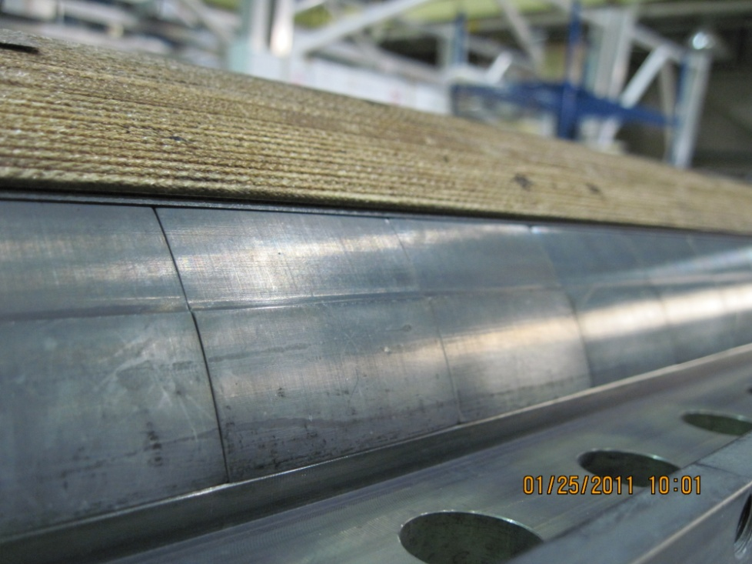
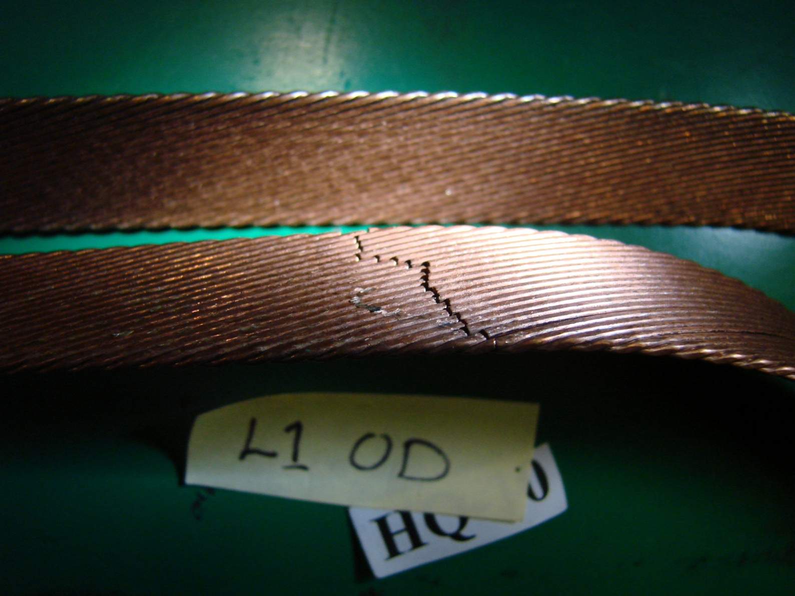
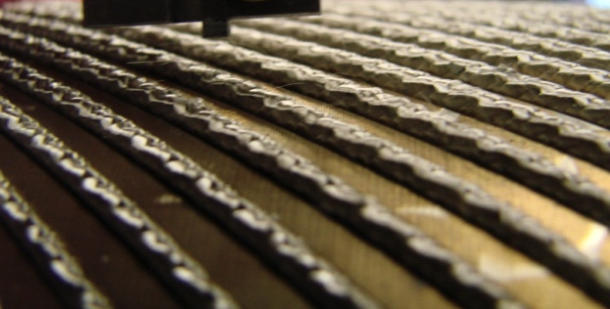
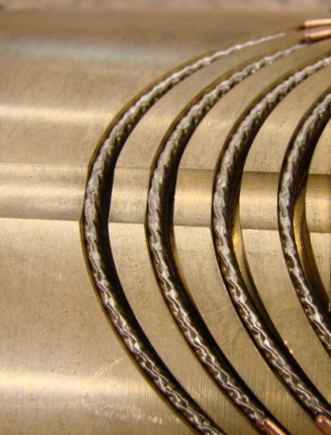
HQ coils after reaction
HQ13
Coil #10 -Broken strands during reaction
What is the impact of winding tension ?
Coil springing out of reaction tooling even with one turn less
No evidence of Sn leak suggests breakage occurred after reaction was completed
CCT3
CCT4
Cable remains below surface with gradual increase in channel size (1.65 mm)
Cable springing out of mandrel channel Reaction - Bronze Thermal expansion dominates cable length (~1%)
The CCT cable is wound without tension
S. Caspi
19

Slide 20
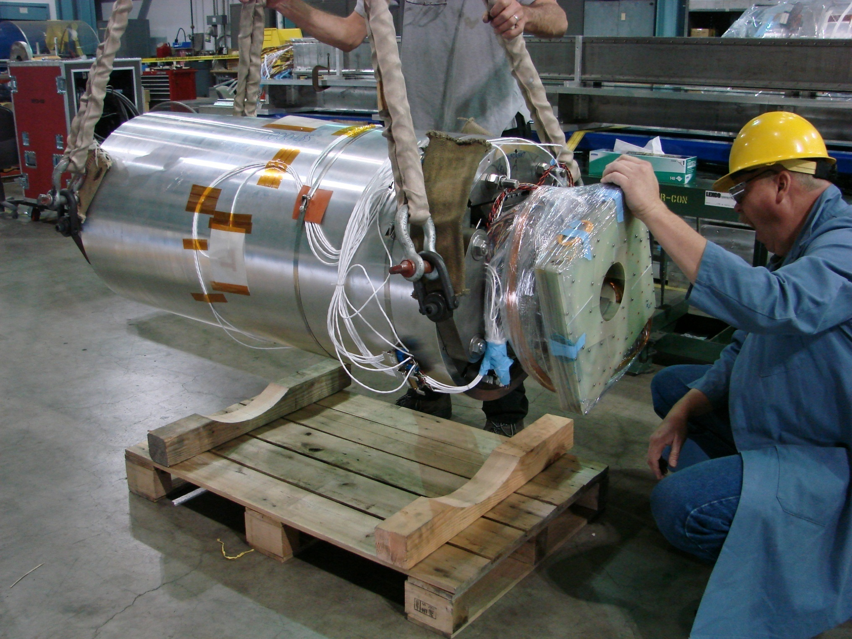
HQ - 3D mechanical analysis
Aluminum rod tension and coil-pole
Pre-loading for 219 T/m
  E.m. force: 1.37 MN
Pre-loading for 170 T/m
  E.m. force: 0.82 MN
  620 kN applied at 4.2 K
120 mm bore
1.9 K - 219 T/m, 14.9 T
S. Caspi
20

Slide 21
Mechanical analysis
Axial stress in the pole
Measured
TQS01a - Bronze islands
TQS02a - Titanium islands
Calculated
S. Caspi
21

Slide 22
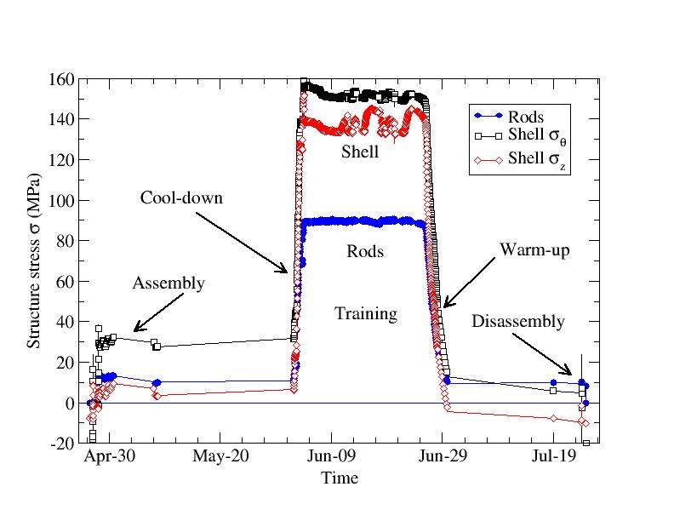
Mechanical analysis
TQS02
Shell and rods maintain stress during operation
S. Caspi
22

Slide 23
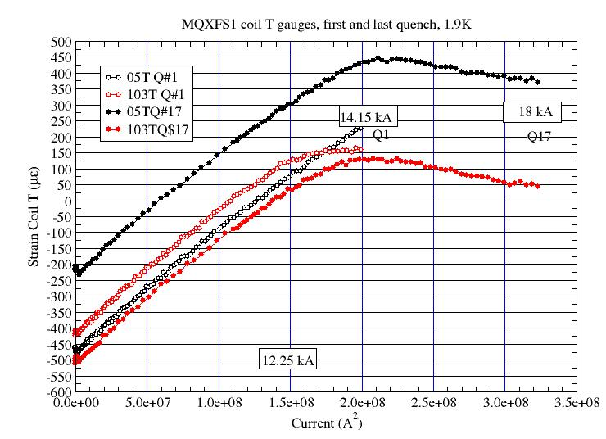
Coils Island azimuthal gauges (150mm MQXF)
Strain should behave linear with I^2
Coils tare away from poles when pre-stress is insuffecient
S. Caspi
23

Slide 24
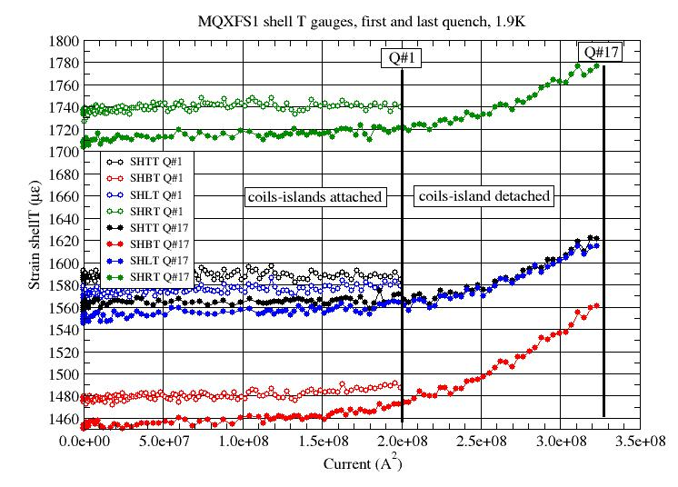
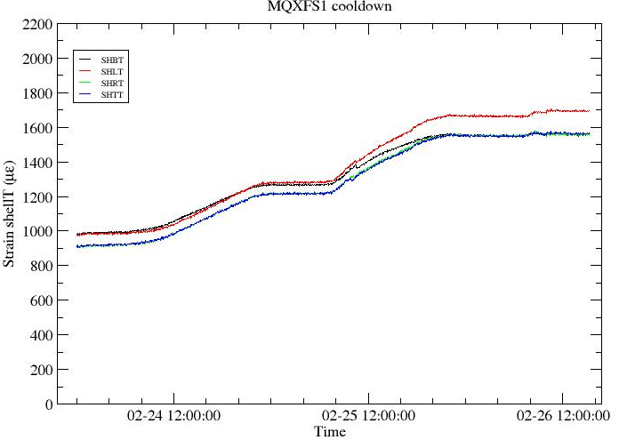
Shell azimuthal gauges (150mm MQXF)
Strain should behave linear with I^2
Shell azimuthal strain should not change as long as coils-islands are bonded
Shell strain increases once detachment takes place
Cool-down
S. Caspi
24

Slide 25
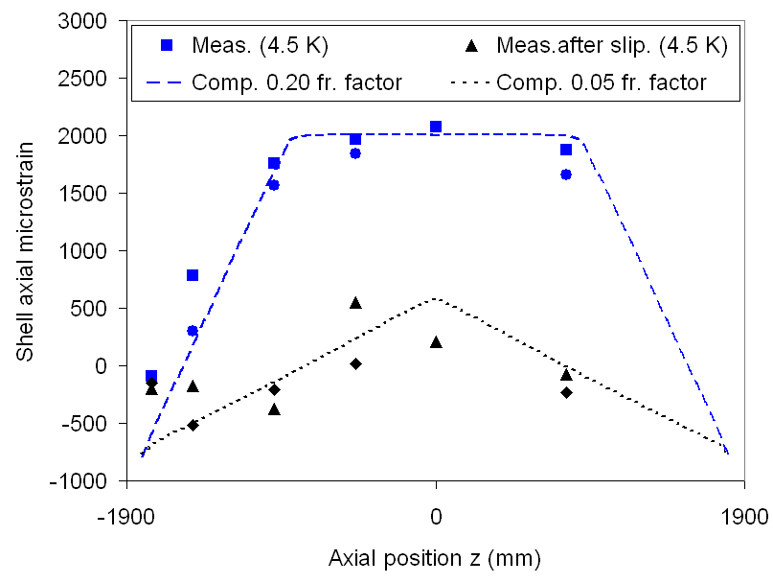
LRS01 Axial strain – long magnets
Shell shrinks more than yoke
Friction limits the shell contractions
Strain at 4.5 K consistent with 0.2 friction model results
During excitation e.m. forces induced slippage
S. Caspi
25

Slide 26
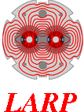
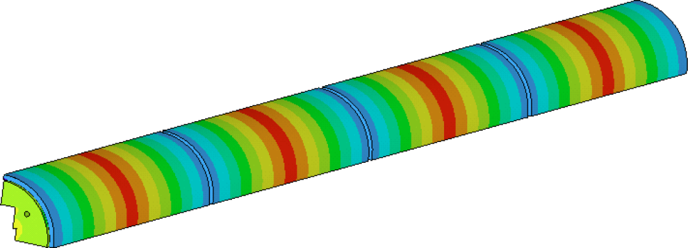
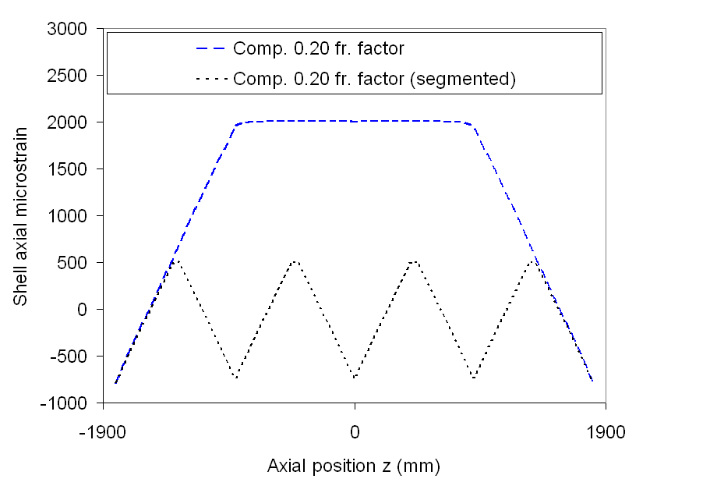
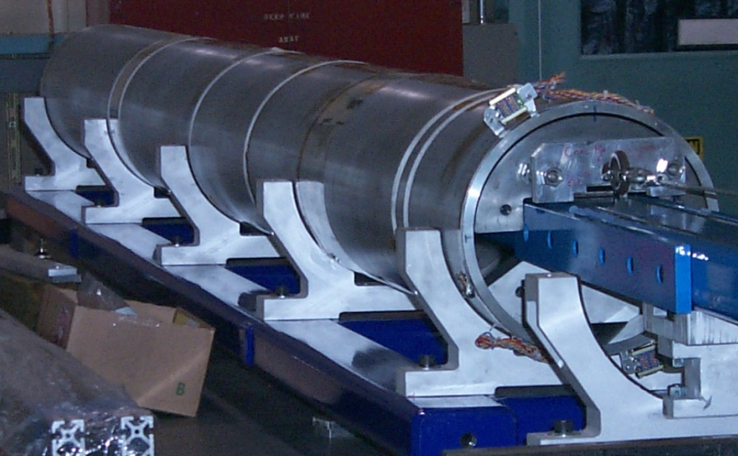
Segmented Shell in LRS02
Shell was divided in 4 segments
No axial strain accumulation
Required for very long shells
Factor of 2 improved homogeneity
Increased field and no slippage
96% SSL with minimal training
S4
S3
S2
S1
LRS01
LRS01b
Structure re-assembly with segmented shell
S. Caspi
26

Slide 27
THANK YOU
CERN, WAMSDO May 2008
27
Notes:
5/16/18
s_caspi@lbl.gov
27

Slide 28
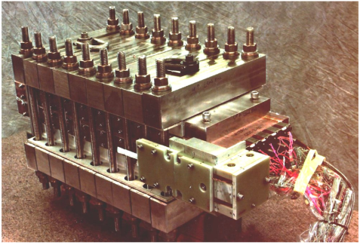
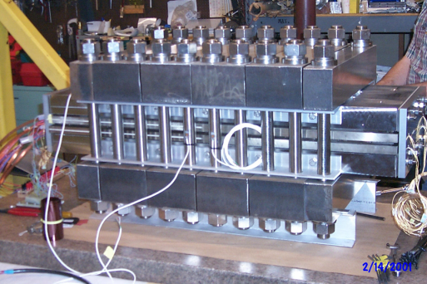






The road to shell structures at LBNL
SQ01 short quad
RD2 - 6 Tesla
RT1 - 12 Tesla
SM-01 - 12 Tesla
TQS, quad
RD3-b - 14.5 Tesla
HD1 - 16 Tesla
LR01 3.6 m long cc, 11.5 T, (2007)
S. Caspi
28
Notes:
Added two more to list since November DOE review. Much simpler than D20.

Slide 29


Technology Quadrupole Shell - TQS
Aluminum shell over iron yoke
Assembly with bladders and keys
Low pre-stress during assembly
High pre-stress with cool-down
Reusable structural components
CERN, WAMSDO May 2008
29
Notes:
5/16/18
s_caspi@lbl.gov
29

Slide 30

3D mechanical analysis
Axial pre-load
E.m. axial force
  2.8 MN
Room temperature pre-load
  Rod stress: 150 MPa
  – 1.7 MN
  Provided by 150-200 t piston
4.2 K pre-load
  Rod stress: 260 MPa
  – 2.8 MN
  Provided to end-shoes
  and wedge (glued)
Paolo Ferracin and Attilio Milanese March 2012
S. Caspi
30

