Slide 1

Synchronization and Sharing Services in IHEP
Qi Mengyao ,Lin Tao
On behalf of Computer Center, IHEP
qmy@ihep.ac.cn

Slide 2
Contents
IHEP Introduction
IHEPBox at IHEP
Data Analysis Service
Ongoing work
Summary, Plans

Slide 3
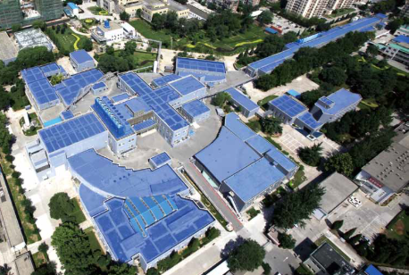
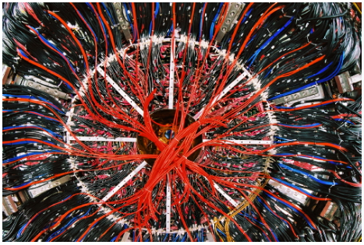
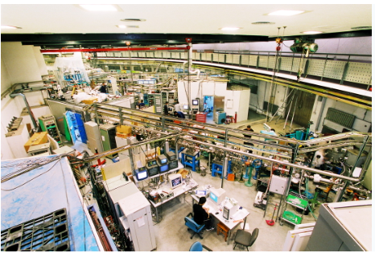
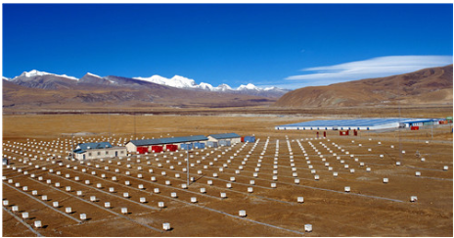
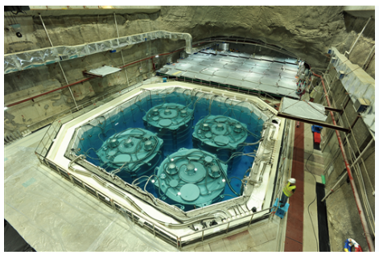
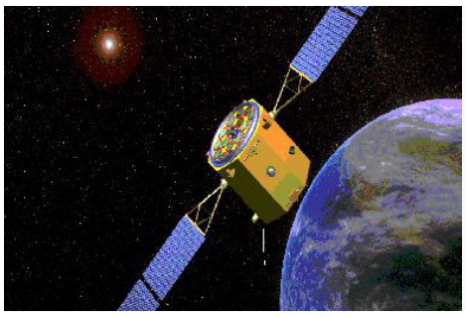
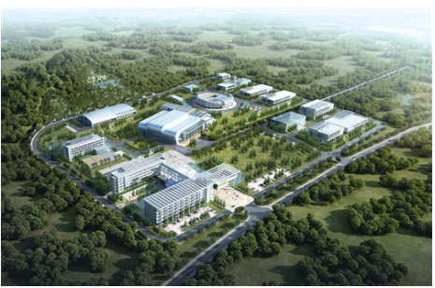
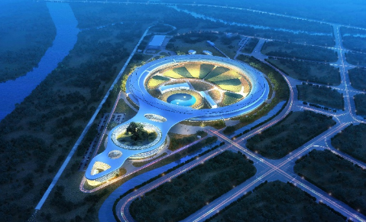
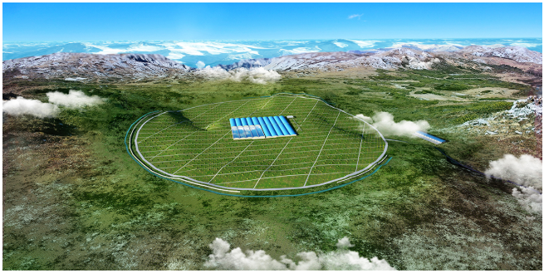
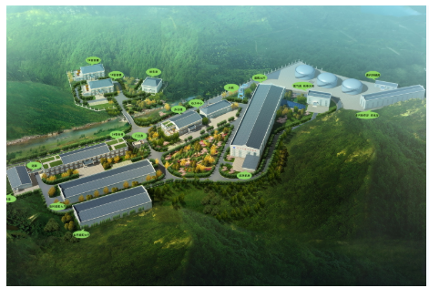
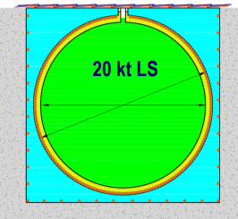
Major Experiments at IHEP
IHEP: The largest fundamental research center in China
IHEP serves as the backbone of China’s large science facilities
BEPC & BEPCII
BES III
Beijing Spectrometer III
Beijing Synchrotron Radiation Facility
Yangbajing Cosmic Ray Observatory
Daya Bay Reactor Neutrino experiment
HXMT
Hard X-ray Modulation Telescope
CSNS
China Spallation Neutron Source
HEPS
High Energy Photon Source
LHAASO
Large High Altitude Air Shower Observatory
JUNO
Jiangmen Underground Neutrino Observatory
Notes:
Beijing Electron Positron Collider (BEPCII/BESIII)
Yangbajing Cosmic Ray Observatory (ASg & ARGO)
Daya Bay Neutrino Experiment
China Spallation Neutron Source (CSNS)
Hard X-ray Modulation Telescope (HXMT)
Accelerator-driven Sub-critical System (ADS)
Jiangmen Neutrino Underground Observatory (JUNO)
Large High Altitude Air Shower Observatory (LHAASO)
High Energy Photon Source (HEPS)
Under planning: XTP, HERD,CEPC …

Slide 4
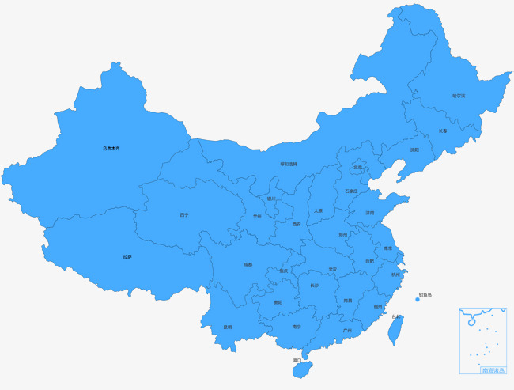
Major Experiments at IHEP
BEPCII/BESIII
  5PB data in 5 years
DYB
  400TB per year data collected
JUNO
  ~2PB raw data per year
LHAASO
  ~6PB raw data per year
  accumulate 20PB+ in 10 years
HXMT
Atlas and CMS Tier2 site
  940TB disk, 1088 CPU cores
lustre
BEPCII/BESII
CEPC
LHAASO
CSNS
JUNO
EOS
DYB

Slide 5


IHEPBox at IHEP
IHEPBox provide a cloud synchronization service
  Available for all IHEP users
  Synchronize files (data at IHEP) and data access
  Easy way to share with other users
  All major platforms supported
  Based on ownCloud integrated with EOS

Slide 6
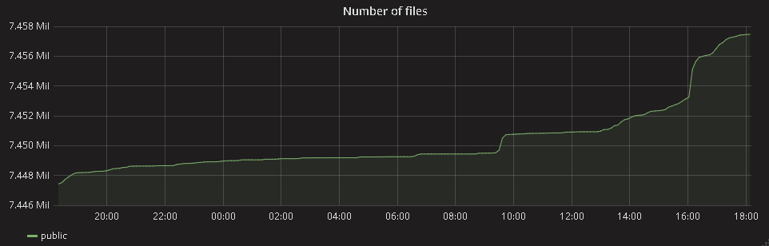
IHEPBox Service Numbers
Fast growing service
  Add-ons to integrate new ways to interact with IHEPBox , such as documents/galleries/calendar/activity…
  Large and growing user base
  8K+ users, 100GB per user
  160 TB ,used 42TB
  17M+ files

Slide 7
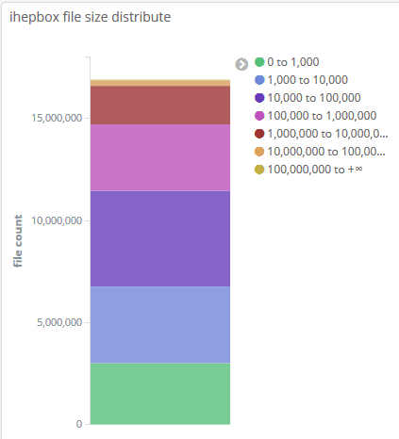
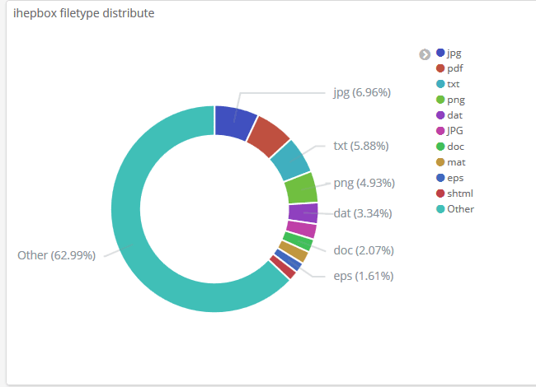
IHEPBox Service Numbers
7

Slide 8
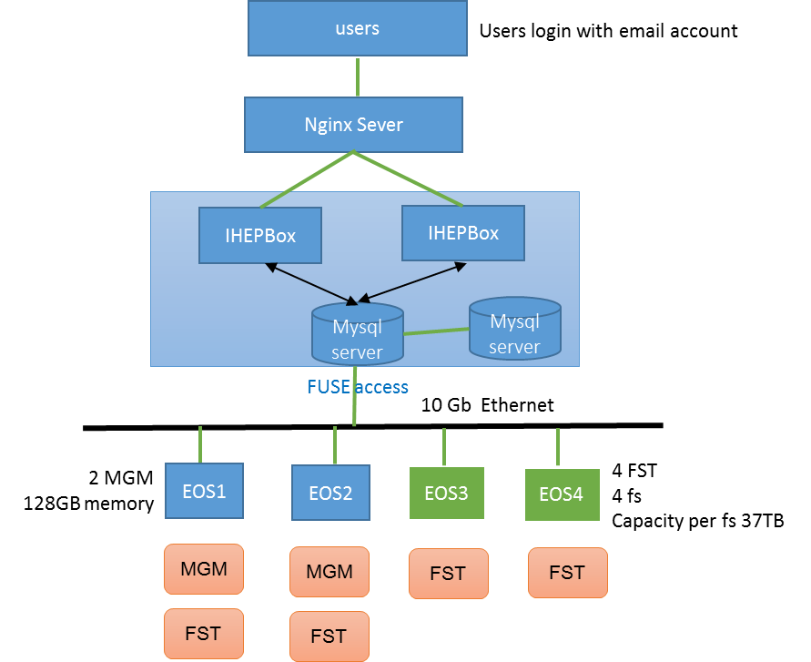
IHEPBox at IHEP
Users
  IHEP LDAP users
  Local users
Application Service
  1 * Nginx
  2 * IHEPBOX Servers
Data Storage
  4 * fst
  Two replication
  2 * Mysql servers

Slide 9
Data analysis service
Physics analysis tasks is challenge due to “big data” (PB scale).
A physics analysis task is split into many jobs manually, while each job will process a part of dataset.
For the physics analysis, the same dataset will be loaded many times due to iteration.
1、Write code, edit job option and update selection criteria.
2、Submit batch jobs.
3、After jobs finished, plot data, analyze result.
4、Go to step 1.
Submitting jobs and plotting are the most time consuming part.
Loading dataset many times also cause I/O performance.
Q: How to reduce the iteration time? A: “Analysis as a Service”

Slide 10
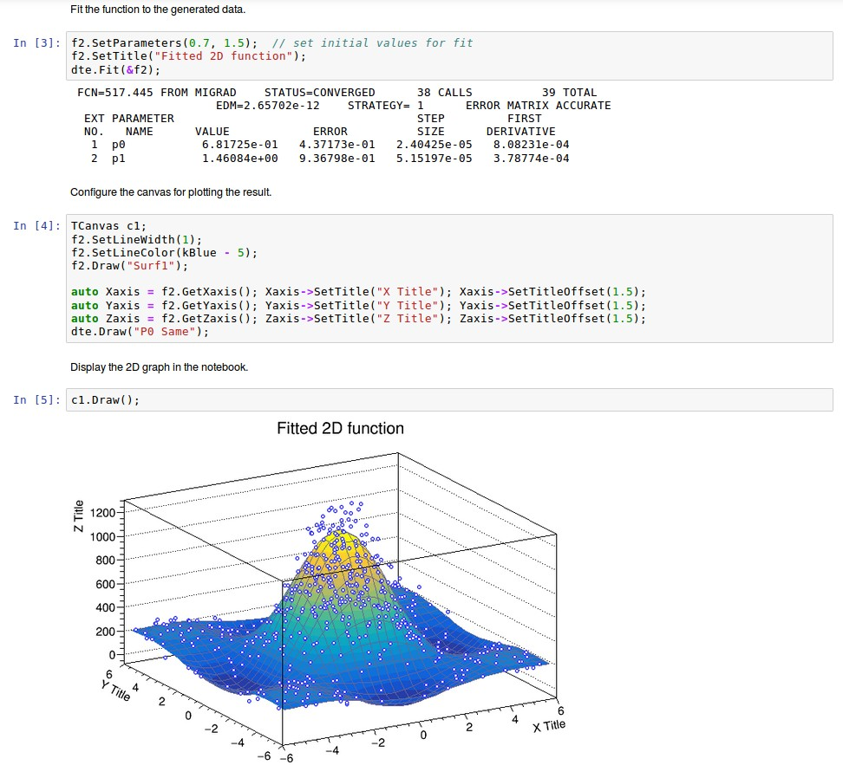

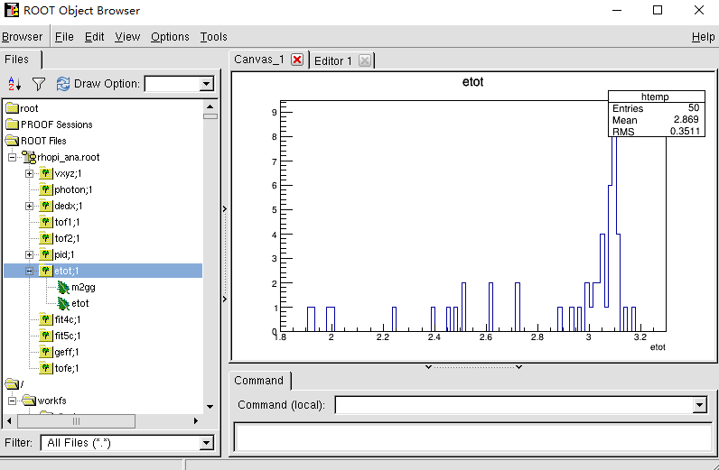
Analysis workflow
Web browser
AFS/SSO Auth
SSH client
X Server for visualization
web-based analysis service
Submit batch jobs
Login Node
Login Node
Login Node
HTCondor
Scheduler
Common software
Middleware
Computing facilities
/afs
/besfs
Computing Node
Powerful computing resources
Computing Node
Computing Node
Storage

Slide 11
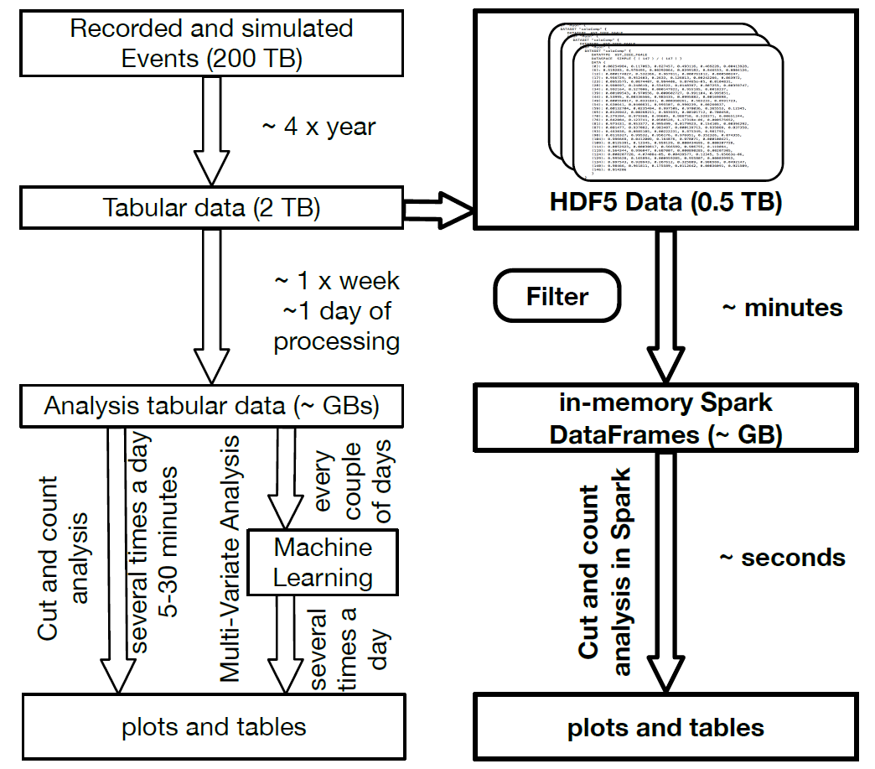
Using “big data” technology: in-memory analysis.
Read once, Analysis multiple times
Data structure become more important.
Traditional analysis
Event by event processing.
Split by jobs, then merge results.
Intermediate files are created for each stage.
I/O bottleneck.
“big data” analysis
In memory analysis.
The properties are processed parallel.
Join operation later.
# RDataFrame in ROOT: https://root.cern.ch/rdataframe-session-chep-2018-0

Slide 12
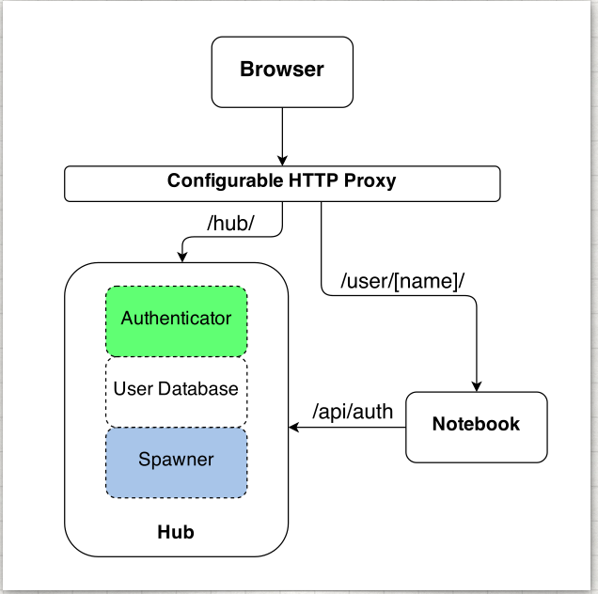
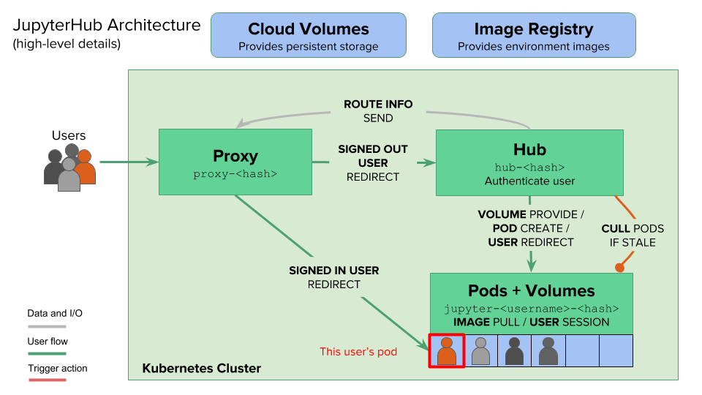
Architecture: +
Kubernetes manages the computing resources.
On-demand, scalable computing.
The backend can be also integrated with HTCondor.
JupyterHub manages multiple instances of the single-user Jupyter notebook.
Authenticates users.
Spawns notebooks for users.

Slide 13
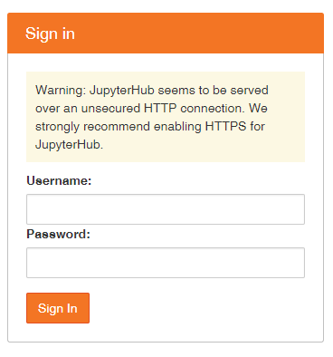
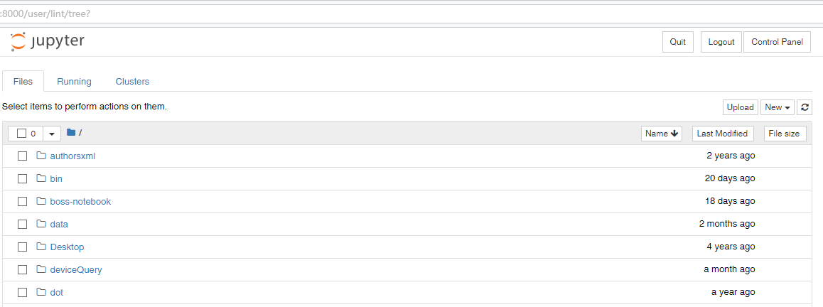
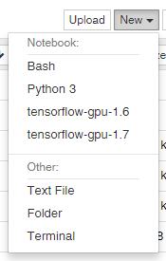
Login using AFS
account.
Current AFS status
2521 IHEP AFS users
Upload your code/data.
Notebook in different kernel.
Normal file
Folder
Terminal

Slide 14


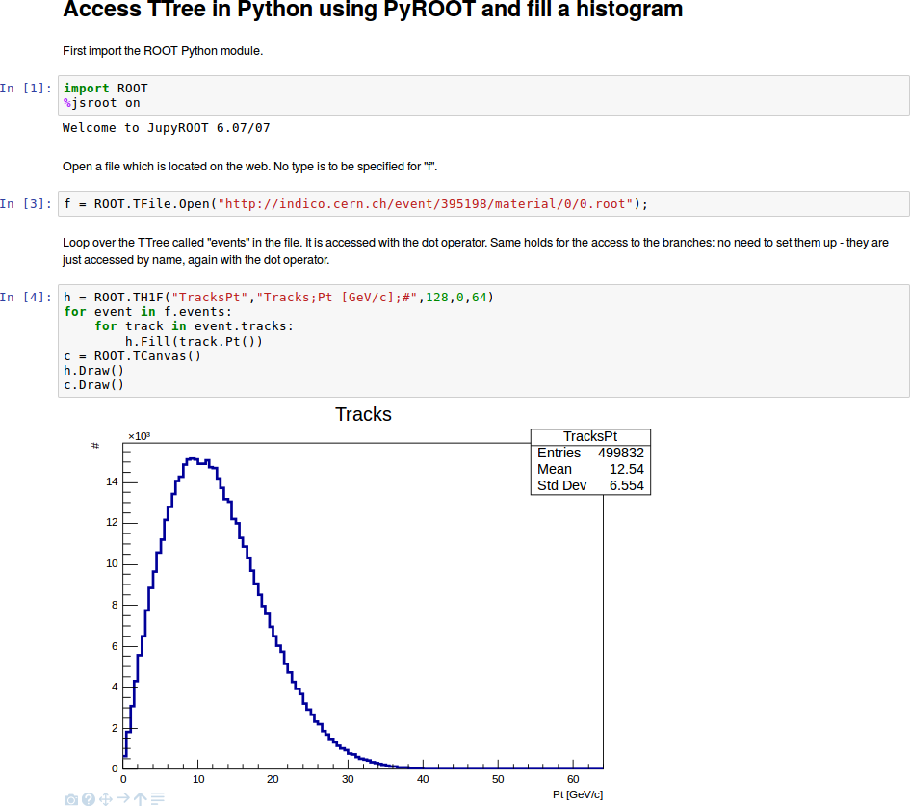
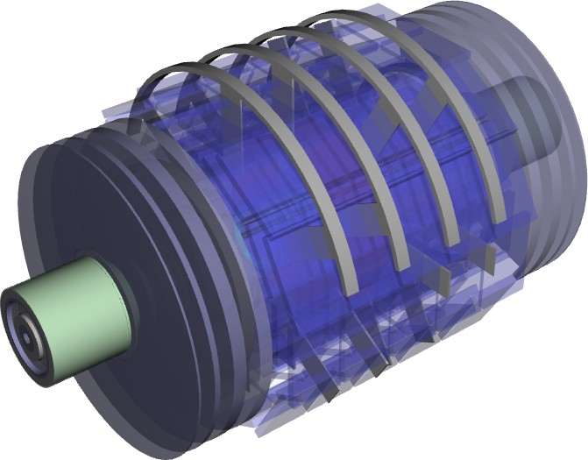
Multiple language support: C++ and Python
ROOT Kernel extension.

Slide 15
Status
Jupyter software stack is deployed at AFS.
Users can start Jupyter and ROOT 6 in their own space.
Setup JupyterHub in a virtual machine and setup Kubernetes in two blade servers.
Challenges
Need to klog manually to get AFS token.
Support multiple users and experiments.
Unified data access between SSH and Web.
How to benefit from “big data” technology.

Slide 16






Ongoing ：Cloud-based open platform
IHEP Auth User
Data, software and computing resources in the cloud. Only a web browser is needed!
Web Portal
IHEPBox
(User Files)
Authentication ：IHEP SSO
Infrastructure:
  Jupyter + IHEPBox + EOS
Software distribution: CVMFS
Storage, in two flavours:
  DATA : EOS and Lustre
  User Files: IHEPBox
Computing manager
C C C
EOS
(Data)
Lustre
(Data)
CVMFS
(Software)

Slide 17
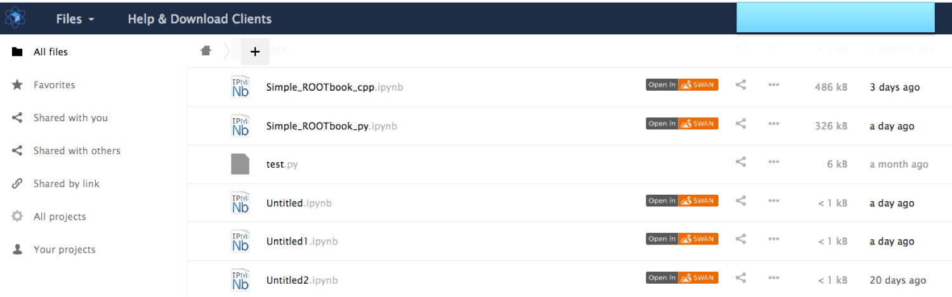
Ongoing ：IHEPBox Integration
Notebook can be opened in IHEPBox

Slide 18
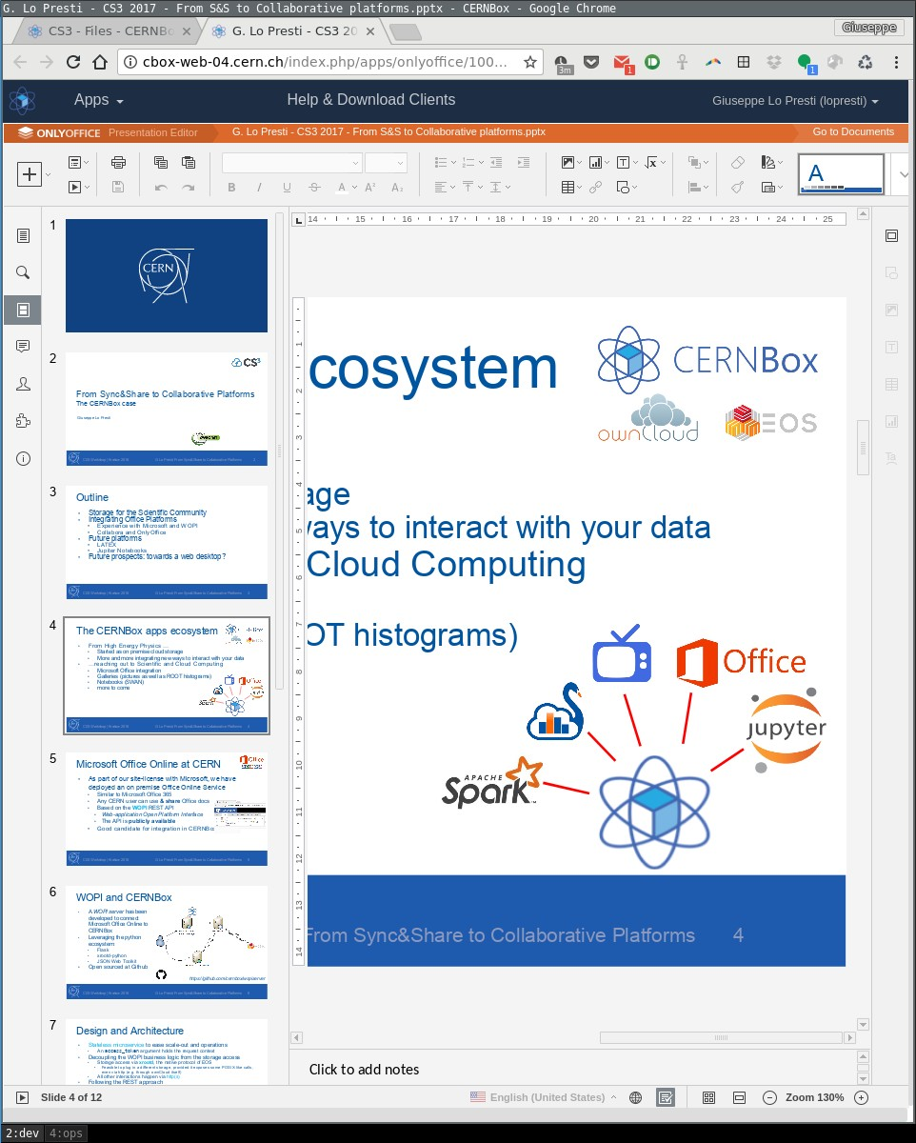
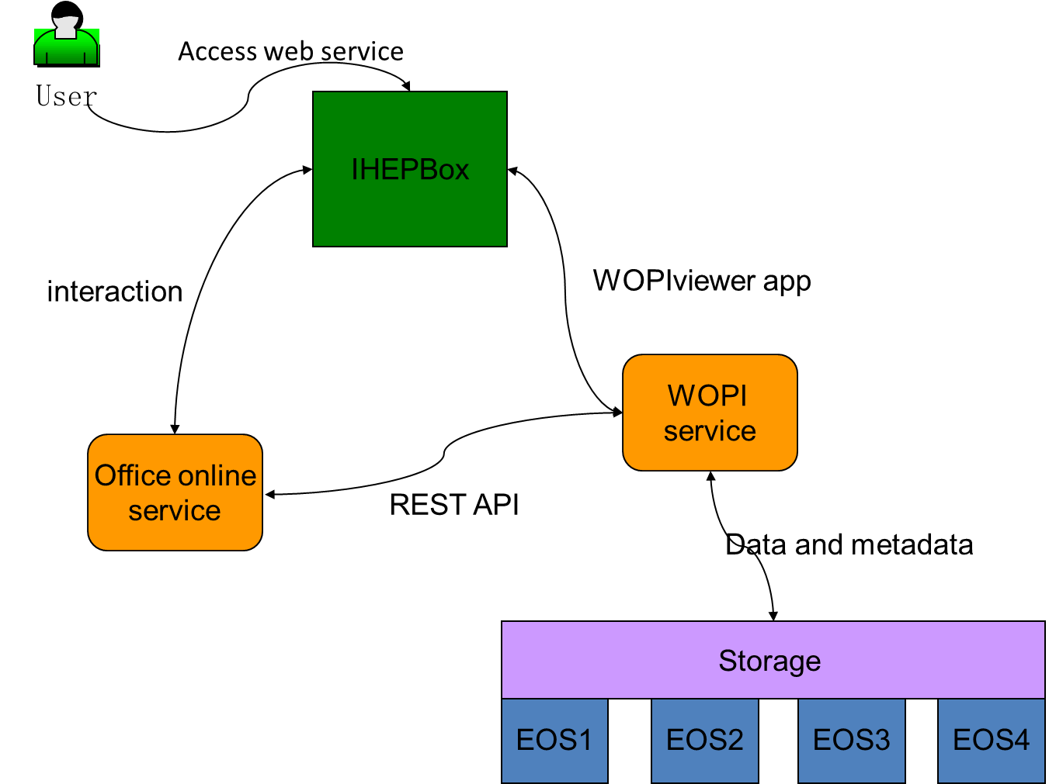
Ongoing ：IHEPBox and WOPI server
A WOPI server will be developed to connect Microsoft Office Online to IHEPBox

Slide 19
Summary , Plans
Prototype service available
  CVMFS for software distribution
  EOS、Lustre mass storage
  IHEPBox Synchronization and sharing
Future plans:
  Jupyter service for deployment ,integrate with IHEPBox
  Unified login accounts
  Experiments data, users’ data accessible on EOS
  Office online service available
  Integrate with experiments software
  Open to all users

