Slide 1

Onedata - Managing Data and Metadata in Hybrid Clouds
Presented by: Lukasz Dutka

Slide 2










WHO WE ARE?
Group of developers bringing hybrid cloud open source platform to life
6+ years devoted development
Our main goal is:
  to deliver data management platform for large scale and distributed problems
  to make the solution decentralized and eventually consistent in order build a mesh of data sources
  to deliver virtual file system for hybrid cloud
The work is supported by:

Slide 3


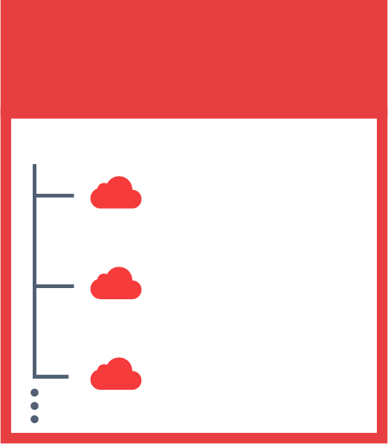

DATA IN HYBRID CLOUD ENVIRONMENTS
JOHN’S SPACES
SENTINEL 2
DEEP LEARNING
SARA’S SPACES
PUBLICATIONS
SENTINEL 2
SKY MAPS
MY DATA

Slide 4
MAIN PROBLEMS ADDRESED BY ONEDATA PLATFORM
Lock-in data collection available only locally on local POSIX file system –should be available in multi cloud hybird environments
Multi-protocol transparent access to data “[…] but we want POSIX”
High Throughput Data Transfers and Replication
On-the-fly remote data delivery
Replication on demand
Heterogeneity of storage technologies
Cache Management
High-throughput data processing
Authentication and authorization integrated with EDUGAIN
1
2
3
4
5
6
7
8
9

Slide 5


EXAMPLE - EMBL-EBI APPLICATION DEPLOYMENT
Cloud - OTC
Private EMBL Cloud - Hinxton
300 VMs
Local processing cluster 300 VMs
Each VM process 4 files at the same time
Connected to POSIX like, Globally Shared
Virtual File System via Oneclient
NFS Test Collection 26 TB
Full Collection size 1.5 PB
High Troughput ~10GB/s
Low Latency Access ~500µs
1 VM
Oneprovider
Local Cache
Ceph on 3 VMs
Capacity 20TB
10G Link
10G Link
GEANT
1 VM
Oneprovider

Slide 6
REAL DATA TRANSFERS BETWEEN HINXTON – OTC – ON THE FLY DATA DELIVERY FOR 24H OF DATA PROCESSING BY 1200 PARALEL JOBS ON 300 VMs
Experiment Specs:
DNA Sequences processing
1046 Input Files ~ 15 – 50 GB
Files represent DNA sequence data that’s compared in turn to each of 24 reference human genes
24 x 1046 = 25104 Jobs in the experiment
No Local Data on OTC Before Experiment starts
24 times of processing the same input fie makes caching very important
Data pre-staging before the experiment is possible but not needed, system automatically delivers needed blocks and optimize access

Slide 7
REAL DATA TRANSFERS BETWEEN HINXTON – OTC – ON THE FLY DATA DELIVERY FOR 24H OF DATA PROCESSING BY 1200 PARALEL JOBS ON 300 VMs
Experiment Specs:
DNA Sequences processing
1046 Input Files ~ 15 – 50 GB
Files represent DNA sequence data that’s compared in turn to each of 24 reference human genes
24 x 1046 = 25104 Jobs in the experiment
No Local Data on OTC Before Experiment starts
24 times of processing the same input fie makes caching very important
Data pre-staging before the experiment is possible but not needed, system automatically delivers needed blocks and optimize access

Slide 8
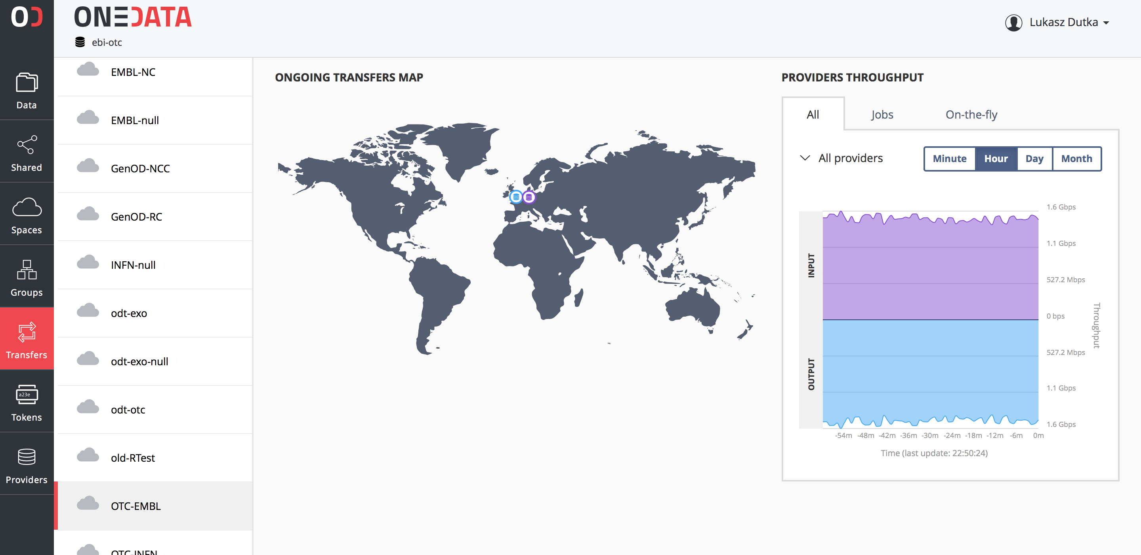
REAL DATA TRANSFERS BETWEEN HINXTON – OTC – ON THE FLY DATA DELIVERY FOR 24H OF DATA PROCESSING BY 1200 PARALEL JOBS ON 300 VMs
Experiment Specs:
DNA Sequences processing
1046 Input Files ~ 15 – 50 GB
Files represent DNA sequence data that’s compared in turn to each of 24 reference human genes
24 x 1046 = 25104 Jobs in the experiment
No Local Data on OTC Before Experiment starts
24 times of processing the same input fie makes caching very important
Data pre-staging before the experiment is possible but not needed, system automatically delivers needed blocks and optimize access

Slide 9
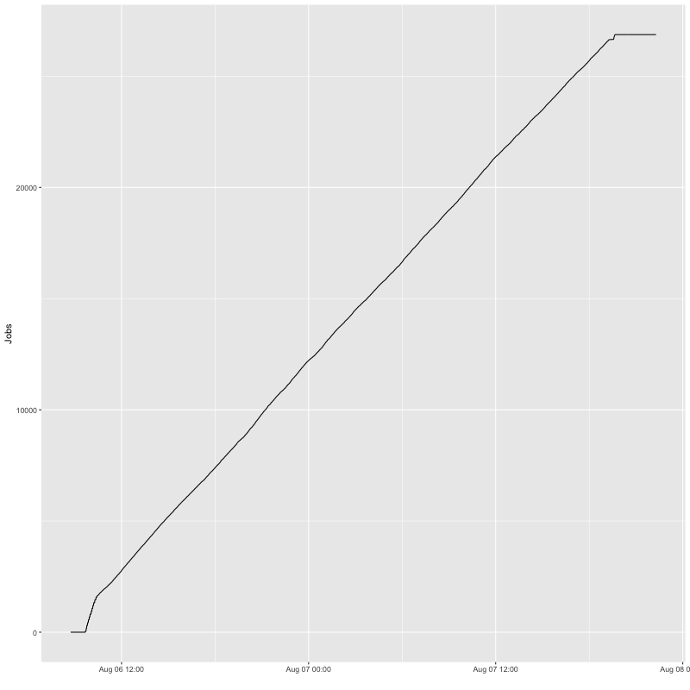
JOBS PROCESSING RATE WHEN DATA DELIVERED ON THE FLY

Slide 10
MULTI-CLOUD ENVIRONMENT
Private Cloud – INFN BARI
Cloud - OTC
Kubernetes 4 VMs
NFS Test
Collection 2.5 TB
Local Cache
Ceph on 4 VMs
Capacity 4 TB
High Troughput ~10GB/s
Low Latency Access ~500µs
1 VM
Oneprovider
1 VM
Oneprovider
GEANT
Cloud - EXOSCALE
10G Link
Kubernetes 4 VMs
Local Cache
Ceph on 4 VMs
Capacity 2 TB
High Troughput ~10GB/s
Low Latency Access ~500µs
1 VM
Oneprovider

Slide 11
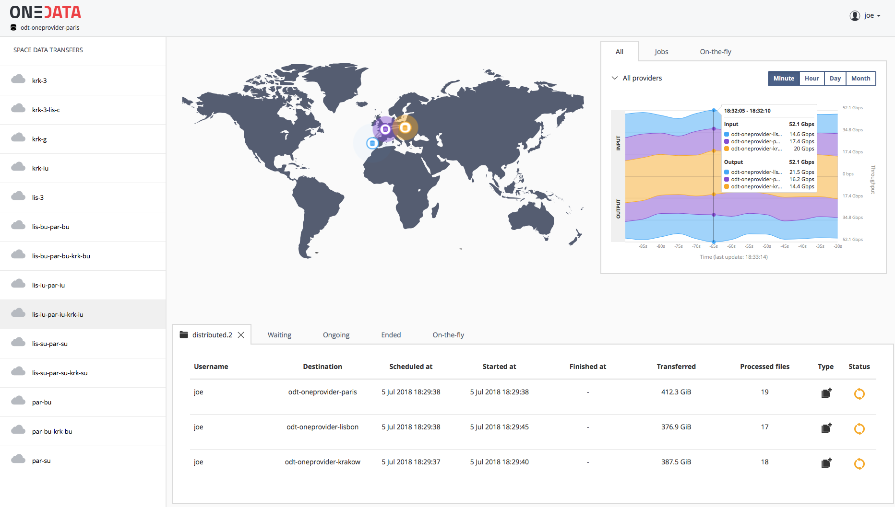
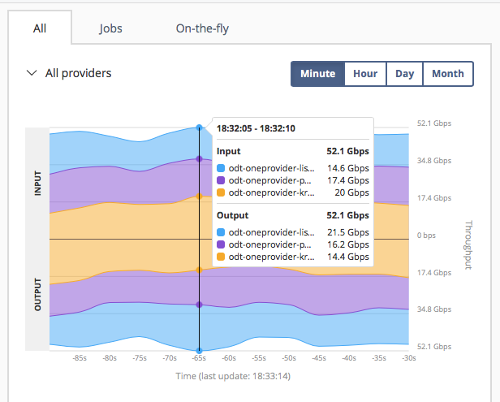
HIGH TROUGHPUT DATA MIGRATION IN PEER TO PEER MESH
Data Transfer Mesh
3 Oneproviders connected by 20+Gbit/s links
Transfer data between all them
Single VM Node per Provider
Linear scalability
Data Migration at combined
Throughput 56 Gbit/s

Slide 12
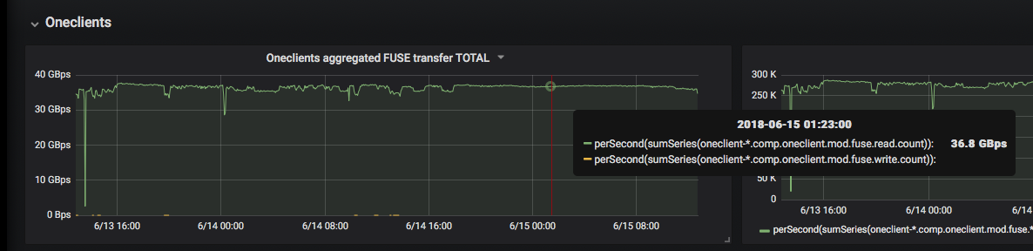
ONEDATA HIGH TROUGHPUT DATA PROCESSING ON HNSC
Onedata Transparent POSIX File System
Processing transparently cached data - 37GBytes/sec

Slide 13
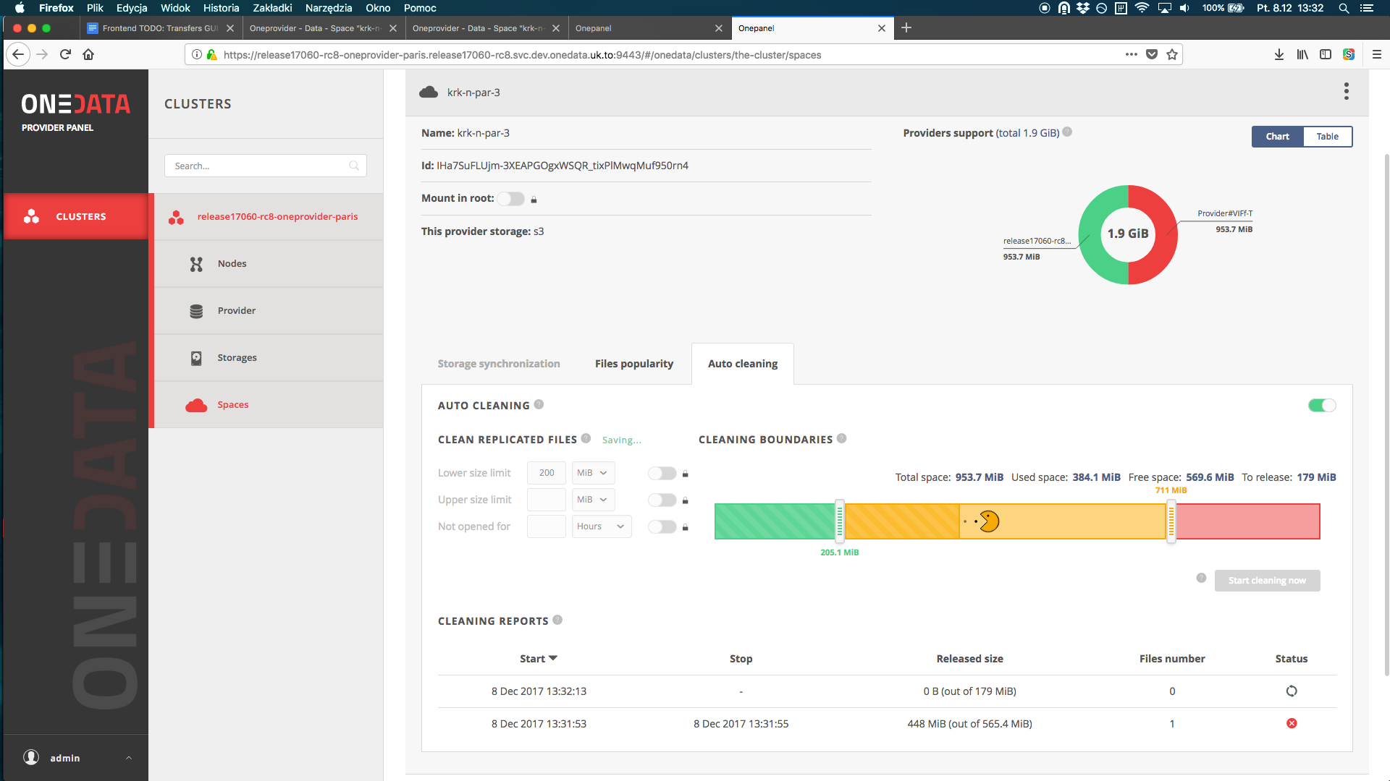
ONEDATA FILE POPULARITY AND SMART CACHING
Onedata can evict least important replicas
Based on file popularity

Slide 14
ONEDATA UNIFIED DATA
MANAGEMENT SERVICE
Sharing Existing
Data Sets
Hierarchical
Groups Synced
with IdPs
DOI/Handle
Minting
Adhoc
Grouping
WEB
GUI
My Data
External
Systems
No-Barrier
Data Sharing
Storage
Heterogeneity
Unified
HTTP
CDMI
API
Policy
Mgmt.
Multi-level
Scalability
REST
API
External
Systems
No Data Lock-in
Open Data Sharing
Many IdPs
Migration
between
Locations
LONG
POLLING
API
Multiple Replicas
Decentralization
Decoupled
Collections
Legacy
Applications
POSIX FILE
SYSTEM
Metadata Annotation
Fine Grain
Access Control
Other
API
Data
Discovery
Data Caching
Virtual
Filesystem
Distributed
Data

Slide 15
QUESTIONS?
Please visit:
www.onedata.org

