Slide 1
SWAN and its analysis ecosystem
D. Castro, J. Moscicki, M. Lamanna, E. Bocchi,
E. Tejedor, D. Piparo, P. Mato, P. Kothuri
https://cern.ch/swan
Jan 29th, 2019
CS3 2019 - Cloud Storage Synchronization and Sharing Services

Slide 2
Introduction

Slide 3

SWAN in a Nutshell
Analysis only with a web browser
  No local installation needed
  Based on Jupyter Notebooks
  Calculations, input data and results “in the Cloud”
Support for multiple analysis ecosystems
  ROOT, Python, R, Octave…
Easy sharing of scientific results: plots, data, code
Integration with CERN resources
  Sofware, storage, mass processing power

Slide 4
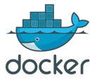


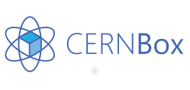


Integrating services
Infrastructure
Software
Storage

Slide 5
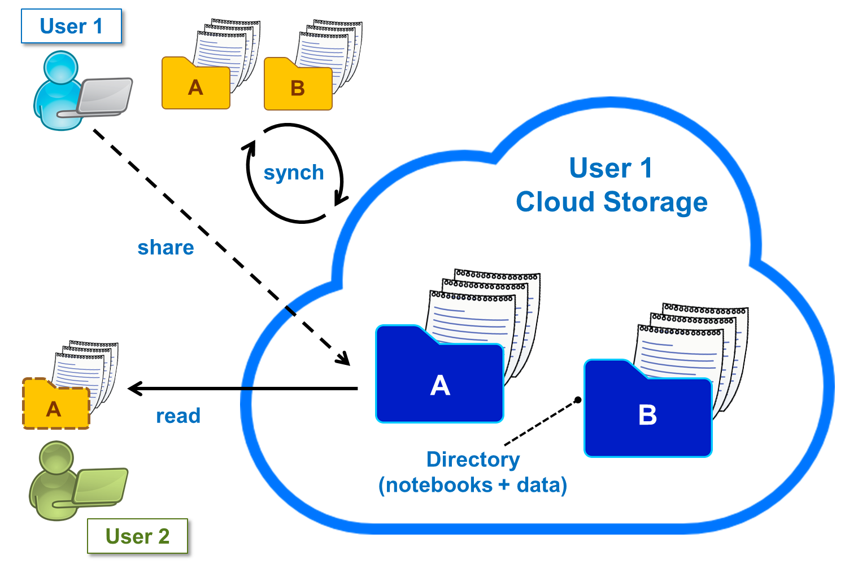

Storage
Uses EOS disk storage system
  All experiment data potentially available
CERNBox is SWAN's home directory
  Storage for your notebooks and data
Sync&Share
  Files synced across devices and the Cloud
  Collaborative analysis

Slide 6

Software
Software distributed through CVMFS
  ”LCG Releases” - pack a series of compatible packages
  Reduced Docker Images size
  Lazy fetching of software
Possibility to install libraries in user cloud storage
  Good way to use custom/not mainstream packages
  Configurable environment
User Software
Jupyter modules
LCG Release
CERN Software

Slide 7
Previously on last CS3 conference…

Slide 8
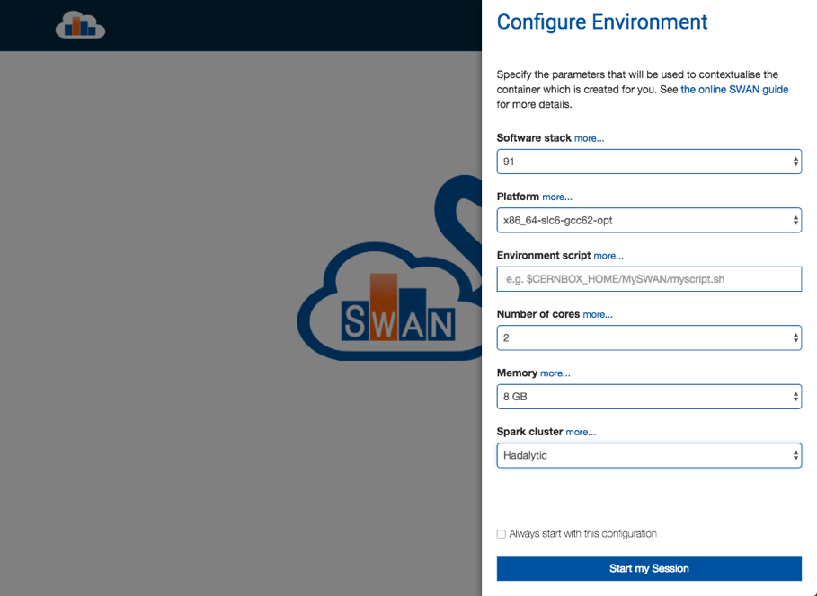
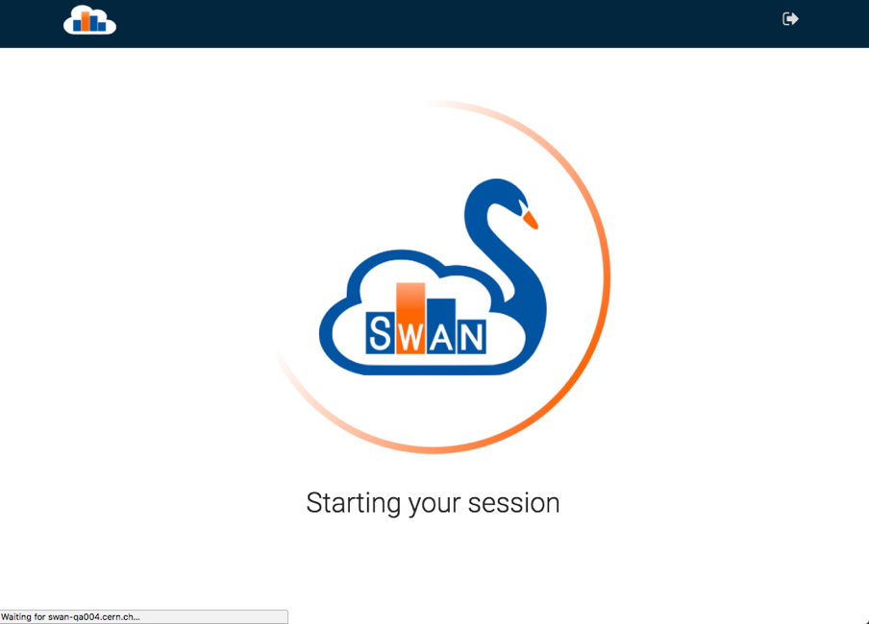
New User Interface

Slide 9
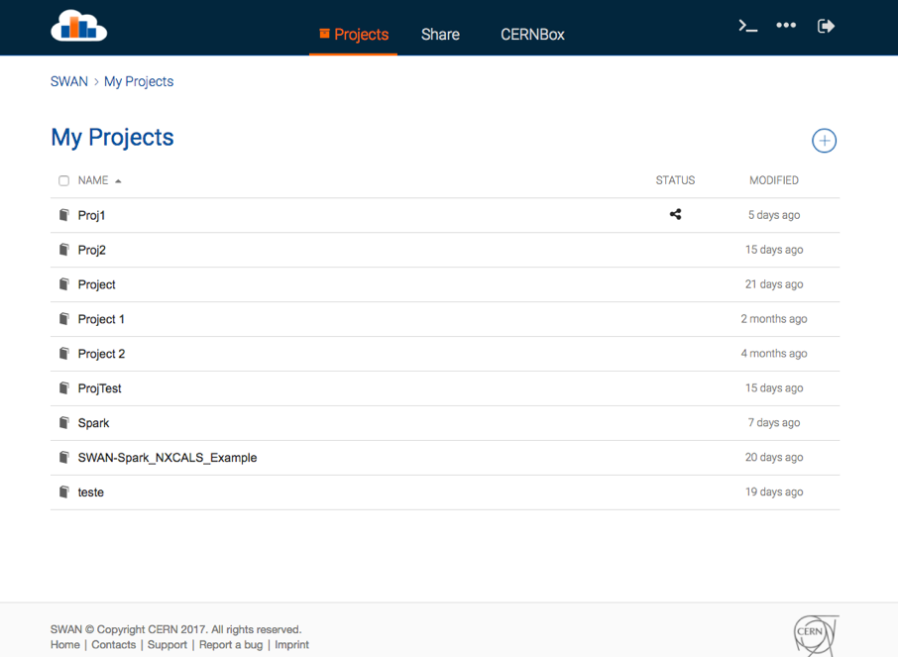
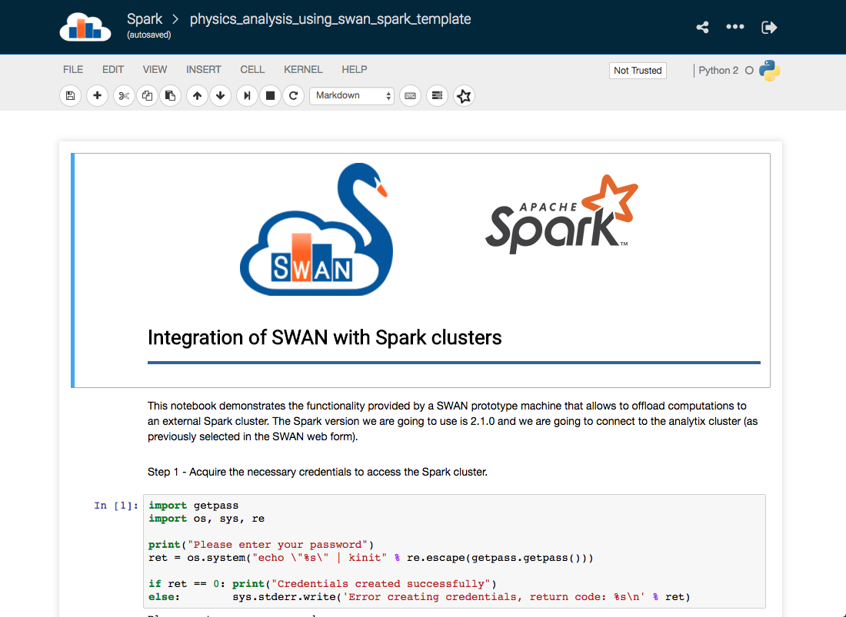
New User Interface

Slide 10
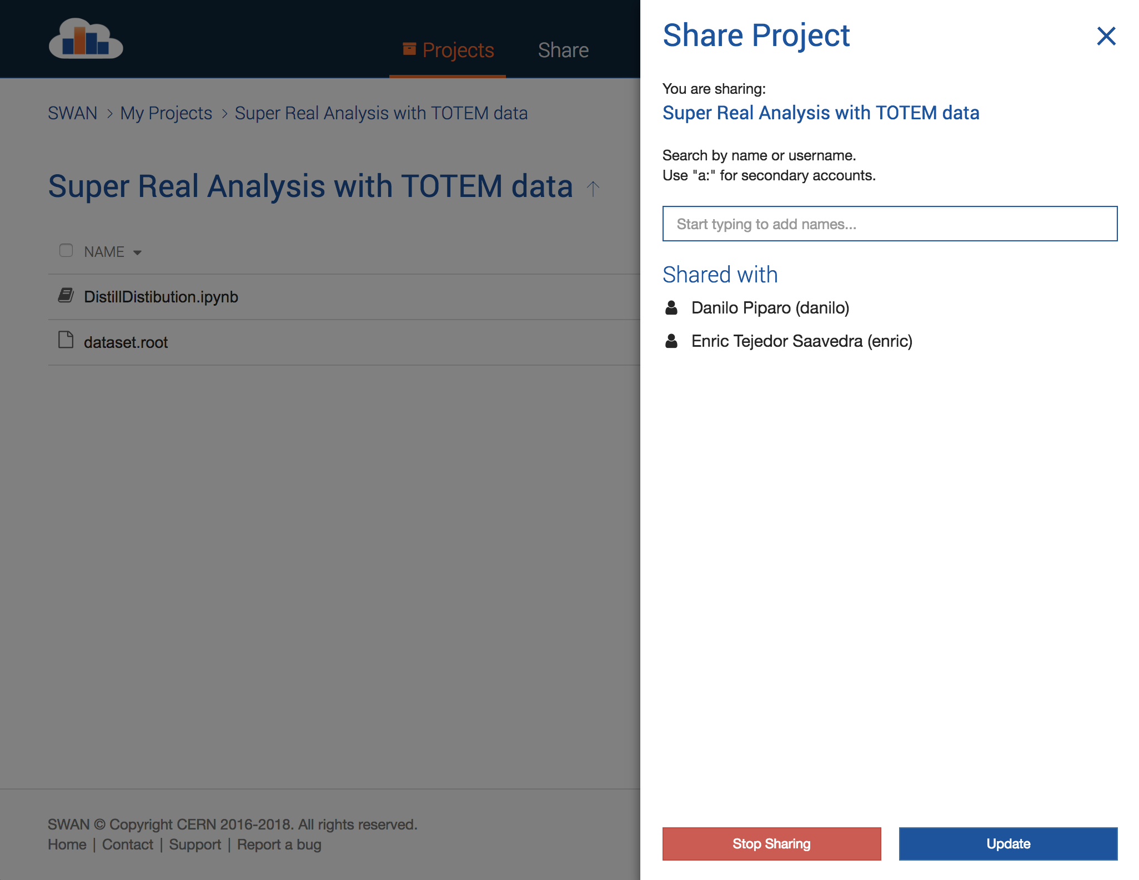
Sharing made easy
Sharing from inside SWAN interface
  Integration with CERNBox
Users can share “Projects”
  Special kind of folder that contains notebooks and other files, like input data
  Self contained

Slide 11
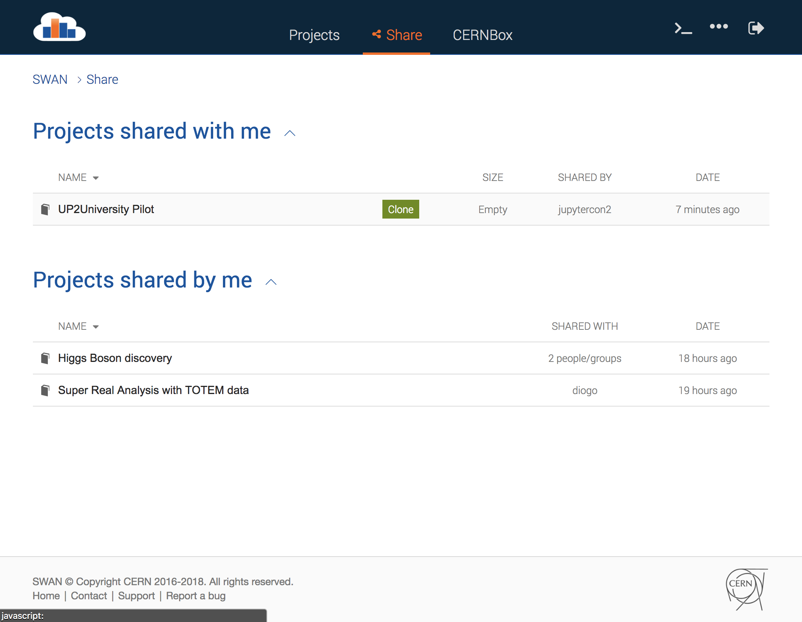
The Share tab
Users can list which projects...
  they have shared
  others have shared with them
Projects can be cloned to the receiver's CERNBox
  The receiver will work on his own copy
Concurrent editing not supported by Jupyter
  Safer to clone

Slide 12



Integration with Spark
Connection to CERN Spark Clusters
Same environment across platforms
  User data - EOS
  Software - CVMFS
Graphical Jupyter extensions developed
  Spark Connector
  Spark Monitor
User Notebook
Spark Cluster
Spark Master
Spark Worker
Python task
Python task
Python task

Slide 13
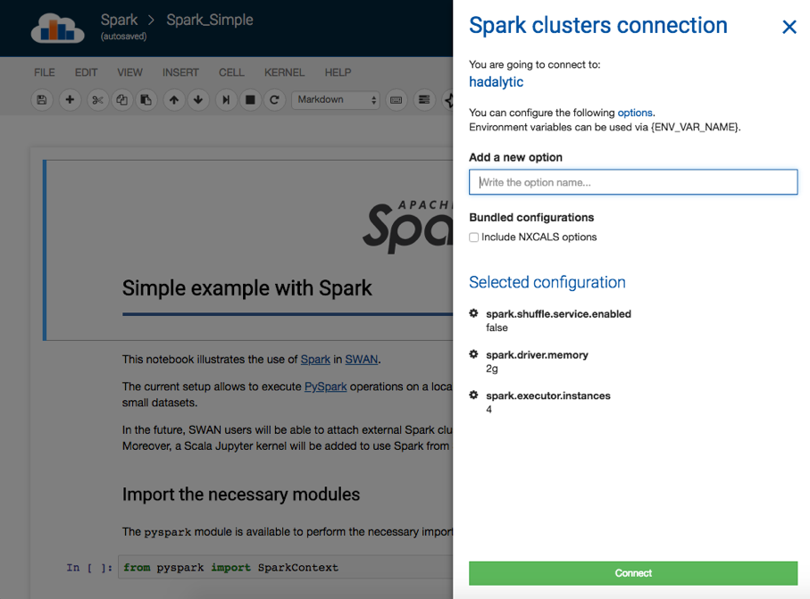
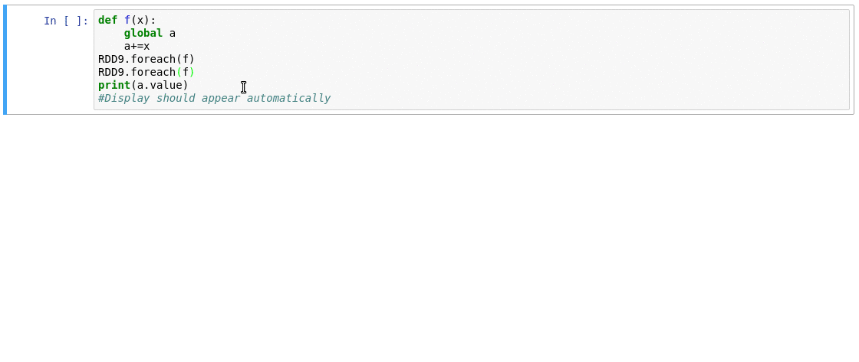
Spark Connector/Monitor

Slide 14
The result

Slide 15
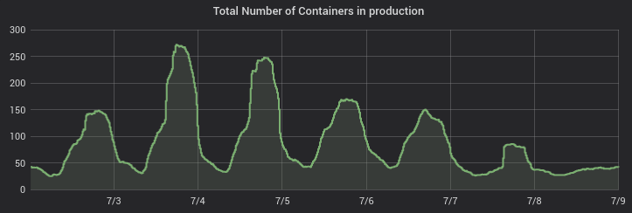
Stats
~200 user sessions a day on average
  Users doubled last year with new SWAN interface
~1300 unique users in 6 months
Spark cluster connection: 15 – 20 % of users
  SWAN as entry point for accessing computational resources
  Used for monitoring LHC accelerator hardware devices (NXCals)
Courses

Slide 16
New developments

Slide 17
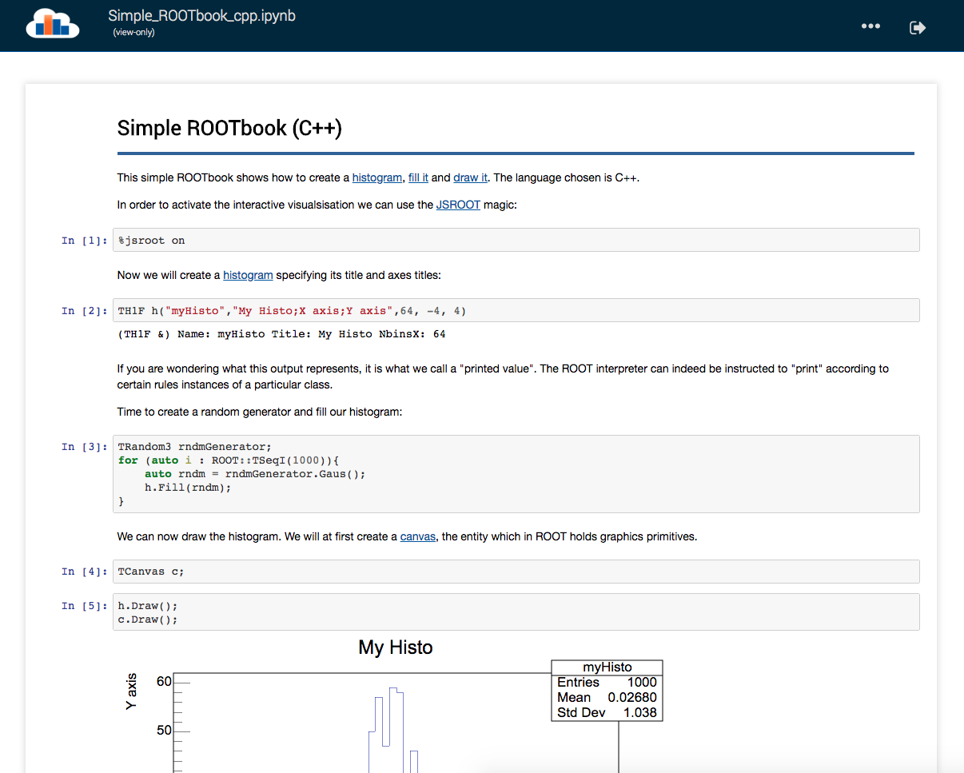
Inspecting a Project
Users can inspect shared project contents
  Browsing of the files
  Static rendering of notebooks
Useful to decide whether to accept or not the shared project

Slide 18
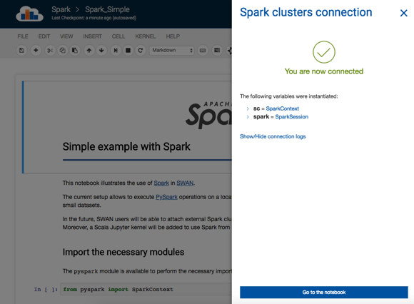
Spark improvements

Slide 19
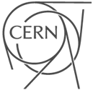
Worldwide LHC Computing Grid (WLCG)
19

Slide 20
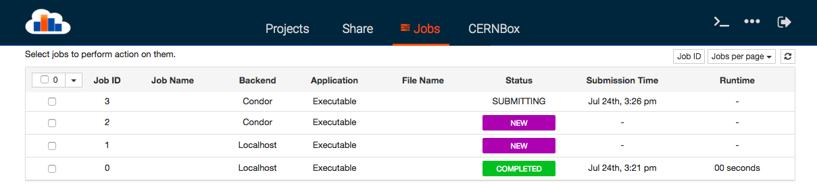
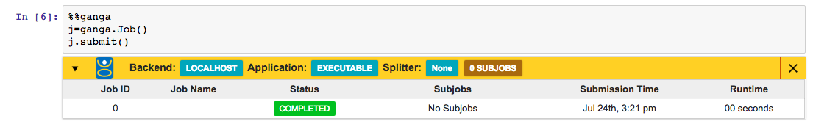
Connecting More Resources
Ongoing effort: submit batch jobs from the notebook
  Monitoring display
  Jobs tab

Slide 21
Outreach, Education

Slide 22
Science Box: SWAN on Premises
Packaged deployment of SWAN
  Includes all SWAN components: CERNBox/EOS, CVMFS, JupyterHub
Deployable through Kubernetes or docker-compose
Some successful community installations
  AARNet
  PSNC
  Open Telekom Cloud (Helix Nebula)

Slide 23

Science Box: SWAN on Premises
UP2University European Project
  Bridge the gap between secondary schools, higher education and the research domain
  Partner universities (OU, UROMA, NTUA, …), pilot schools
  http://up2university.eu
SWAN used by students to learn physics and other sciences
  Let them use the very same tools & services used by scientists at CERN
  Pilot with University of Geneva (Physiscope)
Establishing collaboration with Callysto project

Slide 24
Looking ahead

Slide 25
Future work/challenges
Move to Jupyterlab
  Porting the current extensions
  Concurrent editing
New architecture
  Based on Kubernetes
Exploitation of GPUs
  HEP is looking to ML
  Speed up computation of GPU-ready libraries (e.g. TensorFlow)

Slide 26
Where to find us

Slide 27
Where to find us
Contacts
  swan-talk@cern.ch
  http://cern.ch/swan
Repository
  https://github.com/swan-cern/
Science Box
  https://cern.ch/sciencebox

Slide 28
Conclusion

Slide 29
Conclusion
Changes introduced since last year improved user experience
  Which translated on more users using the service
SWAN became a fundamental Interface for Mass Processing Resources (Spark)
  Not only for Physics analysis but also for monitoring the LHC hardware
The new Jupyterlab interface will bring new possibilities for collaborative analysis
  With the introduction of concurrent editing of notebooks
  Which can help reach more users
Successfully deployed outside CERN premises
  Including on education related projects

Slide 30
SWAN and its analysis ecosystem
Thank you
Diogo Castro
diogo.castro@cern.ch

