Slide 1

Scaling Tightly Coupled Algorithms on AWS
Dr. Scott Eberhardt
Principle Solutions Architect – HPC, AWS
Visiting Reader, Imperial College
Research Computing @ AWS
AWS Worldwide Research & Technical Computing

Slide 2
IT’S ABOUT SCIENCE, NOT SERVERS.
aws.amazon.com/rcp
#AWSresearchcloud
© 2019, Amazon Web Services, Inc. or its Affiliates. All rights reserved.

Slide 3
Unlimited infrastructure
Low cost with flexible pricing
Efficient clusters
Why AWS for HPC?
Faster time to results
Increased collaboration
Concurrent clusters on-demand
© 2019, Amazon Web Services, Inc. or its Affiliates. All rights reserved.

Slide 4

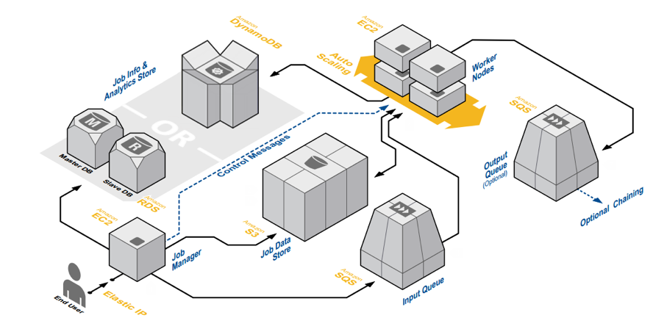
Great Features for HPC Workloads
Experimentation without Fear!
Start and stop instances!
Spot Pricing
Continuous Updates
  Compute
  Network
  Storage
  Services
© 2019, Amazon Web Services, Inc. or its Affiliates. All rights reserved.
Notes:
Regions, availability zones, etc.
Compute: EC2, Storage: EFS, EBS, Security? Network?

Slide 5

Cloud Improves Workload Throughput
Run many Jobs in Parallel
  Eliminate HPC resource contention
  Eliminate queue wait
  Use it when you need it
Right-size clusters and resources
  Optimize each workload for performance
  Pay for only what you use
© 2019, Amazon Web Services, Inc. or its Affiliates. All rights reserved.
Notes:
Regions, availability zones, etc.
Compute: EC2, Storage: EFS, EBS, Security? Network?

Slide 6


Cost advantages
On Premises
Capital Expense Model
Amazon Web Services
Pay As You Go Model
High upfront capital cost
High cost of ongoing support
Use only what you need
Multiple pricing models
© 2019, Amazon Web Services, Inc. or its Affiliates. All rights reserved.

Slide 7



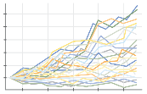
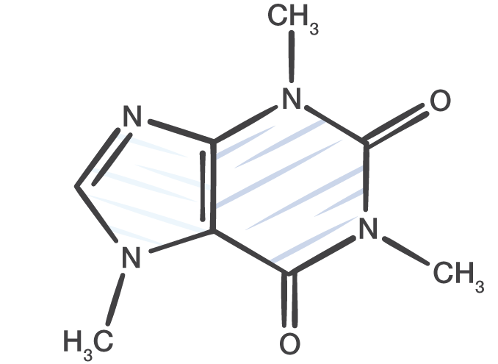


Popular HPC workloads on AWS
Genomics Processing | Modeling and Simulation | Government and Educational Research
Monte Carlo Simulations | Transcoding and Encoding | Computational Chemistry
… and many more
© 2019, Amazon Web Services, Inc. or its Affiliates. All rights reserved.

Slide 8
Defining HPC – example use cases
Clustered (Tightly coupled)
Fluid dynamics
Weather forecasting
Materials simulations
Crash simulations
Seismic processing
Metagenomics
Astrophysics
Deep learning
Data Heavy
Benefits from access to high performance storage
Data Light
Minimal requirements for high performance storage
Risk modeling
Molecular modeling
Contextual search
Logistics simulations
Animation and VFX
Semiconductor verification
Image processing/GIS
Genomics
Distributed / Grid (Loosely coupled)
© 2019, Amazon Web Services, Inc. or its Affiliates. All rights reserved.

Slide 9
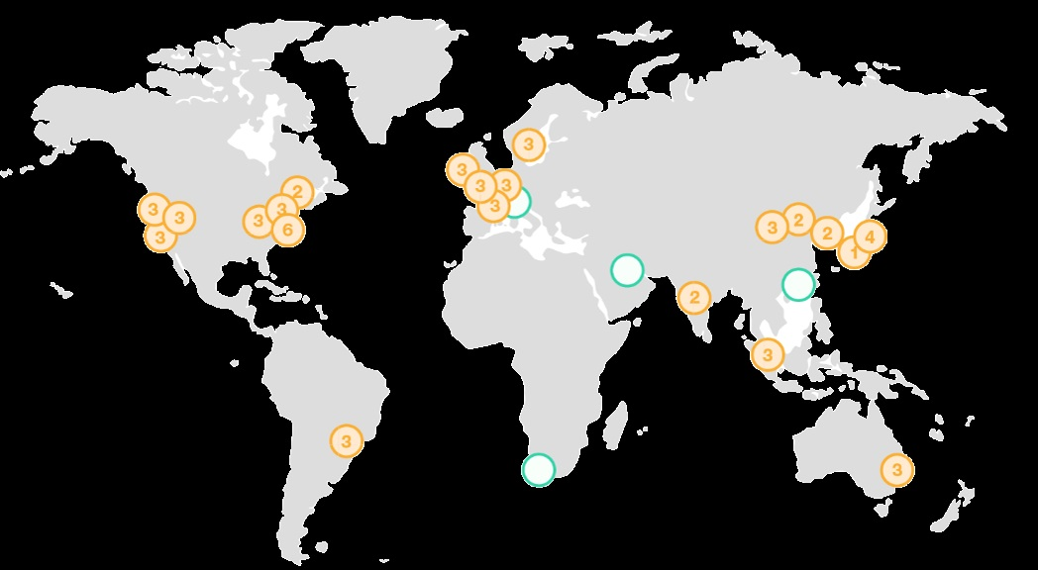
Global Infrastructure
© 2019, Amazon Web Services, Inc. or its Affiliates. All rights reserved.

Slide 10
Important enablers for HPC on the cloud
Compute performance – CPUs, GPUs, FPGAs
Memory performance – high RAM requirements in many applications
Network performance – throughput, latency, and consistency
Storage performance – including shared filesystems
Automation and cluster/job management
Remote graphics for interactive applications
ISV support – including license management
…and SCALE
© 2019, Amazon Web Services, Inc. or its Affiliates. All rights reserved.

Slide 11
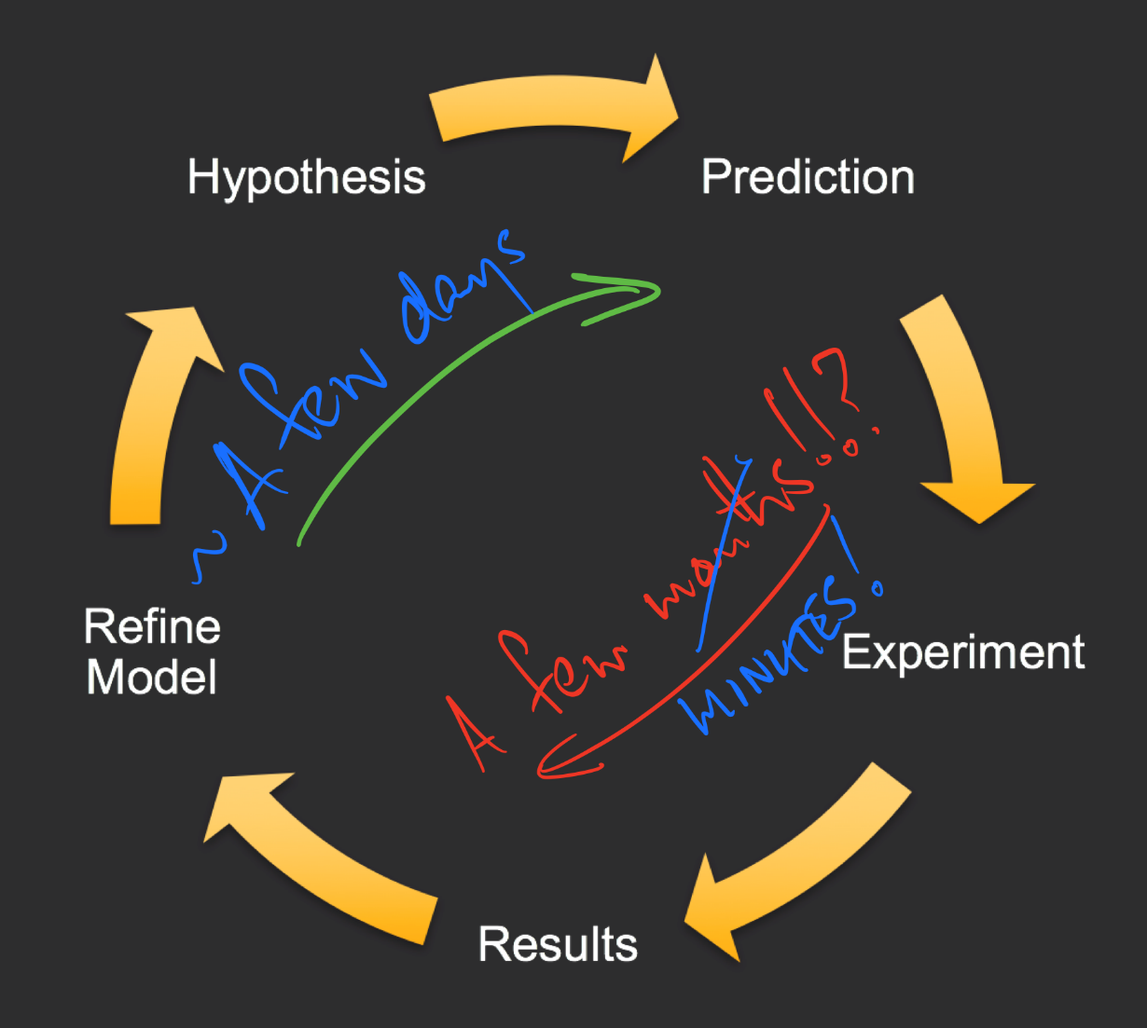
The Scientific Computing Method
Credit: Aristotle
© 2019, Amazon Web Services, Inc. or its Affiliates. All rights reserved.

Slide 12
Cores
Cores
Data Centre
Capacity Limit
Time (days)
Time (days)
© 2019, Amazon Web Services, Inc. or its Affiliates. All rights reserved.

Slide 13
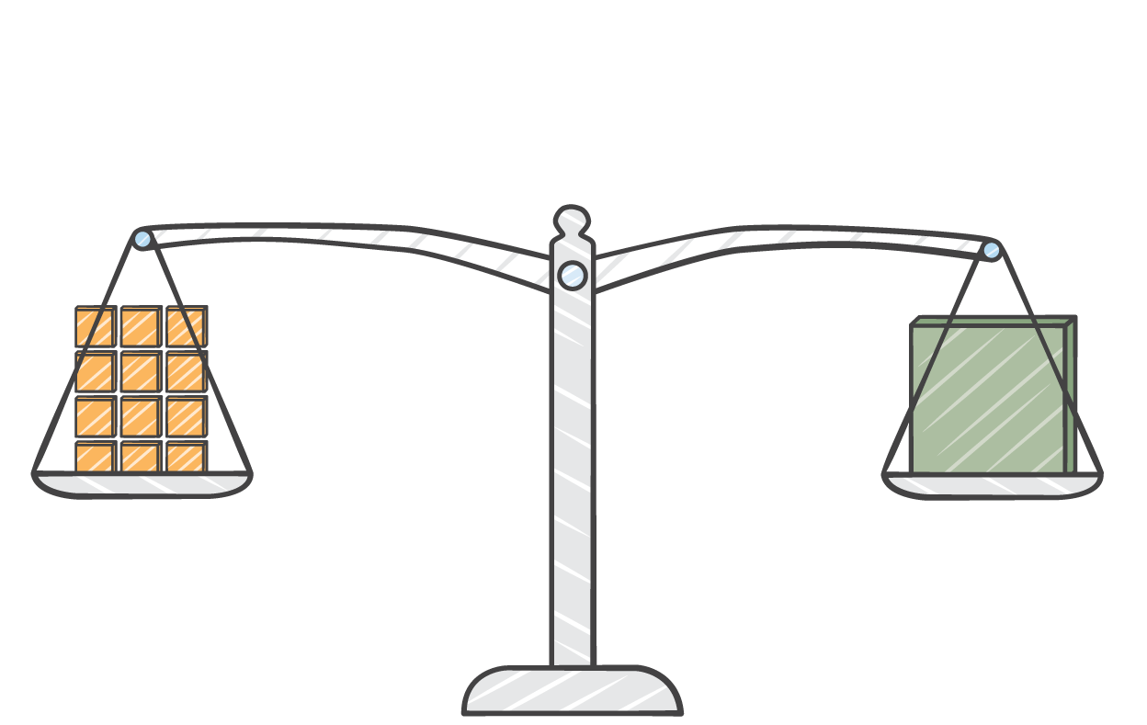
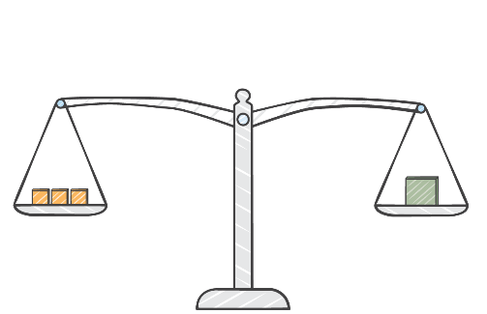
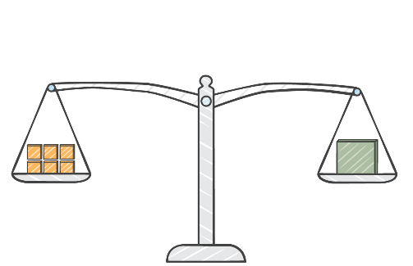
Deploy multiple HPC clusters
Running at the same time, and tuned for each workload
© 2019, Amazon Web Services, Inc. or its Affiliates. All rights reserved.

Slide 14
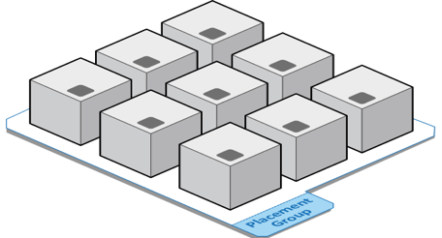
Which architecture Do I choose?
One size does not fit all
Architectures are an opportunity for optimization
The chosen architecture depends on:
  The desired user experience
  The desired deployment method
  The characteristics of the application
100 Gbps
© 2019, Amazon Web Services, Inc. or its Affiliates. All rights reserved.
Notes:
The flexibility and number of options available with AWS means that picking an architecture to get started can be confusing at first. We know that HPC applications are not “one size fits all”. They vary in what works best and this makes the HPC architecture an opportunity for optimization. This can mean optimizing for typical computing criteria, such as memory and disk size, but it also means optimizing for the desired user experience. Is an end to end automation desired. Are the users experienced? Is there only one user or are there many users, say all students with limited experience. These are also considerations that are required when picking an architecture for AWS. The terrific thing about optimizing on AWS is that it is easy to try different ideas and to pick the set up that works best. Many of our HPC customers start with a simple architecture and then trade it out for a more flexible architecture after gaining experience with running on AWS.

Slide 15
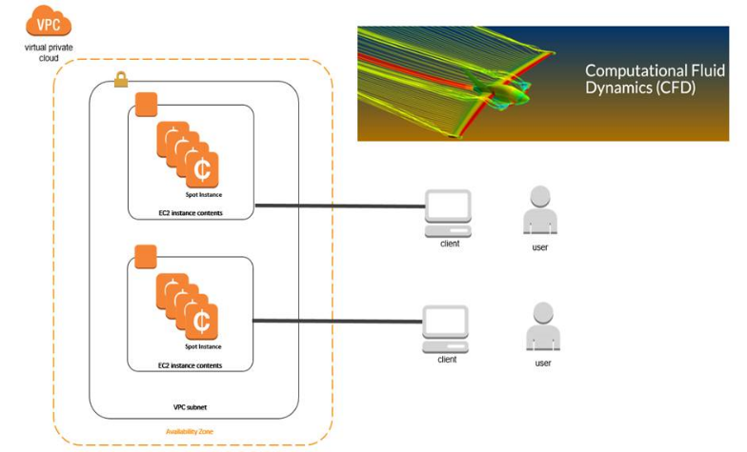

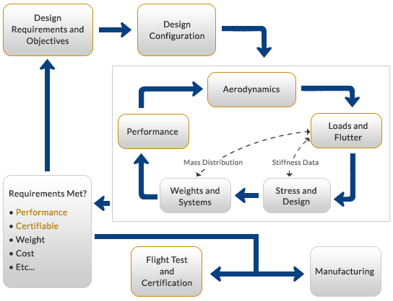
Example in aerospace
Running parallel CFD studies using Siemens STAR-CCM+
  Goal: shorten the time between Design Requirements and Configuration, and Flight Testing
1000+ cores per CFD study, multiple studies required for each workflow iteration
Job-level optimizations:
  Enhanced Networking, Placement Groups
  Amazon Linux, Hyper-threading disabled
Workflow optimizations:
  Spot instances, multiple clusters
  Multiple parallel studies for faster throughput
© 2019, Amazon Web Services, Inc. or its Affiliates. All rights reserved.

Slide 16
Performance considerations
For tightly-coupled cluster workloads
Test using real-world examples Use large cases for testing: do not benchmark scalability using only small examples | MPI libraries Test with Intel MPI and OpenMPI 4.0, and make use of available tunings
Domain decomposition Choose number of cells per core for either pre-core efficiency or for faster results | Network Use a placement group Enable enhanced networking
Processor states Use P-states to reduce processor variability | Hyper-threading and affinity Test with Hyper-threading (HT) on and off – usually off is best, but not always Use CPU affinity to pin threads to CPU cores when HT is off
© 2019, Amazon Web Services, Inc. or its Affiliates. All rights reserved.

Slide 17
Scaling
Amdahl’s Scaling
© 2019, Amazon Web Services, Inc. or its Affiliates. All rights reserved.

Slide 18


What is Amdahl’s Law?
$$Speedup= \frac{1}{\left(1−p\right)+\frac{p}{n}}$$
p – fraction of code that can be run in parallel
n – system resource improvement (number of processors)
Ideal:$\lim_{n→∞}{speedup} =\frac{1}{1−p}$
Or: $\lim_{p→1}{speedup} =n$
© 2019, Amazon Web Services, Inc. or its Affiliates. All rights reserved.

Slide 19
How is it used?
Amdahl’s Law assumes a fixed problem size.
Example: a CFD calculation with a fixed number of cells – eg. 40M
As the number of processors increases, the number of CFD mesh cells per compute core decreases. At some point communication between nodes and cores becomes a bottleneck. This is the driver for low-latency networks.
Note: The lower the latency the fewer CFD mesh cells per compute node are necessary for good scaling. Lower latency usually means better speedup when considering Amdahl’s law.
© 2019, Amazon Web Services, Inc. or its Affiliates. All rights reserved.

Slide 20
Coding Goals
The following have been routine in code architectures since the first vector computers:
Choose algorithms where p is maximized
Reprogram codes
Look for ways to avoid/reduce dependencies
Consider tradeoffs between recalculating and storing
Monitor code execution to find bottlenecks
© 2019, Amazon Web Services, Inc. or its Affiliates. All rights reserved.

Slide 21
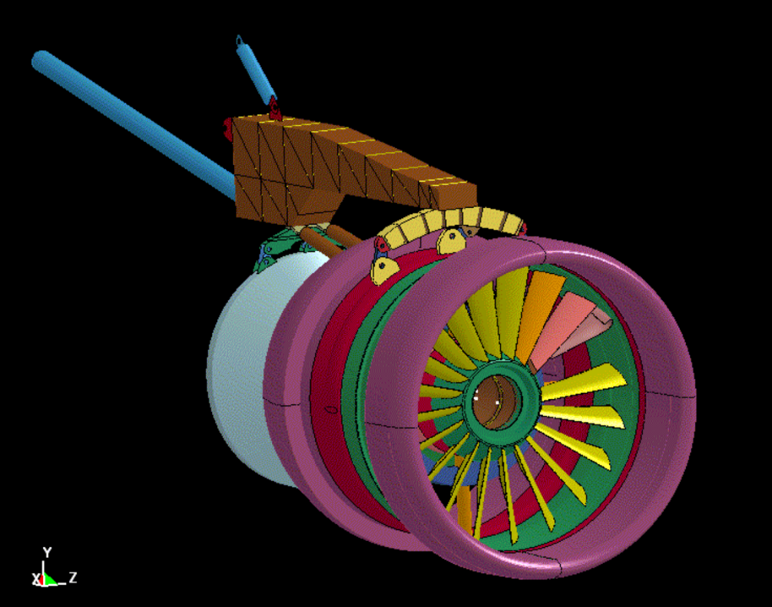
Structural simulation
© 2019, Amazon Web Services, Inc. or its Affiliates. All rights reserved.

Slide 22
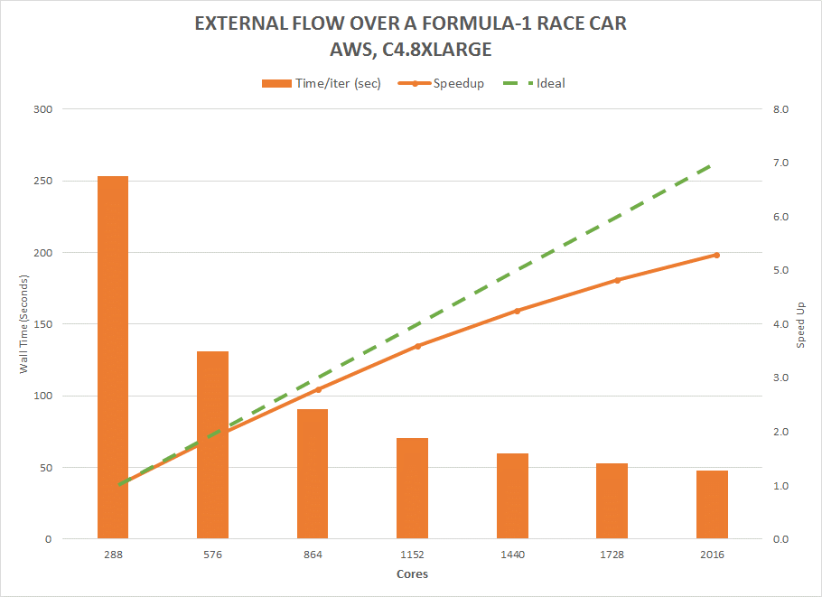
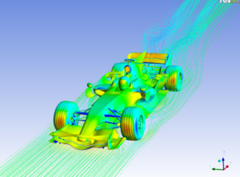
Fluid dynamics – Ansys Fluent
C4.8xlarge instance type
140M cell model
F1 car CFD benchmark
© 2019, Amazon Web Services, Inc. or its Affiliates. All rights reserved.

Slide 23
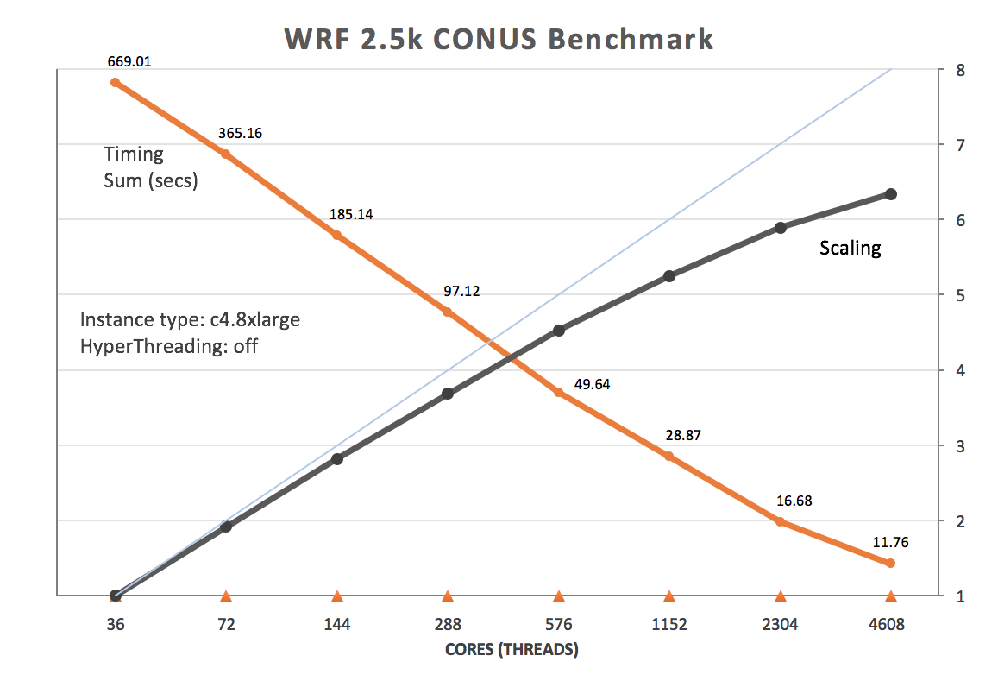
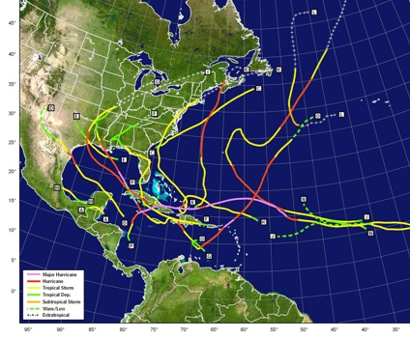
Tightly-coupled HPC – weather
r
© 2019, Amazon Web Services, Inc. or its Affiliates. All rights reserved.

Slide 24
Resources used in this study
Archer: Cray XC30 supercomputer
  two 2.7 GHz, 12-core Intel E5-2697 v2 (Ivy Bridge)
AWS:
  z1d: 4.0 GHZ Intel®Xeon®Scalable Processors; 24 core per instance; 16GB Ram per core; 25 Gigabit network bandwidth
  c5n: 3.0/3.5 GHZ Intel®Xeon®Scalable Processors; 36 core per instance; 5.3 GB Ram per core; 100 Gigabit network bandwidth; New Elastic Fabric Adaptor (EFA) for fast networking
© 2019, Amazon Web Services, Inc. or its Affiliates. All rights reserved.

Slide 25
Methodology
OpenFOAM v1806 in Double Precision (pimpleFoam)
Scotch decomposition for solving, hierarchical (i.e constant x/y/z loading) for meshing
SST-DDES Turbulence Model
ANSA generated 143/280M cell unstructured mesh
Time Step=5e-⁴s with 5 inner iterations
Preconditioned Conjugant Gradient Linear Solver
© 2019, Amazon Web Services, Inc. or its Affiliates. All rights reserved.

Slide 26
Amdahl Scaling: openFoam (pimpleFoam)
© 2019, Amazon Web Services, Inc. or its Affiliates. All rights reserved.

Slide 27
Amdahl Scaling, Alternate View
© 2019, Amazon Web Services, Inc. or its Affiliates. All rights reserved.

Slide 28
Amdahl Scaling, 2nd Alternate View
© 2019, Amazon Web Services, Inc. or its Affiliates. All rights reserved.

Slide 29
Scaling
Gustafson-Barsis Scaling (aka Gustafson’s Law)
© 2019, Amazon Web Services, Inc. or its Affiliates. All rights reserved.

Slide 30


What is Gustafson’s Law?
$$Speedup=\left(1−p\right)+\frac{p}{n}$$
Gustafson’s Law assumes a workload will increase in size linearly with the number of processors. (scalable workload)
For example, scaling is measured at constant CFD mesh cells per core
Ideal:$\lim_{n→∞}{speedup} =1−p$
© 2019, Amazon Web Services, Inc. or its Affiliates. All rights reserved.

Slide 31
Gustafson Scaling: openFoam (pimpleFoam)
© 2019, Amazon Web Services, Inc. or its Affiliates. All rights reserved.

Slide 32
Gustafson Scaling: Alternate View
© 2019, Amazon Web Services, Inc. or its Affiliates. All rights reserved.

Slide 33
Gustafson: Speedup ∝ p/n
© 2019, Amazon Web Services, Inc. or its Affiliates. All rights reserved.

Slide 34
Gustafson: workload
© 2019, Amazon Web Services, Inc. or its Affiliates. All rights reserved.

Slide 35
400 Cell scaling
© 2019, Amazon Web Services, Inc. or its Affiliates. All rights reserved.

Slide 36
Obvious Question:
Why not include 400M cell case with others?
Answer:
They were done by two different people and two different workloads and, therefore, do not follow a consistent process
© 2019, Amazon Web Services, Inc. or its Affiliates. All rights reserved.

Slide 37
Latency
Amdahl and Gustafson scaling both measure latency. Latency includes:
  Non parallel code
  Memory latency
  Cache latency
  Network latency
  Storage latency
© 2019, Amazon Web Services, Inc. or its Affiliates. All rights reserved.

Slide 38
Comments
At high cell/core, or low core count, memory or cache more likely to slow processing (possibly see this in Archer)
At low cell/core, or high core count, network latency more likely to slow processing (see in AWS-z1d and AWS-c5n)
Total execution scaling based on processor workload (cells/core) is linear in all cases
Slope of processor workload (cells/core) seems to follow network latency – faster network → steeper slope = better scaling
Faster network does not mean faster execution time
Coarser mesh has better scaling than finer mesh in all cases, but AWS-c5n has largest difference (best guess: PCG routines)
© 2019, Amazon Web Services, Inc. or its Affiliates. All rights reserved.

Slide 39

Discussion?
© 2019, Amazon Web Services, Inc. or its Affiliates. All rights reserved.

Slide 40
Acknowledgement
Special thanks to Dr. Neil Ashton of Oxford University for providing his openFoam benchmarking data for the 143M cell and 282M cell cases, and Stephen Sachs, of AWS for the 400M cell cases
© 2019, Amazon Web Services, Inc. or its Affiliates. All rights reserved.

Slide 41
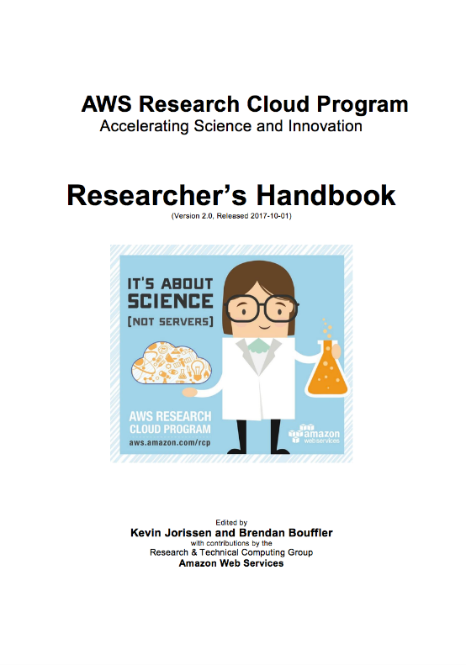
AWS Researcher’s Handbook
The 200-page “missing manual” for science in the cloud.
Written by Amazon’s Research Computing community for scientists.
Explains foundational concepts about how AWS can accelerate time-to-science in the cloud.
Step-by-step best practices for securing your environment to ensure your research data is safe and your privacy is protected.
Tools for budget management that will help you control your spending and limit costs (and preventing any over-runs).
Catalogue of scientific solutions from partners chosen for their outstanding work with scientists.
aws.amazon.com/rcp
© 2019, Amazon Web Services, Inc. or its Affiliates. All rights reserved.

Slide 42

aws.amazon.com/rcp
© 2019, Amazon Web Services, Inc. or its Affiliates. All rights reserved.

