Slide 1


RD51 Test Beam
October 2009
Very Preliminary Data Analysis
Alexopoulos Theodoros², Fanourakis George, Geralis Theodoros¹, Karakostas Kostantinos², Megariotis Menelaos², Ntomari Eleni ^{1, 2}, Tsipolitis Yorgos²
¹NCSR Demokritos
² National Technical university of Athens

Slide 2
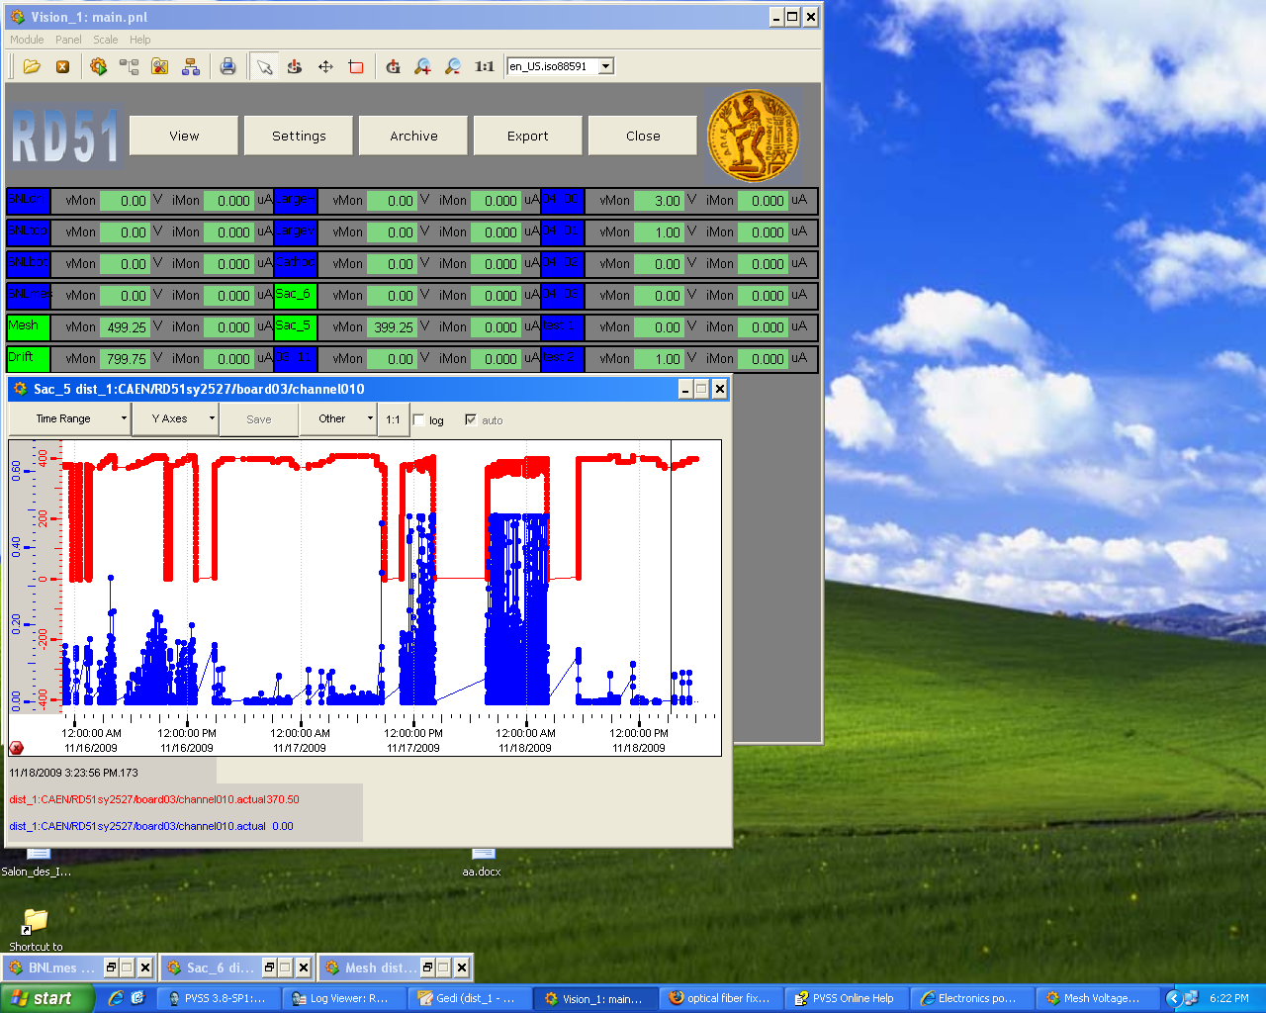
Outlook
The goal of the October test beam was:
  Provide a micromegas telescope for testing different gaseous detectors
    Micromegas detectors
    Readout system
  Provide a High Voltage Power Supply control and monitoring of the voltage (mesh and drift High Voltage for each channel)
Very preliminary Data analysis

Slide 3
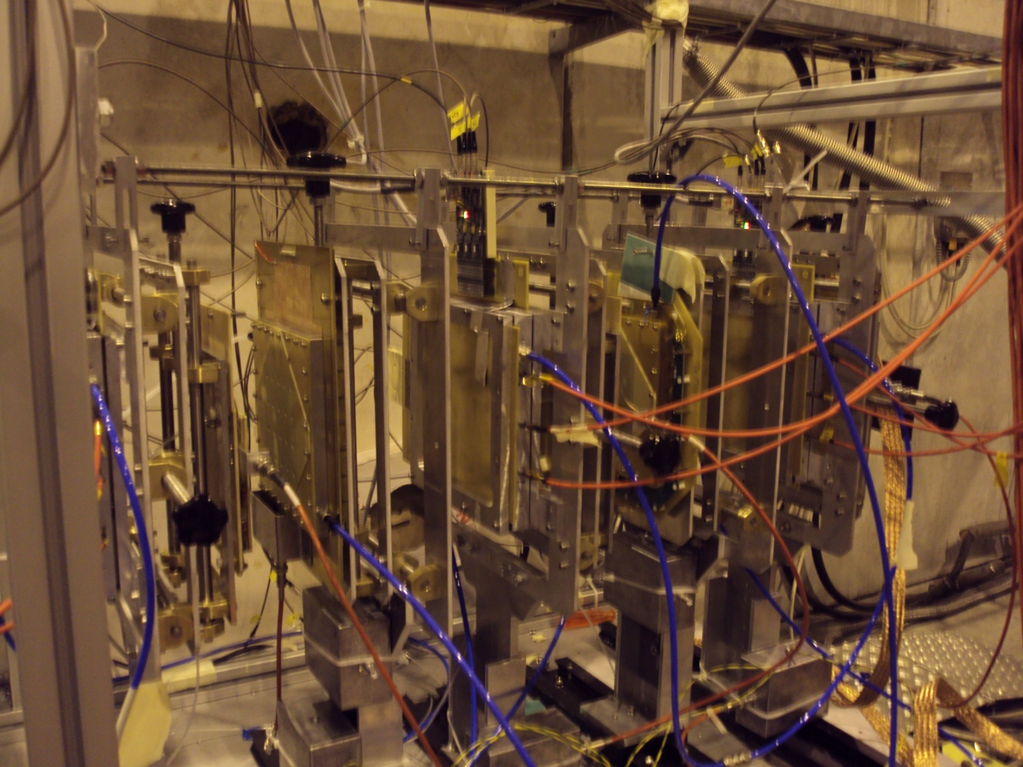
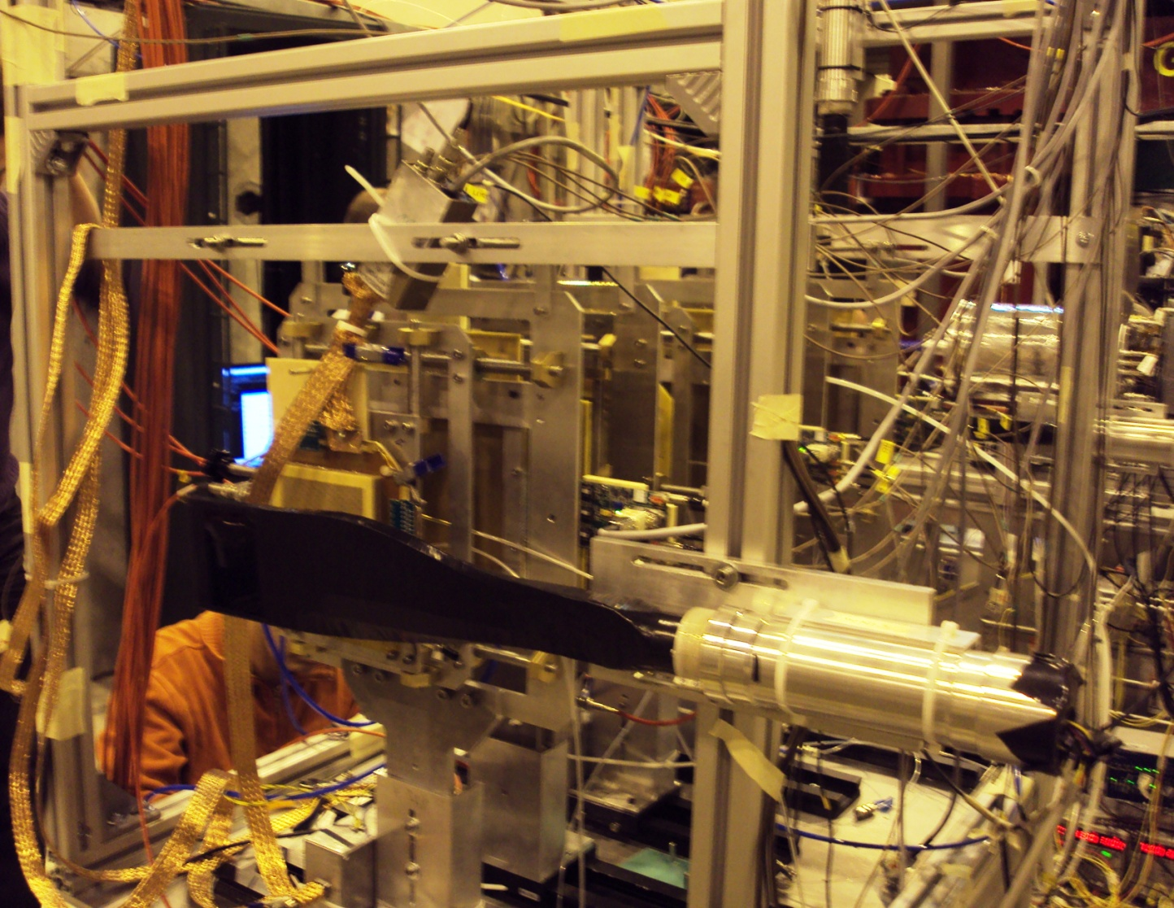
Overview of the set up
Gas mixture: Ar/CO₂ (90%/10%)
The telescope consists of 3 micromegas detectors to reconstruct the track (three (X,Y) points)
Different gaseous detectors (GEM, CMS micromegas) using the tracking information of the telescope
All the detectors were read out with Gassiplex FEE
µM 3
µM 2
µM 1
Beam direction

Slide 4
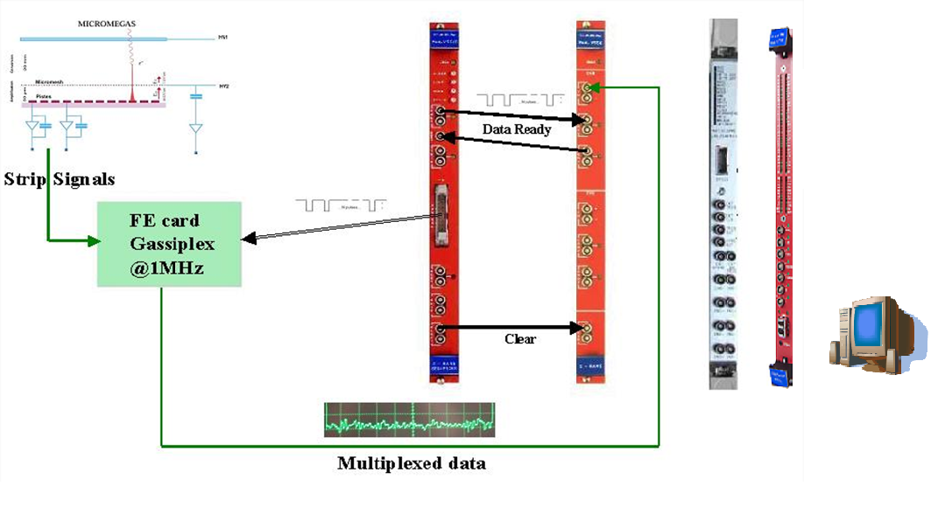

Data Acquisition system- Trigger logic
Scintillators coincidence
telescope
detectors under test
trigger
Trigger to Sequencer
3 control signals :
Clock, Track/Hold, Clear
V2718

Slide 5
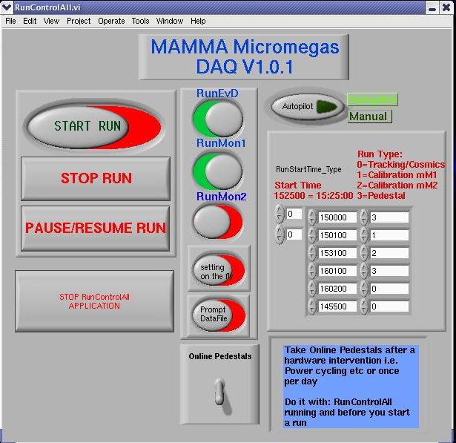
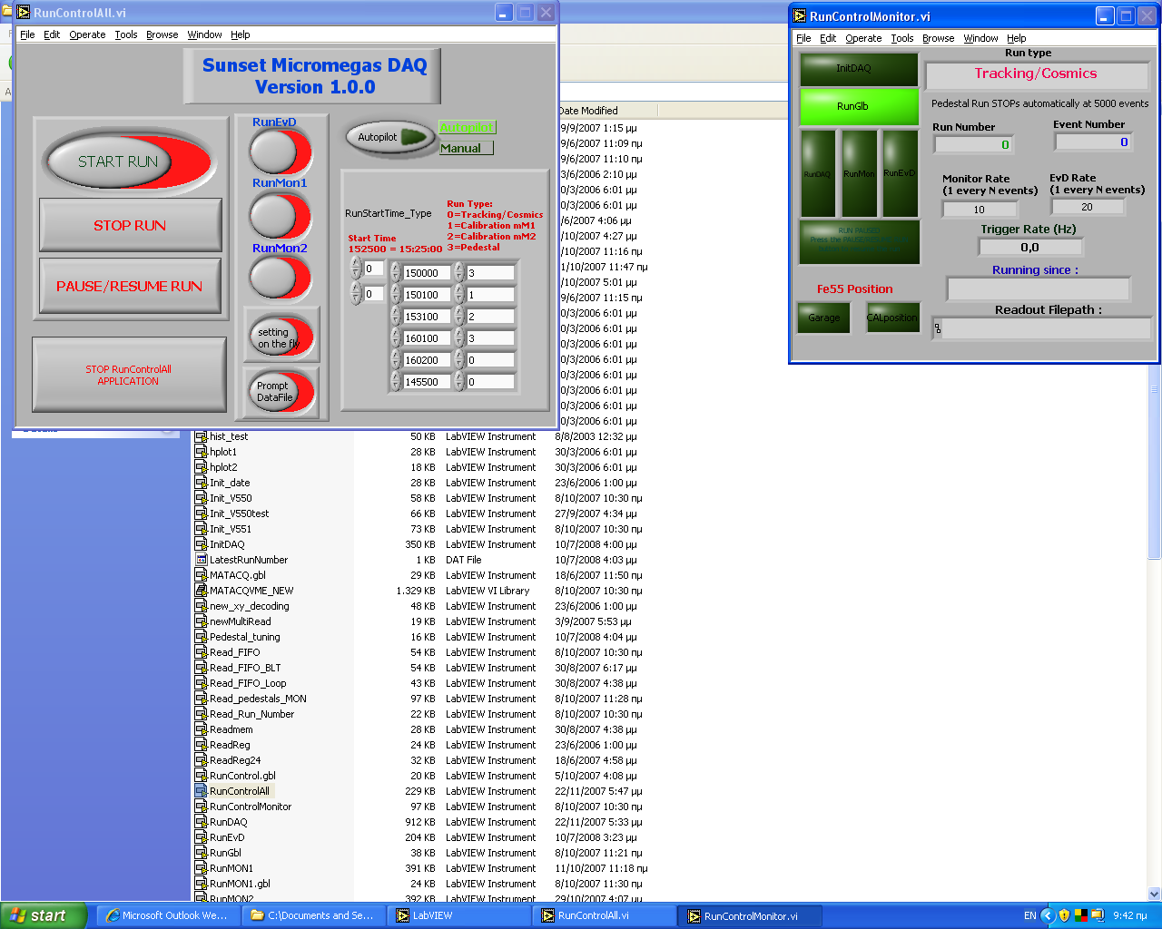
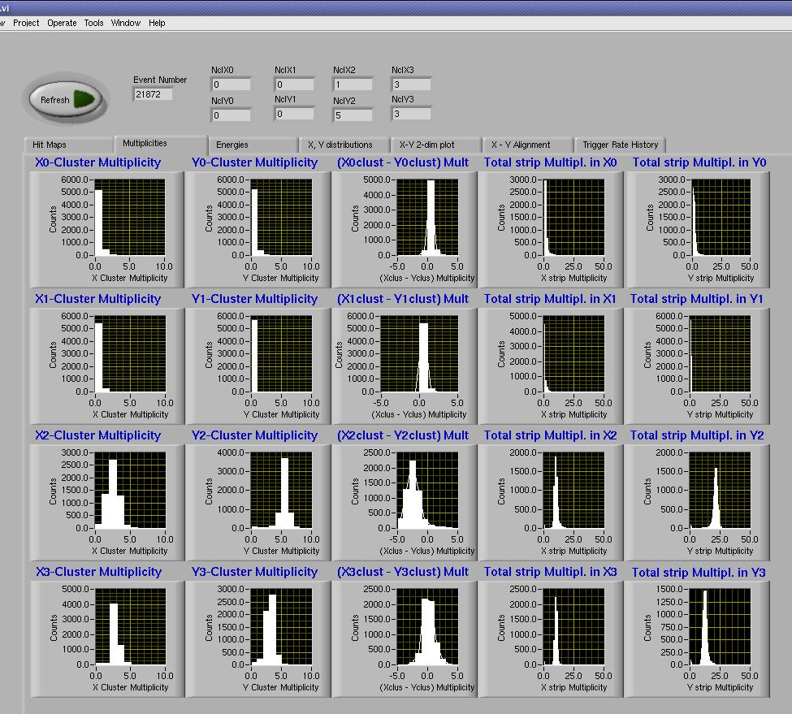
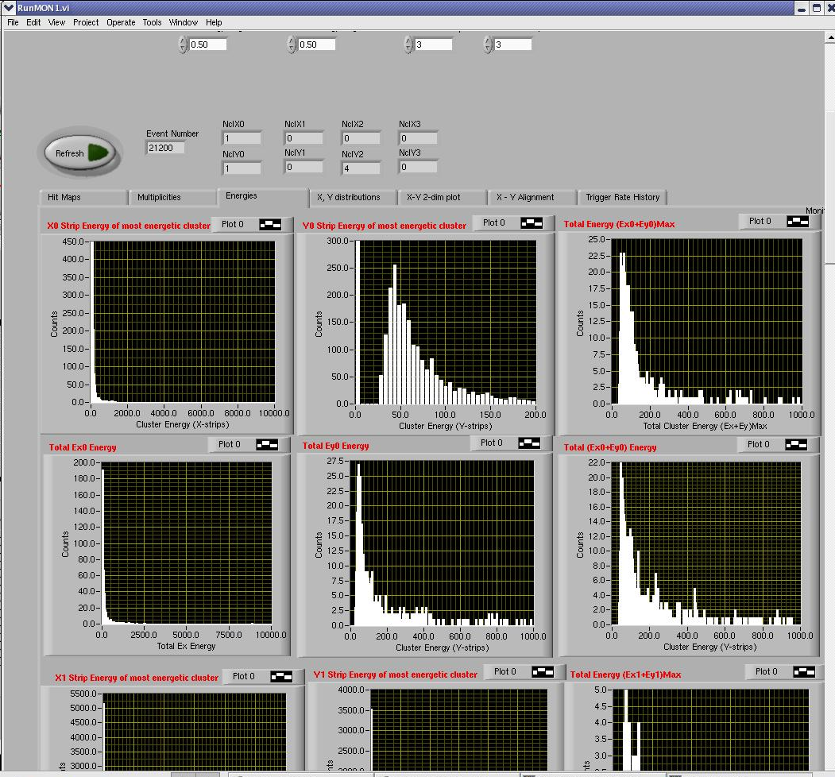
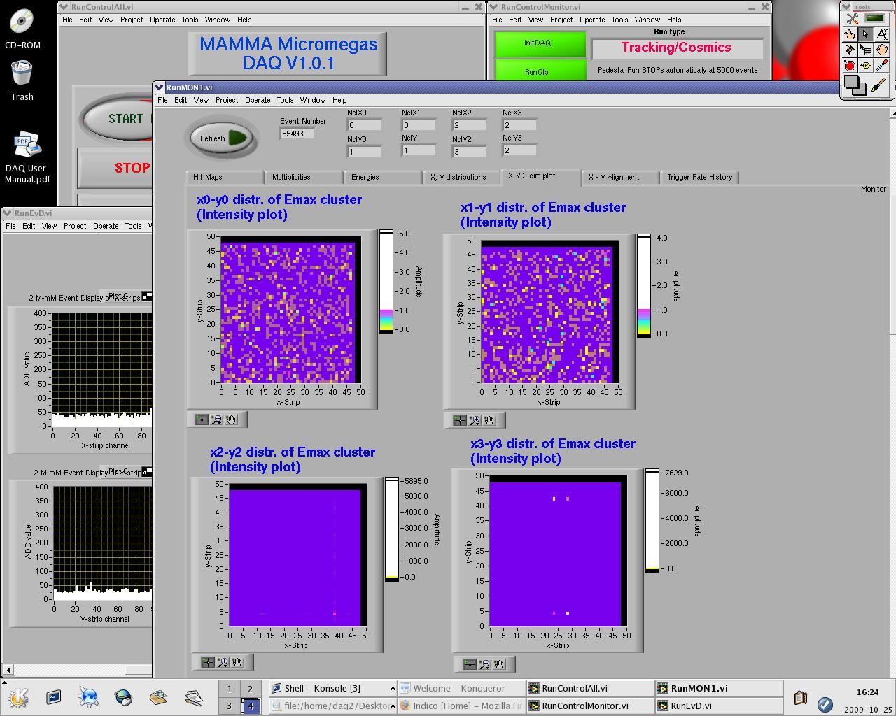
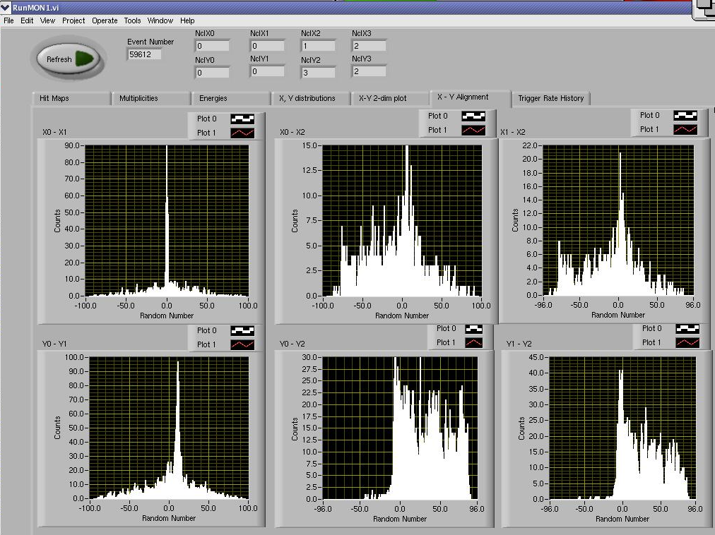
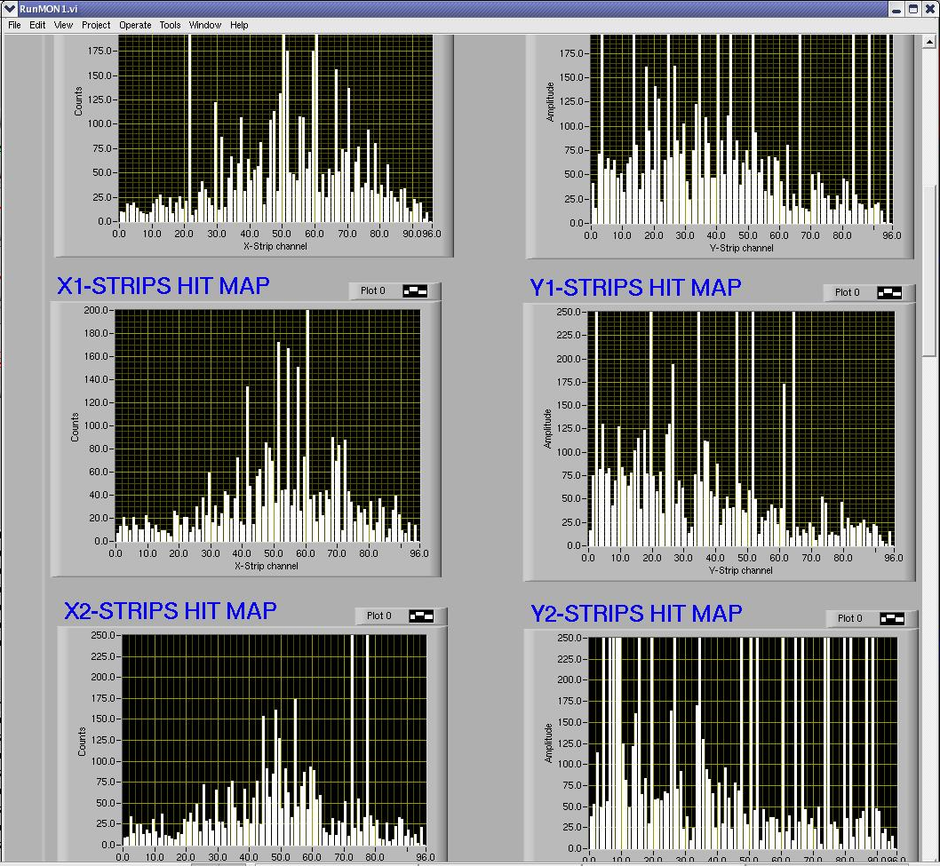
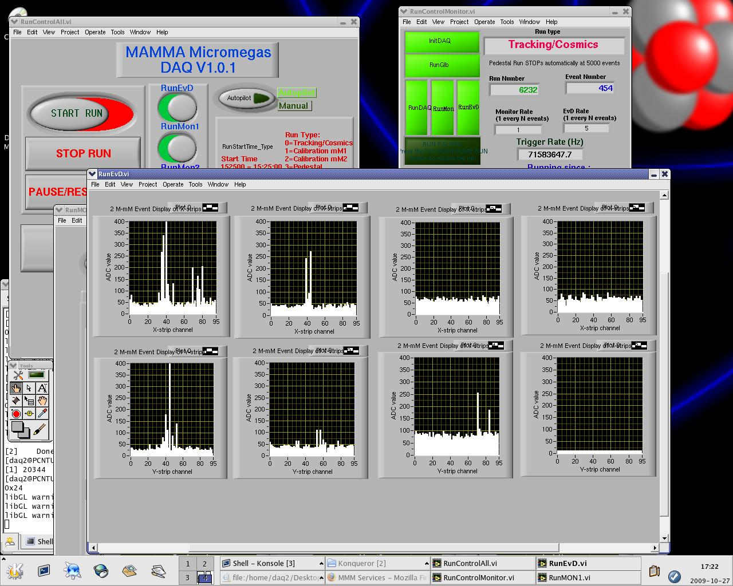
Data acquisition system- data monitoring
The Data acquisition performs 3 tasks:
  recording the events (from the strips),
  displaying the events
  online monitoring
    Hit maps
    Pedestal subtraction
    Energies
    X,Y distributions
    XY 2 dimensions plot
    Alignment
    Trigger Rate History
Maximum readout rate up to
120 events per second
5
Eleni Ntomari

Slide 6
Data analysis - Decoding
All the analysis is performed with the ROOT analysis CERN package
Raw data are converted from the binary DAQ format to ROOT trees
  mmraw: raw data tree
      ADC value
  mmraw_no_ped: raw data tree after pedestal subtraction: use of pedestal run
    ADC value without pedestals
  mmreco: data reconstructed using a clusterization algorithm
      Number of clusters
        For each cluster:
          Centre of gravity of the cluster
          Energy of the cluster
          Number of strips in the cluster
          The first strip of the cluster
          The last strip of the cluster
          The position of the most energetic strip of the cluster
          The energy of the most energetic strip of the cluster

Slide 7
Data analysis – New data format
Raw data are converted from the binary DAQ format to a ROOT file with 3 root trees:
  mmraw: raw data tree
    Run Number
    Run Type
    Run date
    Run start time
    Run end time
    For each event:
      Time stamp
      ADC value
  mmraw_no_ped: raw data tree after pedestal subtraction: calculation of the pedestals for each event
    Event average energy
    Event Sigma
    Sigma Multiplier
    Offset
    ADC value without pedestals
  mmreco: data reconstructed using a clusterization algorithm
    Cluster gap
    Minimum cluster energy
    For each event and for each detector:
      Number of clusters
        For each cluster:
          Centre of gravity of the cluster
          Energy of the cluster
          Number of strips in the cluster
          The first strip of the cluster
          The last strip of the cluster
          The position of the most energetic strip of the cluster
          The energy of the most energetic strip of the cluster

Slide 8
Examples of raw data

Slide 9
Raw data after pedestal subtraction

Slide 10
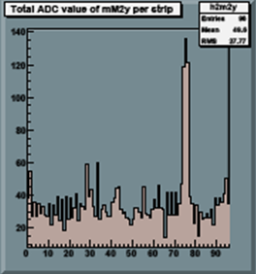
Clusterization Algorithm
After pedestal subtraction, the channels with nonzero ADC value (or ADC value over a certain threshold that is defined-for the moment- using a pedestal run) create a cluster
Neighbouring channels with ADC value greater than the over-threshold channels belong to the same cluster
The charge of the cluster (ADC value) is the total charge of all the strips in the cluster
The cluster position is the centre of gravity of the charge
Two parameters to be optimized:
  Threshold defined by the calculation of the pedestals from test beam events
  Maximum distance (gap) between two channels of the same cluster
ADC value
cluster
strips

Slide 11
Data after clusterization reconstruction

Slide 12
X-Y Detectors alignment
We used only the events with one and only one cluster
Preliminary analysis shows that the telescope micromegas detector are adequately aligned (see table).
The resolution for a single detector is approximately 51.3 μm
We are currently studying in more details the data for other effects like tilting or x/y perpendicularity, etc.
x_{i}-x_{j} | strips | mm | σ(x_{i}-x_{j}) | σ_{xi}[μm]
x₁-x₂ | 0.794 | 0.20 | 0.2278 | 40.3
x₁-x₃ | 5.756 | 1.44 | 0.3144 | 55.6
y₁-y₂ | 0.846 | 0.21 | 0.3233 | 57.2
y₁-y₃ | 0.685 | 0.17 | 0.2937 | 51.9

Slide 13
Efficiency of the Telescope vs Mesh Voltage
T&H delay: 500 ns, Vdrift-Vmesh=300 V

Slide 14
Efficiency of the Micromegas Telescope
We made a scan on the high voltage (Vdrift-Vmesh=const), for different T&H delay signals.
Second drift high voltage scan with Vmesh=const
  Considering the efficiency of the telescope the T&H delay should be between 800 ns and 1100 ns
  For the gas mixture Ar/CO₂ (90%/10%) the “best” difference between the Drift and the Mesh Voltage is 300V
  Work in progress….

