Slide 1

AMVA4NewPhysics
SB Meeting
May 2, 2018

Slide 2
Delegated voters
Andrey and Giovanna delegate Tommaso
Maurizio delegates Pietro
Kostas delegates Daniela
Michel and Fabio delegate Andrea
Present at the meeting:
We have xx/18 eligible votes - quorum for votes is 10 → we are ok

Slide 3
Topics
Organizational issues for 2018 events
  Athens workshop
  CERN outreach workshop
  UNIPD statistics workshop
  UOXF soft skills training event
Budget proposals for 2018 events
AOB

Slide 4
Budget proposals - 1
Athens workshop: will run Jun 20 to Jun 22
  Inviting two speakers – 1.5-2k euro
  Inviting Pietro Vischia (outreach officer) – 550 euro
  expenses for meals (1000 euro), daily bus transportations to-from IASA (800 euro), social dinner (1000 euro)
  Total estimated budget: euro 5000 → max 6000 to vote including 20% contingency
  We propose to approve the expense with common network funds
  ** quoted numbers are approximate, as I did not have the time to fetch the detailed forecast by Costas – apologies for this

Slide 5
Budget proposals - 2
Statistics Workshop in Padova: the biggest event we promised in the proposal
  Taking place September 24-25 in Padova
  inviting 8 statisticians to give lectures; student poster session, dinner
  should be our "showcase" of ESR results and discussion with experts
INSIGHTS will contribute with 1/3 of the expenses, up to euro 5000 (not formally voted yet, but assurances from Glen)
  all 13 ESRS from that network should participate
We estimate a need for up to 15000 euro for everything, 20% contingency included (speaker costs alone are about 8-10k euro; three of them come from the US)
  probably going to be less, 20% contingency thought of to keep broad with request from INSIGHTS

Slide 6
Budget proposals – 3
For the outreach event at CERN I did not receive an estimate of required funding yet
  let us discuss the needs here

Slide 7
Budget proposals - 4
For the soft skills workshop at UOXF, we need to allocate money to ensure good trainers
  Daniela has proposals

Slide 8
Voting on budget expenses
There is urgency to vote for the Athens and Padova events
  inviting people, some tickets already bought to get cheap flights
  Proposal for Athens: up to 6k euro from common pocket (including 20% contingency)
  Proposal for Padova: up to 10k euro from common pocket (up to 5k additional provided by INSIGHTS)

Slide 9
Votes
Do you approve the use of a maximum amount of euro 6,000 from common funds to organize the Athens workshop in June 2018?
Do you approve the use of a maximum amount of euro 10,000 from common funds to organize the Statistics Workshop in Padova in September 2018?

Slide 10
Sustainability
Remaining funds: RTN – 48780 euro; M/O INFN – 9400 euro
With proposed costs, 10k + 5k plus CERN and UOXF events, we should be left with well over 35k earmarked for common events
We have only two other events afterwards to organize (2 network workshops), plus anything else we can think of that is worthwhile
Other expenses: blog (100 euro/y, plus final cost to keep it alive for some more years), others?

Slide 11
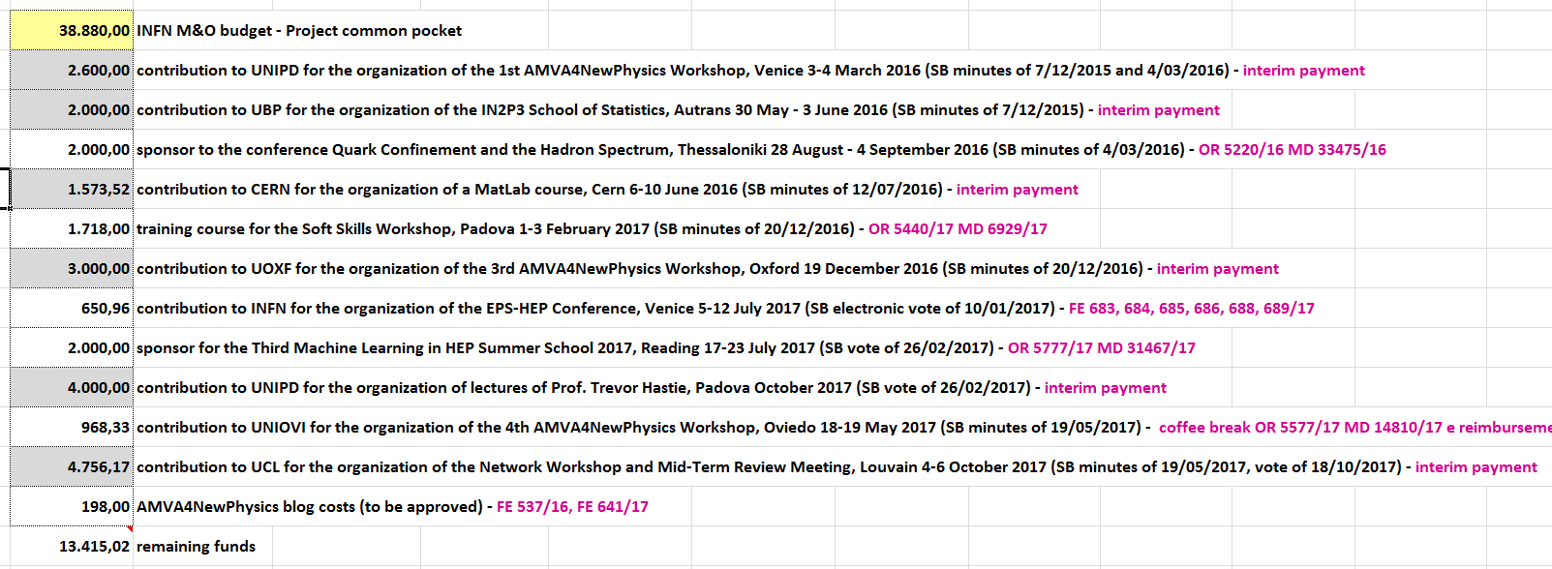
For reference: past expenses
Plus: 2k euro for SOS school 2018; 2k euro for Yandex school 2018
Remaining in INFN M/O pocket: 9400 euro
We allocated 10% of RTN funds from second period payments for new events = 48780 euro
In 2019 we expect two more network workshops, and little else.

Slide 12
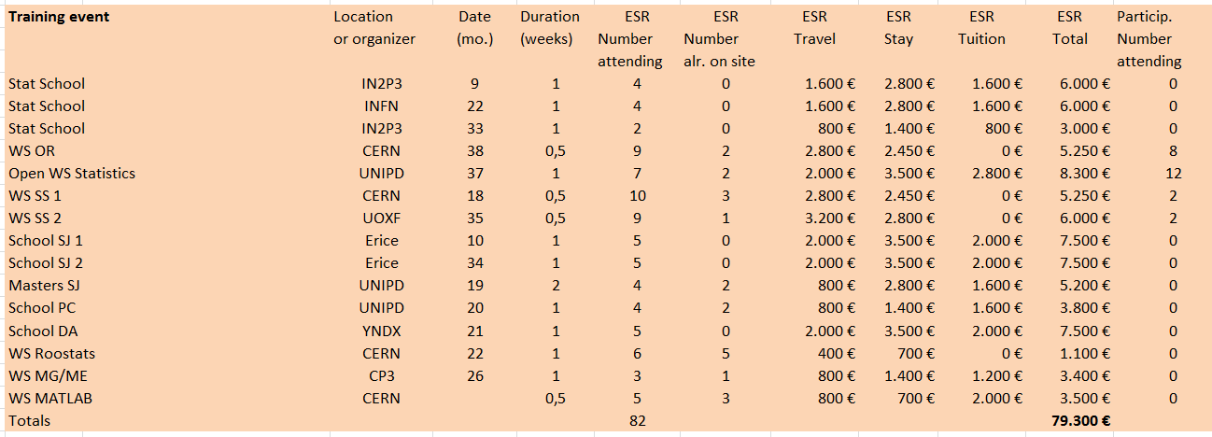
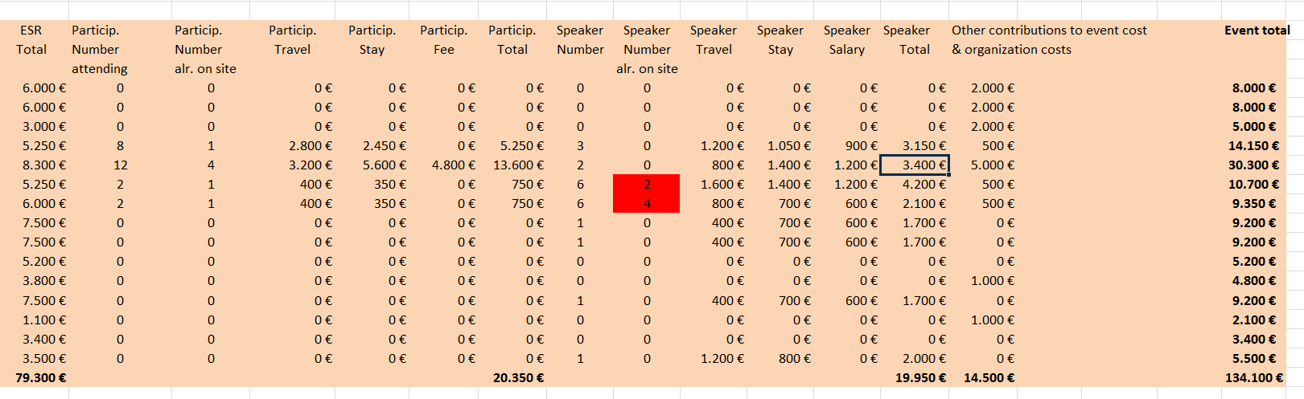
For reference: foreseen budget for network events

