Slide 1



Salvador Carrillo & Fabiola Vázquez
Universidad Iberoamericana, Mexico city

Slide 2


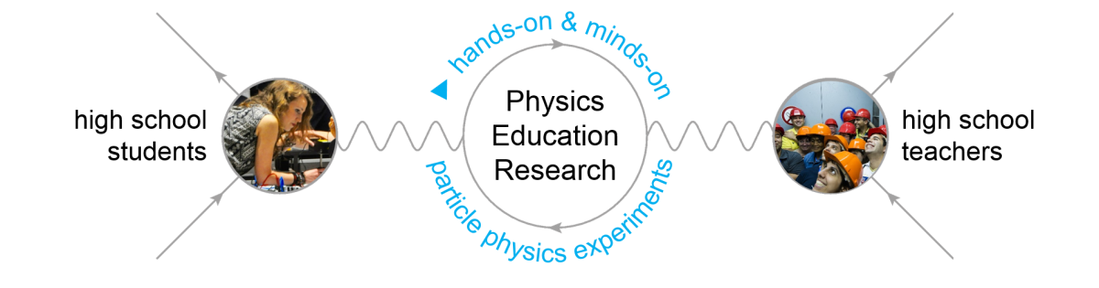

Slide 3
Why are we learning all this things?
You have been learning a lot of what CERN is all about, and about CERN future: The Science behind
How can we use this information?
This morning activity is designed to put together many of what you have learn up to now and work as a Particle Physics analysing real data and getting some answers and many more questions …
The most important point is that we will work as a collaborative group

Slide 4


Today’s activity is meant for …
S'Cool LAB
Summer Camp

Slide 5
Today’s activity is meant for …

Slide 6
Today’s activity is meant for …
CERN Masterclasses are designed to give you a brief passage through what analyzing data is all about:
  At the beginning there will be many, many questions and doubts (So you will need some help) Please feel free to make any question.
  Later you will get more confident and you will get into the “feeling” of what we want you to be measure.
  Later you will be able to analize data very fast … but here is were you can stop, and get some time to think about the whole process: “The Big Picture”. This is the very good time to start to think: why am I doing all this meassurments? What is this all about?

Slide 7
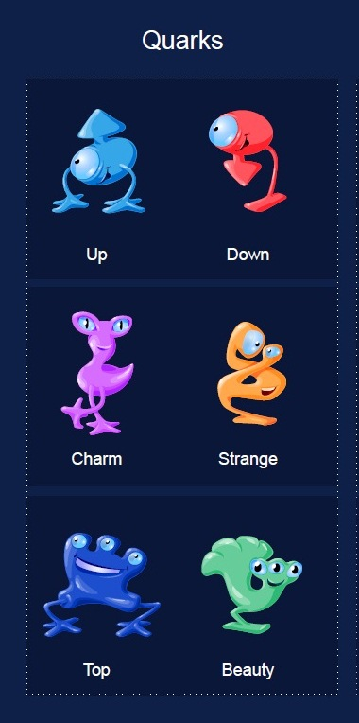

Today’s activity is meant for …
Now we are going to work as hadrons:
Since we will work in pairs we need to choose a “meson” team named by:
quark-antiquark pair
S'Cool LAB
Summer Camp
Any combination ! You can repeat

Slide 8
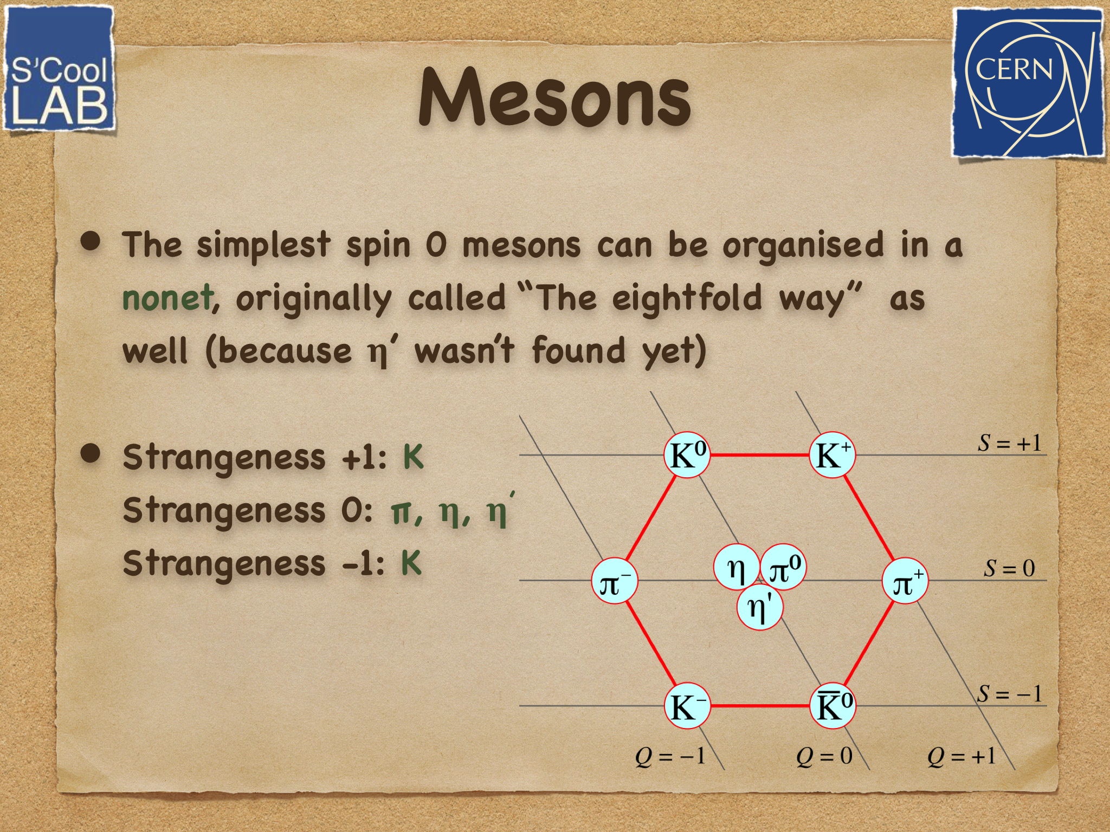
Remember that the Mesons are organised in nonet

Slide 9
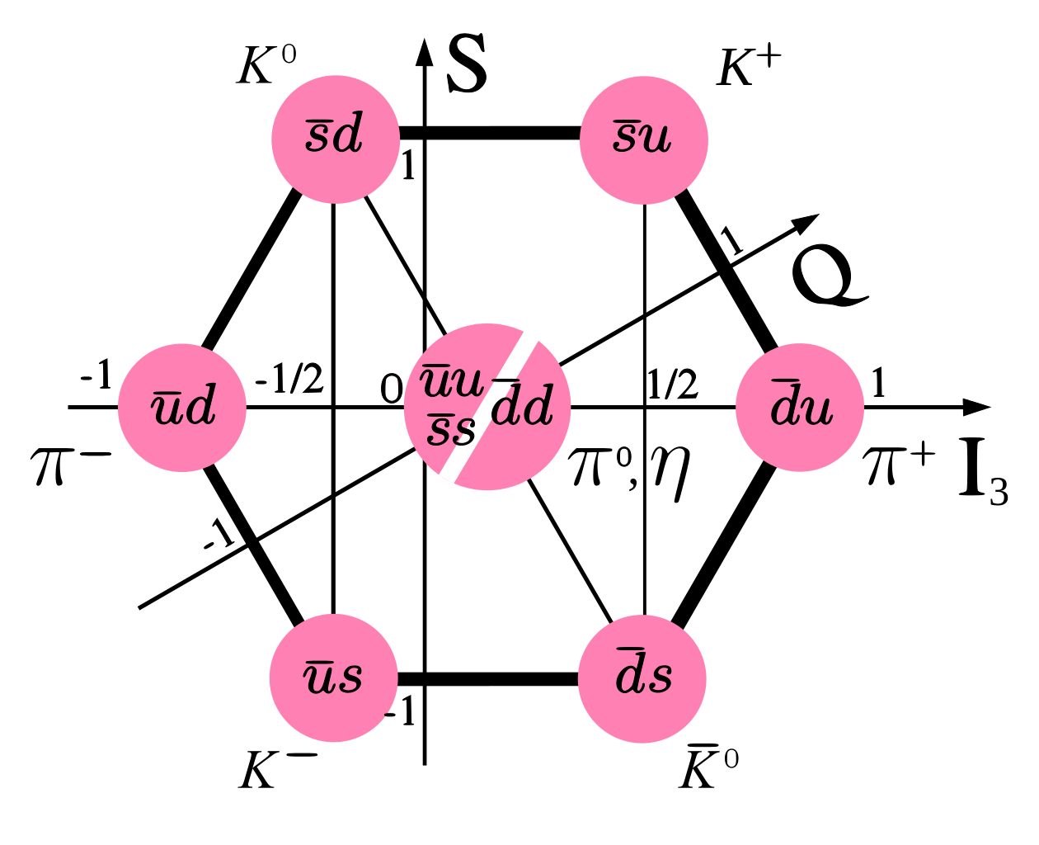

Slide 10
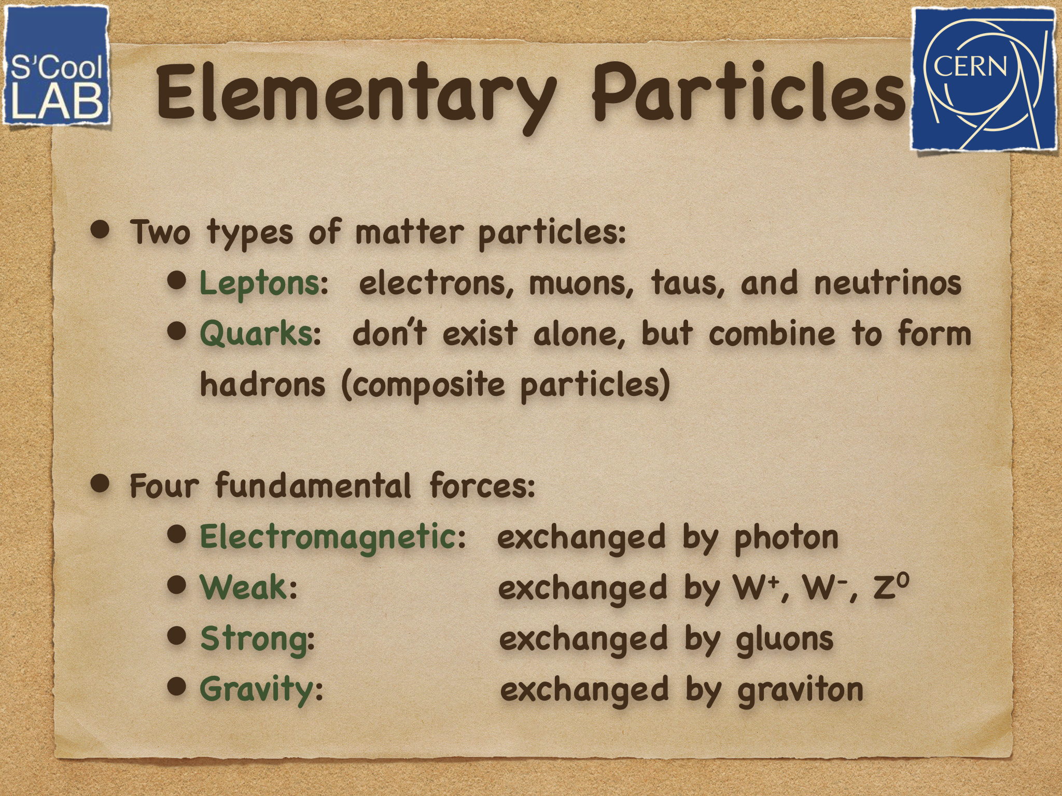
We are going to concentrate our work on:

Slide 11
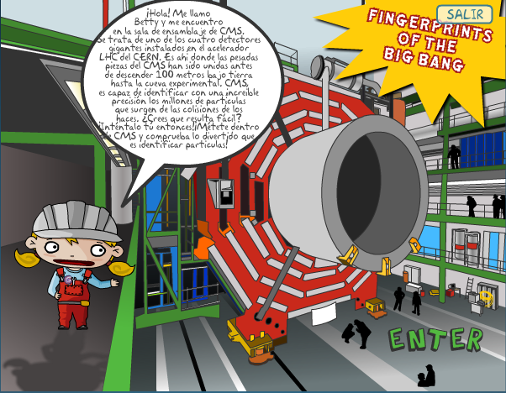
It does not matter wich experiment we are going to use, what matters is that we will “look” for the fingerprints of particles that decay inside a detector
Today you will be a Experimental Particle Physics

Slide 12
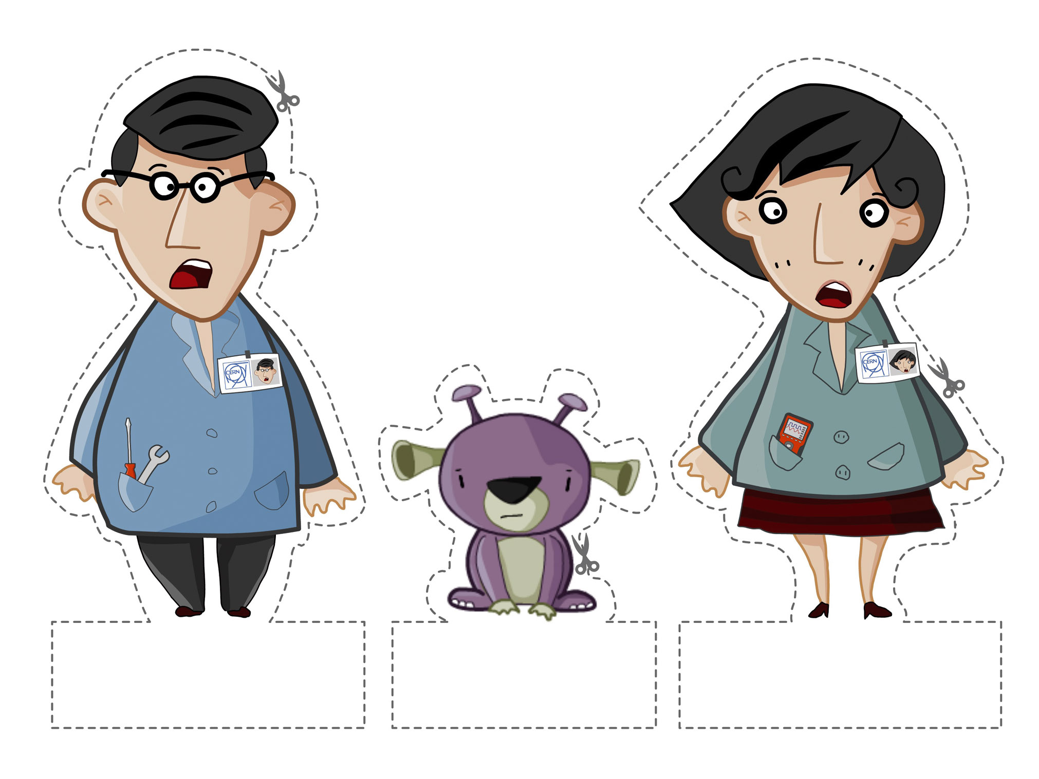

Salvador Carrillo
Fabiola Vázquez

Slide 13
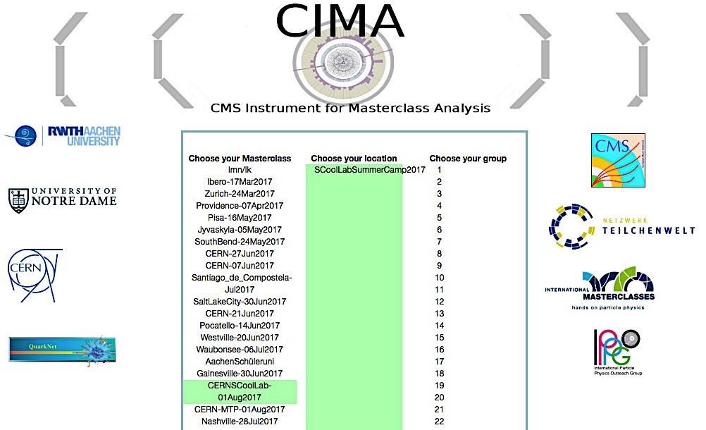


Slide 14
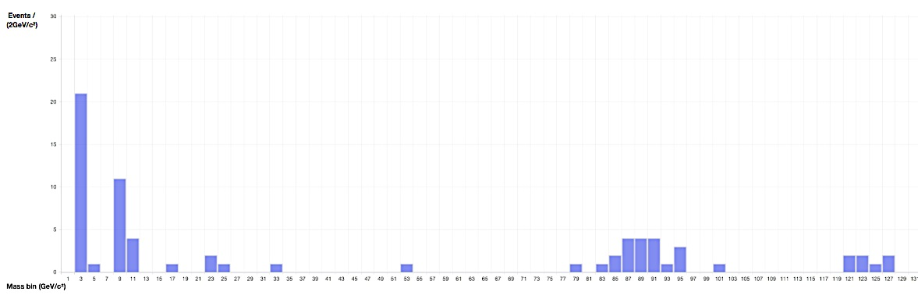
Actual data taken in S’Cool LAB @ CERN 2017
Excellent work students !
Invarian mass GeV/c²
We do have “clean” events in CMS
What are the excess seen in this mass histogram
Can you find the J/Psi? Upsilon? Z⁰?
  Any other?
What about the Higgs?

Slide 15
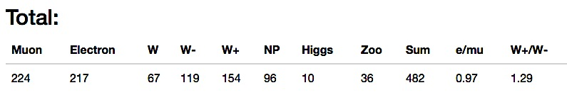
Is there a preference Electrons vs Muons in Nature?
How many Higgs candidates you found?
What is the ratio of W+ vs W- and why?
What can we do with the Zoo events?
Actual data taken in S’Cool LAB @ CERN 2017
Excellent work students !

Slide 16
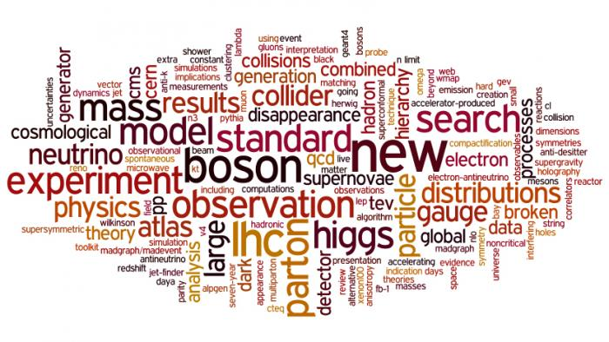
Thanks for your time …

Slide 17
backup

Slide 18
