Slide 1


Fundamental theories and gravitational waves
Alessandra Gnecchi
CERN, Theoretical Physics Department
3 August 2018
H2020-MSCA-IF-2015
702548 GaugedBH

Slide 2
Outline
Introduction
Physical principles and equations of motion
What is a theory?
Why a new theory? Dark matter, dark energy
Gravity and its issues
The Planck scale
Gravity as a wave
Detection of gravitational waves

Slide 3
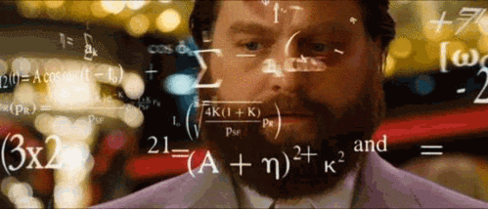
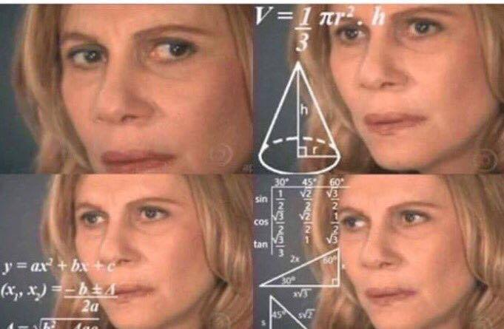
Why a theory?
The work of a physicists is to find laws that govern phenomena we observe.
Look for principles that explain fundamental forces.
Physicists describe these principle through the language of mathematics. It is easy to check the consistency of the mathematics language and follow its logic to make new predictions.
We need this mathematical setup to derive the equations that nature obeys.

Slide 4
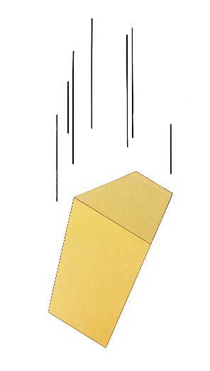
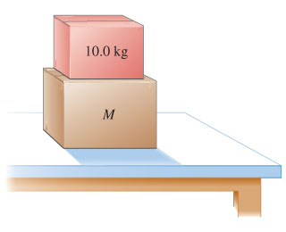
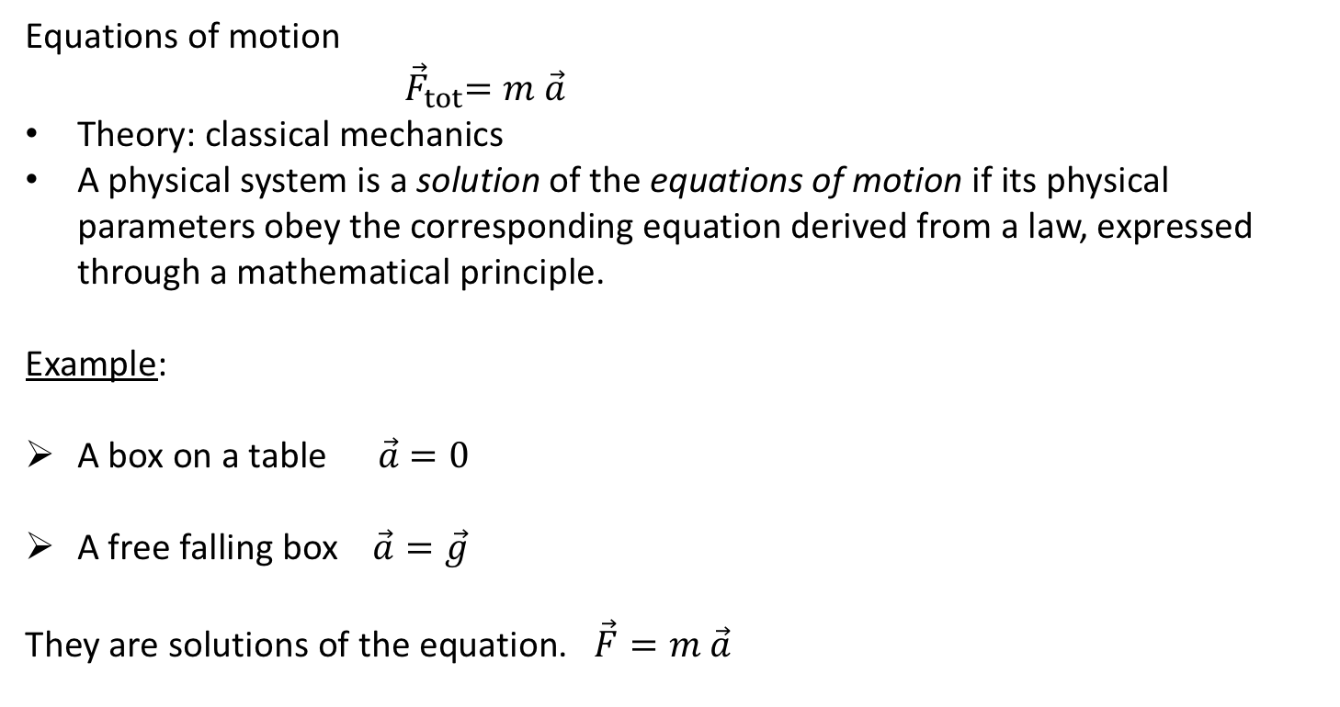
What is a theory?
Equations of motion
${ \vec{F}}_{tot}=m \vec{a}$
Theory: classical mechanics
A physical system is a solution of the equations of motion if its physical parameters obey the corresponding equation derived from a law, expressed through a mathematical principle.
Example:
A box on a table $\vec{a}$ $=0$
A free falling box $\vec{a}=\vec{g}$
They are solutions of the equation. $\vec{F}=m \vec{a}$

Slide 5

What is a theory?
A change of perspective:
Before: A box, an apple... of course they obey Newton’s law (equation of motion), that’s why the law was formulated, by observing these phenomena.
After: With the knowledge of Newton’s law (eom), if we don’t want the box to fall, we will not remove the table below it!!

Slide 6
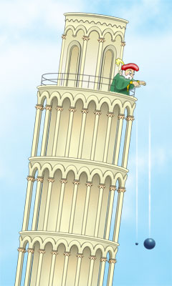
What is a theory?
Physicists keep looking for new (less conventional) phenomena.
Theoretical physicists are continuously moving between the two perspective, to understand the laws of fundamental forces and apply them to predict new phenomena or physical systems that can then be discovered.

Slide 7
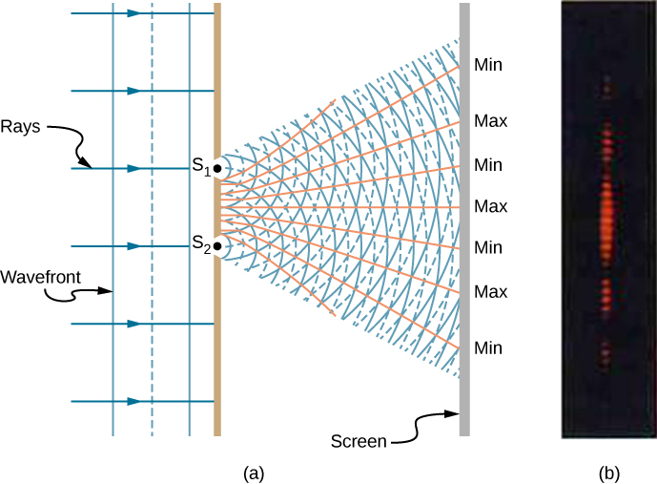
Why are we looking for a new theory?
Experimental physicists look for “discrepancies” in the experiments, by tuning a scale in their experiments. (Energy of the interactions... density of nucleons....)
We say that at that scale, the theory breaks down and one needs a more refined one, which usually involves understanding a new fundamental principle.

Slide 8
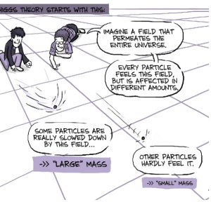
It works!
How do we explain the masses of the fundamental particles?
Based on the already confirmed Standard Model of fundamental interactions, a mechanism was proposed by theorists... to obtain particle masses. Particles simply interact with a new fundamental one, not related to any force.
This particle is the Higgs boson.
Why didn’t we see this particle before LHC?
At lower energies than its own mass (125GeV), this particle is inert. It is like a constant background that we perceive exactly by measuring the masses of the electron, the proton....
At high enough energies, this is no more just a background, but it behaves as a particle that, according to QFT, can decay in lighter particles. That’s what is observed.

Slide 9
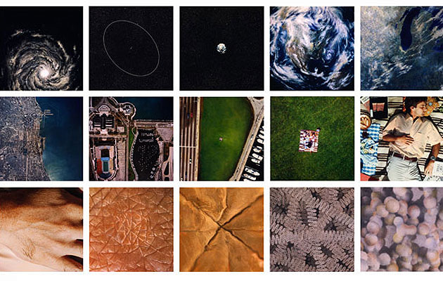
Scales: One theory to rule them all...

Slide 10
Unexplained observations aka Why are we looking for new theories?

Slide 11
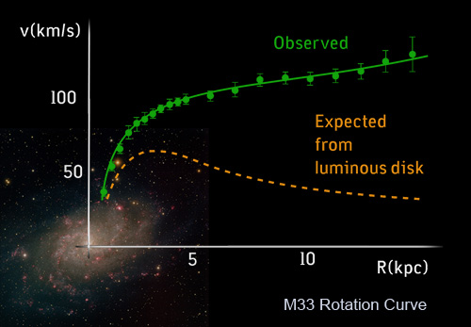
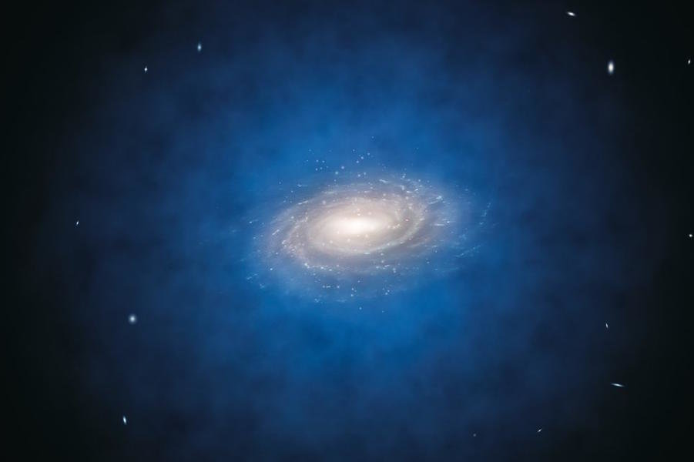
Dark Matter
Visible Matter “Disk”
learner.org/courses/physics/visual/img_lrg/andromeda.jpg
Dark Matter “Halo”
phys.org/news/2017-12-dark-energy-survey-view-halos.html

Slide 12
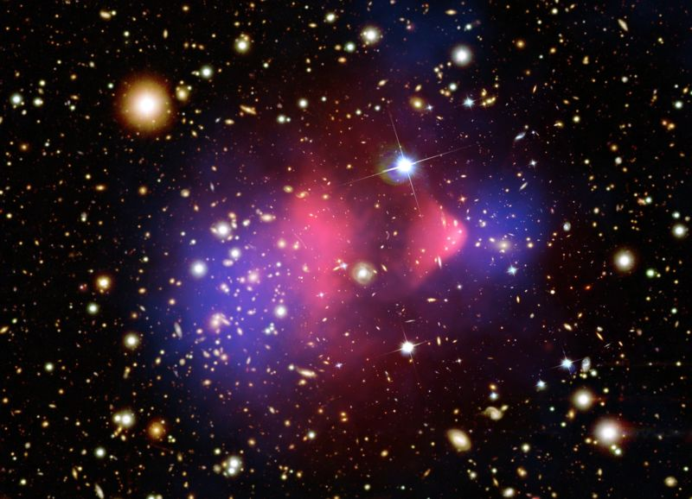
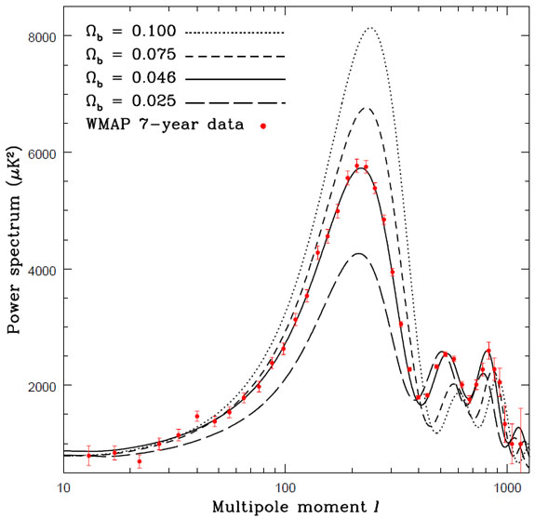
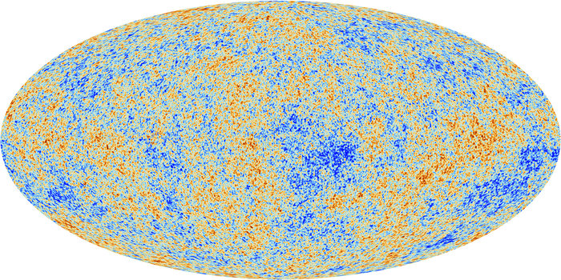
Dark Matter – What We Know
Majority of mass in galaxies
Weak self-interactions
Weak interactions with normal matter
apod.nasa.gov/apod/ap060824.html
esa.int/spaceinimages/Images/2013/03/Planck_CMB
ned.ipac.caltech.edu/level5/March10/Garrett/Garrett3.html

Slide 13
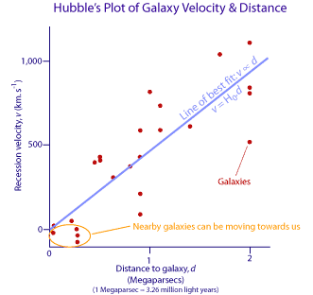
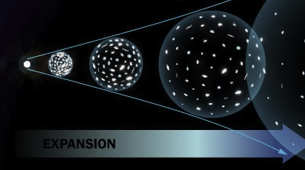
Dark Energy
Universe is expanding
p1repair.com/blog/wp-content/uploads/2017/07/expanding-universe.jpg
Gravity should cause expansion to slow down…
atnf.csiro.au/outreach/education/senior/cosmicengine/hubble.html
…but it’s actually speeding up!
There must be some source of energy causing this acceleration

Slide 14
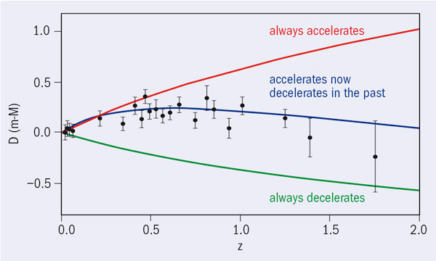
Dark Energy
Universe is expanding
p1repair.com/blog/wp-content/uploads/2017/07/expanding-universe.jpg
atnf.csiro.au/outreach/education/senior/cosmicengine/hubble.html
Gravity should cause expansion to slow down…
…but it’s actually speeding up!
There must be some source of energy causing this acceleration
images.iop.org/objects/ccr/cern/49/2/15/CCdar2_03_09.jpg

Slide 15
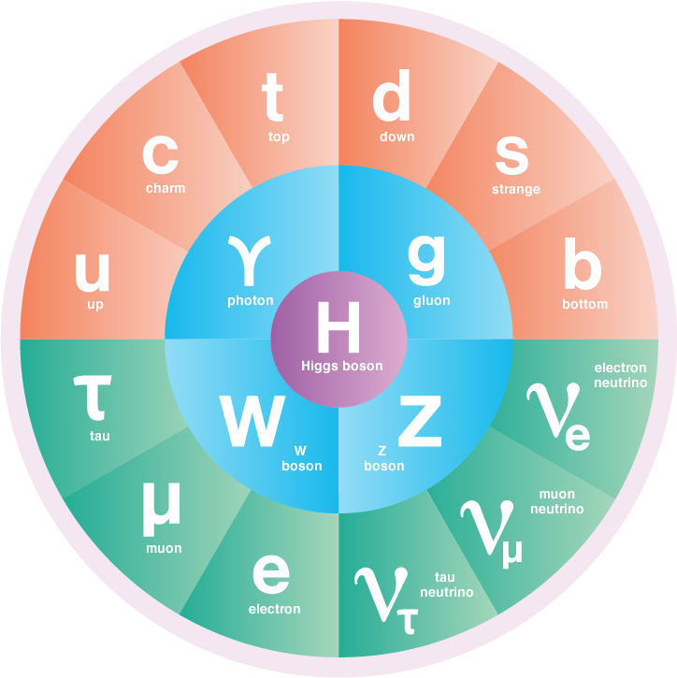
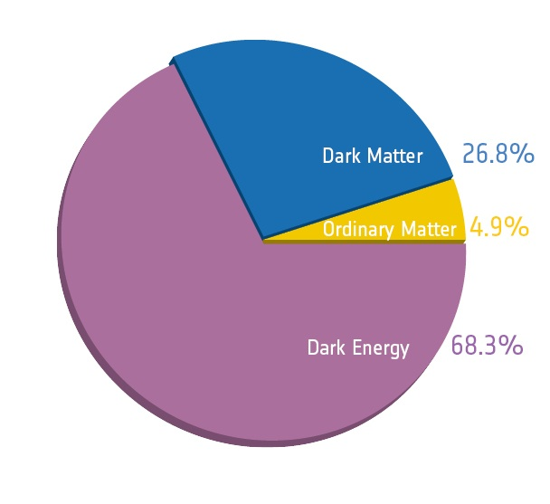
The Unknown Universe
physics.ox.ac.uk/research/dark-matter-dark-energy
Well-understood
symmetrymagazine.org/standard-model/
What are these?!

Slide 16
Gravity

Slide 17


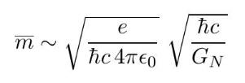



Maxwell & Einstein: energy scales
Electromagnetism
Interaction between two charged particles
Comparing the two forces
$\frac{F_{em}}{F_{G}}≈{ 10}^{42} \left(e\right)$ $≈{10}^{36} \left(p\right)$
(Newtonian) gravity
Interaction between two massive particles
$$α$$
$$M_{Pl}$$

Slide 18
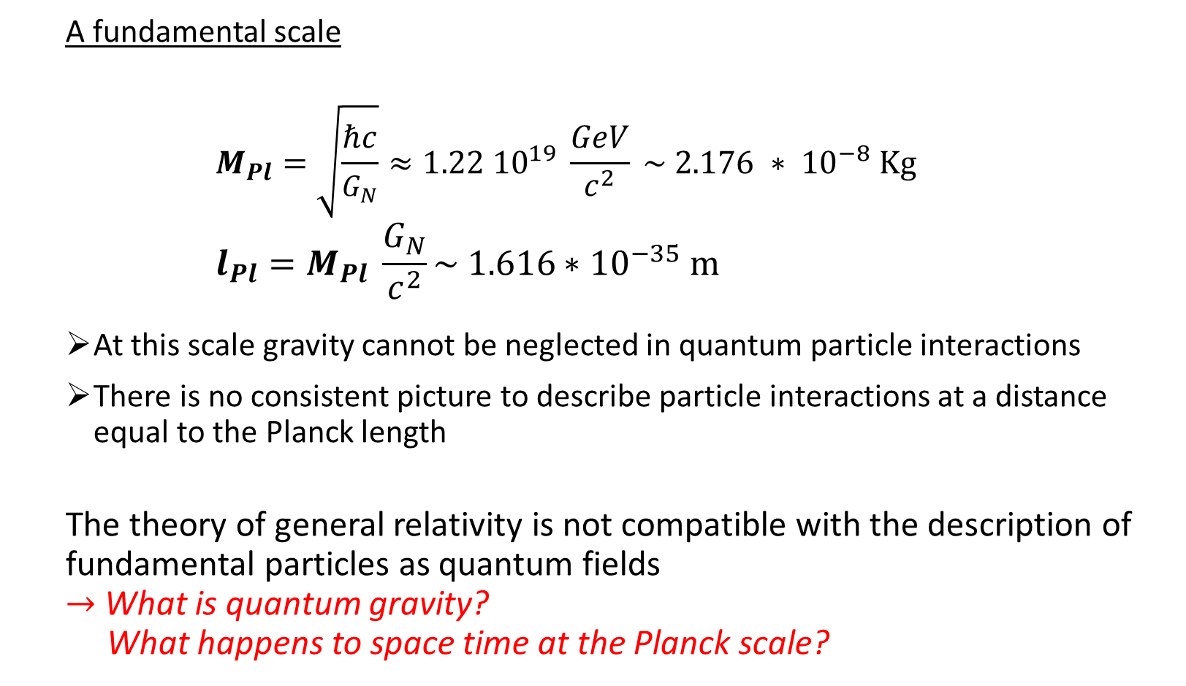
Gravity: Planck scale
A fundamental scale
$$M_{Pl}=\sqrt{\frac{ℏc}{G_{N}}}≈1.22 {10}^{19} \frac{GeV}{c^{2}} \sim 2.176 ∗ {10}^{−8} \text{Kg} \\ l_{Pl}=M_{Pl} \frac{G_{N}}{c^{2}}\sim 1.616∗{10}^{−35} \text{m}$$
At this scale gravity cannot be neglected in quantum particle interactions
There is no consistent picture to describe particle interactions at a distance equal to the Planck length
The theory of general relativity is not compatible with the description of fundamental particles as quantum fields $→$What is quantum gravity? What happens to space time at the Planck scale?

Slide 19
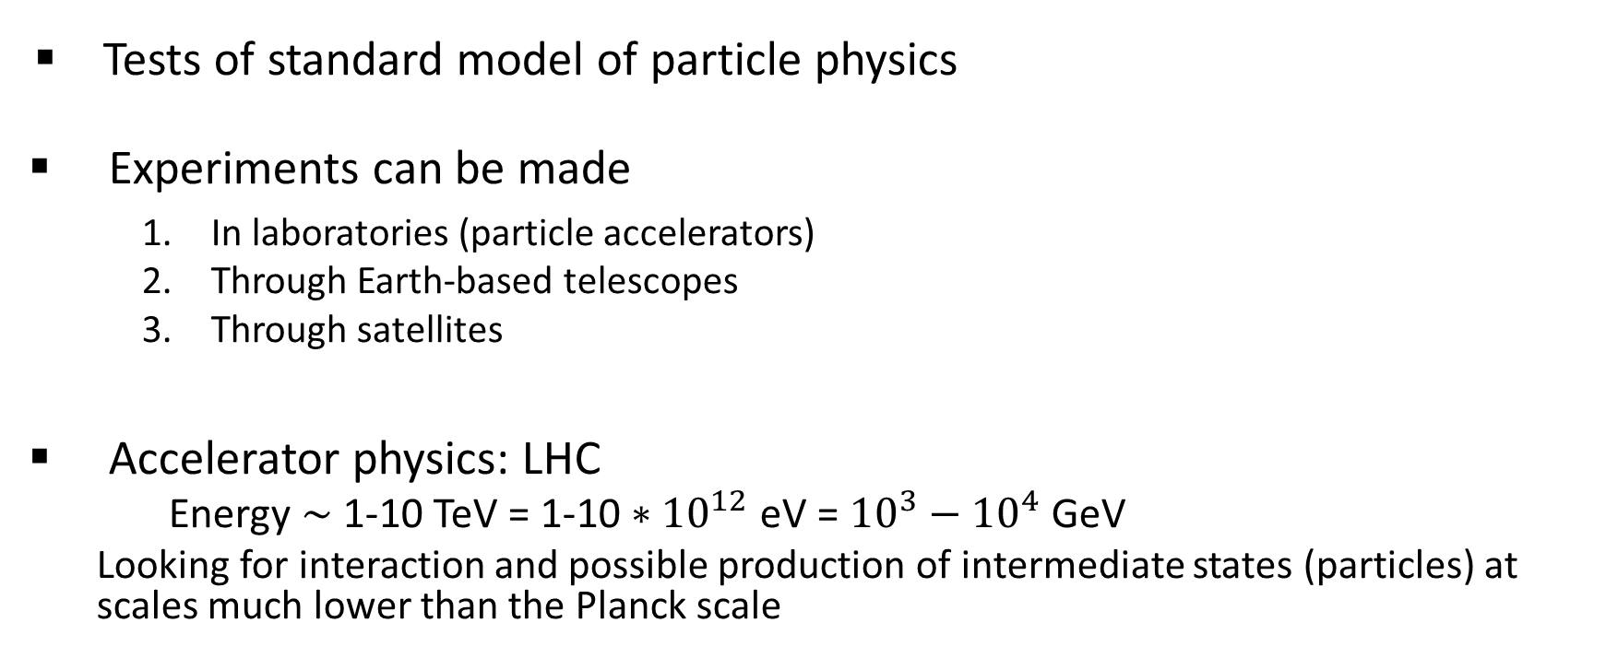
Particle experiments
Tests of standard model of particle physics
Experiments can be made
In laboratories (particle accelerators)
Through Earth-based telescopes
Through satellites
Accelerator physics: LHC
Energy $∼$ 1-10 TeV = 1-10 $∗{10}^{12}$ eV = ${10}^{3}−{10}^{4}$ GeV
Looking for interaction and possible production of intermediate states (particles) at scales much lower than the Planck scale

Slide 20

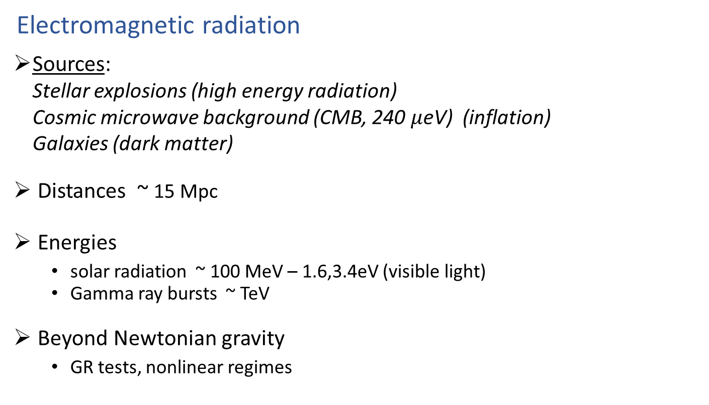
The Universe as a laboratory
Electromagnetic radiation
Sources: Stellar explosions (high energy radiation) Cosmic microwave background (CMB, 240 $μ$eV) (inflation) Galaxies (dark matter)
Distances ~ 15 Mpc
Energies
solar radiation ~ 100 MeV – 1.6,3.4eV (visible light)
Gamma ray bursts ~ TeV
Beyond Newtonian gravity
GR tests, nonlinear regimes
$$1 eV=1.06 ×{10}^{−19} J$$

Slide 21
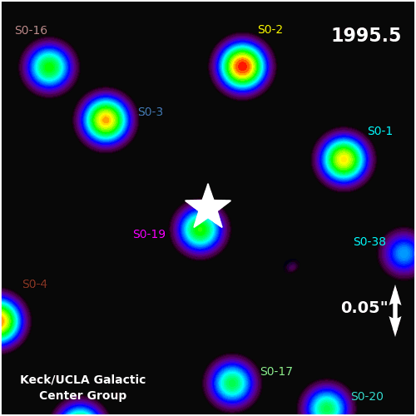
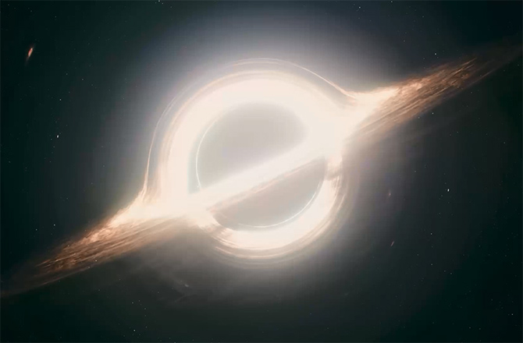
Black holes
Final point of gravitational collapse
Classically do not emit radiation but can be nonetheless studied
Their gravitational attraction influences the orbit of nearby stars
We can now detect gravitational waves!!
Animation created by Prof. Andrea Ghez and her research team
at UCLA and are from data sets obtained with the W. M. Keck Telescopes.
Black holes are the harmonic oscillator of quantum gravity
(A. Strominger)
From the Movie «Interstellar»

Slide 22



Wave phenomena for gravity
Source: matter distribution determines the shape of space-time
Far from the source, where the mass density of the region is much smaller than the source, we are in a region of weak field
There, changes in the distribution of matter are perceived as perturbation over a fixed background
Gravitational systems can be studied by an approximation called linearized gravity (around a fixed background)
$$r \sim \overline{r}$$
weak field region
$$r≫\overline{r}$$
$$g_{μν} ≈ \overline{g_{μν}}+h_{μν}$$

Slide 23
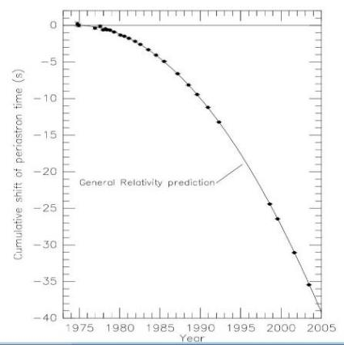
Wave phenomena for gravity
In general, gravitational systems emit gravitational energy by radiation
Gravitational energy loss affects e.g. the orbit period of a system of binary stars
The effect of emitting gravitational waves has been observed in the past in binary systems
PSR B1913+16 - Hulse&Taylor, 1974
Pulsar + NS with period ~8h
1993 Physics Nobel Prize
[ArXiv:astro/ph/0407149
Weisberg-Taylor]

Slide 24
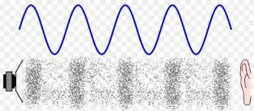

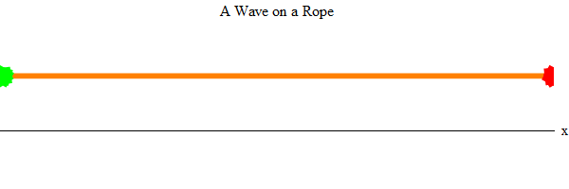
Mechanical waves
Acoustic waves
System of springs
Tension is an elastic force among the components of a rope

Slide 25
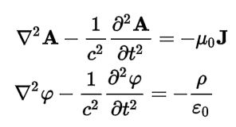
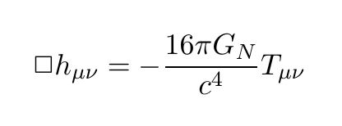


Maxwell & Einstein: waves in vacuum
E&M
Electromagnetic potentials:
$$A_{μ}≡(φ,\vec{A})$$
Gravity (GR)
Space-time geometry, metric tensor
$g_{μν} ≈ \overline{g_{μν}}+h_{μν}$

Slide 26
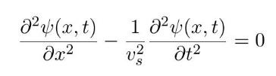
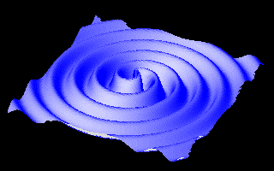
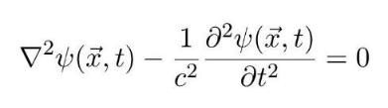
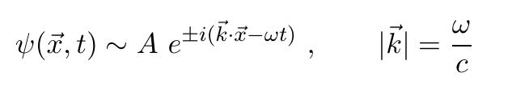
Wave equation
All previous examples are described by the same equation. In vacuum it is expressed as
Waves are solutions of these equations, e.g.
(dispersion relation for light waves in vacuum)

Slide 27
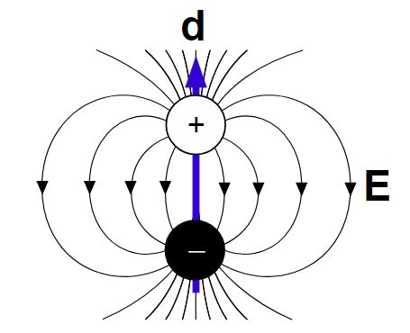
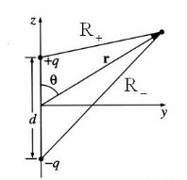

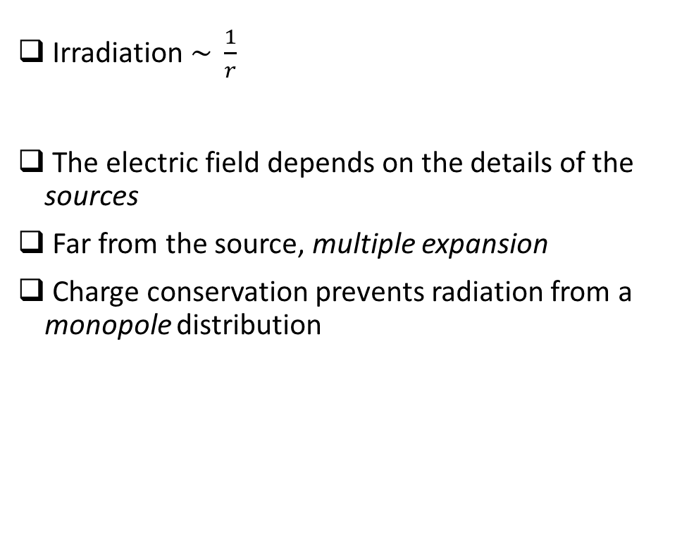
Wave phenomena - light
Irradiation $\sim \frac{1}{r}$
The electric field depends on the details of the sources
Far from the source, multiple expansion
Charge conservation prevents radiation from a monopole distribution

Slide 28
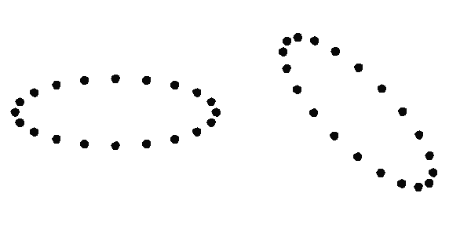
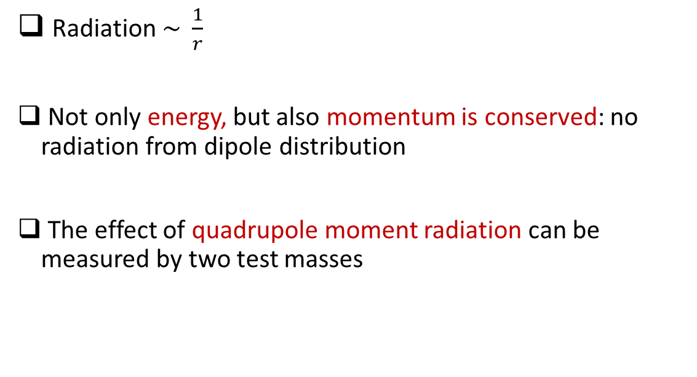
Wave phenomena - gravity
Radiation $\sim \frac{1}{r}$
Not only energy, but also momentum is conserved: no radiation from dipole distribution
The effect of quadrupole moment radiation can be measured by two test masses

Slide 29
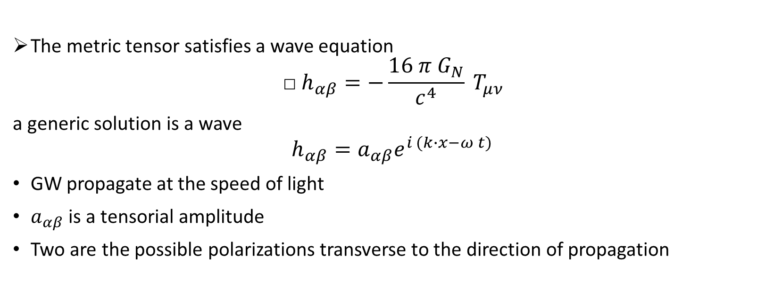
Gravitational waves
The metric tensor satisfies a wave equation $\text{□}h_{αβ}=−\frac{16 π{ G}_{N}}{c^{4}} T_{μν}$
a generic solution is a wave
$$h_{αβ}=a_{αβ}e^{i (k∙x−ω t)}$$
GW propagate at the speed of light
$a_{αβ}$ is a tensorial amplitude
Two are the possible polarizations transverse to the direction of propagation

Slide 30
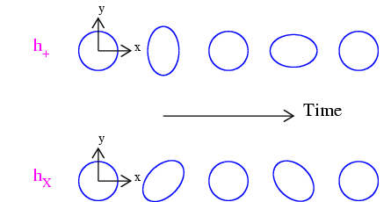
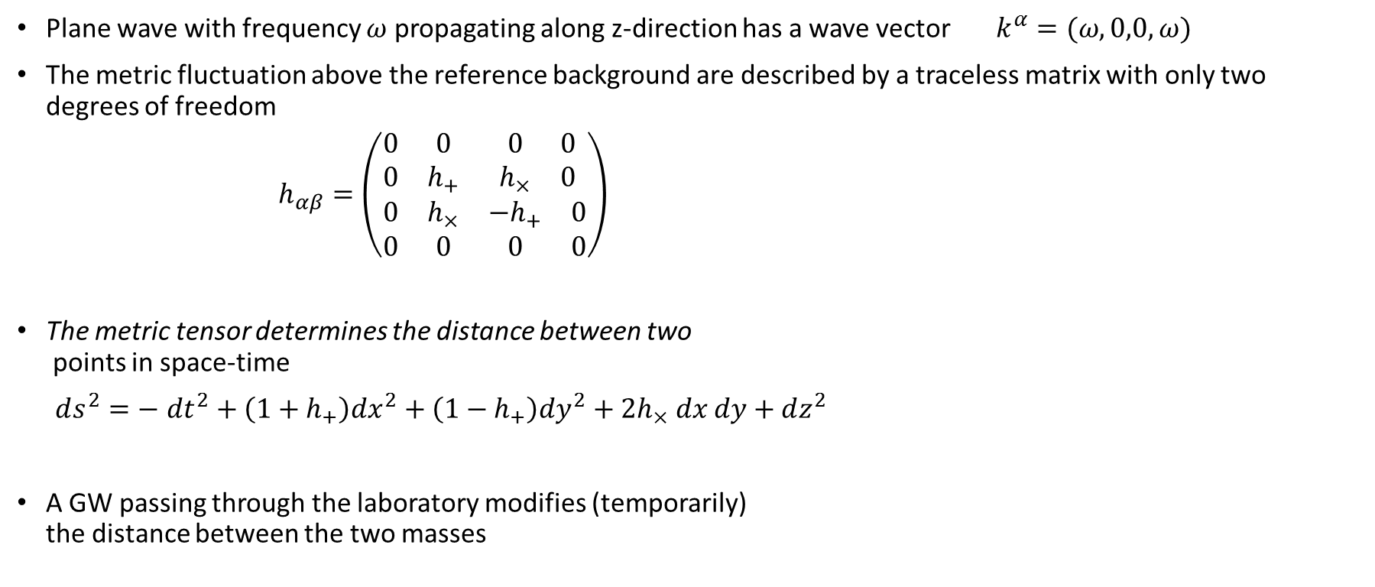
Gravitational waves
Plane wave with frequency $ω$ propagating along z-direction has a wave vector $k^{α}=(ω,0,0,ω)$
The metric fluctuation above the reference background are described by a traceless matrix with only two degrees of freedom
$h_{αβ}=\left(\begin{matrix}\begin{matrix}0 & 0 \\ 0 & h_{+}\end{matrix} & \begin{matrix}0 & 0 \\ h_{×} & 0\end{matrix} \\ \begin{matrix}0 & h_{×} \\ 0 & 0\end{matrix} & \begin{matrix}−h_{+} & 0 \\ 0 & 0\end{matrix}\end{matrix}\right)$
The metric tensor determines the distance between two points in space-time
$ds^{2}=− dt^{2}+\left(1+h_{+}\right)dx^{2}+\left(1−h_{+}\right)dy^{2}+2h_{×} dx dy+dz^{2}$
A GW passing through the laboratory modifies (temporarily) the distance between the two masses
arXiv:1209.0667

Slide 31
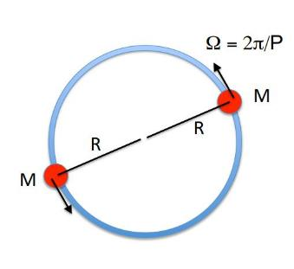


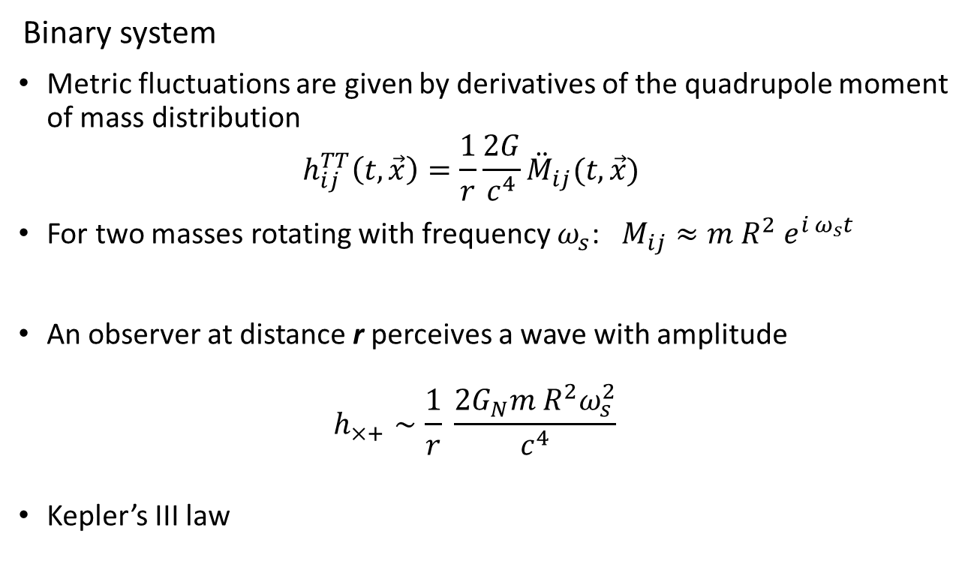
Sources of Gravitational waves
Binary system
Metric fluctuations are given by derivatives of the quadrupole moment of mass distribution $h_{ij}^{TT}\left(t, \vec{x}\right)=\frac{1}{r}\frac{2G}{c^{4}}{\ddot{M}}_{ij}(t, \vec{x})$
For two masses rotating with frequency $ω_{s}$: $M_{ij}≈m R^{2} e^{i ω_{s}t}$
An observer at distance r perceives a wave with amplitude $h_{×+}∼\frac{1}{r} \frac{2G_{N}m R^{2}ω_{s}^{2}}{c^{4}}$
Kepler’s III law
Image by
P.Sutton

Slide 32



Sources of Gravitational waves
Neutron stars binary system $M≈1.4 M_{⊙} , r=5 kpc, ω_{s}=1 {hour}^{−1}$
Detectable amplitude: $h \sim {10}^{−22}$
Interferometers can detect a signal at low noise around a frequency $f\sim 100 Hz$ , which, for the same amplitude $h \sim {10}^{−22}$ gives a distance of$r=15 Mpc$ (~ Virgo galaxy cluster)
The corresponding period being $T\sim 0.02 s$ , the resulting orbital separation is: $R\sim 100 \text{km}$ Very compact objects!!! (NS-NS, NS-BH, BH-BH) (e.g. $R_{⊙}\sim 7 ×{10}^{5}km$)

Slide 33
Detection of Gravitational Waves

Slide 34
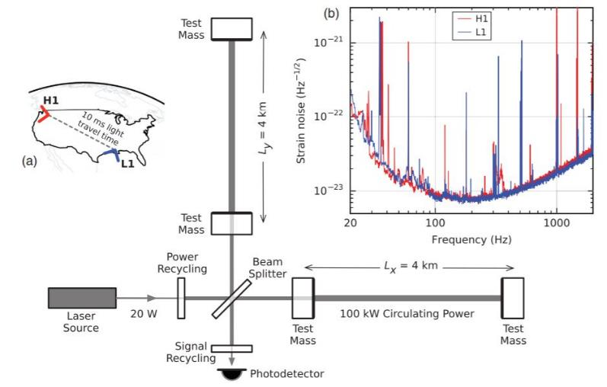
Gravitational waves interferometers
Image by LIGO&Virgo Collaborations
arxiv:1602.03837

Slide 35
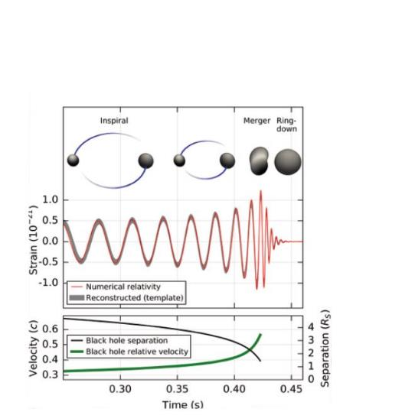

Gravitational waves interferometers
ArXiv:1602.03837
PRL 116, 061102 (2016)
“On September 14, 2015 at 09:50:45 UTC the two detectors of the Laser Interferometer Gravitational-Wave Observatory simultaneously observed a transient gravitational-wave signal.”
LIGO & Virgo
Scientific Collaborations

Slide 36


Gravitational waves interferometers
Laser Interferometer Gravitational-Wave Observatory (LIGO)
LIGO Hanford, Washington
LIGO Livingston, Louisiana
http://www.ligo.org/
Virgo interferometer
Cascina (Pisa)
http://www.virgo-gw.eu/
Hanford Interferometer
Image by LIGO collaboration
Image by Virgo collaboration

Slide 37

GW detection
Black hole mergers
GW150914: 36 + 29 Solar masses
GW151226: 14 + 7.5 Solar masses
GW170104 31 + 19 Solar masses
GW170814 30 + 25 Solar masses
Rivelatori sensibili
alle frequenze intorno a
~100Hz : chirp

Slide 38

GW detection: Neutron stars
16 October 2016:
announcement of event GW170817 –
neutron stars mergere
Emitted energy is not only gravitational radiation
but also light (photons) and matter (elementary
massive particles).
Detection of the emitted radiation by studying
decays into lighter particles through spectral
lines

Slide 39

GW detection: Neutron stars
LIGO-Virgo triangulation
The event was in the black spot of the Virgo detector, still an important information to determine the position of the event with enough accuracy.
With the precise location available, astronomical telescopes could be directed towards the event to receive the radiation throughout the following days

Slide 40
Multimessenger astronomy
New signals received, a new way to look at the Universe!
Electromagnetic waves | Gravitational waves
Accelerated charges | Acceleration of matter distribution
Continued emission in the days (and months following the merger) | Instantaneous emission
Highly interacted with interstellar medium | Transparent to matter
Frequency > 10 MHz | Frequency < 10 kHz (we can hear it!)

Slide 41
Multimessenger astronomy
New discoveries!
EM waves following the merger
Origin of a class of Gamma ray bursts (< 2’’)
Observation of a new state of a neutron star, where heavy nuclei are expelled: kilonova
Confirmation of theoretical hypothesis on the origin of heavier than iron elements (gold, silver..)
Successive more precise position detection

Slide 42
...is this all? where are the puzzles coming from?

Slide 43

Stephen Hawking, 1942 -2018

Slide 44



Black hole thermodynamics
Study light quantum fields on a fixed black hole background
Black holes first law
$$dM=T dS+ Φ dQ$$
Hawking radiation
$$T= \frac{κ}{2π} \sim \frac{1}{2 r_{h}}$$
Particle-antiparticle production from the quantum vacuum in the near horizon region
Hints of a thermodynamics/statistical nature of black holes

Slide 45


Black hole thermodynamics
Bekenstein - Hawking entropy
$$\# dof\sim e^{S}$$
What’s the microscopic origin of entropy for black holes?
GR NO-Hair theorem: uniqueness of black hole solution (given Q,M,J)
Microstates might be described by a theory that extends GR
and possibly allows a quantum description of gravity

Slide 46
Conclusions
The interplay between observations, unexplained phenomena, and mathematical consistency of the physical laws is what keeps the theorists busy (...excited).
The visible Universe offers a rich window to unexplained phenomena
Recent detection of gravitational waves has opened a new era of investigations that may give precious hints on the unification of interactions and the quantum nature of gravity
The future generation of physicists will face interesting challenges... We’re waiting for you!!!! ☺

Slide 47
Thank you!

Slide 48



Maxwell & Einstein: scale di energia
Elettromagnetismo
Forza tra due cariche
Le due forze a confronto
$\frac{F_{em}}{F_{G}}≈{ 10}^{42} \left(e\right)$ $≈{10}^{36} \left(p\right)$
Gravità (newtoniana)
Forza tra due corpi
$$α$$
$$M_{Pl}$$

Slide 49



Electromagnetism: energy scales
The energy of light is quantized by its frequency
$$E=ℏω$$
The coupling of a particle to EM field is described by a fundamental quantity
$$α= \sqrt{\frac{e}{ℏc 4πε_{0}}} ≈ \frac{1}{137}$$
Gamma rays
1 MeV
X-rays
1-100 keV
UV
10-100 eV
Visible
1 eV
IR
10-100 meV, 1eV
Micro-radio waves
${10}^{−9}$ eV, meV
image: Nasa

Slide 50
Fenomeni ondulatori in gravità
In presenza di fenomeni che perturbano il background, dall’equazione della relatività linearizzata si ottengono le equazioni delle onde per il campo gravitazionale
La rivelazione di onde gravitazionali con interferometri avviene quando si verificano fenomeni di fusione che coinvolgono corpi sufficientemente massivi.
È necessario che avvengano fenomeni catastrofici perchè si producano onde gravitazionali?

Slide 51


Wave phenomena for gravity
In general, gravitational systems emit gravitational energy by radiation
Gravitational energy loss affects e.g. the orbit period of a system of binary stars
The effect of emitting gravitational waves has been observed in the past in binary systems
$$g_{μν} ≈ \overline{g_{μν}}+h_{μν}$$
$$r \sim \overline{r}$$
weak field region
$$r≫\overline{r}$$

Slide 52
Onde gravitazionali – rivelazione indiretta
Sistemi binari di stelle con perdita di energia per irraggiamento di onde gravitazionali
prima osservazione PSR B1913+16 , Hulse&Taylor, 1974
sistema binario di pulsar e stella di neutroni con periodo di rivoluzione di sole otto ore
Nobel Prize 1993
[ArXiv:astro/ph/0407149
Weisberg-Taylor]

Slide 53
The physics of waves
Mechanical waves: acoustics, fluid dynamics
Elastic forces
Waves in vacuum:
Electromagnetism
Fundamental forces
Quantum mechanics (wave-particle duality)
General relativity (gravitational waves)

Slide 54

Teoria delle onde gravitazionali
Radiazione di quadrupolo (della distribuzione di materia): il primo contributo non nullo di un campo tensoriale di spin 2
Analogo irraggiamento di onde come in elettromagnetismo, ma il contributo principale non è di dipolo
Metrica come un campo fondamentale
spin ½ : elettroni, muoni, quarks.. (materia)
spin 1: fotoni (mediatori delle interazioni)
spin 0: Higgs!
spin 2: gravitone, la particella che corrisponde alla metrica
spin 3/2?, superpartners?....... aspettiamo nuova fisica da LHC!
La teoria quantistica non è rinormalizzabile! [Goroff,Sagnotti, 1985] siamo in approssimazione semiclassica, non ci curiamo delle singolarità finché il fenomeno ha energia
$E≪m_{Pl}=\sqrt{\frac{ℏ c}{G}}≈{10}^{19}GeV$ (cfr. LHC $≈10 TeV$ $→$ ${10}^{15}$ ordini di grand.)

Slide 55

Gravitational waves
The metric tensor determines the distance between two points in spacetime
$$ds^{2}=− dt^{2}+\left(1+h_{+}\right)dx^{2}+\left(1−h_{+}\right)dy^{2}+2h_{×} dx dy+dz^{2}$$
A GW passing through the laboratory modifies (temporarily) the distance between the two masses

Slide 56
Predictions from theoretical physics
How can we use the laws to predict new physical systems?
The energy scale of gravity.
Example: gravity
The equations of motion of gravity.
On earth:
In the solar system: depending on the

