Slide 1
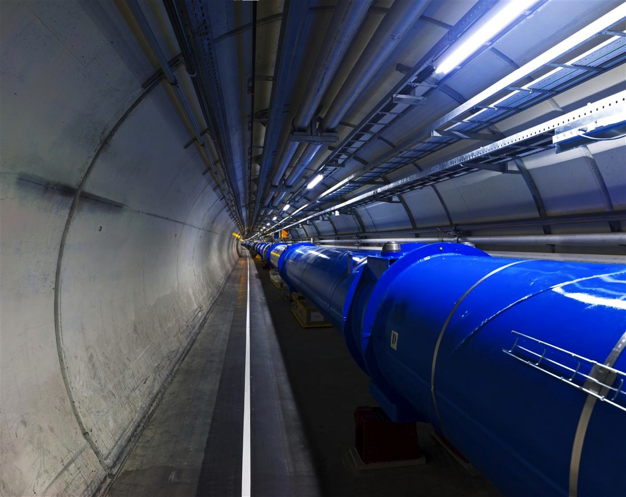
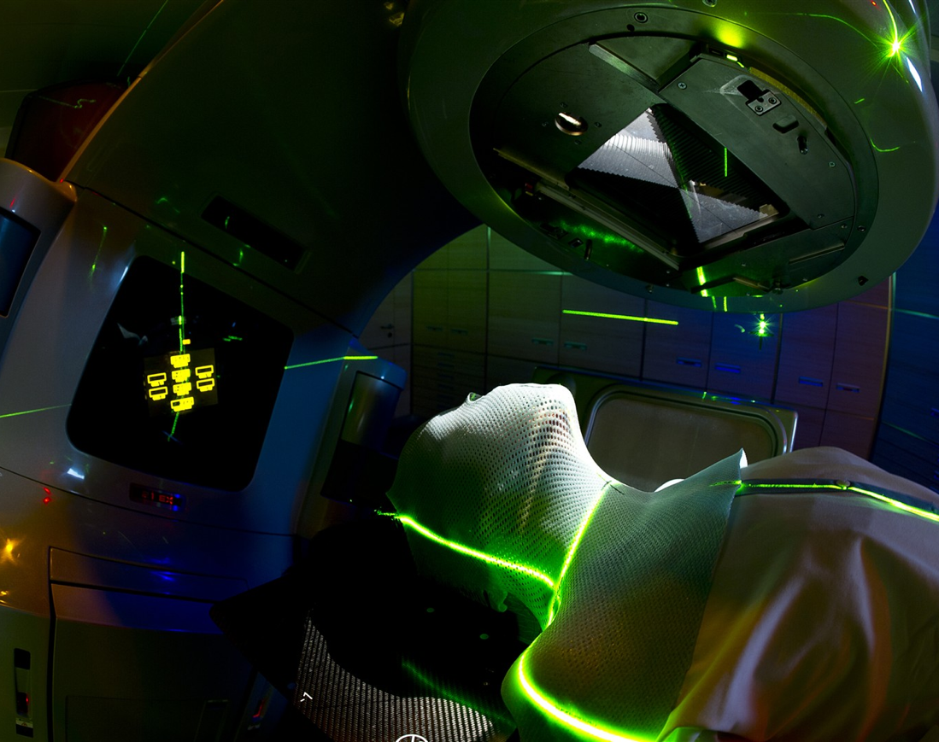

CERN: history and applications
Rita Ferreira
CERN Knowledge Transfer, Medical Applications
rita.ferreira@cern.ch
Credits: Manuela Cirilli, Giovanni Porcellana, CERN Knowledge Transfer

Slide 2

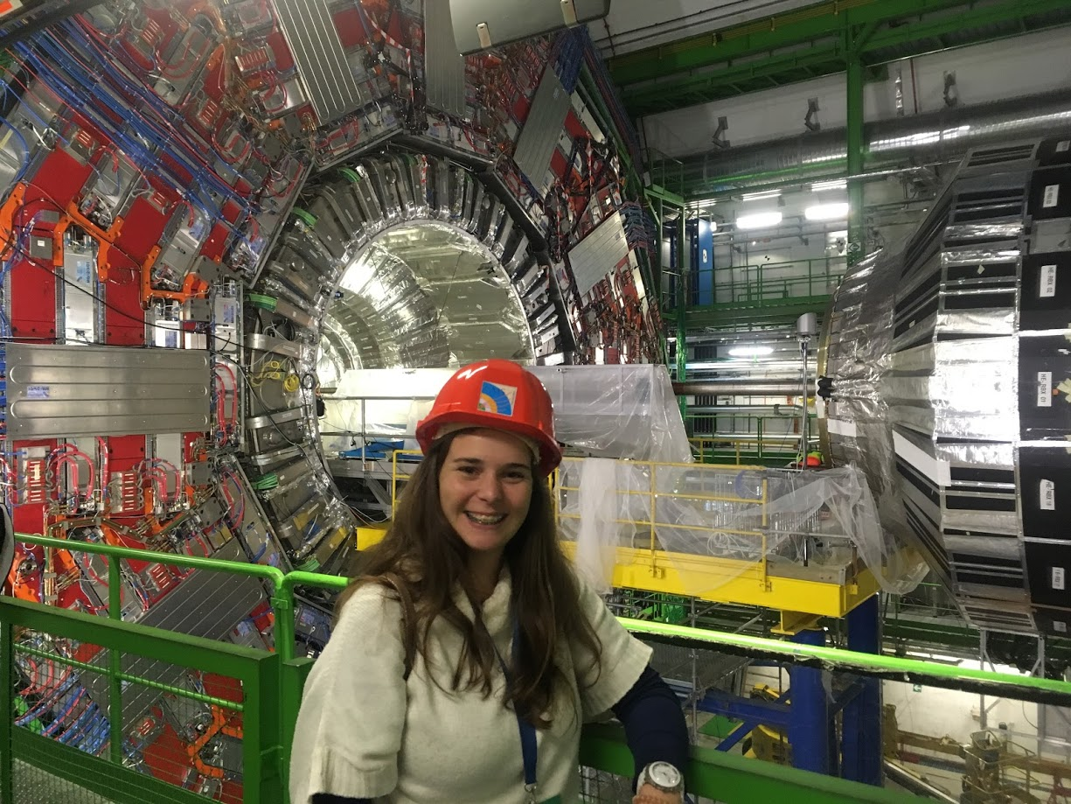

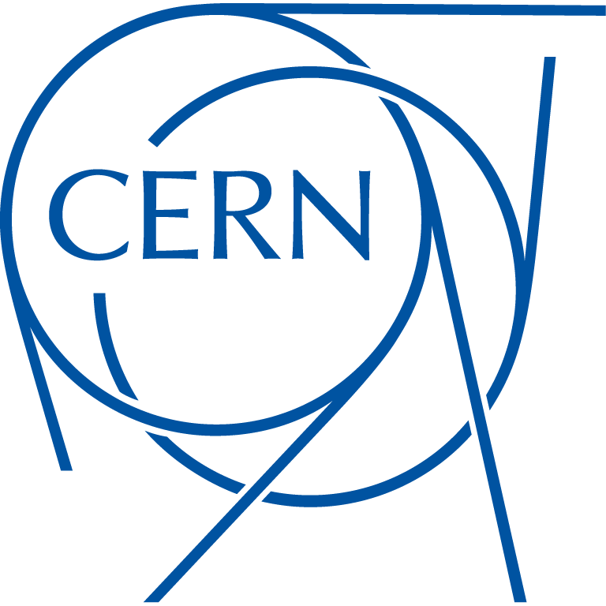
Who?
Rita Ferreira
Chemical and Biochemical Engineer
From Lisbon, Portugal
What (and where)?
PhD/Researcher (before) and CERN (now)
Medical Applications
Accelerators for Hadron Therapy
Magnets
Outreach
…

Slide 3

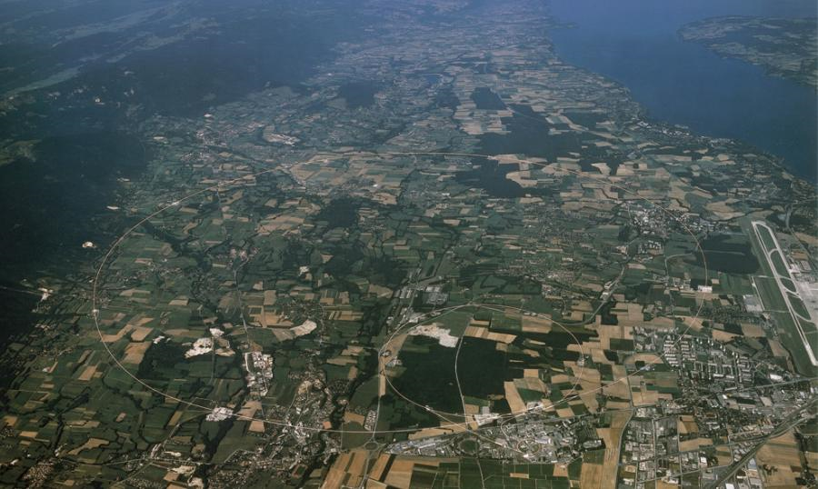
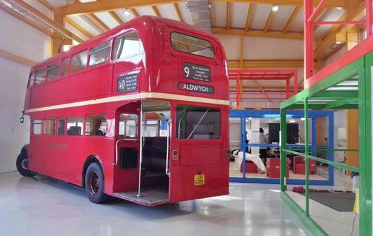
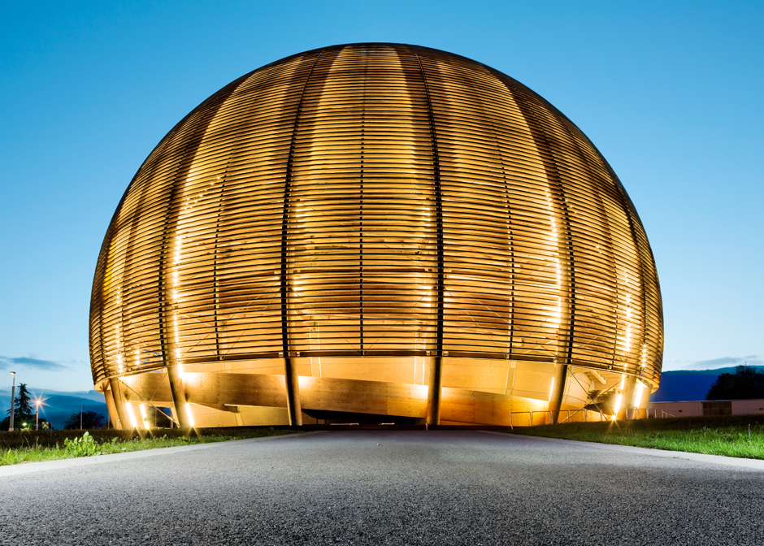
Welcome to CERN!
Conseil Européen pour la Recherche Nucléaire
European Organization for Nuclear Research

Slide 4
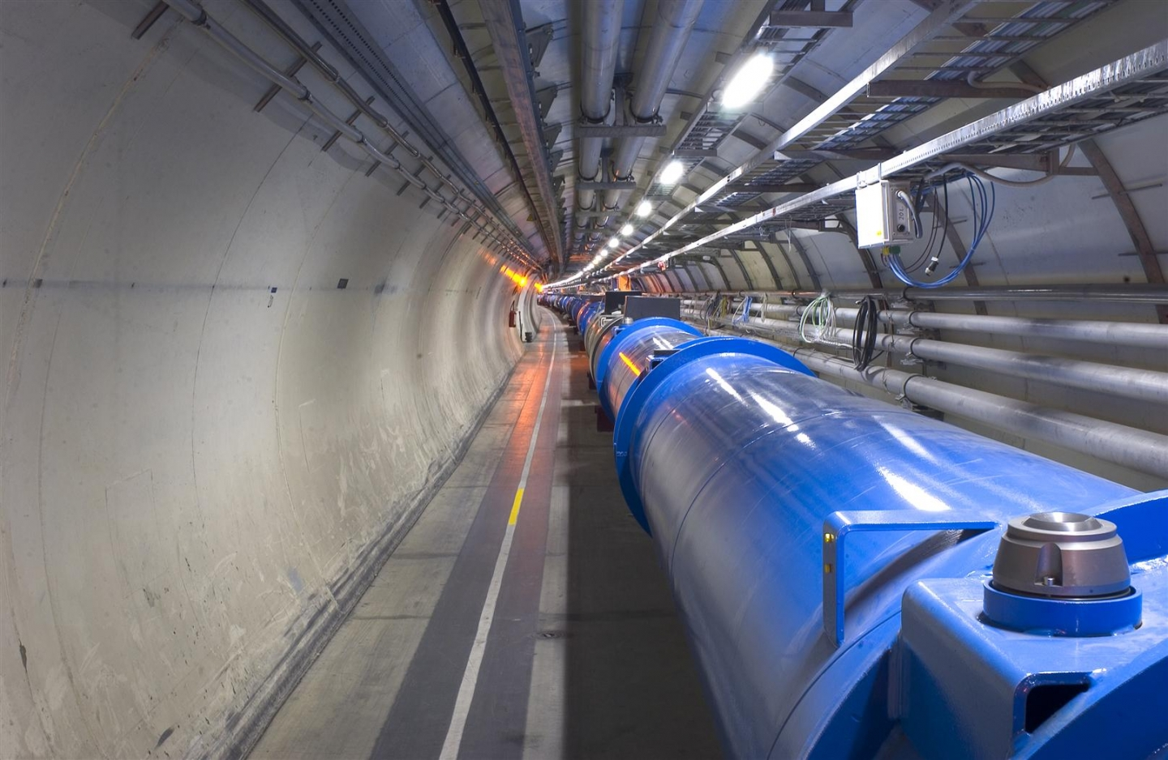
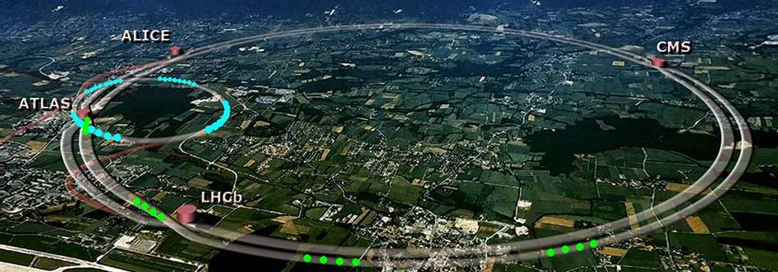
LHC – Large Hadron Collider
World’s largest and most powerful particle accelerator
27 kilometer ring
10 September 2008
4 Particle Detectors
Photos: CERN

Slide 5
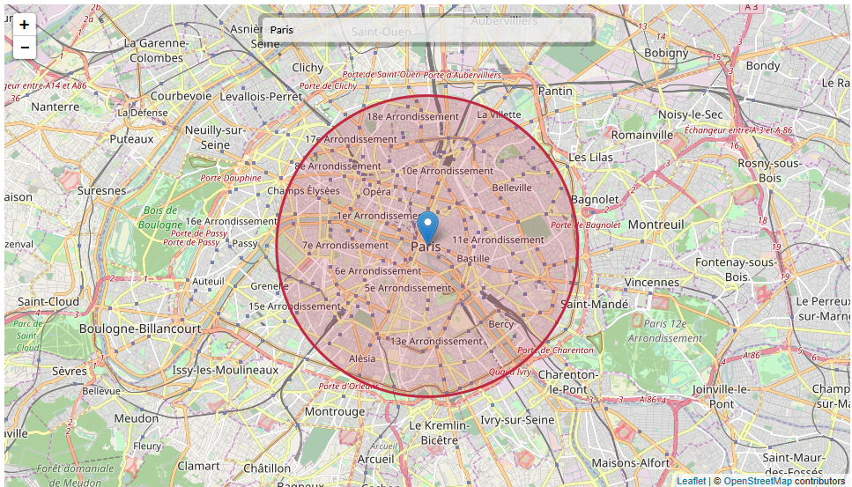
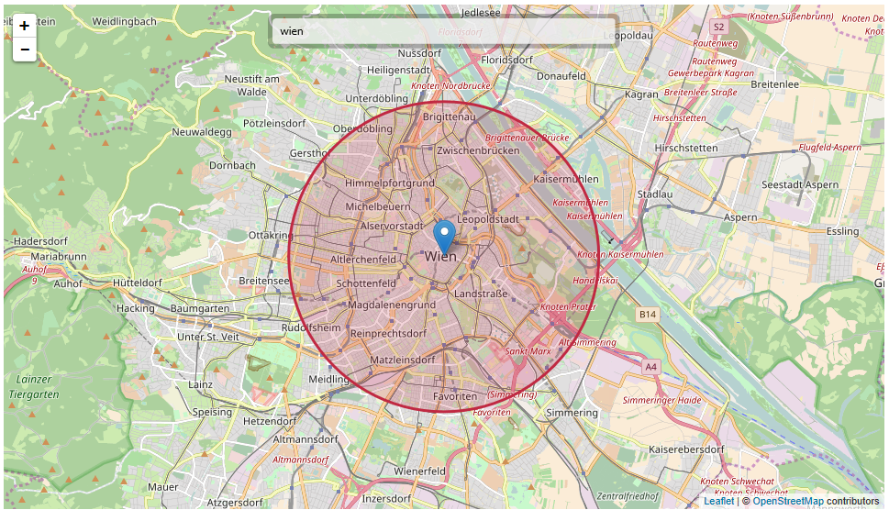
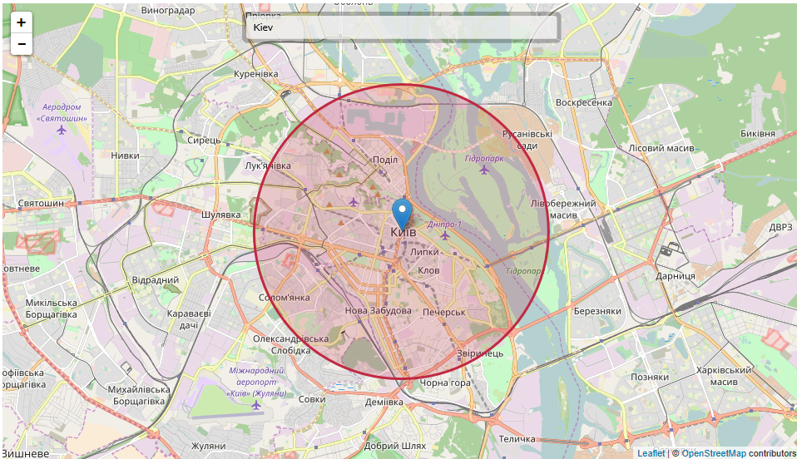
LHC - What if…
http://natronics.github.io/science-hack-day-2014/lhc-map/

Slide 6
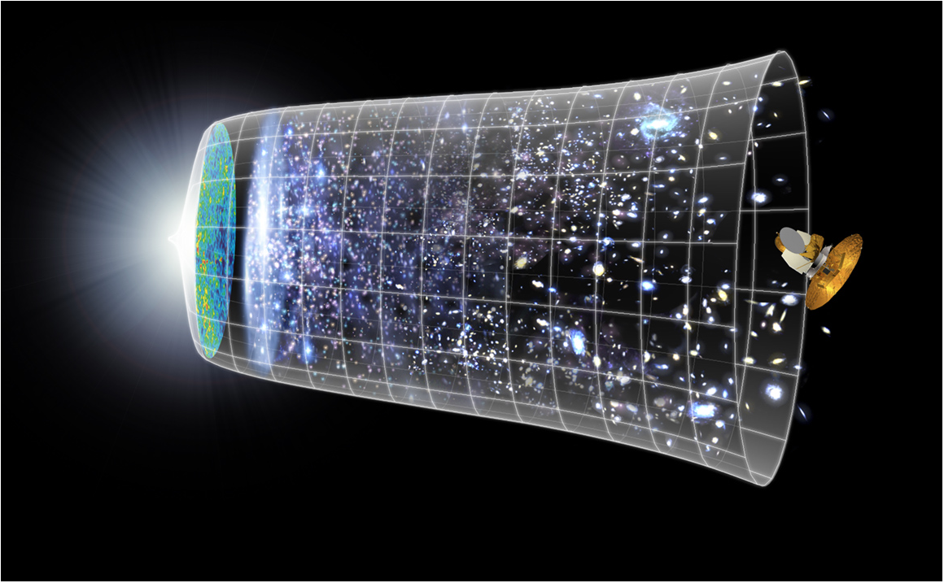
13.7 billion years
Today
10²⁸ cm

Slide 7
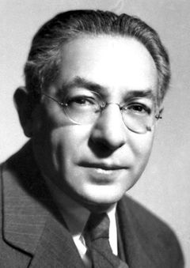
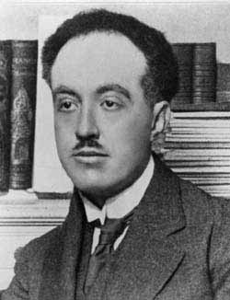
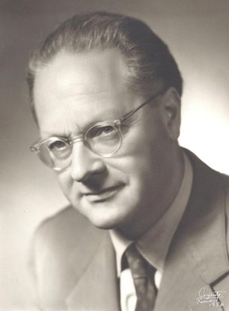
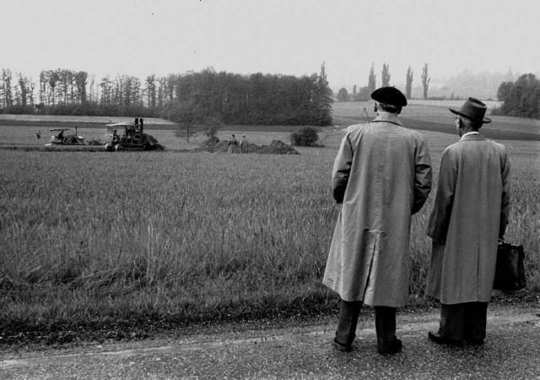
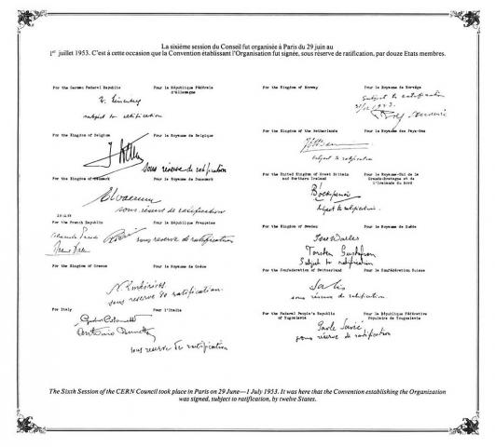
History
12 founding Member States
Isidor Rabi
Louis de Broglie
Edoardo Amaldi
29 September 1954
1954
Notes:
1949 - A handful of visionary scientists imagined creating a European Atomic Physics Laboratory
1954 – First shovel of earth was dug in Meyrin
1954 – September – Convention for European Organization for Nuclear Research officially came into being with 12 founding Member States.
(Belgium, Denmark, France, Germany, Greece, Italy, Netherlands, Norway, Sweden, Switzerland, the United Kingdom, and Yugoslavia).

Slide 8
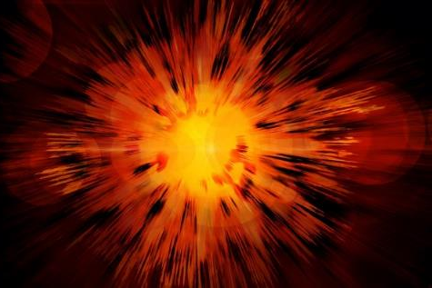
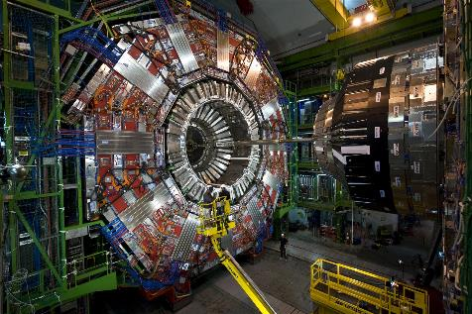
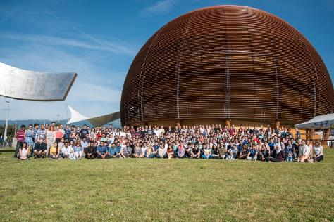
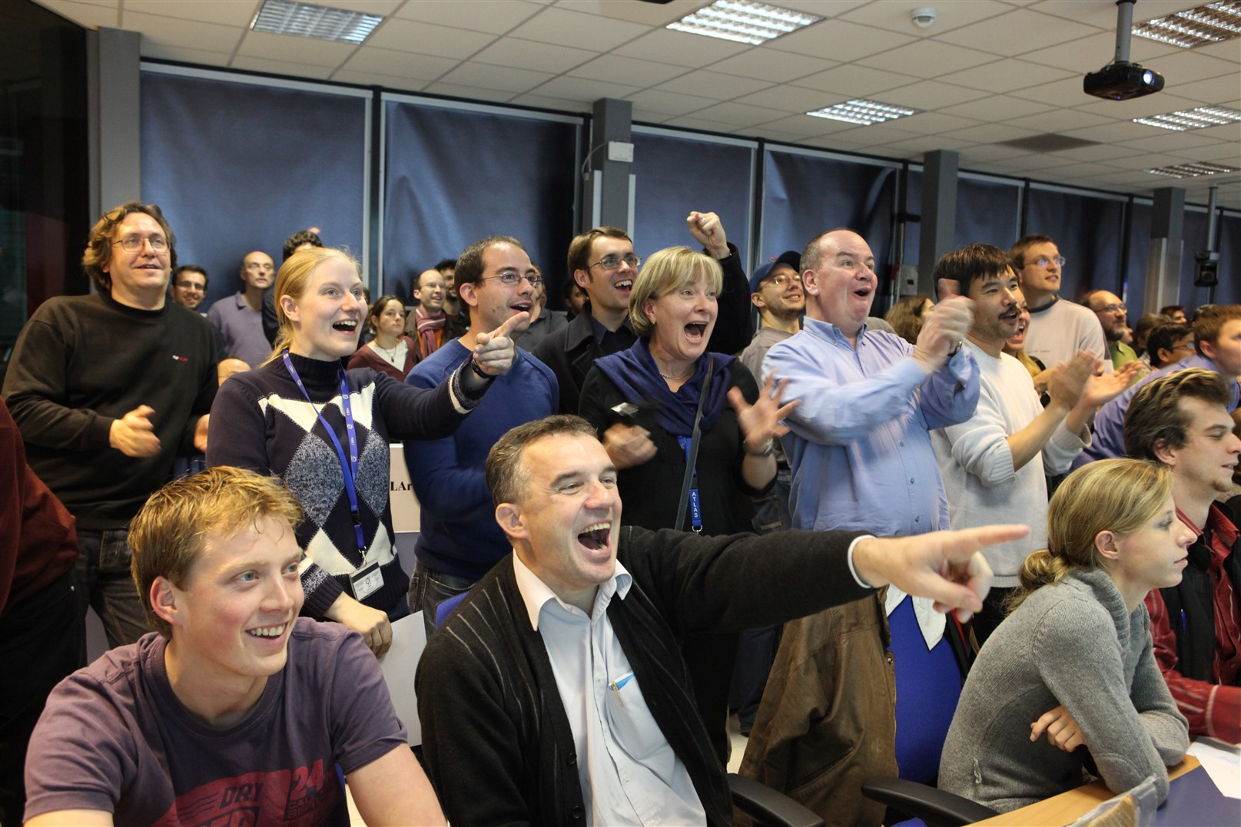
CERN’s mission
Technology
Innovation
Research
Education
Rita Ferreira, 30 March 2017
Collaboration
Notes:
The convention that established CERN in 1954 clearly laid down the main mission for the Organization and today remains essentially the same.
Research: Seeking and finding answers to questions about the universe
Technology: Advancing the frontiers of technology
Education: Training the scientists of tomorrow
And finally Collaboration: Bringing nations together through science

Slide 9
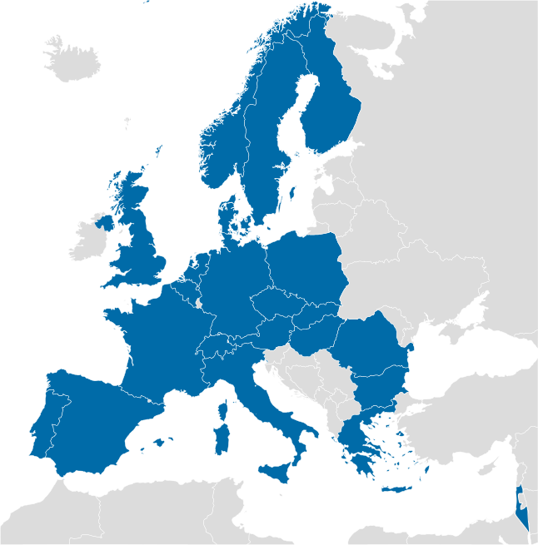
22 Member States
36 Non-member states with co-operation agreements
19 Countries with scientific contacts

Slide 10
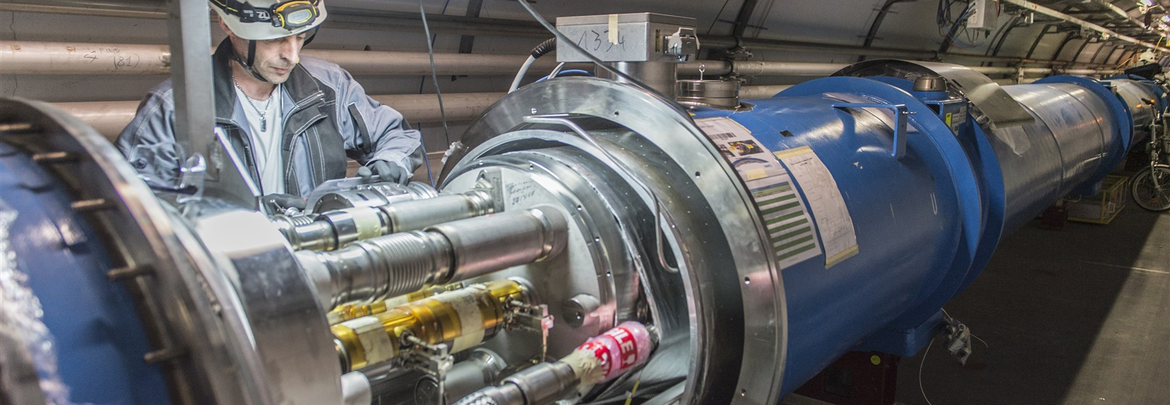
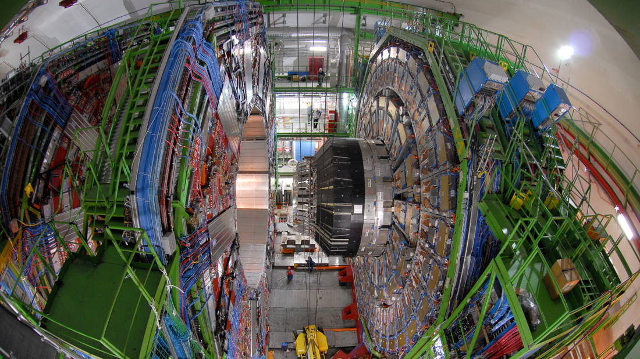
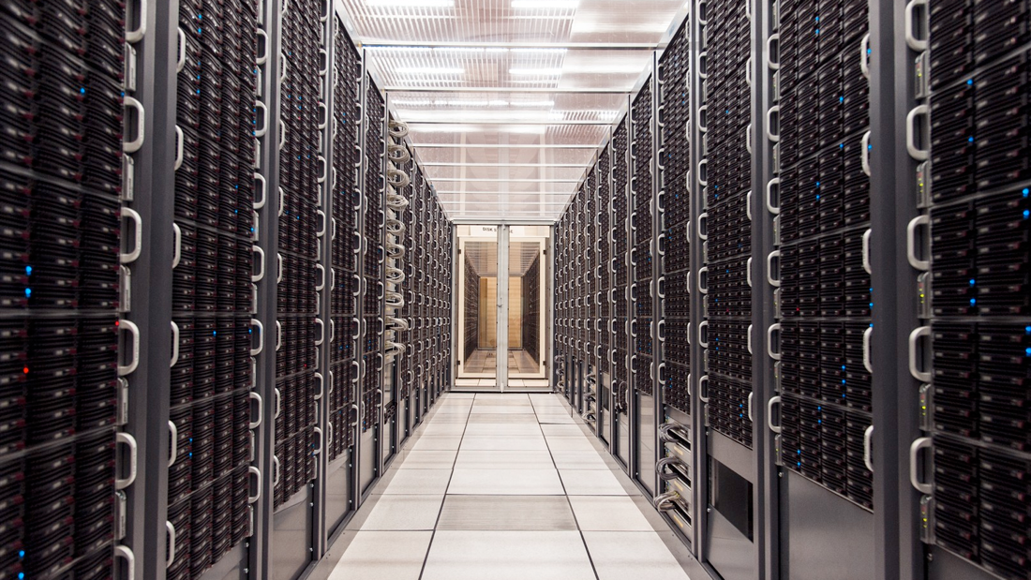
The three pillars
Accelerators
Detectors
Computing

Slide 11
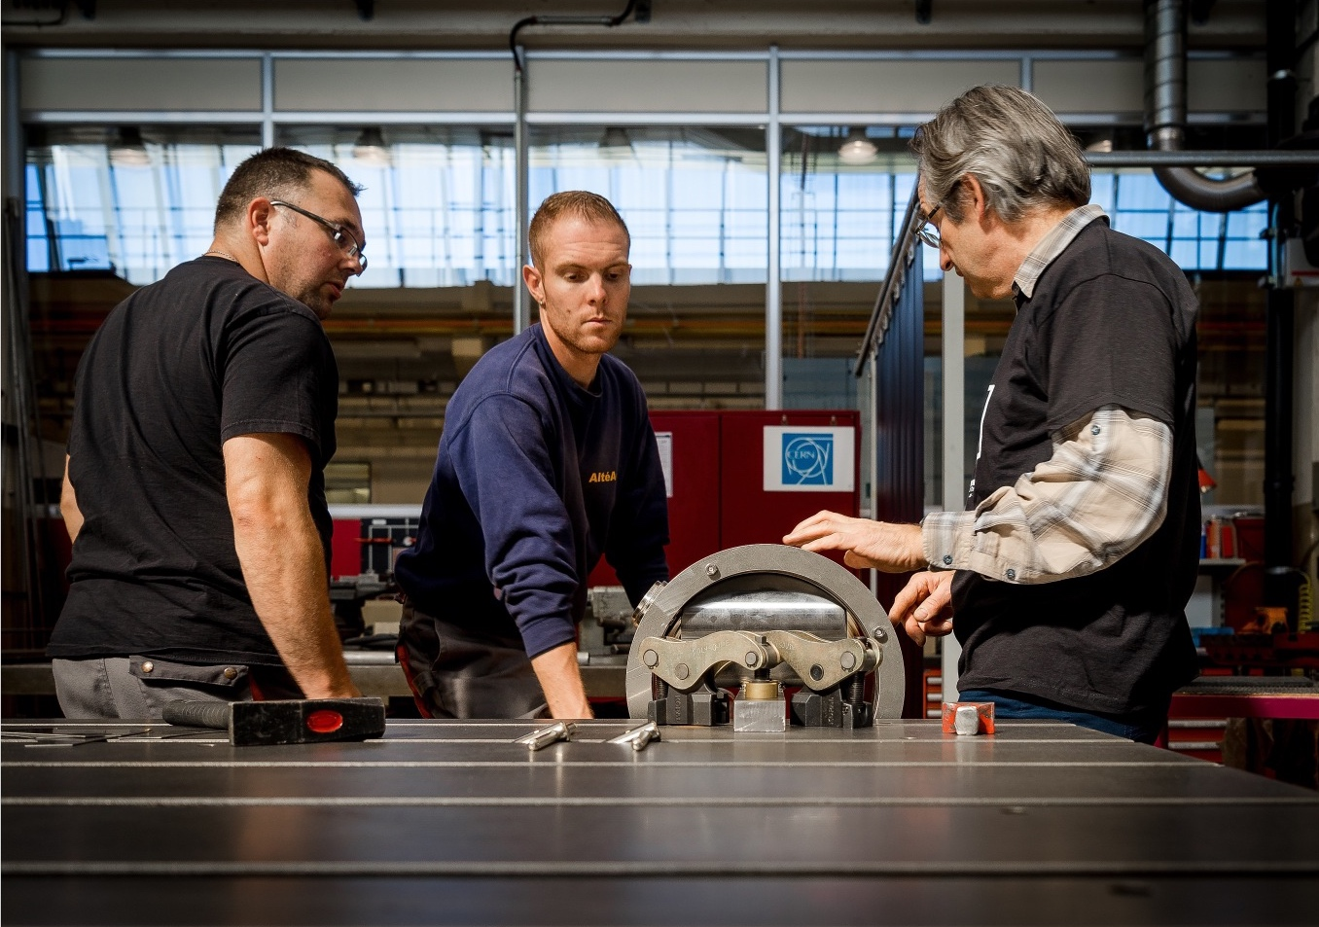
Knowledge Transfer
Everyday, everywhere!

Slide 12
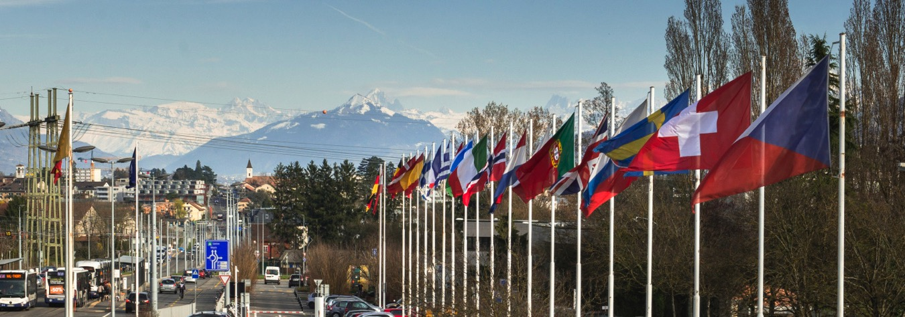
Knowledge Transfer Mission
Maximize the technological and knowledge return to the member states’ industry and society
Promote CERN’s image as a centre of excellence for technology
Notes:
Our daily work is provide an active service to the Organization managing and advising on every aspect related to technology transfer and intellectual property management (evaluate invention disclosures, protect intellectual property, manage the patent portfolio, negotiate licensing and contractual agreements, promote technologies, and provide legal advice on intellectual property issues).
Promote, design and coordinate multidisciplinary activities relevant to life sciences applications.
Communicate CERN’s positive impact on society by raising awareness on positive examples on knowledge transfer through technologies, networks and people.
Promote within CERN a culture of inventiveness for technology applications, a motivation to establish intellectual property and a willingness to collaborate with industry and relevant research laboratories.
Create knowledge exchange opportunities with CERN’s key stakeholders (Member States’ governmental bodies, the European Commission, industry, public and private research institutes, universities, international Organizations.)
Create, organize and develop networks for providing information and maintaining relationships with industry, other research organizations, government agencies and academia.

Slide 13
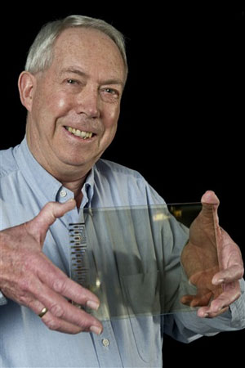
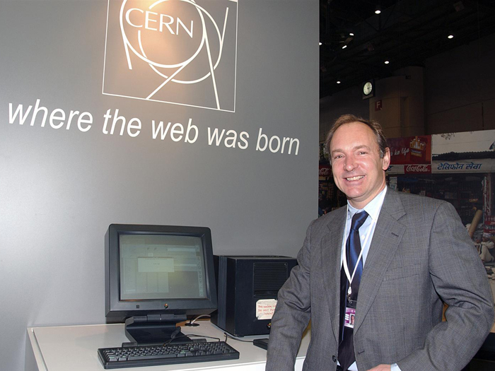
Knowledge Transfer
Tim Berners-Lee
Bent Stumpe
Notes:
1993 - Tim Berners Lee invented the World Wide Web. The web was conceived and developed at CERN to facilitate the information-sharing between scientists in universities and institutes around the world. In 1993 CERN put the world wide web software in the public domain. It was release an open license to more sure way to maximize its dissemination.
1972 - Bent Stumpe, he invented the first capacitive touch screen! This screen that everyone has in smart phones. We use it every day, it was invented here.
1993 – First smartphone with touch screen
2007 – First iPhone
If these two technologies, originally developed for HEP, were not transfer to the world, probably our daily life today will be totally different! So you can understand the importance of knowledge transfer in a place like CERN!

Slide 14
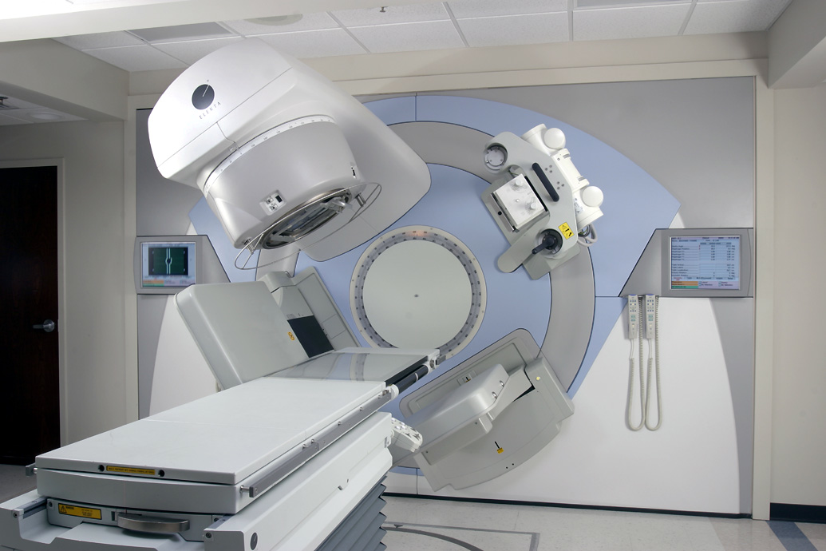
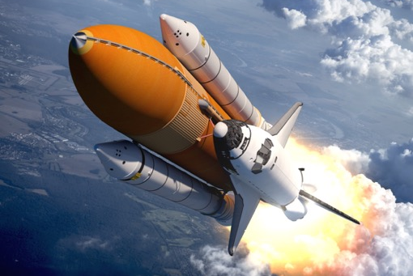
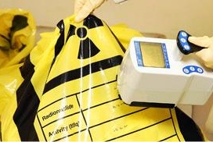
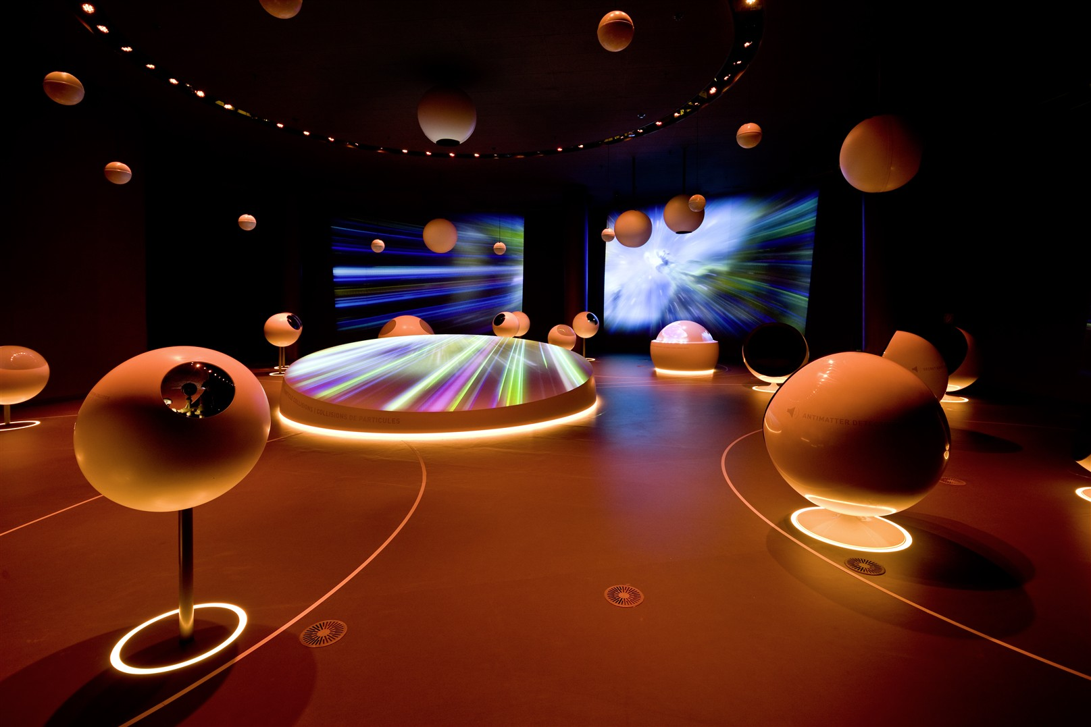
From physics to…
Medicine
Aerospace
Safety
Global Communities
Notes:
What I want to show you, that beyond research in fundamental physics, which is the primary mission of CERN, there are numerous applications from which we can derive benefits.
Like Aerospatiale applications: The conditions in the space are similar to the conditions recreated in our experiments. Low temperature, high vacuum, high radiation level. That’s why we have agreements for ex with the ESA European Space Agency to test material.
Safety, at CERN we always said “Safety first”! Safety technologies developed for high energy physics could be applied to shielding and protection. To dosimetry measurements, etc.
Another application, sometimes difficult to understand is the global communities.
SESAME (synchrotron-light for experimental science and applications in the Middle East) was founded in 2002 with statues similar to CERN. Is composed by 9 Middle East countries, (Bahrain, Cyprus, Egypt, Iran, Israel, Jordan, Pakistan, the Palestinian Authority and Turkey)
SESAME is an important scientific project, it is also helping to build bridges between diverse cultures in a part of the world that usually hits the headlines for its conflicts.
CERN signed a cooperation agreement in 2010 to support research and training. By example, CERN also made KT.
And last, my main area... medical application! HEP could be applied in several medical technologies and I will present you some of our projects and technologies.

Slide 15
The three pillars
Accelerators
Detectors
Computing

Slide 16
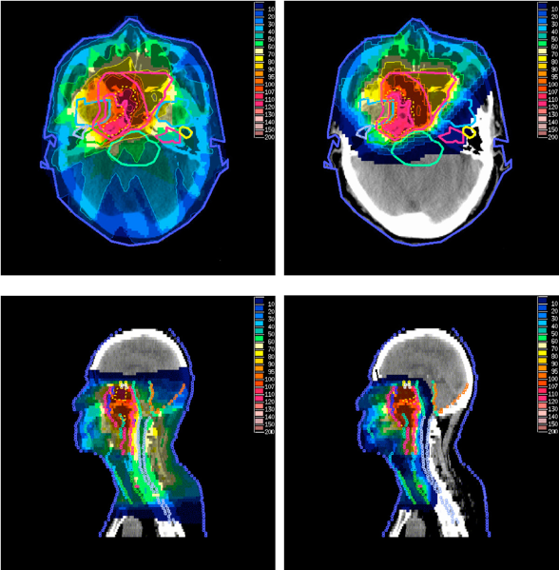
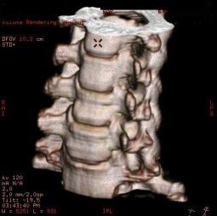

HEP technologies in Medical Application
Cancer treatment
Accelerators
Medical data management and analysis
Medical imaging
Rita Ferreira, 30 March 2017
Detectors
Computing
Notes:
Making a quick match, we can say that accelerators can be applied in radiotherapy, detectors in medical imaging and computing in data management and analysis.

Slide 17
Detectors for Medical Imaging
Medical imaging
Detectors

Slide 18
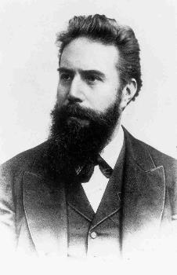
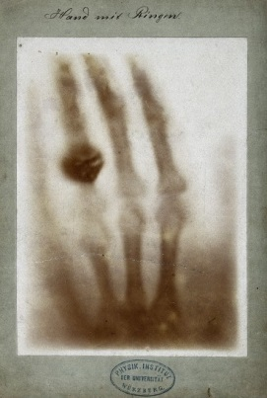

X-rays
8 November 1895: X-rays discovery
22 December 1895: First radiography
Wilhelm Röntgen
Nobel Prize in PHYSICS 1901
Courtesy of Roentgen museum

Slide 19
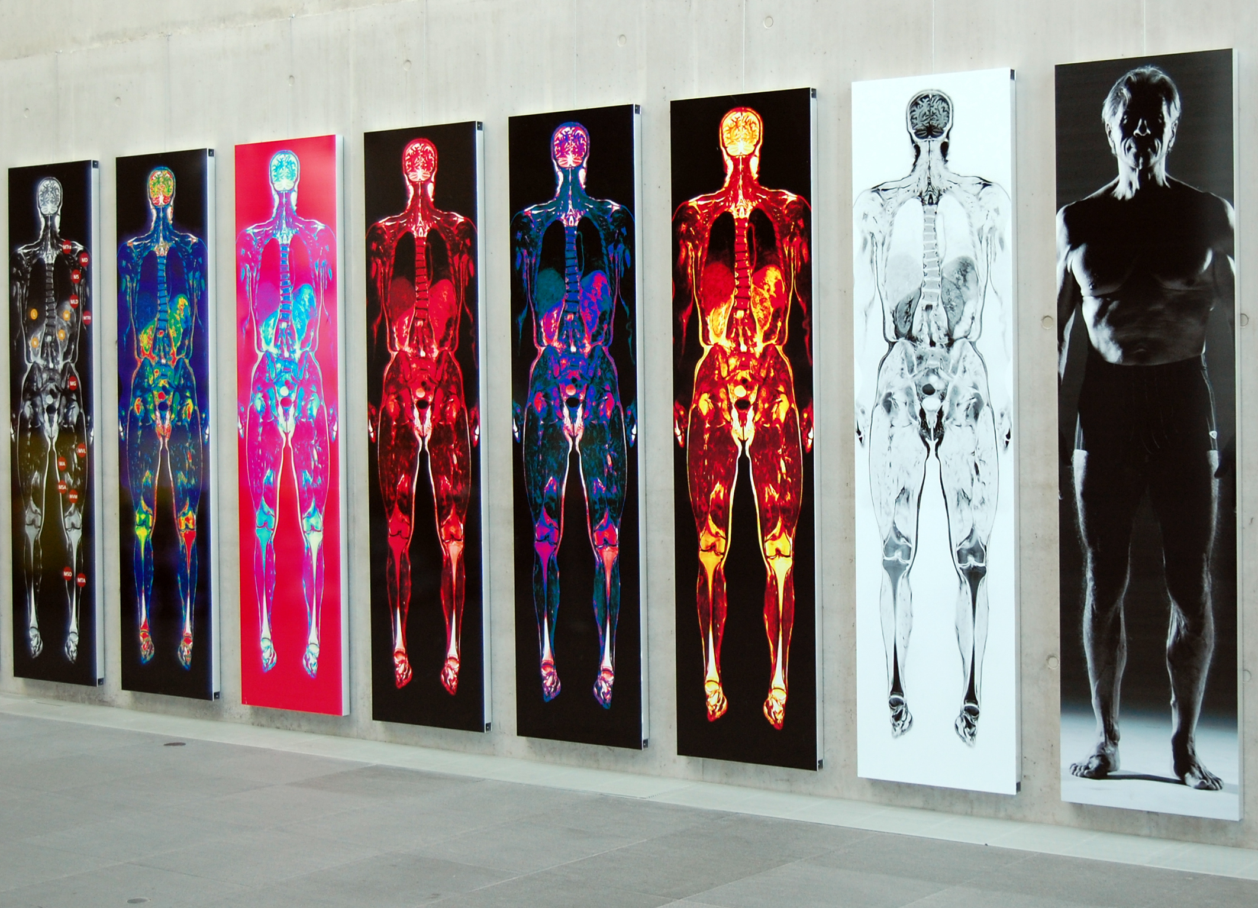
More and more details
Images courtesy of Dr. F. Fellner

Slide 20
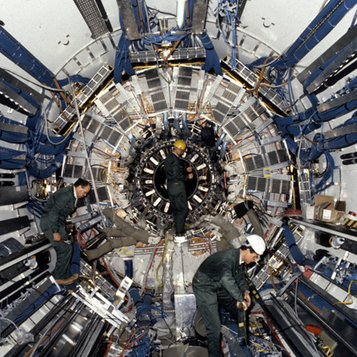
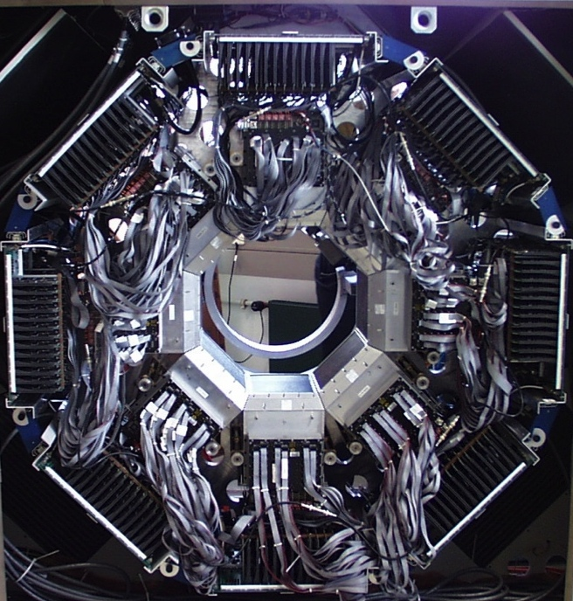
Medical imaging and particle physics:
The same challenge?

Slide 21

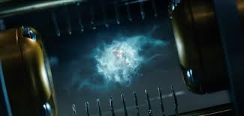
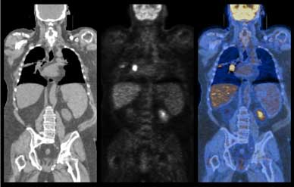
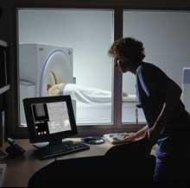
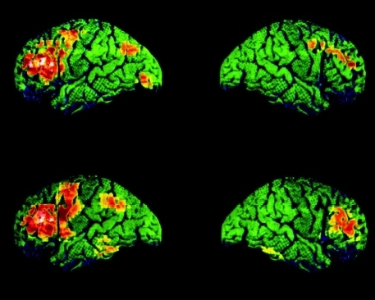
Antimatter – science fiction?
Positrons are used daily in oncology
PET - Positron Emission Tomography
Notes:
And Antimatter. Antimatter is no longer science fiction, or bombs, or angles and demons!
Antimatter is a material composed by antiparticle partners to the corresponding particle. So, usually, when matter in made, the same quantity of antimatter is also created. When this matter and antimatter collide, is expected the annihilation. This creates energy in form of photons (gamma rays).
Positrons are anti electrons. Are the antimatter of the electrons, they have positive charge. Positrons are used daily in PET scans!

Slide 22
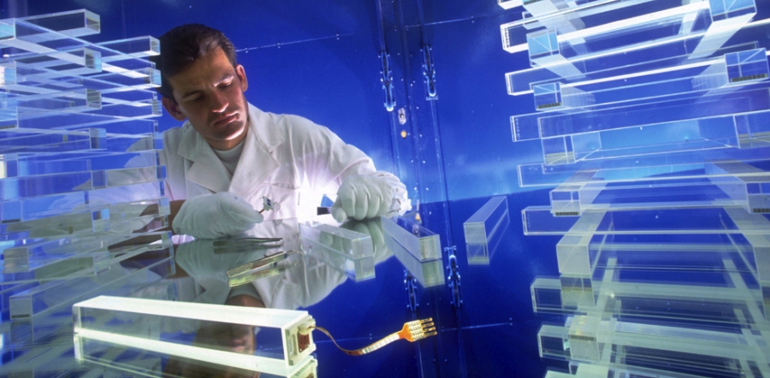
Scintillating Crystals
From LHC experiments to PET

Slide 23
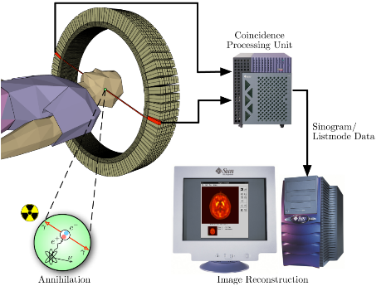
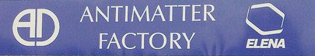
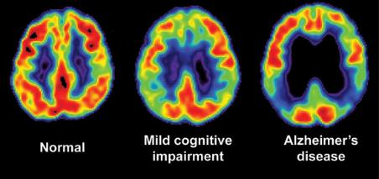
PET Scan
Positrons are used daily in oncology
Notes:
Quickly, the position emission tomography (PET system) is used to detect the gamma rays emitted.
Radioactive trace is put together with sugar and is given to the patient in the blood current. The sugar will fix in the most active cells in the body. The brain, the heart, and the tumors.
And our body is full of electrons, so, when the emitted positrons, are in contact with electron, they emit gamma rays!
The gamma rays are detected by crystal in the PET scan. Through image reconstructions, is possible to obtain images of the most active and non active parts of the body. At the same time, you have the information of position and size of the tumor.

Slide 24

ClearPEM
Dedicated PET for breast imaging
Photo: HealthHub

Slide 25
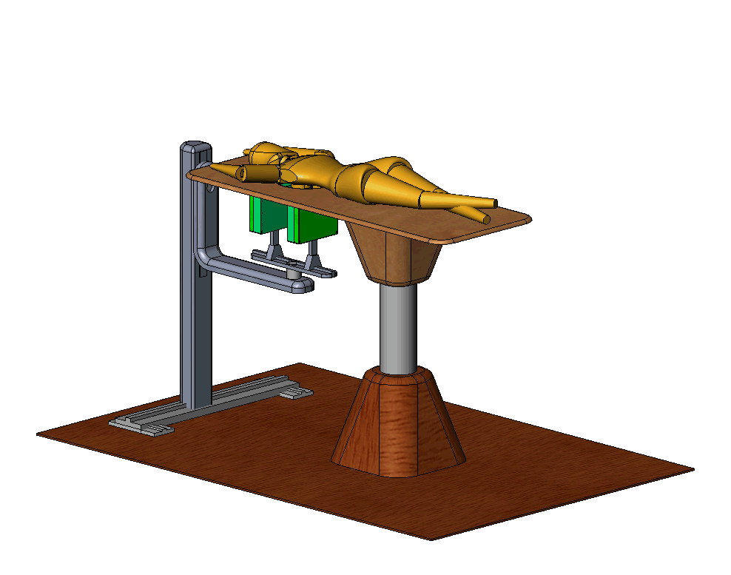


Crystal PEM
PET detector dedicated to breast cancer screening
  extremely sensitive to small tumour masses
Spatial resolution1-2 mmLYSO:Ce scintillating crystals
High counting sensitivity
Short PET exam
Coupled to ultrasound
Detection of 3 mm breast lesions in less than 7 minutes exams

Slide 26


MediPix
High Energy Physics original development:
  Particle track detectors
Main properties:
  Fast fully digital device similar to the electronic chip in a digital camera but sensitive to X-rays instead of visible light
  Good conversion efficiency of low energy X-rays
  Can create the first true colour images with X-rays

Slide 27
Accelerators for Cancer Treatment
Cancer treatment
Accelerators

Slide 28



Cancer and its treatments
Every year millions of new cases globally
Second most common cause of death in Europe, Canada and US.
Conventional Treatment
Chemotherapy
Radiotherapy
Surgery

Slide 29

The “3 Cs” of radiotherapy
Cheap:
  The least expensive cancer treatment method (around 5% of total cost)
Cure:
  Good cure rate
Conservative:
  Generally non-invasive, fewer side effects
Notes:
Linear Accelerators

Slide 30



Collateral Damage
X-rays
Source: Rinecker Proton Therapy Center

Slide 31

Accelerators for cancer treatment
Innovative practice
Hadron Therapy
"Hadron therapy is not a replacement for conventional radiotherapy or surgery, but is an additional tool in the toolbox of the oncologists"
Robert Miller of the Mayo Clinic in the US
Notes:
Robert Wilson was the first person talking about having therapy with protons instead photons. After II World war, when he worked at Harvard, Wilson published a seminal paper called “Radiological use of fast protons” which founded the field of proton therapy.
Ernest Lawrence, actually he was a PhD student of Lawrence, which won the Nobel Prize in physics in 1939 for the invention of the cyclotron.

Slide 32


Protons vs X-rays
Hadron Therapy
Courtesy of MedAustron
X-rays
Protons

Slide 33


PIMMS at CERN (1996-2000)
Proton Ion Medical Machine Study
linacs for
carbon ions
and protons
400 MeV/u synchrotron
p
p
p
C
C
RF cavity
Resonance sextupole
Sextupole horiz. chromaticity
Sextupole vert. chromaticity
Betatron
core
Circumference C = 76.84 m
Tune horizontal Q_{x} = 1.67
Tune vertical Q_{z} = 1.72
Sextupole vert.
chromaticity
Sextupole horiz. chromaticity
Electrostatic septum
CERN - TERA - MedAustron
Injection septum
Extraction septum

Slide 34


CNAO – Italy
First Patient 2011
Collaboration agreement with CERN
MedAustron – Austria
First Patient 2016
Collaboration agreement with CERN
Exploitation of jointly developed know-how

Slide 35

European Centers

Slide 36



The Miniature Linear Accelerator
A new high-frequency RFQ
Compact, lightweight, low beam loss
2.5 MeV/m (vs <1 MeV/m)
First Application
Proton Therapy
Potential Applications
On-site radioisotope production
Alpha-particle radiotherapy
Analysis of archeological materials
Notes:
Radio Frequency Quadrupole (RFQ)
Due to the High frequency and to an innovative Beam Optics design, the accelerating gradient is more than twice that of conventional RFQ’s
first application - injector for proton therapy linacs
A.D.A.M. that will commercialize this accelerator as part of complete proton therapy systems, under a licence with CERN.
Due to their compactness, light-weight and low beam loss features, this RFQ design open other potential applications requiring operation in non-nuclear environments and/or portability.
Such as On-site radioisotope production for PET. The accelerator could be installed in a standard hospital room next to the scanner, the radiation shielding being limited to the isotope production target requiring.
Acceleration of alpha particles to generate the isotopes required by new advanced radiotherapy techniques for cancer treatment.
Analysis of archeological materials. This application has being explored for spectrometric analysis of artworks. PIXE (Particle induced X-ray Emission) is a powerfull non-destructive elemental analysis technique now used routinely. The innovative CERN design would allow to reach the 3 MeV energy required for PIXE analysis in about one metre. The portable accelerator could then be deployed in museums or used on site for the analysis of frescos and other non-transportable artefacts.

Slide 37

AMIT – Advanced Molecular Imaging Technologies
A cyclotron small enough to fit in a hospital lift
Compact cyclotron for single dose production of radioisotopes for non-standard PET demands
First prototype in 2016 and possibility of industrialization
Collaboration agreement with CIEMAT
Photo: CIEMAT
Notes:
Around 90% of the PET clinical scans are currently performed with the isotope 18F, due to the suitability of the FDG radiotracer for a vast number of applications. But in the last years, other tracers have also been considered, including some based on 11C.
The delivery of FDG in large production centres is a cost-effective solution for populated areas, but the interest for other PET isotopes and tracers has raised expectations that cannot be met by this concept of centralized production.
One of the goals of the AMIT project was to develop a compact cyclotron for in-situ single dose production of 18F and 11C, providing the minimum required energy and current in order to reduce the system footprint and shielding needs.
CERN participated in the project as a scientific partner via a collaboration agreement with CIEMAT in order to provide consultancy and contribute in accelerator cryogenics.

Slide 38
Computing in Medical Field
Medical data management and analysis
Computing

Slide 39

Big Data
Longstanding tradition of participation and support for IT infrastructures for health research since 2001
Many requests for “help” with architectures, data storage and sharing, analysis, computing technologies.
Courtesy Alberto Di Meglio
Challenge:
Other communities reuse the same infrastructure, tools and methods as HEP
Photo credits: http://www.martingrandjean.ch
Notes:
CERN has a great background in big data.
With that, we have longstanding tradition of participation and support for IT infrastructure for health research.
Specially for help with architecture, data storage and sharing, analysis and computing technologies.
The big challenge is transfer our tools and technologies for other communities to reuse the same tools and methods as high energy physics.

Slide 40


The fourth pillar

Slide 41


The collaborative spirit of particle physics and medical applications
Creative Commons Licence
This work is licensed under a Creative Commons Attribution-NonCommercial-ShareAlike 4.0 International License
http://creativecommons.org/licenses/by-nc-sa/4.0/
Thanks for your attention!!!

Slide 42

Cern: Virtual particle therapy centre
https://www.youtube.com/watch?v=wgwDJiTYDI0

Slide 43

ENVISION
https://cds.cern.ch/record/1611725

Slide 44

How to KT?

