Slide 2
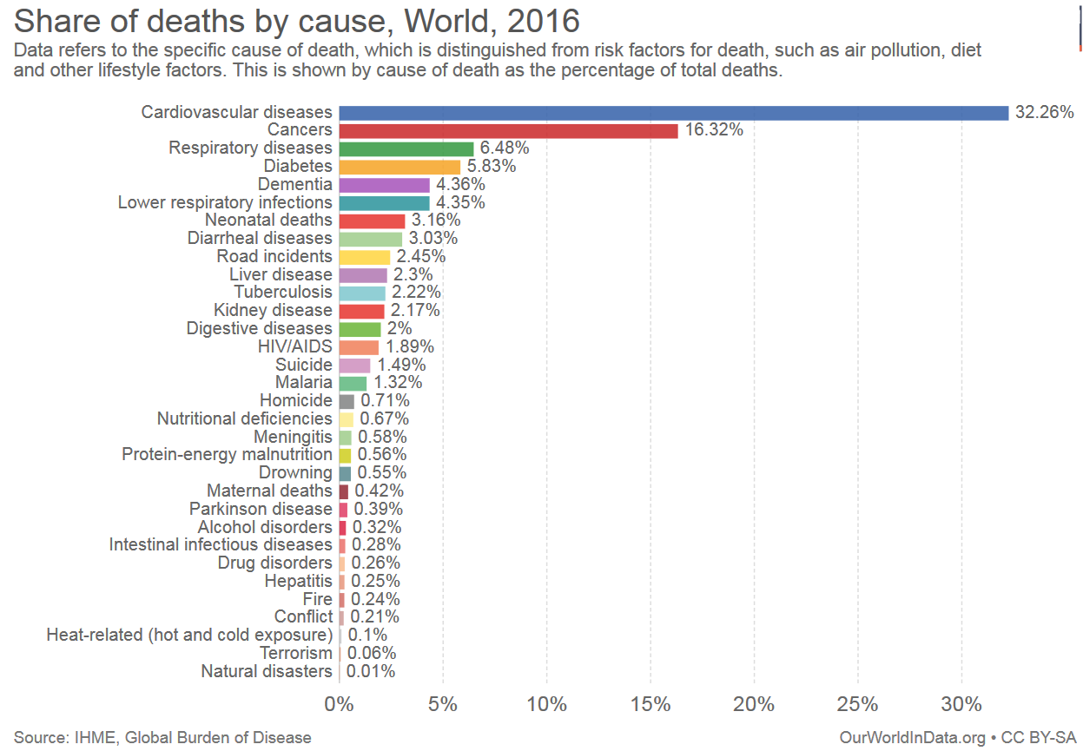
Statistic
Notes:
In the us 38% of all men and women are diagnosed with cancer at some point during their lifetime (https://www.cancer.gov/about-cancer/understanding/statistics)
2

Slide 3
Beams for Cancer Treatment
Johanna Pitters
31/07/2018
Summer Camp Lecture
Notes:
3

Slide 4
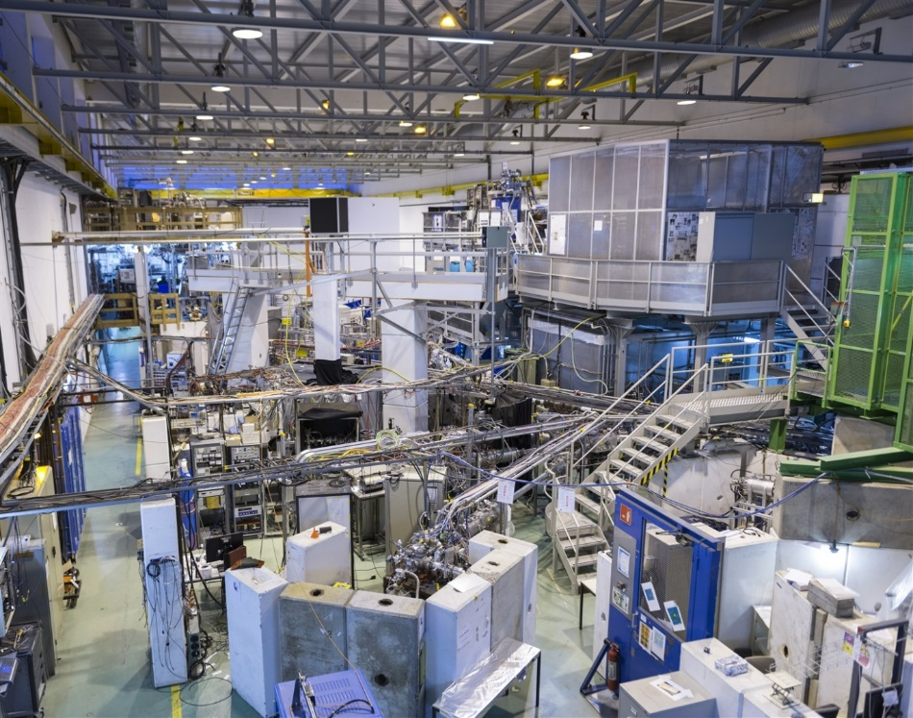
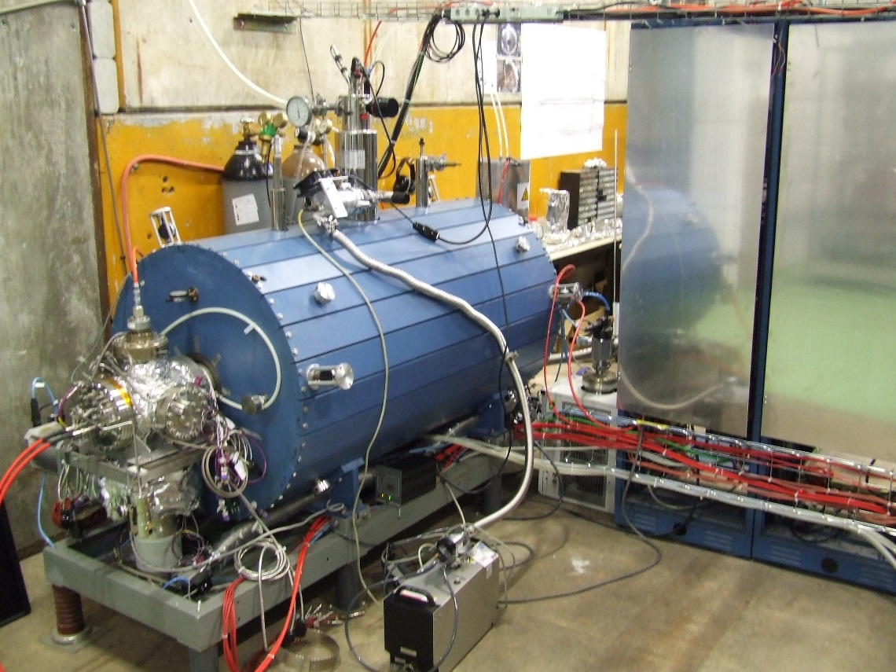

Slide 5
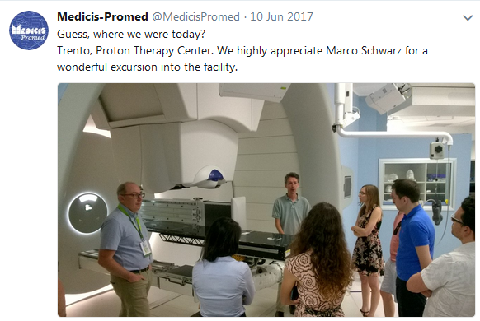

Slide 6
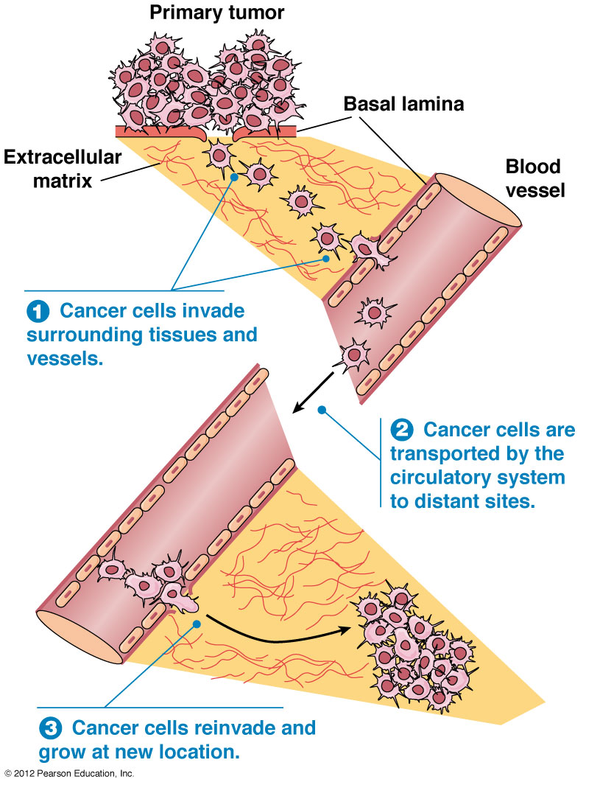
What is cancer?
https://www.mun.ca/biology/desmid/brian/BIOL2060/BIOL2060-24/CB24.html
Notes:
Cancer= malignant cells that devide in an uncontrolled way
Primary tumor, spread through circulatory system, invade new locations
Early diagnostic is key to success
6

Slide 7
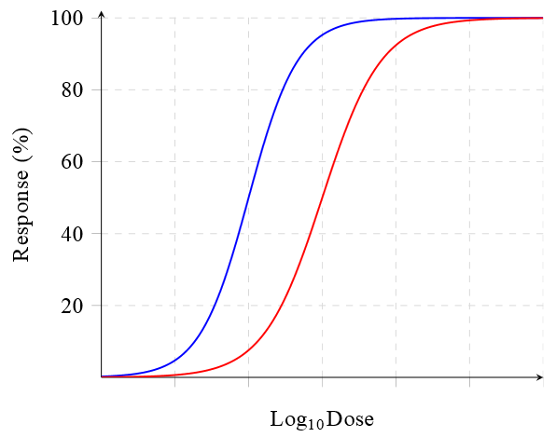
Dose-Response-Curve
Treatment: higher response from cancer cells than normal, healthy tissue
Harm to healthy tissue may induce unwanted side effects
tumor
healthy tissue
Notes:
7

Slide 8
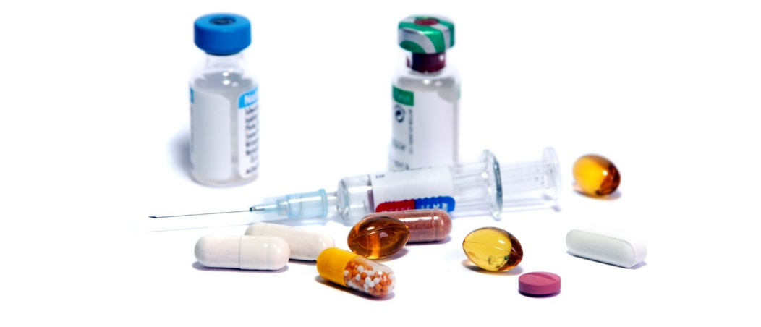
Treatment methods
Chemotherapy
(Systemic therapy)
Notes:
8

Slide 9
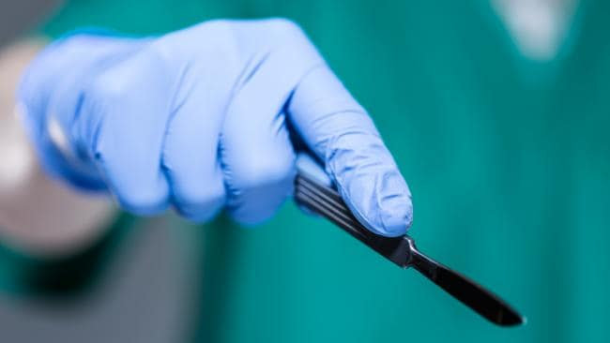
Treatment methods
Chemotherapy
(Systemic therapy)
Surgery
Notes:
9

Slide 10
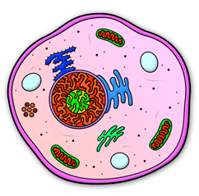
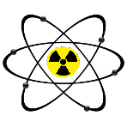
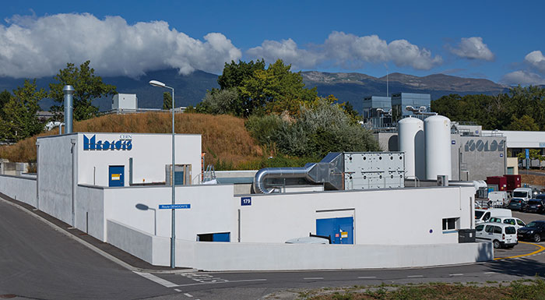
Treatment methods
Receptor
Radioisotope + Linker + Carrier
Radiopharmaceuticals
(Targeted therapy)
Chemotherapy
(Systemic therapy)
Surgery
Production of radioisotopes
at CERN Medicis facility
Notes:
10

Slide 11
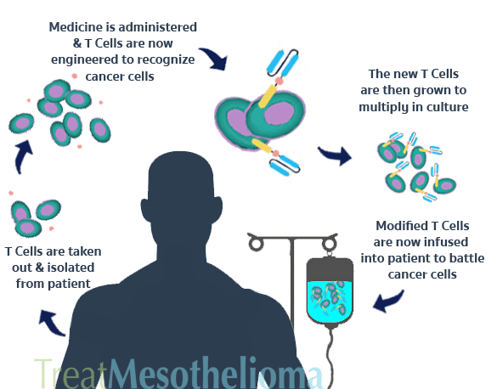
Treatment methods
Receptor
Radioisotope + Linker + Carrier
Radiopharmaceuticals
(Targeted therapy)
Chemotherapy
(Systemic therapy)
Immunotherapy
Surgery
https://www.treatmesothelioma.org/treatment/complementary/immunotherapy/
Notes:
11

Slide 12
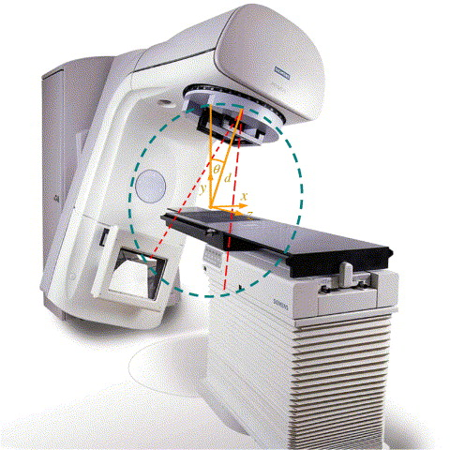
Treatment methods
Receptor
Radioisotope + Linker + Carrier
Radiopharmaceuticals
(Targeted therapy)
Chemotherapy
(Systemic therapy)
Immunotherapy
External beam irradiation
Surgery
https://www.treatmesothelioma.org/treatment/complementary/immunotherapy/
Notes:
12

Slide 13
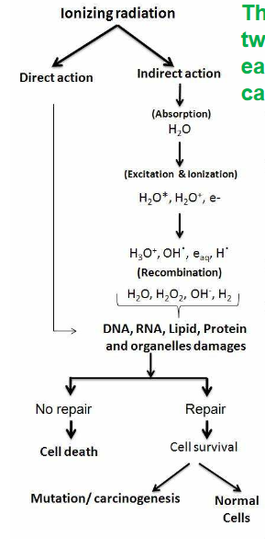
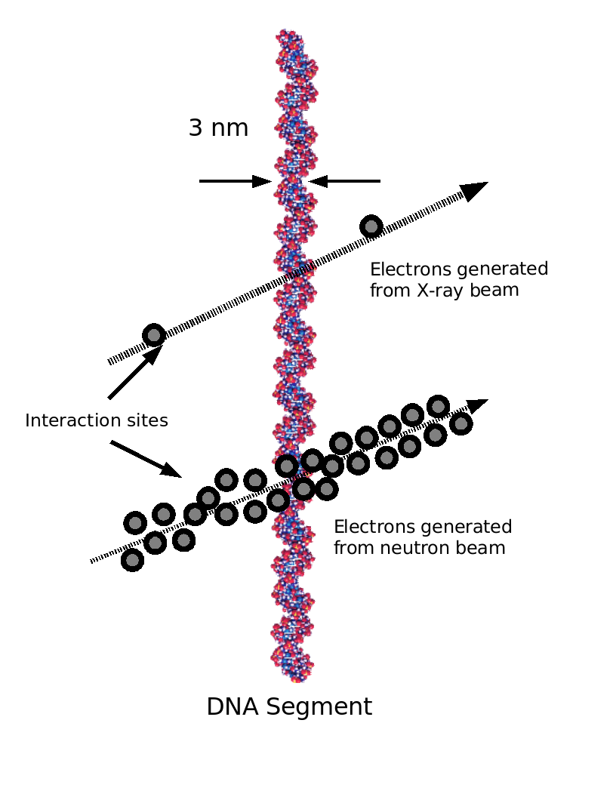
Cell damage through
ionizing radiation
Physical stage:
Excitation and Ionization
Chemical stage:
-> chemical bonds break
-> formation of free radicals
Biological stage:
cell cycle stops while cell attempts to repair

Slide 14

Cell damage through
ionizing radiation
Physical stage:
Excitation and Ionization
Chemical stage:
-> chemical bonds break
-> formation of free radicals
Biological stage:
cell cycle stops while cell attempts to repair
Irreversible DNA damage
-> Apoptosis

Slide 15
Cell damage through
ionizing radiation
low ionization density
More likely to cause severe DNA damage
e.g. through double- strand breaks
high ionization density
http://radioactivityci2010.pbworks.com/w/page/30525316/Fast%20Neutron%20Therapy
http://radioactivityci2010.pbworks.com/w/page/30525316/Fast%20Neutron%20Therapy

Slide 16
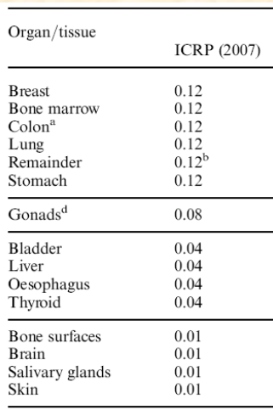
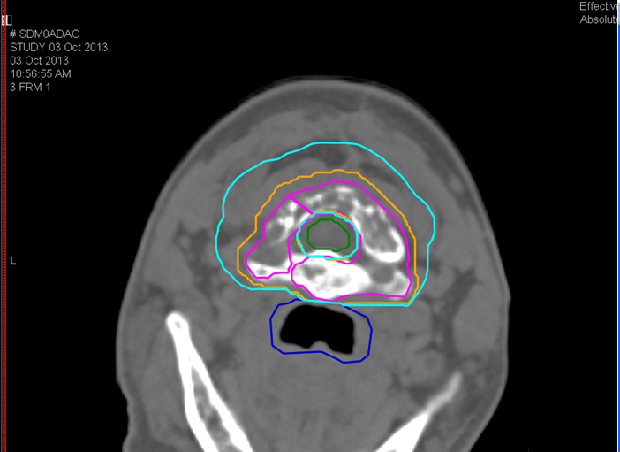
Dose
Dose Equivalent dose Effective dose
Gy [J/kg] Sv [J/kg] Sv [J/kg]
Damage to tissue
weighted: radiation
Damage to organ
weighted: tissue
Energy deposited in tissue
Photons (1)
Electrons (1)
Protons (2)
Heavy ions (20)
Neutrons
...
CIRT 73.6 GyE
16 fractions IMPT

Slide 17
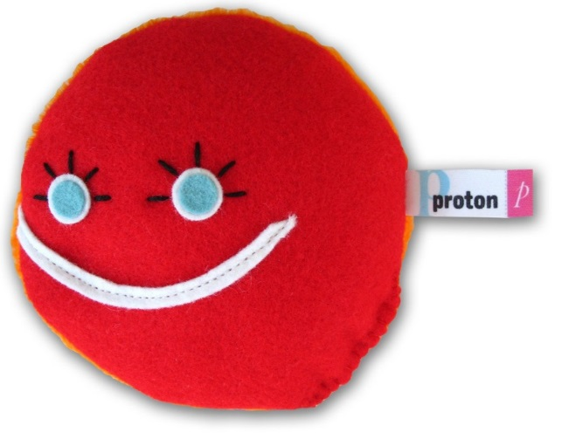
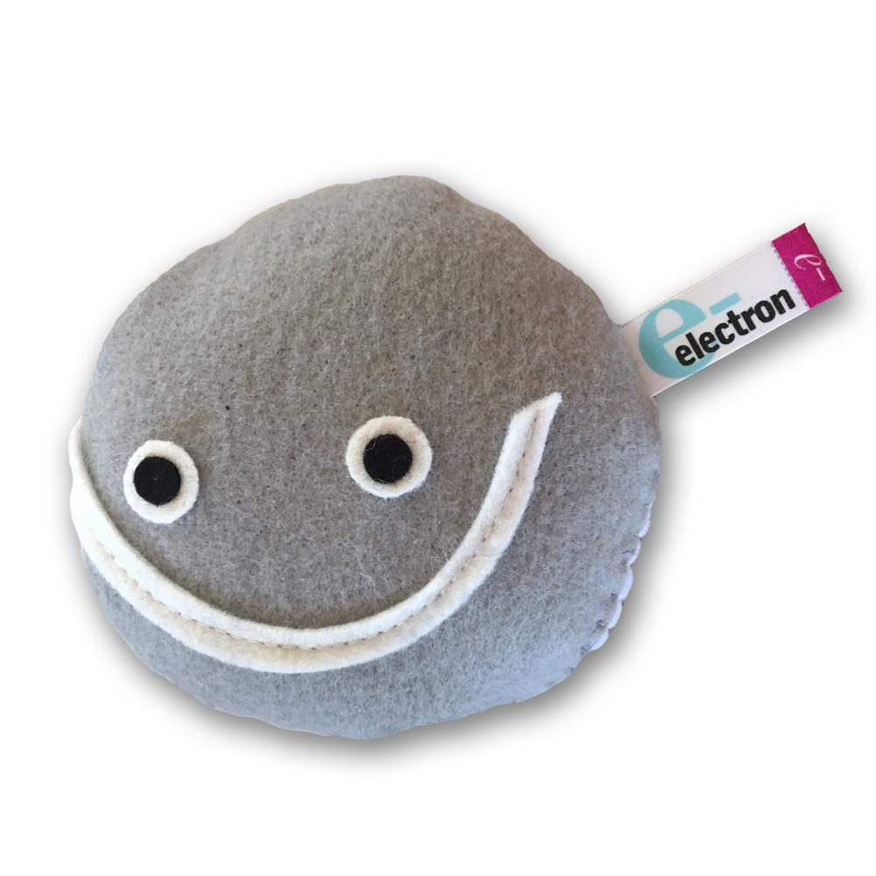
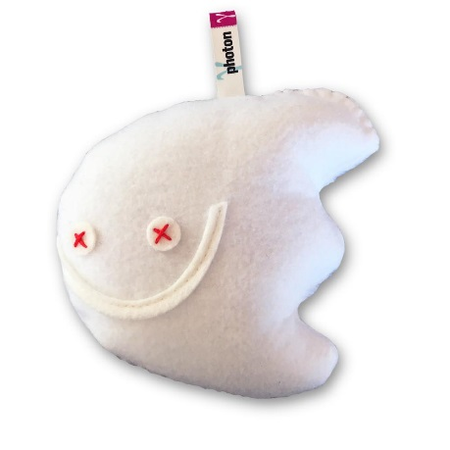
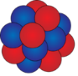
External Beam Irradiation
electron
proton
carbon ion
photon
How do they deposit energy in the tissue?
Where do they deposit energy in the tissue?
www.particlezoo.net

Slide 18
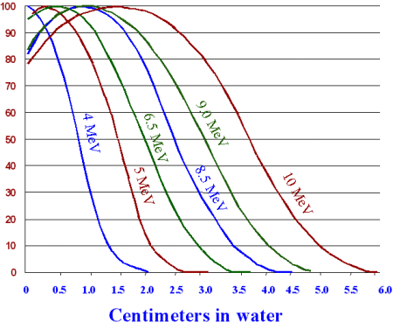

Electrons
Energy loss:
- Inelastic scattering -> excitation, ionization
- Radiative stopping → ‘bremsstrahlung’ (goes up with electron energy and Z)
Scattering through collisions
-> broadening of the beam
Relative Dose [%]
http://www.sfowler.com/investigations/Mail%20Irradiation.htm
Nucleus

Slide 19
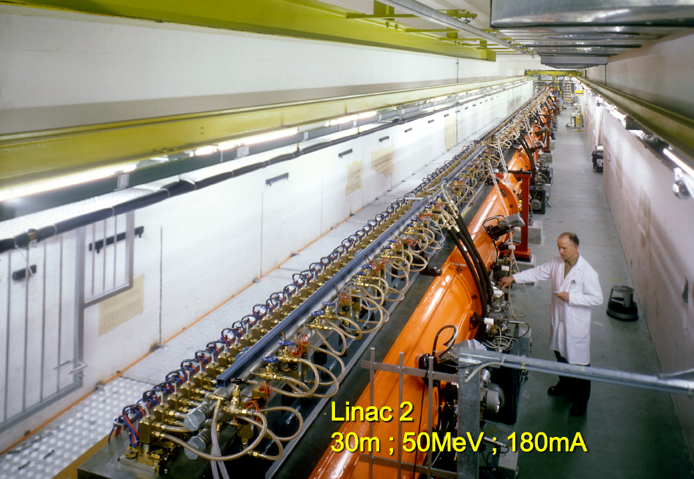
Electrons
LINAC – linear accelerator

Slide 20
Electrons
Proton LINAC
LINAC – linear accelerator

Slide 21
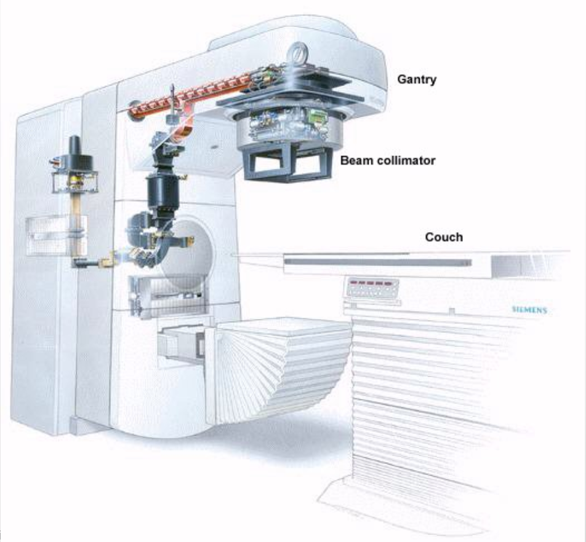
Electrons
Electron LINAC
4 – 25 MeV electrons
http://tulectures.web.cern.ch/TULECTURES/Folien/06_Linearbeschleuniger_MB.pdf

Slide 22

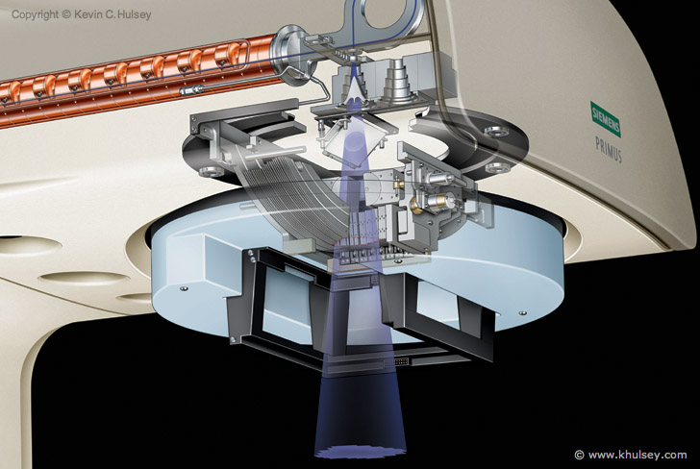
Electrons
Collimator
for transverse beam shaping
http://tulectures.web.cern.ch/TULECTURES/Folien/06_Linearbeschleuniger_MB.pdf

Slide 23
Electrons
Gantry allows for irradiation from all angles
http://tulectures.web.cern.ch/TULECTURES/Folien/06_Linearbeschleuniger_MB.pdf

Slide 24


Photons
Intensity of photons decreases exponentially with penetration depth
Interaction with matter through:
www.radsafemedical.com

Slide 25
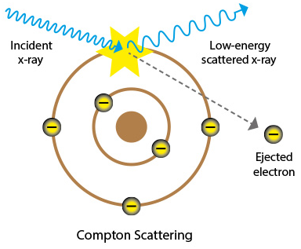
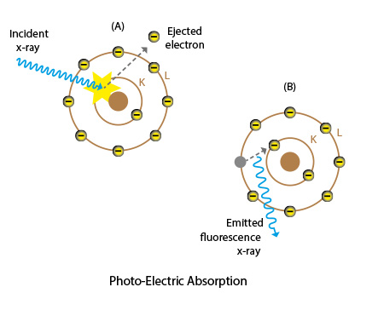
Photons
Intensity of photons decreases exponentially with penetration depth
Interaction with matter through:
Compton Scattering
Photoeletric Effect
Electron
Z
Positron
Pair Production
www.radsafemedical.com

Slide 26
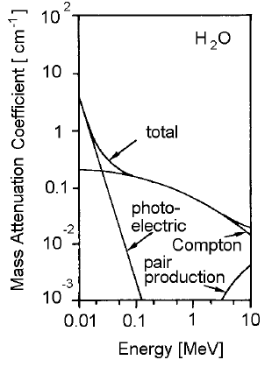
Photons
Intensity of photons decreases exponentially with penetration depth
Interaction with matter through:
Compton Scattering
Photoeletric Effect
Electron
Z
Positron
Pair Production
www.radsafemedical.com

Slide 27
Photons
Intensity of photons decreases exponentially with penetration depth
Dose build-up
Interaction with matter through:
Photoelectric effect
Compton scattering
Pair production
Dose [%]
Most of the biological effect comes from secondary electrons
Dose buid-up as electrons tend to move in forward direction
Depth in water [cm]
https://www.uniklinik-freiburg.de/roentgen/live/lehre/kursplan/strahlentherapie.pdf

Slide 28
Photons
Electrons
Energy loss:
- Inelastic scattering -> excitation, ionization
- Radiative stopping → ‘bremsstrahlung’ (goes up with electron energy and Z)
Scattering through collisions
-> broadening of the beam
Production of photons from
bremsstrahlung of electrons on target
Nucleus

Slide 29

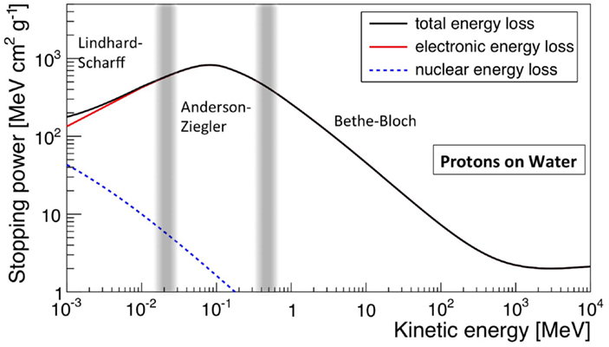

Protons
Ion approaches Bohr-velocity
DOI=10.3389/fonc.2015.00150
Viscous drag ~v
Excitation and ionization
of target electrons

Slide 30
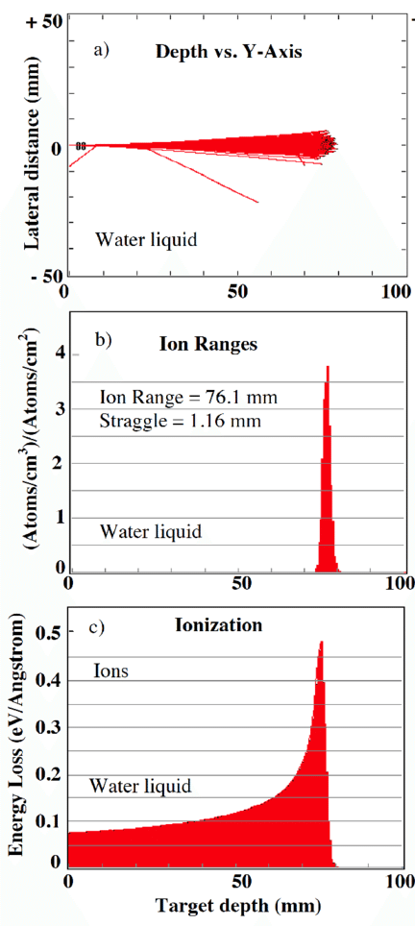
Protons
Protons stop!
Protons lose most of their energy towards the end of their track!
Bragg peak
DOI: 10.2174/1872210509999141222224121

Slide 31
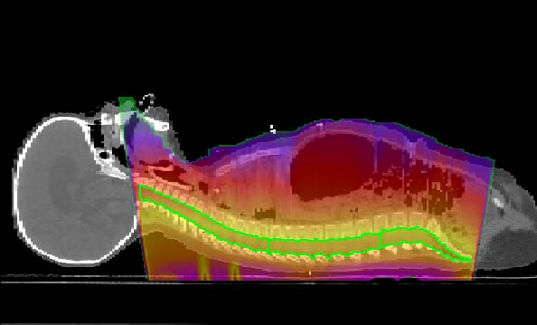
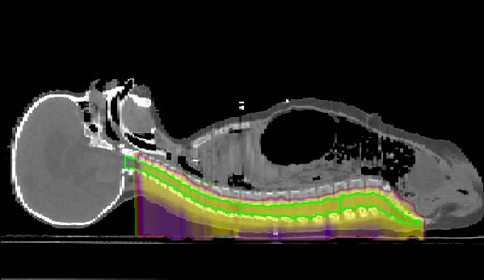
Protons
Photons
Protons
Bragg peak
+ healthy tissue can be spared
+ very precise dose deposition

Slide 32
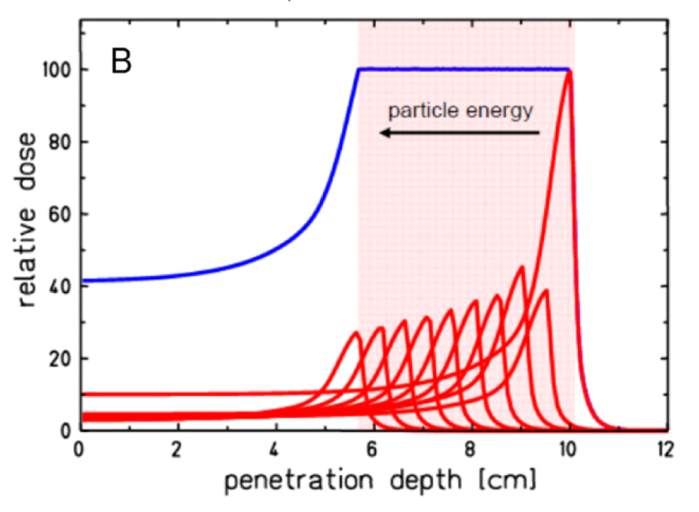
Protons
Beam delivery:
SOB – Spread-out Bragg peak
Tumor divided in slices, each slice
at a certain depth irradiated with
corresponding energy

Slide 33
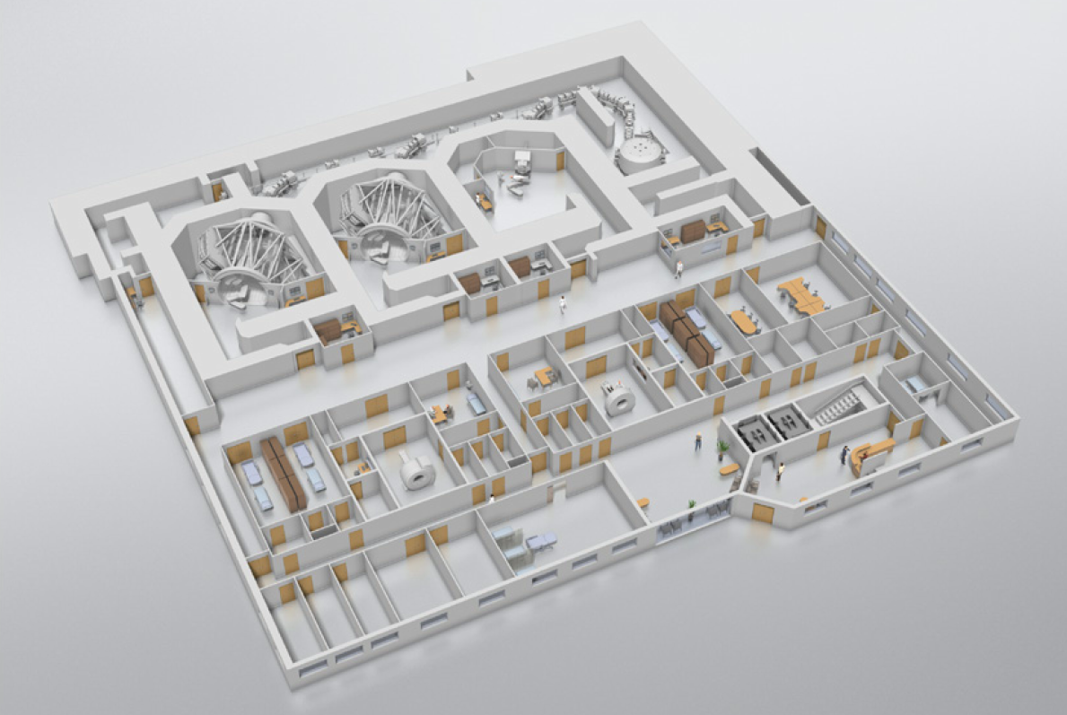
Protons
DOI: 10.1088/0034-4885/79/9/096702

Slide 34
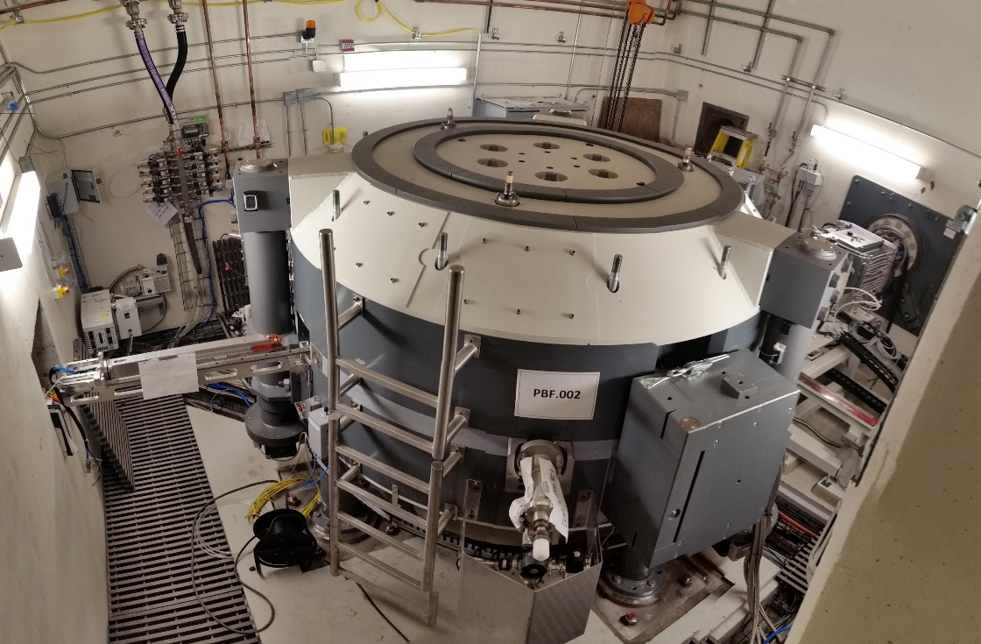
Protons
Cyclotron
DOI: 10.1088/0034-4885/79/9/096702

Slide 35
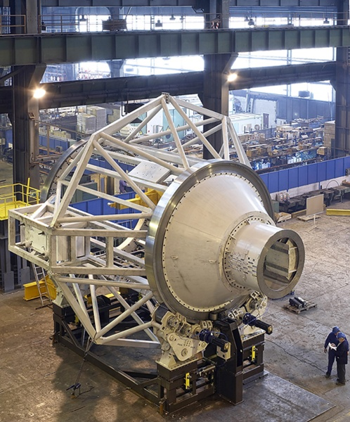
Protons
IBA proton gantry
100 t
DOI: 10.1088/0034-4885/79/9/096702
http://discovermagazine.com/2014/oct/14-precision-vs-profits

Slide 36
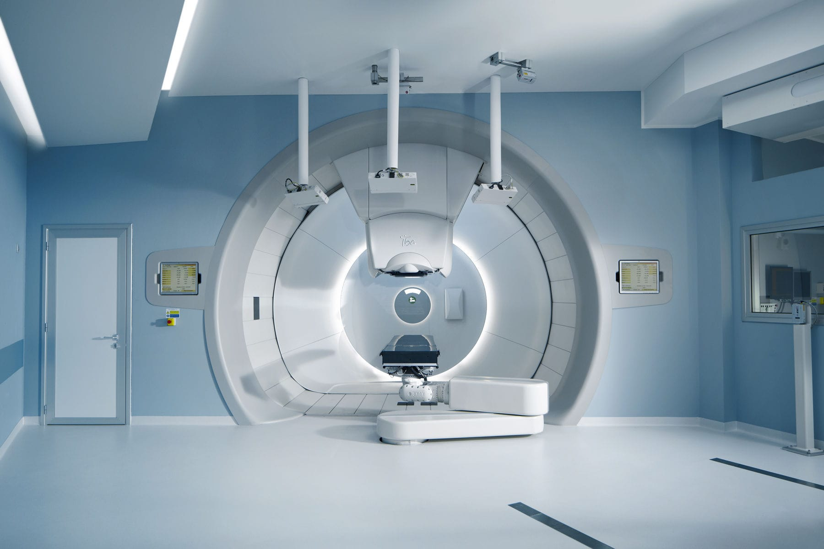
Protons
Gantry treatment room
DOI: 10.1088/0034-4885/79/9/096702
http://www.medicalexpo.com/prod/iba/product-101137-666281.html

Slide 37
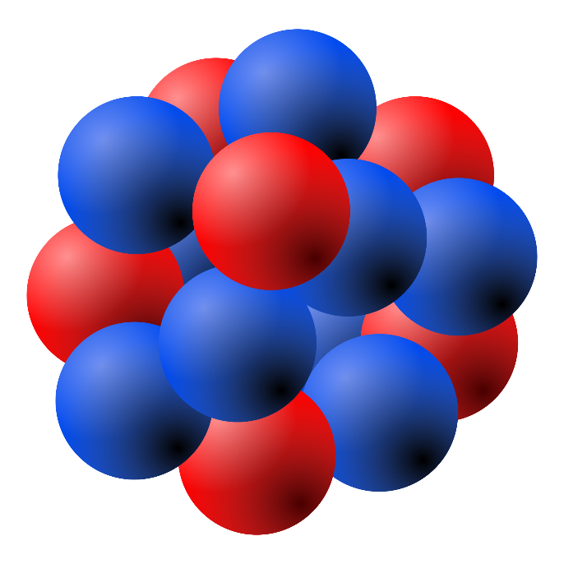
Carbon Ions
High density ionization:
→ High biological effectiveness
→ DNA double-strand breaks
→ Radioresistant tumors
proton track
carbon ion track
http://radioactivityci2010.pbworks.com/w/page/30525316/Fast%20Neutron%20Therapy

Slide 38
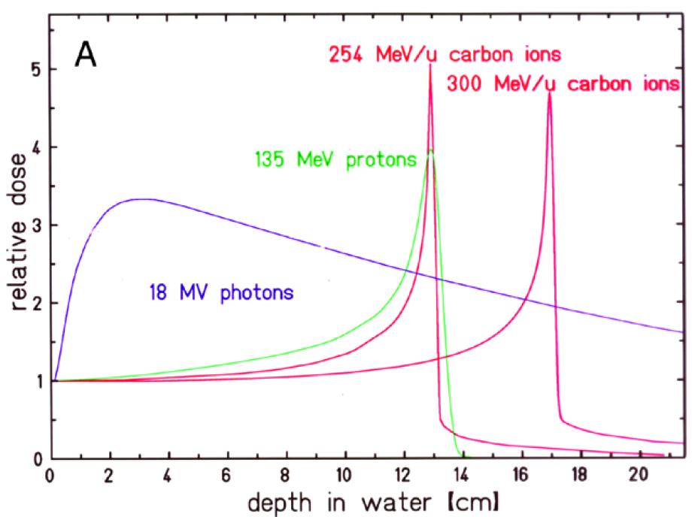
Carbon Ions
High density ionization:
→ High biological effectiveness
→ DNA double-strand breaks
→ Radioresistant tumors
proton track
carbon ion track
http://radioactivityci2010.pbworks.com/w/page/30525316/Fast%20Neutron%20Therapy

Slide 39
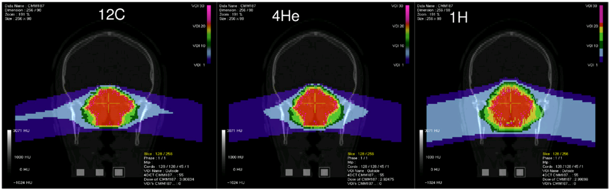
Carbon Ions
High density ionization:
→ High biological effectiveness
→ DNA double-strand breaks
→ Radioresistant tumors

Slide 40
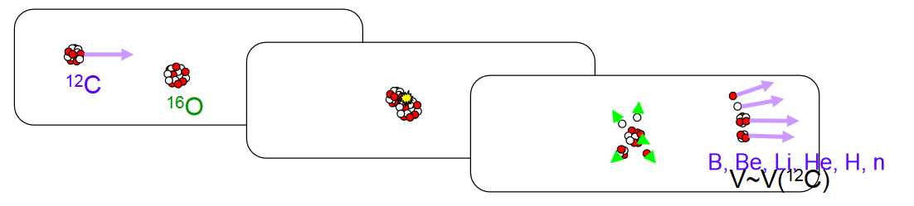
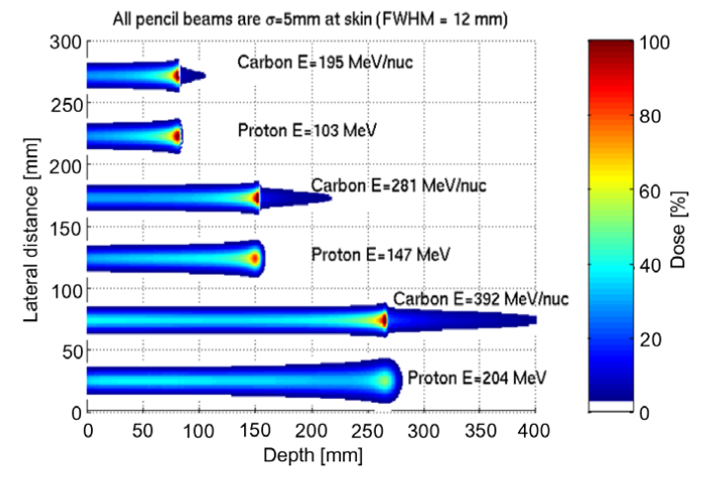
Carbon Ions
projectile
target atom
projectile fragmentation
http://flab.phys.nagoya-u.ac.jp/workshop/2008/emws03docs/s09_Toshito.pdf
target fragmentation
Projectile fragments can travel beyond the Bragg peak
→ fragmentation tail
Radiotherapy and Oncology 95 (2010) 3–22

Slide 41
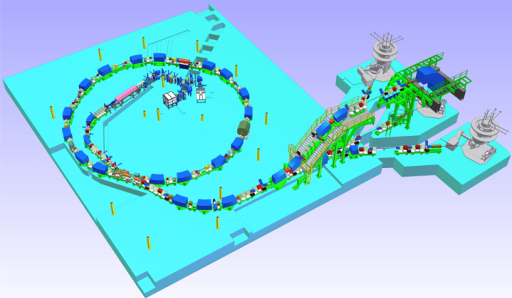
Carbon Ions
Synchrotron
25m diameter
7 MeV/u LINAC
2 ECR sources
Synchrotron for
protons and carbon ions
4 treatment lines
3 treatment rooms
World-wide
only 10 centers

Slide 42
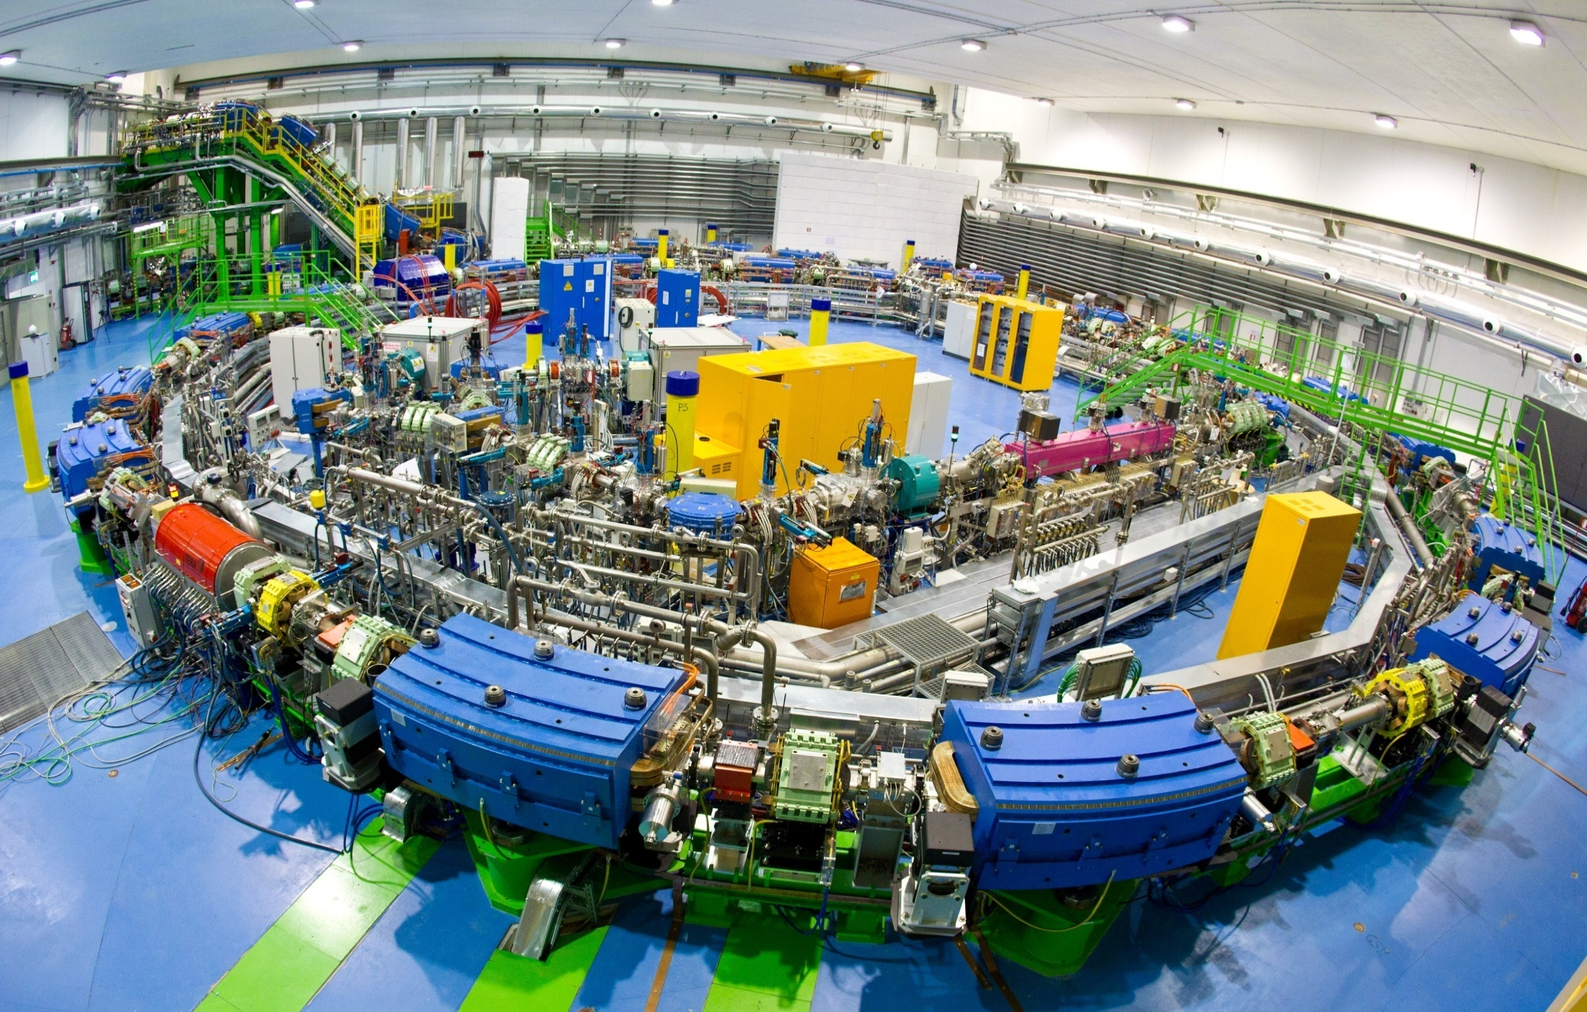
Carbon Ions

Slide 43
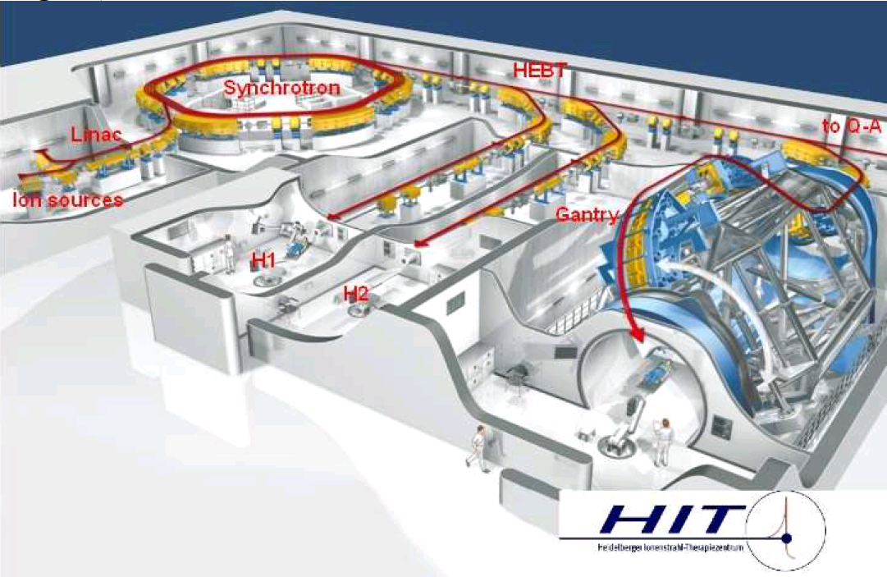
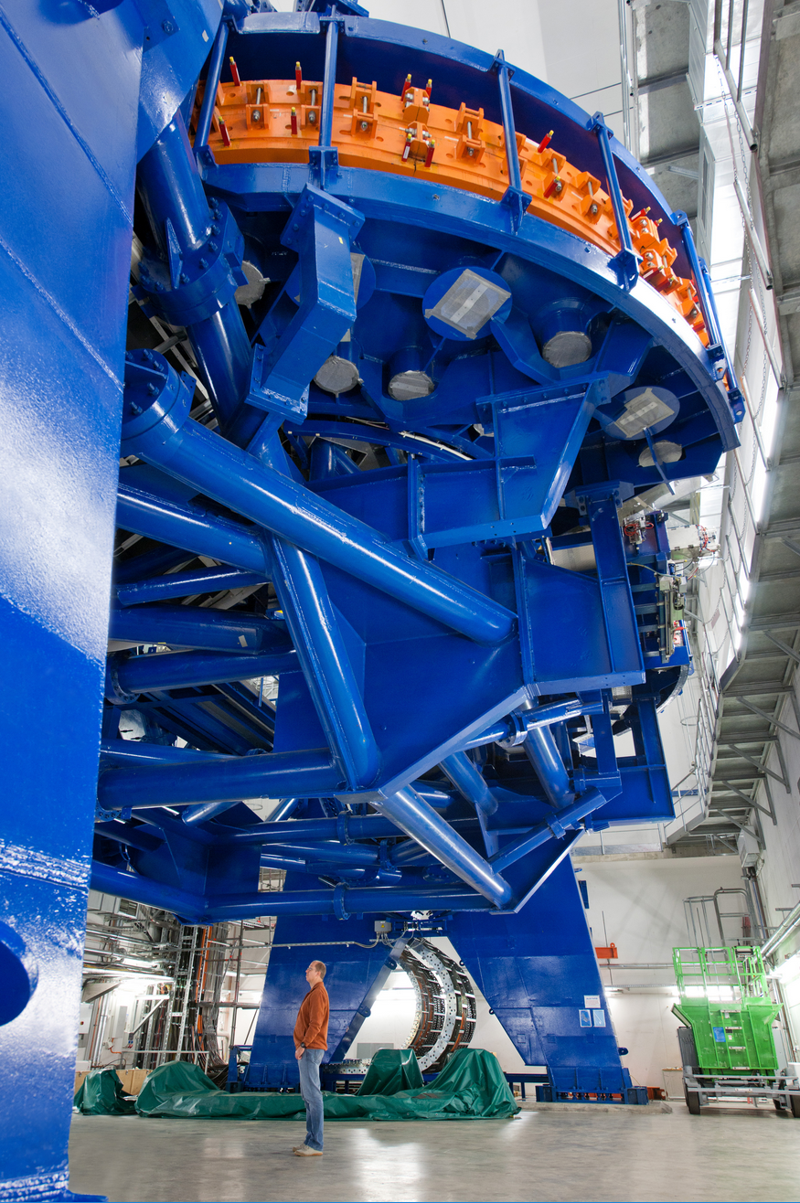
Carbon Ions
HIT carbon ion gantry
450 t of rotating parts

Slide 44
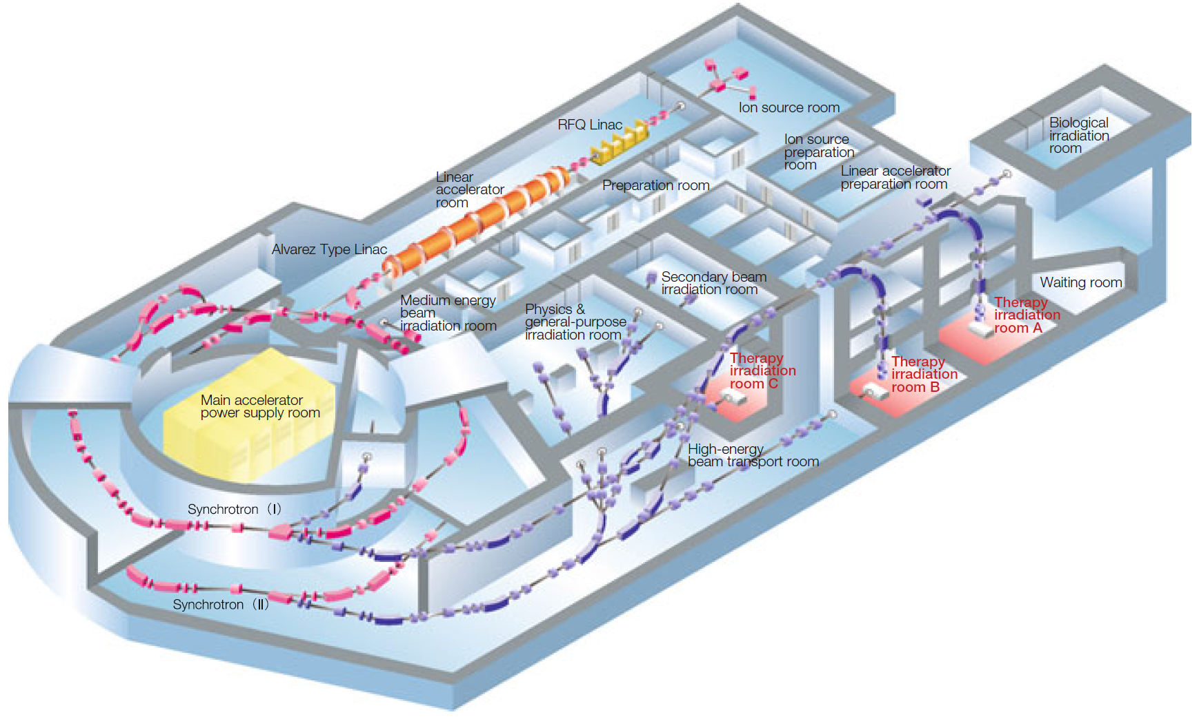
Carbon Ions
HIMAC, Japan

Slide 45
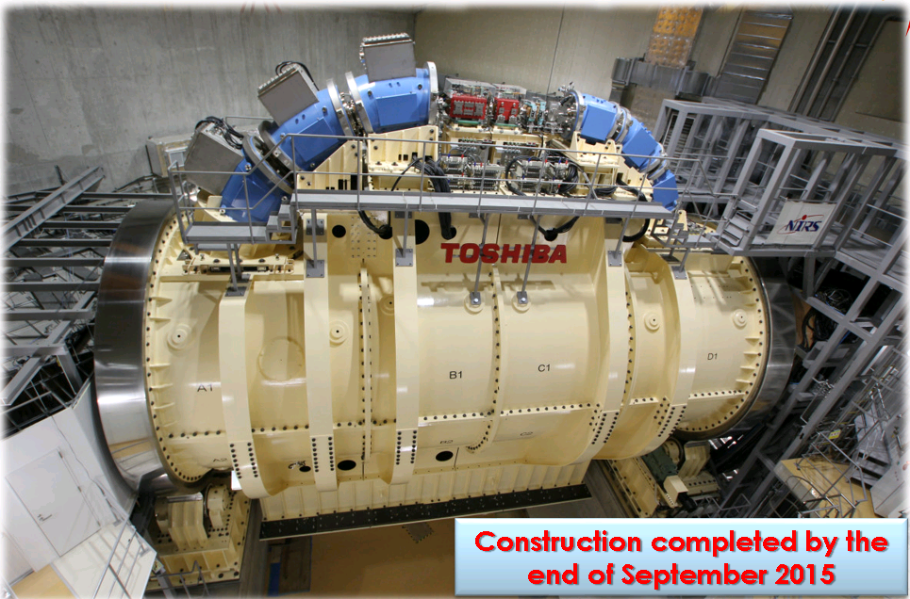
Carbon Ions
HIMAC, Japan
‘compact’
superconducting
gantry

Slide 46
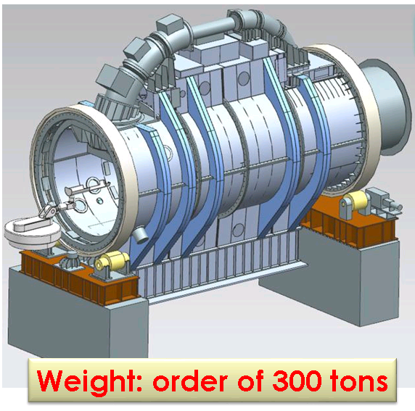
Carbon Ions
HIMAC, Japan
‘compact’
superconducting
gantry

Slide 47
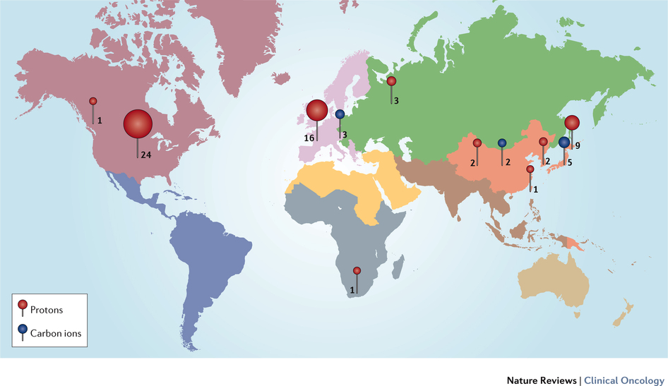
Proton and Carbon Centers world-wide
60 Proton Centers
10 Carbon Ion Centers
More than
120 Centres
expected for 2022
Durante M, Orecchia R, Loeffler JS, 2017

Slide 48

Summary: Dose-depth profile
http://www.wikiwand.com/en/Electron_therapy

Slide 49
Summary: Dose-depth profile
http://www.wikiwand.com/en/Electron_therapy

Slide 50
Your turn!
Which treatment would you suggest for these patients?
# | Patient
1 | well localized brain tumor close to brain stem at 10 cm depth
2 | widespread bronchial carcinoma (lung cancer) at 10 cm depth, heart should be spared
3 | tumor on chest wall, healthy heart muscle starts at 2.5 cm depth
4 | Aderhautmelanom (tumor of the eye), healthy eye tissue and optic nerve must not be irradiated!
5 | Chondrosarcoma, tumor on scull base, radioresistant
6 | inoperable liver tumor, skin should be spared as far as possible
7 | skin cancer, reaching 3 cm deep, critical organ at 5 cm depth
# | Treatment
A | 5 MeV electrons
B | 9 MeV electrons
C | Photons
D | Photons
E | 60 MeV protons
F | 115 MeV protons
G | Carbon ions

Slide 51
Your turn!
Which treatment would you suggest for these patients?
# | Patient
1 | well localized brain tumor close to brain stem at 10 cm depth | F
2 | widespread bronchial carcinoma (lung cancer) at 10 cm depth, heart should be spared
3 | tumor on chest wall, healthy heart muscle starts at 2.5 cm depth
4 | Aderhautmelanom (tumor of the eye), healthy eye tissue and optic nerve must not be irradiated!
5 | Chondrosarcoma, tumor on scull base, radioresistant
6 | inoperable liver tumor, skin should be spared as far as possible
7 | skin cancer, reaching 3 cm deep, critical organ at 5 cm depth
# | Treatment
A | 5 MeV electrons
B | 9 MeV electrons
C | Photons
D | Photons
E | 60 MeV protons
F | 115 MeV protons
G | Carbon ions

Slide 52
Your turn!
Which treatment would you suggest for these patients?
# | Patient
1 | well localized brain tumor close to brain stem at 10 cm depth | F
2 | widespread bronchial carcinoma (lung cancer) at 10 cm depth, heart should be spared | C
3 | tumor on chest wall, healthy heart muscle starts at 2.5 cm depth
4 | Aderhautmelanom (tumor of the eye), healthy eye tissue and optic nerve must not be irradiated!
5 | Chondrosarcoma, tumor on scull base, radioresistant
6 | inoperable liver tumor, skin should be spared as far as possible
7 | skin cancer, reaching 3 cm deep, critical organ at 5 cm depth
# | Treatment
A | 5 MeV electrons
B | 9 MeV electrons
C | Photons
D | Photons
E | 60 MeV protons
F | 115 MeV protons
G | Carbon ions

Slide 53
Your turn!
Which treatment would you suggest for these patients?
# | Patient
1 | well localized brain tumor close to brain stem at 10 cm depth | F
2 | widespread bronchial carcinoma (lung cancer) at 10 cm depth, heart should be spared | C
3 | tumor on chest wall, healthy heart muscle starts at 2.5 cm depth | A
4 | Aderhautmelanom (tumor of the eye), healthy eye tissue and optic nerve must not be irradiated!
5 | Chondrosarcoma, tumor on scull base, radioresistant
6 | inoperable liver tumor, skin should be spared as far as possible
7 | skin cancer, reaching 3 cm deep, critical organ at 5 cm depth
# | Treatment
A | 5 MeV electrons
B | 9 MeV electrons
C | Photons
D | Photons
E | 60 MeV protons
F | 115 MeV protons
G | Carbon ions

Slide 54
Your turn!
Which treatment would you suggest for these patients?
# | Patient
1 | well localized brain tumor close to brain stem at 10 cm depth | F
2 | widespread bronchial carcinoma (lung cancer) at 10 cm depth, heart should be spared | C
3 | tumor on chest wall, healthy heart muscle starts at 2.5 cm depth | A
4 | Aderhautmelanom (tumor of the eye), healthy eye tissue and optic nerve must not be irradiated! | E
5 | Chondrosarcoma, tumor on scull base, radioresistant
6 | inoperable liver tumor, skin should be spared as far as possible
7 | skin cancer, reaching 3 cm deep, critical organ at 5 cm depth
# | Treatment
A | 5 MeV electrons
B | 9 MeV electrons
C | Photons
D | Photons
E | 60 MeV protons
F | 115 MeV protons
G | Carbon ions

Slide 55
Your turn!
Which treatment would you suggest for these patients?
# | Patient
1 | well localized brain tumor close to brain stem at 10 cm depth | F
2 | widespread bronchial carcinoma (lung cancer) at 10 cm depth, heart should be spared | C
3 | tumor on chest wall, healthy heart muscle starts at 2.5 cm depth | A
4 | Aderhautmelanom (tumor of the eye), healthy eye tissue and optic nerve must not be irradiated! | E
5 | Chondrosarcoma, tumor on scull base, radioresistant | G
6 | inoperable liver tumor, skin should be spared as far as possible
7 | skin cancer, reaching 3 cm deep, critical organ at 5 cm depth
# | Treatment
A | 5 MeV electrons
B | 9 MeV electrons
C | Photons
D | Photons
E | 60 MeV protons
F | 115 MeV protons
G | Carbon ions

Slide 56
Your turn!
Which treatment would you suggest for these patients?
# | Patient
1 | well localized brain tumor close to brain stem at 10 cm depth | F
2 | widespread bronchial carcinoma (lung cancer) at 10 cm depth, heart should be spared | C
3 | tumor on chest wall, healthy heart muscle starts at 2.5 cm depth | A
4 | Aderhautmelanom (tumor of the eye), healthy eye tissue and optic nerve must not be irradiated! | E
5 | Chondrosarcoma, tumor on scull base, radioresistant | G
6 | inoperable liver tumor, skin should be spared as far as possible | D
7 | skin cancer, reaching 3 cm deep, critical organ at 5 cm depth
# | Treatment
A | 5 MeV electrons
B | 9 MeV electrons
C | Photons
D | Photons
E | 60 MeV protons
F | 115 MeV protons
G | Carbon ions

Slide 57
Your turn!
Which treatment would you suggest for these patients?
# | Patient
1 | well localized brain tumor close to brain stem at 10 cm depth | F
2 | widespread bronchial carcinoma (lung cancer) at 10 cm depth, heart should be spared | C
3 | tumor on chest wall, healthy heart muscle starts at 2.5 cm depth | A
4 | Aderhautmelanom (tumor of the eye), healthy eye tissue and optic nerve must not be irradiated! | E
5 | Chondrosarcoma, tumor on scull base, radioresistant | G
6 | inoperable liver tumor, skin should be spared as far as possible | D
7 | skin cancer, reaching 3 cm deep, critical organ at 5 cm depth | B
# | Treatment
A | 5 MeV electrons
B | 9 MeV electrons
C | Photons
D | Photons
E | 60 MeV protons
F | 115 MeV protons
G | Carbon ions

Slide 58



Beam delivery
3D scanning:
Tumor divided in voxels
→ Z: energy slice
→ XY: raster scanning
Additional challenge:
patient movements
→ beam gating
→ on-line imaging?
M. Pullia 2018 – Ions for cancer therapy, Workshop Archamps

Slide 59





Procedure
Medical doctor
-> marks boundaries
-> dose
Medical physicists
Video
CIRT 73.6 GyE
16 fractions IMPT
S. Rossi The CNAO experience, talk at Archamp Ion Workshop

Slide 60

Ideas for the future – smaller, cheaper, faster
TULIP - TUrning LInac around Patient
LINAC-based:
+ compact
+ fast energy change
+ shorter treatment time

Slide 61

Ideas for the future
CABOTO
CArbon BOoster for Therapy in Oncology

Slide 62
Spare slides on PET imaging in hadron therapy
Notes:
62

Slide 63


p
p
target fragmentation
¹H
Fiedler et al., in Ion Beam Therapy, Springer-Verlag Berlin Heidelberg 2012
Notes:
63

Slide 64

p
p
¹²C
target fragmentation
projectile fragmentation
¹H
¹²C
Fiedler et al., in Ion Beam Therapy, Springer-Verlag Berlin Heidelberg 2012
Notes:
64

Slide 65

PET scanning in hadron therapy
target fragmentation
¹H
Positron
Emission
Tomography
+ therapy control
+ dose verification
biological washout
low intensities
projectile fragmentation
¹²C
Fiedler et al., in Ion Beam Therapy, Springer-Verlag Berlin Heidelberg 2012
Notes:
65

Slide 66
Notes:
66

Slide 67


¹¹C
¹¹B
e⁺
$$υe$$
Notes:
67

Slide 68
e⁺
e⁻
Notes:
68

Slide 69


$$γ$$
$$γ$$
Notes:
69

Slide 70
P
E
T
Notes:
70

Slide 71
¹²C
Notes:
71

Slide 72
¹¹C
Notes:
72

Slide 73



11C aided hadron therapy
12C
11C
¹¹C primary beam
increased β⁺ activity
maximum at Bragg peak
-> PET imaging for dose
verification
Dose
Dose
β⁺ activity
β⁺ activity
R. S. Augusto et al., NIM B376 (2016) 374-378

Slide 74

Relative Dose [%]
Depth in Water [mm]

