Slide 1
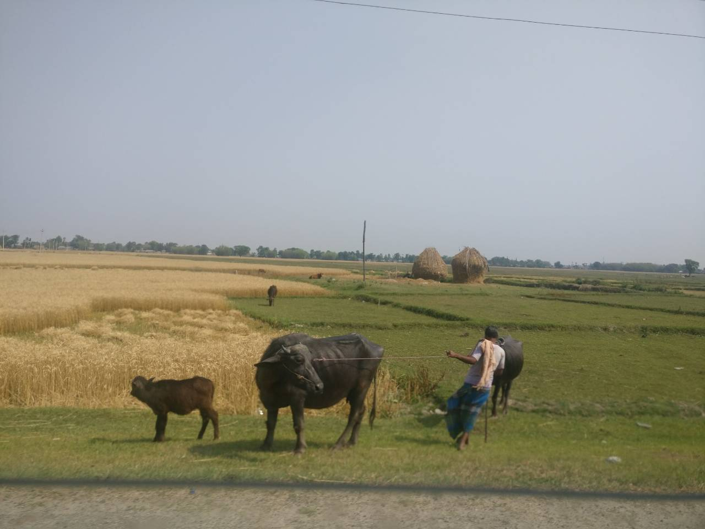
Making of pregnancy detection kit for cattle of Nepal
A Journey from IDEA to STARTUP

Slide 2
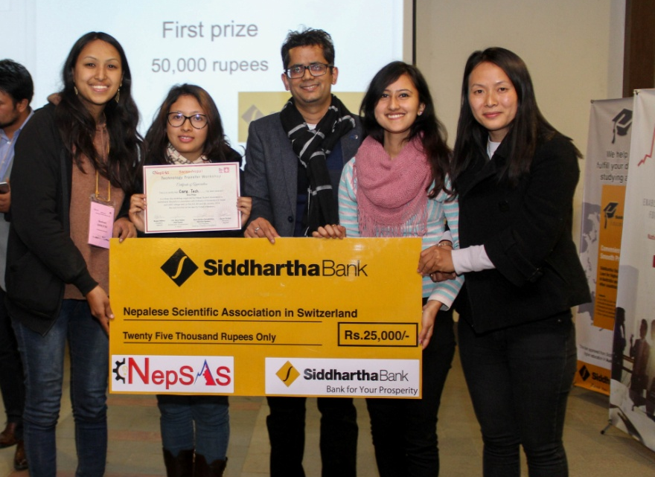
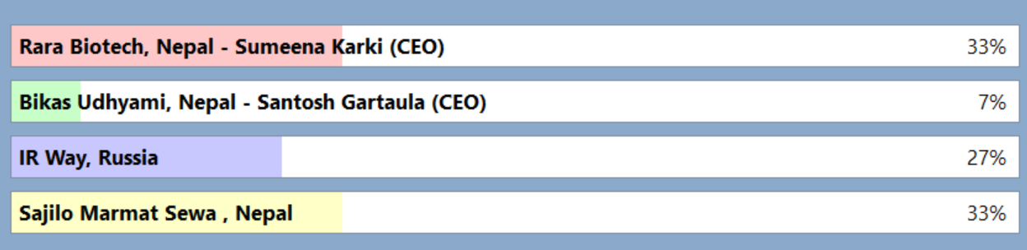
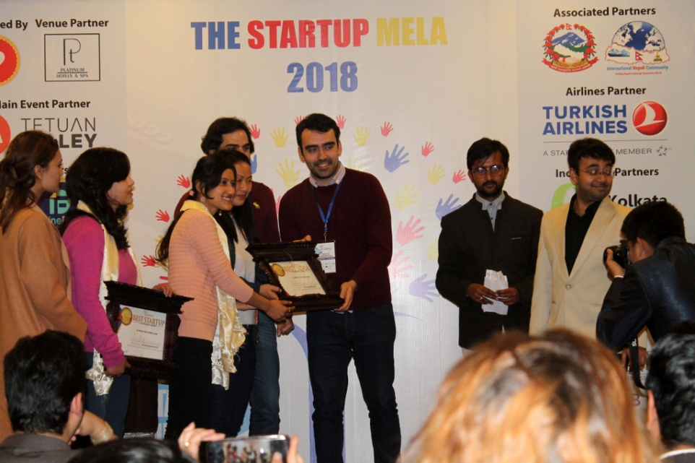
Success story……
Best idea
Swiss-Nepal Technology transfer workshop
January 2018
Best Startup
World Innovation forum
1st day pitch, 12th June-2018
Best idea
The Startup Mela
February 2018

Slide 3
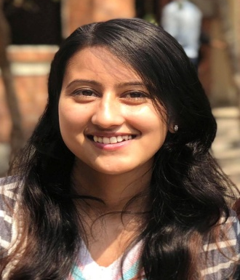
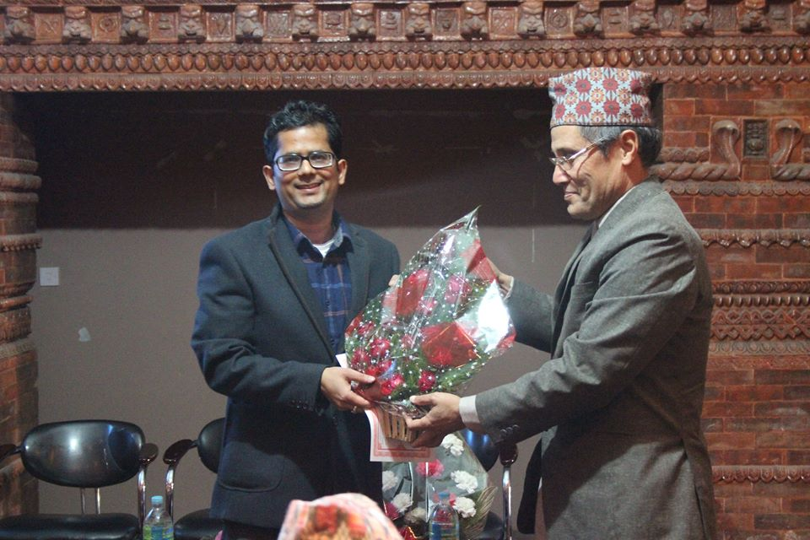
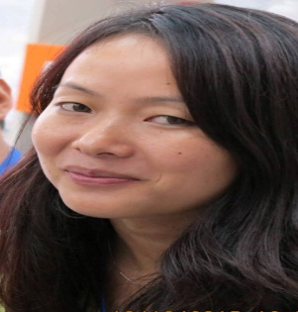
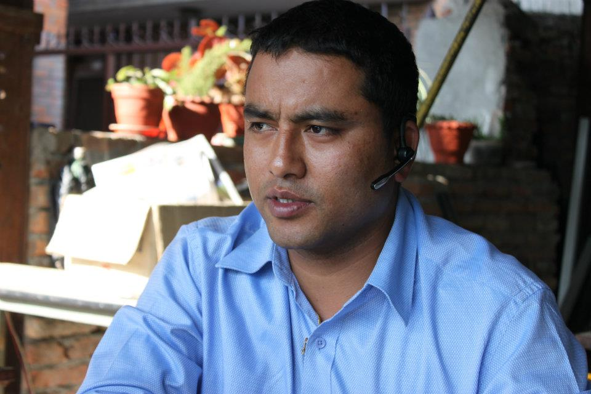
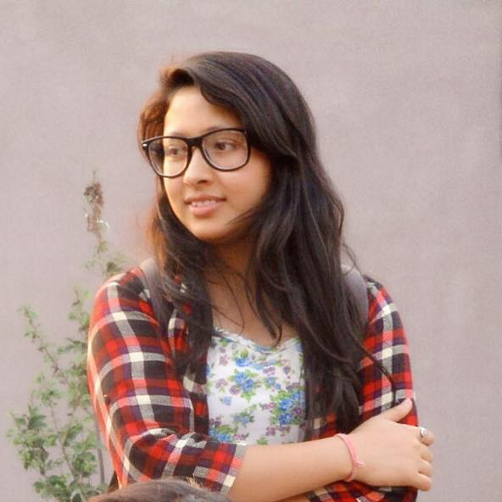
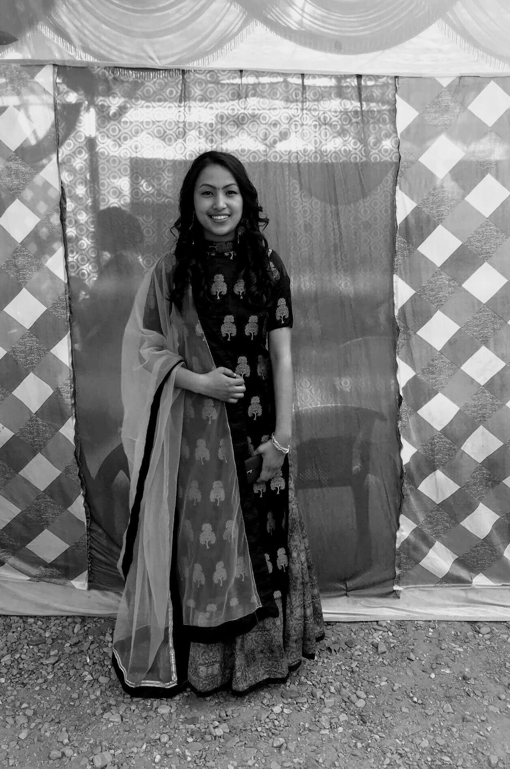
Team of experience
SUMEENA KARKI
CEO
M. Sc Biotechnology
RAVINDRA SAPKOTA
Senior Scientist
PhD
GAURI THAPA
Scientific Officer
M. Sc Biotechnology
ROSHANI SHRESTHA
Marketing Head
B. tech Biotechnology
SAJAN MAHARJAN
Financial Advisor
BBA
AMINA BANIYA
Director
B. tech Biotechnology

Slide 4
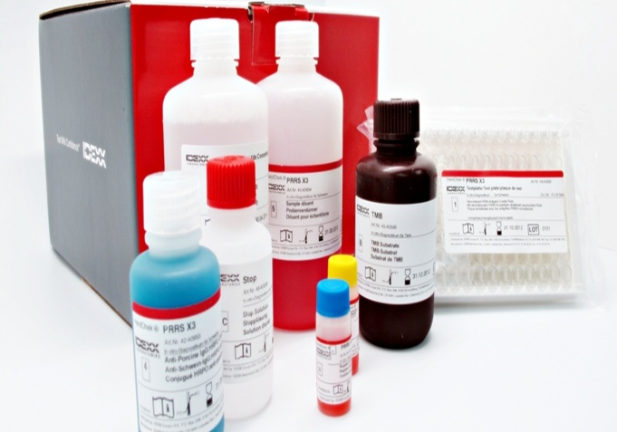
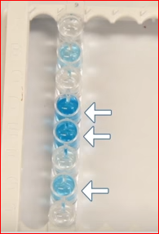



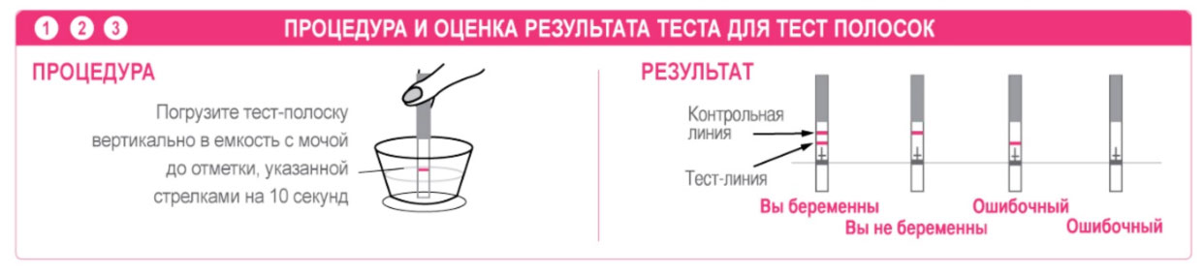
Other product
Our product
RARA BioTech
IDEXX ELISA Kit
Not Pregnant
Pregnant
Maybe
Pregnant
Not Pregnant
Expensive ( ᷉5USD/test)
Color based
Need expertise
- Antibody Specific to Nepalese cattle (>95%)
- User friendly
- Compact ( ᷉10cm) and one time use
Line based method for detection
3USD cheaper

Slide 5
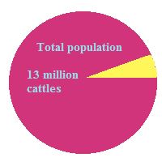
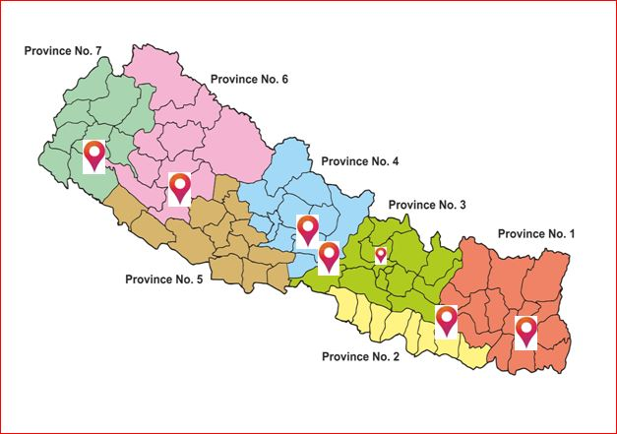
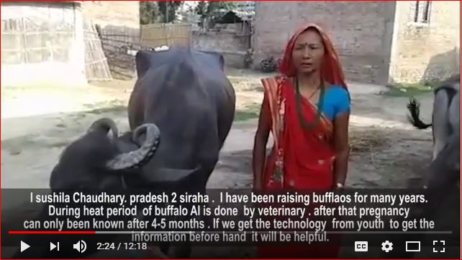

Market validation and business opportunity
Target
0.5%
Turnover per year will be 0.13million USD
Surveyed area
https://www.youtube.com/watch?v=lNfRvCrnnOU&t=1s

Slide 6

Challenges
Marketing strategy to convince farmers
d\\
Team Development
Lab to Market
Pregnancy kit for cattle
Developing Business modules
Convincing Investors
Notes:
Team Development: science background only, needed team members in all fields
Developing business module: finding ways to for cheap production
Convincing investors: young girls, money from investors
Marketing strategy: ways and means reach out and convince farmers.

Slide 7
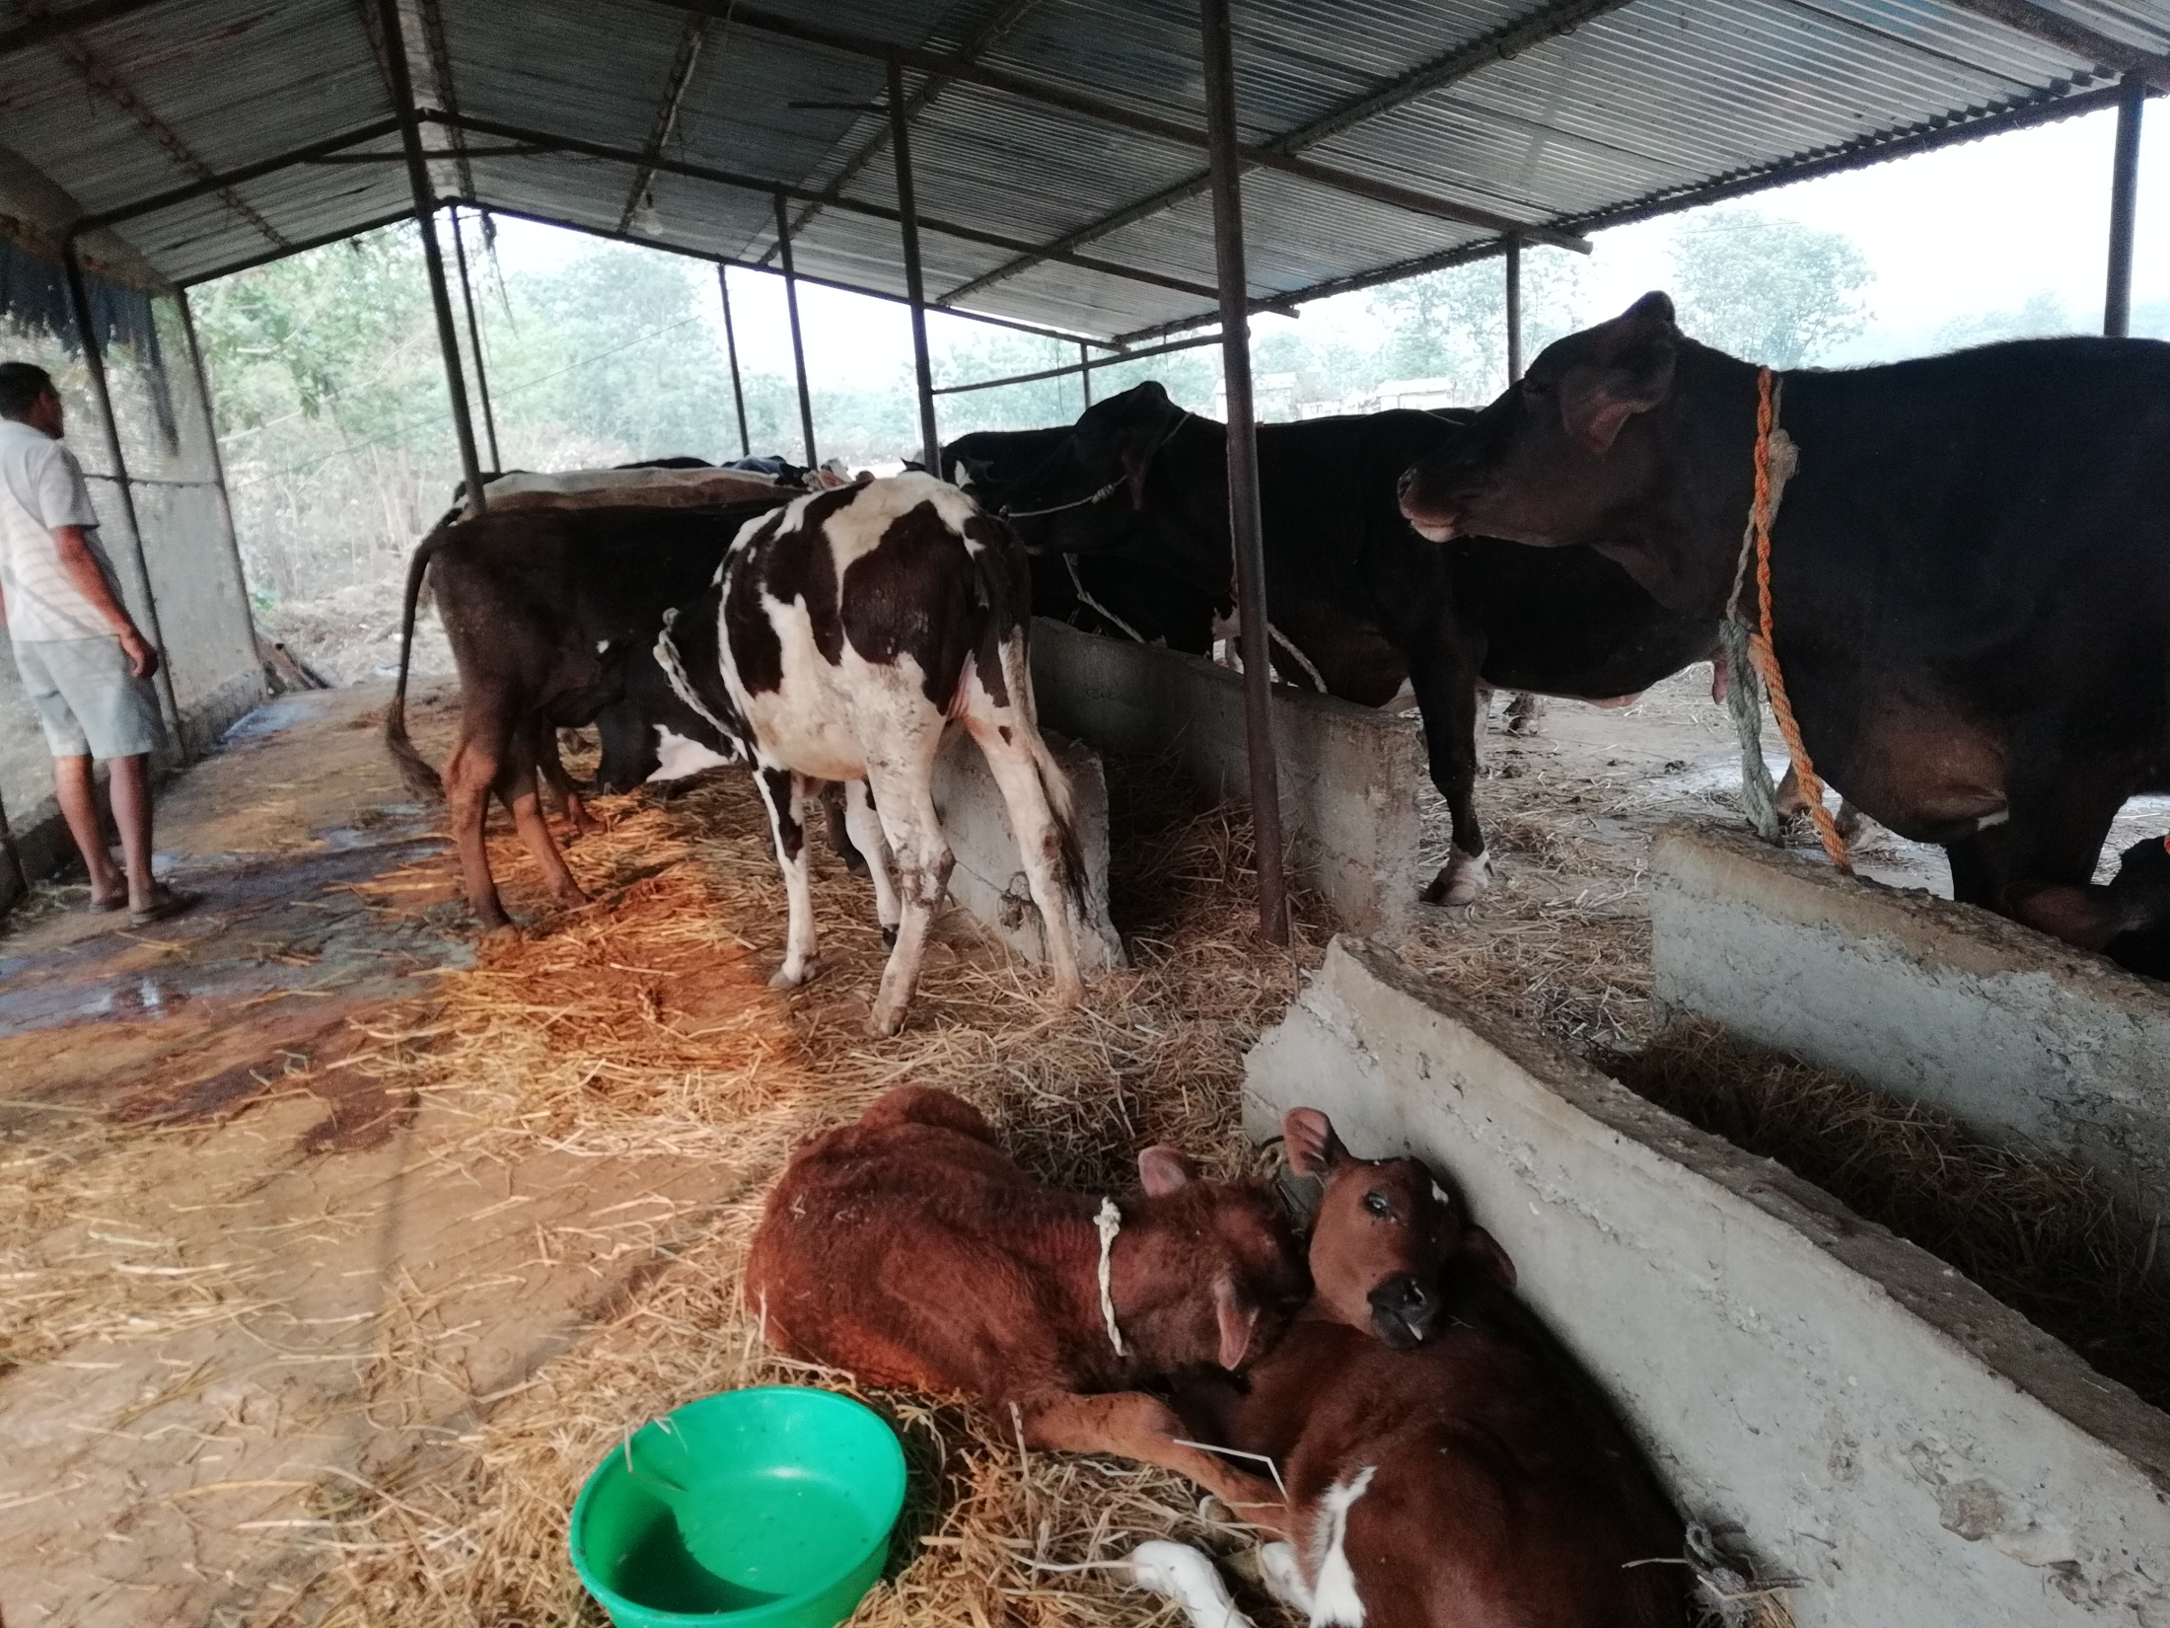
+
Fund raising
Mass Production
Pregnancy kit
$ 1000
$ 800
$ 400
Winter
$ 400
Marketing and Sales
New member
Research and Development
Validation of Antibody
Prototype testing

Slide 9

Steps towards improvement
Diverse team
Accelerator programs
Mentorship
Global exposure
Collaboration
  Research institution
  Business company
Adequate funding for
  Research
  Lab set-up

Slide 10

Looking forward to…
Solve other pressing problems
Business through Research based product
Convenient agro-technology
Sales maximization
Globalization

Slide 11
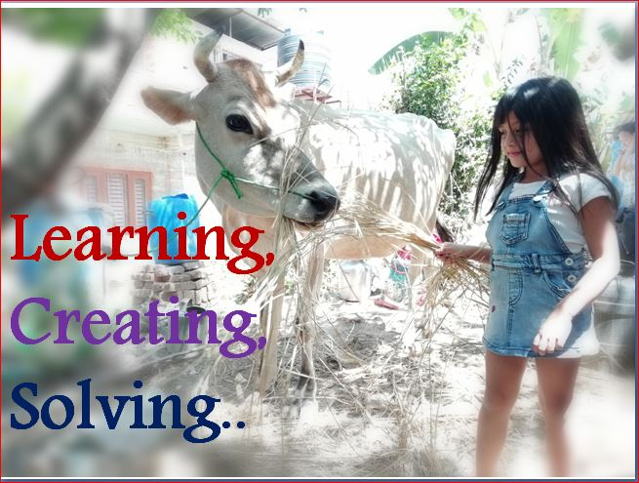
Thank you!

