Slide 1
+ + + +
+ + + +
+ + + + +
Integrated Geo-ICT Platform to
Increase Crop Productivity and Profitability
Data-driven Agriculture
Rajan Man Bajracharya
MD, Pathway Technologies
Founder, GeoKRISHI Initiative
www.geokrishi.farm
www.pathway.com.np
rajan@pathway.com.np
Notes:
Data importance ra .... GIS mapping ko advantages …

Slide 2
Challenge & Opportunities
Agri-Sector
EMPLOYS
60%
Smallholder
Farmer Supply
80%
Globally
We Imported USD 280 million worth of semi & processed food
Import rises 3 times in 5 years
Nepal is blessed with diverse agro-climatic conditions

Slide 3





Data Landscape
Government Organization
Research Organization
CBS, DoS
National MIS
(AMIS)
HH Survey
Meaningful
Information
Data-driven solution to make agriculture more precise, productive, resilient, and profitable.
Notes:
In order to answer these question … you need to rely on several type of data ….

Slide 4






Bridging the Gap
Intelligent System
Science
End user
Simplified Science
Adopt scientific methods
Contextualized Info.
Closing the Gap between Science and Practice
Data Driven Approach
Decision Making
Utilize untapped data
Evidence based Analytics

Slide 5
Solving Key Problems
Farmer
Poor Crop Yield
Q1. What is the Most Profitable Crops to Grow?
Technician
Job Frustration
Q2. How to make agricultural extension services more effective and better recommendation?
Planner
Substance farming
Q3. How to plan and identify areas for agriculture productivity?
Agro Input Company
Trust
Q4. How to increase customer loyalty?

Slide 6
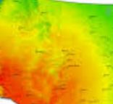
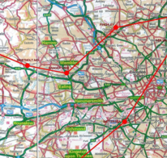
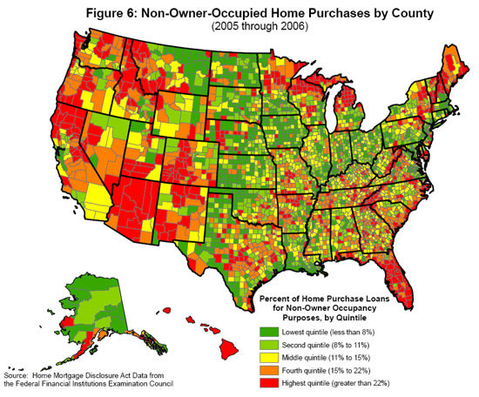
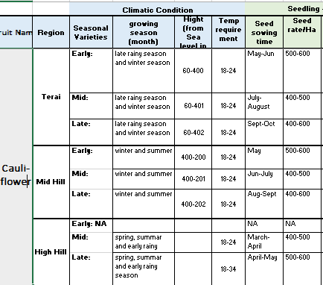
Conceptual System Framework
GIS & Satellite Products
Product & Tool
“what to grow, where, when and how”
Farm Management
Tools to optimize use of fertilizer
Virtual Collection Center
Agriculture
Data
Infrastructure
@pixel level
Crop Model
Geo-physical
Slope, Aspect, Elevation
Crop Suitability Engine
Soil Characteristics
Soil fertility, moisture, NDVI, texture, pH
Baseline
Database
Crop Recommendation
Climatic
Rain, Temperature
Market Intelligence
Sectorial
Database
Monitoring
Crop Health, Drought..
Technology Stack
Statistical Data
Spatial
Database
Open Science/Source
Crop Chart
Crop variety wise requirement parameter
Mobile/Web Apps
Drone & Sensor Technologies
Agriculture Census
Production, yield
Farm
Database
Earth Observation
Demography
Age, sex, migration
Cloud Computing
Crowd sourcing
“Precision Agriculture” technologies are changing the way that farmers manage their crops

Slide 7
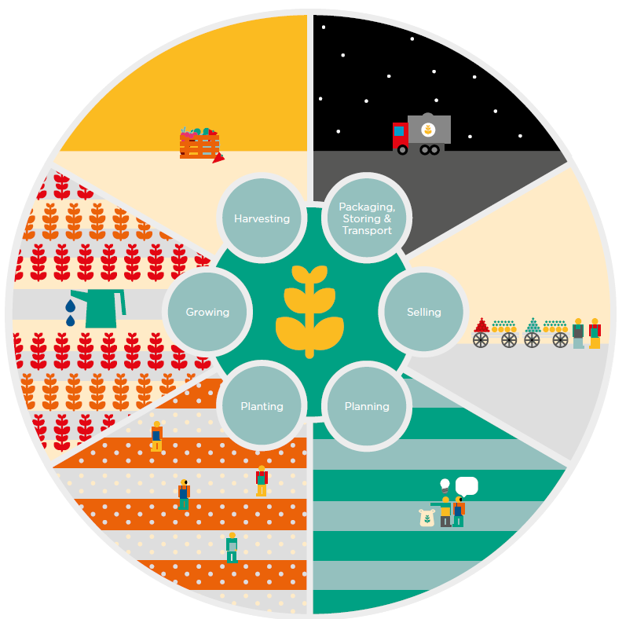


GeoKRISHI: Software Product & Tool
Planning/Preparation
Farmer’s/Farm profile
Crop Suitability evaluation on comparatively advantage crop
Guidelines and Report tool
2. Planting/Growing Phase
Soil testing (low-cost devices)
Fertilizer calculator
Crop health monitoring
3. Post-Harvest/Market
Virtual collection center
Connecting traders & farmer/coops
4.
Harvest
5.
Package
3.Grow
6. Sales
1.
Plan
2. Prep.
Target Users:
Immediate User (Technician)
Next User
(Planner)
End User
(Farmer, Cooperatives)
Figure. Agriculture Stages

Slide 8
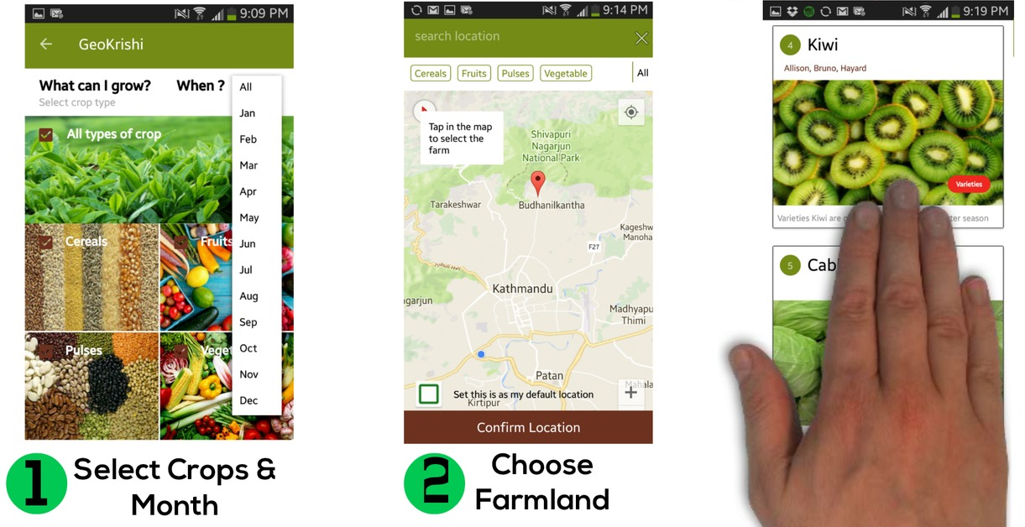
What to Grow When, Where and How?

Slide 9
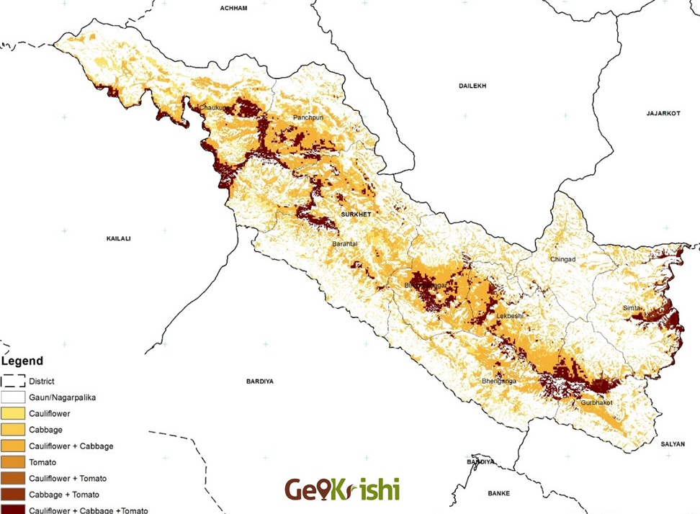
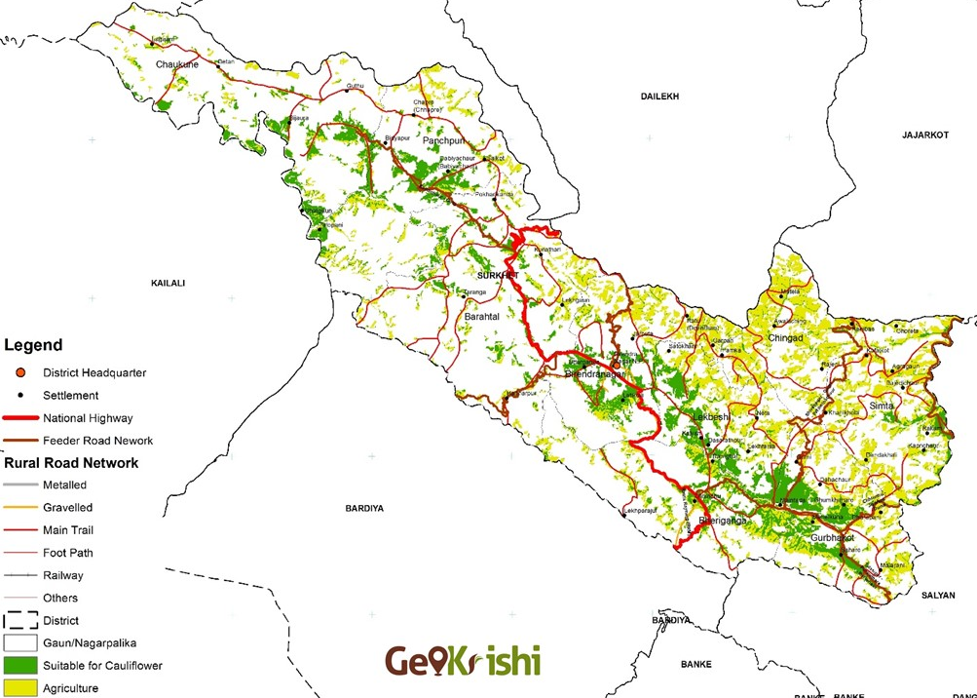
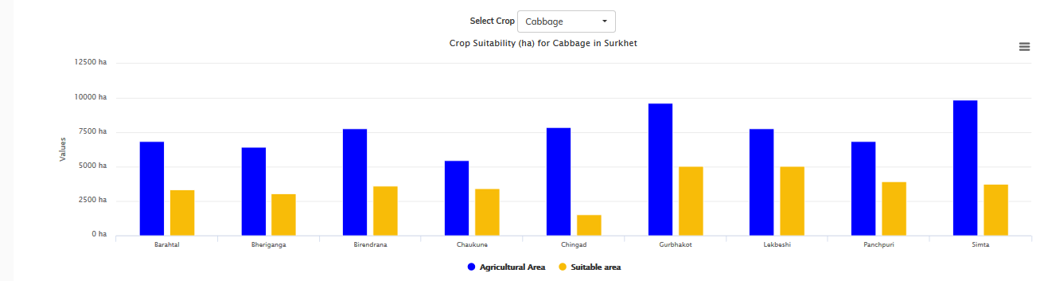
Web-based: Decision Support Platform
Identify area for agriculture commercialization
Why: Increase crop productivity throu’
data-driven solution
Identify cluster, block, zone for
Agricultural Development
What to Grow, When and Where
Climate Resilient Agriculture
Data
Geo/Bio-physical Characteristics
(slope, aspect, elevation, sun-shine,
soil texture, fertility, pH etc.)
2. Climatic Parameter
(Rainfall, temperature)
3. Economic Parameter
(Accessibility, infrastructure, price, cost)

Slide 10
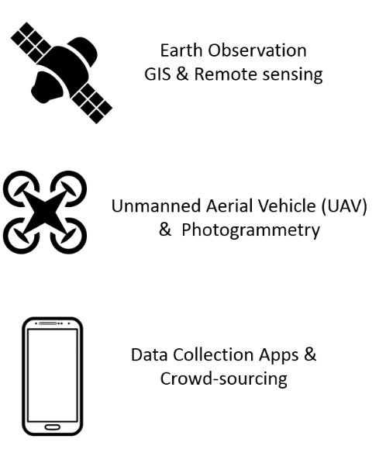
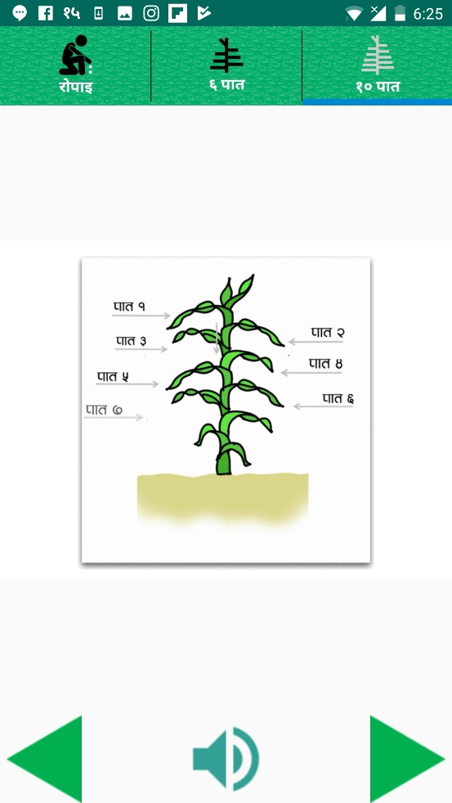
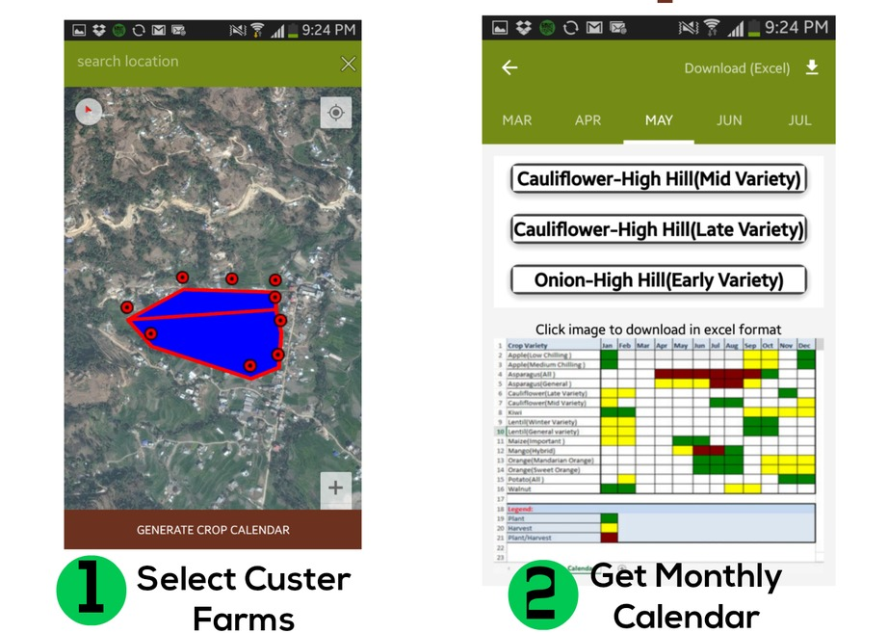
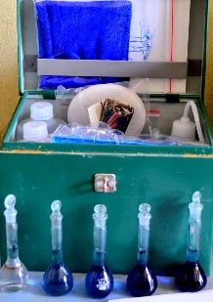
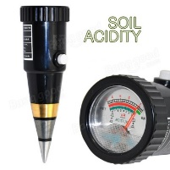

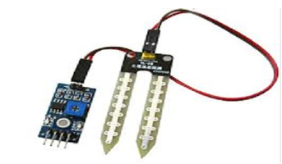
Value added Tools
Increase
efficiency of
Maize production
by 2000 Kg /hector
List suitable crop at farm or community level.
Advanced Fertilizer Calculator
5 days weather forecast information
Animation
Audio

Slide 11
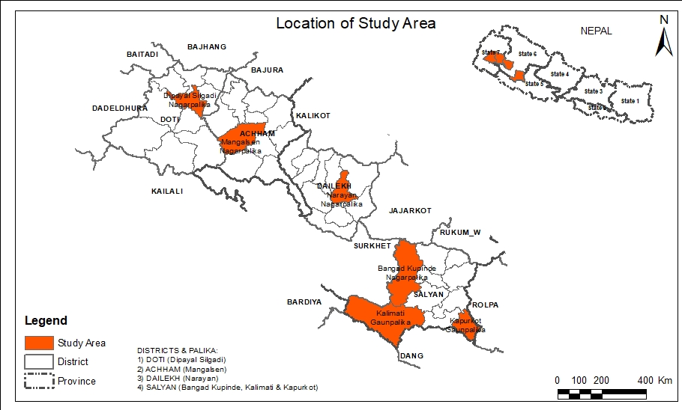
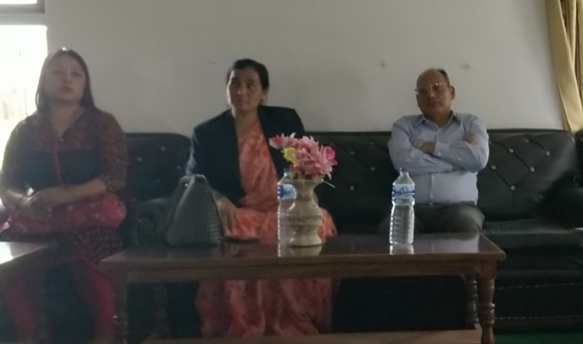
Piloting in Remote settings
Promoting High Value Agriculture Products
Province 6
Surkhet , Salyan
2. Province 7
Achham, Doti Dailekh,
3. Province 1 & 2
Diverse climatic condition is home for commercial off season vegetables and fruits production
Hon. Bimala KC (Chetana),
Agri Minister, Karnali Pradesh
Notes:
Here, we are co-creating three different service delivery model ….and later, combine these 3 models to evolve as a ‘sustainable business model’.
Because solution is often not yes or no, but why and how. Understanding different perspectives develops empathy and helps teams figure out win-win situation.

Slide 12
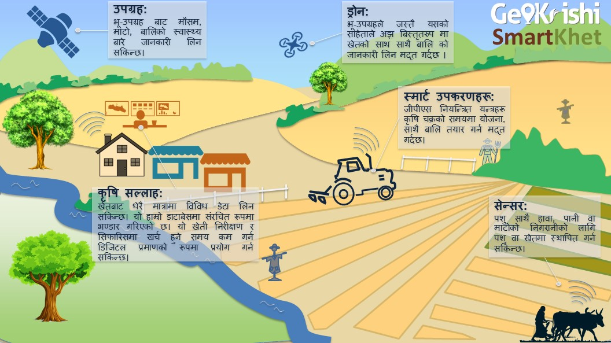
Co-creating Business - Smart Village
1. Private Enterprises/JTA’s/ Youth
Franchising with local leaders
2. Cooperatives
Smart Coops – connecting grower & traders.
3. Municipal Authority
Customized Agriculture Advisory Center(s).
Farmers at the heart of smart village
Innovation is needed both from Technological aspect and Service Delivery Mechanism

Slide 13
Partnership Opportunity and Possible Collaboration
1. Crop Suitability Evaluation
Competitive Advantage Crops (adding economic dimension)
2. Soil Lab
  Digital Soil Database and Mapping
  Innovation using low cost devices & IoT
  3. Crop Health and Disease Surveillance
  Satellite and/or smartphone photo
  UAV
  Intelligent Agriculture Advisory and Call Centers
We want to be closely associated with the individuals and institutions in this space in order to develop tools that are likeable and useful for farmers and can help them create better impact in the society.
Notes:
What we are seeking

Slide 14

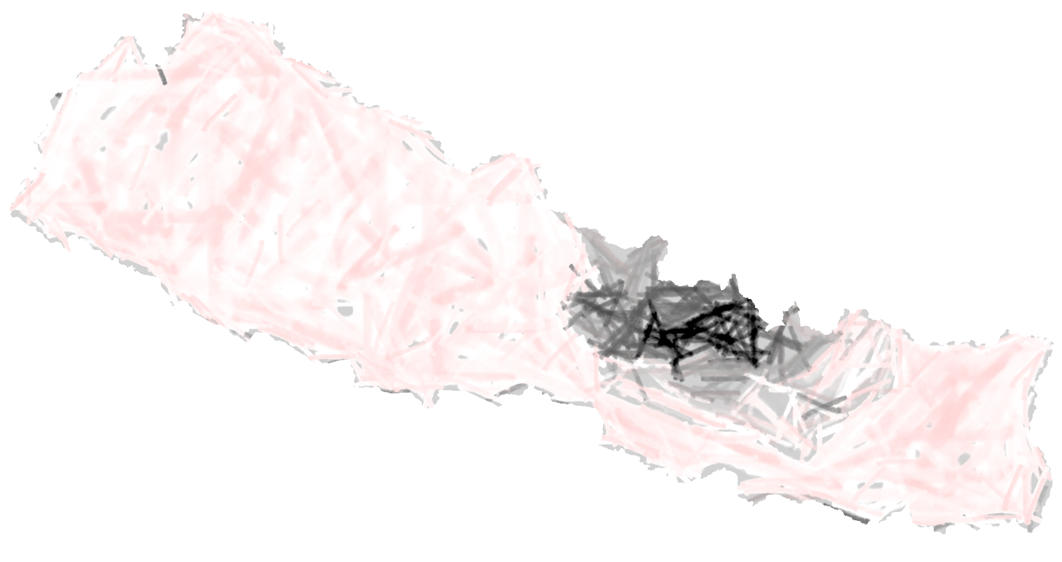

Thank You
www.dds4dev.org
www.geokrishi.farm
Thapathali, Kathmandu
E: rajan.man@gmail.com
M: 98510-94030

