Slide 1


Introduction to ORION Space and Our Project on PocketQube
Swiss-Nepal Technology Transfer Seminar 2018
CERN, Geneva
16 June 2018
PRAJAPATI Rakesh Chandra
Founder/CEO ORION Space
Vice-President NepSAS

Slide 2
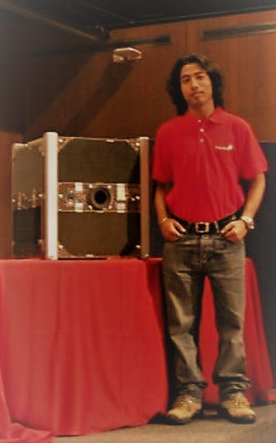
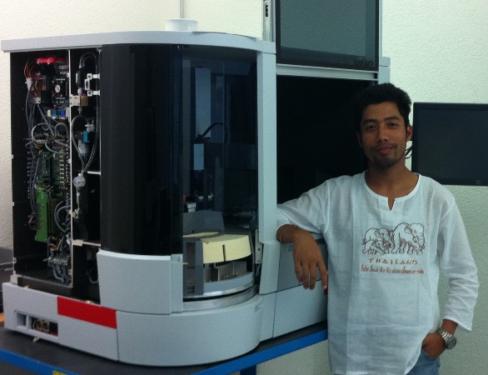
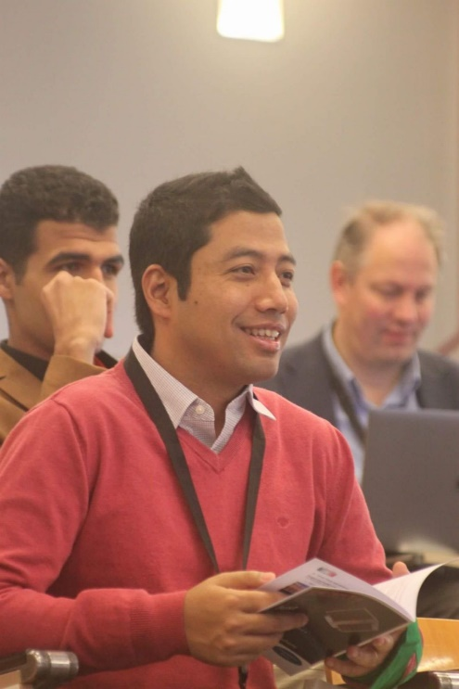
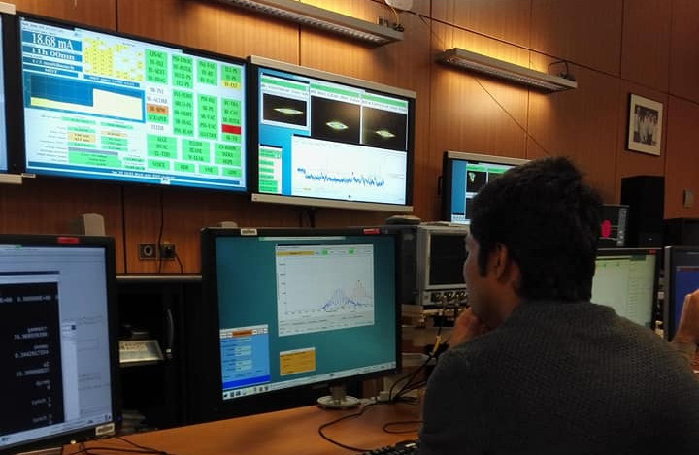
Rakesh Chandra PRAJAPATI
10 years of experience in R&D (Research and Development), SI (System Integration), V&V (Verification and Validation), AIT (Assemble, Integrate, and Testing) in Biomedical and Space Engineering.
Founder/CEO of ORION Space
Masters in Electronics and Space Technology from EPFL, Switzerland
Interest in Physics (Science and Technology of Particle Accelerator, JUAS 2018)
SwissCube CubeSat Launch
23-09-2009, EPFL

Slide 3
What bring us together?
Let's do
something
for
Nepal

Slide 4
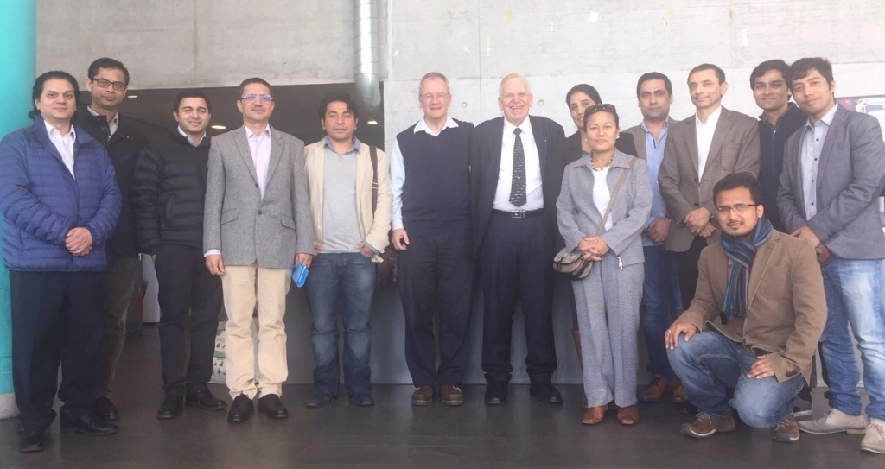
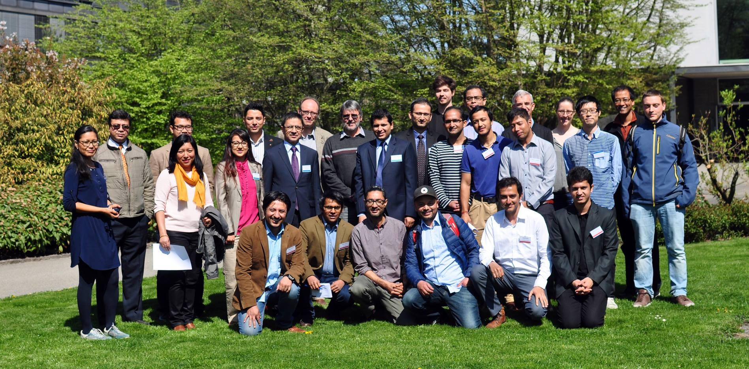
Swiss-Nepal Technology Transfer Seminar
«I want to promote Space Education in Nepal»
2016, EPFL
2018, CERN
NepSAS
is synonymous to
“Let’s do something for Nepal”
2017, ETHZ

Slide 5
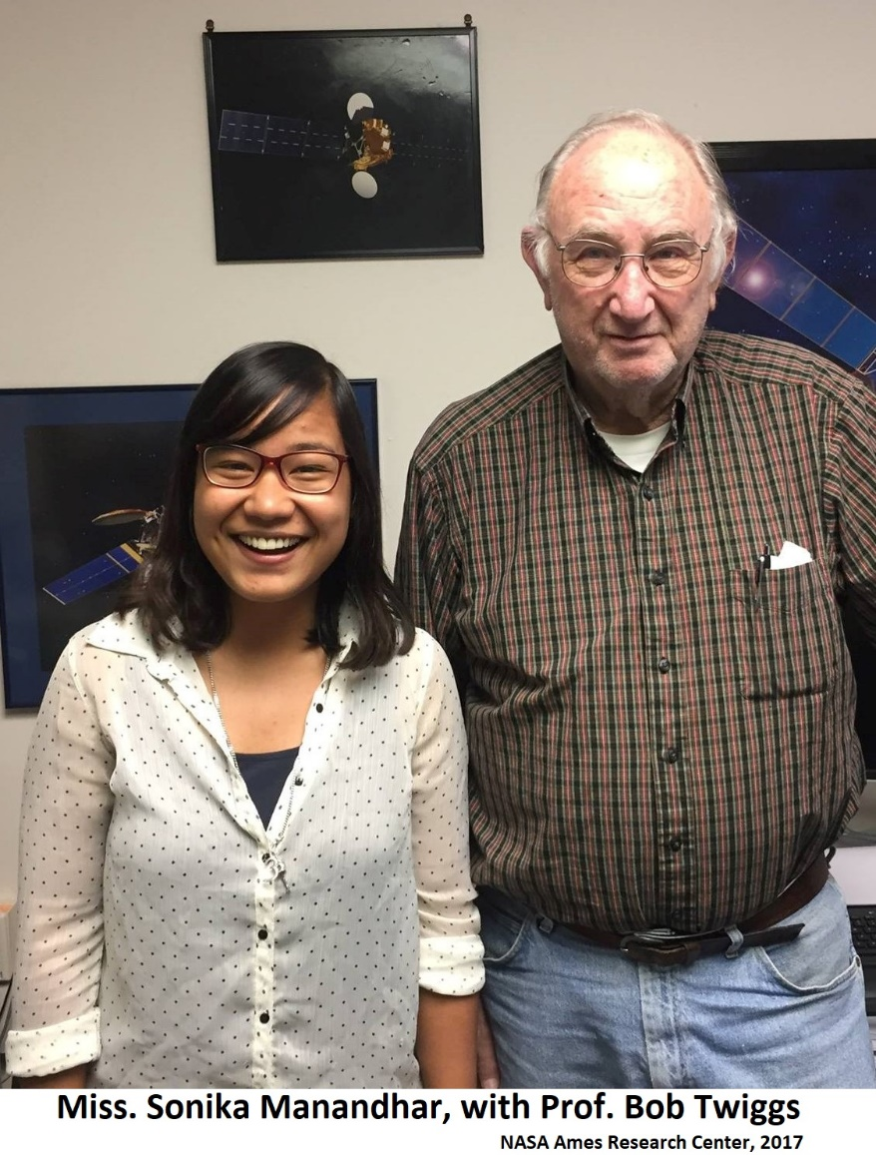
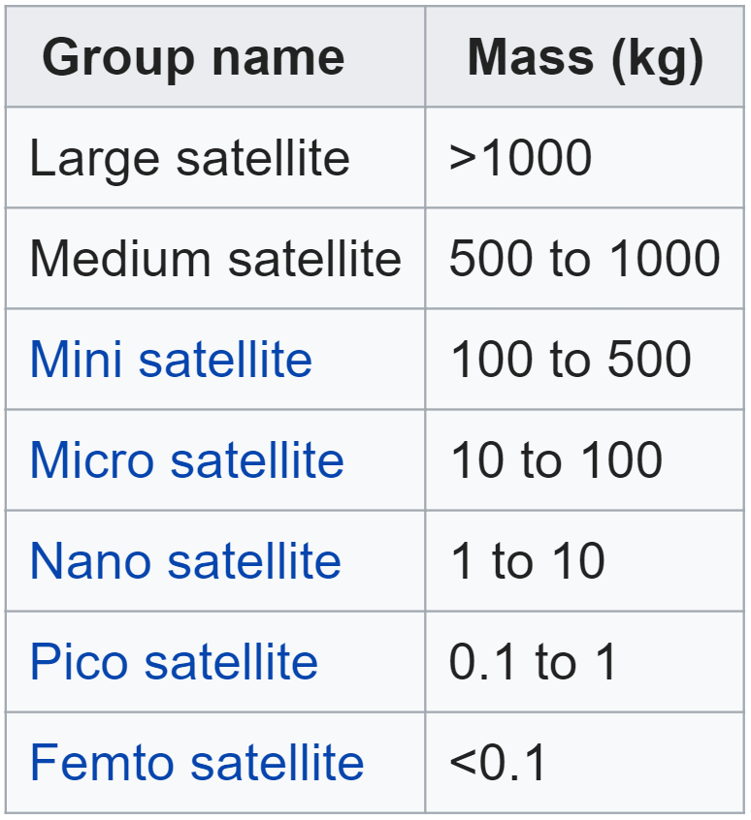
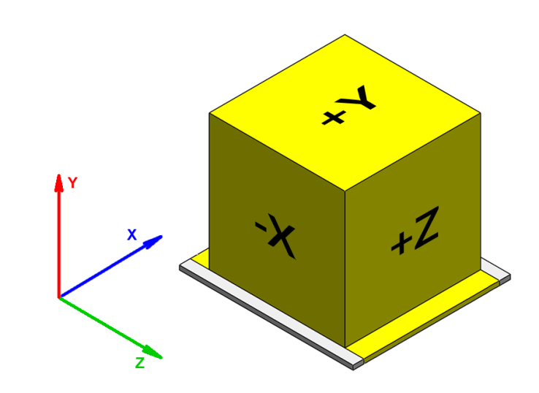
Pico/Nano-Satellites and PocketQube
Educational Satellite (Prof. Bob Twiggs)
  CubeSat (10cm x 10cm x 10cm, 1kg) in 1999
  PocketQube (5cm x 5cm x 5cm, 250g) in 2009
  CanSat in 1998
Miss. Manandhar is Engineer & Public Relation Officer, ORION Space

Slide 6
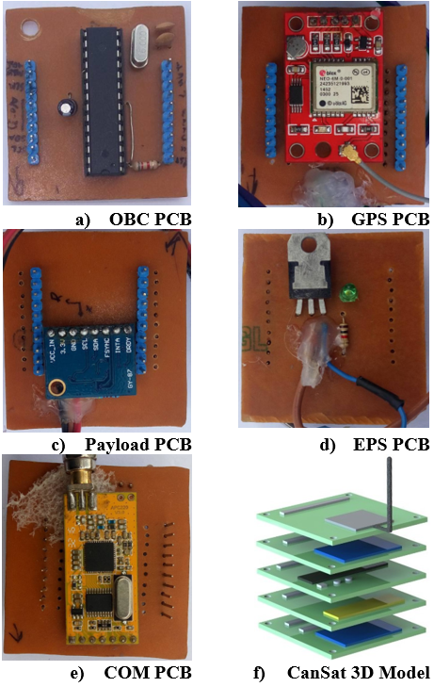
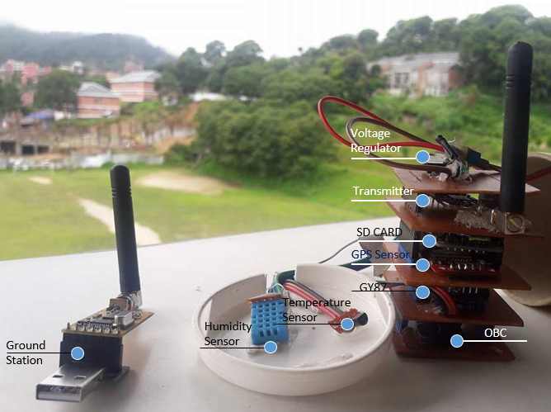
Crawl-Walk-Run: Started with CanSat Project
(Stacked)
Stackable PCBs of CanSat Sub-Systems
1st Prize: Winner of Swiss-Nepal Technology Transfer 2017
(Pollution Measurement of Kathmandu Valley)

Slide 7
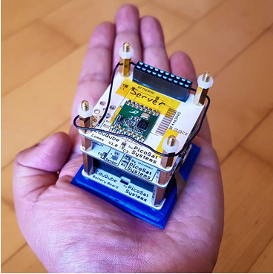
Pico-Satellite: PocketQube
Why Pico/Nano-Satellites?
  Cheaper
  Shorter Development Time
  University Project
  Capacity Building
PocketQube
  5cm x 5cm x 5cm
  250g
EduQube Kit

Slide 8
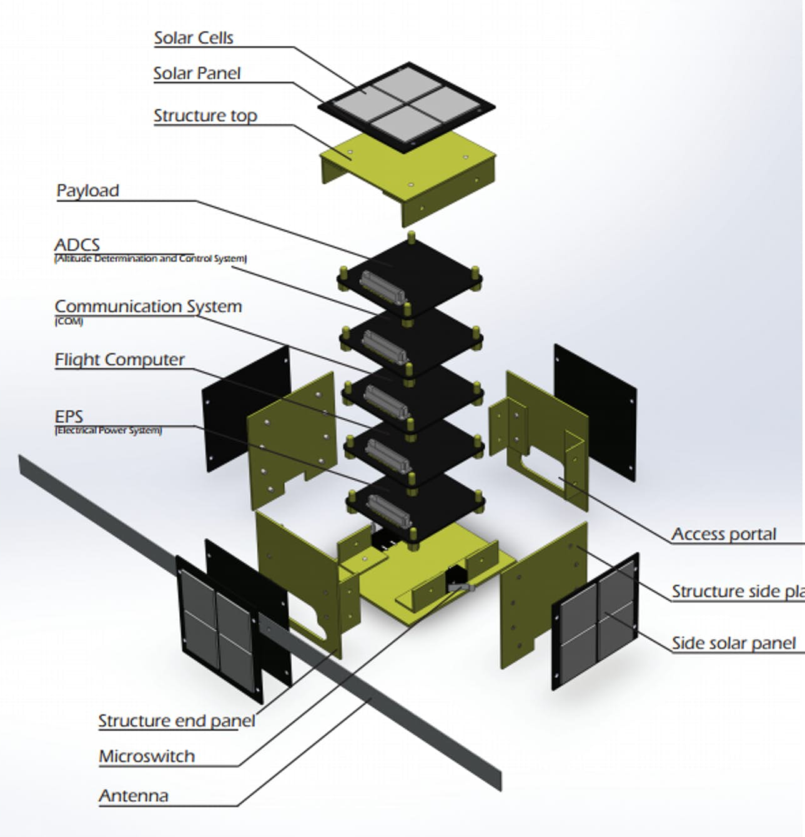
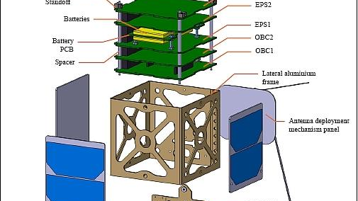
Why PocketQube?
Potential Users
  Education
  Research
  Commercial
Application
  Education and Training
  Science
Early Career Development
  Next generation engineers
  Working in Nepal (with family and friends)

Slide 9
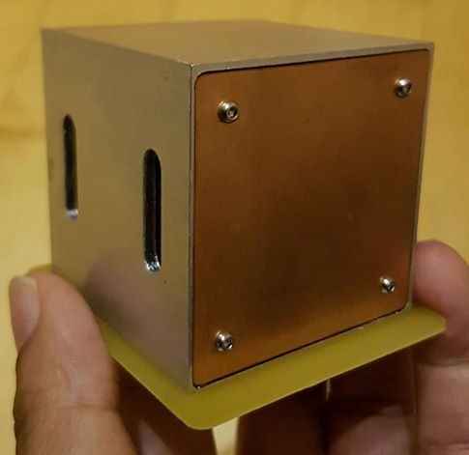
Challenge of building PocketQube
Limited volume for payload
  1P = 5cm X 5cm X 5cm
Limited power for operation
  250mW
First teach and prepare the man-power, and start building it!

Slide 10
PocketQube Cost and Mission Ideas
Self funded project (for Hardware Development)
  Need support for Launch cost
Two engineers and Internship students
Our Science Mission
  To measure the Space radiation
Our Mission Time
  To launch within 2 years
COST ESTIMATION
Hardware Development | 10k | CHF
Assembly, Integration, and Test | 5k | CHF
Thermal Vacuum and Vibration Test | 5k | CHF
Ground Station Building | 5k | CHF
Launching PocketQube to LEO | 25k | CHF
Total | 50k | CHF

Slide 11
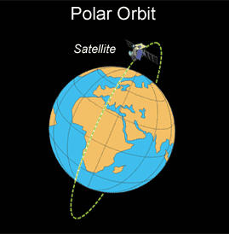
Other Applications of PocketQube
Future Applications for Sustainable Business:
ADS-B (Flight) Tracing for Nepal
  Monitor Flights
  Prevent Flight Accident
In Orbit Demonstration/Validation
  Launch new technology, and design for testing
Building and marketing of pico-satellite kits
  Training and Education

Slide 12
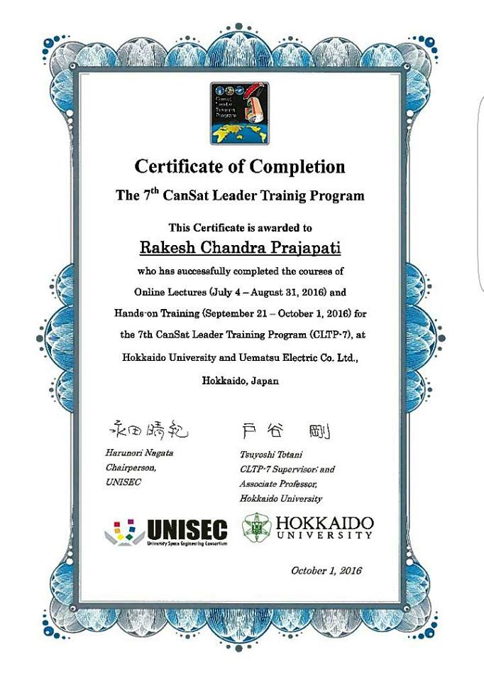
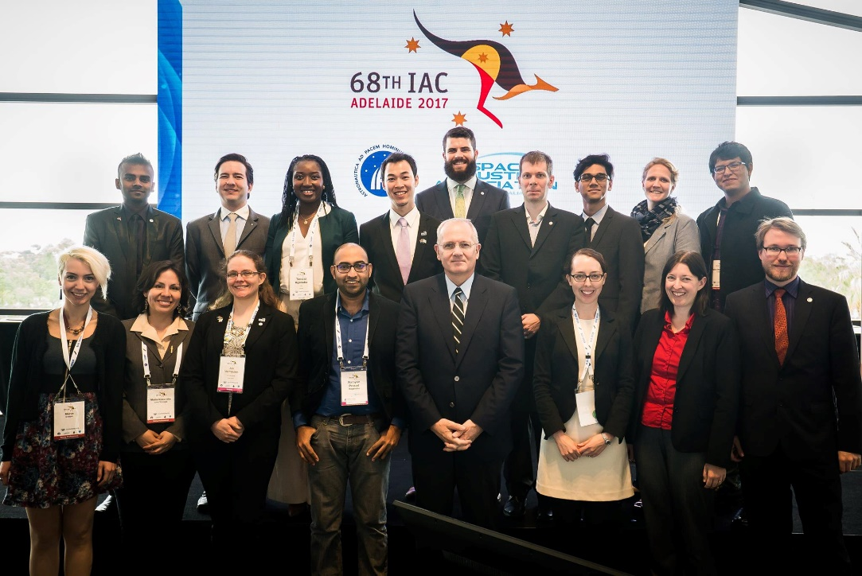
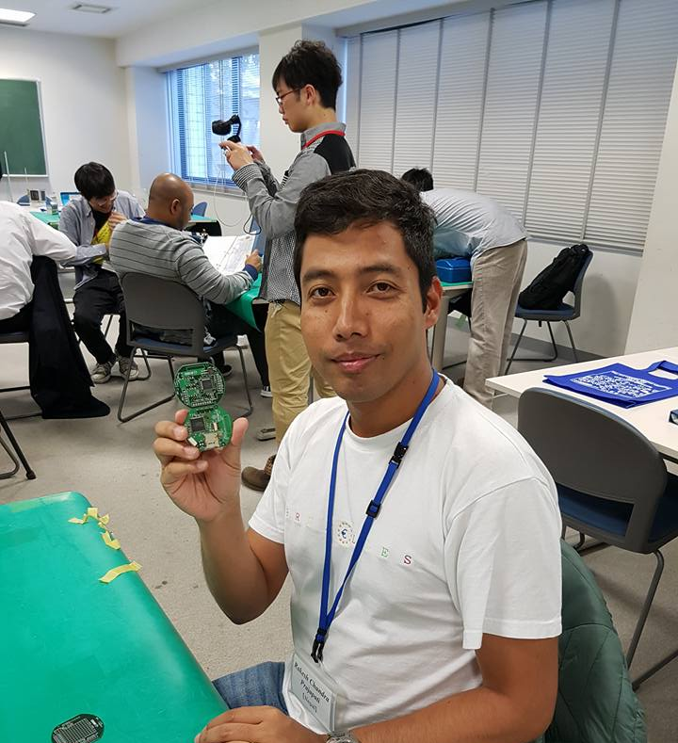

Trainings and Award to ORION Space
CLTP-7 Training, Japan
IAF Emerging Space Leaders
Grant Program, 68th IAC Australia
Helps for professional development
Training in Korea, 2018

Slide 13
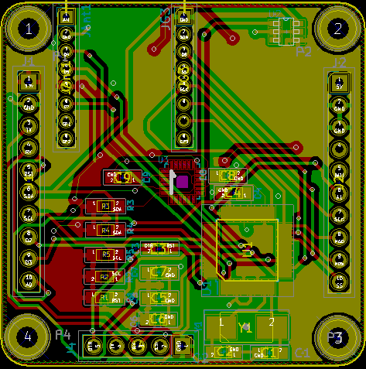
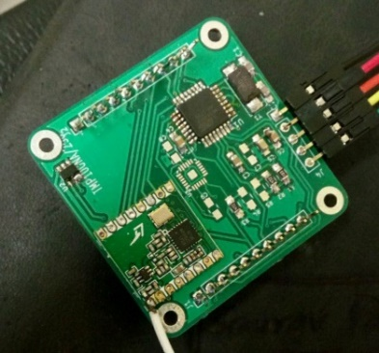
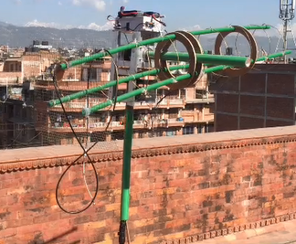
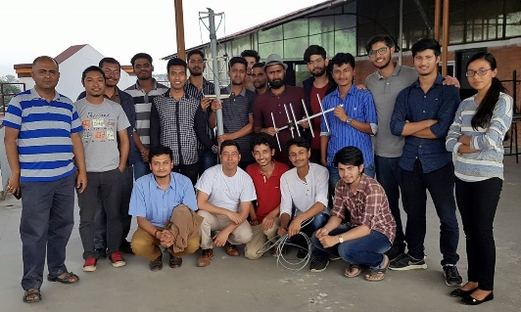
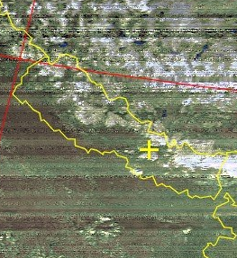
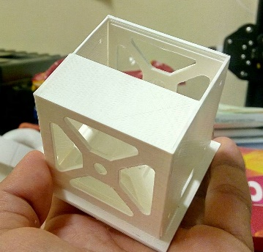
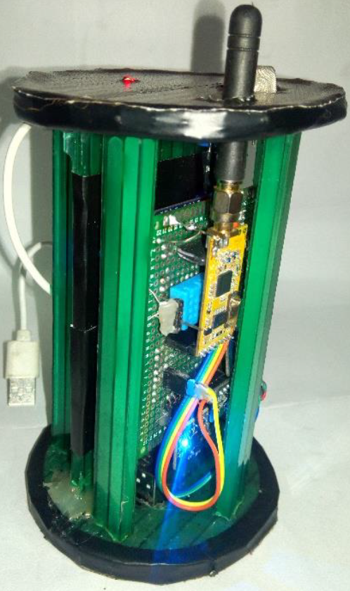

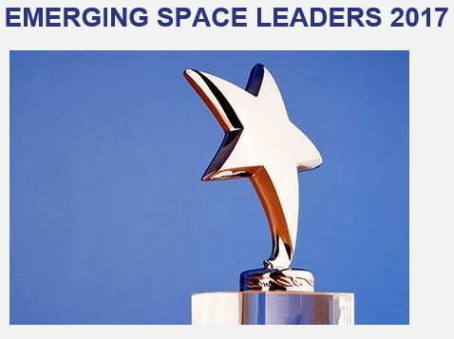
ORION Space
What is our Goal?
  Promote Space Education
  Space Engineering and Technology
  Training and Workshop
Why ORION Space?
  Capacity Building
  Technology Demonstration
  Technical Development
Motivation?
  Space Job Opportunity in Nepal
PocketQube’s PCBs Development at ORION Space
Ground Station Development
Antenna Workshop and NOAA Weather Satellite Image
3-D Print Structure
CanSat
Training in Japan, 2016
ESL Award in Australia
Training in Korea, 2018

Slide 14
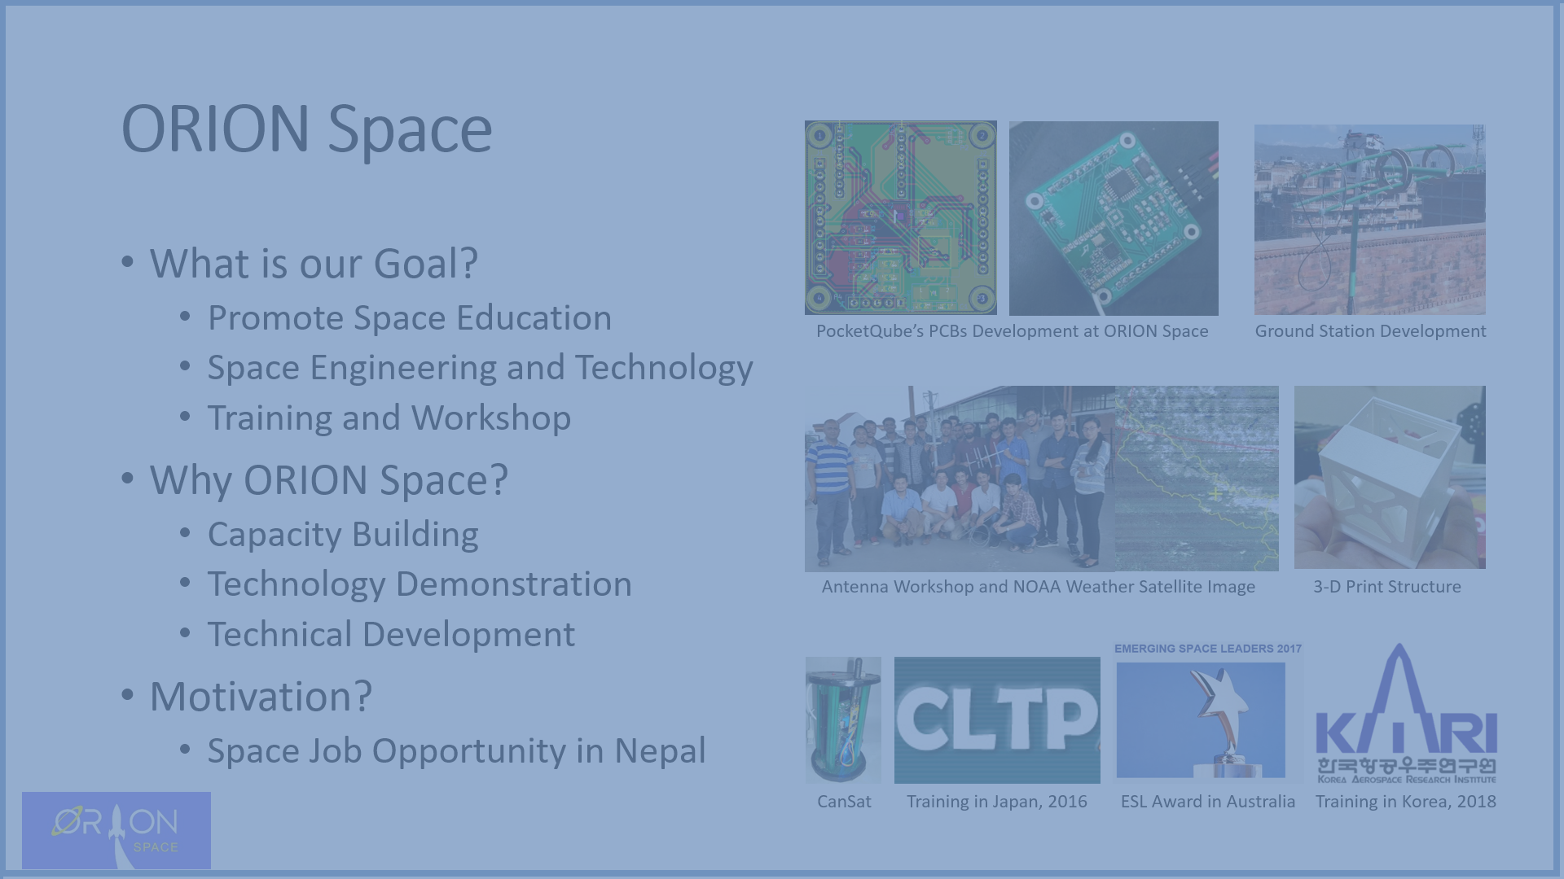
INSPIRE THE NEXT
GENERATION
OF
ENGINEERS

Slide 15
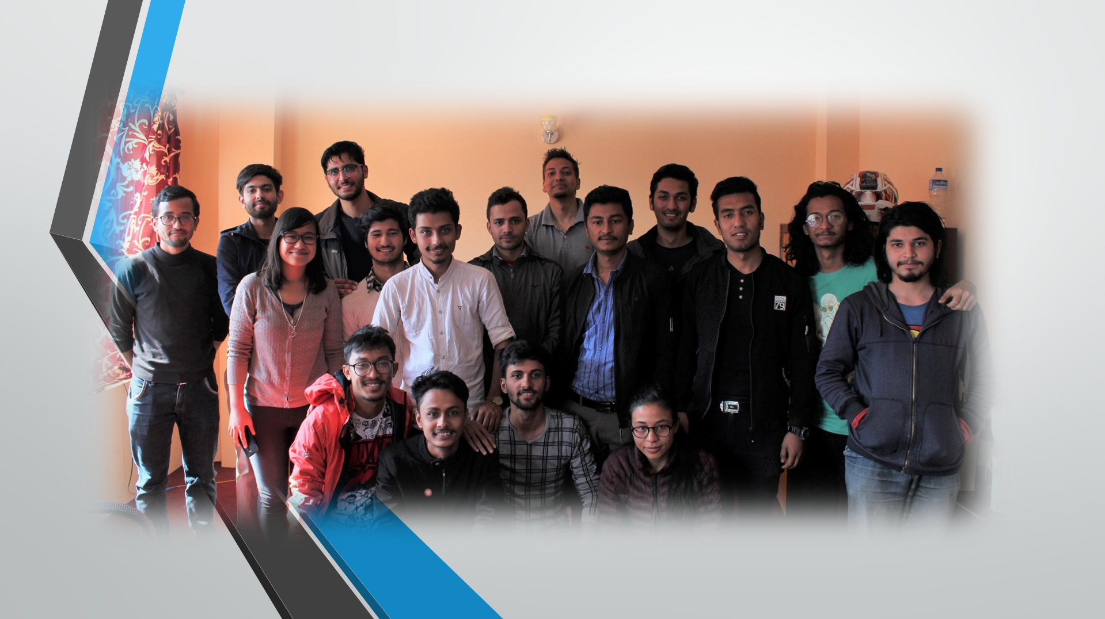
ORION Space – Team 2018

Slide 16

ORION Space
rakeshchandra.prajapati@gmail.com
0041-78-610-18-31
For Funding UBS Bank
CH02 0024 3243 4607 5540 R
https://www.facebook.com/ORIONSpaceNepal/
© Ananda K. Maharjan, Graphic Designer - Newa Lipi/Ranjana Lipi

