Slide 1
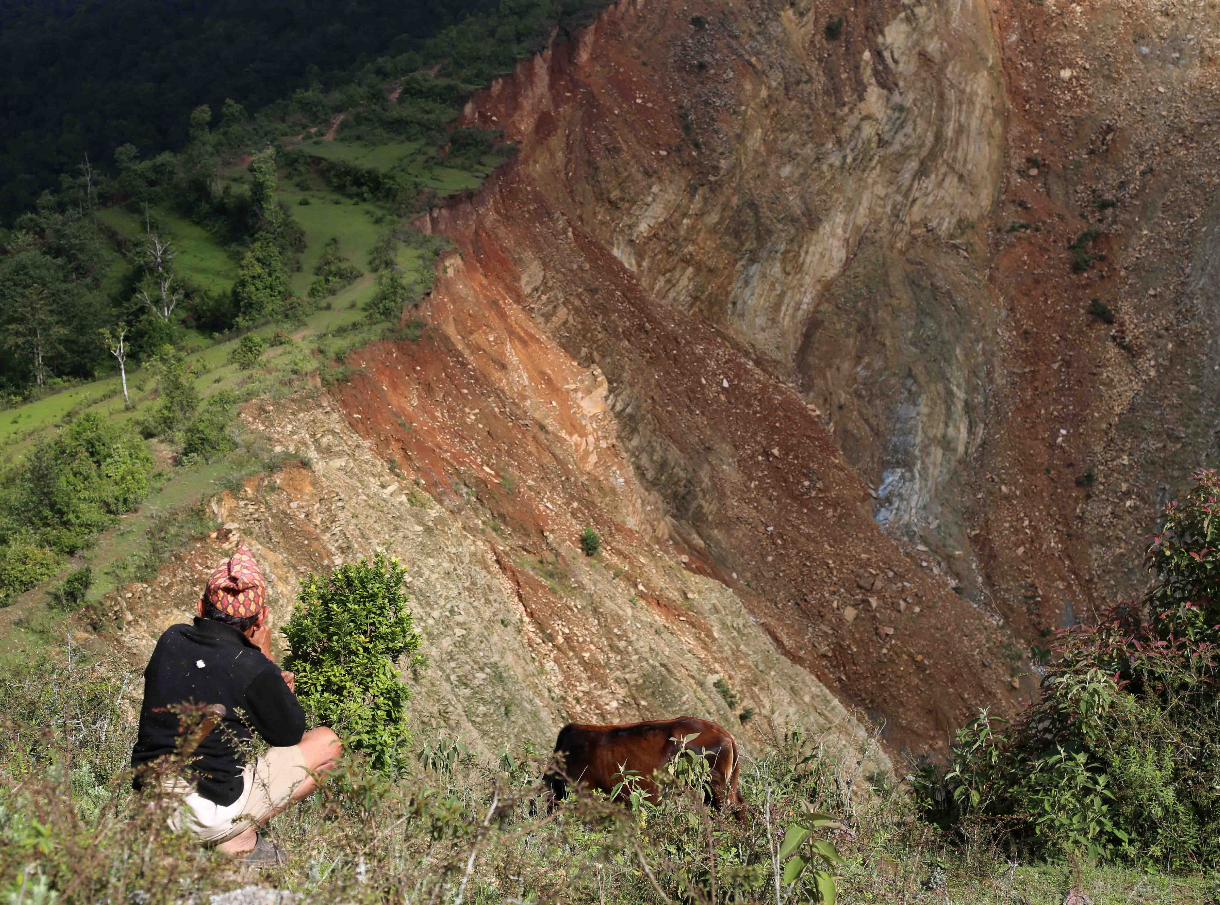



Community livelihood, UAV remote sensing and landslide risk reduction
Bijulikot landslide area, Ramechap district, Nepal
Joel Kaiser, Uttam Pudasaini, Andrew Kos and Carl Adams
1

Slide 2
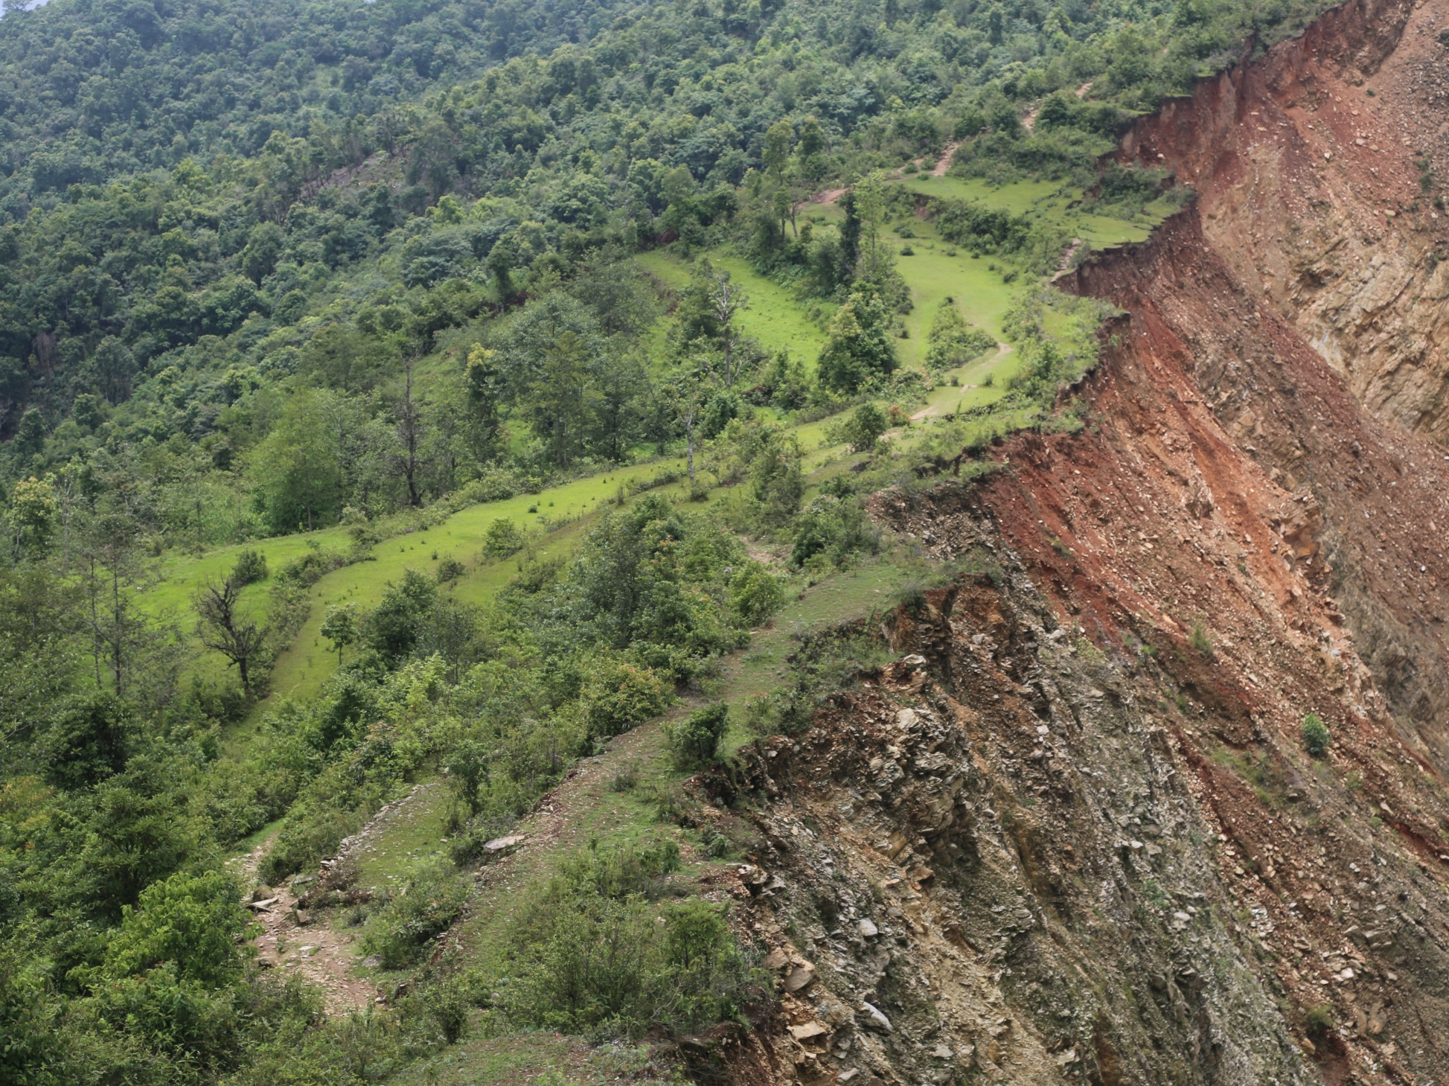
Loss of Land = Loss of Livelihood

Slide 3
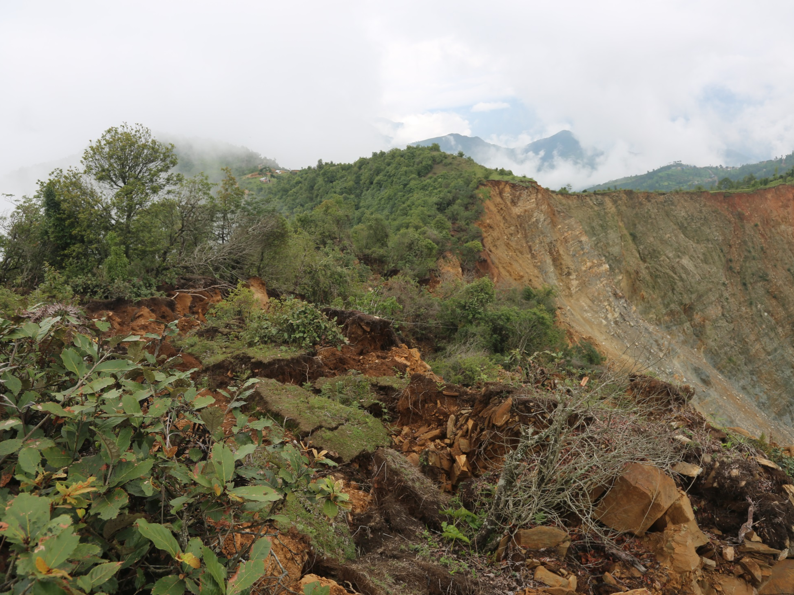
Loss of Land = Loss of Livelihood

Slide 4
Objectives
Apply state of art RS and monitoring technology in Nepal context
Establish rates of landslide activity
Calculate relative displacement magnitudes
Estimate land loss:livelihood scenarios Estimate

Slide 5
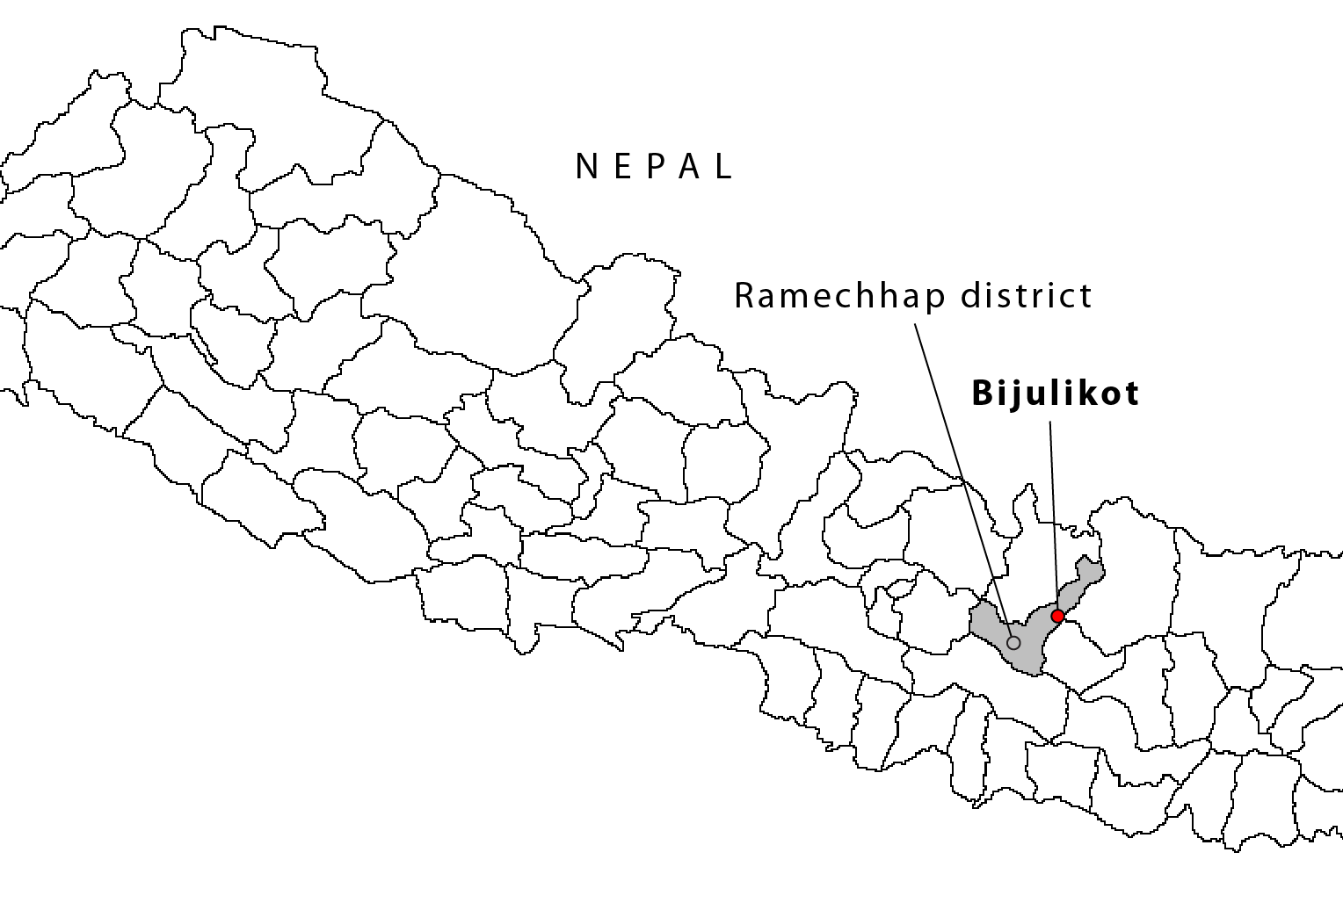
Study Area
KTM

Slide 6
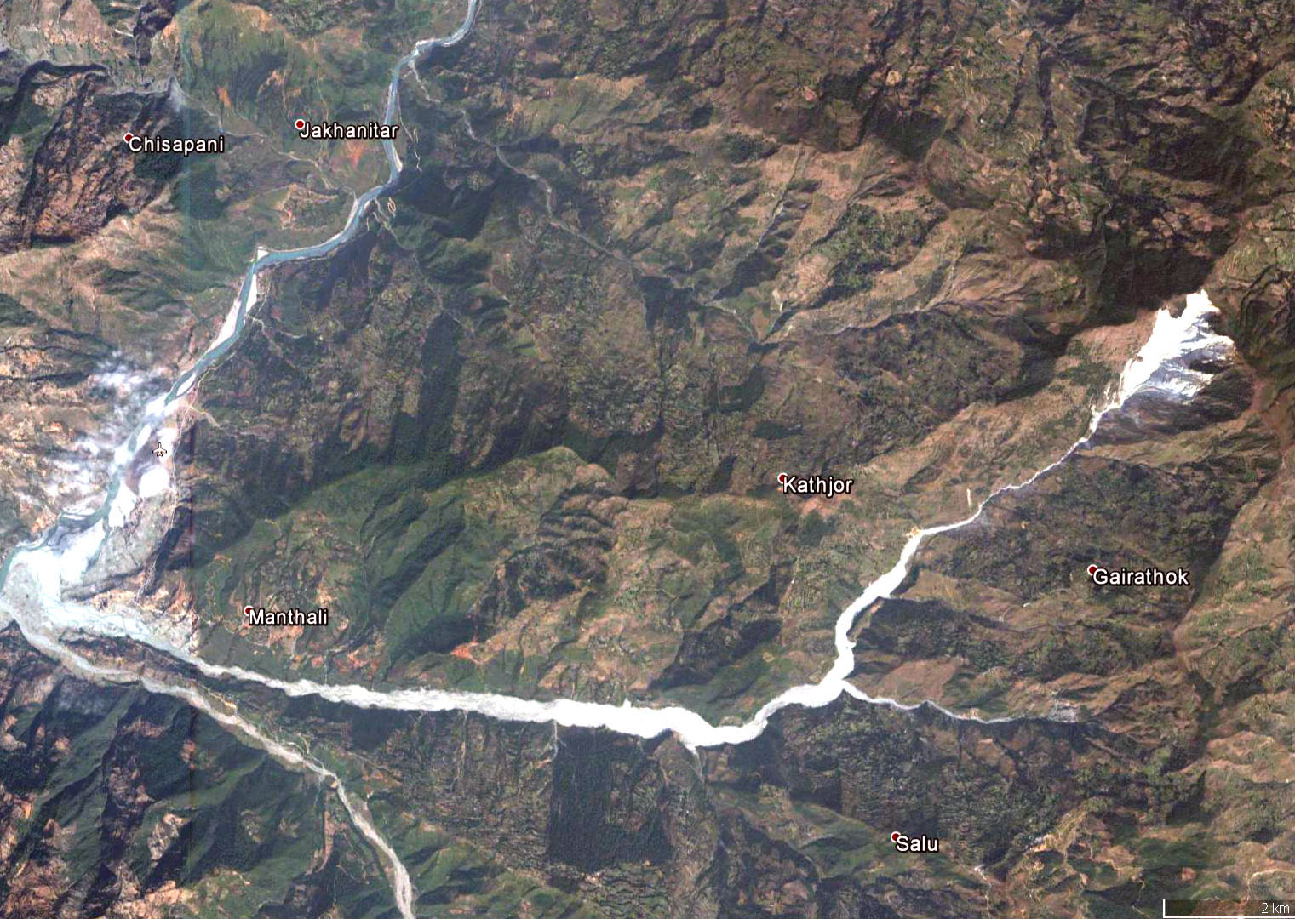
Study Area

Slide 7
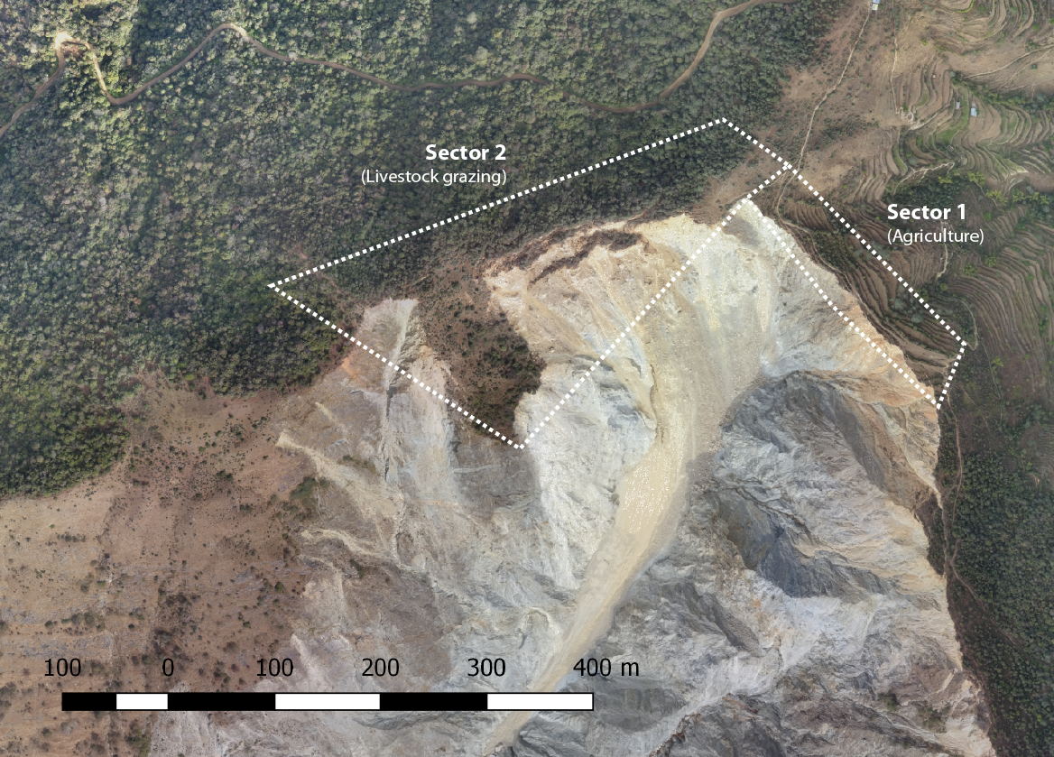
Delineation of Study Area (Sectors)

Slide 8
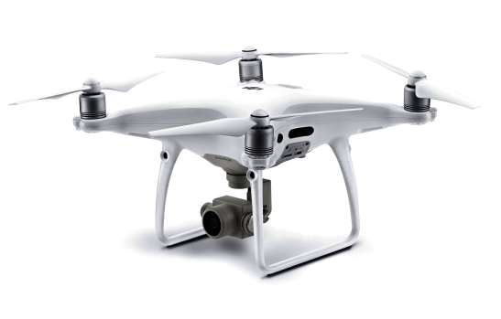

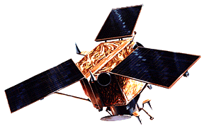
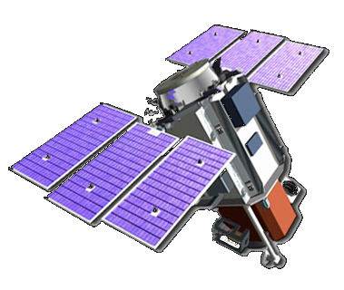
Remote Sensing | UAV & Satellite Imagery
Date | Sensor | Resolution
Sept 2017 | Phantom quadcopter (UAV) | ca. 14 cm
11.01.2017 | Sensefly ebee (UAV) | ca. 10 cm
03.01.2009 | Ikonos (SAT) | 1.5m
03.11.2003 | Quickbird (SAT) | 0.5m
Phantom Quadcopter
Sensefly Ebee
Ikonos
Quickbird

Slide 9
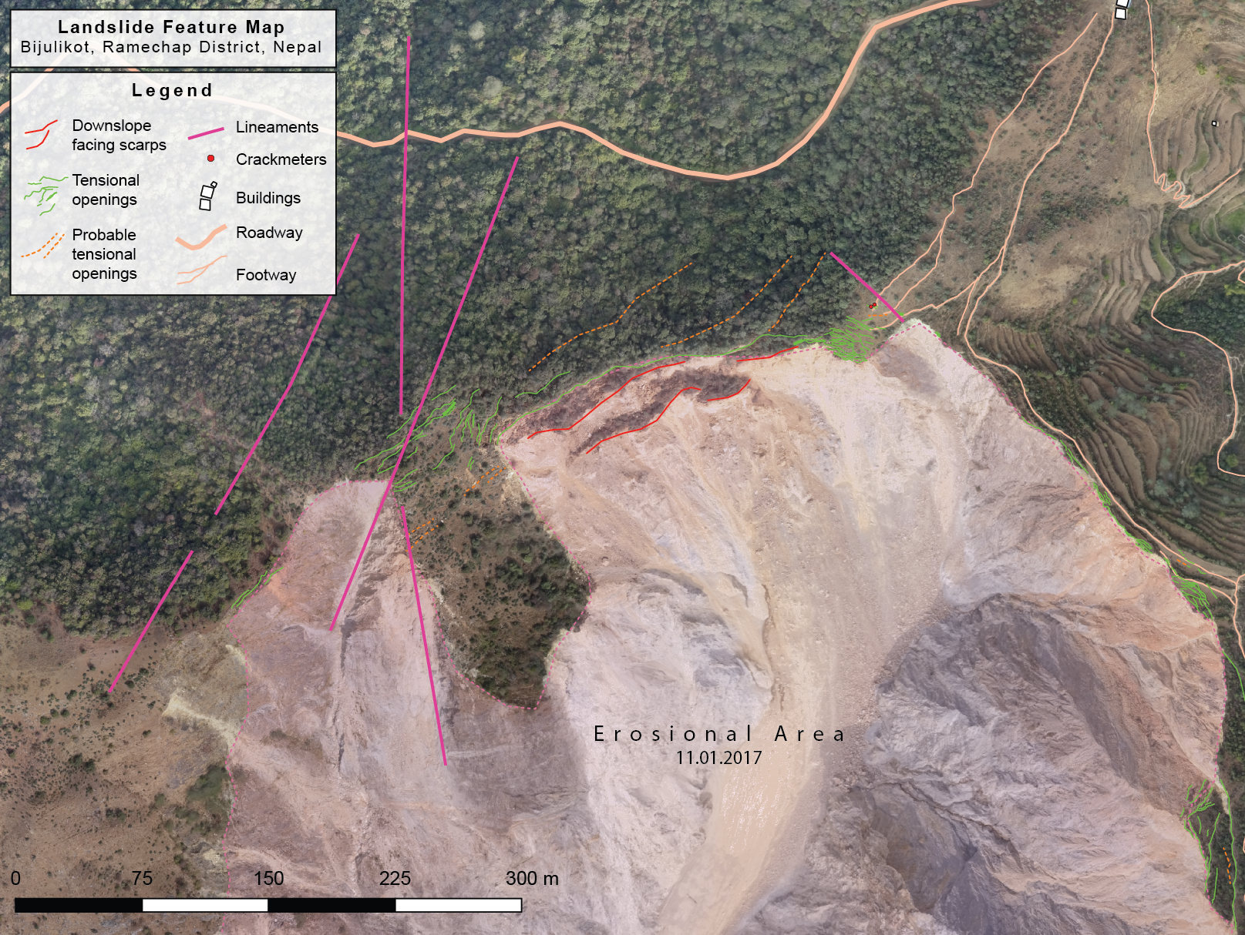

Slide 10
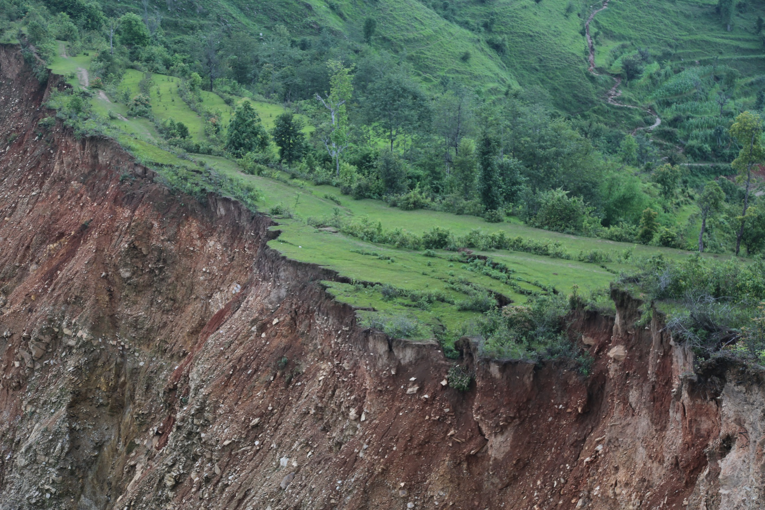
Notes:
Livelihood areas affected by landslide – loss of terraces for rice and grazing.

Slide 11
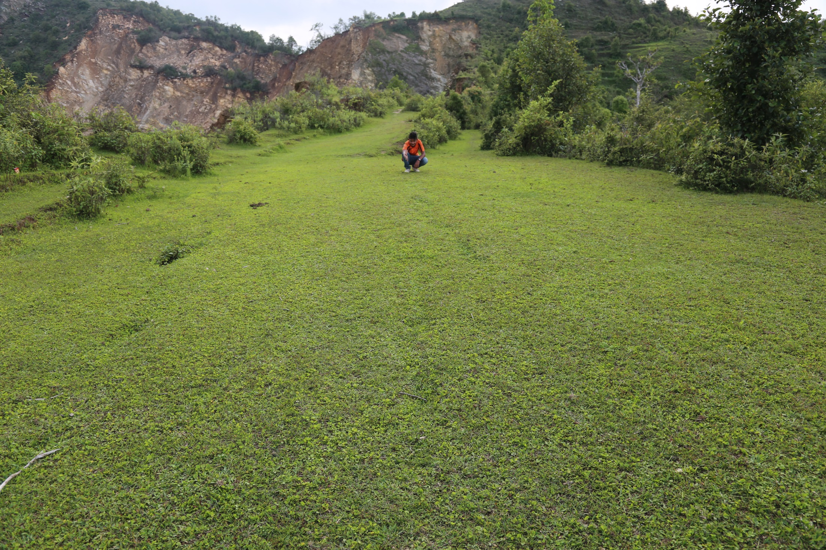
Notes:
Very subtle evidence for landslide activity shown by the white arrrows (the beginnings of tensional opening, e.g. Movement of ground downwards and towards the left of image)

Slide 12
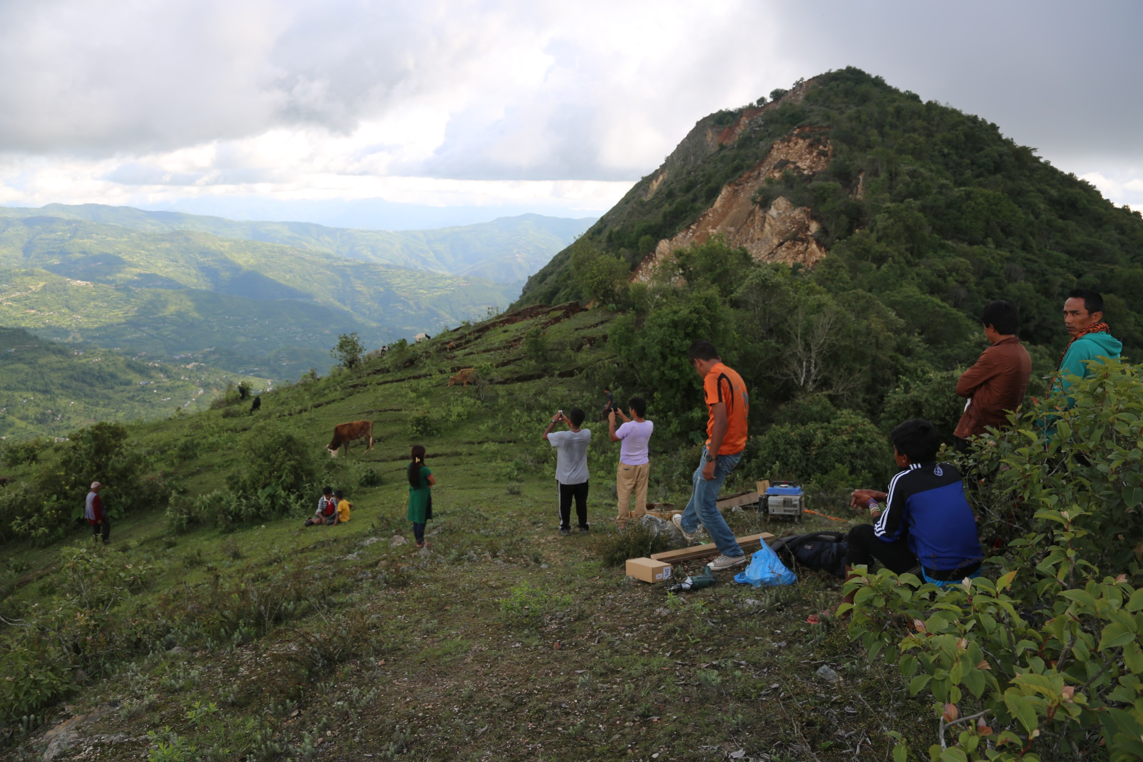
Notes:
Installation site for insitu monitoring

Slide 13
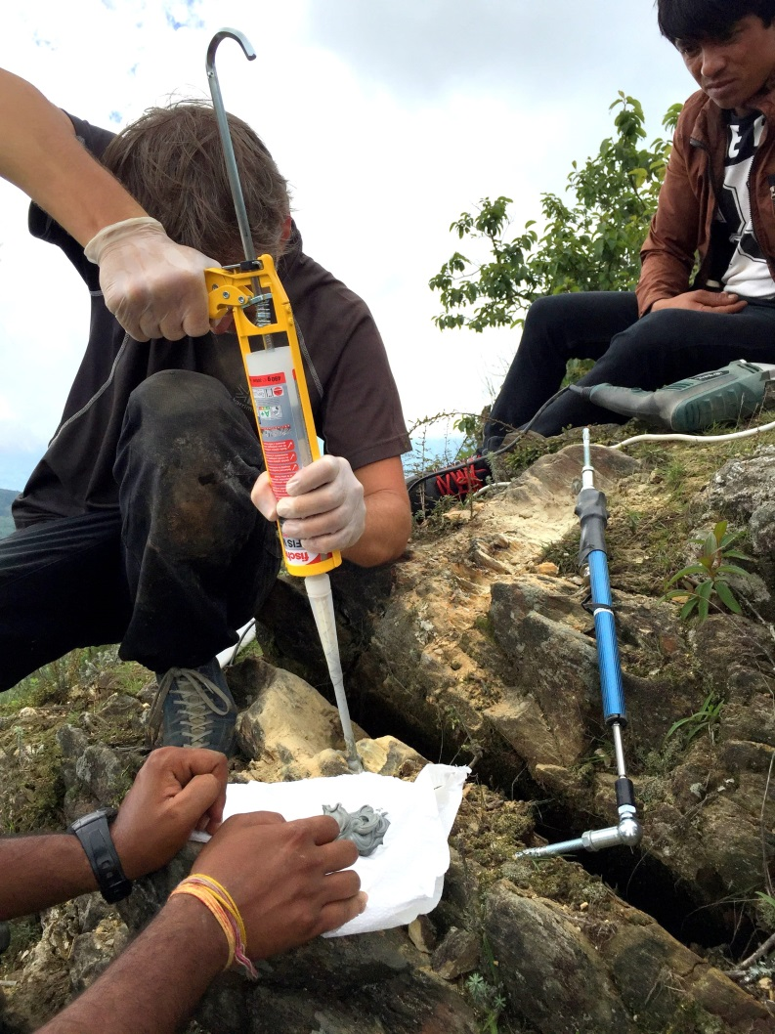
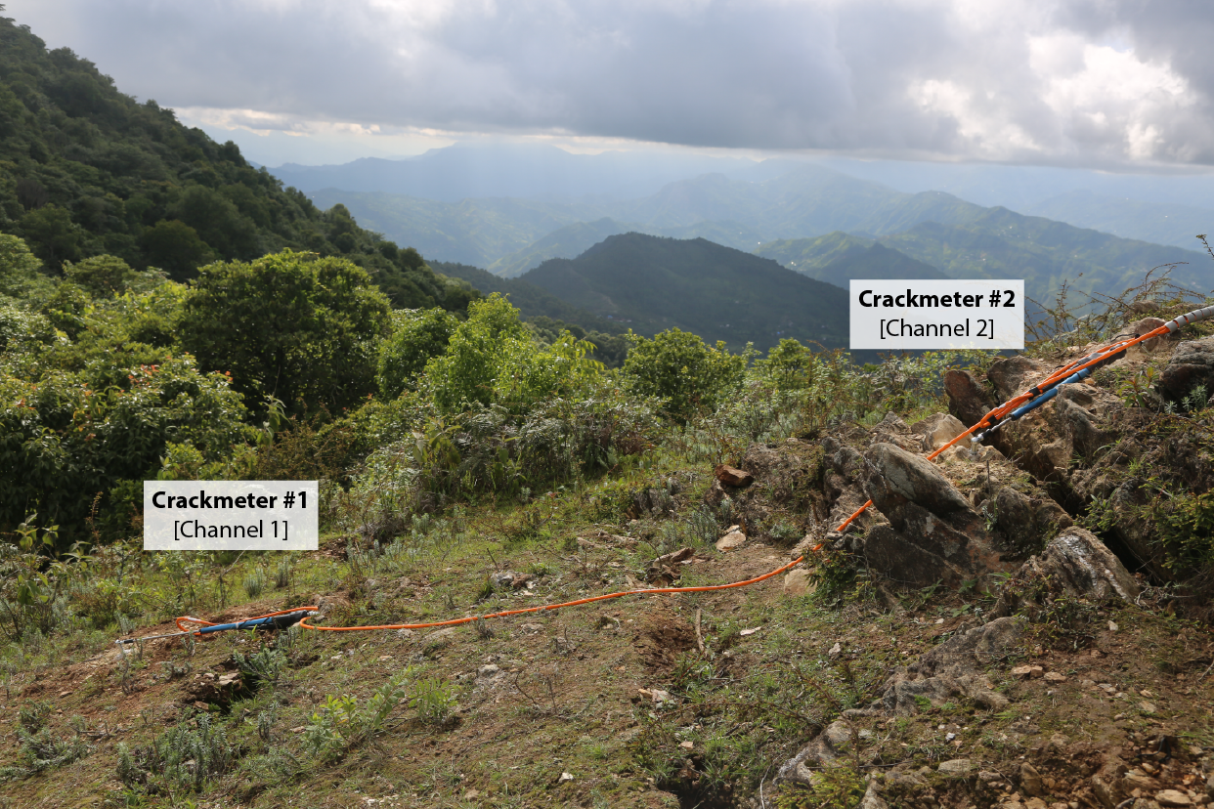
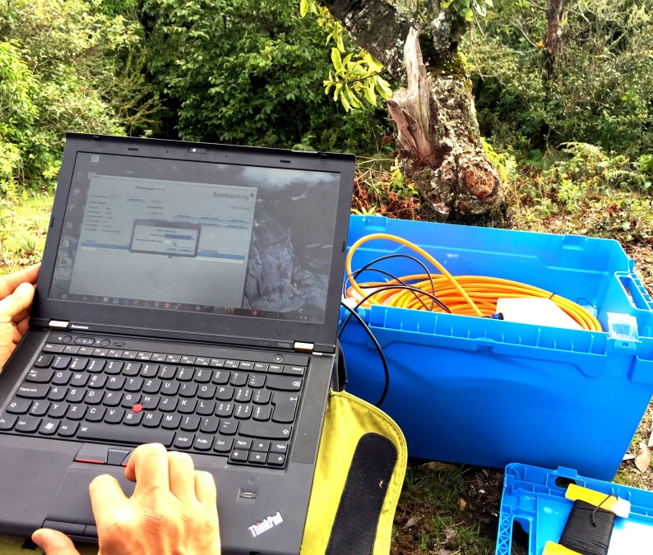
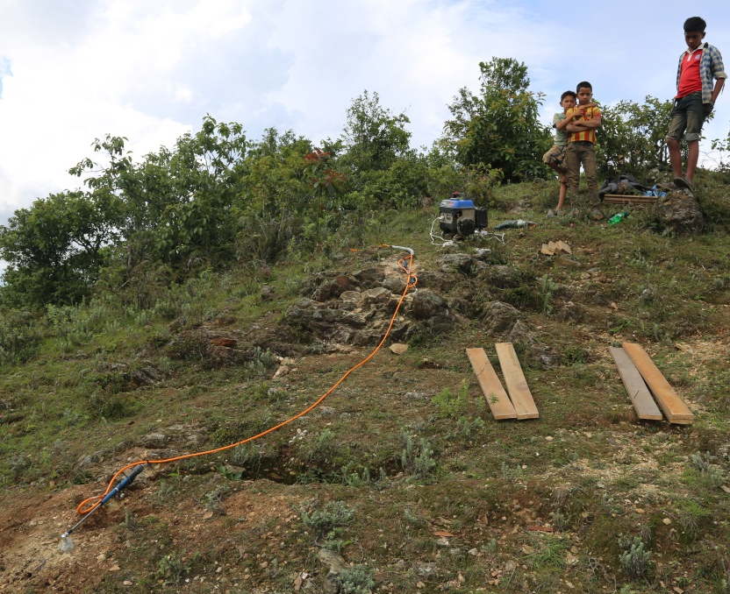


Slide 14
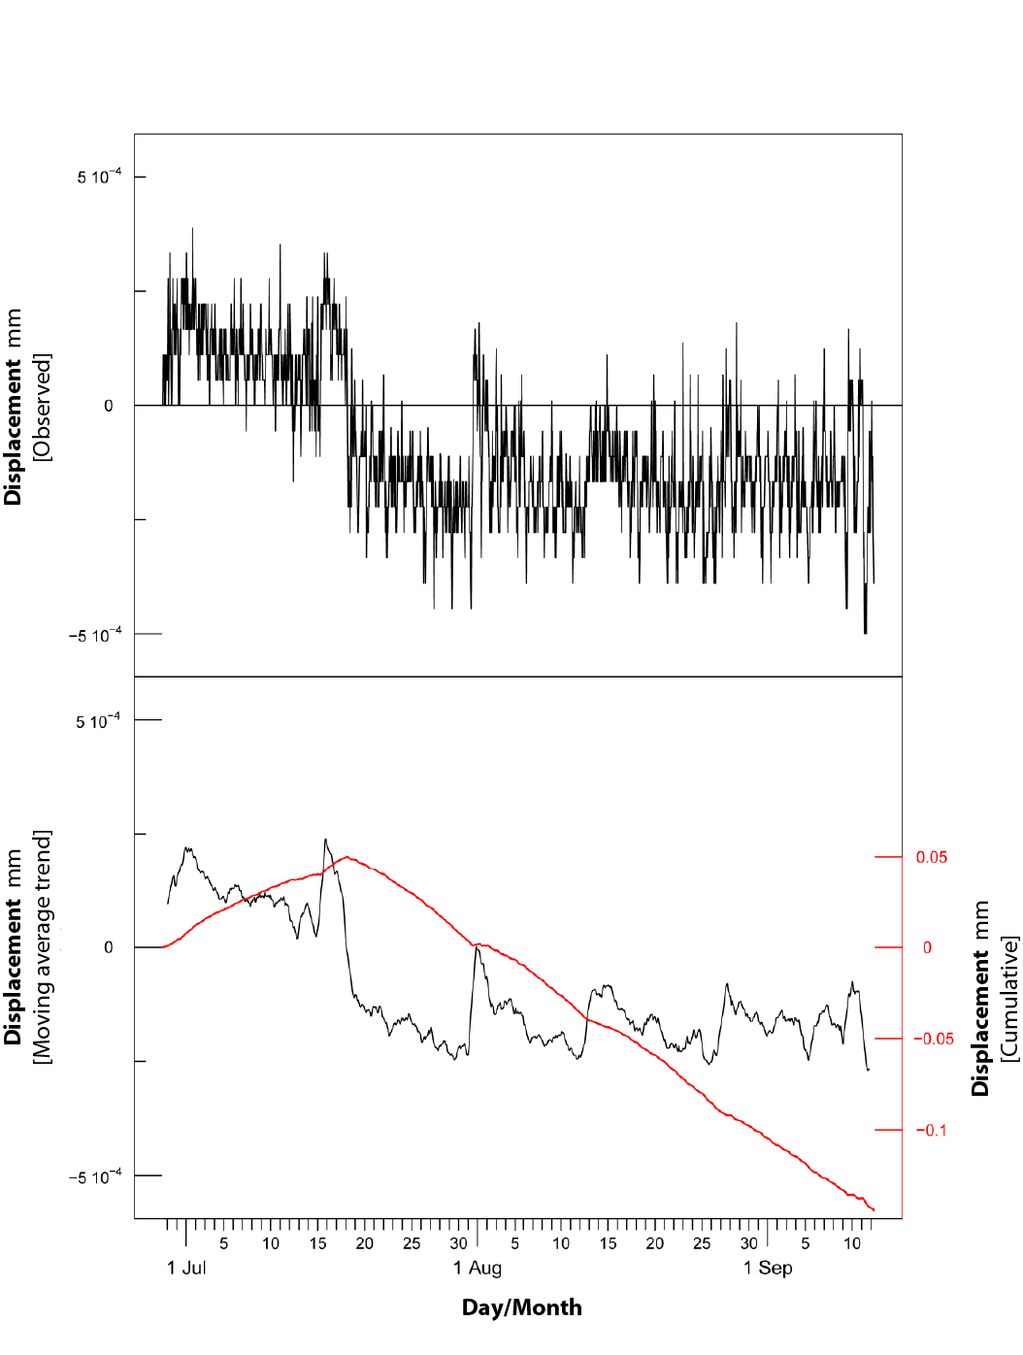
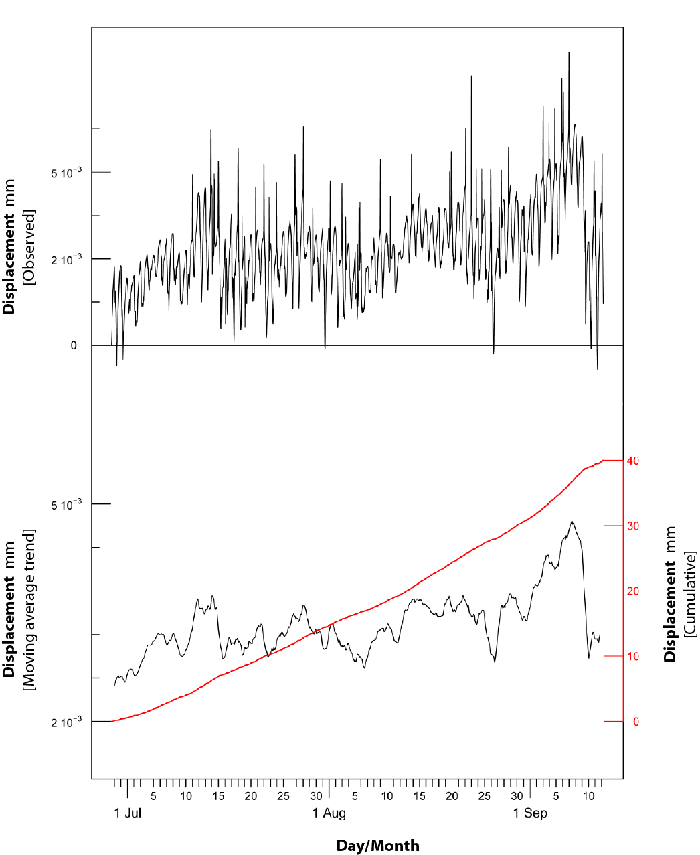
Field Monitoring
Crackmeter #2
Crackmeter #1
Notes:
Blacklines above show all displacement data points e.g opening and closing of cracks
Blacklines below are smoothed to see the behaviour more clearly
Redlines are the cumulative values of displaement over the measurement period (ca 2.5 months)
Graph on right shows significant crack opening of 4cm in 2.5 months (during monsoon period)

Slide 15
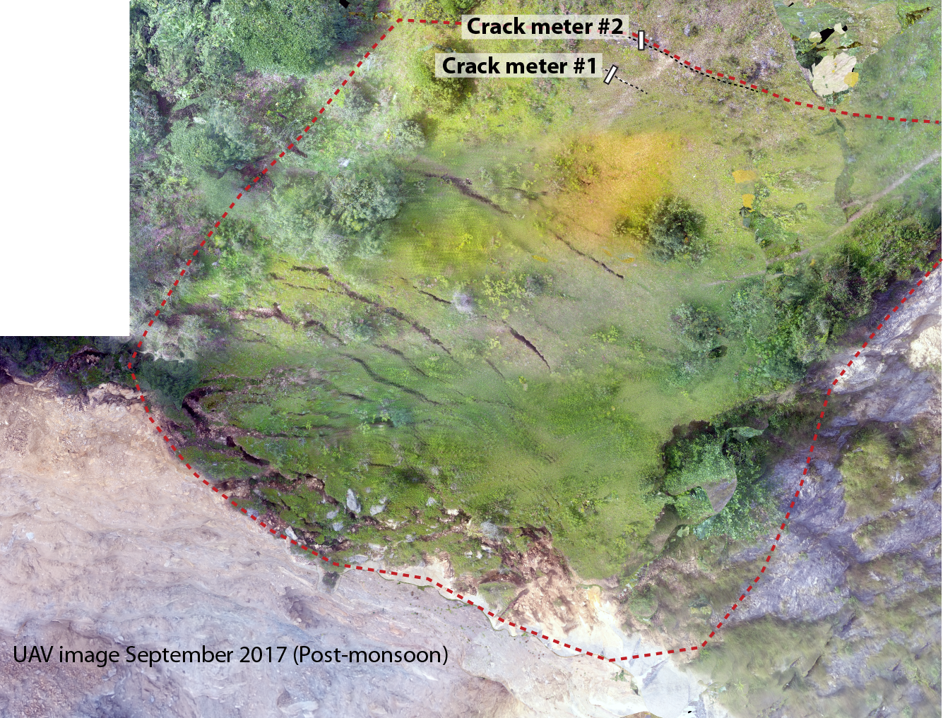
Notes:
Post monsoon rapid acquistion, some minor failure of material at the front of the block (bottom of image)

Slide 16
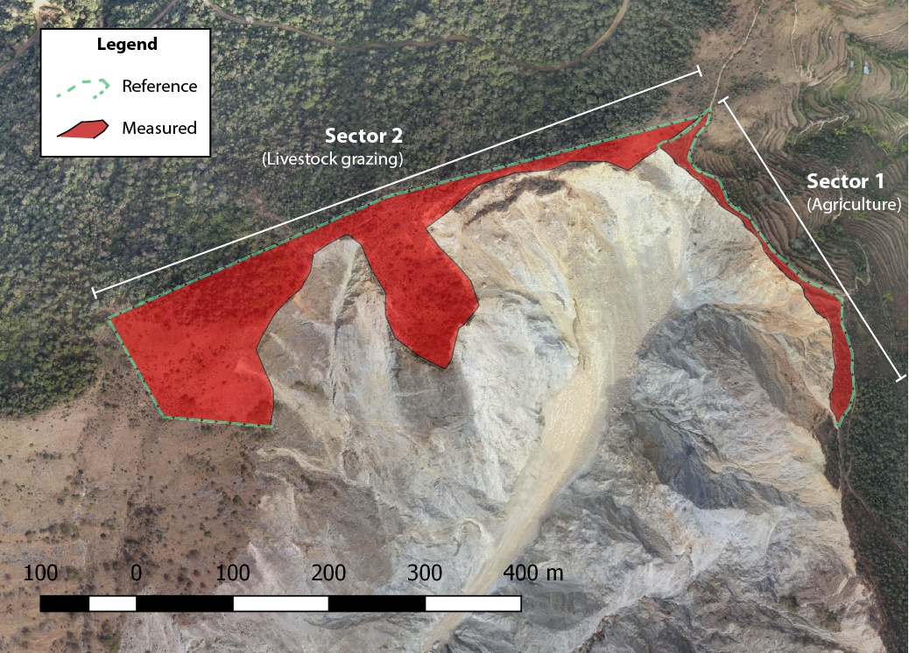
Reference & measured areas in sector 1& 2
Notes:
A measured area was compared to a reference area for sector 1 and 2 for all satellite and uav images to determine the magnitude of relative land loss

Slide 17
Land-loss measured in sectors 1 & 2
Sector 1
Date | Measured surface area m² | Δ surface area loss per interval m² | Δ surface area loss per year m²
11.01.2017 | 5’394 | (2009-2017) 9’564 | (2009-2017) 1’191
03.01.2009 | 14’959 | (2003-2009) 55 | (2003-2009) 11
03.11.2003 | 15’014
Sector 2
Date | Measured surface area m² | Δ surface area loss per interval m² | Δ surface area loss per year m²
11.01.2017 | 43’611 | (2009-2017) 8’835 | (2009-2017) 1’100
03.01.2009 | 52’446 | (2003-2009) 11’673 | (2003-2009) 2’256
03.11.2003 | 64’119

Slide 18
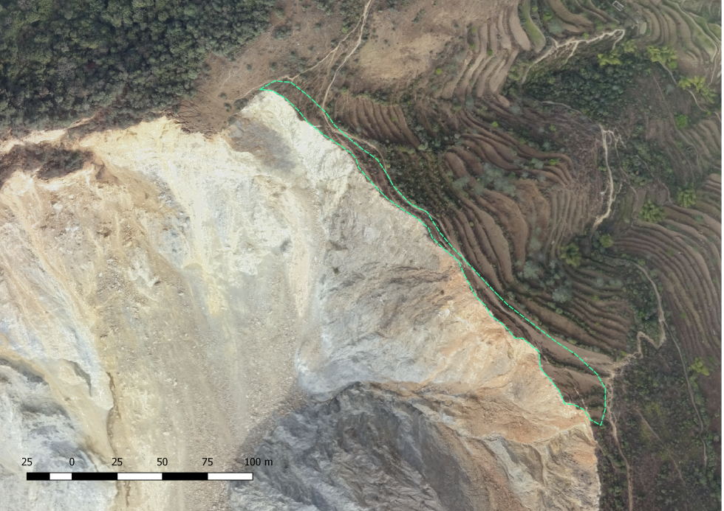
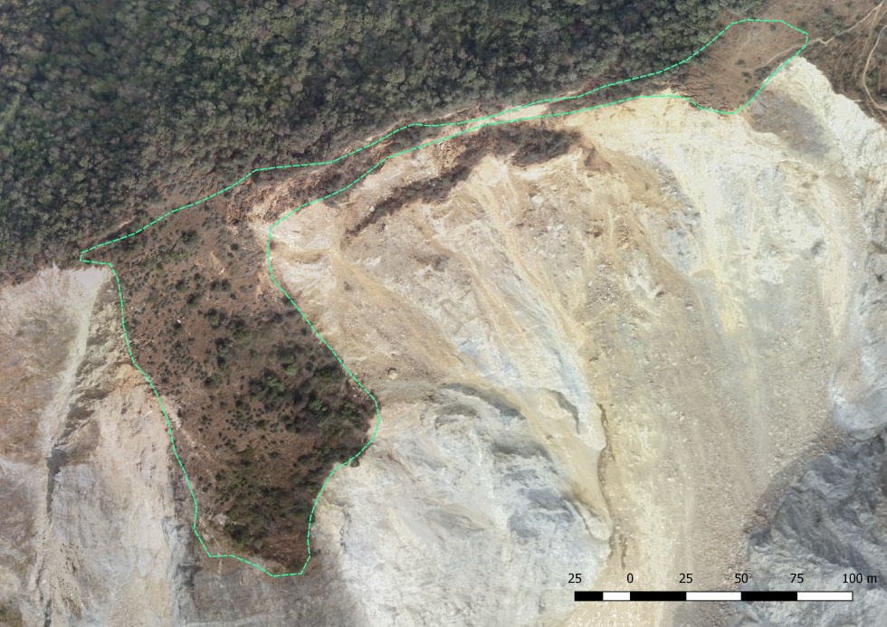
Land-loss future projection
Sector | Potential land loss (m²) from landslide erosion | Projected # of years until landslide erosion is complete: Slow rate of landslide activity** | Projected # of years until landslide erosion is complete: Fast rate of landslide activity**
1 | 2’576 | 242 | 2
2 | 15’753 | 14 | 7
Sector 1
Sector 2

Slide 19
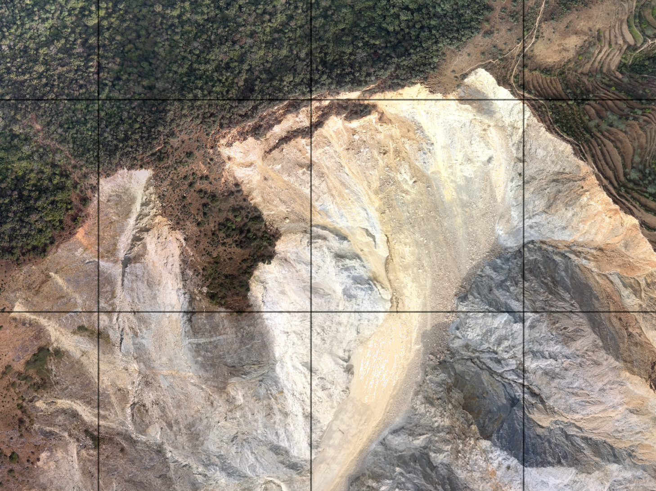
Recent Changes (Jan 2017)
Land loss
Post monsoon 2017

Slide 20
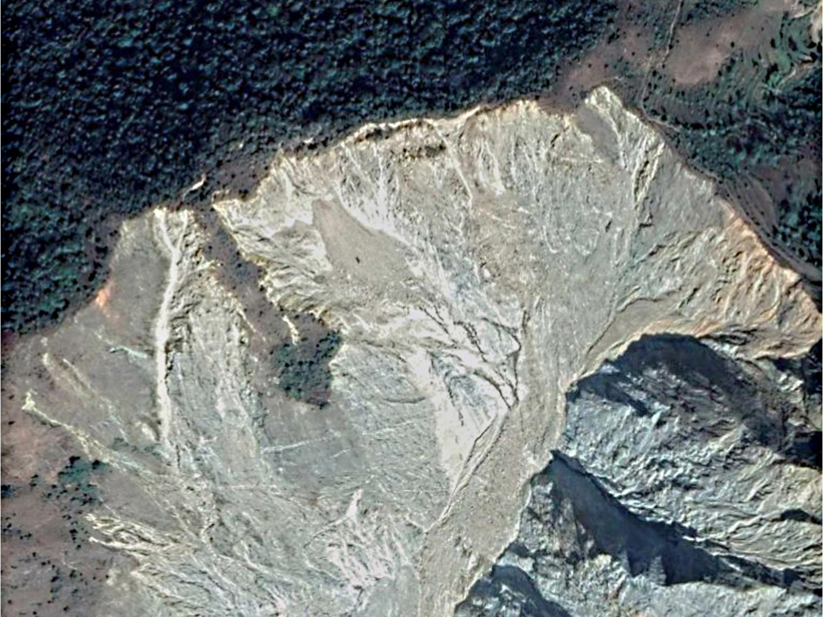
Recent Changes (Dec 2017)
Notes:
Satellite image image from dec 2017, showing large post-monsoon failure of sector 2
The fast rate of landslide activity appears to be more valid – earthquake activity would hasten the loss of land to a greater degree (by how much is difficult to estimate)

Slide 21
Summary of Findings
Geological predisposition for landslide is significant.
Livelihood affected within 10 years, however....
Monsoon (rainfall triggering) speeds-up erosion (e.g. Dec 2017)
When the land area is totally gone, how will it affect livelihood (e.g. Individual family/families?)
How individual families maybe affected could not be estimated due to Lack of detailed information about land use/ownership.

Slide 22
Further work required
Accurately calculate effect on livelihood (rapid/slow scenarios)
Begin relocation consultation with villagers at high risk
Continue monitoring landslide erosion rates – Address land erosion due to monsoon rainfall triggering
Scaling to other sites/regions with high geological predisposition for landslide/debris flow
Determine levels of risk for flash flood/debris flow for downstream villages.
Determine erosion/sediment transport mechanisms to forecast risk of downstream flash flood/debris flow

Slide 23

Questions & Discussion
Many thanks for your attention
This study is a small example of how science can support planning and resiliency building for vulnerable societies and secure the perspective of future generations.

