Slide 1
Mobile Lab: Bringing Diagnostic Services to Home
Ghumti Lab Team
Prakash Thapa (Software engineer)
Shruti Jha (Medical microbiologist)
Ranjan Mishra (Cancer Biologist)
Rakesh Chandra Prajapati (Electrical and space engineer)

Slide 2
Who are we ?
Prakash Thapa
Ranjan Mishra
Shruti Jha
Rakesh Chandra Prajapati
Notes:
Story

Slide 3
Problem
Growing middle class
Active group abroad
Migration (Internal & External)
Inherent hesitation
Time
Transportation & availability.
Notes:
Active age groups abroad with elderly and kids left in Nepal
Lack of will among the people to visit hospitals for routine checkups
Prolongation and exacerbation of health issues due to delayed or missed diagnosis
Issues with transportation to near health provider as well as their availability.

Slide 4
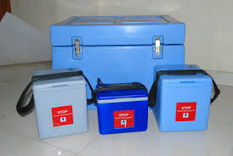

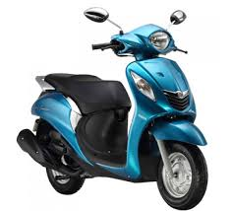
Solution:
Online platform + Mobile lab-box
+

Slide 5
Mobile lab box
Sample units : blood, urine..
Serology kits
Viral kits
Vaccines
Temperature control (1 day of stable temperature maintenance)
In accordance to biosafety Guidelines

Slide 6
Goal
Accessible and user friendly diagnostic services
develop a culture of routine health check up in Local population
Vaccination services
Improved specificity and sensitivity of laboratory tests
Bringing families and well wishers closer

Slide 7
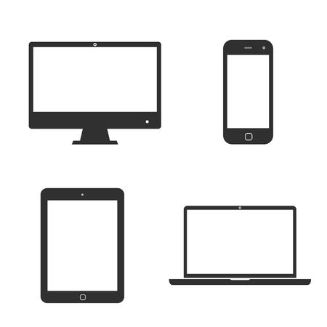

How the system works?
01
Central Data storage system
06
Security & Encryption
Authentication
Registration
Report
Presentation
02
05
Processing & submission
Info. about
patient
Lab
Analysis
03
04
Payment
Sample
collection
Mobile Team

Slide 8
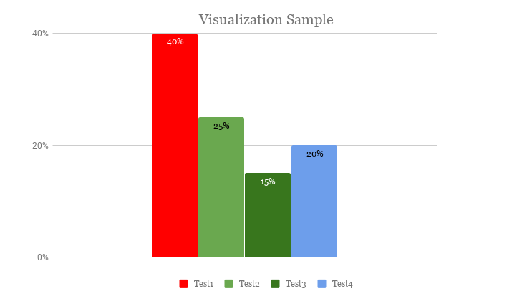

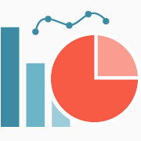


Result
Notes:
Story

Slide 9
Plan
phase 1
phase 2
phase 3
phase 4
T 1
T2
T3
T4
T6
T7
T8
T9
T10
T11
T12
T13
T14
T15
T16
T20
Concept
Test instrument Design
project kick start
market feed back
software design / Development
System Improvement
approval from government
marketing
partnership with health care providers, laboratories
instrumentat realisation
Instrument advancements
LOREM

Slide 10
Status
Concept refinement
System development
Approval from government

Slide 11
Challenges
Duplication
Dependence on pathology labs
Traffic and road in Nepal
Government approval for carrying biological samples
Payment System in Nepal

Slide 12

Thank you

