Slide 1
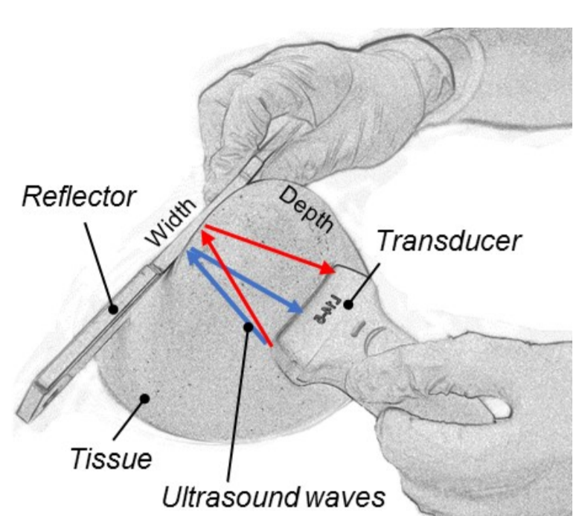
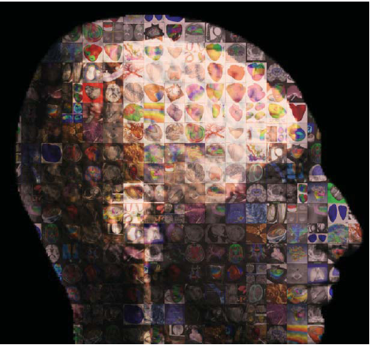
Computational Science for Medicine and Robotics
Swiss-Nepal Technology Transfer Seminar
Nicholas Ayache, Asclepios INRIA. Digital Patient
ReflectUS, ETH Zürich
16.06.2018, CERN
Dr. Ajad Chhatkuli, ETH Zürich

Slide 2
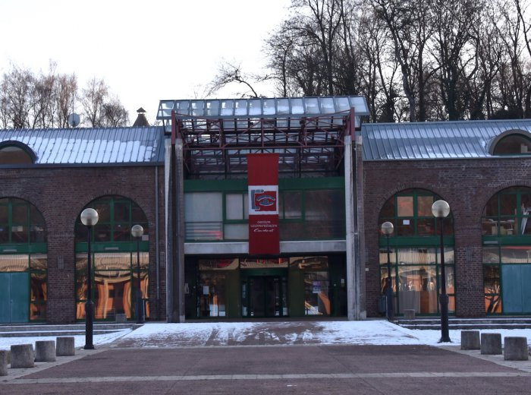
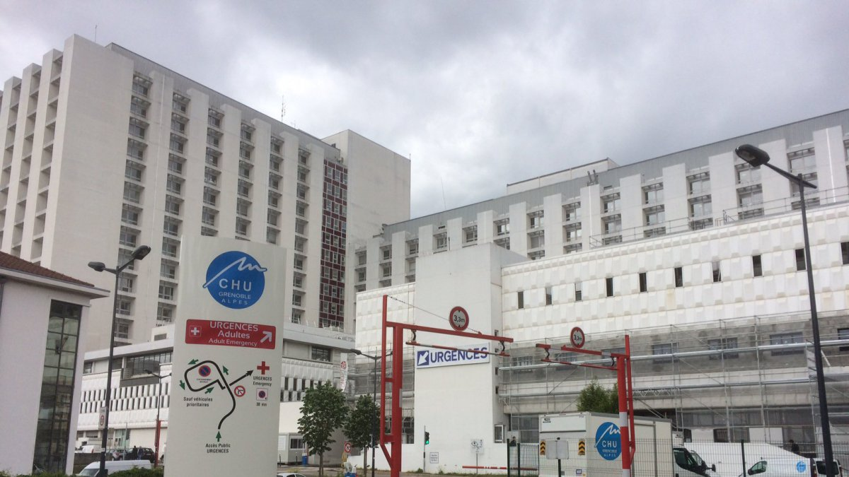
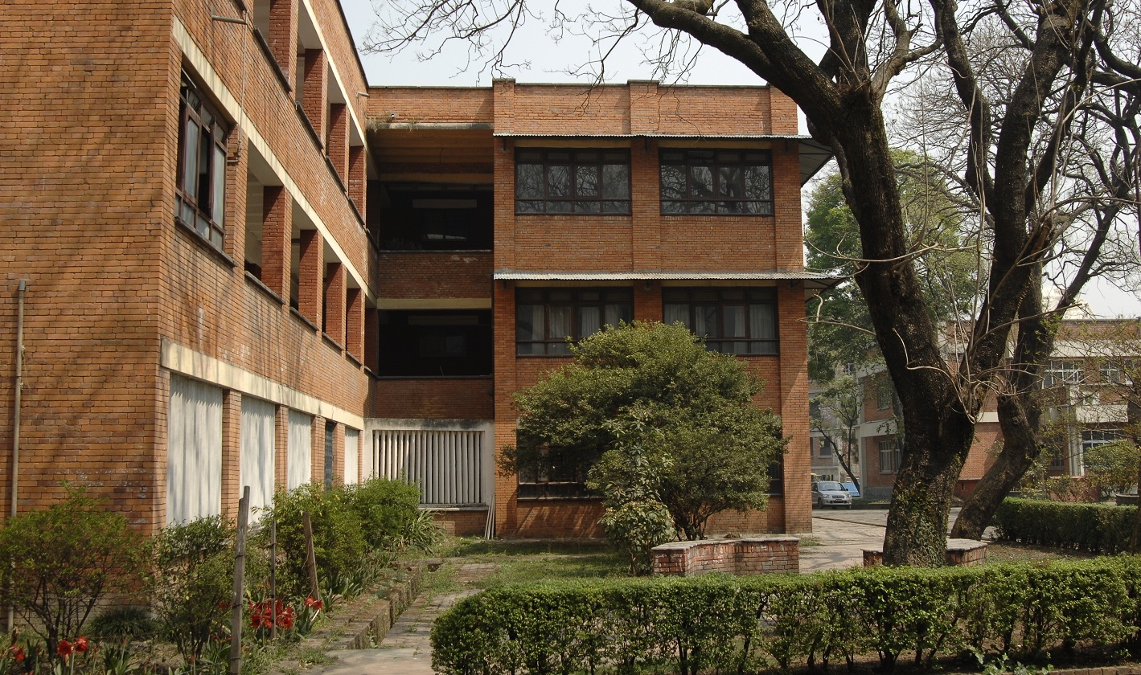
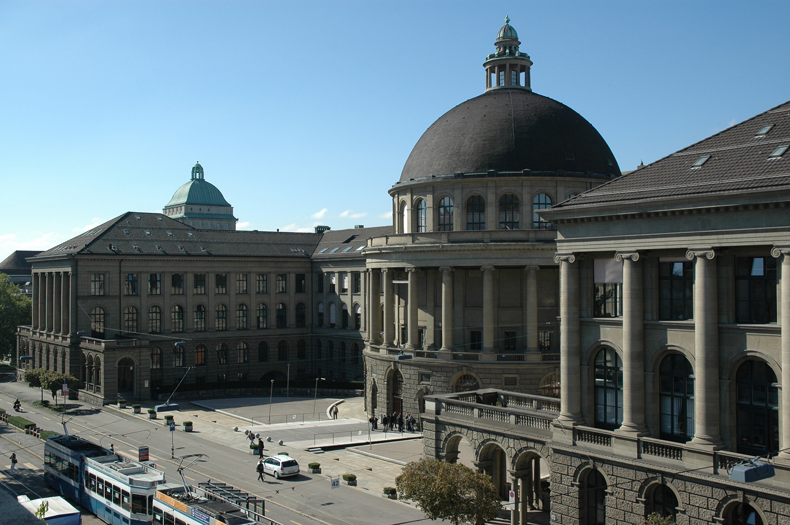
Short Bio
MSc. - Université de Bourgogne, France
PhD - Université de Clermont-Auvergne, France
B.E. - IOE, Pulchowk Campus, Nepal
PostDoc – ETH Zürich, Switzerland

Slide 3
Computational Science
Applied Mathematics
Better Understanding
Transportation
A.I.
Computer Science
Health & Medicine
Life Sciences
Agriculture
Automation and Robotics

Slide 4
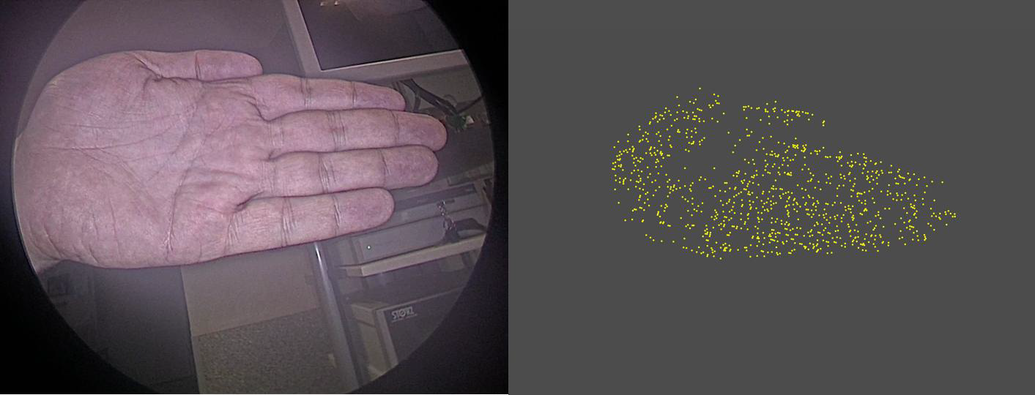
Images to 3D shapes

Slide 5
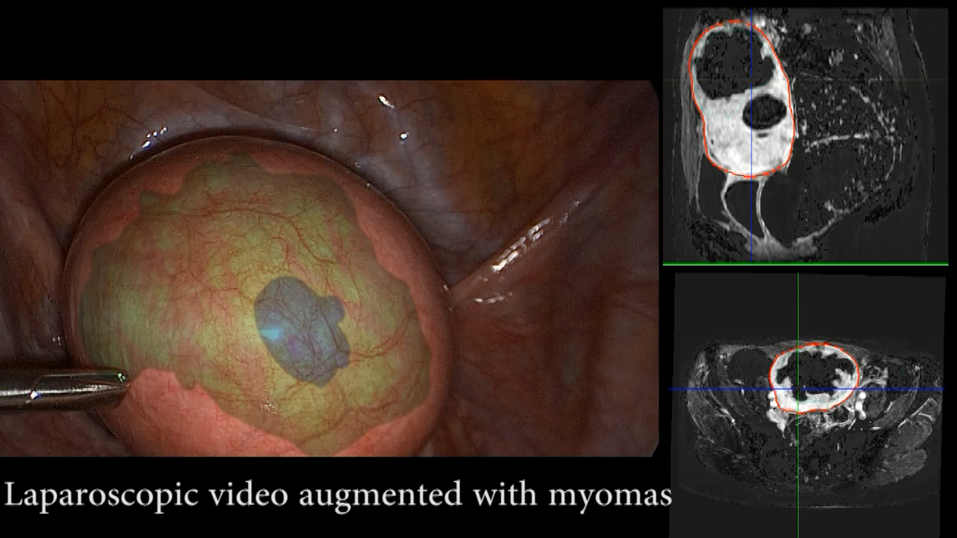
Application in Medicine
ENCoV-CNRS, France
Mixed Reality System to aid surgeons

Slide 6
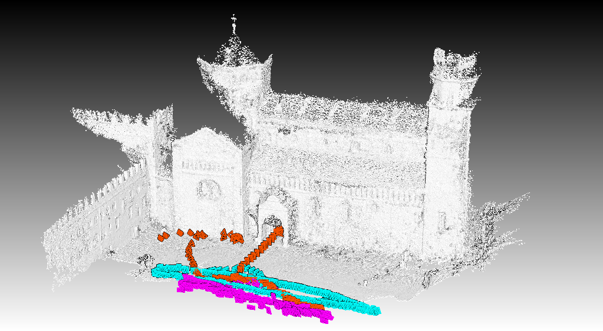
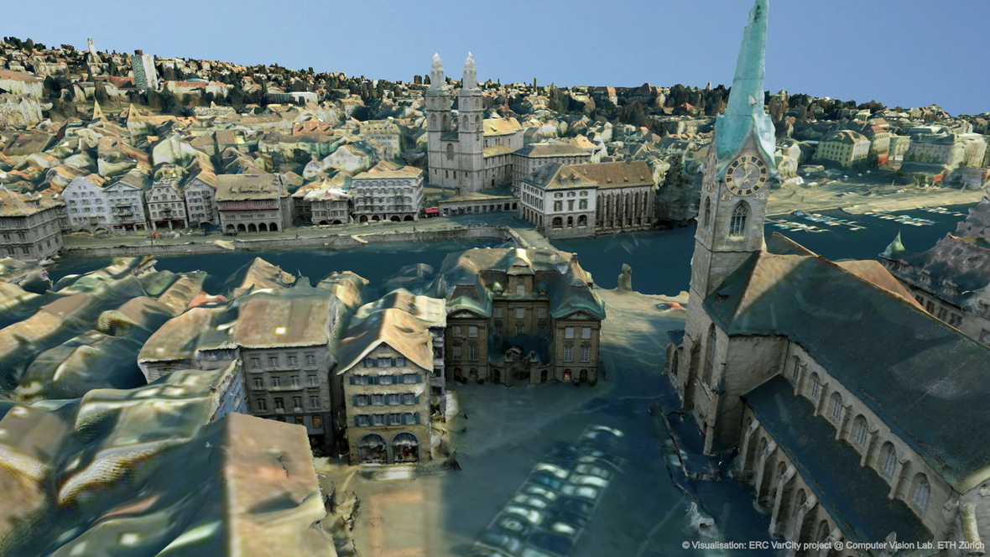
Broader applications (Research @ETH Zürich)
Images to 3D models of Buildings – EU project Replicate
3D city map – VarCity

Slide 7
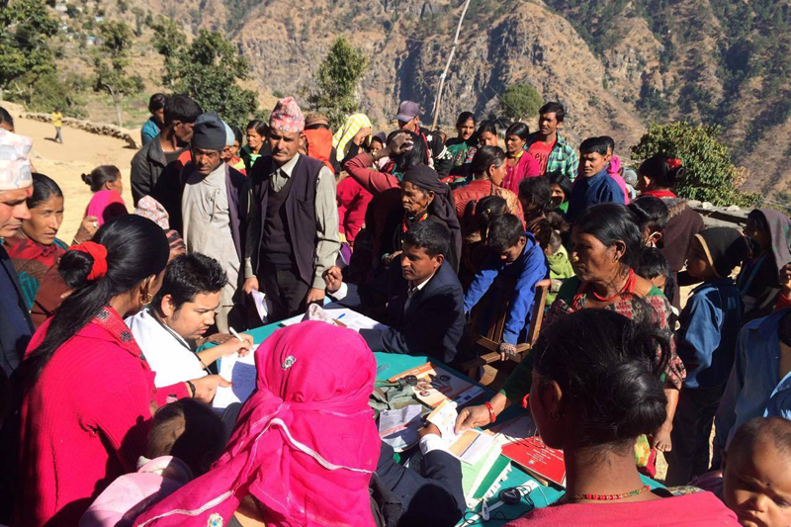
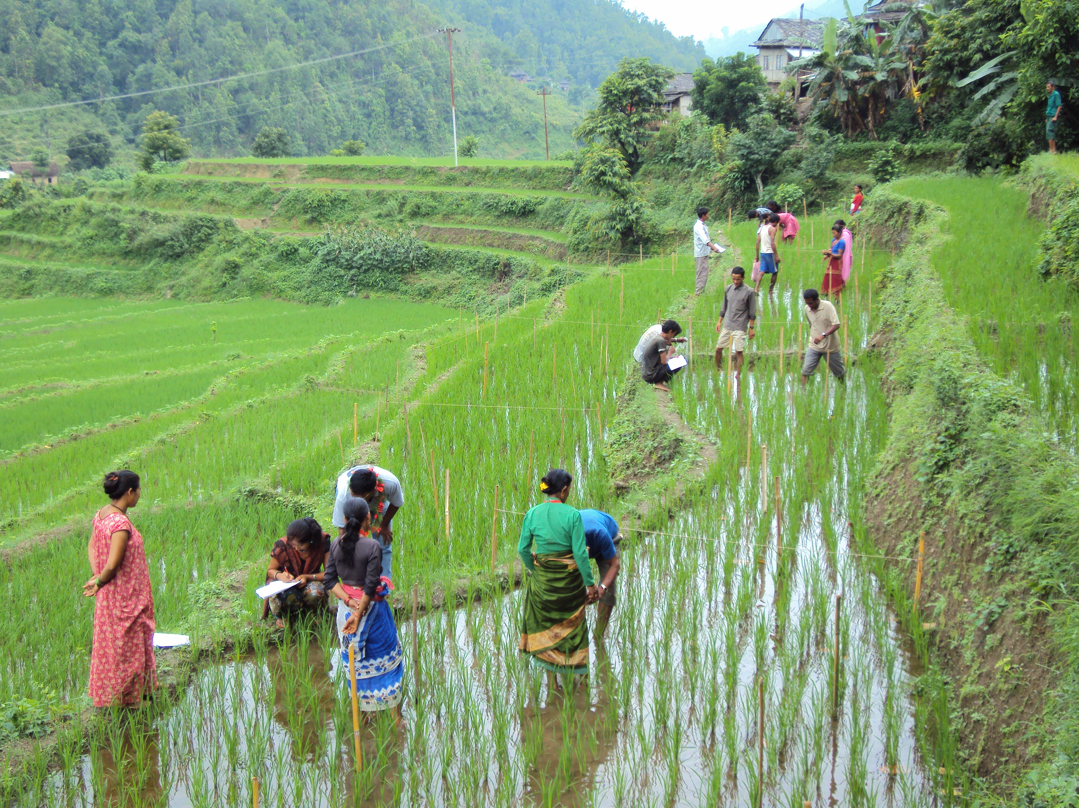
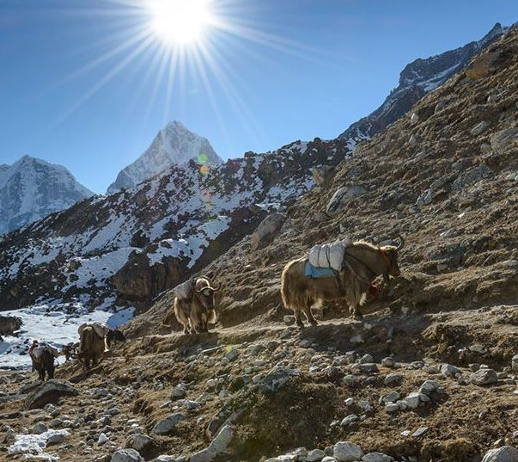
Nepal: Challenges to opportunity
Source: The Himalayan Times
Source: FAO
Source: Himalayas on Foot
Few doctors, few resources, more people
Hilly terrain, labor intensive agriculture
Mountains, difficult transportation

Slide 8
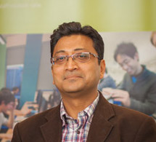
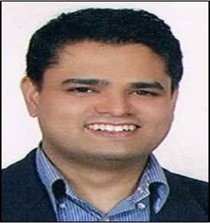
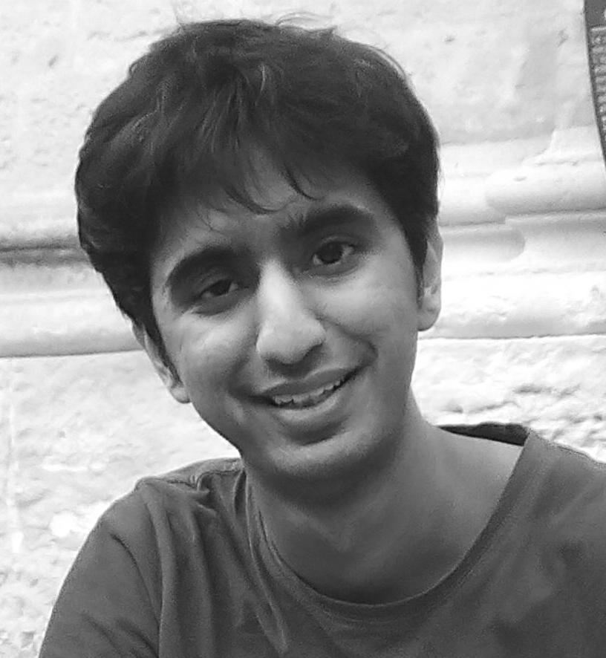
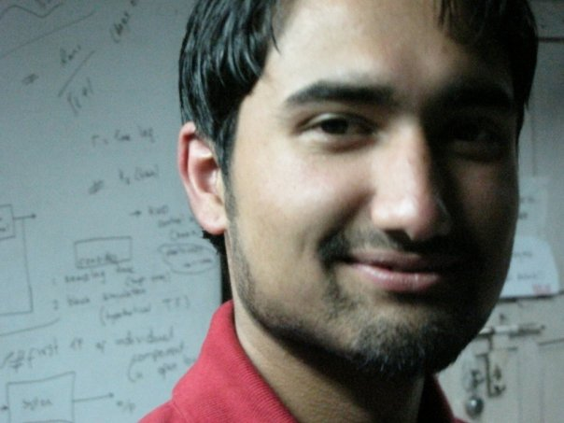
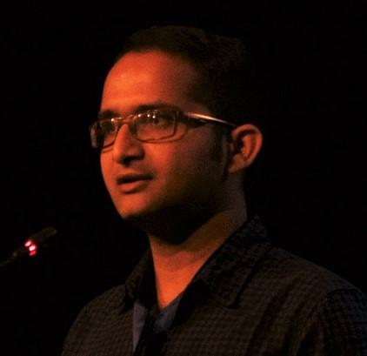
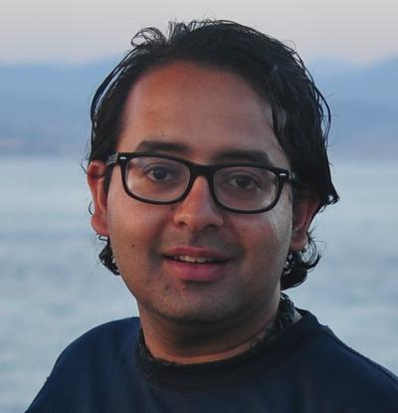
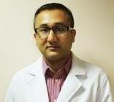
NAAMII
Reader, University of York, UK
PostDoc, INSERM, France
Postdoc, ETH, Switzerland
Postdoc, KCL, UK
Postdoc, ETH, Switzerland
PostDoc, QUT, Australia
Computational Science Experts
+
Orthopedic Surgeon
नेपाल व्यावहारिक गणित, कम्प्युटर तथा सूचना प्रविधि विज्ञान अनुसन्धान संस्था
NepAl Applied Mathematics and Informatics Institute for research (NAAMII)

Slide 9
Long-term Goals
Scientific and Academic:
  High quality research efforts in Nepal
  Creating Research and learning opportunity in higher education.
Translation
  Developed technology to products.
Technology Transfer
  Transferring technology from developed nations to Nepal.

Slide 10
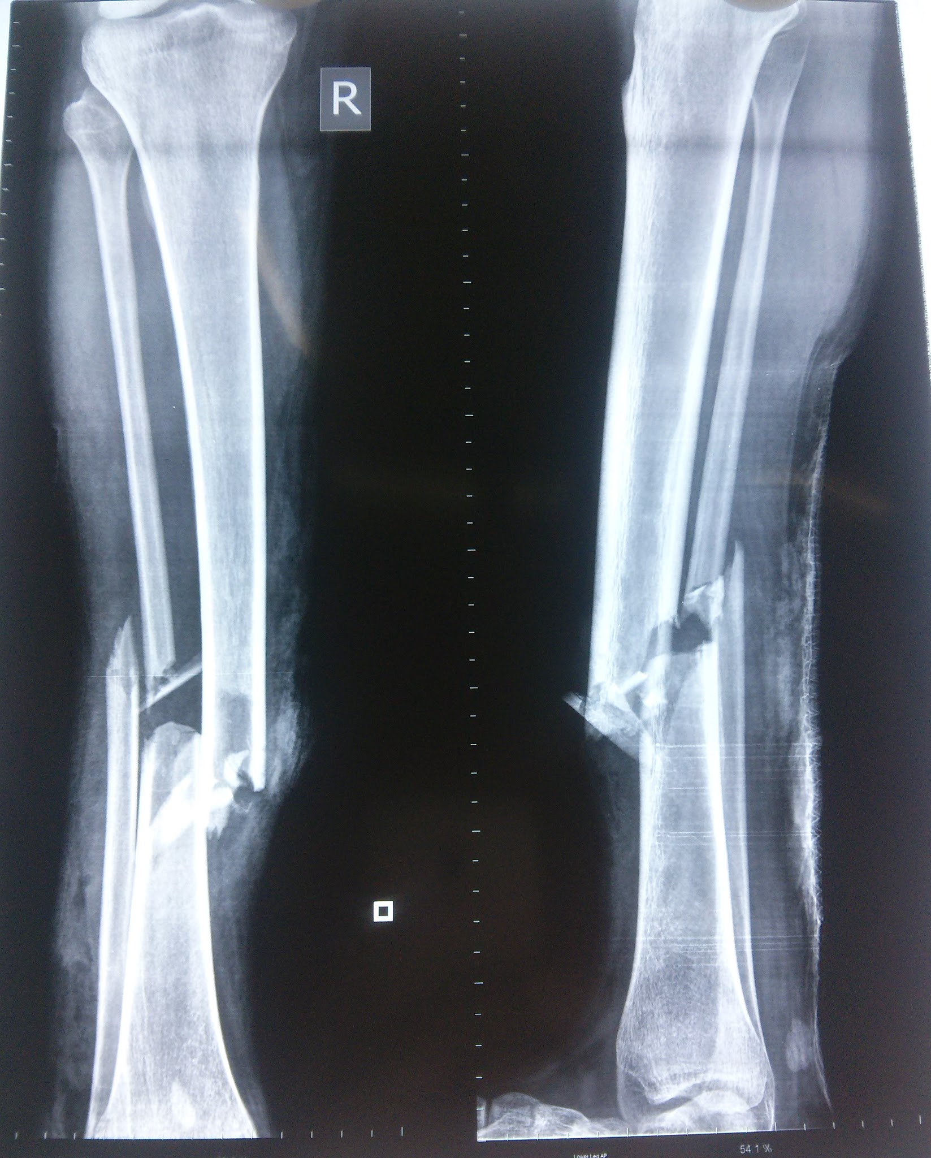
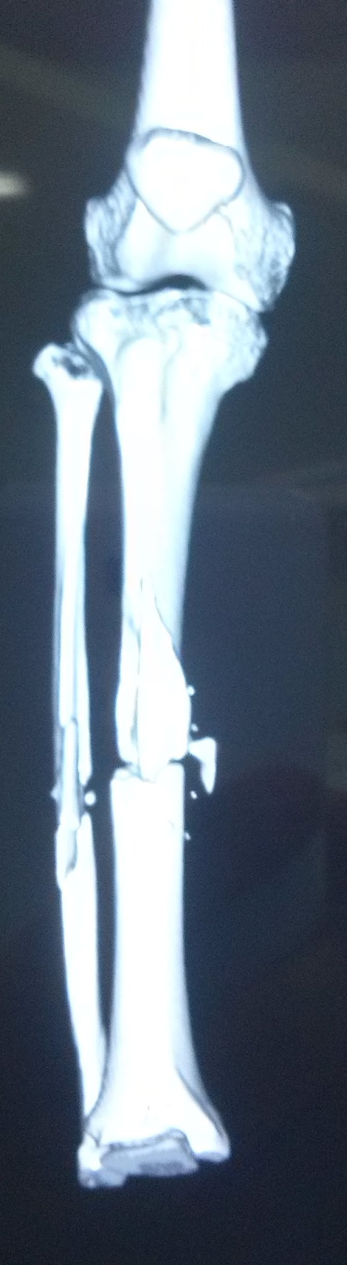
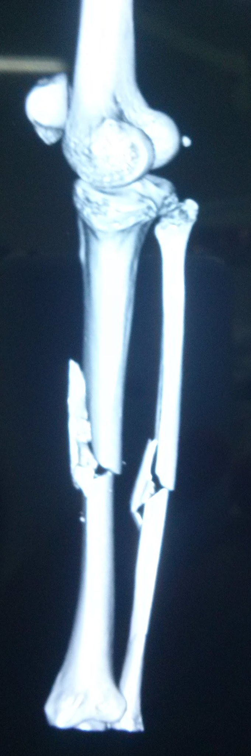
Current activities: Selected Projects
X-ray Images to 3D Bone structure
Motivation/Objective
3D printed bones for surgery planning
Usually Requires MRI/CT images
Low cost 3D from only X-ray images.
Source: NAAMI/Possible Health

Slide 11
Current activities: Selected Projects
Drone-based plant disease identification in agriculture
Motivation/Objective
Difficult terrain, easier surveillance with drones.
Research opportunity
Source: Dr. Suresh Manandhar

Slide 12
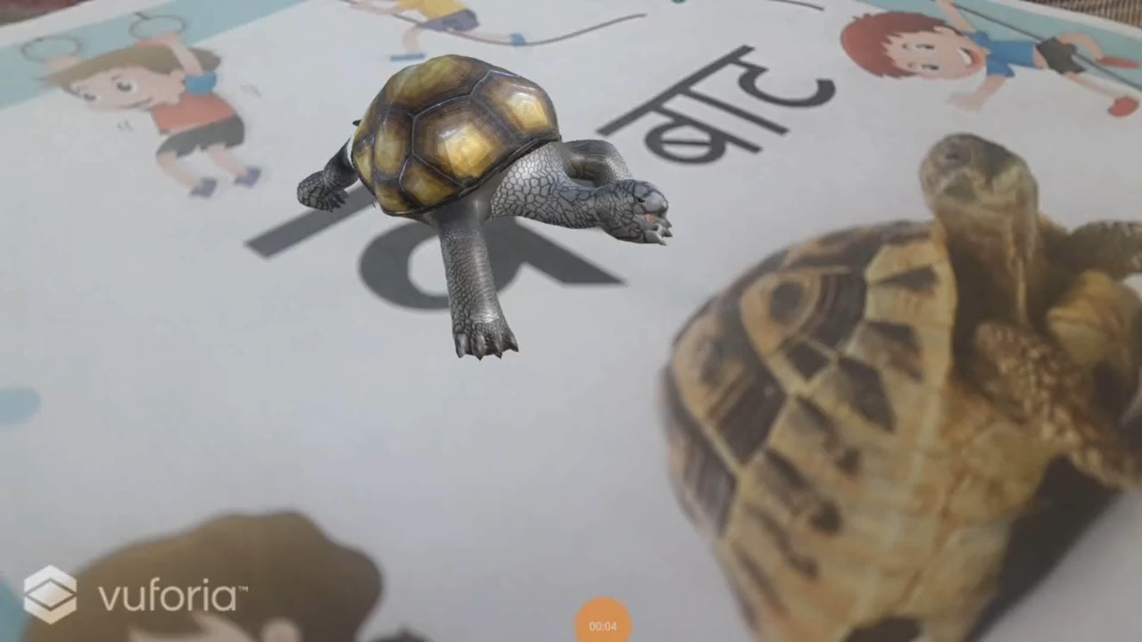
Current activities: In NepSAS
Mentoring projects in NepSAS and other supervision activities.
Mixed-reality for learning – 2nd Runner up in the event

Slide 13
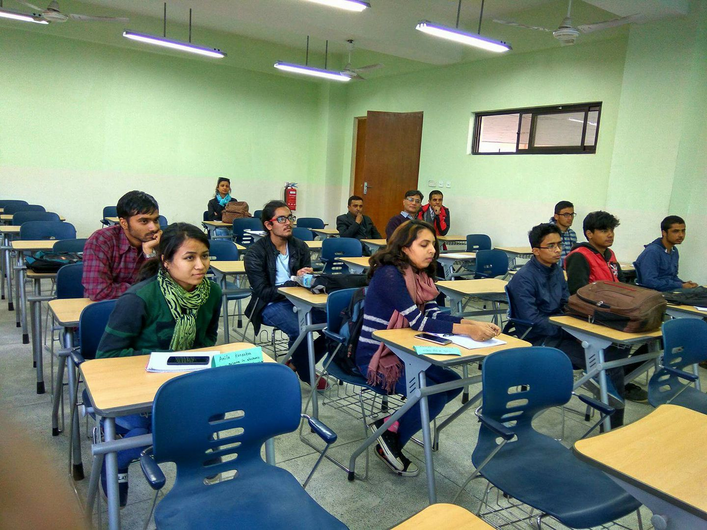
Current activities: Winter School 2018
2 weeks intensive and potentially free programme on computational science.
Source: Winter School 2016
Bishesh Khanal, Abhishek Dutta

Slide 14
Thank you!

