Slide 1


Swiss-Nepal Technology Transfer 2018
Renewable Energy opportunities in Nepal An Outlook
Presenter: Avip Bastakoti
Notes:
You might all be wondering why I am here today stating the obvious? Its is kind of pointless but never-the-less, we have a lot at stake here.

Slide 2


Vast Renewable Potential
HYDROPOWER: 83 GW(Th. 42 GW)
SOLAR: 80,000 GWh/day (4.5h sun per day (6.8h))
WIND: 3,000 MW
Daily Power demand in Nepal, (2017): 1350 MW(peak time)
Daily Power demand in Switzerland, (April 2018): 167.16 GW
Nepal’s Potential: 90.93 GW
=> Export 95%+ Energy
Notes:
Recent statistics show the massive potential of RE in Nepal. The amazing thing is that if realized we can practically export more than 90% of the production. The math does not lie.

Slide 3
Contents
Present day scenario (1”)
What we can do? (2”)
Future outlook… (1”)
Conclusion and regards (1”)
Notes:
Explain the need of transition highlighting the NDC and SDG’s. Mention the acute problem of climate change and embark on a quest to make the audience question themselves…

Slide 4
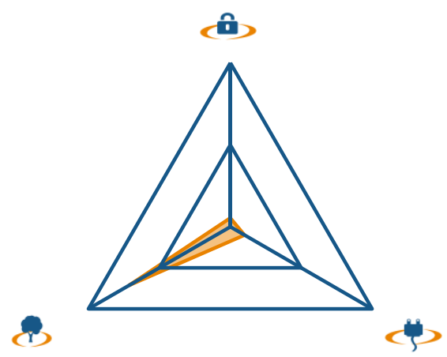

Energy Trilemma Index- Year 2015
Energy
Security
Energy
Security
Sustainability
Energy Equity
Energy Equity
Sustainability
https://www.worldenergy.org/data/trilemma-index/country/nepal/
Notes:
Energy trilemma is a performance indicator of a country in terms of its energy security, supply and sustainability. We are a bit better on sustainability because of our existing HPs. But what if we could turn this into this? The answer is huge implementation of RE systems.

Slide 5

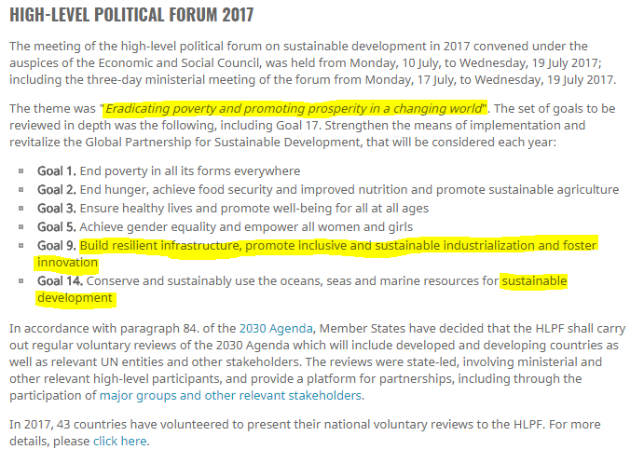


https://unfccc.int/news/nepal-submits-its-climate-action-plan-ahead-of-2015-paris-agreement
https://sustainabledevelopment.un.org/hlpf/2017
http://theduran.com/syria-signs-paris-climate-change-accord-us-country-no-board/
https://sustainabledevelopment.un.org/hlpf/2017
http://www4.unfccc.int/ndcregistry/PublishedDocuments/Nepal%20First/Nepal%20First%20NDC.pdf
Notes:
After the groundbreaking Paris Climate Accord, Nepal joined the front of the pack by committing to 20% by 2020 and 80% electrification by renewables by 2050 in the primary energy sector along with high commitments on other policy and power plants.

Slide 6
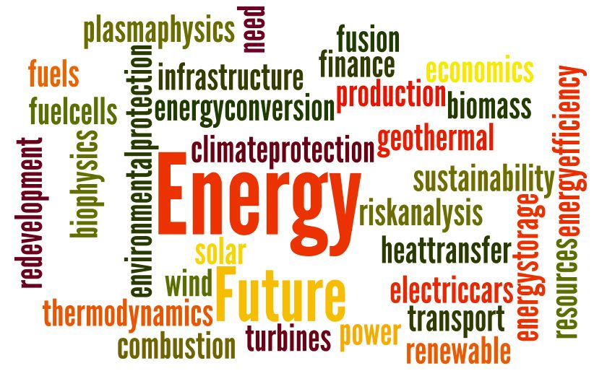
http://blog.wennergren.org/wp-content/uploads/2017/04/energy-sciences.jpg
Notes:
Nepal's NDC focuses on Renewables, Energy efficiency, sustainability and climate and land protection.

Slide 7
Measures
Water and Electricity Cogeneration
Rural Electrification
Biomass, Biogas and Waste Management(a.k.a. Energy Efficiency)
Notes:
Today, I would like to present 3 simple measure that could be implemented in the present context in order to reap immense benefits in the coming days. They are:

Slide 8
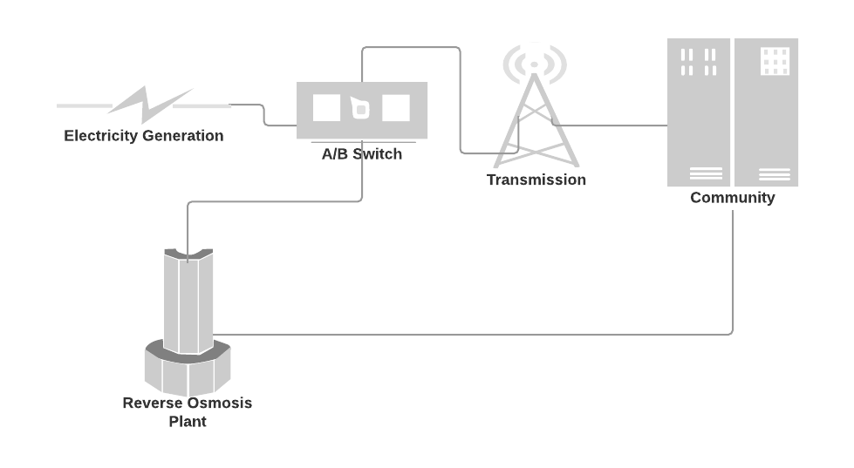
High Demand/ Low Flow
Renewable Sources
Electricity
Low Demand/ High Flow
Clean Drinking Water
Clean Drinking Water and Electricity to the community with job opportunities and improved living standard.
Notes:
What we see in a traditional Power Plant is this. Power generated is fed to the grid and supplied to the consumers. But what happens when there is excess generation? (pause for a moment). Nothing, Either the the power plant is shut down or operates at the demand speed => loss of useful energy. Alternatively, in this approach we install a Water filtration plant next to the HP which is operated with the excess generated energy to filter the water and provide it to communities. It would solve the crisis ( as 80% do not have access to clean drinking water, rather the water is contaminated) of clean drinking water (SDG 6) and contributing to the lifestyle of the people.

Slide 9

Rural electrification to end energy import based on my research on
“SOLAR POWER OPPORTUNITY IN NEPAL TO END ENERGY IMPORT AND LOAD SHEDDING”
Takes the commitment of NEA for the fiscal year 17/18 as a reference
Daily solar irradiation 4.66KWh/m²day equivalent to running 4* water pumps throughout the day!
Think: Electricity for efficient LED bulbs?
Solar farming of 500m² sufficient to generate electricity amounting to 77KW.
Using as much as 0.018% of unused land in Jumla
COMMUNITIES THAT CAN BE PROFITED
*Assuming that the pumps are 1KW each
Notes:
This is a WIP. As seen earlier, Nepal has 3-5 times more solar irradiation than almost all European countries => SOLAR highly profitable. In a research carried out in Jumla, we see that land area less than half a Km is enough to power entire villages in Nepal (as energy demand is not so high). Implementing these kinds of projects which consists of relatively less risky assets would be very interesting to investors.

Slide 10
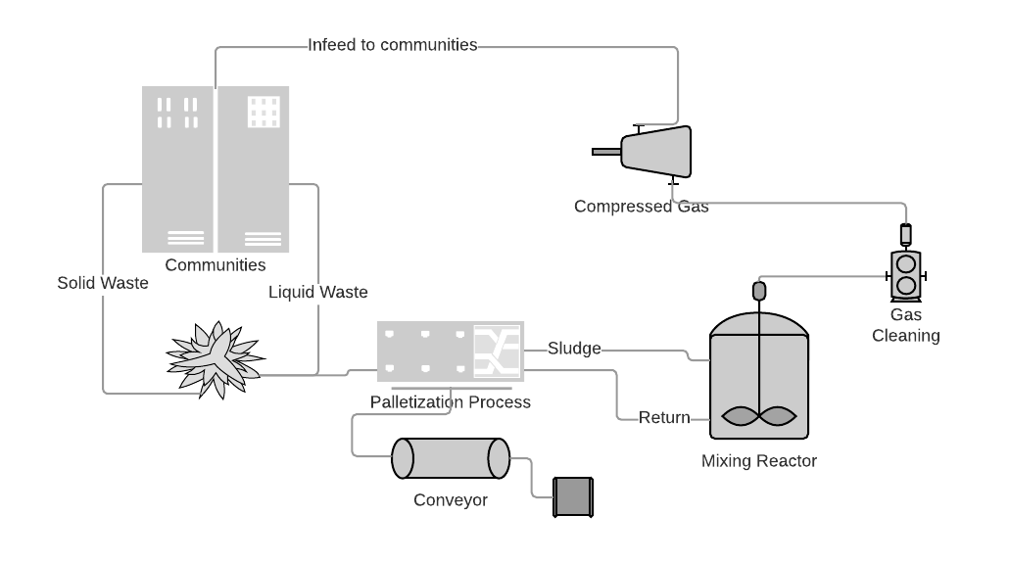
Pallets
Notes:
My third and the final idea is about Waste Management!! A trending topic among all the environmentalist. There is One simple answer => cogeneration! As we can see here, utilizing the waste(solid and liquid) from communities and using it with some basic engineering methods to make blocks/pallets for heating purposes from solid waste and then to biogas via the sludge pipe to a reservoir and converting into Biogas. Simple! By this we Solve the problem of waste management, heating and energy for cooking. This is a solid example of application of energy efficiency and cogeneration.

Slide 11
Final words...
Change is hard,
Proper mindset and tools bring about positive change,
Platform should be provided to exchange knowledge (like NEPSAS event)
Modern engineering practices and conventional practices should be combined,
Mitigation and adaptation measure should be applied as soon as possible to combat the global threat: ”CLIMATE CHANGE”
Energy efficiency and sufficiency is the key!
Notes:
Bringing about change in a underdeveloped country is hard, people need to be made aware. On the other hand, these people are also very open towards positive change once they are made aware and they they help and apply themselves to bring about change in the society. This coupled with proper policies would bring about huge avalanche of positive change and then finally help Nepal make the long awaited Energy Transition. Places like NEPSAS today, in my opinion will help people to bring about a positive mindset so that we can one day in the foreseeable future go back and give back our hard earned knowledge and experience to our country.

Slide 12





Acknowledgements
WEGECON

Slide 13
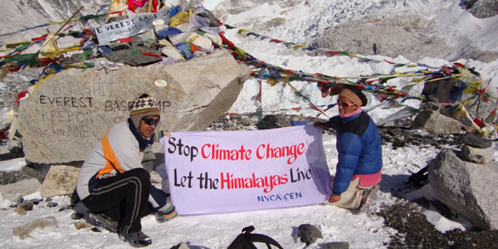
The future is green energy, sustainability and renewable energy.
Arnold Schwarzenegger
THANK YOU
http://chimalaya.org/2012/07/26/nepals-youth-fight-to-save-himalayas-from-pollution-and-climate-change/
Notes:
Lastly I would like to quote a saying by my favorite personality and my motivation. The governor of California Arnold Sch.. Thank you.

Slide 14
References
https://www.ipcc.ch/pdf/special-reports/srren/drafts/SRREN-FOD-Ch01.pdf
Bastakoti, Avip. “Solar Power Opportunity in Nepal to End Energy Import and Load Shedding. "University of Freiburg, 2017
https://upload.wikimedia.org/wikipedia/commons/thumb/3/3b/Flag-map_of_Switzerland.svg/500px-Flag-map_of_Switzerland.svg.png
https://www.iconspng.com/image/90931/nepal-map-flag

