Slide 1

Cryo BLM:
LS2 Modification
Christos Zamantzas

Slide 2
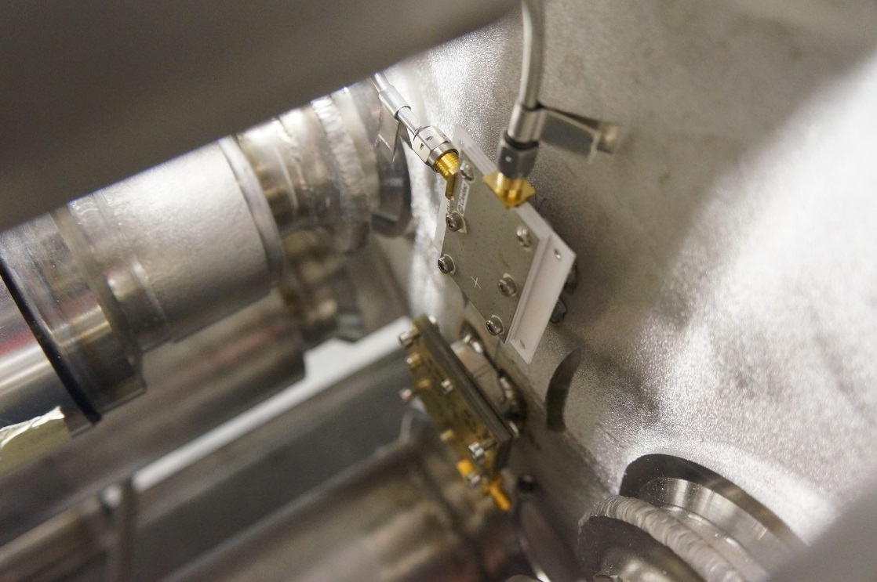
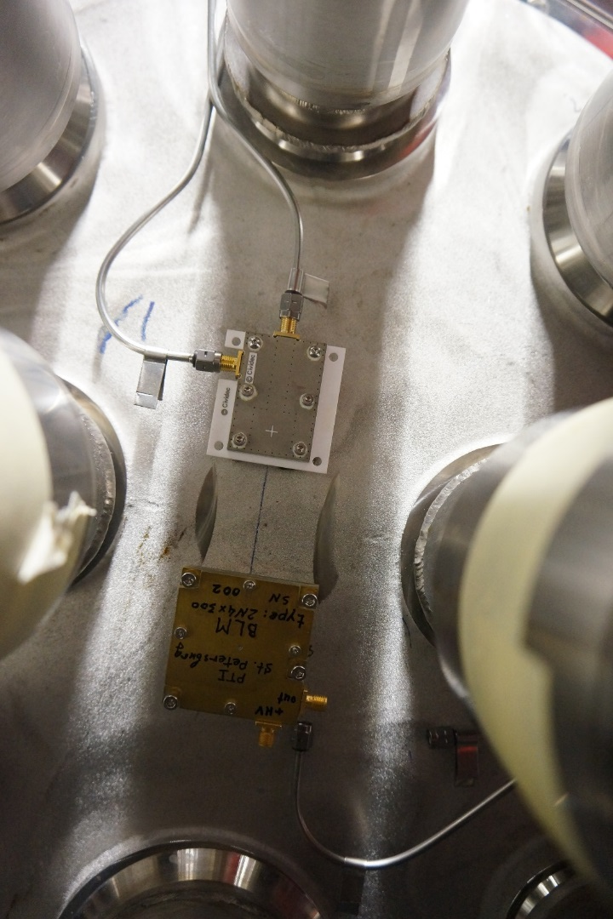
Current Installation

Slide 3
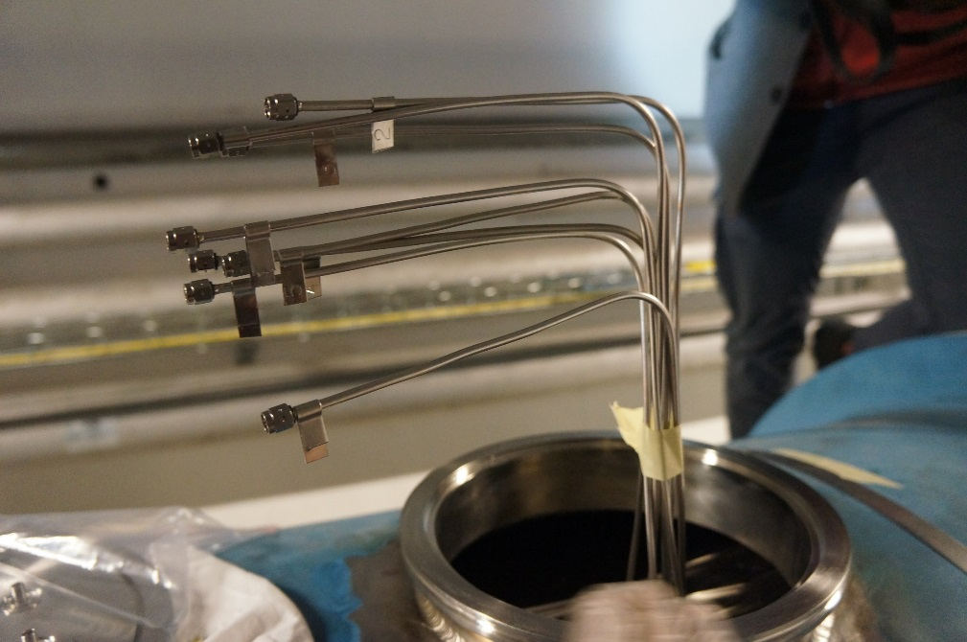
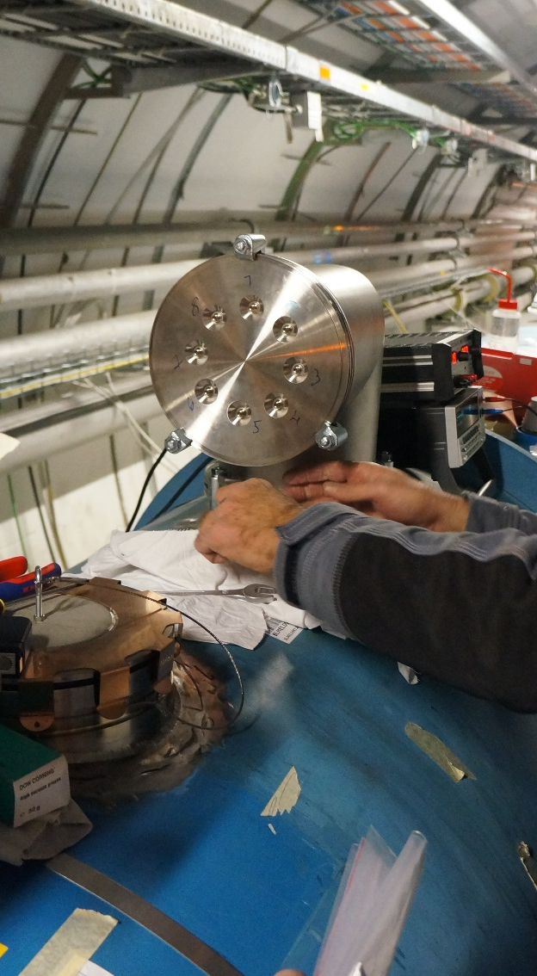
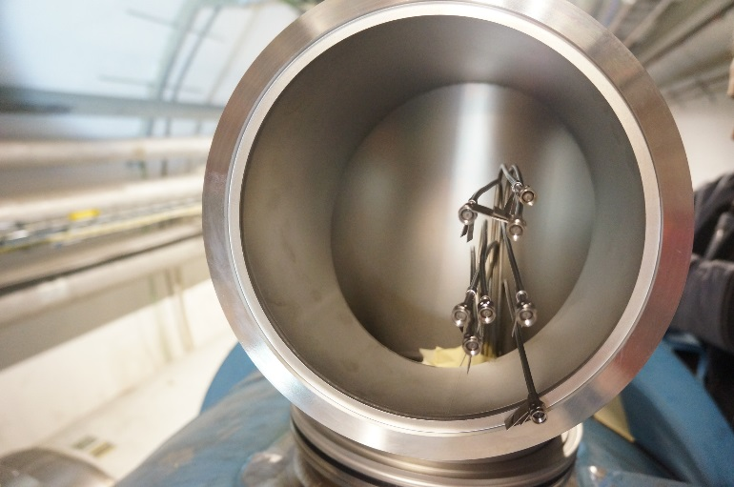
Feedthroughs

Slide 4
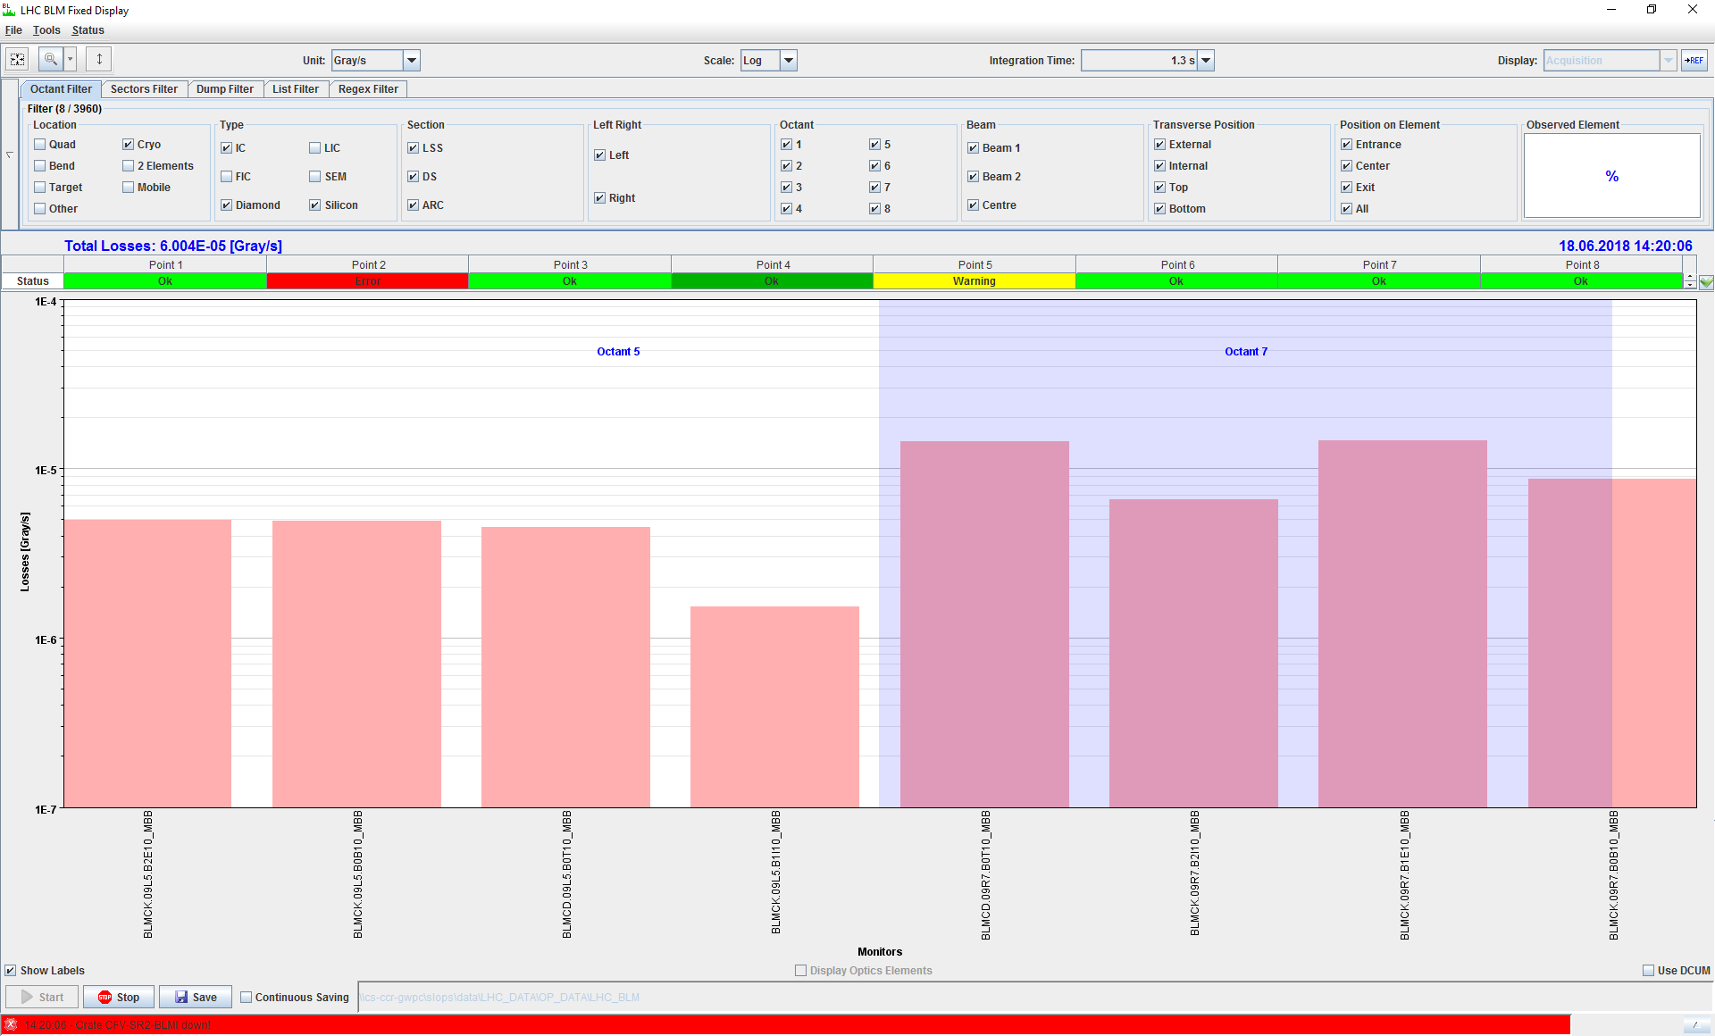
Measurements
2 x Diamonds and 6 x Silicon detectors installed at interconnects
9L5 (between 10L5 and 9L5) and 9R7 (between 8R7 and 9R7)
EXPERT NAMES:
BLMCK.09L5.B1I10_MBB
BLMCD.09L5.B0T10_MBB
BLMCK.09L5.B2E10_MBB
BLMCK.09L5.B0B10_MBB
BLMCK.09R7.B2I10_MBB
BLMCD.09R7.B0T10_MBB
BLMCK.09R7.B1E10_MBB
BLMCK.09R7.B0B10_MBB

Slide 5
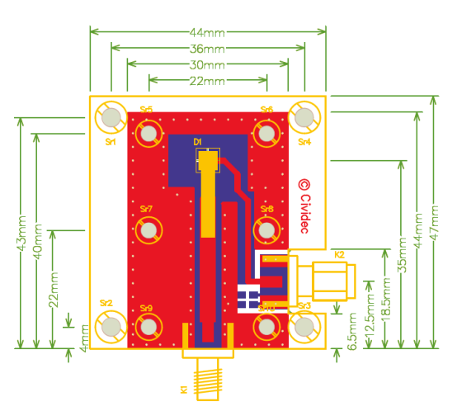
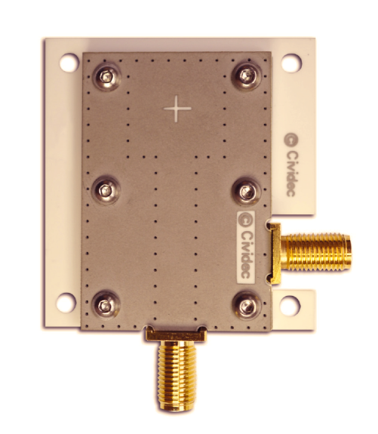
Design parameters
Cryo dBLM with HV supply, HV filter, charging capacitance
Readout transmission line 50Ω
No ground outside
sCVD diamond sensors
Ceramics material (Al2O3)
Four mounting holes (d=3 mm)
Six assembly holes
New ceramic PCB and enclosure

Slide 6
Status
Agreement to open the interconnects during LS2
  Not for the 11T installation
PCB Design has been completed
  Order of 10 PCB to be launched this week
New feedthroughs with isolation needed
Number of channels to add still open
  8.5 KCHF per detector

Slide 7
Thank you

