Slide 1
HL-LHC HEL BPM
Preliminary design considerations

Slide 2
Outline
Specifications
First ideas
Beam signals
LF system
HF system
Acquisition system
Summary

Slide 3
Specifications:
 | Proton beam | Electron beam | Comments
Intensity | ? - 2.5E11 (63A) | ? - 5A
Bunch / Pulse length | 1ns | 86us | P=4σ; E_beam off 3us; tr = 200ns
Relativistic β | 1 | 0.2 | E_{Beam} Low β = 5* charge density
Resolution | 5um | 5um
Relative accuracy | 30um | 30um
Time resolution | 1s | 1s | TBD
Functional specifications not so clear (to me):
  E_beam on continuously and only off in abort gap?
  Injection and / or only stable beams?
  Pilots, batches, full machine…

Slide 4
First ideas
Same BPMs for the two beams
  Minimize mechanical offsets
Same electronics for the two beams to minimize electrical offsets
  Frequency separation
    Different electronics for the two beams. Bigger offsets
    A lot of 11kHz lines will make it very difficult
  Time separation
    Measure E_{Beam} in abort gap and P_{Beam} outside, using same part of spectrum
    Same electronics for two beams, if same amplitude range
Low frequency (< 40MHz) or High frequency (40MHz++)
  Depends if E_{Beam} modulation is possible?

Slide 5
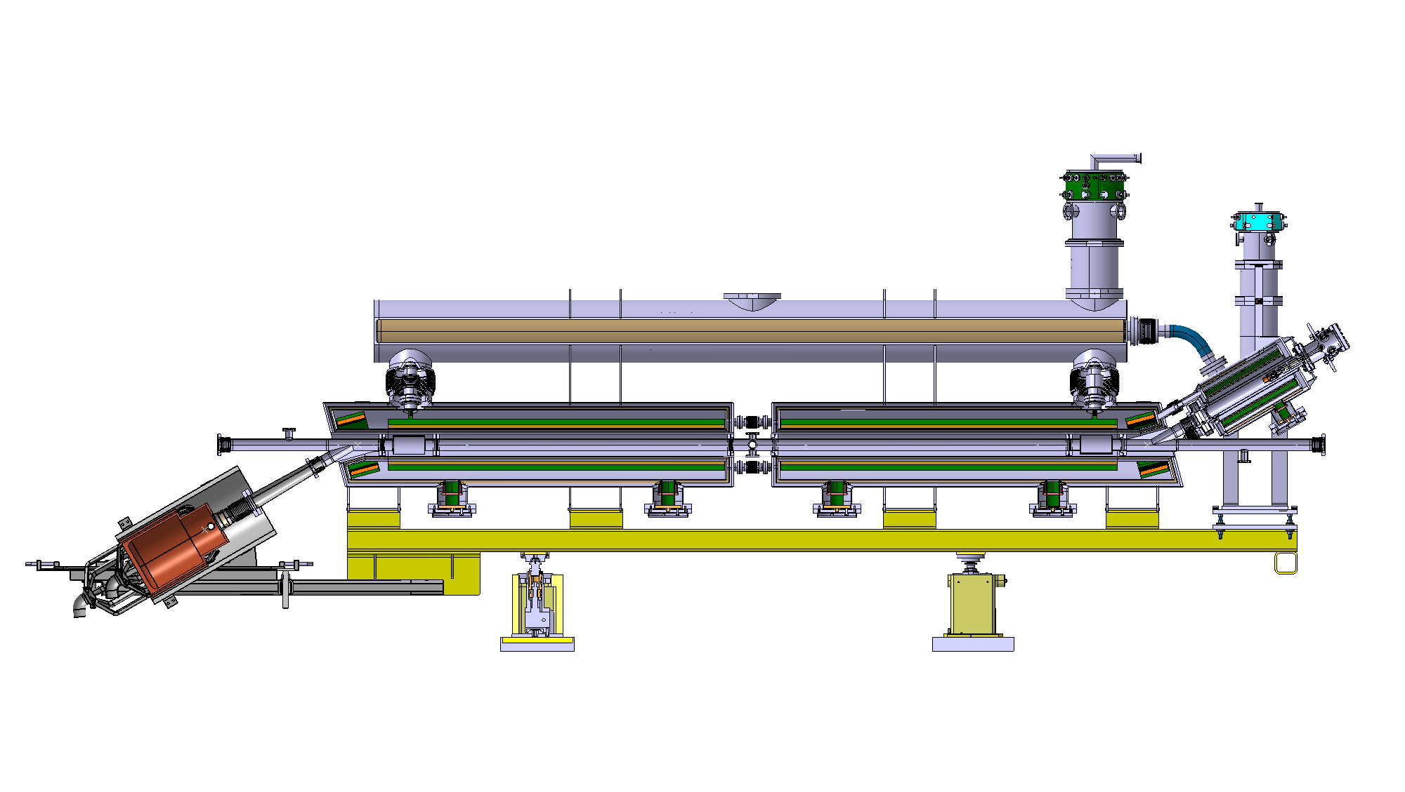
BPMs for Hollow Electron Lens

Slide 6
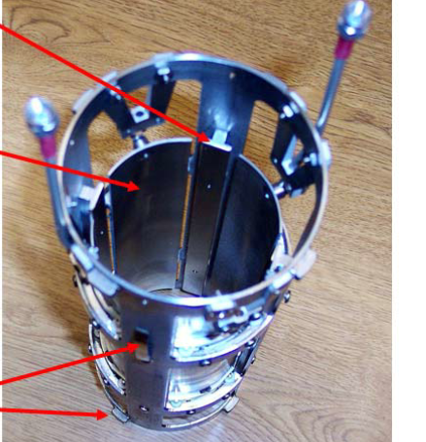
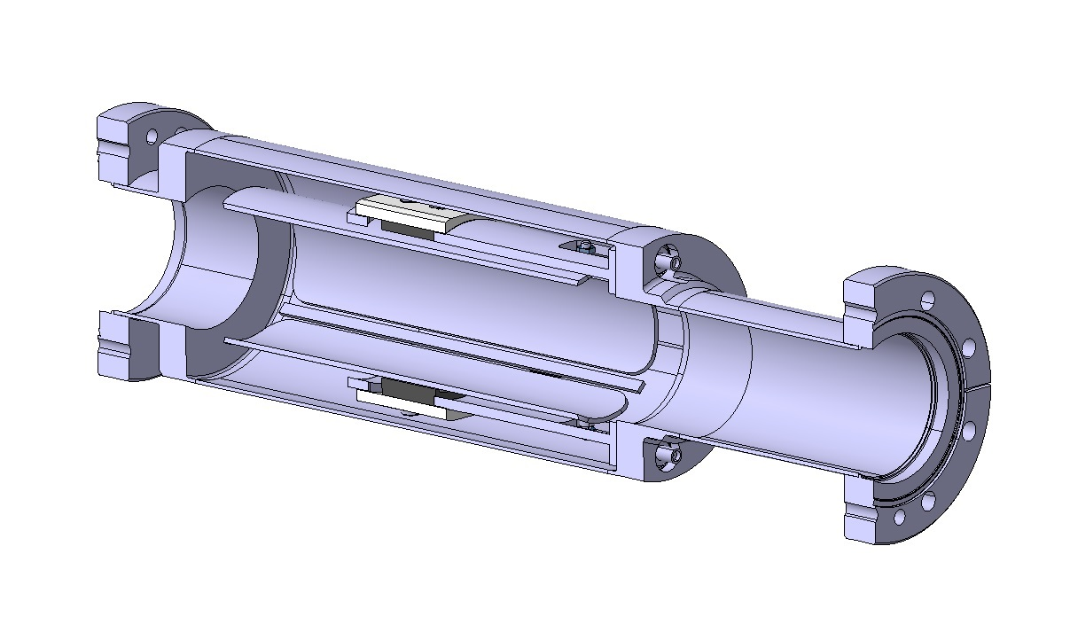
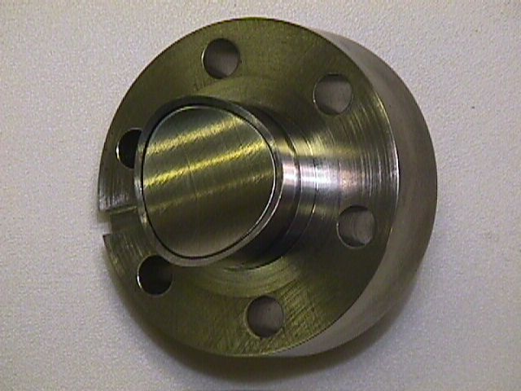
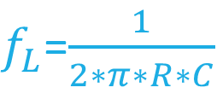
BPMs considered
Present HEL BPM design
Button BPM
L= 100mm, ϕ=75⁰; C=20pF, R=50Ω
D= 20mm; C=20pF; R=50Ω
FNAL TEL 2 BPM
Z_{coup_E} = 15.9 ohms
Z_{coup_E} = 1.1Ω
Z_{coup_P} = 3.1 ohms
Z_{coup_P} = 0.2Ω
$f_{L}$=$\frac{1}{2∗π∗R∗C}$

Slide 7
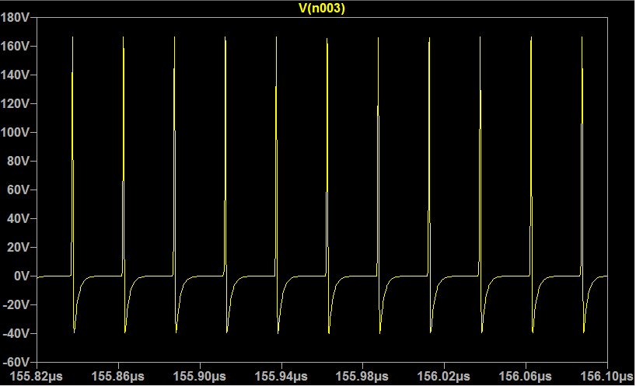
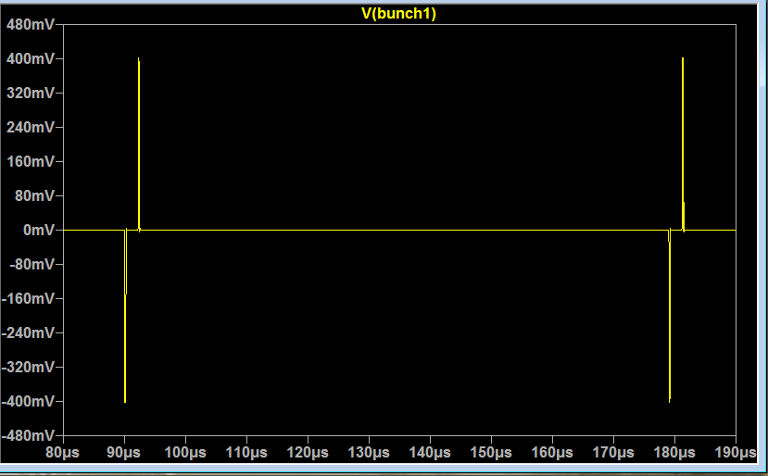
Wide band Beam signals with electrostatic BPM
200Vp
Zcpl_E = 15.9 ohms
Protons :
I= 63A, 25ns
Zcpl_P = 3.1 ohms
~160MHz
(20pF, 50Ω)
Response (V)
0.8Vpp
0
Electrons :
I= 5A,
Tr=200ns,
off 2us
0
Frequency (Hz)
E_{Beam}
Off / on
E_{Beam} spectrum heavily filtered

Slide 8
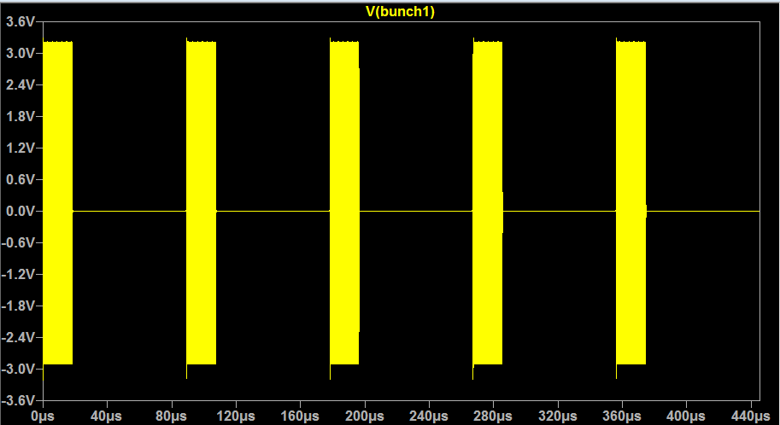
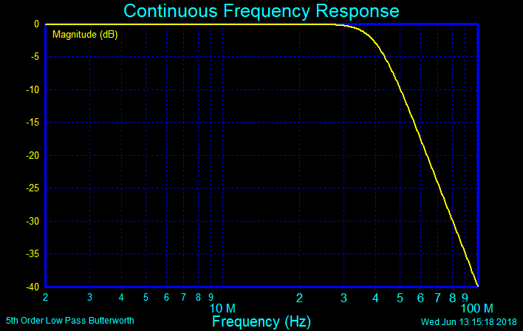
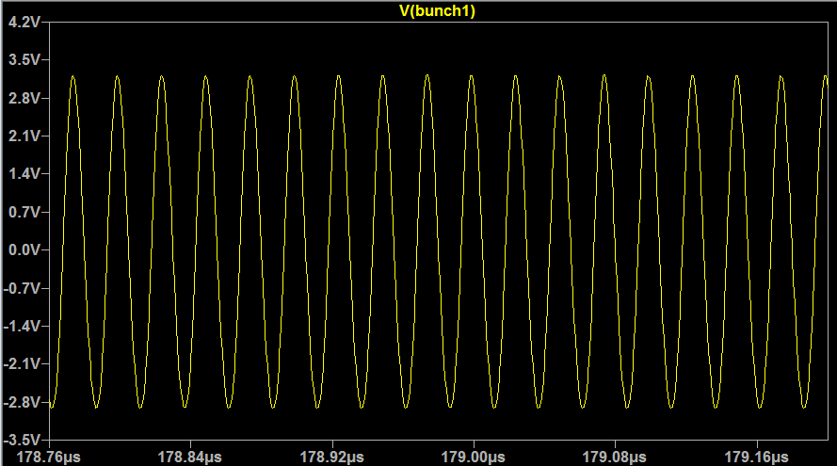
With 40MHz LP filter
Low frequency: P_{Beam} signals with electrostatic BPM
6Vpp
Still a factor ~10 too high

Slide 9
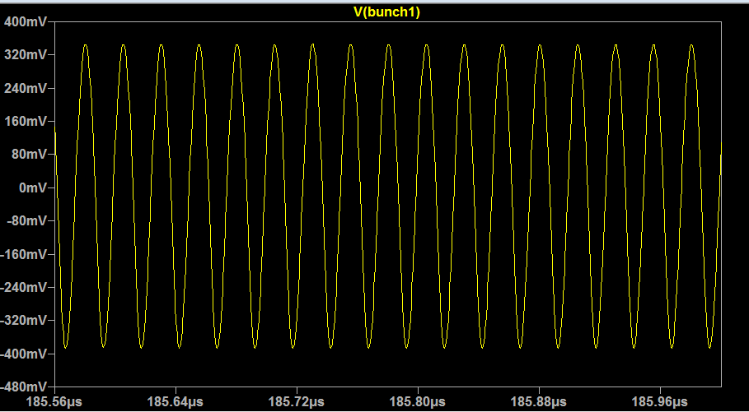
With 25MHz LP filter
0.8Vpp
With button BPM signal levels would be 15 times smaller ~25mV.
Electrostatic BPM seems better suited for the LF version
BP filter should be considered to minimize noise and offsets
Amplitudes shown for max currents
BPM coupling impedance for E_{Beam} = 15.9Ω.
20% modulation @20MHz, 1A = ±8V/10=0.8V
(Factor ~10 less signal due to BPM high pass)
0.8Vpp

Slide 10
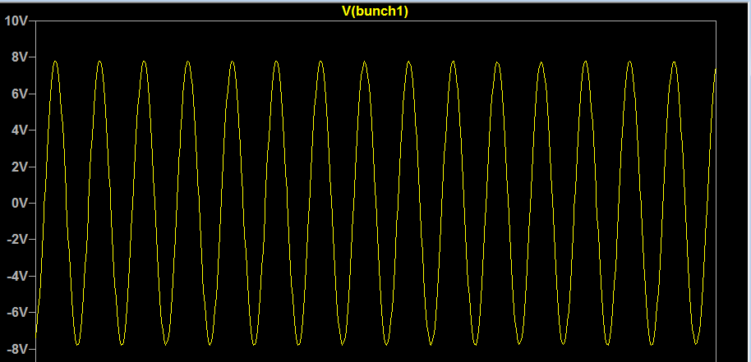
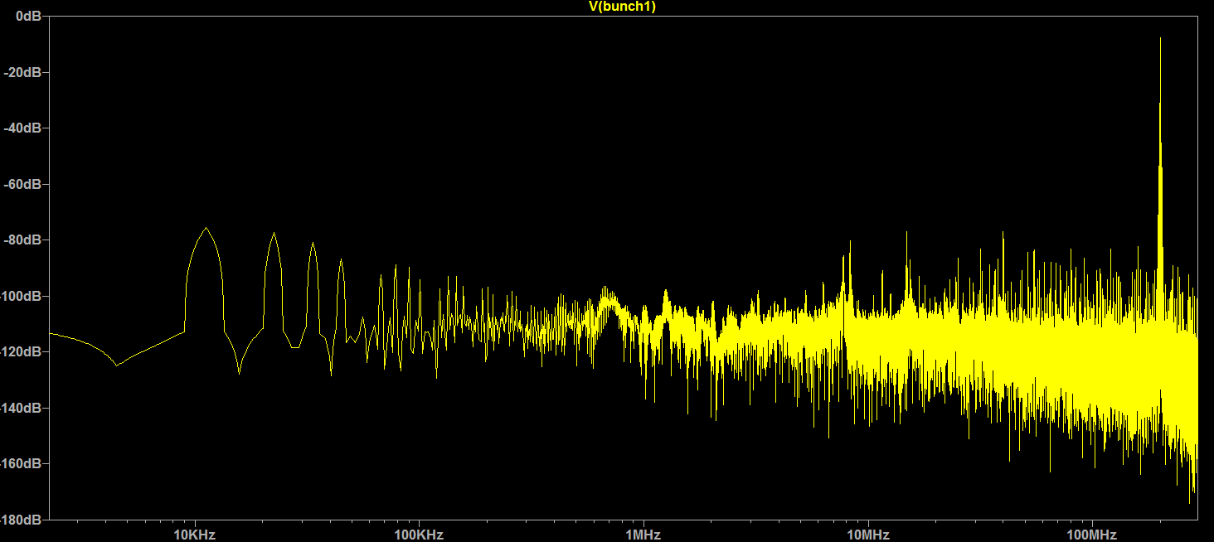
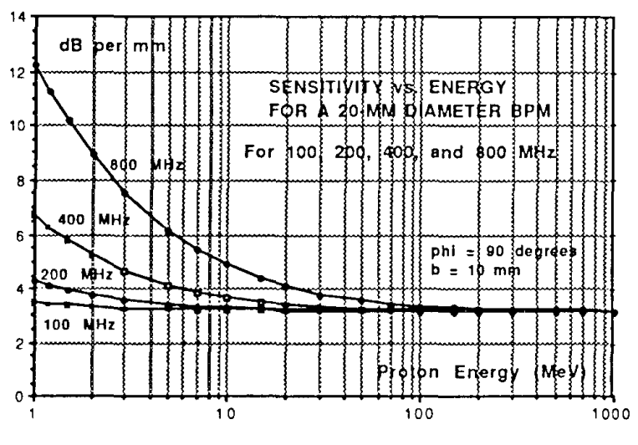
High Frequency: With E_{Beam} modulation @ 200MHz
Working in BPM pass band
Electrostatic BPM coupling impedance for E_{Beam} = 15.9Ω.
20% sinewave modulation 1A = ±8V
Button BPM amplitudes ~ 500mVp
NEED 20% modulation
Higher resolution on E_{Beam}
  Number of 5ns periods in 2us : 400
  20*higher amplitudes
100MHz no sensitivity change @ β=0.2
β=0.2
Proton beam with 200MHz, 5MHz BP, 5th order, 2.5E11, σ= 0.25ns

Slide 11
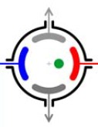
Possible acquisition system
DOROS
D
Continuous digitization
1
Digitize abort gap timing to organize data in memory
Abort gap

Slide 12
Summary:
We can tailor the signal conditioning (filter) to have only one acquisition system for the 2 beams, ADC included.
Low frequency system:
  Electrostatic BPM needed to get sufficient signal levels
  Resolution still to be estimated but ~100* worse than high frequency system
  Resolution can be significantly improved with high load resistance, but electrode charging could be a serious issue
High Frequency system
  In BPM passband > 200MHz
  20% Modulation is needed
  Can be very narrow band around harmonic / modulation frequency
  Low beta effect on BPM sensitivity to be verified. 100MHz seems OK
Acquisition system
  DOROS type seem a very good option

