Slide 1

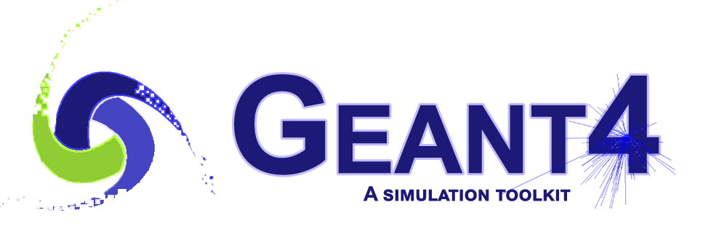

Investigations in the ATLAS geometry
National Research
Tomsk
State
University
Evgueni Tcherniaev
Geant4 development team

Slide 2
Outline
  Introduction
  Side effect of some GeoModel features
  Statistics of Geant4 solid methods
  Usage of Boolean solids
  Usage of G4Polycone solids
  CPU consumption by Solids & Navigator
  Miscellaneous
  Summary

Slide 3
Introduction

Slide 4
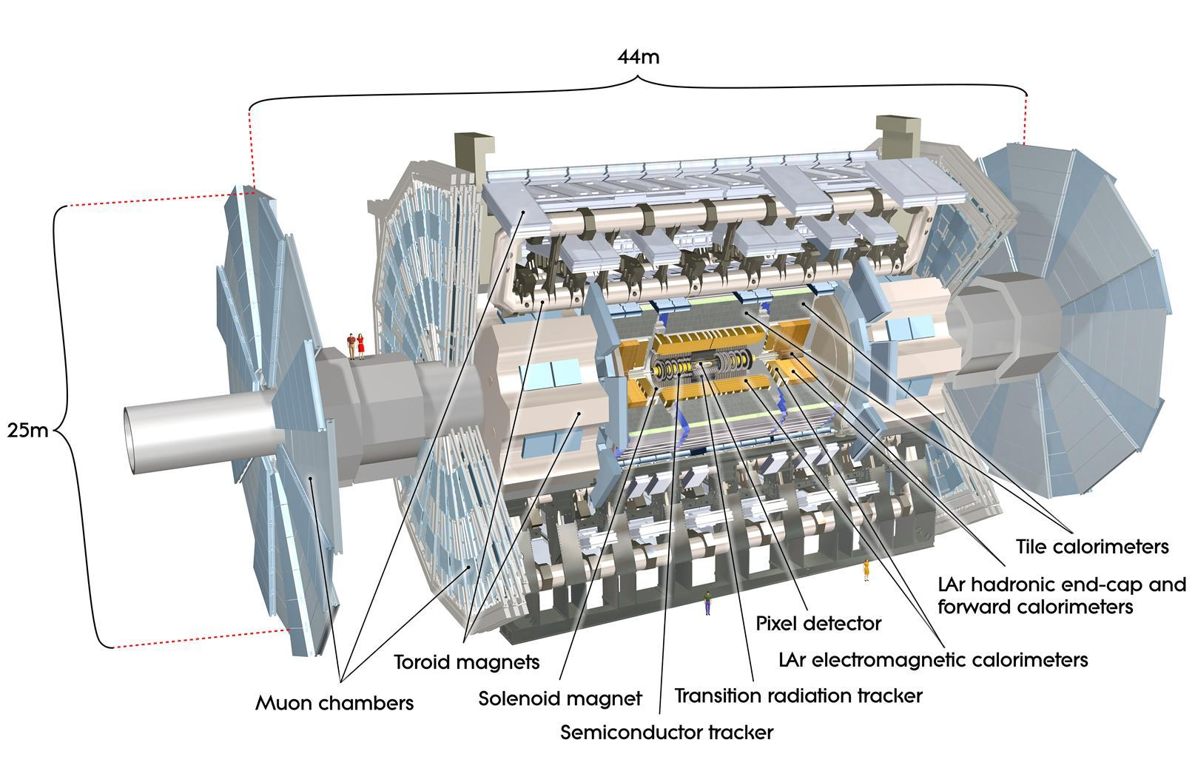
Analysis of the ATLAS geometry
The purpose of the analysis was to gather quantitative information on usage of Geant4 solids in the simulation of very complex detector.
Gathered information was used:
  To enhance of Geant4/Geometry code by taking into account the specifics of the shapes used in the detector description
  To spot places, where the ATLAS geometry description can be optimized
It also has improved the ability to predict the impact on the performance of various modifications

Slide 5
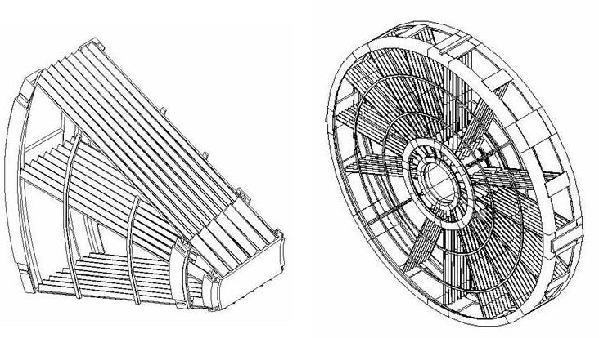
Specifics of the ATLAS geometry
ATLAS geometry description is very complex
  It contains several millions of physical volumes
ATLAS geometry description is very detailed, for example:
  7756 G4Box solids have volume < 1 cm³, of those 472 have volume < 1 mm³
  798 G4Tubs solids have volume < 1 cm³, of those 123 have volume < 1 mm³
There is a custom solid used for navigation inside
EMEC (Electromagnetic End-cup Calorimeter).
Simulation inside EMEC takes >35% of CPU.
ATLAS geometry description is based on GeoModel:
  GeoModel is a library of C++ classes that can be
  used to describe detector geometries
  GeoModel often means also a structure of geometrical primitives that, in principle, can be transferred into the structures of various simulation packages
  To transfer the GeoModel structure into the Geant4 structure a tool Geo2G4 is used

Slide 6
Side effect of some GeoModel features
Issue with TRT mother volume
Fake overlaps

Slide 7
Analysis of ATLAS GDML dump
Geant4 has a number of useful tests which work with GDML files: overlap check, Geantino test, real simulation test
When running those tests with the GDML dump, provided by the ATLAS simulation group, we have faced a couple of unexpected issues:
  Original GDML dump did not loaded:
  PANIC! - Overlapping daughter with mother volume.
  Daughter physical volume TRT
  is entirely outside mother logical volume TRT::TRT !!
  After a manual fix of the GDML file, the overlap check has discovered several rather big, suspicious overlaps

Slide 8
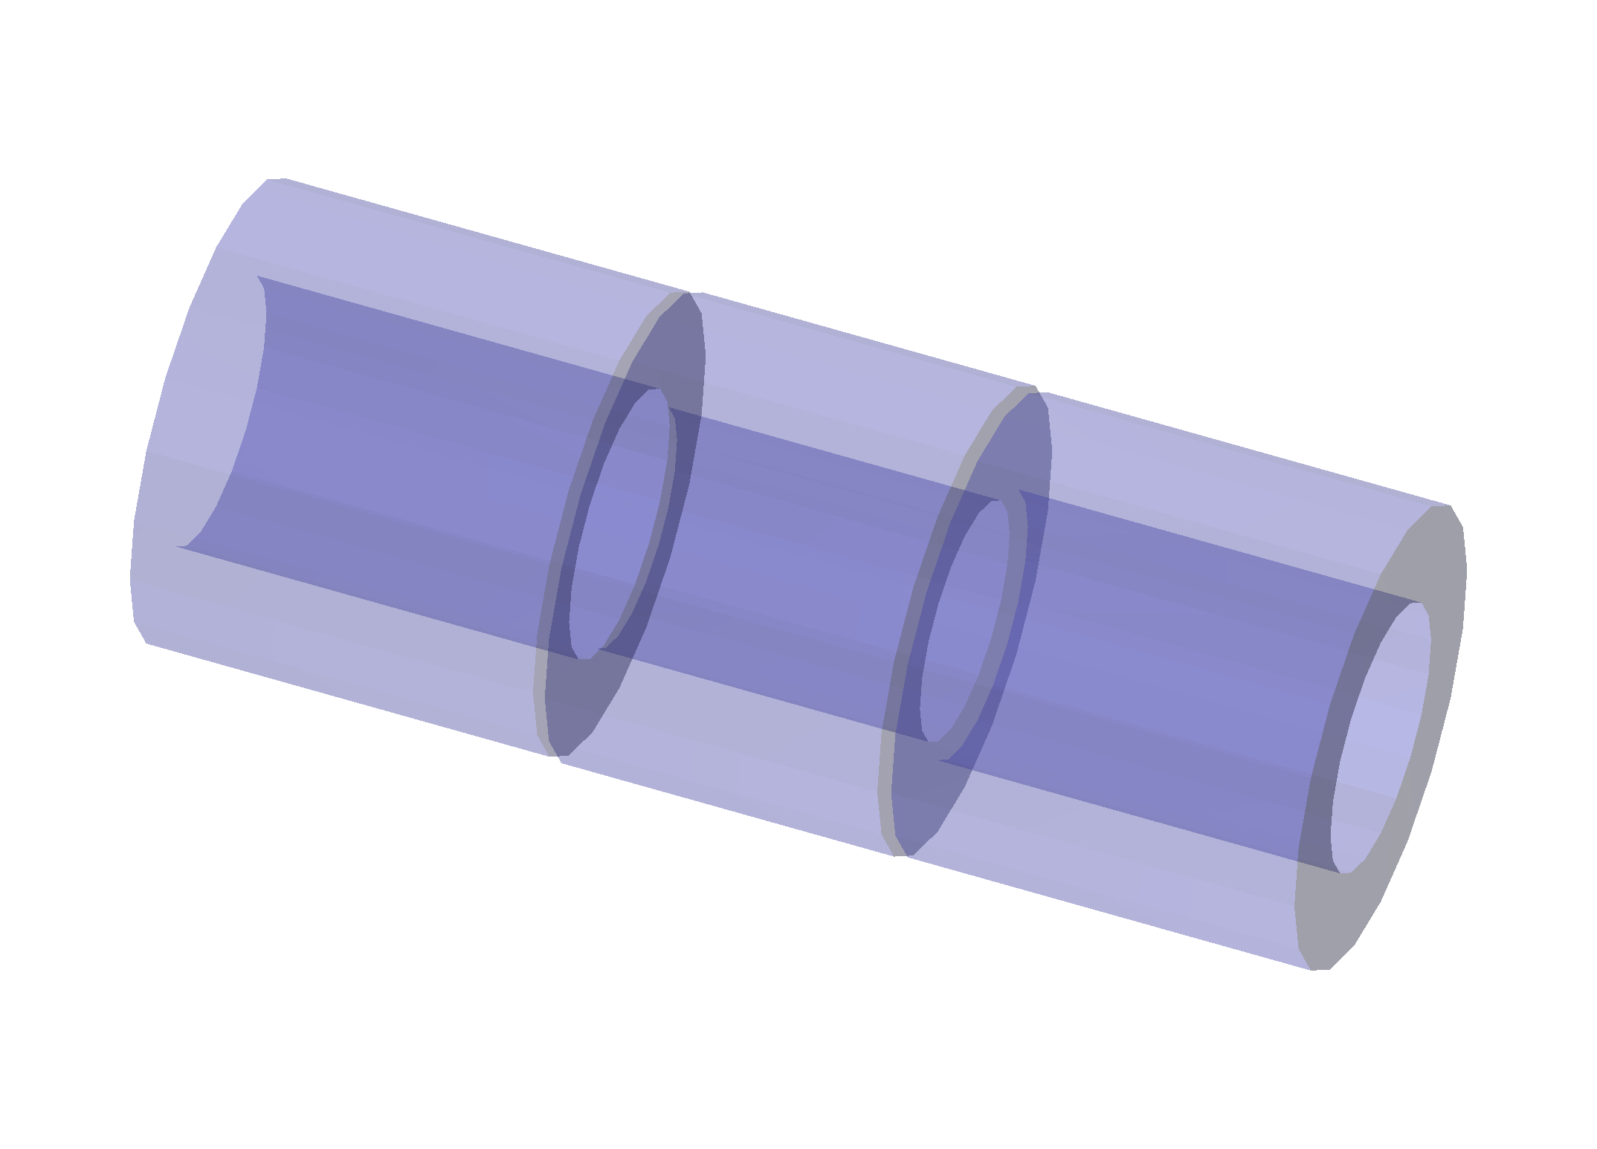
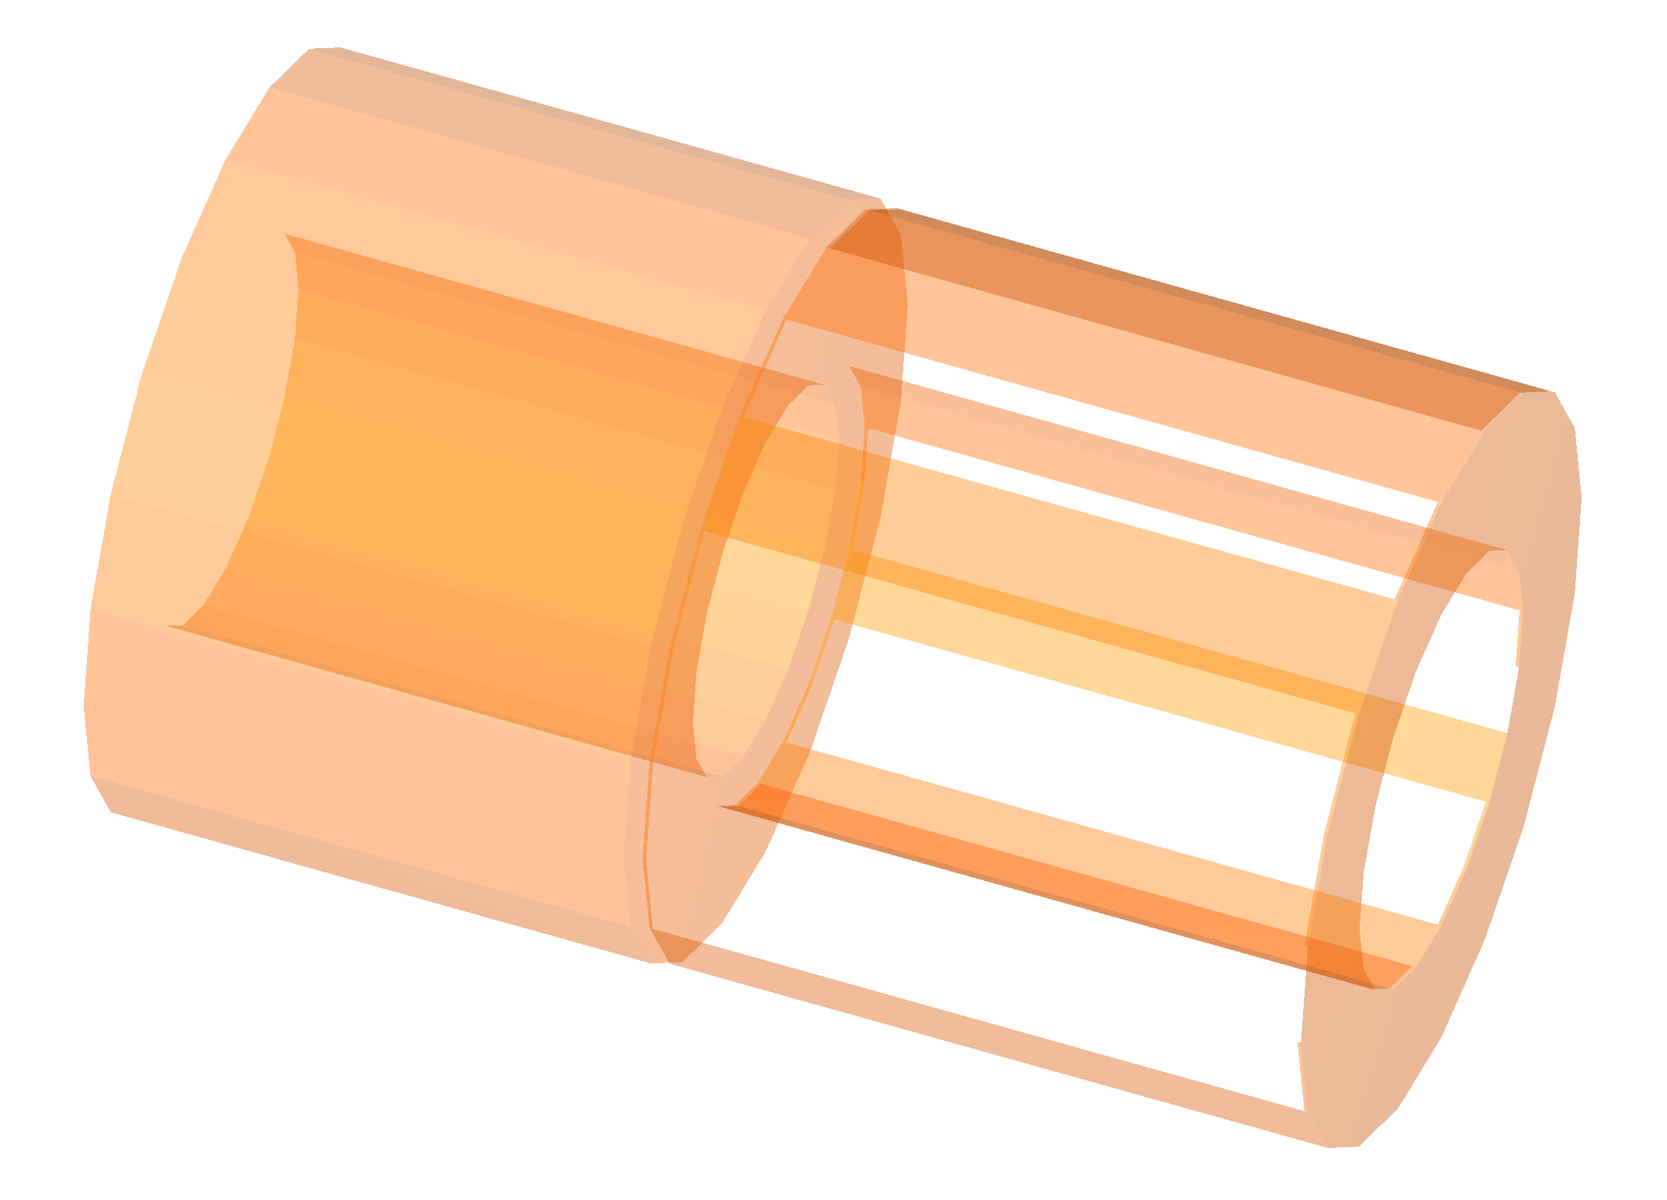
Issue with TRT mother volume in GDML
The mother volume of TRT (Transition Radiation Tracker) is described as a union of its daughter volumes
In the original GDML file both end cups were placed on the same side relative to the central barrel (problems with rendering are caused by that)
A bit of history: the issue with TRT in the GDML dump has been discovered in November 2014. It was considered as a bug in the GDML writer. Indeed, a bug in the GDML writer has been found and fixed. However...
The same issue has been re-discovered three years later, in October 2017 – the bug fixed in 2014 was not the reason of the issue with TRT
Finally, during ATLAS Hackathon in February 2018 the issue with TRT has been understood and fixed

Slide 9
Use of G4DisplacedSolid objects
The reason of the issue with TRT was a construction of a G4DisplacedSolid object from another G4DisplacedSolid object.
Although G4DisplacedSolid is meant to be used as an internal class for Boolean solids, it has all methods required for the navigation and is used in ATLAS/GeoModel as an ordinary solid.
To fix the issue, the constructors of G4DisplacedSolid have been enhanced to handle the case of nested displaced objects.
The modification has also improved the performance of Boolean operations in such a case.

Slide 10
Overlap check
The existence of overlaps in the detector geometry description means that there are some issues in the geometry definition that may lead to incorrect result of the simulation
Geant4 tracking algorithms are quite sensitive to overlaps, which can be the cause of various issues during tracking, for example skipping of material (and eventually sensitive material)
Below is the result of overlap check in the GDML dumps:
  Inner Detector – 1983 overlaps
  Calorimeters – 172 overlaps
  Muon System – 332 overlaps

Slide 11
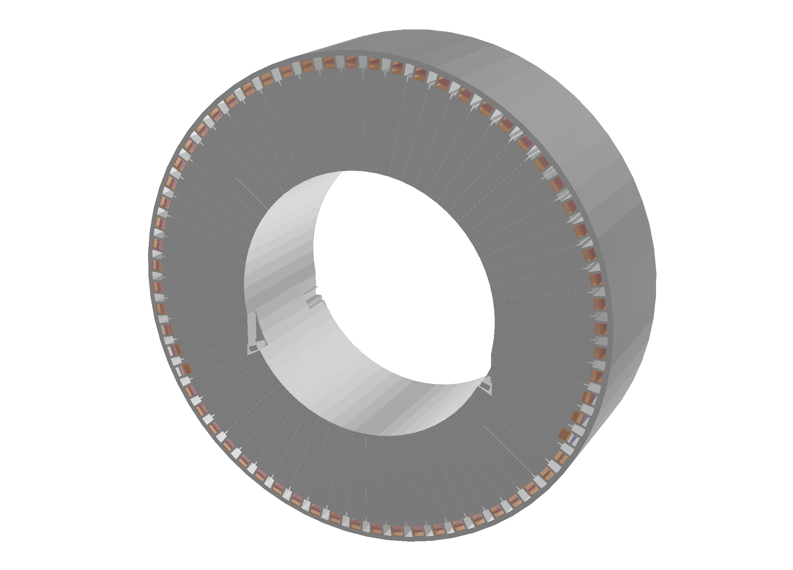
  Propagation of Boolean subtraction to daughter volumes.
  Fake overlaps
A number of fake overlaps (20-40 cm) have been observed in the end cups of the Tile calorimeter
The fake overlaps have appeared as a result of automatic propagation by GeoModel of Boolean subtraction, applied to a sector of the end cup (see the image), to its daughter volumes
If the result of a Boolean operation (subtraction or intersection) is a null object, the Geant4 overlap check may report an overlap. In such a case the warning message on overlap will be preceded by a warning message on a failure to pick up a random point on the surface of the object:
All attempts to generate a point on the surface have failed!
The solid created may be an invalid Boolean construct!
Null objects do not create problems for tracking, however they consume execution time

Slide 12
Statistics of Geant4 solid methods

Slide 13
Distribution of calls by Solids and Methods
Number of calls for simulation of 10 ttbar events, Geant4 10.01.patch03.atlas05
 | Inside x 10⁶ | Normal x 10⁶ | SafetyToIn x 10⁶ | SafetyToOut x 10⁶ | DistanceToIn x 10⁶ | DistanceToOut x 10⁶ | TOTAL x 10⁶
G4Box | 421 | 1 | 19 | 5 | 9 | 4 | 459
G4Trap | 978 | 1 | 111 | 42 | 38 | 23 | 1193
G4Polycone | 336 | 1 | 21 | 120 | 9 | 41 | 528
G4Tubs | 172 | 9 | 168 | 124 | 66 | 46 | 585
G4Trd | 34 |  | 16 | 14 | 6 | 9 | 79
G4Extruded | 3 |  | 3 |  |  |  | 6
G4Union | 1287 | 3 | 23 | 6 | 14 | 22 | 1355
G4Subtraction | 38 |  | 13 | 1 | 2 |  | 54
G4Displaced | 1385 | 1 | 34 | 4 | 19 | 5 | 1448
It took quite a bit of time to understand why there is so many calls to Inside() for G4Union, G4DisplacedSolid, G4Box and G4Trap
The reason was just in three identical Boolean solids that had 42 components

Slide 14
Usage of Boolean solids
Bad practices in usage of Boolean solids
CPU consumption by TMT

Slide 15
Booleans solids in ATLAS geometry
Boolean solids, except G4MultiUnion, do not have internal optimization. The time required for calculations in Boolean solids scales at best with the number of components, often worse than this because of rather complicated logic of the calculations.
Below is a list of Boolean volumes in different parts of the Atlas detector:
  Inner Detector – 465 Boolean volumes
  3 volumes are composed of 42 components
  others are composed of 2 – 11 components
  Tile Calorimeter – 15863 Boolean volumes
  Almost all Boolean solids can be replaced with Extruded Solids
  Muon System – 2869 Boolean volumes
  >170 volumes have 30 - 82 components

Slide 16
Typical “bad practices” in using Boolean solids
Below is a list of typical usage of Boolean solids that can degrade the performance:
Usage of Boolean subtraction to define holes
A better way to define holes is to define them as daughter volumes
Describing a mother volume as a union of its daughter volumes
A better way to group volumes is to use G4AssemblyVolume
Usage of a Boolean solid with complex shape for very low level volume
A better way is to split the solid into simple parts and, if required, group the parts using G4AssemblyVolume
A solid defined for Thermal Management Tile (TMT) is an extreme example of the case 3) – the TMT solid has been constructed as a union of 6 G4Box solids and 36 G4Trap solids

Slide 17
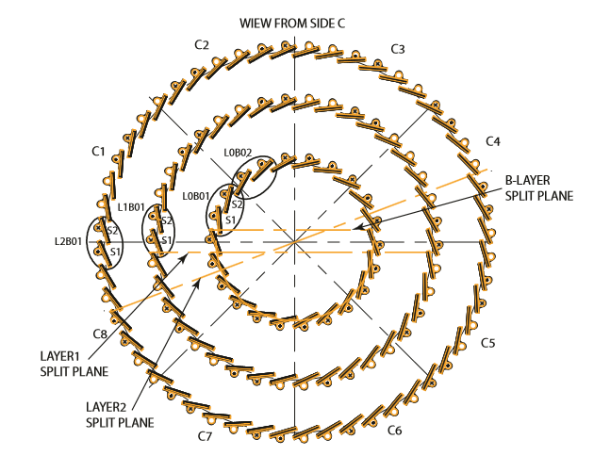
ATLAS Pixel detector – 112 staves
No. of staves: B-layer – 22, Layer 1 – 38, Layer 2 – 52

Slide 18
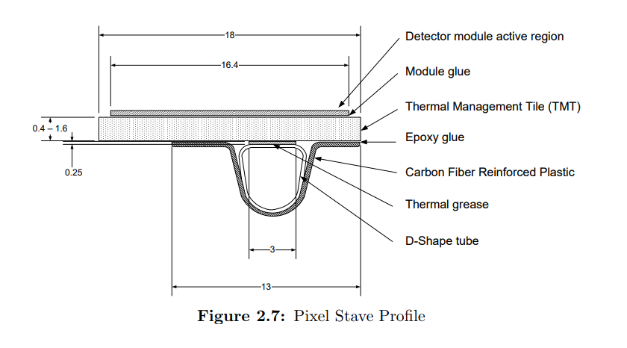
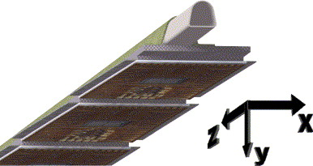
Pixel Stave Profile. Thermal Management Tile

Slide 19
Redefinition of TMT: old vs new
Profile comparison of two geometries:
aibuild027.cern.ch, SLC6, 1.20 GHz
FullG4 simulation, Geant4 10.01.patch03.atlas07, 10 events
Average time per event: 238.0 s vs 232.9 s (~2% less)
 | Inside x 10⁶ | Normal x 10⁶ | SafetyToIn x 10⁶ | SafetyToOut x 10⁶ | DistToIn x 10⁶ | DistToOut x 10⁶
G4Box | 72.9 | 37.6 | 1.3 | 1.2 | 21.2 | 18.6 | 5.1 | 4.9 | 9.8 | 8.7 | 4.6 | 4.2
G4Trap | 124.2 | 58.0_ | 1.0 | 1.0 | 110.3 | 107.3 | 43.4 | 44.2 | 38.0 | 34.2 | 23.6 | 23.0
G4Trd | 32.8 | 30.9 | 0.5 | 0.5 | 18.5 | 17.7 | 15.4 | 15.0 | 7.3 | 7.0 | 10.3 | 10.0
G4Tubs | 150.4 | 146.9 | 9.1 | 8.9 | 165.9 | 162.4 | 122.5 | 121.0 | 65.2 | 64.4 | 45.3 | 44.7
G4Extruded | 3.9 | 3.6 |  | 4.0 | 3.5 | 0.5 | 0.5 | 0.6 | 0.5 | 0.1 | 0.1
G4Polycone | 317.0 | 314.8 | 1.6 | 1.6 | 21.6 | 21.3 | 115.7 | 114.8 | 9.0 | 8.9 | 39.0 | 38.8
G4Union | 1168.7 | 33.9__ | 3.4 | 1.8 | 23.0 | 16.6 | 6.4 | 4.7 | 13.8 | 8.7_ | 22.7 | 3.2_
G4Subtraction | 62.9 | 42.4 | 0.4 | 0.3 | 17.8 | 15.1 | 2.8 | 2.2 | 3.4 | 2.9 | 1.2 | 0.9
G4Displaced | 1171.4 | 73.2__ | 1.4 | 1.3 | 36.4 | 28.5 | 4.7 | 4.8 | 19.9 | 14.1 | 5.3 | 4.0
Total | 3104 | 741_ | 19 | 17 | 419 | 391 | 316 | 312 | 167 | 149 | 152 | 128
 | 4177 vs 1738 (G4Tubs – 548, G4Polycone – 500)

Slide 20
Redefinition of TMT. Summary
Redefinition of TMT has reduced the number of calls to Inside()by several times:
  more than 4 times in comparison Geant4 10.01.patch03.atlas07
  (741 x10⁶ instead of 3104 x10⁶)
  more than 6 times in comparison with Geant4 10.01.patch03.atlas02
  (741 x10⁶ instead of 4700 x10⁶)
Combination of Geant4 10.01.patch03.atlas07 & new TMT may give 5% improvement in the performance of FullATLASG4 simulation
After redefinition of TMT, 60% of calls are to the methods of G4Tubs and G4Polycone (31.5% + 28.8%)

Slide 21
Usage of G4Polycone solids
EMEC Wheels
Beam pipe
World and Muon system volumes

Slide 22
General statistics
After redefinition of TMT the distribution of calls to Geant4 Solids is as follows:
  ~30% to the methods of G4Polycone
  ~30% to the methods of G4Tubs
  ~40% to the methods of other G4 solids
So, it is clear that revision of G4Tubs and, especially, G4Polycone has sense
There are 135 different G4Polycone solids, below is the summary of their usage
EMEC Wheels
Muon System
Beam Pipe
N. of Z-sections | N. of solids | % of calls | % of time | N. of Z-sections | N. of solids | % of calls | % of time
Nz = 2 | 25 solids | 32.6% | 10.1% | Nz = 12 | 4 solids | 2.0% | 6.7%
Nz = 3 | 17 solids | 54.4% | 33.7% | Nz = 17 | 1 solid | 0.1% | 0.5%
Nz = 4 | 31 solids | 2.1% | 1.9% | Nz = 18 | 3 solid | 1.7% | 8.7%
Nz = 5 | 5 solids | 0.4% | 0.5% | Nz = 24 | 1 solid | 0.3% | 2.4%
Nz = 6 | 38 solids | 2.3% | 3.6% | Nz = 26 | 1 solid | 0.7% | 5.3%
Nz = 7 | 4 solids | 0.1% | 0.2% | Nz = 32 | 1 solid | 0.4% | 3.8%
Nz = 10 | 1 solid | 0.3% | 0.7% | Nz = 34 | 2 solids | 0.7% | 7.0%
 |  |  |  | Nz = 38 | 1 solid | 1.3% | 14.9%

Slide 23
Potential optimization
There are three places where relatively simple modifications in the geometry can improve the performance:
EMEC Inner and Outer Wheels (estimated percentage of time is ~40% or
~4% of CPU)
Beam Pipe mother volume (estimated percentage of time is ~15% or
~1.5% of CPU)
World volume + Muon System mother volume (estimated percentage of
time is ~9% or ~0.9% of CPU)
Remark: (% of CPU time) ~= (% of time spent in G4Polycone) / 10

Slide 24
EMEC Inner Wheel
All solids below have exactly the same parameters:
  G4Polycone : Nz=2 Sphi=0º Dphi=360º (can be replaced with G4Cons)
  z, r_{min}, r_{max} = 0, 302.3, 610.4
  z, r_{min}, r_{max} = 514, 344.3, 695.3
FullG4 simulation, 10 events, 500 x10⁶ calls to G4Polycone methods
 | Inside x 10⁶ | Normal x 10⁶ | SafetyToIn x 10⁶ | SafetyToOut x 10⁶ | DistToIn x 10⁶ | DistToOut x 10⁶
LAr::EMEC::Neg::InnerWheel | 4.65 |  | 0.28 | 5.31 | 0.06 | 0.11
::Absorber-BoundingPolycone | 19.69 |  |  | 4.93 |  | 2.59
::Electrode-BoundingPolycone | 14.65 |  |  | 2.32 |  | 1.36
::Glue-BoundingPolycone | 17.35 |  |  | 3.42 |  | 2.57
::Lead-BoundingPolycone | 18.68 |  |  | 7.05 |  | 1.93
Total | 106.5 x10⁶ ( 21% )
LAr::EMEC::Pos::InnerWheel | 2.20 |  | 0.17 | 2.47 | 0.04 | 0.06
::Absorber-BoundingPolycone | 9.33 |  |  | 2.28 |  | 1.25
::Electrode-BoundingPolycone | 6.95 |  |  | 1.08 |  | 0.66
::Glue-BoundingPolycone | 8.26 |  |  | 1.62 |  | 1.24
::Lead-BoundingPolycone | 8.72 |  |  | 3.18 |  | 0.91
Total | 49.5 x10⁶ ( 10% )

Slide 25
EMEC Outer Wheel
All solids below have exactly the same parameters:
  G4Polycone : Nz=3 Sphi=0º Dphi=360º (a union of two hollow cones)
  z, r_{min}, r_{max} = 0, 613.4, 1999.9
  z, r_{min}, r_{max} = 63.2, 623.8, 2034
  z, r_{min}, r_{max} = 514.0, 698.3, 2034
 | Inside x 10⁶ | Normal x 10⁶ | SafetyToIn x 10⁶ | SafetyToOut x 10⁶ | DistToIn x 10⁶ | DistToOut x 10⁶
LAr::EMEC::Neg::OuterWheel | 7.95 |  | 0.27 | 8.99 | 0.04 | 0.10
::Absorber-BoundingPolycone | 35.26 |  |  | 8.67 |  | 4.88
::Electrode-BoundingPolycone | 26.12 |  |  | 4.14 |  | 2.57
::Glue-BoundingPolycone | 31.87 |  |  | 6.24 |  | 4.84
::Lead-BoundingPolycone | 31.15 |  |  | 10.49 |  | 3.33
Total | 186 x10⁶ ( 37% )
LAr::EMEC::Pos::OuterWheel | 2.12 |  | 0.15 | 2.29 | 0.01 | 0.03
::Absorber-BoundingPolycone | 9.65 |  |  | 2.24 |  | 1.42
::Electrode-BoundingPolycone | 7.12 |  |  | 1.08 |  | 0.74
::Glue-BoundingPolycone | 8.94 |  |  | 1.72 |  | 1.41
::Lead-BoundingPolycone | 8.20 |  |  | 2.42 |  | 0.91
Total | 50 x10⁶ (10%)

Slide 26
EMEC Wheels. Summary
EMEC Inner and Outer Wheels take 78% of calls to G4Polycone and approximately 40% of the time spent in G4Polycone
The G4Polycone solids used in the EMEC Wheels are auxiliary objects, they are not used in any logical or physical volumes
Suggestions:
  Replace the G4Polycone solids in EMEC Inner Wheel (Nz=2) with G4Cons
  Consider replacement of the G4Polycone solids in EMEC Outer Wheel (Nz=3) with simpler shapes

Slide 27
Beam pipe
The BeamPipe mother volume is a Boolean union of its daughter volumes. It consists of three parts: one G4Tubs solid (BeamPipeCentral) and two G4Polycone solids (BeamPipeFrw)
BeamPipeFrw & BeamPipeCentral & BeamPipeFrw
BeamPipeFrw has 38 Z-sections (37 tubes), takes 1.3% of calls to G4Polycone and approximately 15% of the time spent in G4Polycone
Suggestions:
  Eliminate the BeamPipe mother volume - BeamPipeCentral and BeamPipeFrw can be included directly to the World volume
  In addition BeamPipeFrw can be simplified

Slide 28
World volume and Muon System mother volume
The structure of the top volumes:
  Atlas –> MUONQ02 –> MuonSys
  –> CALO
  –> IDET
  –> BeamPipe
World volume (Atlas) has 18 Z-sections (17 cylinders) and takes 0.39% of calls to G4Polycone
MUONQ02 has 34 Z-sections (33 tubes) and takes 0.36% of calls to G4Polycone
MuonSys has very similar shape to the shape of MUONQ02 (34 Z-sections) and takes 0.32% of calls to G4Polycone
Atlas + MUONQ02 + MuonSys take approximately 9% of the time spent in G4Polycone
Suggestions:
  Simplify the World volume
  Revise (simplify or, possibly, entirely eliminate) the bounding volume for Muon system

Slide 29
CPU consumption by Geometry & Navigator

Slide 30
Profile of Geantino test
Comparison of the CPU time spent by the Geantino test and the CPU time of real simulation has allowed to estimate CPU consumption by the Geometry & Navigation code.
Below is distribution of calls by Solids and Methods for the Geatino test run on the GDML dump, where 112 physical volumes with TMT have been removed
MacBook Pro, Intel Core i5, 2.7 GHz
100k events, No. of steps: 159.739.590, CPU time: 186 s
 | Inside x 10⁶ | Normal x 10⁶ | SafetyToIn x 10⁶ | SafetyToOut x 10⁶ | DistToIn x 10⁶ | DistToOut x 10⁶
G4Box | 236 | 4 | 38 | 15 | 34 | 21
G4Trap | 30 |  | 28 | 25 | 25 | 25
G4Trd | 264 | 2 | 54 | 62 | 50 | 65
G4Tubs | 640 | 0.6 | 84 | 44 | 76 | 41
G4Extruded | 17 | 0.6 | 2 | 1 | 2 | 1
G4Polycone | 28 | 0.3 | 5 | 13 | 5 | 6
G4Union | 164 | 7 | 23 | 19 | 21 | 21
G4Subtraction | 656 | 6 | 15 | 26 | 13 | 25
G4Displaced | 865 | 4 | 54 | 8 | 52 | 15
Total | 2900 | 25 | 303 | 213 | 278 | 220
 |  | All – 1039 (G4Tubs – 246, G4Polycone – 29)

Slide 31
Profile of real simulation
aibuild027.cern.ch, SLC6, 1.20 GHz
Simulation of 10 ttbar events, Geant4 10.01.patch03.atlas07 (currently under verification)
No. of steps: unknown, CPU time: ~250 s / event (>35% in EMEC)
 | Inside x 10⁶ | Normal x 10⁶ | SafetyToIn x 10⁶ | SafetyToOut x 10⁶ | DistToIn x 10⁶ | DistToOut x 10⁶
G4Box | 38 | 1 | 19 | 5 | 9 | 4
G4Trap | 101 | 1 | 111 | 42 | 38 | 23
G4Trd | 29 |  | 16 | 14 | 6 | 9
G4Tubs | 146 | 9 | 168 | 124 | 66 | 46
G4Extruded | 2 |  | 3
G4Polycone | 332 | 1 | 21 | 120 | 9 | 41
G4Union | 1162 | 3 | 23 | 6 | 14 | 22
G4Subtraction | 35 |  | 13 | 1 | 2
G4Displaced | 1149 | 1 | 34 | 4 | 19 | 5
Total | 2994 | 16 | 408 | 316 | 163 | 150
 |  | All – 1053 (G4Tubs – 413, G4Polycone – 192)

Slide 32
CPU consumption by Solids & Navigator
Quantitative characteristics of two tests are very similar:
  Number of calls to Inside(): 2994 vs 2900 (x10⁶)
  Number of calls to other functions: 1053 vs 1039 (x10⁶)
So, the execution time of the Geantino test can be used as a good estimation of the CPU time consumed by Geant4 Solids & Navigator in real simulation:
  Conversion factor between the platforms: 2.70 GHz / 1.20 GHz = 2.25
  Estimation of the execution time of the Geantino test on aibuild027.cern.ch: 186 * 2.25 >= 420 s
  CPU time that would be consumed by Geant4 Solids & Navigator in one event: 420 / 10 >= 42 s
  Estimated percentage: 42 / 250 >= 17%
  Estimated percentage if to exclude the time spent in EMEC (>35%): 42 / (250 * 0.65) >= 26%
Taking into account that in real simulation there were more calls to G4Tubs and G4Polycone,
413 vs 246 (x10⁶) and 192 vs 29 (x10⁶) respectively, it will be correct to say that the percentage of
CPU time consumed by Geant4 Solids & Navigator varies between 20% and 30%

Slide 33
Miscellaneous
Resolution of G4Exception messages
Enhancement of G4AffineTransform
Optimizations in navigation code

Slide 34
Resolution of G4Exception warnings
There were 72 G4Exeption messages during simulation of 500 events with
current production version Geant4 10.01.patch03.atlas02:
  63 messages - Track stuck or not moving.
  8 messages - Proposed step is zero; hstep = 0 !
  1 message - Expected normal-global-frame to be valid, i.e. a unit vector!
All G4Exeption messages have disappeared in Geant4 10.01.patch03.atlas07 which at present time is under verification
  The disappearance of Track stuck or not moving is explained by the revision of G4Trd (code taken from Gean4 10.04)
  The disappearance of Proposed step is zero is explained by the bug fix in the calculation of the normal at the endpoint of current step in G4Navigator::GetLocalExitNormal() (code taken from Gean4 10.04.p02)
  It looks that the message on invalid normal was due to calculation errors. It has disappeared after last modifications in G4DisplacedSolid (Gean4 10.04.p02)

Slide 35
Enhancement of G4AffineTransform (1)
G4AffineTransform is a class that is used to define the position of solids and to make transformation of points and vectors
It is implemented as a 4x3 transformation matrix – a 3x3 rotation matrix and
a 3-vector shift
All methods are inlined
The methods that are used at navigation:
  Inverse()– it returns the inverse transformation matrix
  Invert()– it inverts the transformation matrix
  InvertProduct(t1,t2)– it calculates t1*(t2⁻¹)
  TransformPoint(p)– it transforms a point
  TransformAxis(v)– it transforms a vector

Slide 36
Enhancement of G4AffineTransform (2)
G4AffineTransform::InvertProduct(t1,t2) has been optimized:
  now it does 36 multiplications instead of 45 as before
  A specialization for the case where t2 is a pure translation has been added. In such a case the computation of the product is very light:
  3 subtractions, 12 assignments, no multiplications
Four new methods have been added:
  InverseTransformPoint(p)– it makes inverse transformation of a point
  InverseTransformAxis(v)– it makes inverse transformation of a vector
  InverseNetRotation()– it returns inverse rotation matrix
  InverseNetTranslation()– it returns the shift vector of the inverse transformation

Slide 37
Optimizations in the navigation code
Inverse transformation of points and vectors does not require addition computations in comparison with direct transformation:
  G4ThreeVector G4AffineTransform::TransformPoint(const G4ThreeVector& vec) const
  {
  G4double vecx = vec.x(), vecy = vec.y(), vecz = vec.z();
  return G4ThreeVector( vecx*rxx + vecy*ryx + vecz*rzx + tx,
  vecx*rxy + vecy*ryy + vecz*rzy + ty,
  vecx*rxz + vecy*ryz + vecz*rzz + tz );
  }
  G4ThreeVector G4AffineTransform::InverseTransformPoint(const G4ThreeVector& vec) const
  {
  G4double vecx = vec.x() - tx, vecy = vec.y() - ty, vecz = vec.z() - tz;
  return G4ThreeVector( vecx*rxx + vecy*rxy + vecz*rxz,
  vecx*ryx + vecy*ryy + vecz*ryz,
  vecx*rzx + vecy*rzy + vecz*rzz );
  }
New methods in G4AffineTransform allowed to eliminate Calculation/Instantiation of the inverse transformation in several navigation classes, for example:
G4ThreeVector md = Td.Inverse().TransformPoint(mp);
has been replaced with:
G4ThreeVector md = Td.InverseTransformPoint(mp);

Slide 38
Summary

Slide 39
A detailed quantitative statistics on the use of Geant4 in ATLAS has been gathered. Jira tickets dedicated to specific findings can been found at the Epic collection ATLASSIM-3678 Improve the description of ATLAS in Geant4.
In particular:
  ATLASSIM-3556 Overlaps detected in MC16 geometry when running in standalone Geant4
  ATLASSIM-3557 Optimizing Boolean solid use in ATLAS G4 geometry
  ATLASSIM-3680 Revision of TMT
  ATLASSIM-3778 Optimizing G4Polycone usage in ATLAS G4 geometry
  ATLASSIM-3761 Performance comparison of four geant4 patches
A number of improvements have been done in Geant4, namely in G4Box, G4DisplacedSolid, G4UnionSolid, G4AffineTransform and navigation code (10.01.patch03.atlas07).
The improvements will be included in Geant4 10.05
The issue with the description of the TRT mother volume in GDML has been fixed
The G4Exception warnings observed during simulation of 500 events have disappeared
The combination of Geant4 10.01.patch03.atlas07 & optimization of TMT has shown
5% speed-up in the performance for FullATLASG4 simulation and 11% speed-up for ATLFASTII
Further improvement of the performance can be achieved by optimizing G4Polycone usage in the ATLAS geometry and revising G4Polycone code in Geant4

Slide 40
Thank you!

