Slide 1
Blockchain
Swiss Opportunities
Notes:
Oak V-entures

Slide 2


Oak V
We build and develop companies from the most advanced technologies to sustainably improve the world.
We scout opportunities → design businesses → execute ventures

Slide 3
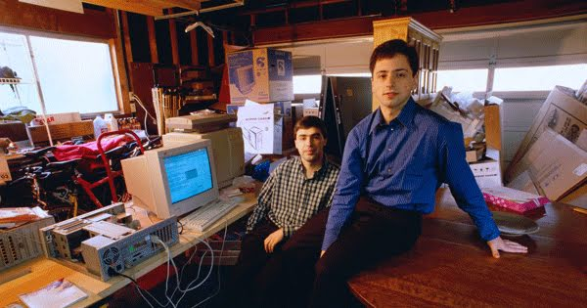
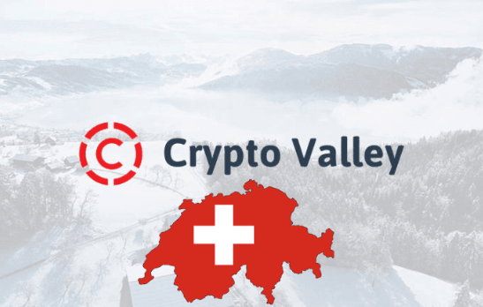
Why are we here today?
Notes:
Larry Page and Sergey Brin

Slide 4
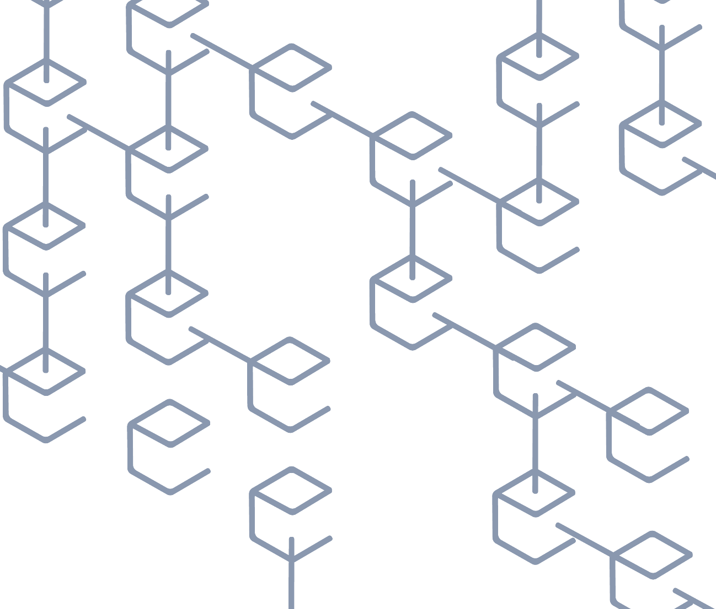

What is Blockchain?
Blockchain is a system of incentives and transaction architecture that allows the decentralized gathering, verification and record of transactions on a distributed ledger
Blockchain is a digitized, distributed ledger that immutably records and shares information
The Information stored in decentralized, secured ledger system, creates a “chain” of chronological data that no one party can control or alter
The value of Blockchain lies in the system’s ability to authenticate and track transactions in real time without the need of a third party
This is done through “mining”: multiple players generate, validate and add to the block chain a block of transactions, generally in exchange for further currency
Notes:
Blockchain is the best known distributed ledger technology. A ledger is a database which keeps a final and definitive record of transactions. Records, once stored, cannot be tampered without leaving behind a clear track. Blockchain enables a ledger to be held in a network across a series of nodes, which avoids one centralised location and the need for intermediaries’ services. This is particularly helpful for providing trust, traceability and security in systems that exchange data or assets. There is a lot of potential for blockchain to be used in many different areas such as financial services, supply chains or healthcare.

Slide 5
Why is Blockchain relevant?
Robust
Difficult to tamper
Decentralized
Public transactions / Private members
Portability of crypto currency

Slide 6
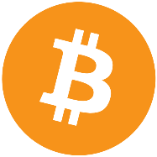
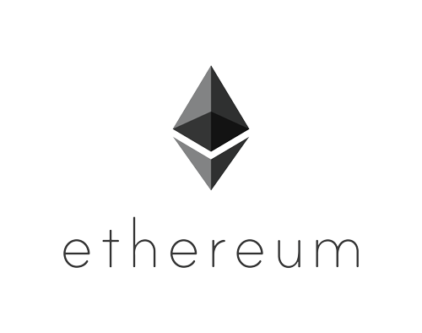
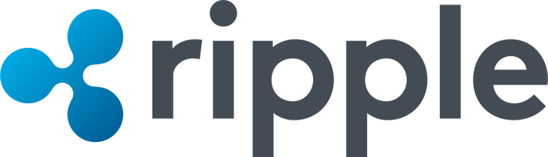
What is a crypto currency?
Cryptocurrencies are designed to work as a medium of exchange that uses cryptography to secure its transactions, control the creation of additional units, and to verify the transfer of assets through a blockchain. Here are the 3 main players:
Most popular coin started in 2009, Mkt Cap 150 $bn, not fully programmable
Scalability might be an issue due to “proof of work” mining
High energy consumption, long time to validate transactions, high transaction fee
Second most popular coin started in 2014, Mkt Cap 72 $bn,
Can write “smart contracts” with Solidity language,
“Ether” intended as “Fuel” for decentralized companies and apps, used for main ICOs
XRP is the third most popular coin started in 2012, Mkt Cap 29 $bn,
Fast transaction time (3-5 seconds), XRP intended as “bridge” between fiat currencies
Ripple Payment system getting tested by corporate partners (e.g. Amex)
Ripple is centralized, XRP currency not instrumental for Ripple Payment system
Notes:
What we do is relatively simple: we want to tap into underdeveloped technical resources….

Slide 7
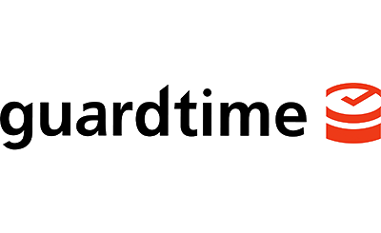
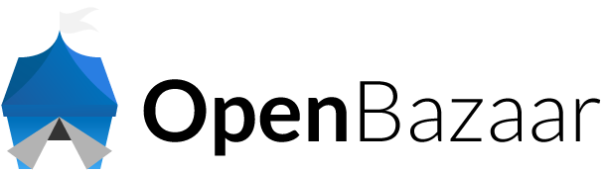
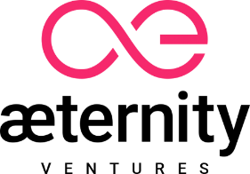

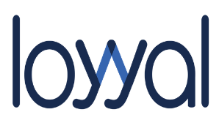
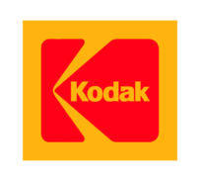
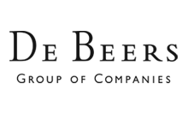
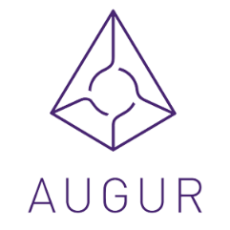
Block Chain is not only crypto currencies
Verified digital signatures used to secure the health records of one million Estonian citizens
Online retailer with no fees
Marine insurance
Supply chain Auditing
Smart contracts activated when network consensus agrees conditions have been met
Loyalty point management
Property rights management for pictures
Transparent/ Ethical supply chain
Crowdsorced forecasting
Automated payouts based on trigger event
Notes:
https://www.forbes.com/sites/bernardmarr/2018/01/22/35-amazing-real-world-examples-of-how-blockchain-is-changing-our-world/3/#115f28a92e6b

Slide 8
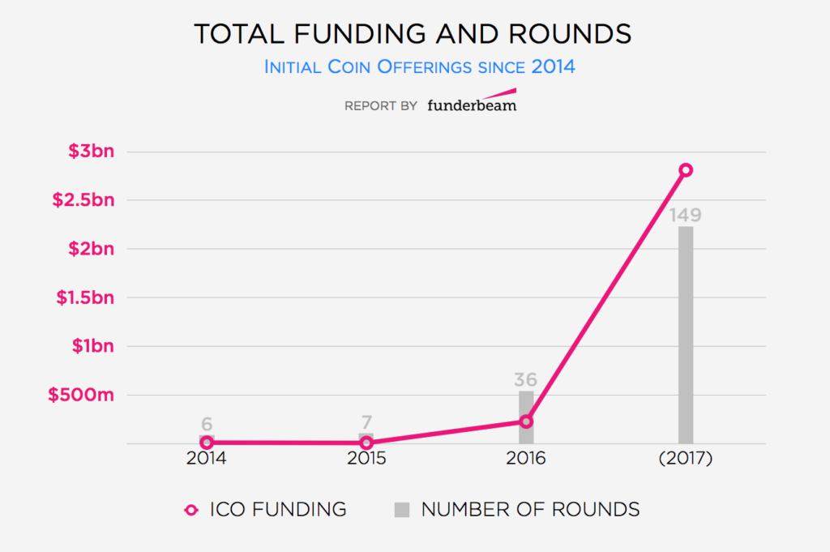
Blockchain is growing fast
ICO (blockchain) funding started gaining traction in 2016 and exploded in 2017 - funding increased from US$228 million to US$2.8 billion
The number of rounds has quadrupled and nearly reached 150 in 2017.

Slide 9
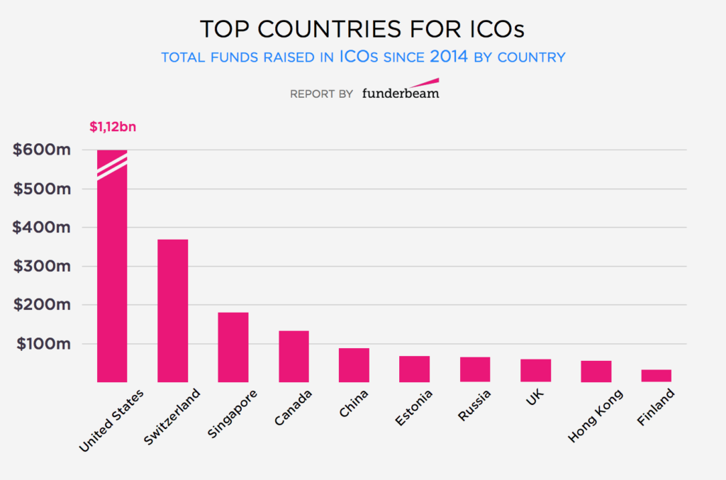
Switzerland is the European leader
North America has the most funding out of all regions
However, Switzerland represents 58% of the Europe total funding raised with about US$370 million through 13 campaigns.

Slide 10
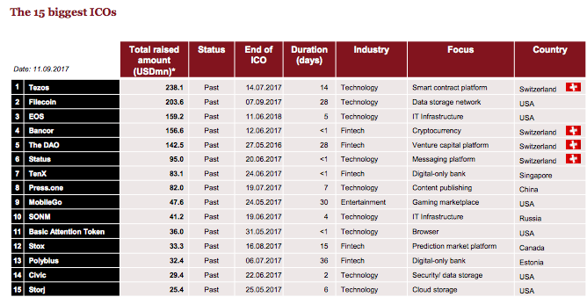
Switzerland is the global crypto leader
Switzerland hosted some of the world’s largest ICOs:
  Tezos, over US$238 million,
  Bancor, with US$156 million,
  The DAO, US$142 million,
  Status, US$95 million.
In December 2017, Switzerland-based Singularity Net ICO raised US$36 million in just over one minute, making it the fastest ICO campaign ever.

Slide 11
Why Switzerland?
«The liberal regulatory system was decisive for settling our
business in Zug.»
Vitalik Buterin, Founder of Ethereum
«One of Zug’s attractions is the exceptional level of expertise available in the
areas of cryptography and security.»
Johann Gevers, Founder and CEO of Monetas
«Switzerland provides all the benefits of a modern society including a highly educated population, a fiscally responsible government and a well-maintained physical and technological infrastructure.»
XAPO LLC

Slide 12
Swiss favorable regulation
Swiss Financial Market Supervisory Authority (FINMA) is fully focused on blockchain and cryptocurrencies.
FINMA categorizes tokens into three types based on the economic function and purpose:
  Payment tokens: These are intended to be used as a means of payment for acquiring good or services or as a means of money or value transfer.
  Utility tokens: These provide access digitally to an application or service by means of a blockchain-based infrastructure at the point of issue.
  Asset tokens: These represent assets such as debt, equity or other claim on the issuer, whether that’s a share in future company earnings or capital flows. Asset tokens are analogous to equities, bonds or derivatives, and are regarded as securities.
Most recently, a blockchain taskforce composed by Finance Minister Ueli Maurer and Economics and Education Minister Johann Schneider-Ammann, together with both federal and local officials, as well as members of various blockchain startups and legal representatives, is investigating on how to regulate the sector. It will report back to the government by the end of 2018.

Slide 13
Ecosystem: Switzerland’s “Crypto Valley”
Notes:
What we do is relatively simple: we want to tap into underdeveloped technical resources….

Slide 14
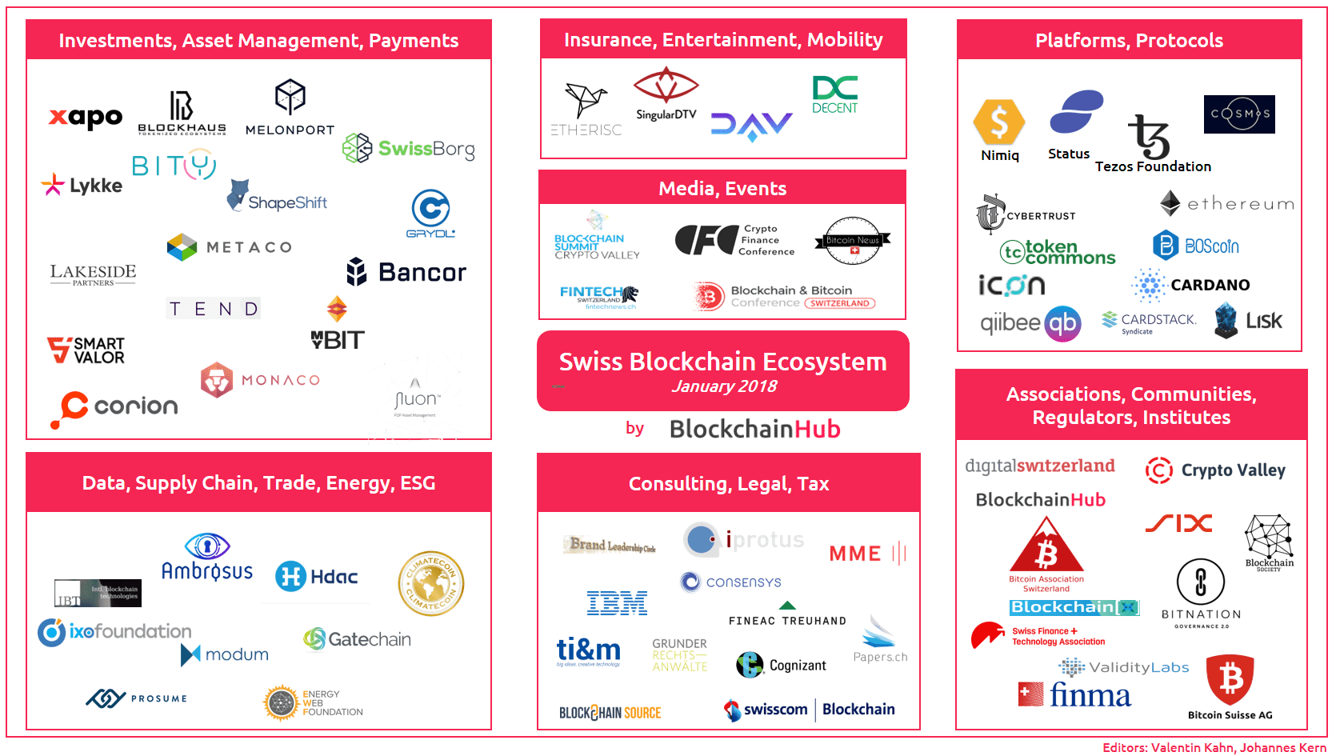

Slide 15
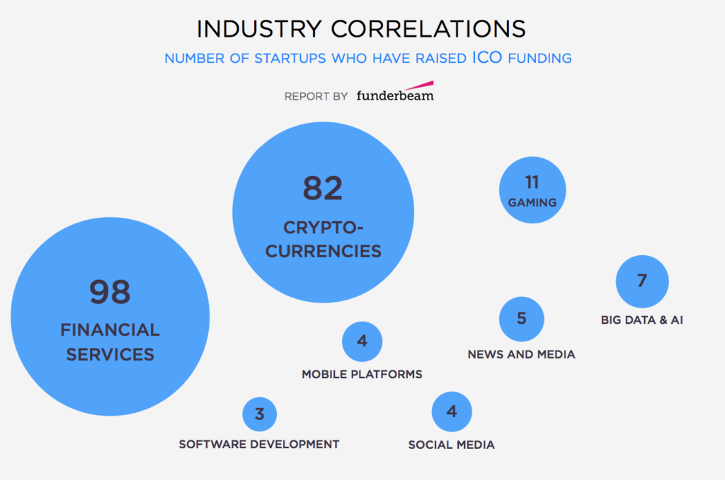
Key blockchain sectors
Financial services and cryptocurrencies is the big place to play
Gaming, Big Data and artificial intelligence are growing fast
There is plenty of space for opportunities

Slide 16



What about Geneva?
Oak V

Slide 17
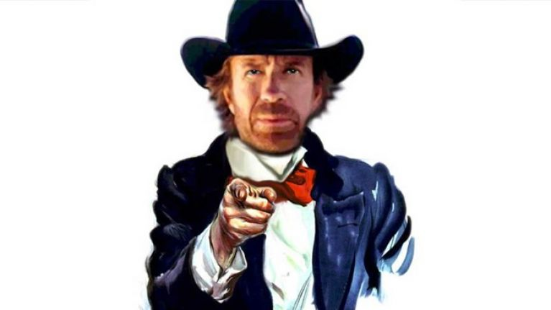
Oak V opportunities
Apply blockchain solutions to existing problems in the banking world
Democratize global money transferring
Any other idea you might want to develop

Slide 18
Thank you
www.oak-v.com
francesco@oak-v.com

