Slide 2

Michal Simon
Client side implementation of secure xroot/root protocol
12/06/2019
Michal Simon

Slide 3
Outline
Secure root/xroot protocol
Client enforced encryption
Server enforced encryption
Implementation
12/06/2019
Michal Simon

Slide 4
Secure xroot/root protocol
Secure xroot/root protocol using TLS for encryption
Prerequisite for
  token based authentication/authorization
  further evolution of TPC mechanism
  transferring confidential data with xroot/root protocol
12/06/2019
Michal Simon

Slide 5
Highlights
Based on OpenSSL
  For performance reasons OpenSSL asynchronous API has been employed
Uses same port for encrypted and unencrypted traffic to simplify service operations
Level of encryption can be enforced by server (potential replacement for request signing)
12/06/2019
Michal Simon

Slide 6
Client enforced encryption
By choosing roots/xroots protocol, the user enforces encryption
The client notifies server by setting kXR_wantTLS flag in kXR_protocol request
12/06/2019
Michal Simon

Slide 7
Server enforced encryption
Server may force the client to convert to TLS by setting kXR_gotoTLS flag in kXR_protocol response
Server may ask the client to:
  kXR_tlsLogin: to convert to TLS right away
  kXR_tlsSess: to convert to TLS after logging in
  kXR_tlsData: to encrypt read and write requests
  kXR_tlsTPC: to encrypt requests issued due to TPC
12/06/2019
Michal Simon

Slide 8
Expected
The server knows in which cases to convert to TLS (e.g. kXR_tlsData), but doesn’t know what will happen after kXR_protocol
The client knows what will follow (e.g. kXR_bind), but doesn’t know the configuration of the server
To avoid additional RTTs, the client has to let the server now in advance what is the next request to come (e.g. kXR_ExpBind + kXR_tlsData = upgrade to TLS)
12/06/2019
Michal Simon

Slide 9
Encrypt only control stream
The server might instruct the client to encrypt only the control stream (0) but not the data (reads and writes)
Useful for the HEP use case
In this case client has to open and bind a second unencrypted connection right away after the main encrypted connection has been established
12/06/2019
Michal Simon

Slide 10
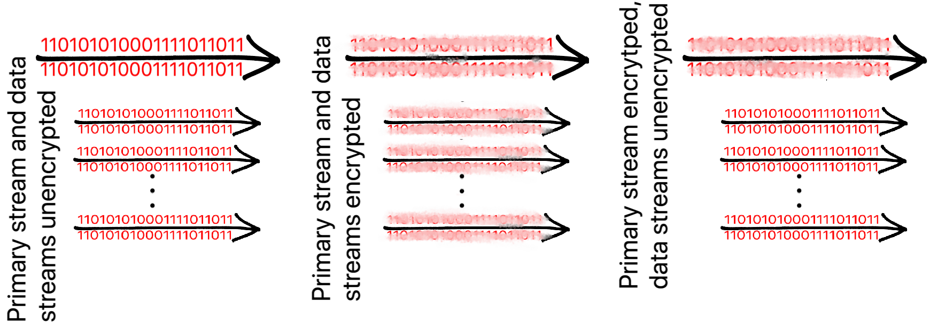
Encrypted / unencrypted / ctrl encrypted only
12/06/2019
Michal Simon

Slide 11
TLS upgradable connection
Every connection by default is unencrypted
During kXR_protocol request/response exchange it is decided if the connection should be encrypted
Hence, the connection abstraction (socket, socket handler) is upgradable to TLS
This design allows XRootD to use same port for unencrypted and encrypted traffic
12/06/2019
Michal Simon

Slide 12
Implementation
For performance reasons we have chosen to use:
  OpenSSL asynchronous API with an event loop
  OpenSSL socket BIO (avoids unnecessary in-memory copies of data)
12/06/2019
Michal Simon

Slide 13
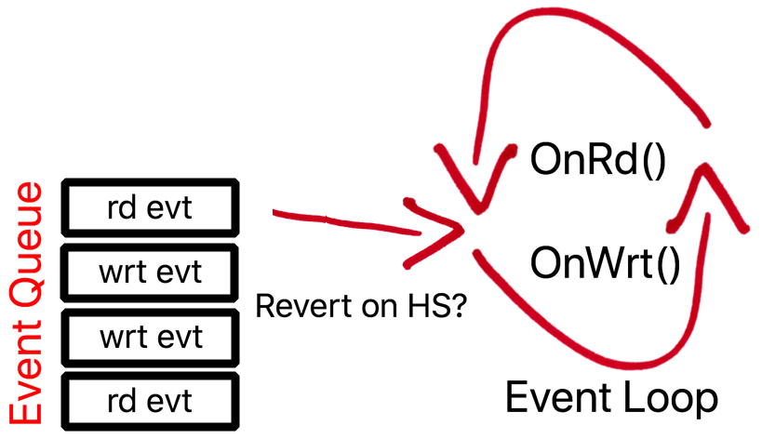
Implementation
Since server may decide to redo TLS handshake at any time any SSL_read might require a write event and vice versa SSL_write might require a read event
In this case we have to revert the event loop and call read callbacks on write events and write callbacks on read events
12/06/2019
Michal Simon

Slide 14
Questions?
12/06/2019
Michal Simon

