Slide 1
Evaluation of the Presto Query Engine for integrating relational databases with big data platforms at scale
Lightning Talk
Andrew Waldman
14/08/2018

Slide 2

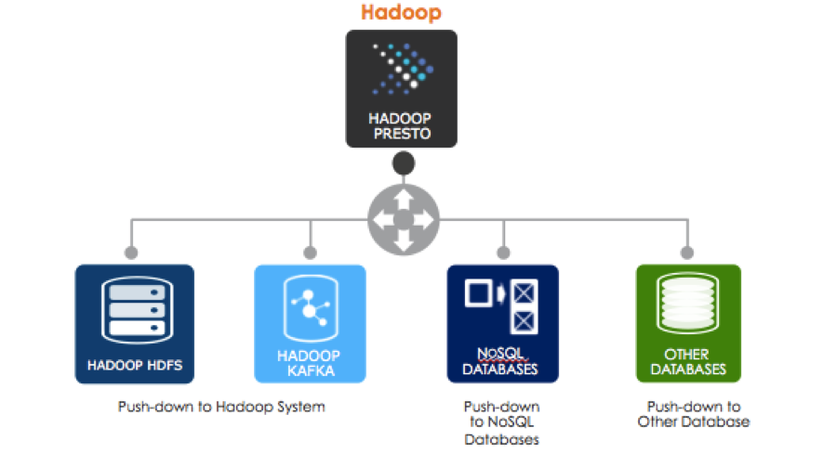
WHAT IS PRESTO?
A distributed SQL query engine
  - Typically run on top of a Hadoop cluster
  - Open source
  - Already well established in the cloud sector
SQL-on-Anything
  - HDFS (Parquet, Avro etc.), S3
  - Relational DBS (Oracle, MySQL, PostgreSQL, SQLServer…)
  - NoSQL (Cassandra, Kudu)
  - Apache Kafka and more
  (data sources are pluggable)
  - Local File System
  You can Query different data sources from one query!!!

Slide 3

Objectives of the Project
Is it worth adding to the current Hadoop service portfolio?
Get Presto running
(installation and configuration)
Performance comparison on different data sets
(with current frameworks)
Evaluation of native and open source connectors
Usability of PaaS
(Presto as a Service)

Slide 4
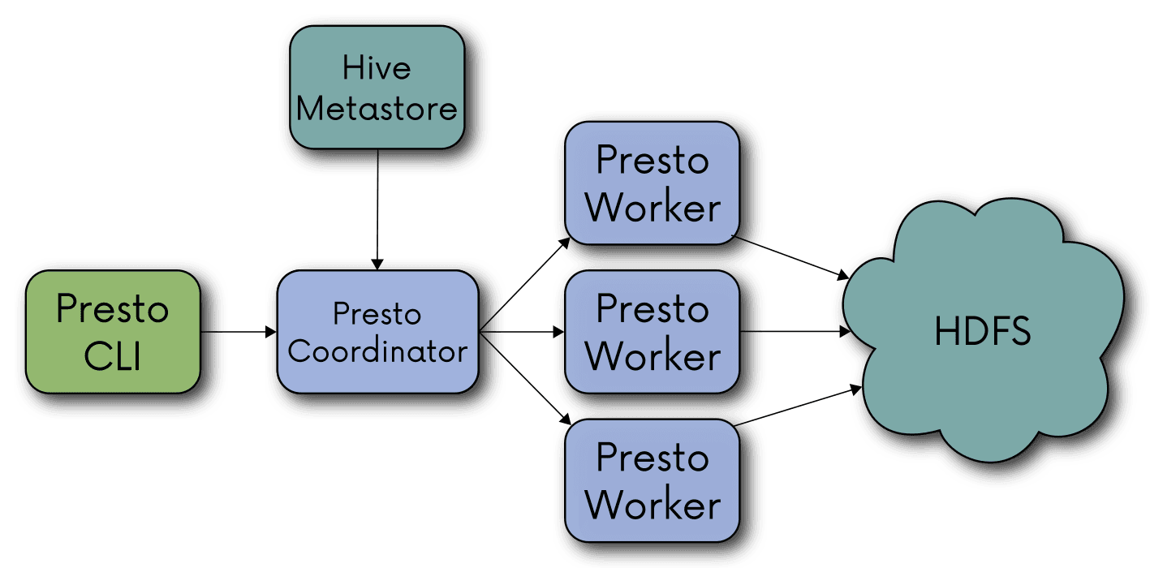
Control System Dataset Tests (WinCC*)
Begin evaluating Presto
  Using Hive connector to connect to Hive metastore
  Run 5 different types of queries varying in complexity
  Using numerous sets of different resource configurations
4 configurations
  Single core, CPU and Thread
  4 Machines, single CPU and single Thread
  8 Machines, single CPU and single Thread
  8 Machines, all CPU and Multi Threading
with daily as (select day,stddev(value_number) dev,element_id from psen.eventhistory_00000008 group by day,element_id) select element_id,stddev(dev) from daily group by element_id having stddev(dev)>100000 order by 2;
*Time is x/100 after decimal not seconds
*CERN production data set

Slide 5
TPC-DS Test Set 2
100GB (Presto, Impala, Spark)
Same set of queries as for the previous test set
Automated result collection
Ran on the Hadalytic cluster
*Time is x/100 after decimal not seconds

Slide 6

Connectors and Catalogs
A connector is software to make a connection between Presto and endpoint
A catalog is an instance of a connector (a configured connector to access particular endpoint).
Connector
Catalog

Slide 7
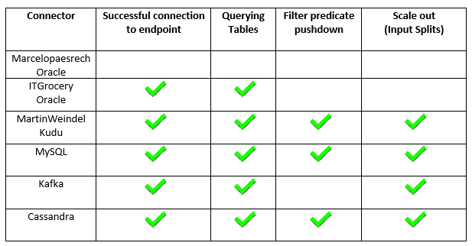
Summary of Connector Testing
Native connectors where very easy to configure and get working
The Native connectors could perform aggregations and predicate queries with no problems
The open source connectors where less consistent in working than the Native ones. With the Oracle open source connectors not working and so preventing full evaluation

Slide 8

Conclusion
The presto query engine when running against TPC-DS benchmark data and WinCC data, performance was slightly behind the current framework, Impala
However, when it comes to compatibility and being able to connect to multiple data sources and query data even at once
Presto is more future-proof.
Also eases building of hybrid systems
(OLTP + archive)
This leads to the conclusion that it would be worth considering as an additional framework to be added to production alongside Spark and Impala

Slide 9
QUESTIONS?
Andrew.waldman@cern.ch

Slide 10

CONTACTS
ANDREW WALDMAN
CERN openlab Student
andrew.waldman@cern.ch
ZBIGNIEW BARANOWSKI
CERN openlab Supervisor
zbigniew.baranowski@cern.ch
ALBERTO DI MEGLIO
CERN openlab Head
alberto.di.meglio@cern.ch
ANDREW PURCELL
CERN openlab Communications Officer
andrew.purcell@cern.ch
EMIL KLESZCZ
CERN IT-DB emil.kleszcz@cern.ch
KRISTINA GUNNE
CERN openlab Administration/Finance Officer
kristina.gunne@cern.ch
www.cern.ch/openlab

