Slide 1
POSEIDON
Analyzing the secrets of the Trident Node Monitoring Tool
Supervisors: David Smith, Servesh Muralidharan
Leonardo Kuffo – Escuela Superior Politecnica del Litoral (ESPOL, Ecuador)
IT – DI – WLCG: Understanding Performance
15/08/2018
Notes:
10 s

Slide 2
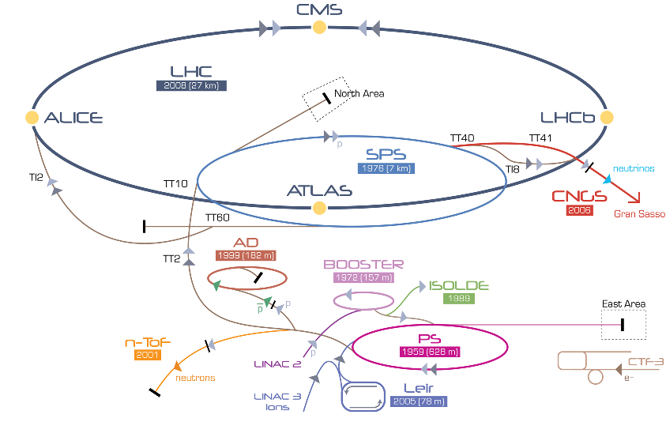


Notes:
10 seg

Slide 3


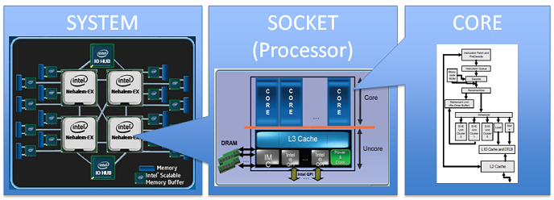
Does it do the correct things?
How good is it?
Efficiency / Good Style
Memory Usage / CPU utilization
Intel® Performance Counter Monitor - A better way to measure CPU utilization
By Thomas Willhalm (Intel), Roman Dementiev (Intel), Patrick Fay (Intel)
Notes:
20 seg
Sometimes if we want to improve performance… (back to bullet 1)

Slide 4

Trident
Monitoring and Load characterization tool
Trident monitors the relevant hardware and software counters throughout the excecution of an application at the node level, such that it does not induce significant overhead.
Not limited only to monitor CPU Usage or Memory utilization
Currently collecting metrics sush as: Memory bandwidth, core utilization, active processor cycles, etc.
Notes:
(20s)
That’s why the IT department at cern developed a novel tool called Trident. Which is a monitoring and load characterization tool. This tool is focused only in…… And that’s why the use of this tool do not induce significant overhead….. It is also not limited…. And it is currently collecting …….

Slide 5


+ TRIDENT
Is my application performing well?
Counters Data
Notes:
(10s)
Now… getting back to our code. If we as a programmer want to know what is happening at a low level, we could use trident to see all of these interesting metrics that happens in the processors when we are executing our applications. The problem is that, this kind of data, sometimes is too complex to understand for programmers which are not experts in the computing architecture field. And therefore, no useful information can be obtained from Trident. That’s when Poseidon takes place…

Slide 6

POSEIDON
(I hope you get why Poseidon… because I just got it yesterday)
Notes:
(5s)
So… who is gonna help us use the Trident??

Slide 7

POSEIDON
Transforming Trident Data into Knowledge
← Guy who must improve applications performance…
Objective
Provide understandable feedback to physicist and programmers in how their applications performs under different workloads.
Importance
If we understand what is happening, we can improve.
Notes:
(20s)

Slide 8
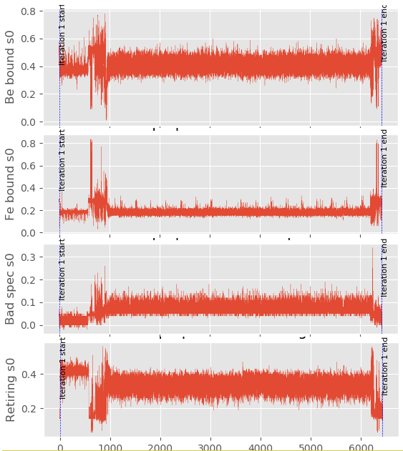
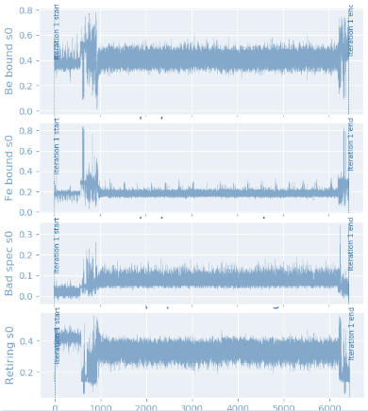
HOW POSEIDON WORKS
Trident Metrics of an application
Trident Metrics of Benchmarks
WE KNOW YOU! (maybe)
WE KNOW THEM!
Match
Notes:
(30 s)

Slide 9
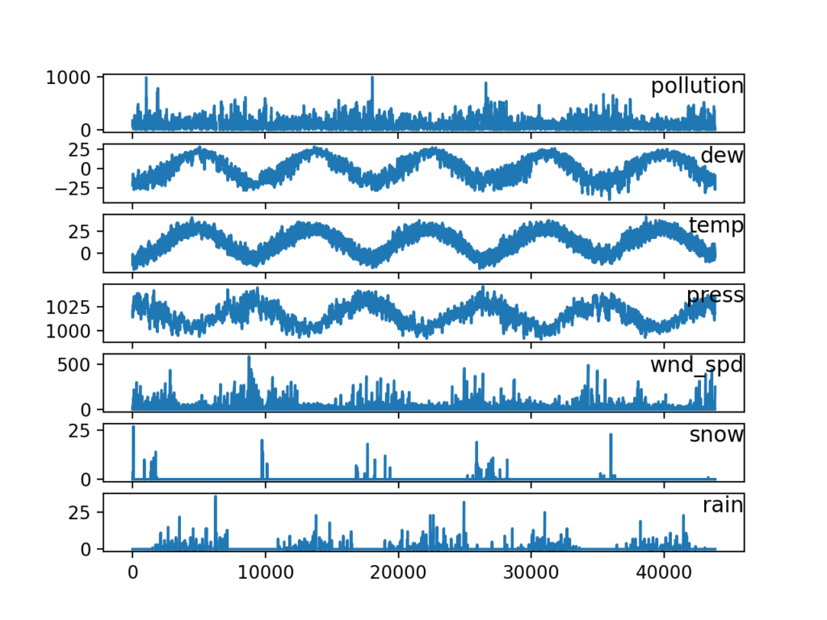
HOW POSEIDON WORKS
We can attack our problem as a Multi-variate Time series classification problem.
The benchmarks are our classes. At the end, the application workflow will be matched to benchmarks.
We can attack our problem as a Multi-variate Time series classification problem.
The benchmarks are our labels to predict. At the end, the application workflow will be matched to a benchmark.
Benchmarks Trident Metrics
Application Workflow Trident Metrics
Match
WE KNOW YOU! (maybe)
WE KNOW THEM!
Notes:
(30 s)

Slide 10
POSEIDON PIPELINE
Trident Metrics of Benchmarks
Train a classification model
WEASEL TRANSFORMATION
&
Support Vector Machine (SVM)
Notes:
10 s

Slide 11
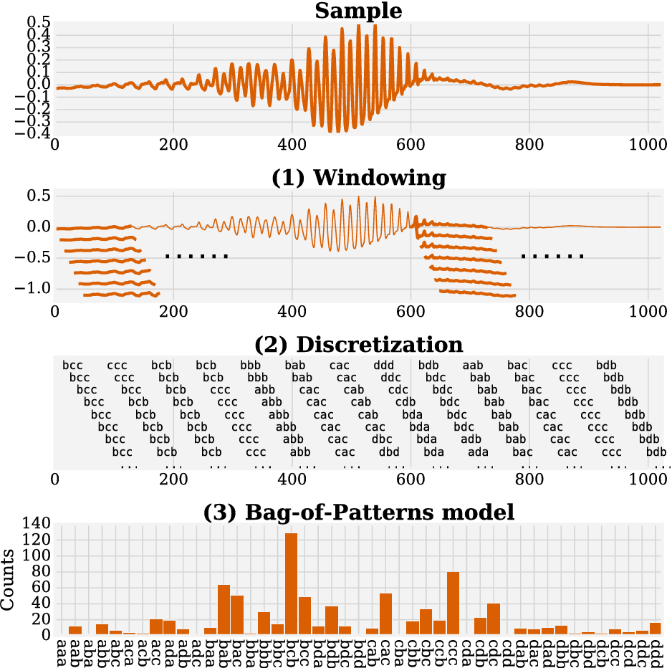
WEASEL TRANSFORMATION
Word ExtrAction for time SEries cLassification
Schäfer, P., & Leser, U. (2017, November). Fast and accurate time series classification with weasel. In Proceedings of the 2017 ACM on Conference on Information and Knowledge Management (pp. 637-646). ACM.
Notes:
10s
Extract the invariant features from the time series

Slide 12
POSEIDON PIPELINE
Trident Metrics of an application
Let the model find the degree of similarity with each benchmark in the repository.
of any segment
BINARY SEGMENTATION
Fryzlewicz, P. (2014). Wild binary segmentation for multiple change-point detection. The Annals of Statistics, 42(6), 2243-2281.
Notes:
20s

Slide 13
RESULTS & FUTURE WORK
96.36% of accuracy on evaluation data
Test and evaluate POSEIDON results on actual application workflows.
Poseidon can turn into a handy software tool for people who write code at CERN to understand and improve their code at a very low level in a quick fashion.
Notes:
20s

Slide 14



Thanks Everyone
Special Thanks to: Servesh, David, Markus, Carmen, Family, Dog & Friends.
lkuffo@espol.edu.ec
Leonardo Kuffo
lkuffo
Project Progression Available Online: https://docs.google.com/document/d/1VgfBxB82IjWcZ9I6kn0jBdWfP82tjIpb5ccVQclrIvE/edit?usp=sharing

Slide 15
References
Schäfer, P., & Leser, U. (2017). Multivariate time series classification with weasel+ muse. arXiv preprint arXiv:1711.11343.
Aminikhanghahi, S., & Cook, D. J. (2017). A survey of methods for time series change point detection. Knowledge and information systems, 51(2), 339-367.
Killick, R., Fearnhead, P., & Eckley, I. A. (2012). Optimal detection of changepoints with a linear computational cost. Journal of the American Statistical Association, 107(500), 1590-1598.
Fryzlewicz, P. (2014). Wild binary segmentation for multiple change-point detection. The Annals of Statistics, 42(6), 2243-2281.
Lin, J., Khade, R., & Li, Y. (2012). Rotation-invariant similarity in time series using bag-of-patterns representation. Journal of Intelligent Information Systems, 39(2), 287-315.
Schäfer, P., & Leser, U. (2017, November). Fast and accurate time series classification with weasel. In Proceedings of the 2017 ACM on Conference on Information and Knowledge Management (pp. 637-646). ACM.

