Slide 1

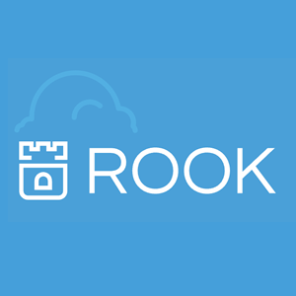

Evaluating Ceph Deployments with Rook
Presented by: Rubab Zahra Sarfraz
Supervised by: Dan van der Ster, Julien Collet (IT-ST-FDO)
16-08-18
Notes:
Good afternoon everyone,
My name is Rubab and I am working in IT Storage department.
My project is about evaluating a new way to deploy storage clusters at CERN and to see whether we should launch our new clusters with this approach or not.

Slide 2

What is Ceph?
Ceph is an open source distributed storage system designed for excellent reliability, performance and scalability.
OpenStack Images and Volumes (RBD)
HPC scratch spaces (CephFS)
Private NFS-like file shares (CephFS)
S3.CERN.CH: object storage compatible with Amazon S3 (RGW)
lhc@home, mattermost...
Notes:
What is the ceph thing that I had to deploy? It’s an opensource distrubuted storage system that is designed to satisfy your storage cases all in one.
here at cern we use ceph in several ways listed here: Ceph’s block storage for OpenStack Images and Volumes, CephFS for HPC and NFS-like shares, and the new S3 service

Slide 3


Slide 4
It’s not always rainbows and butterflies….
Ceph operations can be improved:
Time consuming to deploy
Non-trivial upgrade process
Slow to adapt number of servers to client load
Failure tolerance requires several standby servers (wasting resources)
Requires expert operators
Notes:
Now everything is fine. People are using it without any worries. Life is good….except for the people who deploy and manage ceph clusters.
Because it takes hours to deploy a ceph cluster and if you want to upgrade to new release, it will involve complicated steps. It also takes time to horizontally scale when load increases. Failure tolerance waste resources and generally all the operations require you to be an expert. As a human being, I would like my life to be a bit easy:

Slide 5

Solution:
Notes:
Kubernetes...because why not? So the idea is to deploy services in containers managed by kubernetes. In order to make our life even easier, we have another friend called, Rook.

Slide 6

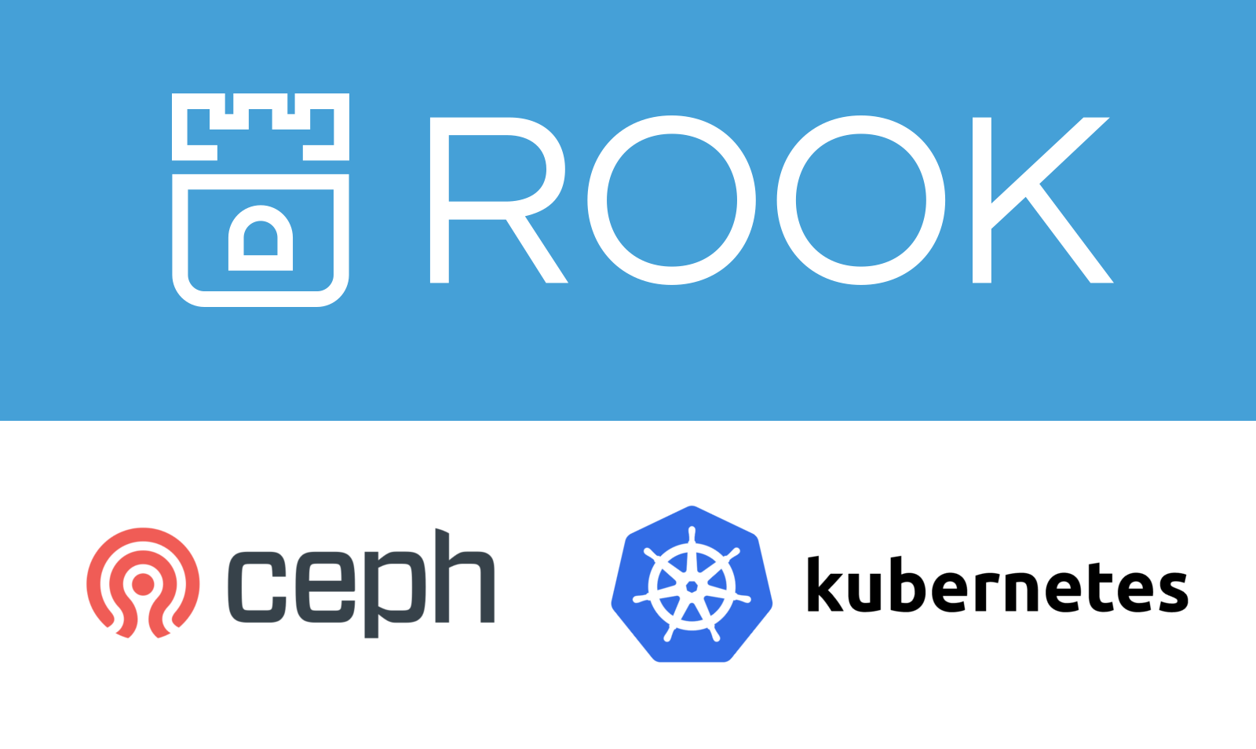
Solution: ROOK Kubernetes
Rook: An orchestrator for Ceph that integrates with cloud native environment
Notes:
Rook is an orchestrator for ceph that runs over top of kubernetes and manages ceph’s lifecycle.

Slide 7
My Project
Evaluate operating Ceph clusters in Kubernetes using Rook according to CERN’s storage use cases
Notes:
So my project is about evaluating ceph clusters in kubernetes using Rook

Slide 8
My Project
Evaluate operating Ceph clusters in Kubernetes using Rook according to CERN’s storage use cases
Deployment
deploy Ceph clusters with
code that is still in development stage:
Orchestrator CLI
Notes:
The first module was to deploy code that is shence I had to fix some bugs to deploy that.

Slide 9
My Project
Evaluate operating Ceph clusters in Kubernetes using Rook according to CERN’s storage use cases
Deployment + Development
enhance code base (contribute to open
source) to fit to our use-cases at CERN
deploy Ceph clusters with
code that is still in development stage:
Orchestrator CLI
Notes:
.The second module was to enhance code base to satisfy our storage use cases here at CERN such as adding S3 support.

Slide 10
Evaluation Criteria
Time to deploy whole cluster
Time to add new OSDs in a running cluster
Autoscaling: adding/removing S3/CephFS daemons
Ceph upgrades: how much is it automated?

Slide 11
Evaluation Criteria
Time to deploy whole cluster
Time to add new OSDs in a running cluster
Autoscaling: adding/removing S3/CephFS daemons
Ceph upgrades: how much is it automated?
Evaluation Environment
Deployed clusters for S3 workloads:
Virtual Environment: 3 OpenStack VMs with 10+ volume attachments
Physical Environment: 3 Physical Servers with 5.5 TB 50+ disks each

Slide 12
Results and Conclusion
Metric | Puppet | Rook w/ K8s
Time to deploy whole cluster | > 3 hours
Time to add new OSDs in a cluster | > 1 hour
Autoscaling S3/CephFS daemons | > 1 hour
CEPH upgrades | Manual
Notes:
Current ceph deployments take this amount of time

Slide 13
Results and Conclusion
Metric | Puppet | Rook w/ K8s
Time to deploy whole cluster | > 3 hours | < 15 minutes
Time to add new OSDs in a cluster | > 1 hour | < 2 minutes
Autoscaling S3/CephFS daemons | > 1 hour | < 2 minutes
Ceph upgrades | Manual | Manual (WIP)

Slide 14
Results and Conclusion
Elastic: can load-adapt number of S3 and CephFS servers
Failure tolerant: replace daemons automatically without hot-standbys
Point and click: orchestration requires much less expertise
S3 and Automated Upgrades: still work-in-progress (Future work!)
Rook + Kubernetes: fast growing community
Notes:
In addition to be time efficient, it’s elastic and fault toleratn

Slide 15
Results and Conclusion
Elastic: can load-adapt number of S3 and CephFS servers
Failure tolerant: replace daemons automatically without hot-standbys
Point and click: orchestration requires much less expertise
S3 and Automated Upgrades: still work-in-progress (Future work!)
Rook + Kubernetes: fast growing community
Verdict: Spawn your next cluster with Rook already!
Notes:
In addition to be time efficient, it’s elastic and fault toleratn

Slide 16
Acknowledgements
Dan van der Ster
Julien Collet
Theofilos Mouratidis
Herve Rousseau
Spyridon Trigazis
Ricardo Brito Da Rocha
Arne Wiebalck
Thank you!
rubab.zahra.sarfraz@cern.ch

Slide 17


