Slide 1
Matomo Web Analytics for
CERN Web Services
Christian Toth
Supervisors:
Andreas Wagner, Bruno Silva De Sousa, Ismael Posada Trobo

Slide 2
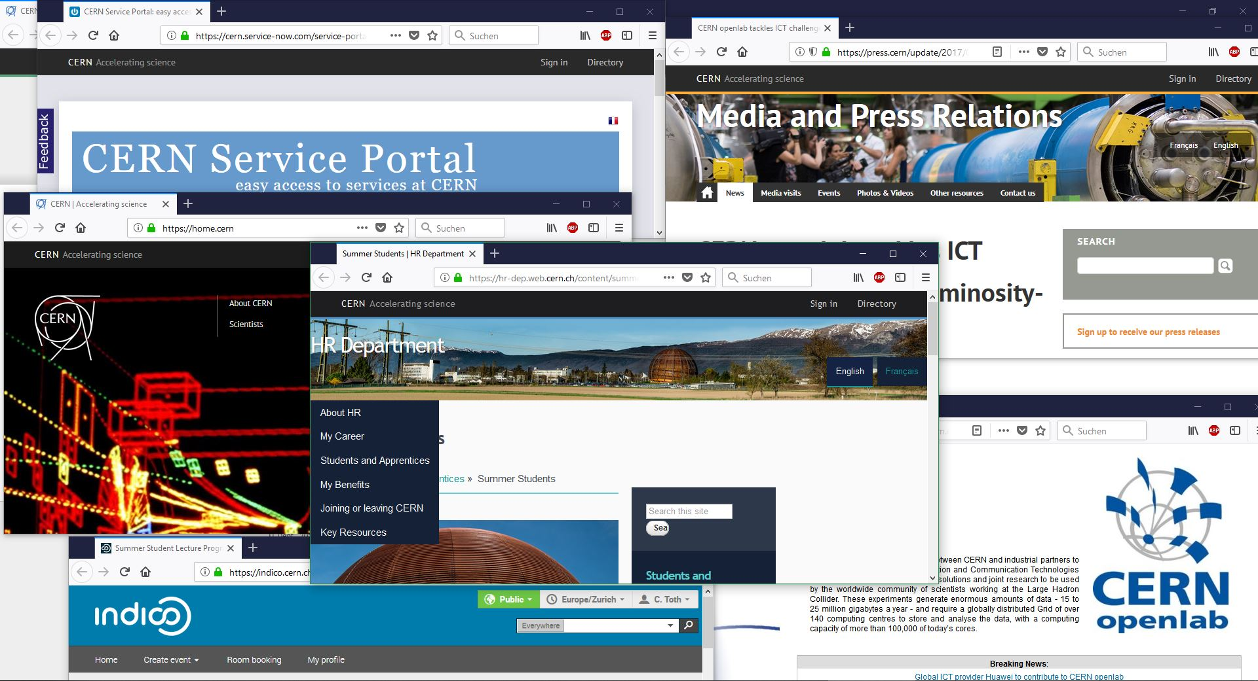

Slide 3
14000 Websites

Slide 4


Slide 5


Data Ownership
OpenSource
GDPR Compliant
Extensible

Slide 6
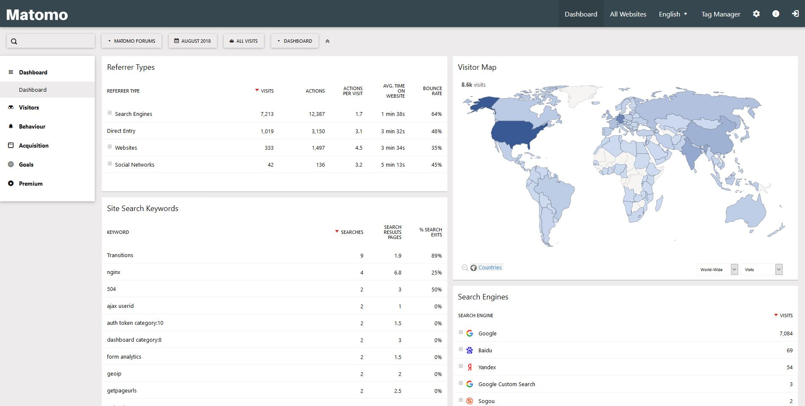

Slide 10

Current Status

Slide 11

Current Status

Slide 12

Current Status

Slide 13
Current Status
Plugin

Slide 14

Next Steps
Finish Integration

Slide 15
Next Steps
Finish Integration
Scalability Testing

Slide 16
Next Steps
Finish Integration
Scalability Testing
Migration

Slide 17
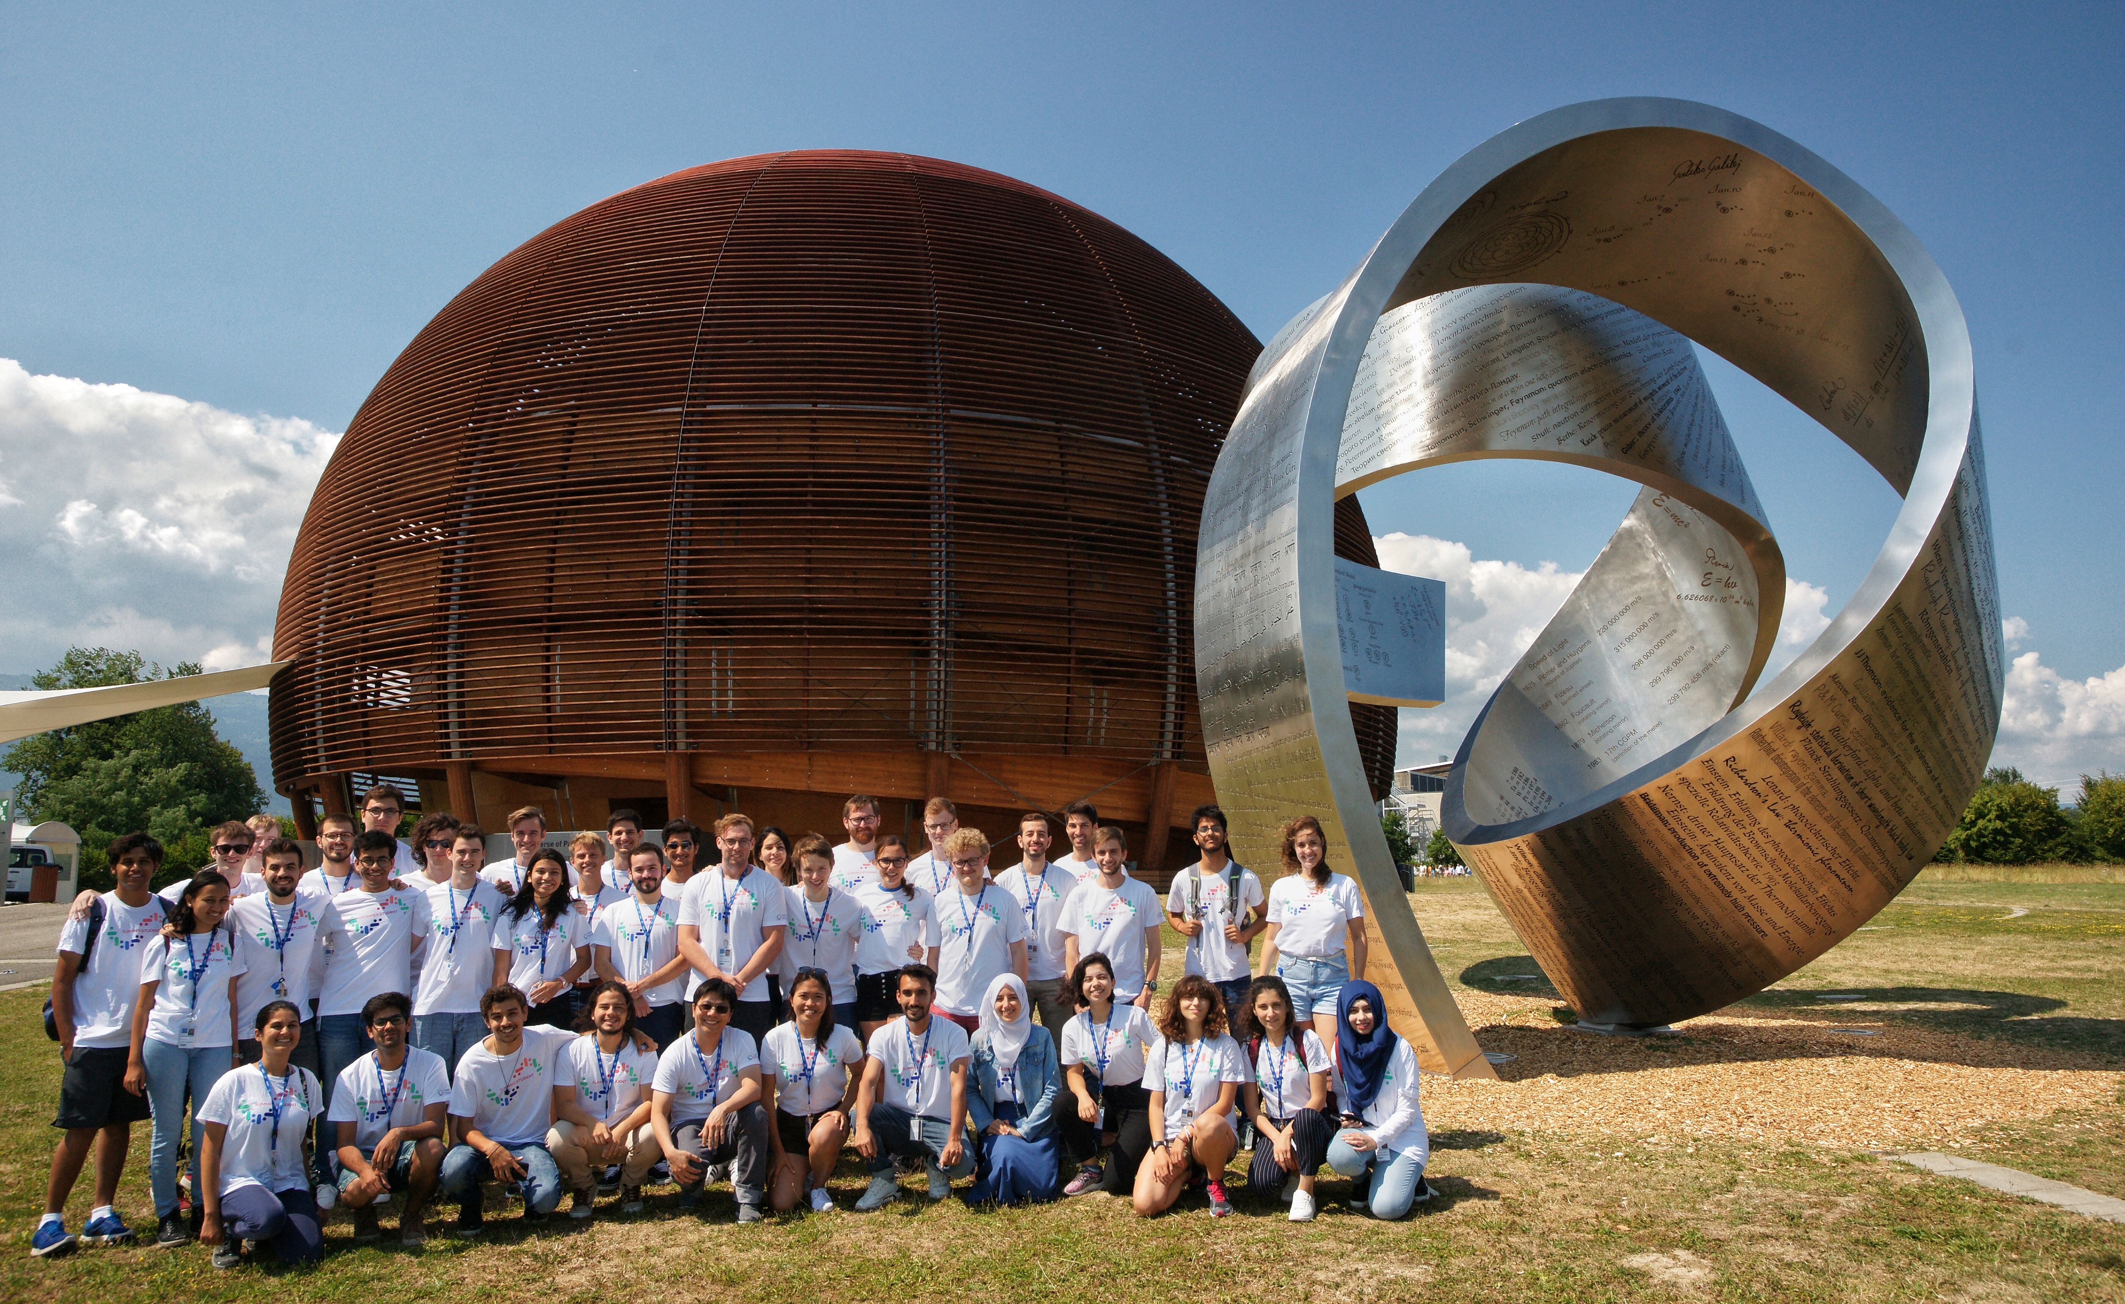
Thank YOU!

