Slide 1
Mechanical Simulation of Nb₃Sn Coils
G. Vallone, B. Bordini, N. Bourcey, M. Daly, P. Ferracin, C. Fichera, P. Grosclaude, M. Guinchard,
S. Izquierdo Bermudez, C. Loffler, J. C. Perez
37th EuroCirCol WP5 Coordination Meeting
CERN, 22/05/2018

Slide 2
Outline
Introduction
MQXF – ‘block coil’ model
Cable stacks ‘strand’ model
MQXF ‘strand’ model
11T ‘block coil’ model
Conclusion

Slide 3
Outline
Introduction
MQXF – ‘block coil’ model
Cable stacks ‘strand’ model
MQXF ‘strand’ model
11T ‘block coil’ model
Conclusion

Slide 4
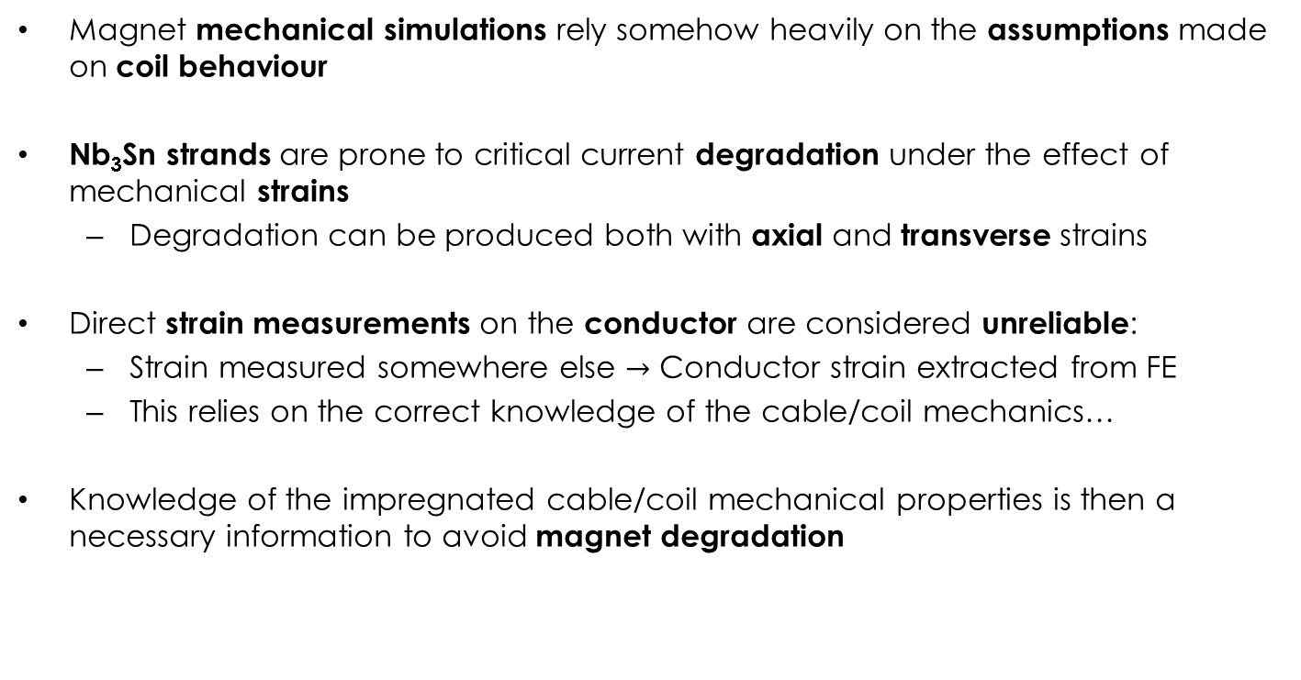
Introduction
Magnet mechanical simulations rely somehow heavily on the assumptions made on coil behaviour
Nb₃Sn strands are prone to critical current degradation under the effect of mechanical strains
  Degradation can be produced both with axial and transverse strains
Direct strain measurements on the conductor are considered unreliable:
  Strain measured somewhere else $→$ Conductor strain extracted from FE
  This relies on the correct knowledge of the cable/coil mechanics…
Knowledge of the impregnated cable/coil mechanical properties is then a necessary information to avoid magnet degradation

Slide 5
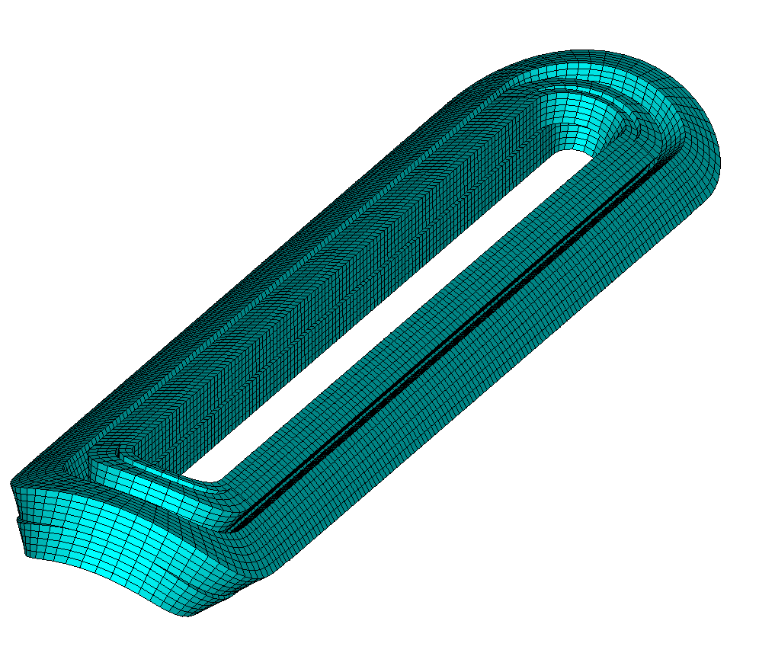
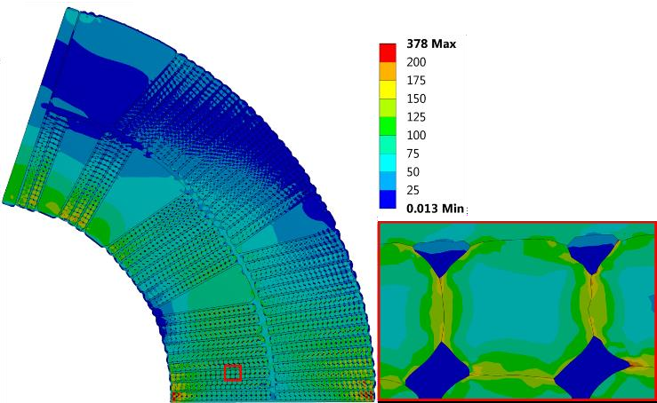
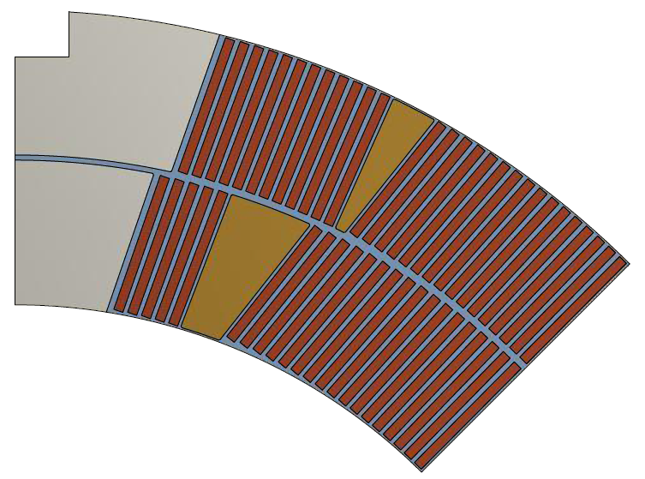
Modelling Strategies
Block Model
Cable Model
C. Löffler et al., EUCAS 2017
Strand Model
M. Daly et al., MT25, 2017
Block model is the current standard approach:
  Coil approximated as an uniform block with uniform mechanical properties
  Properties were measured in the past on impregnated coil stacks
  Orthotropic in 2D, isotropic in 3D
This consistent way of modelling also allowed to define an empirical limit on the coil equivalent stress (150:200 MPa - H. Felice et al., IEEE TAS, 2011)
New modelling strategies are currently under development

Slide 6
Outline
Introduction
MQXF – ‘block coil’ model
Cable stacks ‘strand’ model
MQXF ‘strand’ model
11T ‘block coil’ model
Conclusion

Slide 7
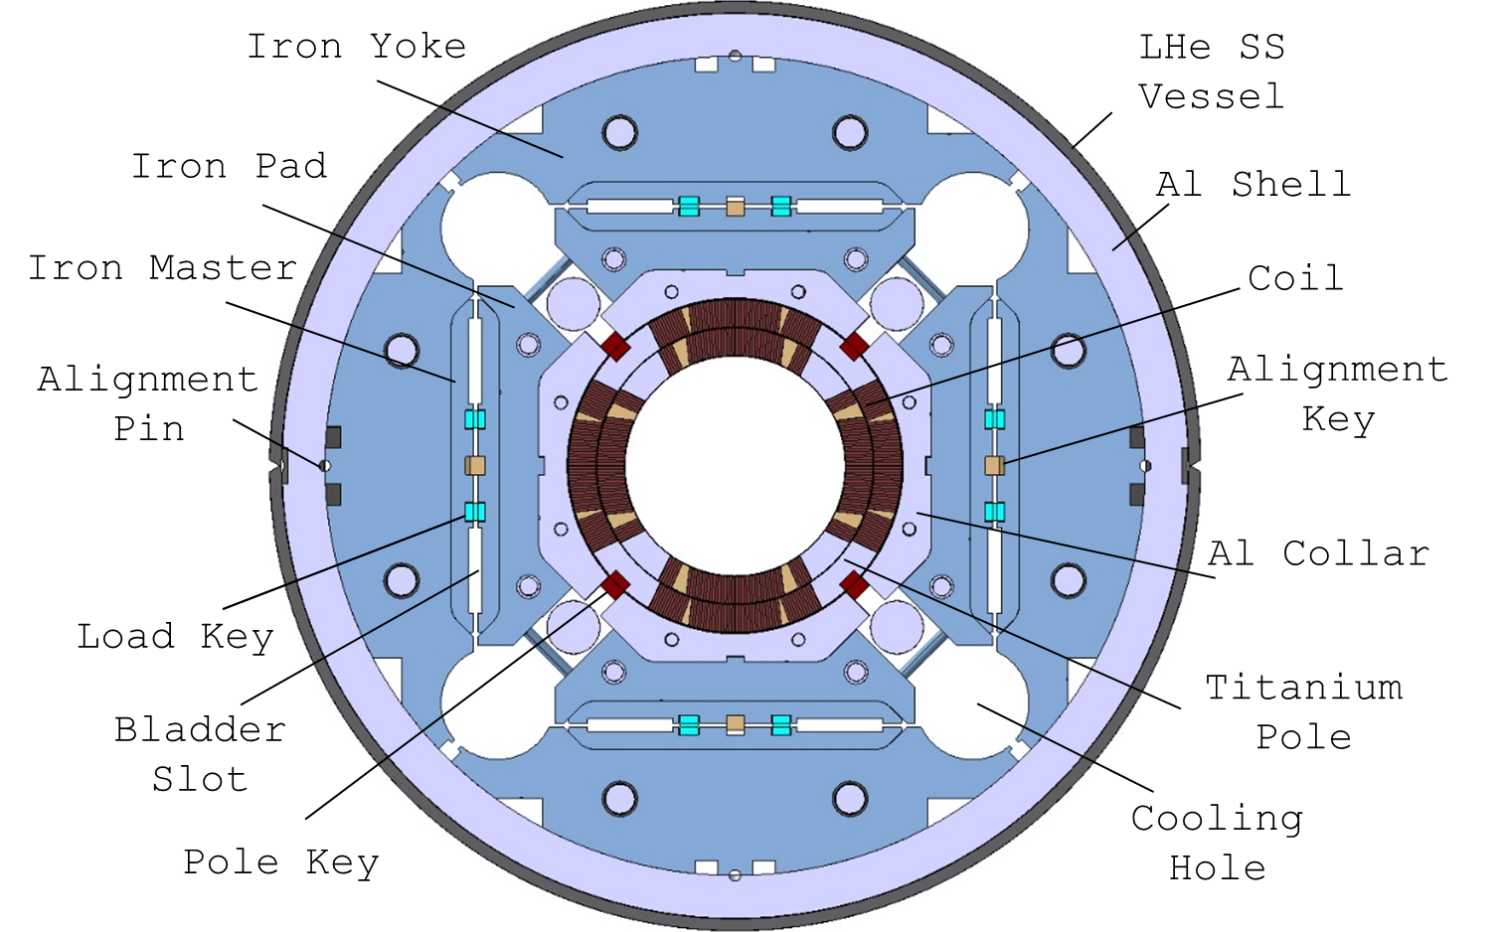
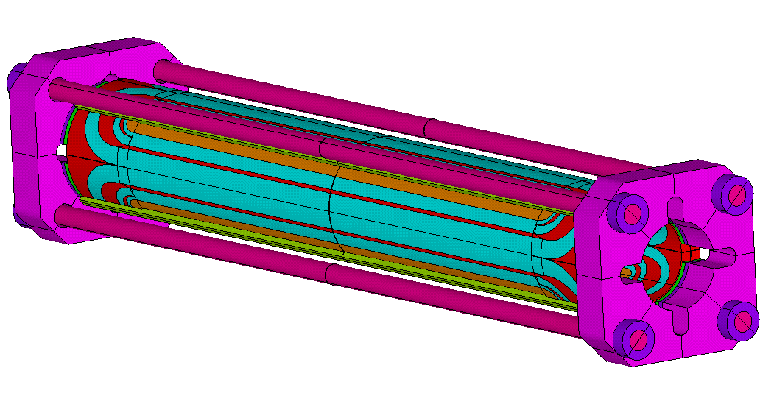
MQXF – Mechanical Structure
Azimuthal preload at R.T. applied with bladders & keys
  Al shell compresses the coils. Part of the force is absorbed by the pole key
Longitudinal preload at r.t. applied pre-tensioning the rods
Both increased by the differential thermal contraction during cool-down

Slide 8
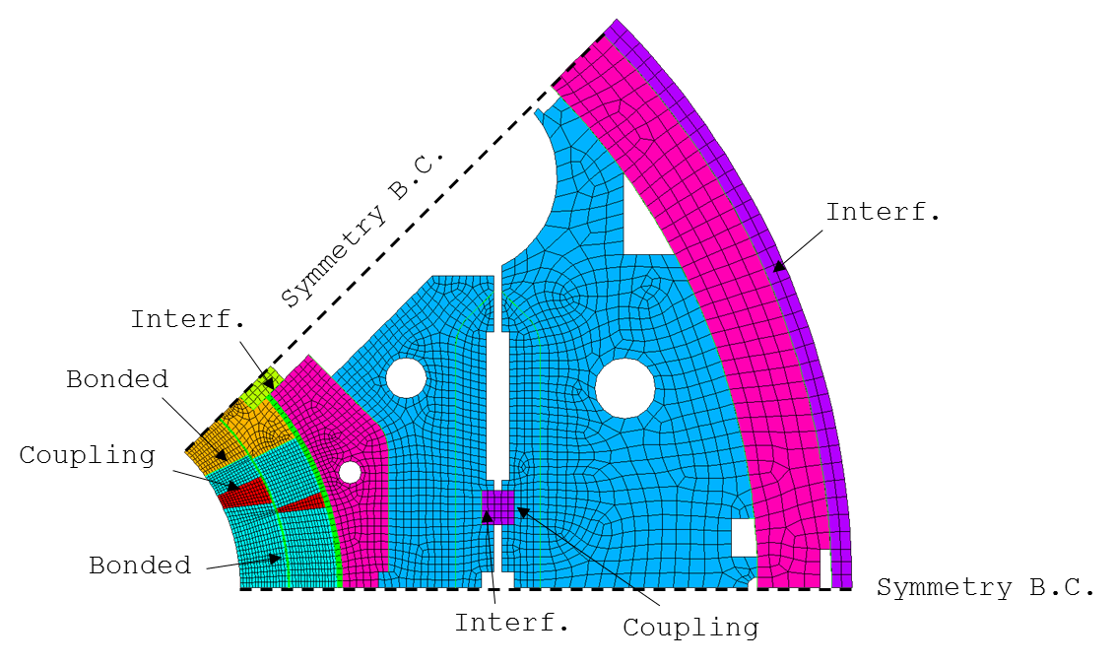
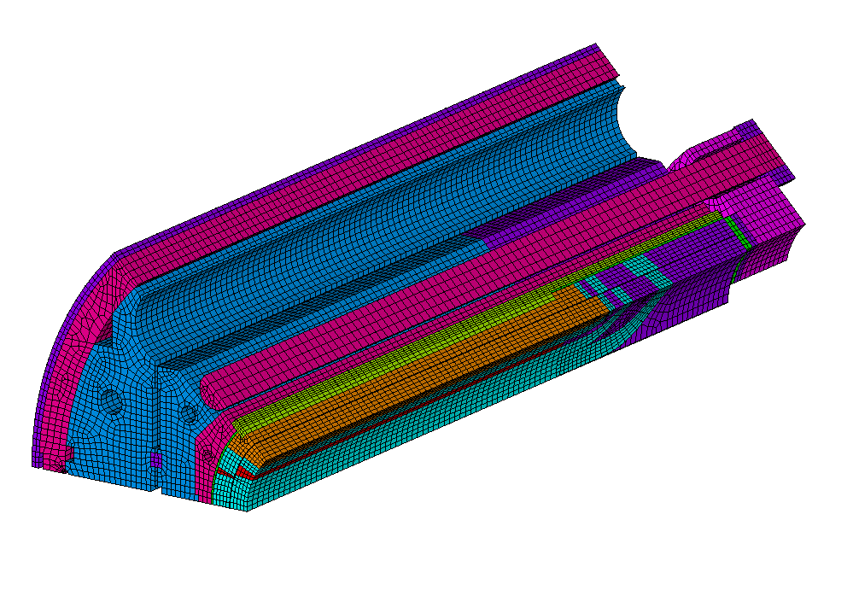
MQXF – Block Coil Model
Coil modelled as a block. Simulations in 2D and 3D.
Coil properties from LARP experience:
  Elastic modulus (linear elastic): 44 GPa (azimuthal), 52 GPa (radial)
  Orthotropic in 2D, isotropic in 3D
  Thermal contraction: 3.35 mm/m

Slide 9
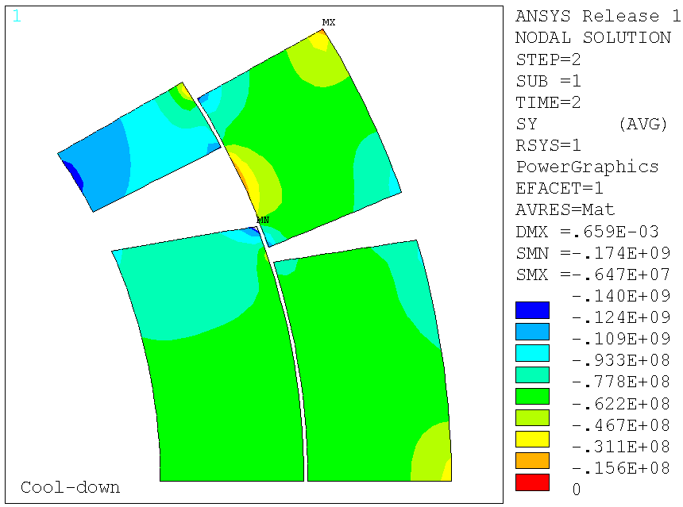
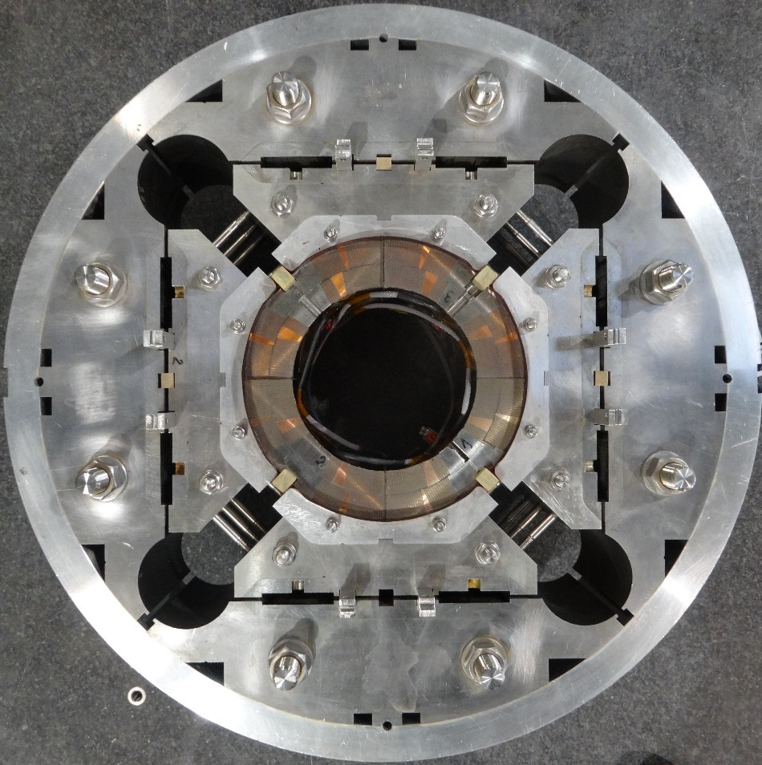
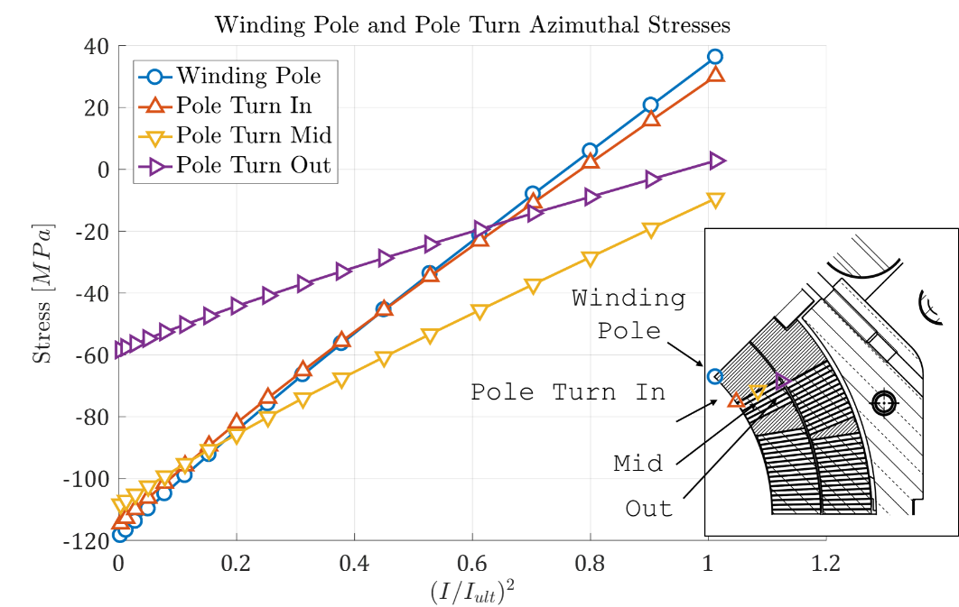
Short Model - Strain Gauge Locations
Shell
Pole

Slide 10
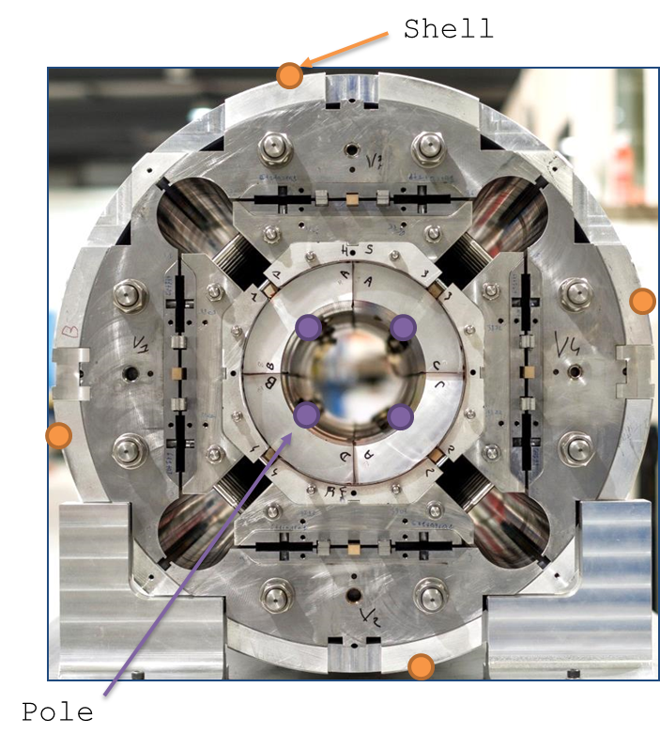
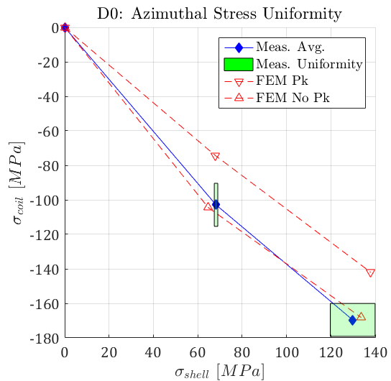
Mechanical Model – MQXFSD0
Cool-Down
Loading
Mechanical structure was tested with aluminium dummy coils
Transfer Function: force provided by the structure vs coil prestress
  Very good agreement with the numerical model results
  No calibration was performed

Slide 11
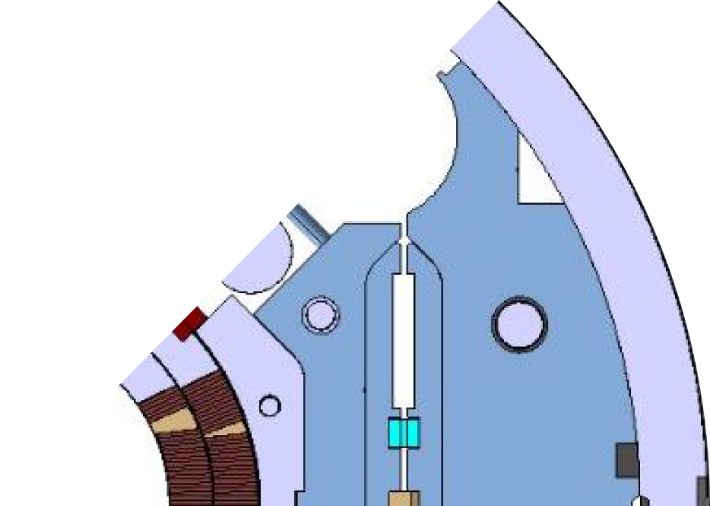

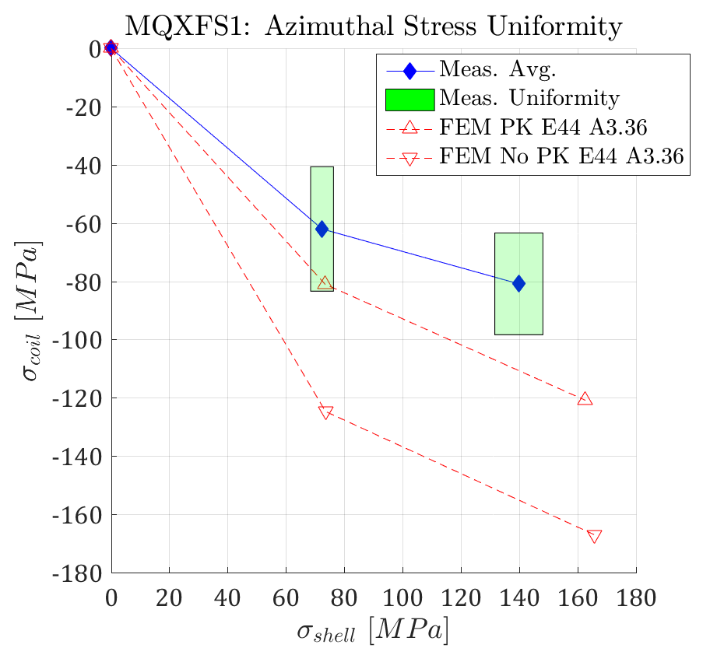
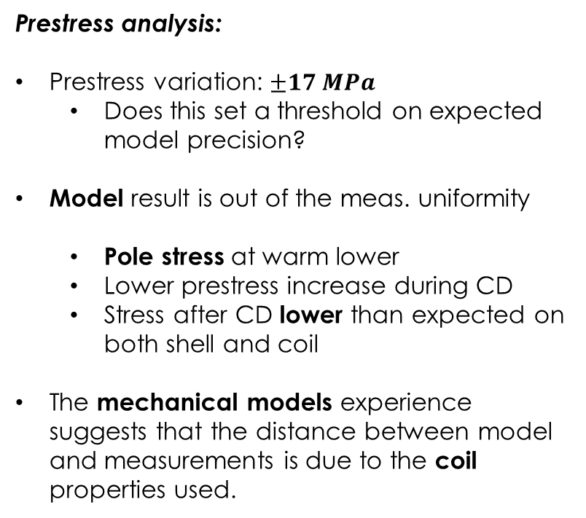
MQXFS1 – Transfer Function
Shell
  Prestress analysis:
  Prestress variation: $±17 MPa$
    Does this set a threshold on expected model precision?
Model result is out of the meas. uniformity
  Pole stress at warm lower
  Lower prestress increase during CD
  Stress after CD lower than expected on both shell and coil
The mechanical models experience suggests that the distance between model and measurements is due to the coil properties used.
Pole
Loading
Cool-Down

Slide 12
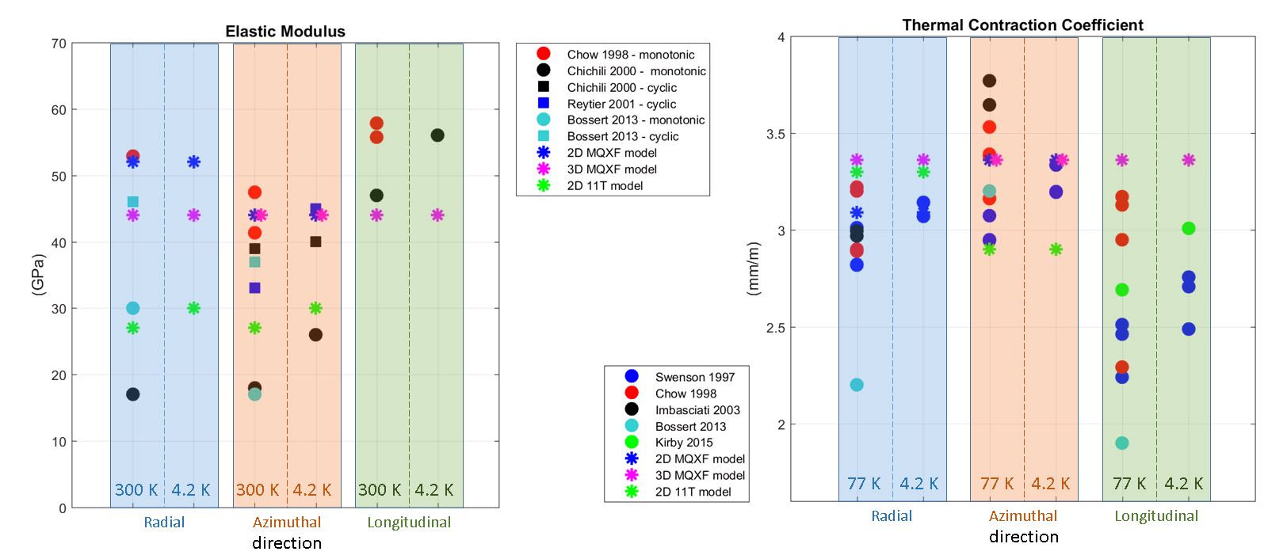
Coil Properties – Available Data
Y – azimuthal
Z – longitudinal
X – radial
Available coil properties measures highly dispersed
Measured Young modulus: 15-60 GPa. Also depends upon cyclic/monotonic loading phase
Measured thermal contraction: 2-4 mm/m

Slide 13
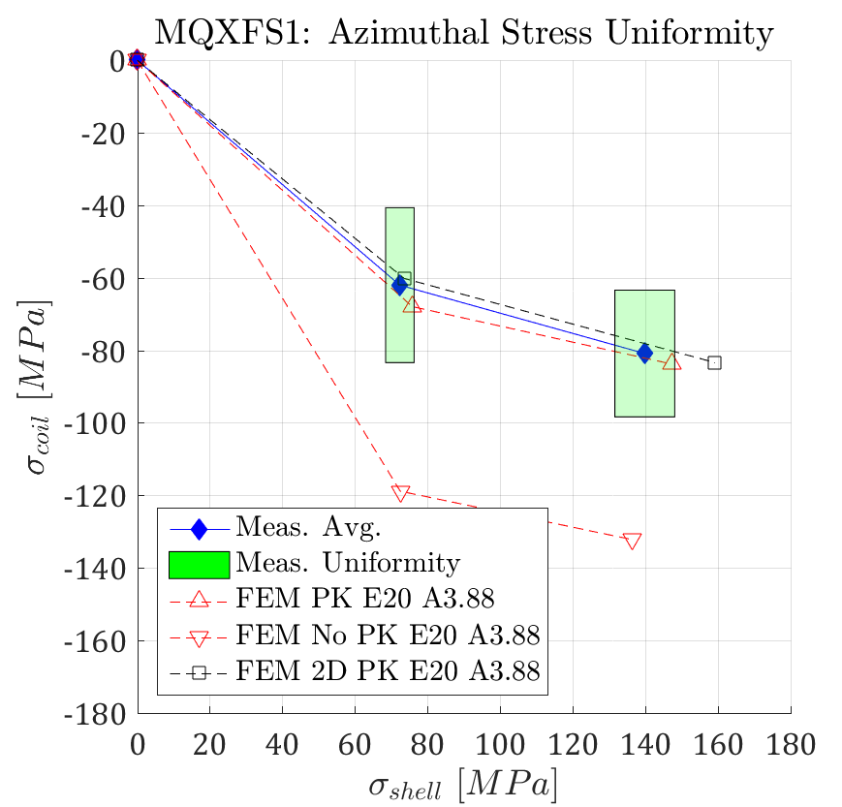
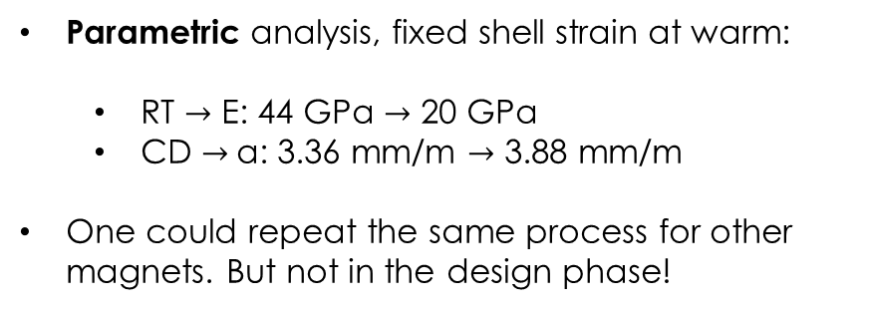
Azimuthal Pre-stress
Parametric analysis, fixed shell strain at warm:
  RT $→$ E: 44 GPa $→$ 20 GPa
  CD $→$α: 3.36 mm/m $→$ 3.88 mm/m
One could repeat the same process for other magnets. But not in the design phase!
Shell
Pole

Slide 14
Outline
Introduction
MQXF – ‘block coil’ model
Cable stacks ‘strand’ model
MQXF ‘strand’ model
11T ‘block coil’ model
Conclusion

Slide 15
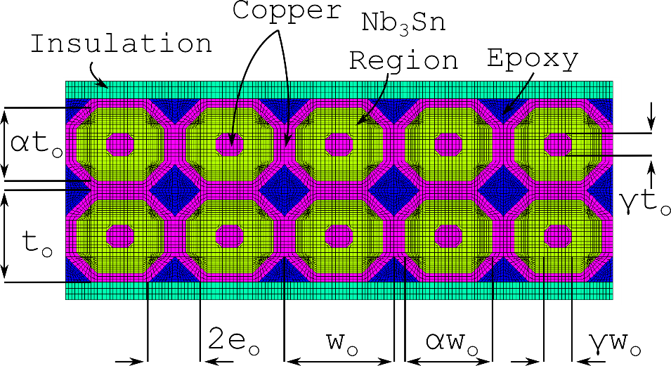
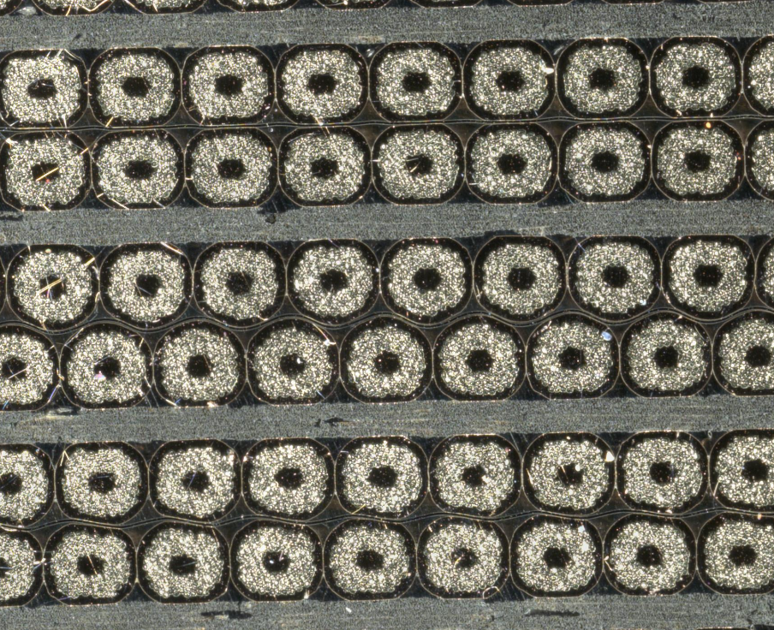
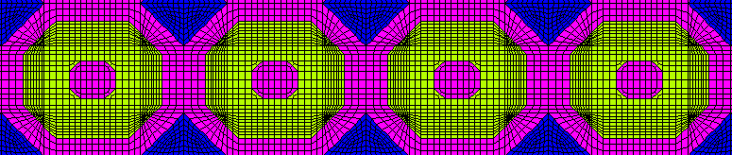
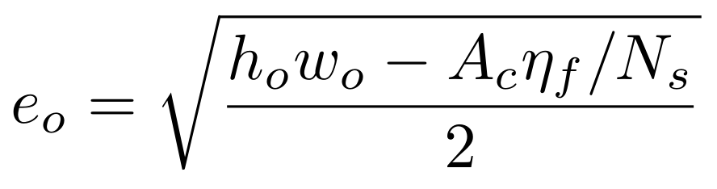
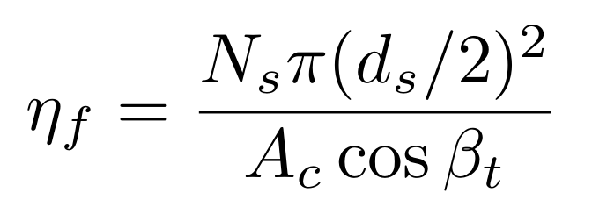
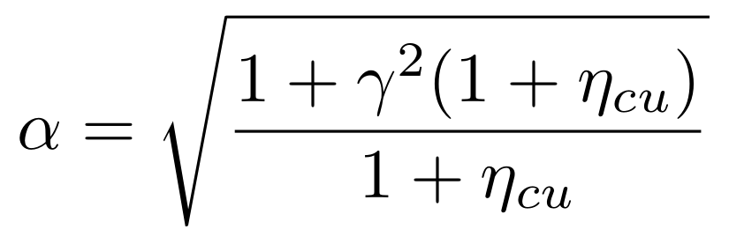
Cable Stacks – FE Model (1)
2D FE model of the cable stack
Material properties from literature
Geometry from a mix of image analysis and simple geometric formulas to match the filling factor, copper-non copper etc.

Slide 16
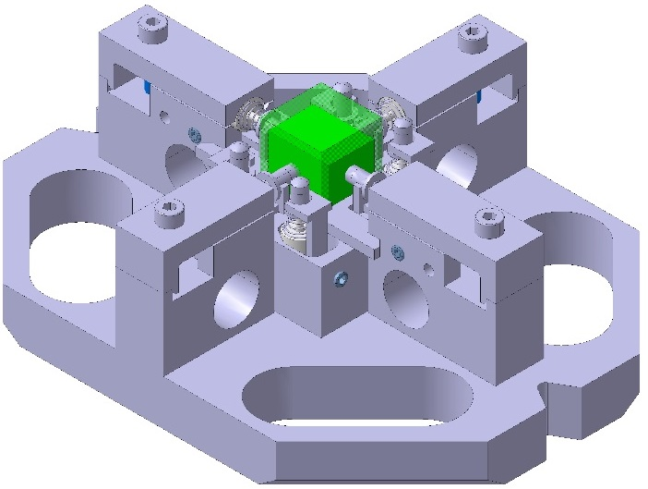
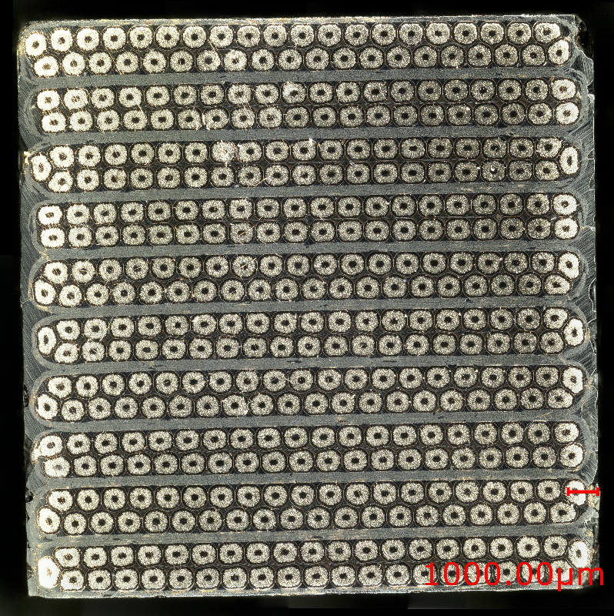
Cable Stacks – Transversal Pressure (1)
Measurements on stacks of impregnated cables have always been used as a reference for coil elastic modulus measurements
There is a significant spread (15-50 GPa, azimuthal direction) in the values available in literature
  The modulus seems sensible to the particular cable tested/testing procedure
As a consequence, an extensive campaign was launched almost 2 years ago
Work to be published by C. Fichera et al.

Slide 17
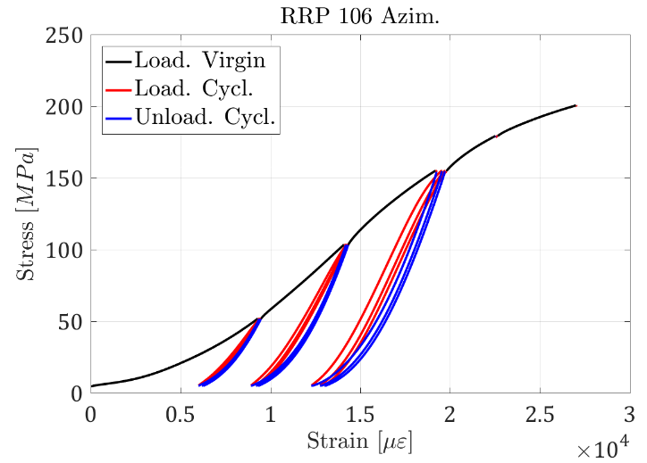
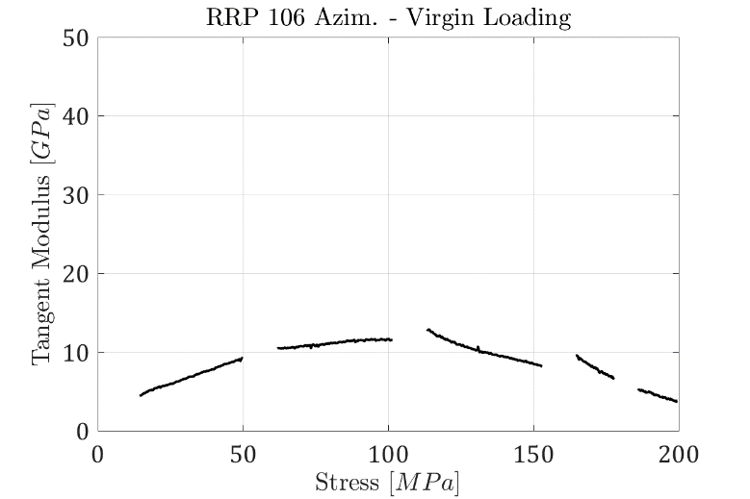
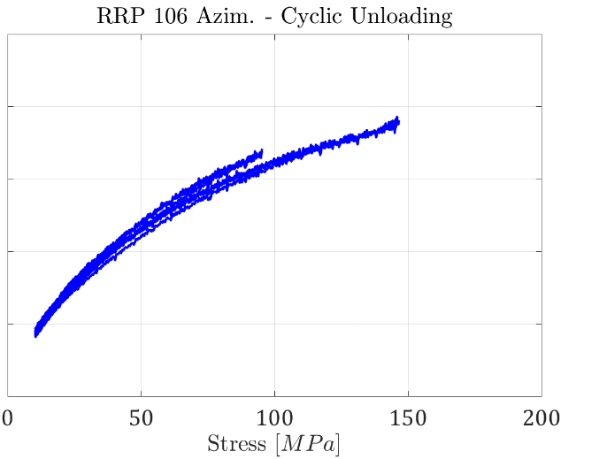
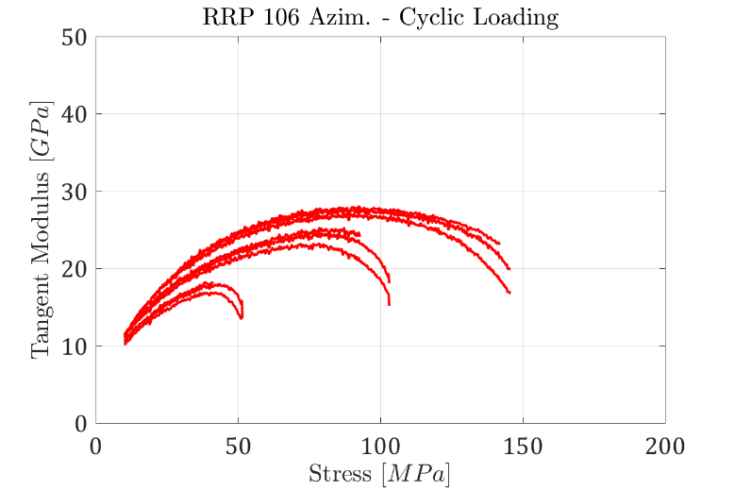
Cable Stacks – Transversal Pressure (2)
Very different behaviour in the three phases
The chord and tangent modulus† vary continuously during the test
Probably difficult to condensate the coil elastic properties in a single number (elastic modulus)
† ASTM - E111 - 04

Slide 18
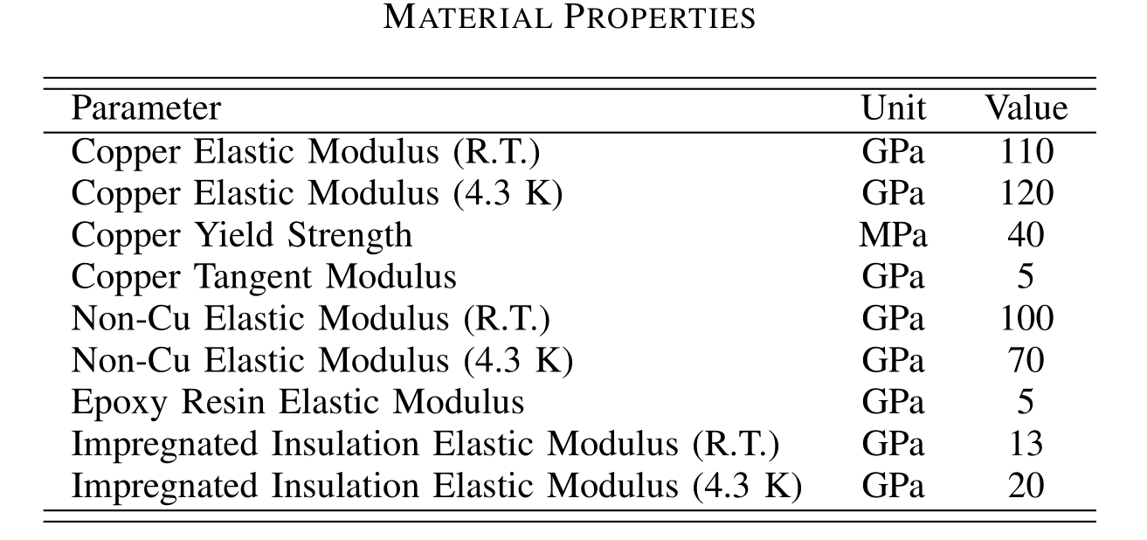
Cable Stacks – FE Model (2)
Virgin/cyclic behaviour explained by copper plasticization
FE slope reasonably good especially considering that no model calibration was necessary
Initial phase may be due to compaction

Slide 19
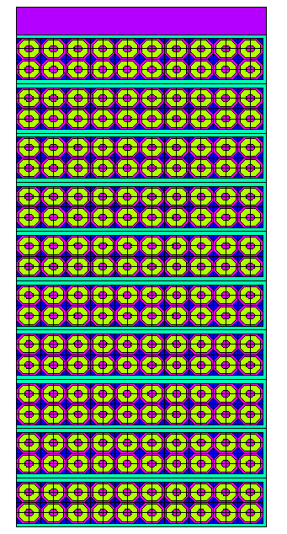
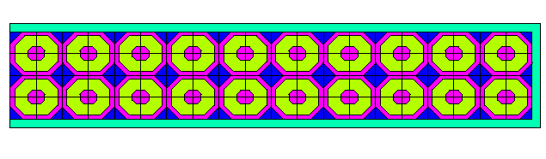
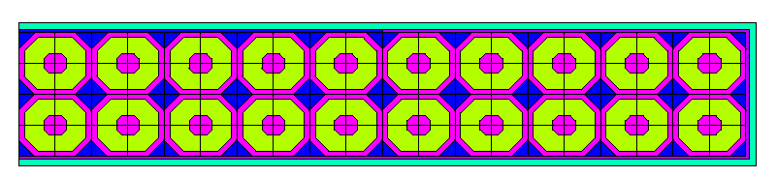
Comparison with 1T Cable
MQXF
11T
How the modelling strategy performs on a different cable?
We measured with the same procedure also 11T cable stacks
MQXF and 11T Cable comparison
Mica assumed to be elastic, 170 GPa

Slide 20
11T/MQXF - Meas. Comparison
Very similar results for virgin loading
  Explained by Cu hardening/compaction?
Cycling behaviour:
  The ‘shape’ is very similar
  The 11T specimen are slightly stiffer ~5-10 GPa
11T Data: M. Daly et al., IEEE TAS, 2017

Slide 21
Mechanical Model – Results (1)
11 T Stack Modulus - Model:
  Virgin Loading – 17 GPa
  Unloading - 42 GPa
MQXF Stack Modulus - Model:
  Virgin Loading – 14 GPa
  Unloading - 37 GPa

Slide 22
Outline
Introduction
MQXF – ‘block coil’ model
Cable stacks ‘strand’ model
MQXF ‘strand’ model
11T ‘block coil’ model
Conclusion

Slide 23
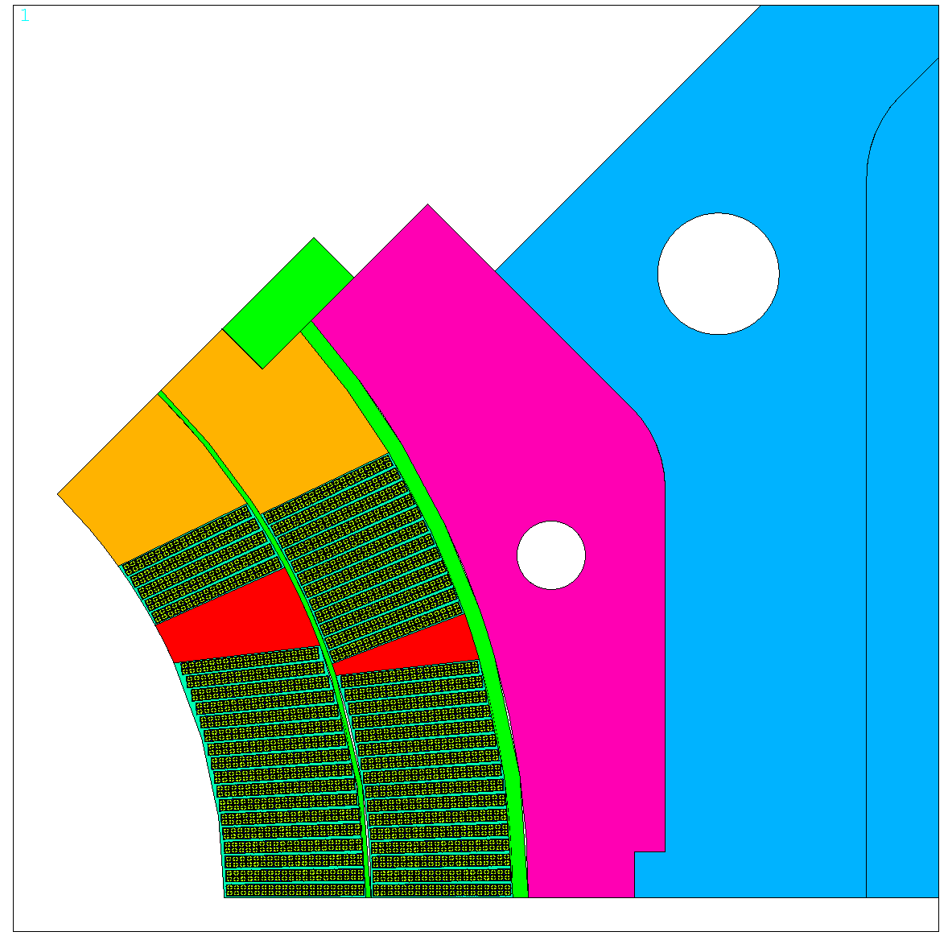
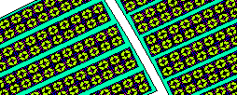
MQXF – Strand Model
Strand MQXF magnet model. Same approach as before // work in progress!
  Pros:
    Useful to verify the strain inside the strand
    We are not relying on properties measured on the stacks
  Cons:
    We have extensive experience with block models
    Even a 2D model can become computationally heavy
Strand model results at R.T. in agreement with measurements/block model
No calibration done!

Slide 24
Outline
Introduction
MQXF – ‘block coil’ model
Cable stacks ‘strand’ model
MQXF ‘strand’ model
11T ‘block coil’ model
Conclusion

Slide 25
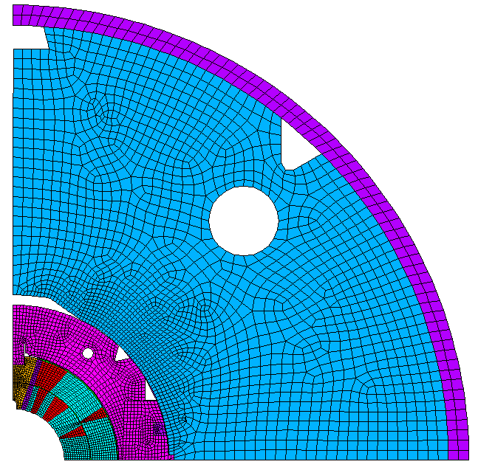
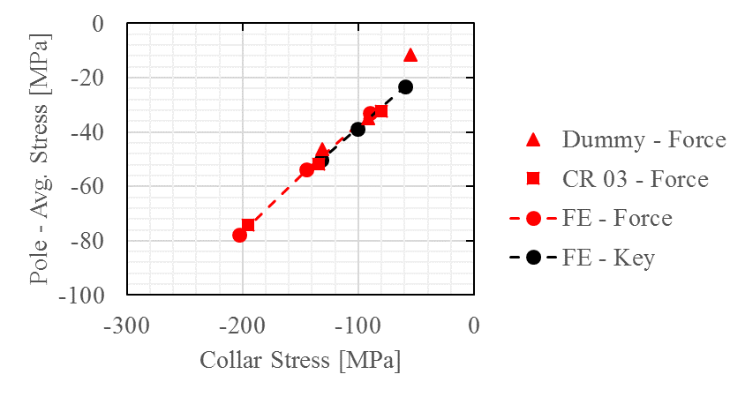
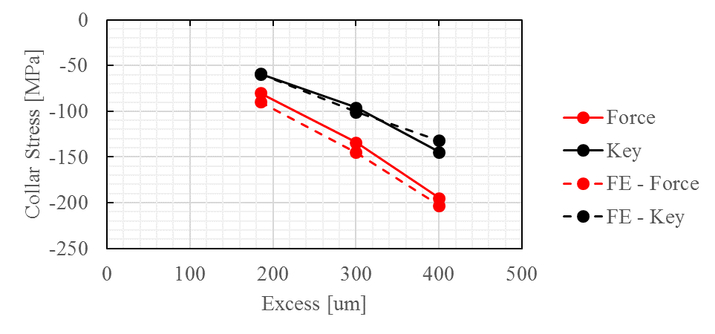
11T - Block Coil Model
Coil block model
Most of the prestress applied during collaring
Coil ‘plasticity’ (spring-back)accounted for using a bilinear curve
Material properties currently used:
  10/30 GPa (loading, unloading)
Collar
Pole

Slide 26
Outline
Introduction
MQXF FE – ‘block coil’ model
Cable stacks ‘strand’ model
‘Strand’ model - applications
Conclusion

Slide 27
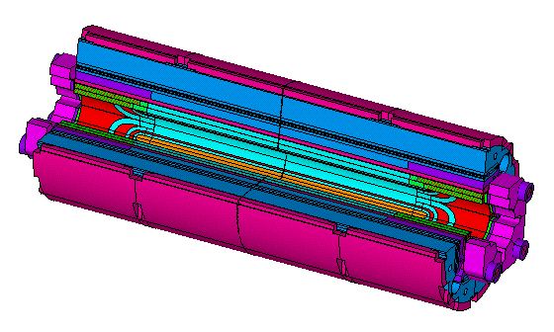
Conclusion
MQXF FE model calibration:
  Good agreement at the macroscopic level
  The same approach could be used on other magnets (different cable, resin, etc.). Not feasible at the design stage!
Impregnated cable stacks:
  Strongly non-linear behaviour
  Part of this behaviour can be explained by the copper plasticization (and compaction)
  Cable components properties available in literature
  Stack strand model looks reasonably close to reality
FE Model at the strand level allows to match the RT transfer function
The cable stack model seems to be able to predict the critical current degradation in the reversible region
Mat. properties currently used:
  MQXF: 20 GPa, elastic
  11T: 10/30 GPa, bilinear

Slide 28
Extra

Slide 29
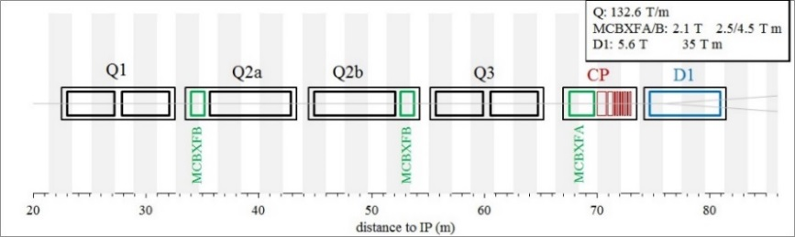
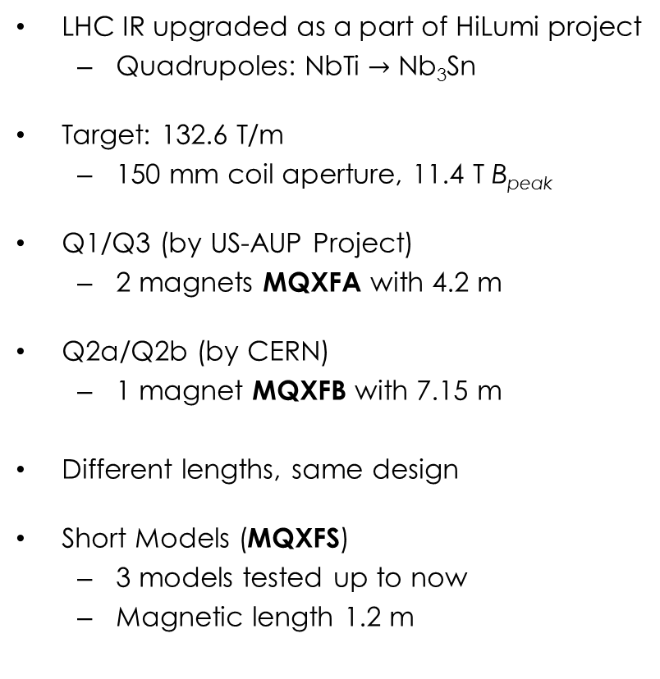
MQXF Design
LHC IR upgraded as a part of HiLumi project
  Quadrupoles: NbTi $→$ Nb₃Sn
Target: 132.6 T/m
  150 mm coil aperture, 11.4 T B_{peak}
Q1/Q3 (by US-AUP Project)
  2 magnets MQXFA with 4.2 m
Q2a/Q2b (by CERN)
  1 magnet MQXFB with 7.15 m
Different lengths, same design
Short Models (MQXFS)
  3 models tested up to now
  Magnetic length 1.2 m

Slide 30
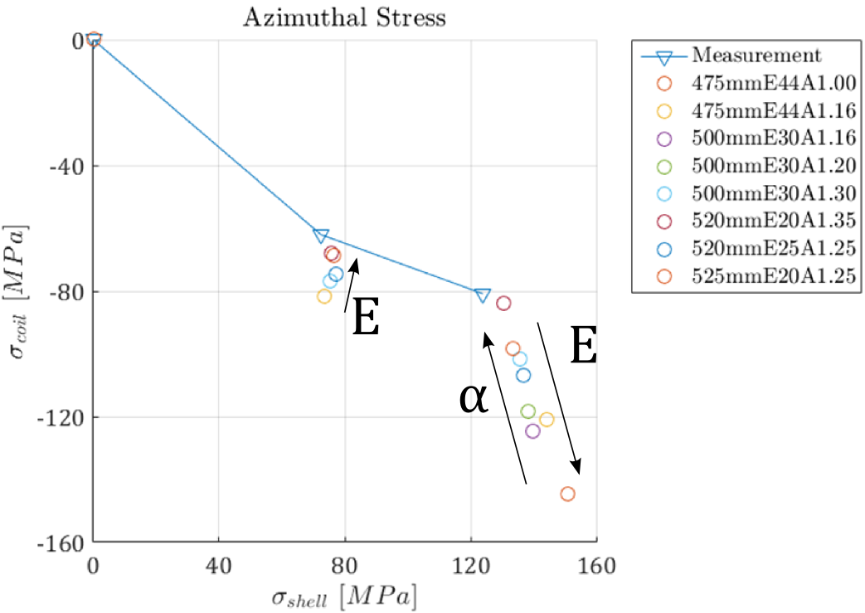
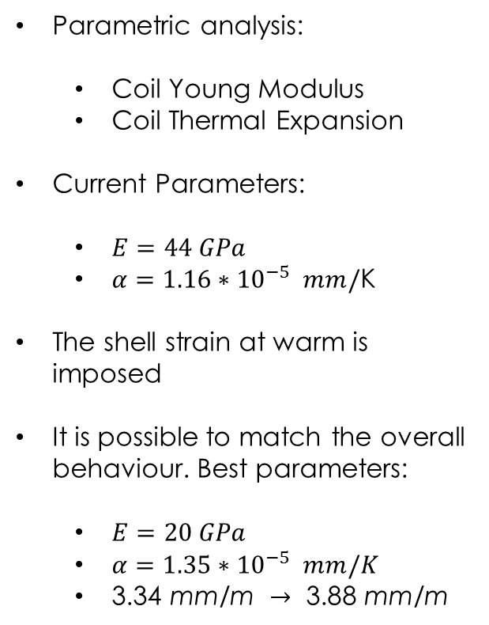
MQXFS1 – Material Calibration
Parametric analysis:
  Coil Young Modulus
  Coil Thermal Expansion
Current Parameters:
  $E=44 GPa$
  $α=1.16{∗10}^{−5} mm/$K
The shell strain at warm is imposed
It is possible to match the overall behaviour. Best parameters:
  $E=20 GPa$
  $α=1.35{∗10}^{−5} mm/K$
  $\text{3.34 }\text{mm}\text{/}\text{m} →\text{ 3.88 }\text{mm}\text{/}\text{m}$

Slide 31
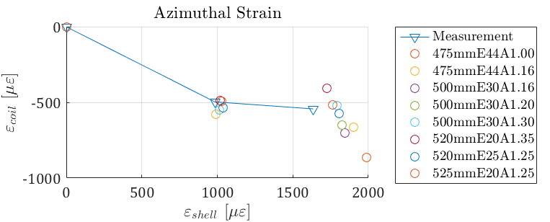
MQXFS1 – Material Calibration
Best stress calibration parameters does not coincide with strain ones.
Possible improvement:
  Orthotropic Coil behaviour
  Friction parametric study

Slide 32
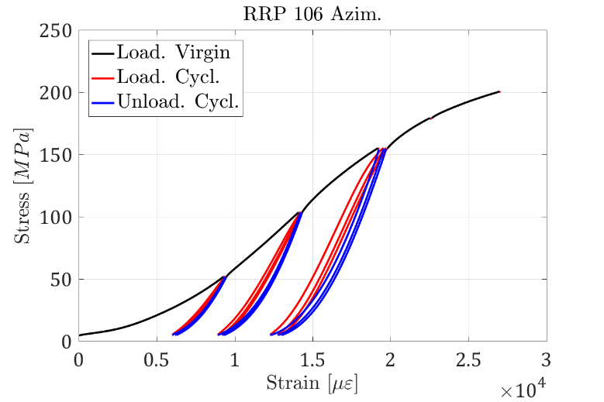
Cable Stacks – Transversal Pressure (2)
The specimen (MQXF RRP cable) shows a clear division in three zones:
  Virgin loading (black)
  Unloading (red)
  Cyclic loading (blue)
How to extract a number representative of the modulus from such a result?

Slide 33
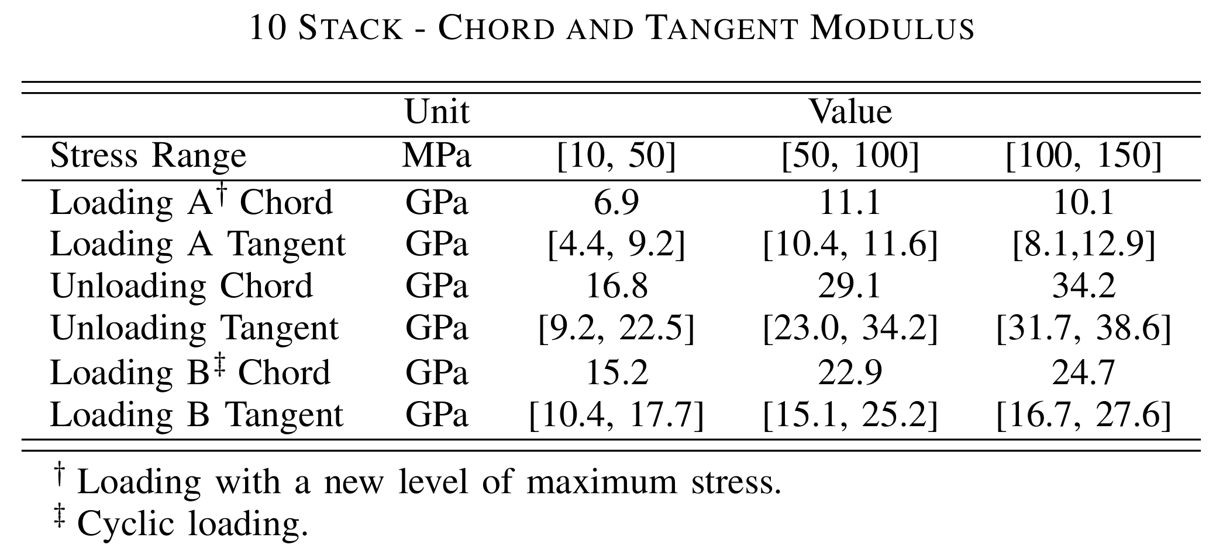
Cable Stacks – Transversal Pressure (3)

Slide 34
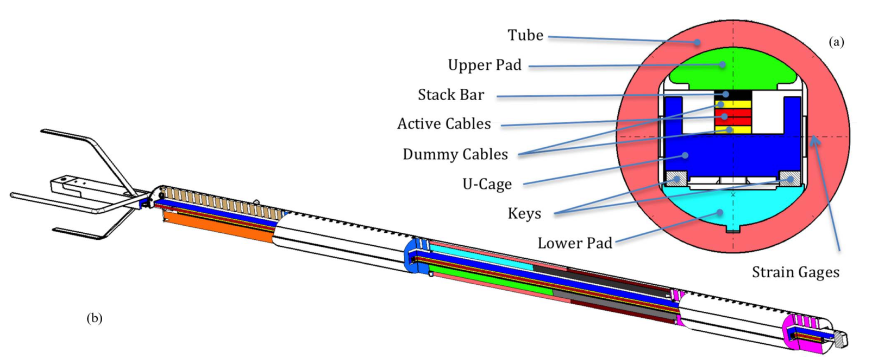
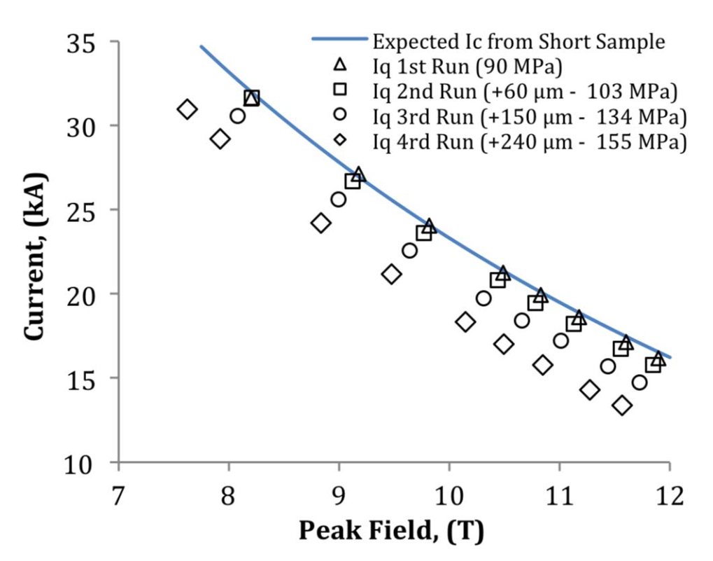
FRESCA Sample Holder (1)
A novel FRESCA sample holder was built and used at CERN. This tool allows to measure the critical current of stacks of impregnated cables under transversal pressure.
First results (2014) show how the reversible degradation on a PIT cable can change the critical current between 90 and 155 MPa
B. Bordini et al., IEEE TAS, 2014

Slide 35


FRESCA Sample Holder (2)
2D mechanical and electro-magnetic model of the sample holder
Cable stack represented with the mechanical approach validated from 10-stack measurements
  Same methodology but different strand/cable parameters

Slide 36



Stack Degradation – Results
Quench currents are matched reasonably well. Notice that:
  On the last loading there was a small irreversible degradation
  The quenches at 90 MPa were at short sample limit. The model correctly predicts the same strain function at 0 MPa
  Only one fitting parameter (scaling the strain from the strand to the filament)
The upper critical field as computed fitting the critical currents is also well captured by the model

